Slide 1
Basic Techniques
Chapter 1. Basic Static Techniques

Slide 2
Static Analysis
Examine payload without executing it to determine function and maliciousness
Scanning content
Several techniques:
Using antivirus tool (Virus Total introduced before)
Using Hash
Information from file header, function and strings

Slide 3
Antivirus Tool
Antivirus relies on a database of identifiable pieces of known code (suspicious)
Use behavioral or pattern matching algorithms
Database is static, malware author can easily modify the code and evade detections
Use VirusTotal to check through multiple engines (cloud-based solutions)
Question: how does malware authors utilize VirusTotal?
Always update your local Antivirus software

Slide 4
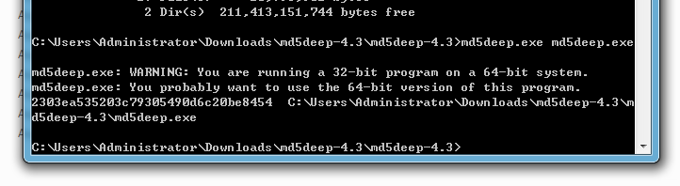
Hashing to get Malware Fingerprint
Hashing program produces unique hash
MD5/SHA-1/SHA-256 hashes
Example – use md5deep to calculate hash
Share/search the hash online or with other analyst to identify the malware

Slide 5
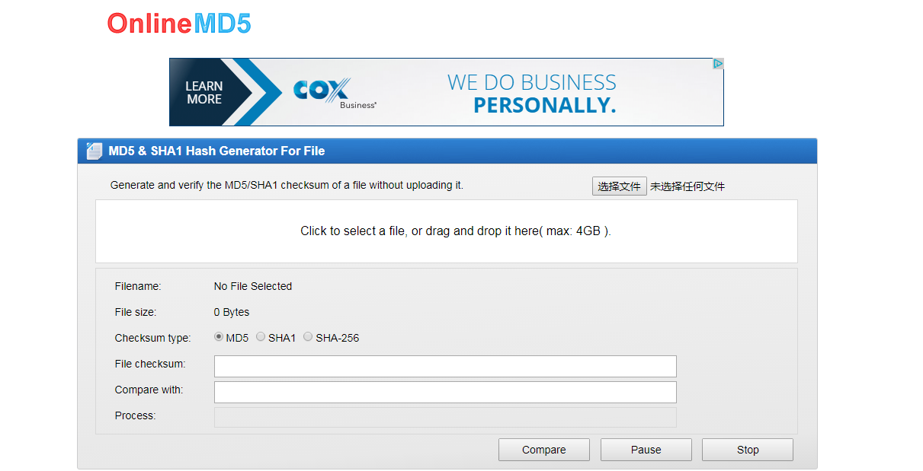
Use MD5 Hash Online
http://onlinemd5.com/

Slide 6
A Quick Note about MD5 Hash
Hash: different files, different hash – like our fingerprints
Collisions of hash – can counterfeit digital signatures (break MD5/SHA-1)
MD5/SHA-1 is breakable – Prof. Xiaoyun Wang from Shandong University in China (at Tsinghua University now)
How to Break MD5 and Other Hash Functions, EUROCRYPT, 2005.
Finding Collisions in the Full SHA-1, CRYPTO, 2005.
Use SHA-256

Slide 7
Finding Strings
Search through strings in program to get hints about functionality
Stored in ASCII/Unicode format
String ended with a NULL terminator
String.exe downloaded from http://bit.ly/ic4plL
Generate false positives (memory address, CPU instructions or data)

Slide 8
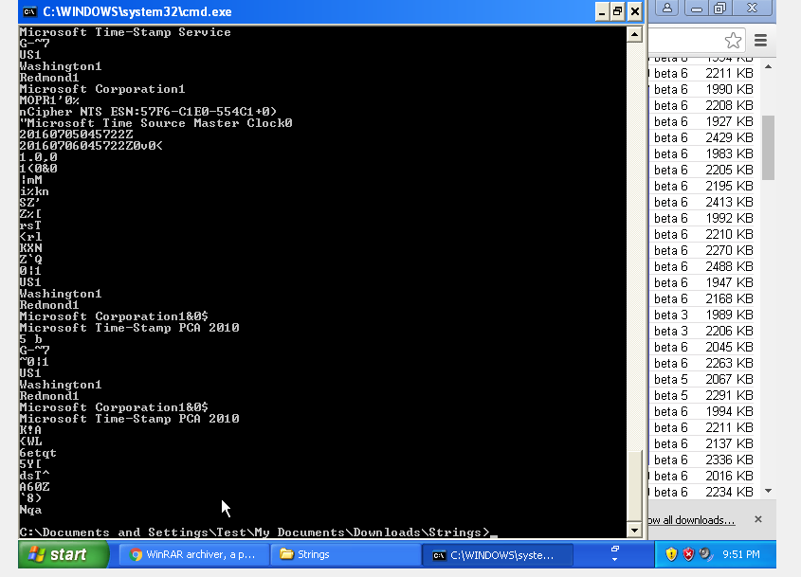

Slide 9
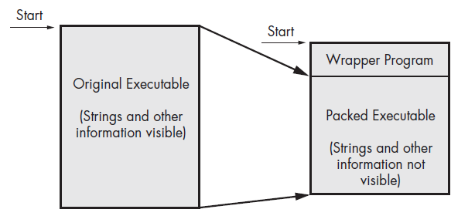
Packing and Obfuscation
Packing: compress/encrypt the program to make it hard to analyze
Obfuscation: hide the execution of malware
Legit programs always include many strings – malware contains very few strings (obfuscated or packed)
Packed or obfuscated code will at least include LoadLibrary and GetProcAddress to access functions
Only accessible to the wrapper program

Slide 10
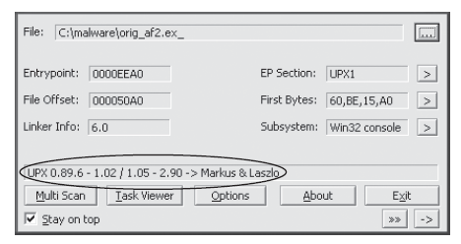
Detect Packer with PEiD
Detect Packer with PEiD – unfortunately, development stopped after 2011.
Used a UPX packer ( a classic one), so use UPX unpacker to unpack it.

Slide 11
Portable Executable (PE) File Format
PE file is a data structure
Includes a header: type of application, required library functions, space
Imports libraries statically or dynamically through linking
Static link:
Rare in Windows, all code from that library is copied into executable (grow size)
Two common APIs:
LoadLibrary and GetProcAddress
Dynamic link:
Most common, host searches for necessary libraries when loaded; function executes within the library
Know the functions used is important- knows what the program does

Slide 12
PE File Headers and Sections
PE file contains:
.text section: contains the instructions that CPU executes; only section that includes code
.rdata section: contains import and export information (dependencies)
.data section: contains the program’s global data, not local data.
.rsrc section: includes resources needed by executable such as icons, images, menus, strings.

Slide 13
Static Analysis: PotntialKeyLogger.exe
Table 1-2: get a list of DLLs and functions imported
From Table 1-2 , need clues to tell it is a keylogger
Imports from Kernel32.dll – FindFirstFile/FindNextFile – search through directories
Imports from User32.dll: lots of GUI – the malware may have an interface; SetWindowsHookEx: receive keyboard inputs, usually used by malware
Imports from Advapi32.dll: this program uses registry
Table 1-3: Less imports from packed program

Slide 14
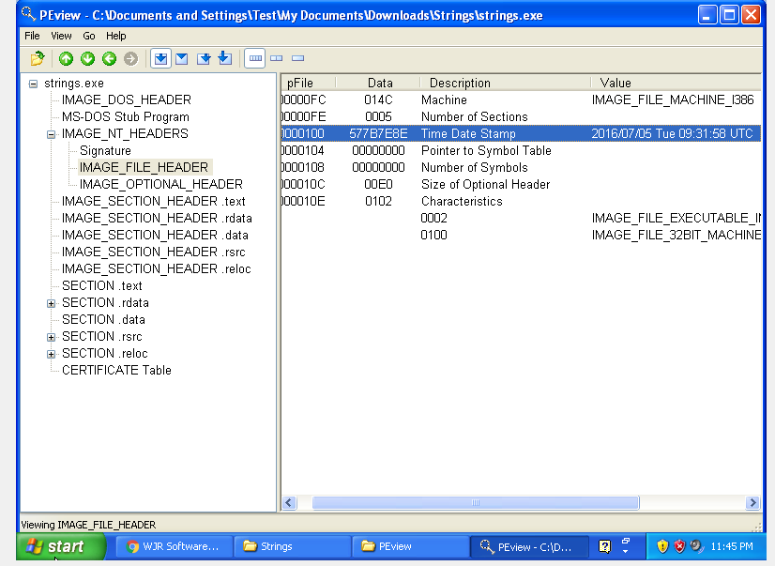
Use PEview
TimeStamp tells when the program is compiled; info about how old is the attack (can be modified)

Slide 15
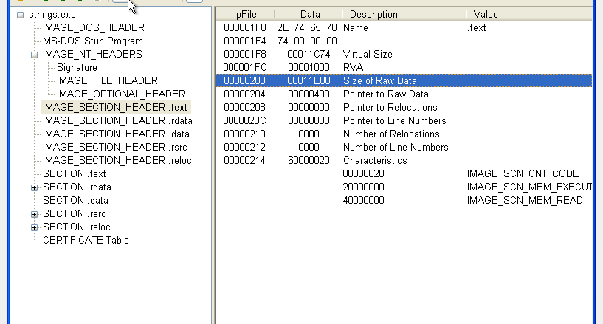
Use PEview
Virtual Size and Size of Raw Data: if Virtual Size is much larger, it is packed
-> means it needs more space in memory than on disk

Slide 16
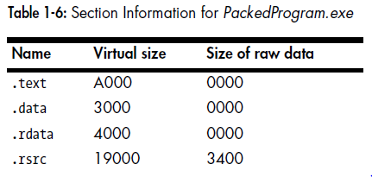
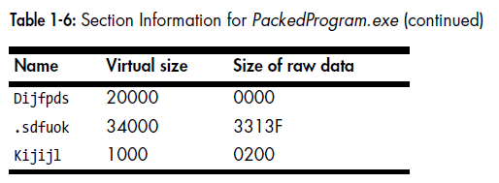
Comparison of packed program
Virtual Size much larger than raw data;
raw data is zero-> takes no space on disk
Section names are suspicious

Slide 17
In-Class Homework
Form into groups of max. 2 students each group
See instructions from the course website (www.lions.odu.edu/~c1wang)
Answer question including screenshots/notes/explanations in a word file

