Slide 1
Review - Basics of Logic Design

Slide 2

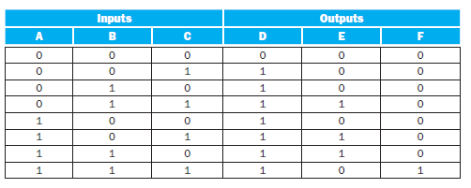
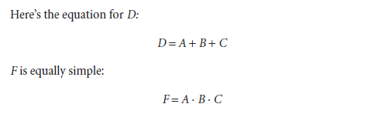
Logic Equations

Slide 3
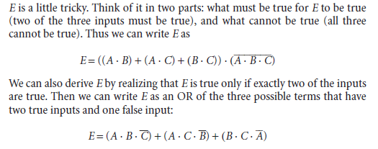
Logic Equations

Slide 4

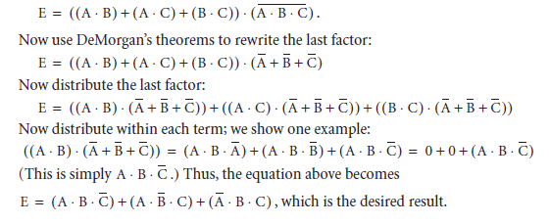
Logic Equations

Slide 5
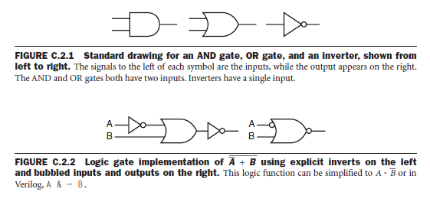
Gates
Any logical function can be constructed using
AND gates, OR gates, and inversion.

Slide 6
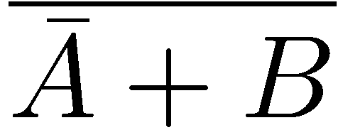

Gates
How do you realize the following logic function using gates?

Slide 7
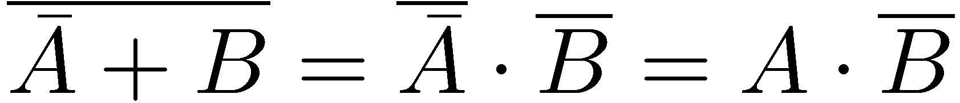
Gates
Another way to realize the same logic function?
Using DeMorgan’s Theorem

Slide 8


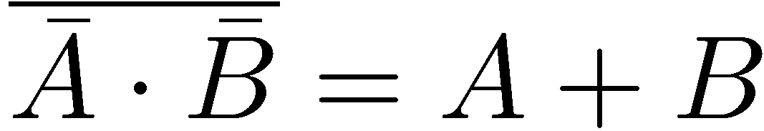
Gates

Slide 9
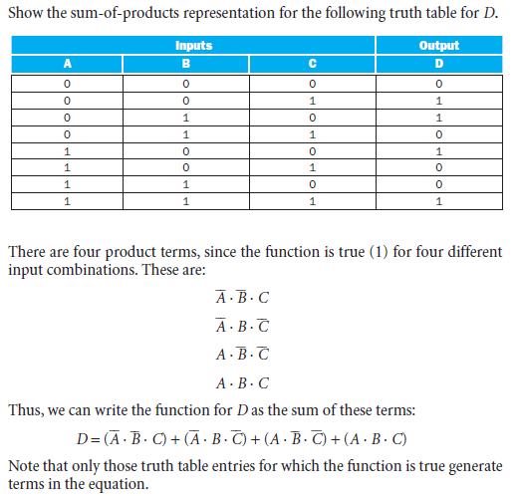
Truth Table to Sum of Product

Slide 10
Multiplexor – Sum of Product

Slide 11
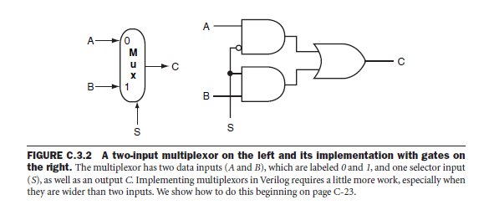
Multiplexor

Slide 12
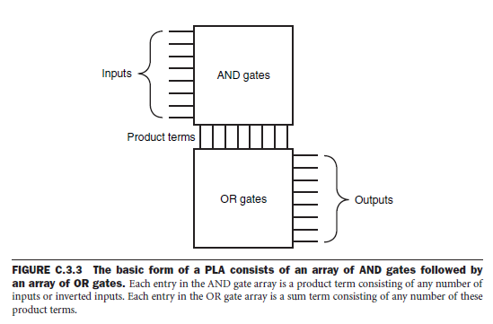
Programmable Logic Array (PLA)

Slide 13
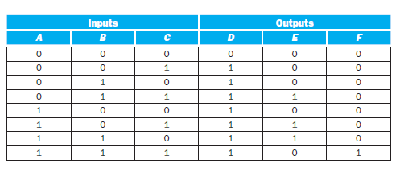

Programmable Logic Array (PLA)
Show the PLA implementation using (a) dots diagram, and (b) Gates for the
following truth table

Slide 14
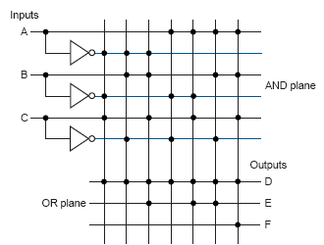
Programmable Logic Array (PLA)

Slide 15
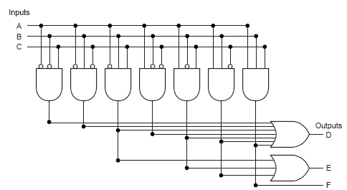
Programmable Logic Array (PLA)

Slide 16
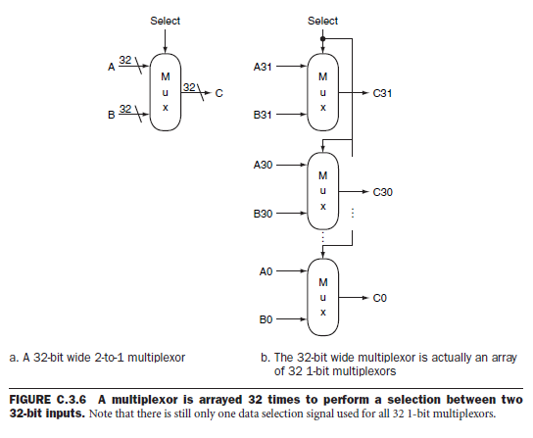
Array of Logic Elements

Slide 17
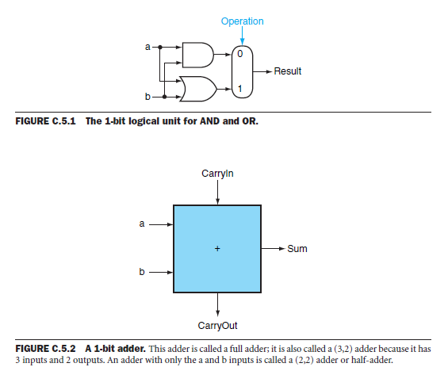
1-Bit ALU

Slide 18
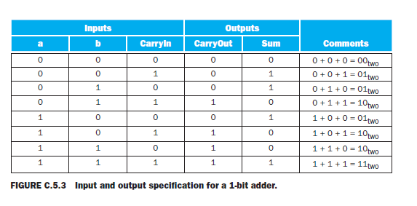
1-Bit ALU

Slide 19
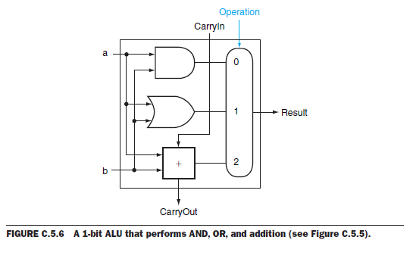
1-Bit ALU

Slide 20
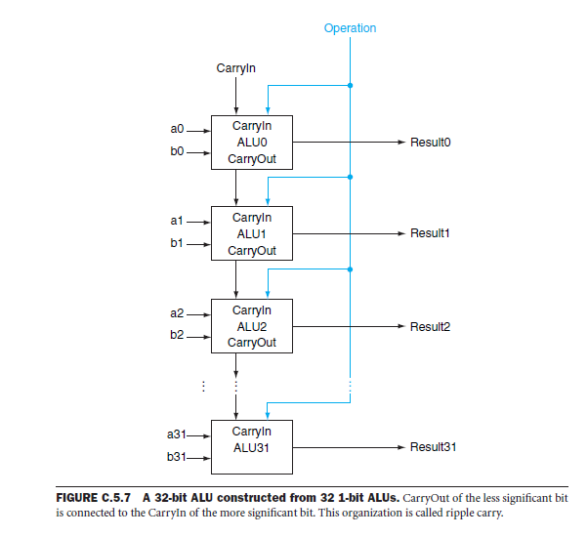
32-Bit ALU

Slide 21
Sequential Elements
Register: stores data in a circuit
Uses a clock signal to determine when to update the stored value
Edge-triggered: update when Clk changes from 0 to 1
Clk
D
Q
D
Clk
Q

Slide 22
Sequential Elements
Register with write control
Only updates on clock edge when write control input is 1
Used when stored value is required later
Clk
D
Q
Write
Write
D
Clk
Q

Slide 23
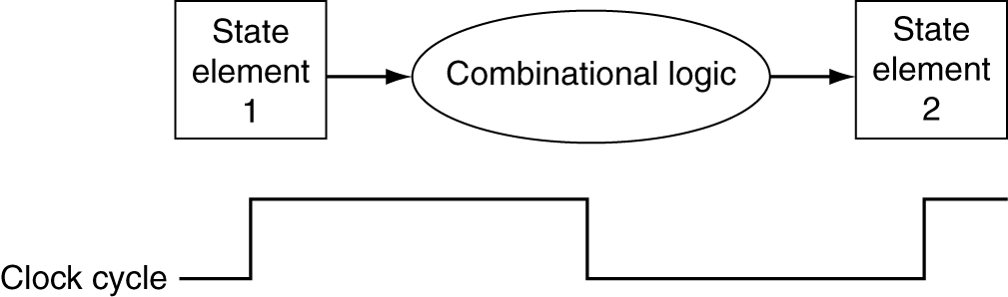
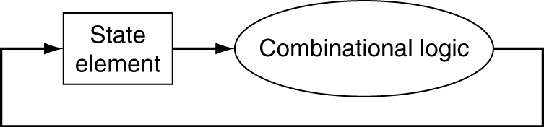
Clocking Methodology
Combinational logic transforms data during clock cycles
Between clock edges
Input from state elements, output to state element
Longest delay determines clock period

Slide 24
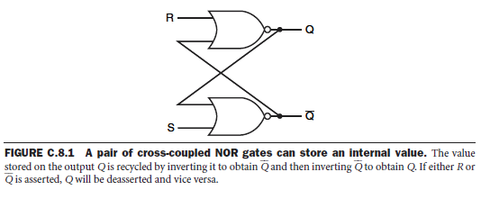
Basic Memory Element

Slide 25
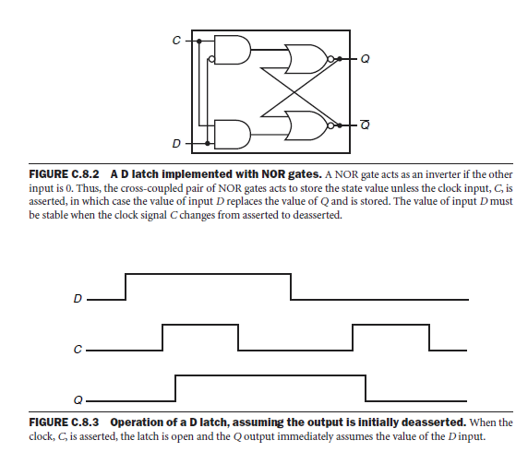
D Latch

Slide 26
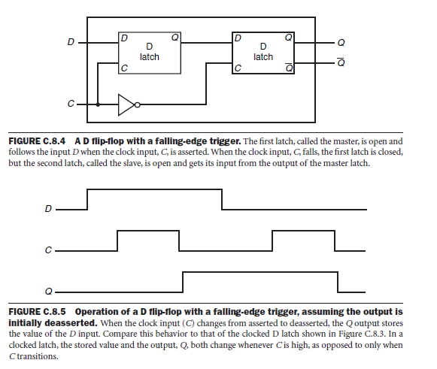
D Flip Flop

Slide 27
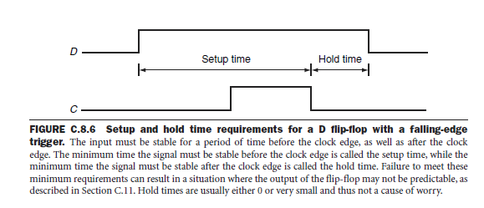
D Flip Flop

Slide 28
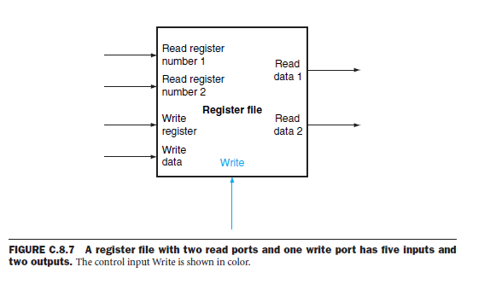
Register File

Slide 29
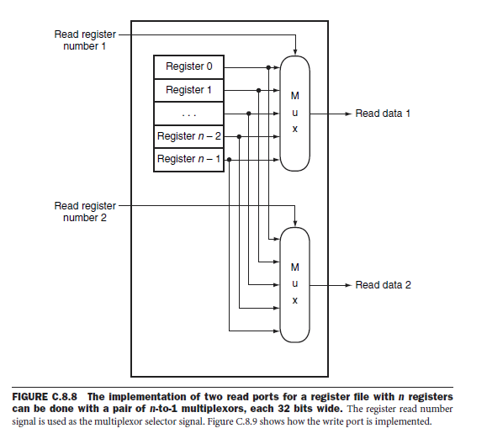
Register File – Read Port

Slide 30
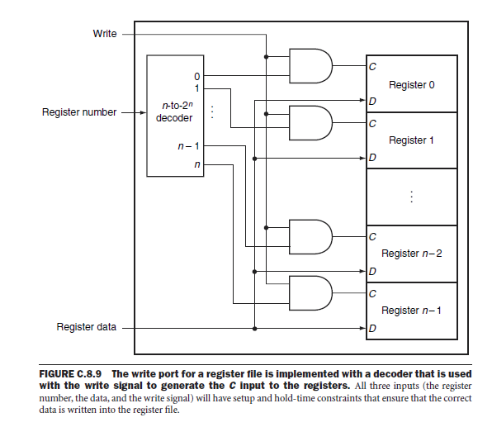
Register File – Write Port

Slide 31
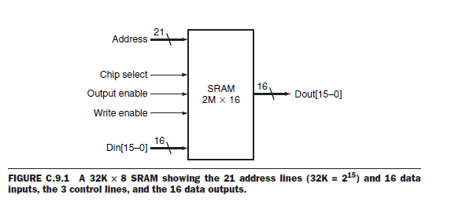
SRAM Memory

Slide 32
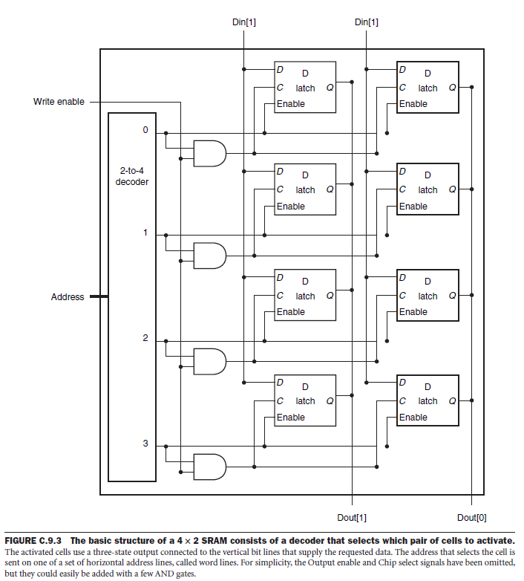
SRAM Memory

Slide 33
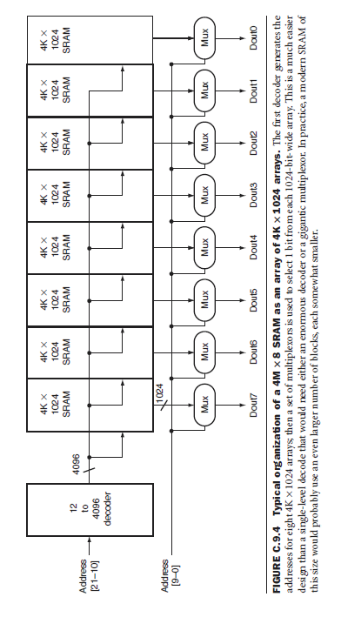
SRAM Memory

Slide 34
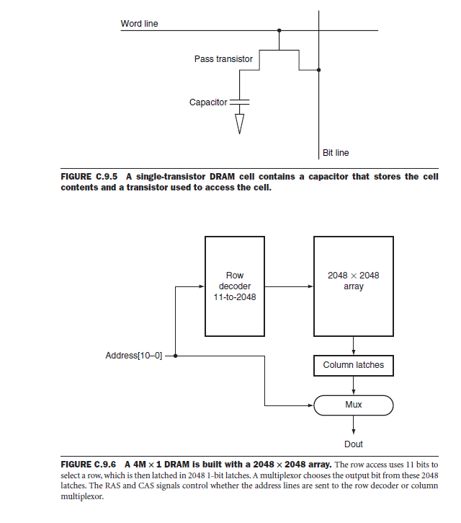
DRAM Memory

Slide 35
Reminder
§4.2 Logic Design Conventions
Please review what I covered in the class today.
Next class could be a quiz!!

