Slide 1
Chapter 4
The Processor

Slide 2
Introduction
§4.1 Introduction
CPU performance factors
Instruction count
Determined by ISA and compiler
CPI and Cycle time
Determined by CPU hardware
We will examine two MIPS implementations
A simplified version
A more realistic pipelined version
Simple subset, shows most aspects
Memory reference: lw, sw
Arithmetic/logical: add, sub, and, or, slt
Control transfer: beq, j

Slide 3
Representing Instructions
Instructions are encoded in binary
Called machine code
MIPS instructions
Encoded as 32-bit instruction words
Small number of formats encoding operation code (opcode), register numbers, …
Regularity!
Register numbers
$t0 – $t7 are reg’s 8 – 15
$t8 – $t9 are reg’s 24 – 25
$s0 – $s7 are reg’s 16 – 23
§2.5 Representing Instructions in the Computer

Slide 4
MIPS R-format Instructions
op
rs
rt
rd
shamt
funct
6 bits
5 bits
5 bits
5 bits
5 bits
6 bits
Instruction fields
op: operation code (opcode)
rs: first source register number
rt: second source register number
rd: destination register number
shamt: shift amount (00000 for now)
funct: function code (extends opcode)

Slide 5
R-format Example
op
rs
rt
rd
shamt
funct
6 bits
5 bits
5 bits
5 bits
5 bits
6 bits
add $t0, $s1, $s2
special
$s1
$s2
$t0
0
add
0
17
18
8
0
32
000000
10001
10010
01000
00000
100000
00000010001100100100000000100000₂ = 02324020₁₆

Slide 6
Hexadecimal
Base 16
Compact representation of bit strings
4 bits per hex digit
0 | 0000 | 4 | 0100 | 8 | 1000 | c | 1100
1 | 0001 | 5 | 0101 | 9 | 1001 | d | 1101
2 | 0010 | 6 | 0110 | a | 1010 | e | 1110
3 | 0011 | 7 | 0111 | b | 1011 | f | 1111
Example: eca8 6420
1110 1100 1010 1000 0110 0100 0010 0000

Slide 7
MIPS I-format Instructions
op
rs
rt
constant or address
6 bits
5 bits
5 bits
16 bits
Immediate arithmetic and load/store instructions
rt: destination or source register number
Constant: –2¹⁵ to +2¹⁵ – 1
Address: offset added to base address in rs
Design Principle 4: Good design demands good compromises
Different formats complicate decoding, but allow 32-bit instructions uniformly
Keep formats as similar as possible

Slide 8
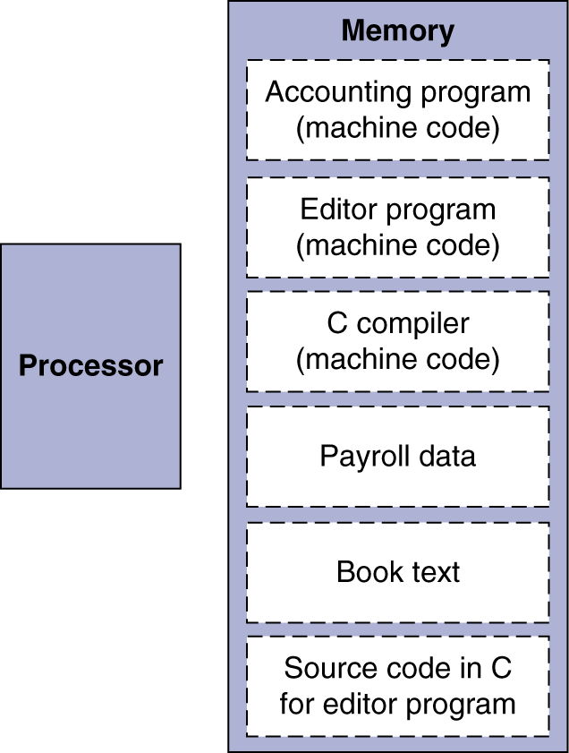
Stored Program Computers
The BIG Picture
Instructions represented in binary, just like data
Instructions and data stored in memory
Programs can operate on programs
e.g., compilers, linkers, …
Binary compatibility allows compiled programs to work on different computers
Standardized ISAs

Slide 9
Instruction Execution
PC → instruction memory, fetch instruction
Register numbers → register file, read registers
Depending on instruction class
Use ALU to calculate
Arithmetic result
Memory address for load/store
Branch target address
Access data memory for load/store
PC ← target address or PC + 4

Slide 10
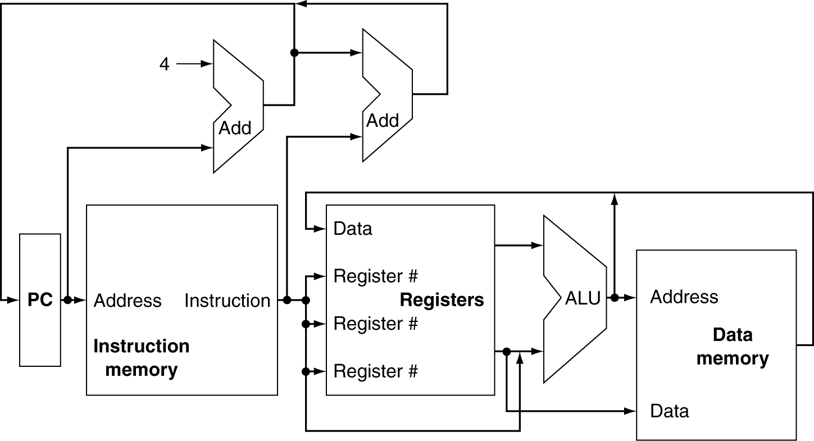
CPU Overview

Slide 11
Multiplexers
Can’t just join wires together
Use multiplexers

Slide 12
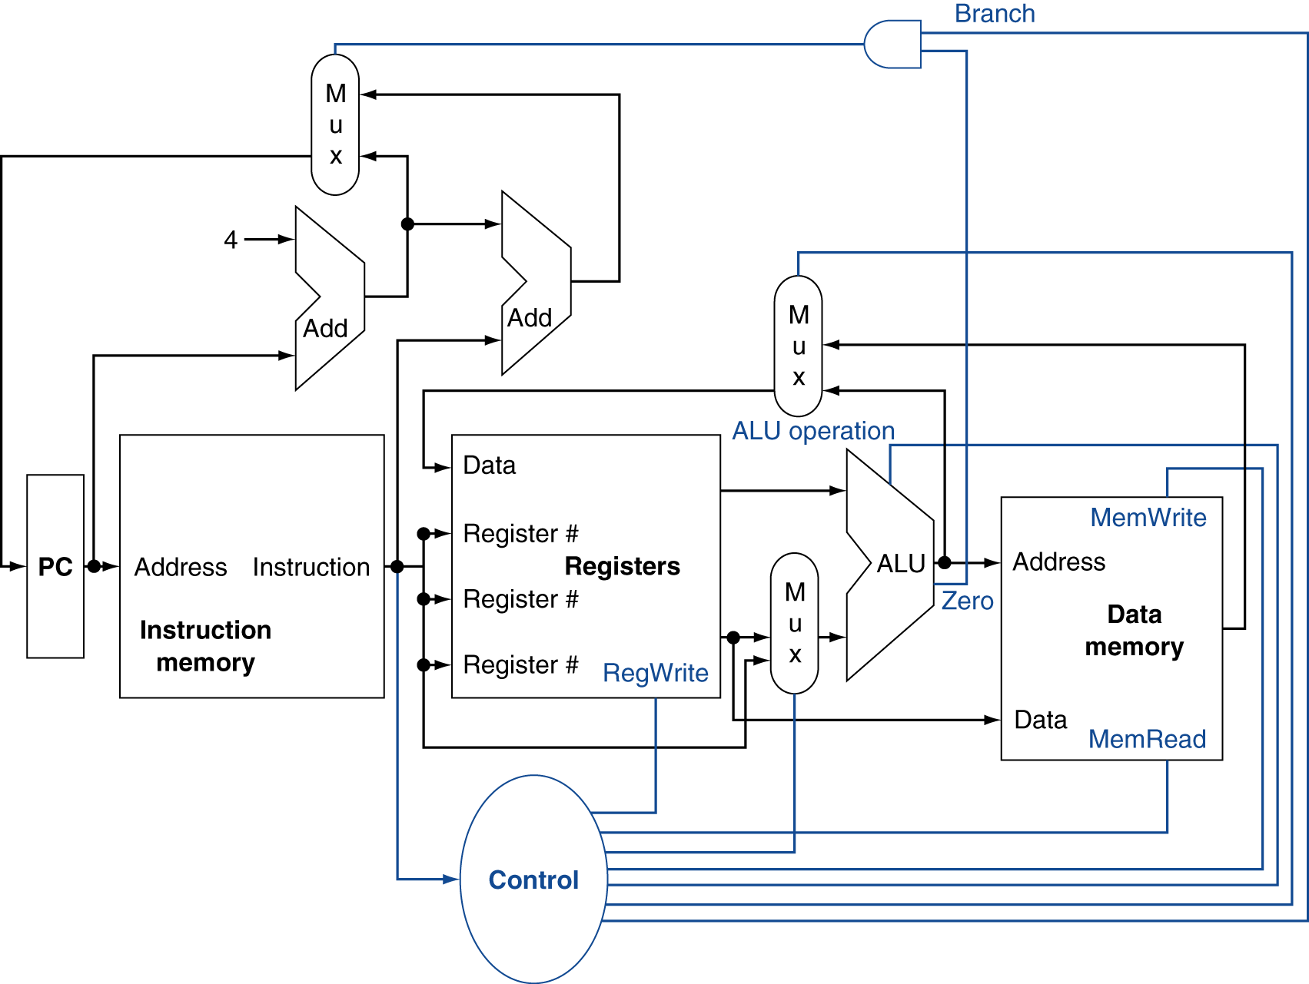
Control

Slide 13
Sequential Elements
Register: stores data in a circuit
Uses a clock signal to determine when to update the stored value
Edge-triggered: update when Clk changes from 0 to 1
Clk
D
Q
D
Clk
Q

Slide 14
Sequential Elements
Register with write control
Only updates on clock edge when write control input is 1
Used when stored value is required later
Clk
D
Q
Write
Write
D
Clk
Q

Slide 15
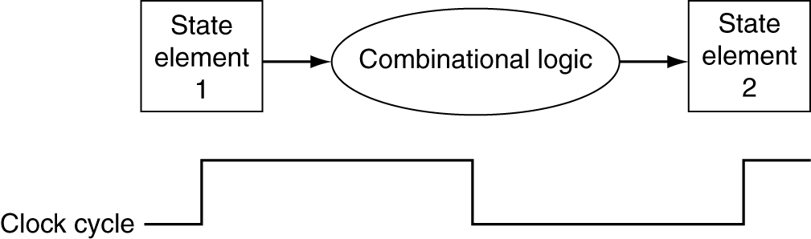
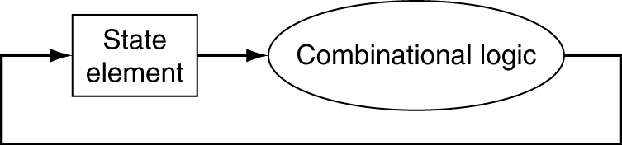
Clocking Methodology
Combinational logic transforms data during clock cycles
Between clock edges
Input from state elements, output to state element
Longest delay determines clock period

Slide 16
Building a Datapath
Single Cycle Datapath
Elements that process data and addresses in the CPU
Registers, ALUs, mux’s, memories, …
Registers and memories during read act like combinational logic
We will build a MIPS datapath incrementally
Refining the overview design
§4.3 Building a Datapath

Slide 17
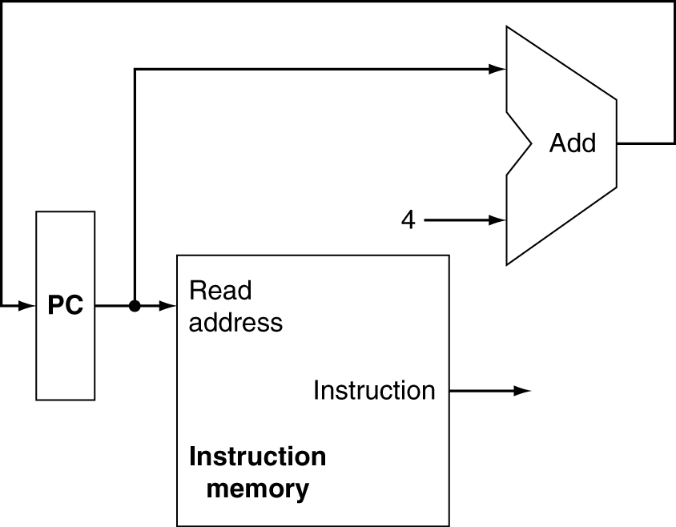
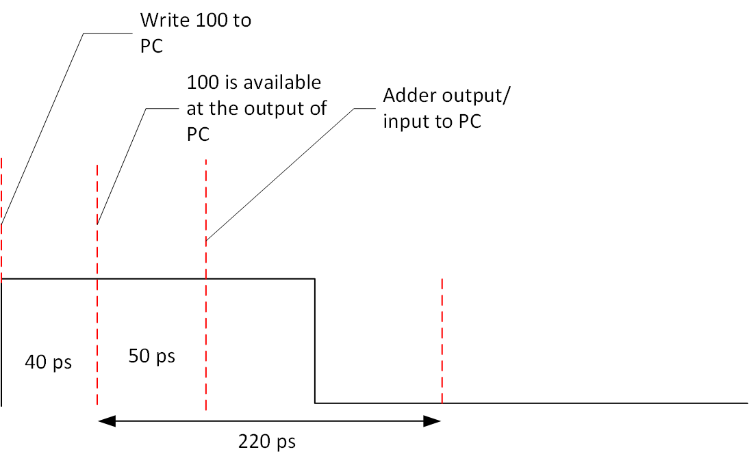
Instruction Fetch
50ps
100
40ps
220ps
Instruction memory in read mode is a
combinational element

Slide 18
Instruction Fetch
Increment by 4 for next instruction
32-bit register

Slide 19
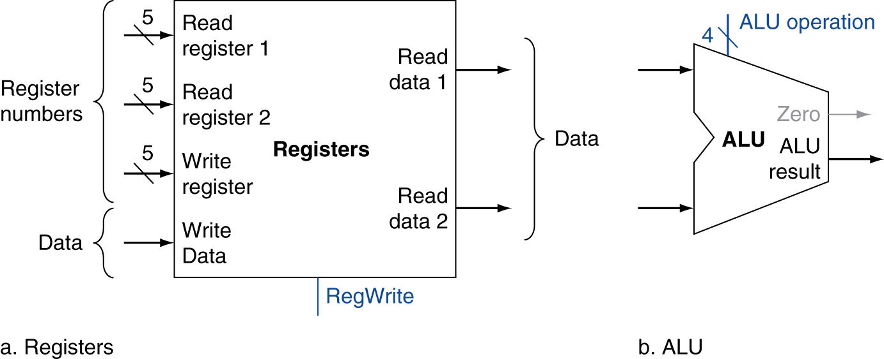
R-Format Instructions
Read two register operands
Perform arithmetic/logical operation
Write register result

Slide 20
MIPS I-format Instructions
op
rs
rt
constant or address
6 bits
5 bits
5 bits
16 bits
Immediate arithmetic and load/store instructions
rt: destination or source register number
Constant: –2¹⁵ to +2¹⁵ – 1
Address: offset added to base address in rs
Design Principle 4: Good design demands good compromises
Different formats complicate decoding, but allow 32-bit instructions uniformly
Keep formats as similar as possible

Slide 21
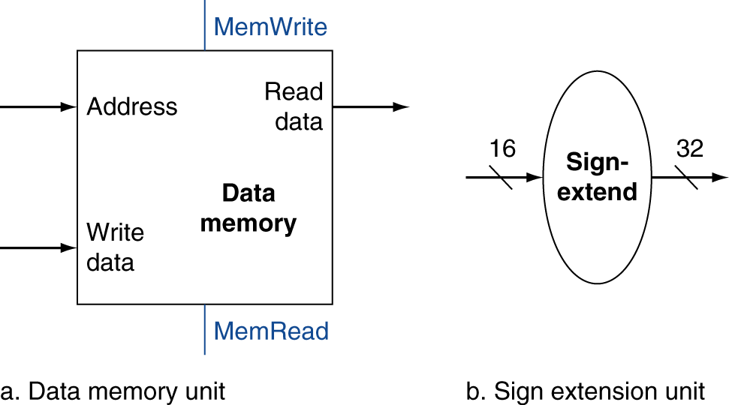
Load/Store Instructions
Read register operands
Calculate address using 16-bit offset
Use ALU, but sign-extend offset
Load: Read memory and update register
Store: Write register value to memory

Slide 22
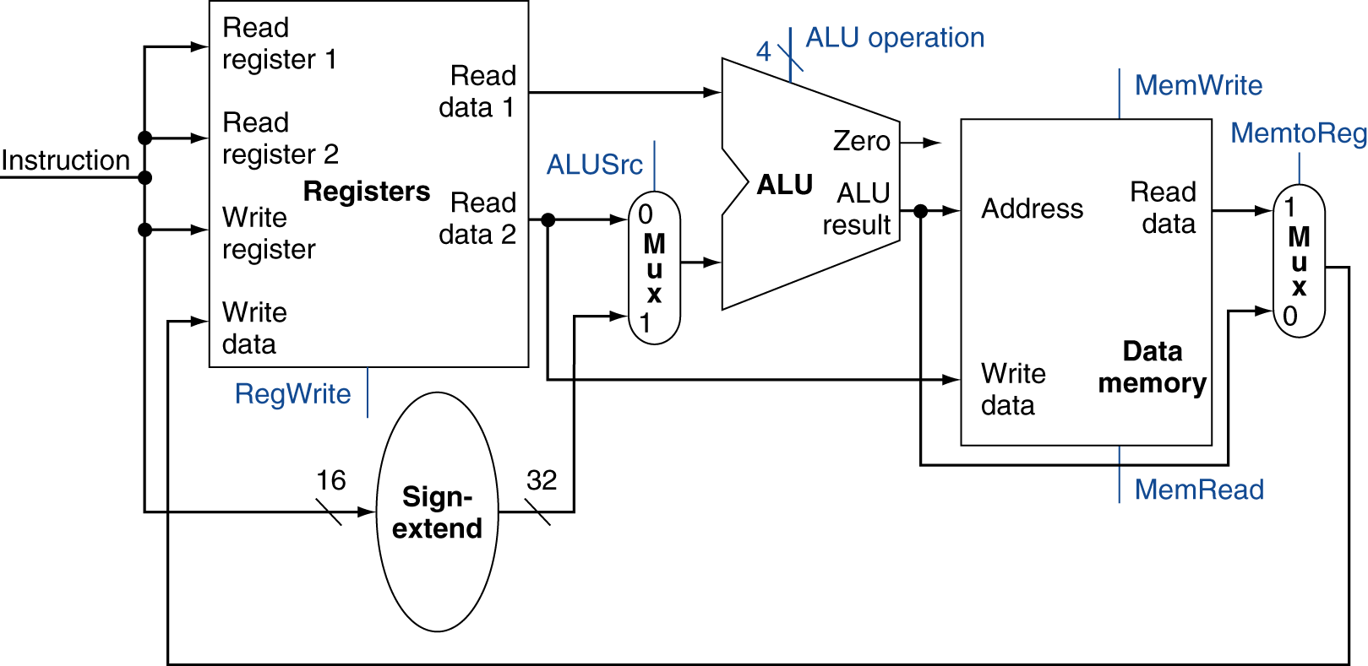
R-Type/Load/Store Datapath

Slide 23
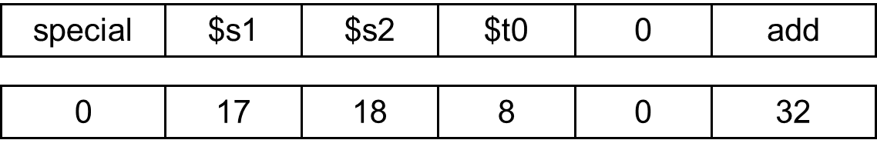
R-Type - add $t0, $s1, $s2
0
0

Slide 24
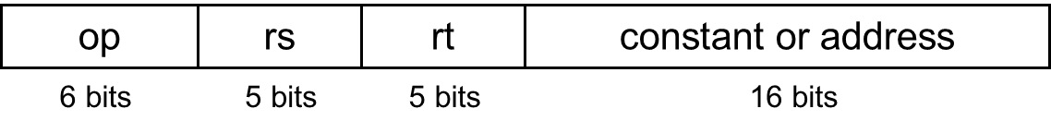
I-Type - lw $t0, 1200($t1)
35
9
8
1200
1
1

Slide 25
I-Type - sw $t0, 1200($t1)
43
9
8
1200
1
1

Slide 26
Branch Instructions
Read register operands
Compare operands
Use ALU, subtract and check Zero output
Calculate target address
Sign-extend displacement
Shift left 2 places (word displacement)
Add to PC + 4
Already calculated by instruction fetch

Slide 27
Branch Addressing
Branch instructions specify
Opcode, two registers, target address
Most branch targets are near branch
Forward or backward
op
rs
rt
constant or address
6 bits
5 bits
5 bits
16 bits
PC-relative addressing
Target address = PC + offset × 4
PC already incremented by 4 by this time

Slide 28
Branch Addressing
Example:
1000: beq $t3, $t5, 12
1004: << Next Instruction>>
Memory address for the branch instruction
4
11
13
12
6 bits
5 bits
5 bits
16 bits
$TargetAddress=1004 +12∗4$= 1052

Slide 29
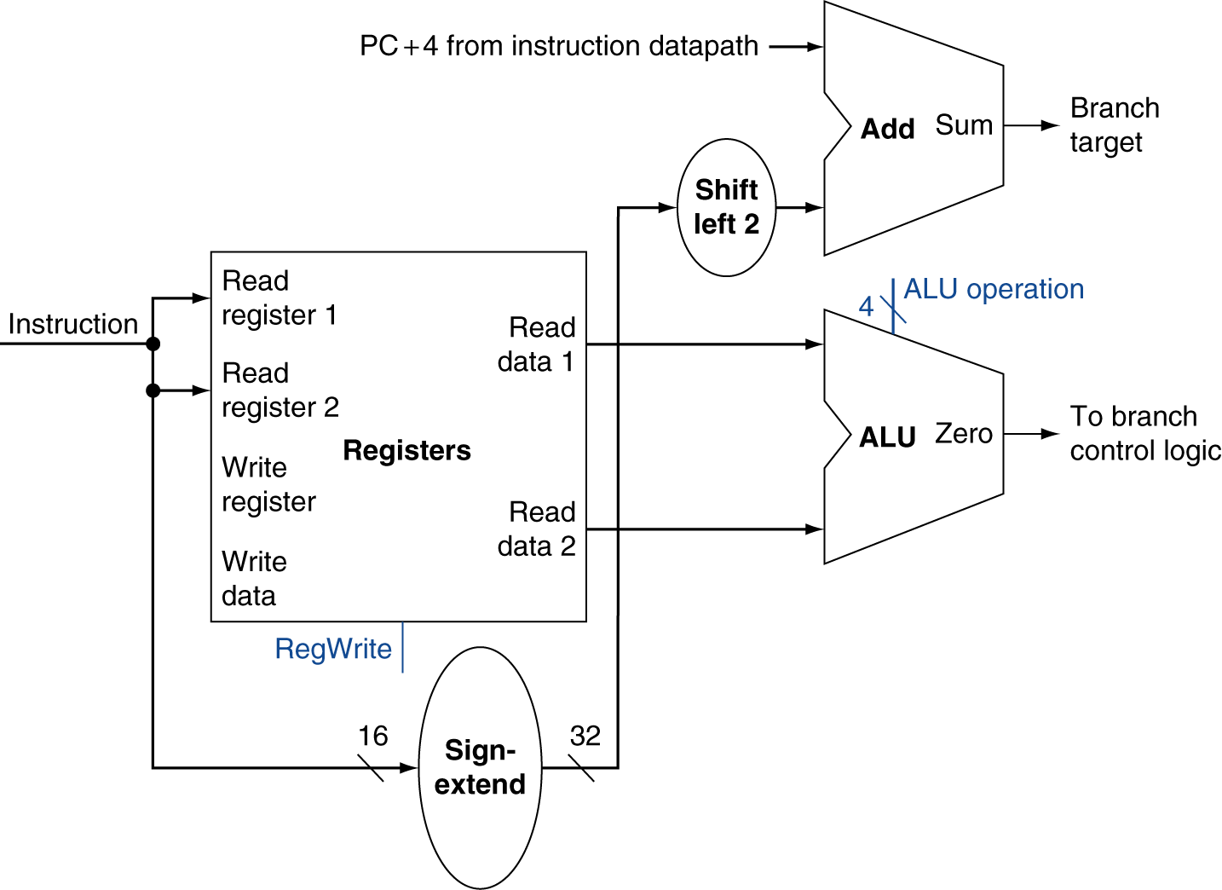
Branch Instructions
4
11
13
12
6 bits
5 bits
5 bits
16 bits
1004
Just re-routes wires
1052
48
12
12
Sign-bit wire replicated
$TargetAddress=1004 +12∗4$= 1052

Slide 30
Composing the Elements
First-cut data path does an instruction in one clock cycle
Each datapath element can only do one function at a time
Hence, we need separate instruction and data memories
Use multiplexers where alternate data sources are used for different instructions

Slide 31
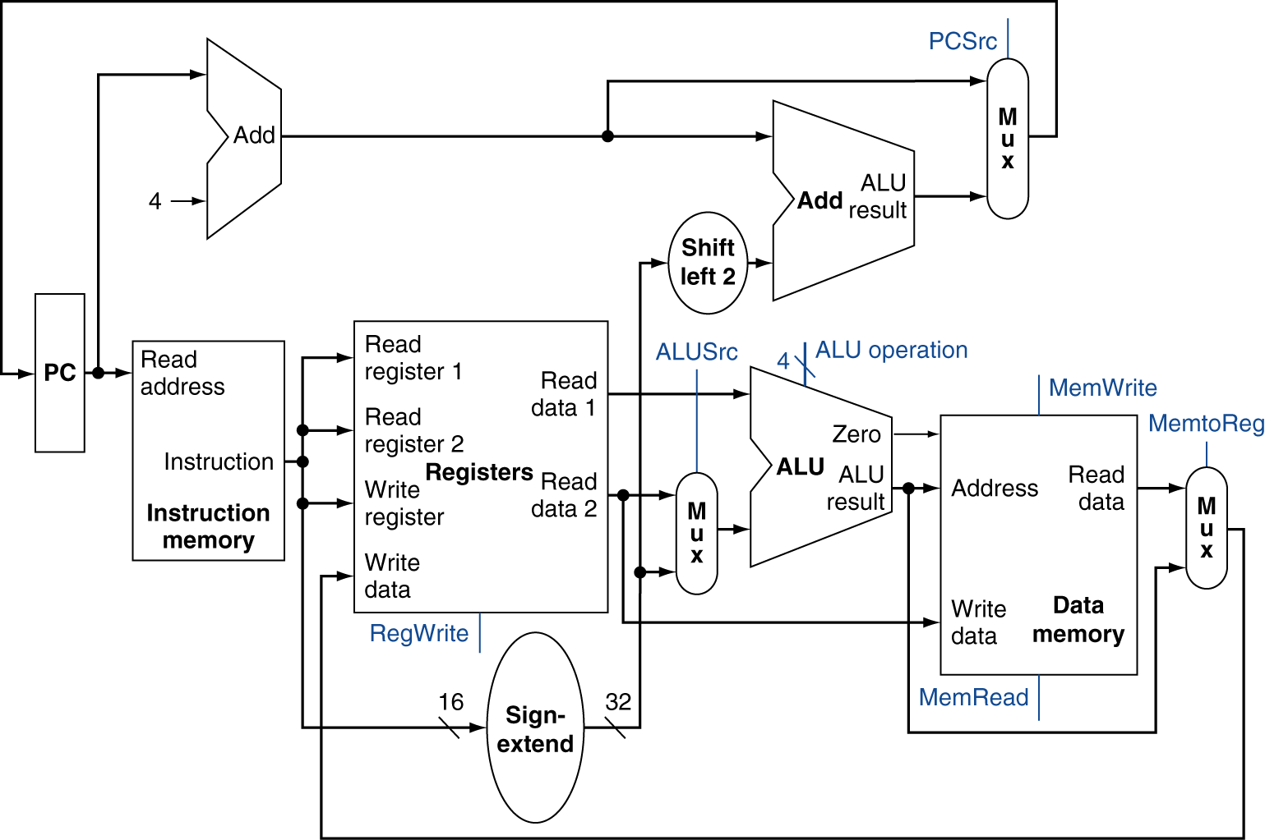
Full Datapath

Slide 32
Reminder
§4.2 Logic Design Conventions
Please review what I covered in the class today.
Review: Chapter 4.1, 4.2 and 4.3
Next class could be a quiz!!

