Slide 1
Chapter 4
The Processor-II
Reference: Section 4.4, Appendix B, Appendix D

Slide 2
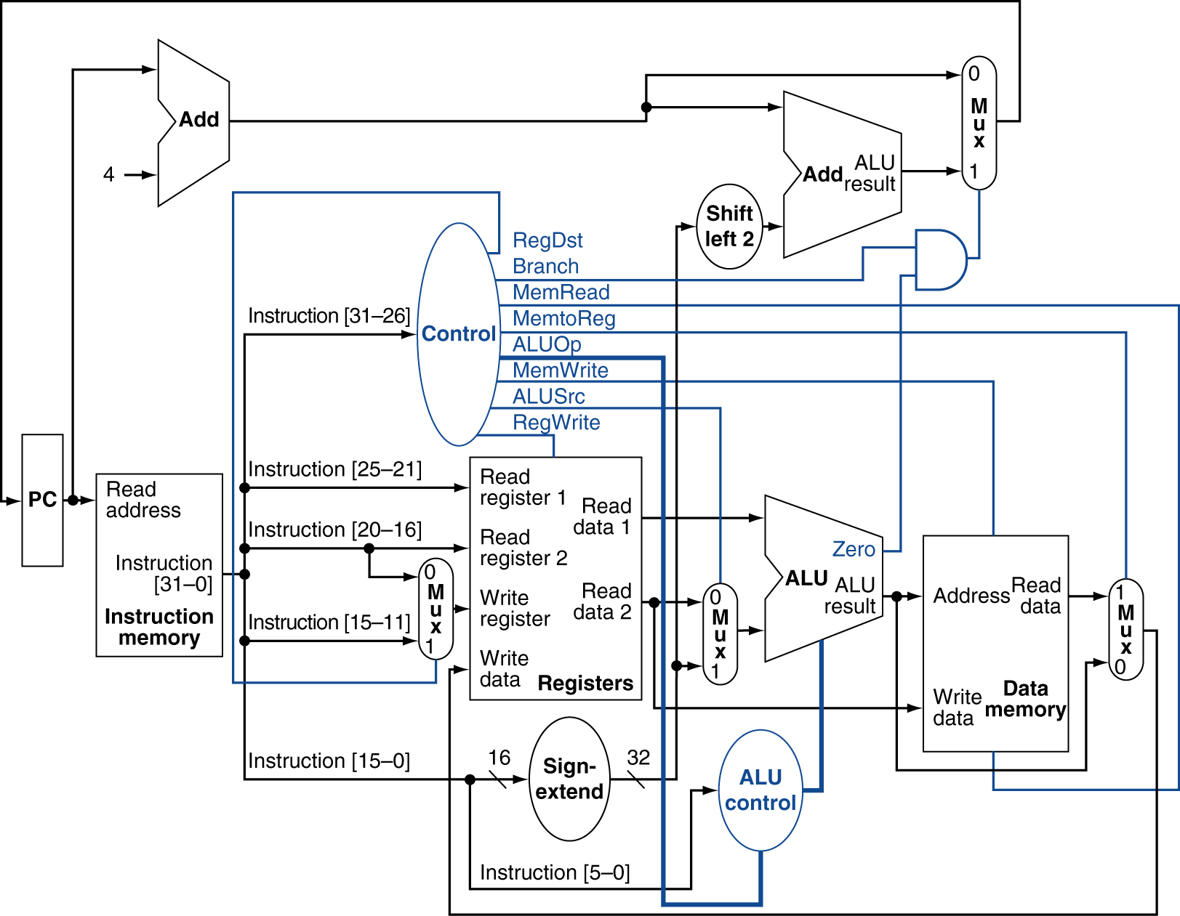
Datapath With Control
For load instruction these lines hold write register #
For add instruction these lines hold write register #

Slide 3
The Main Control Unit
Control signals derived from instruction
R-type
0
rs
rt
rd
shamt
funct
31:26
25:21
20:16
15:11
10:6
5:0
Load/ Store
35 or 43
rs
rt
address
31:26
25:21
20:16
15:0
Branch
4
rs
rt
address
31:26
25:21
20:16
15:0
opcode
always read
read, except for load
write for R-type and load
sign-extend and add

Slide 4
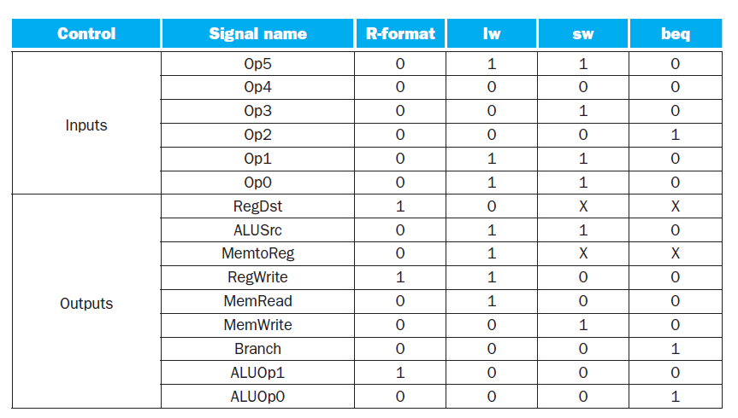

Slide 5

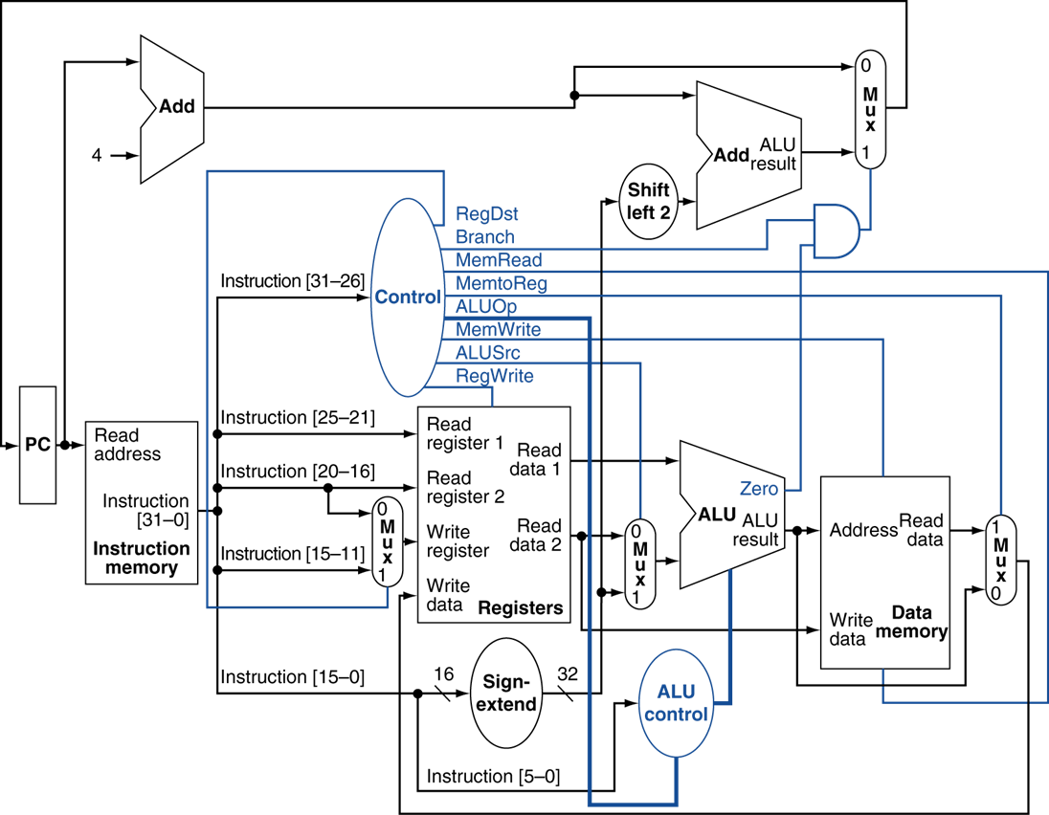

Slide 6
Truth Table Layout
Input
Output

Slide 7
$$ALUSrc=Op5 . \overline{Op4} . \overline{Op3} . \overline{Op2} . Op1 . Op0 + Op5 . \overline{Op4} . Op3 . \overline{Op2} . Op1 . Op0$$

Slide 8
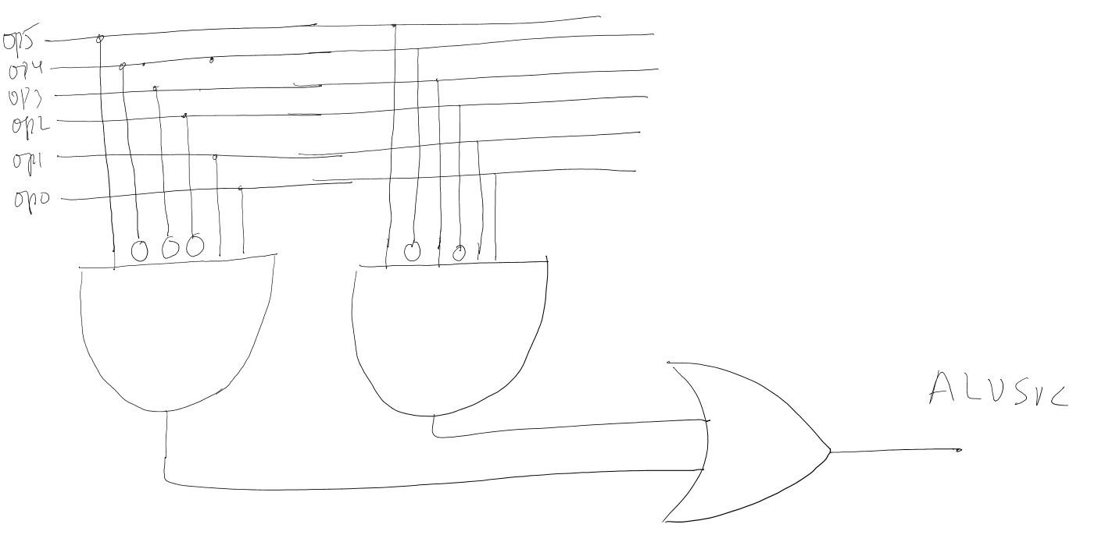
$$ALUSrc=Op5 . \overline{Op4} . \overline{Op3} . \overline{Op2} . Op1 . Op0 + Op5 . \overline{Op4} . Op3 . \overline{Op2} . Op1 . Op0$$

Slide 9
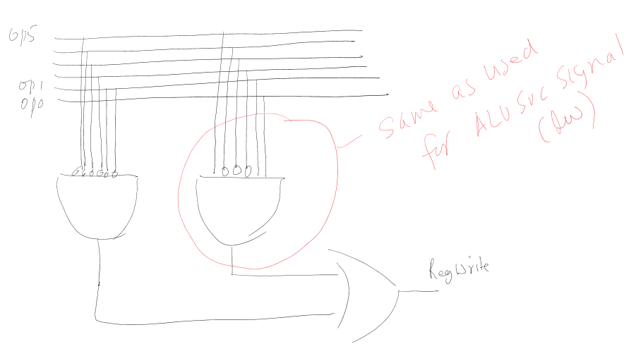

Slide 10
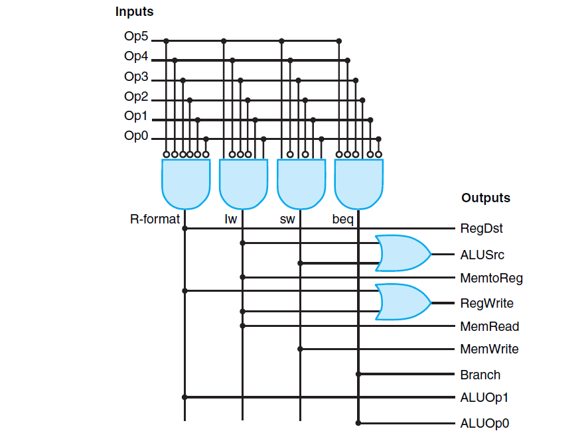

Slide 11
ALU Control
ALU used for
Load/Store: F = add
Branch: F = subtract
R-type: F depends on funct field
§4.4 A Simple Implementation Scheme
ALU control | Function
0000 | AND
0001 | OR
0010 | add
0110 | subtract
0111 | set-on-less-than
1100 | NOR

Slide 12
ALU Control
Assume 2-bit ALUOp derived from opcode
Combinational logic derives ALU control
opcode | ALUOp | Operation | funct | ALU function | ALU control
lw | 00 | load word | XXXXXX | add | 0010
sw | 00 | store word | XXXXXX | add | 0010
beq | 01 | branch equal | XXXXXX | subtract | 0110
R-type | 10 | add | 100000 | add | 0010
 |  | subtract | 100010 | subtract | 0110
 |  | AND | 100100 | AND | 0000
 |  | OR | 100101 | OR | 0001
 |  | set-on-less-than | 101010 | set-on-less-than | 0111

Slide 13
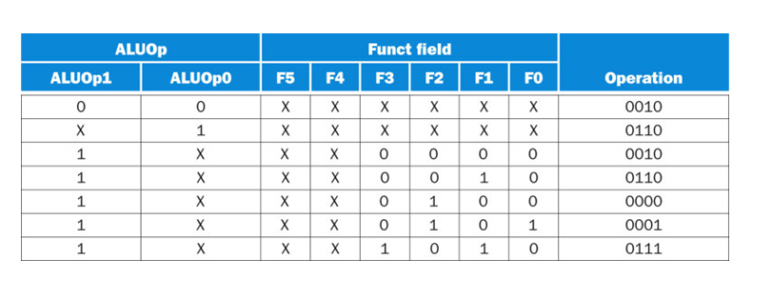
Input
Output
Row 1
Row 2
Row 7
ALUOp1 = 1 and ALUOp0=1 combination is never
generated, so it is OK to put don’t care for ALUOp0
ALUOp1 = 1 and ALUOp0=1 combination is never
generated, so it is OK to put don’t care for ALUOp1

Slide 14
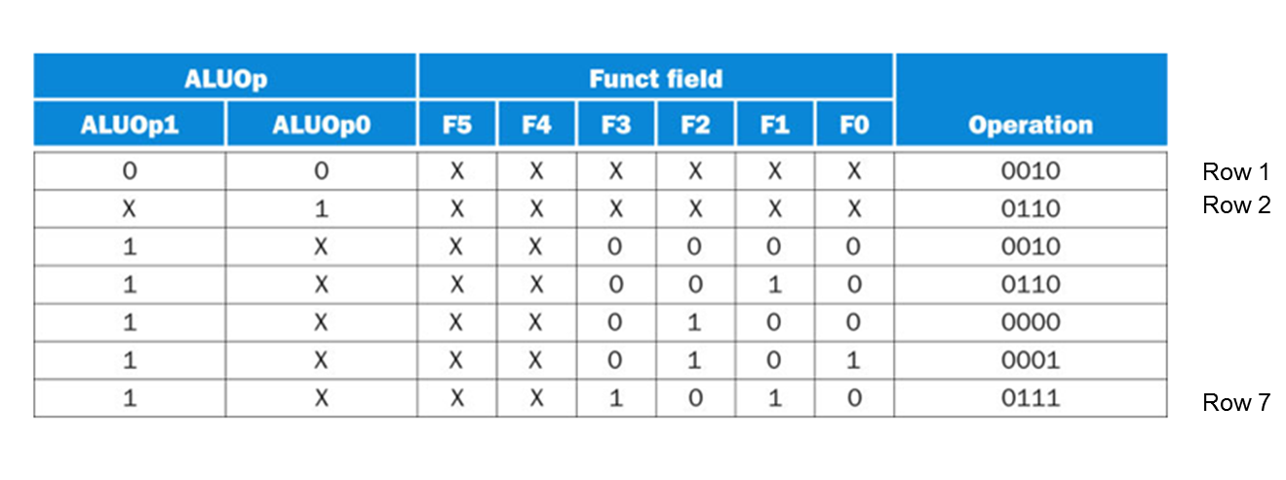
Truth Table
Layout
Input
Output

Slide 15
Operation 2
Don’t care entries help us to have a compact truth table and also optimize the
logic design

Slide 16
Optimization using don’t care entries
A truth table with don’t care entries in a row minimizes to a function where the input corresponding to don’t care is ignored, for example:
=
=

Slide 17
Operation 2
Use sum of product term:
$Operation2=ALUOp0+ALUOp1. \overline{F3}$ . $\overline{F2}$ . $F1$. $\overline{F0}$ $+ALUOp1.$ $F3$ . $\overline{F2}$ . $F1$. $\overline{F0}$
$Operation2=ALUOp0+ALUOp1. \overline{F2}$ . $F1$. $\overline{F0}$

Slide 18
Datapath With Control

Slide 19
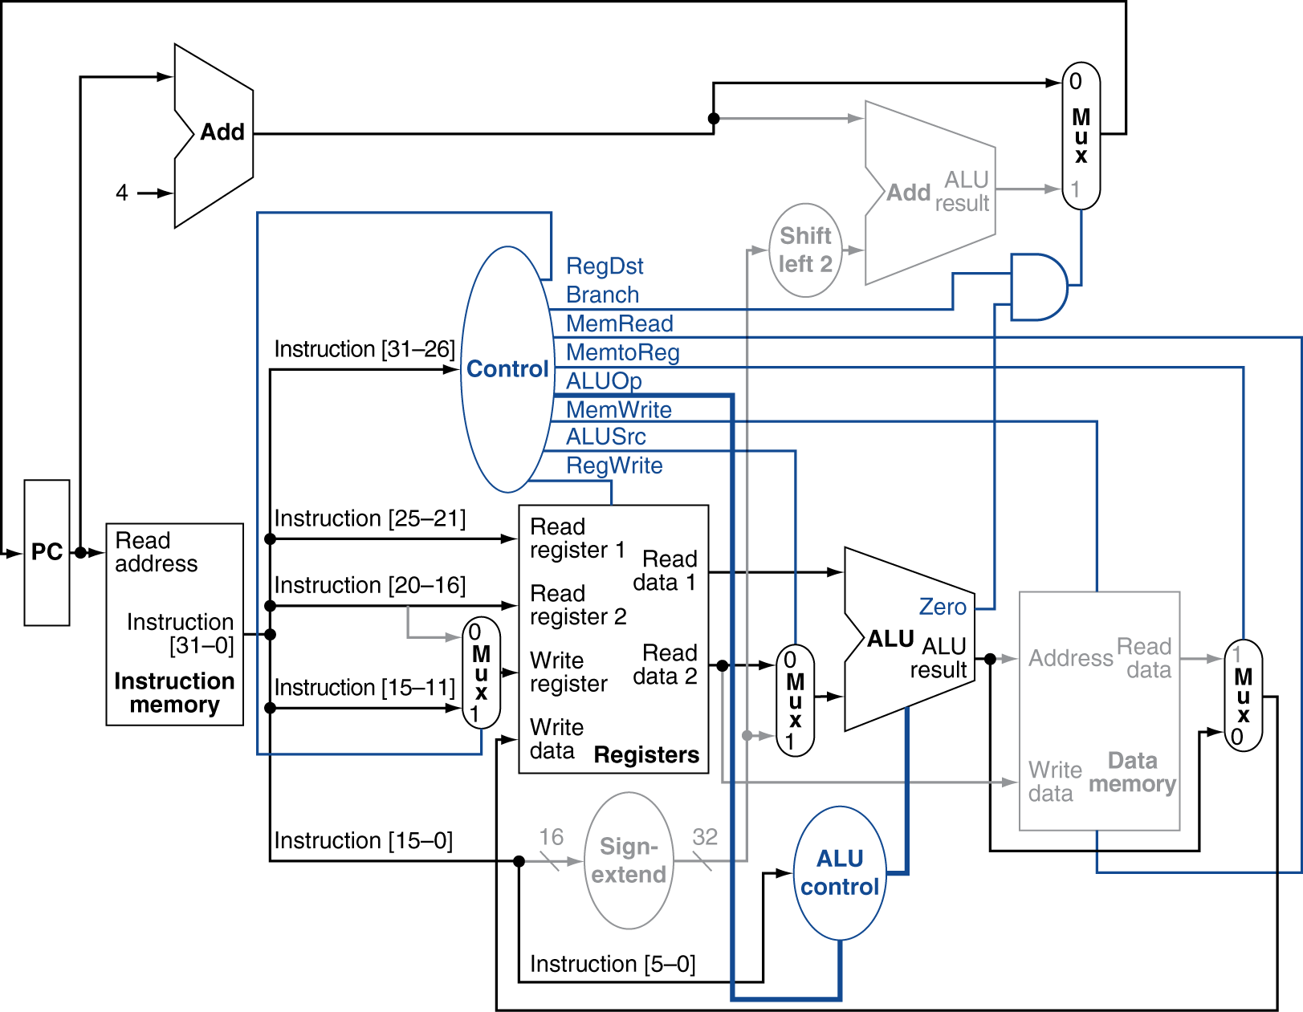
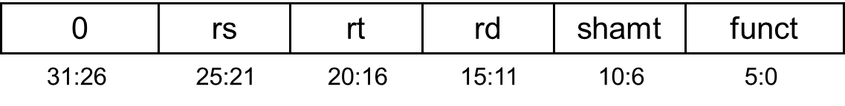
R-Type Instruction
add $t1, $t2, $t3
sub $t1, $t2, $t3

Slide 20
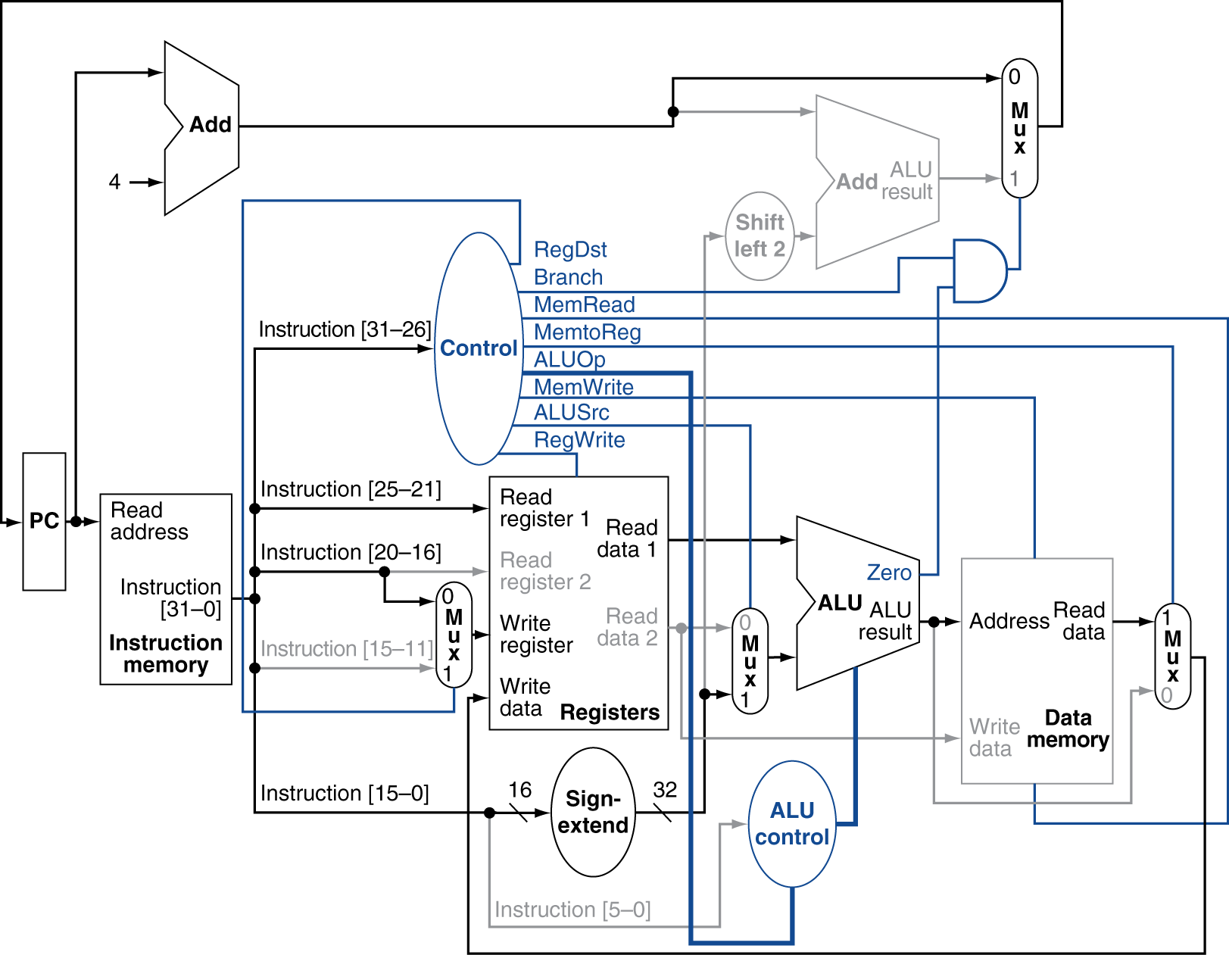
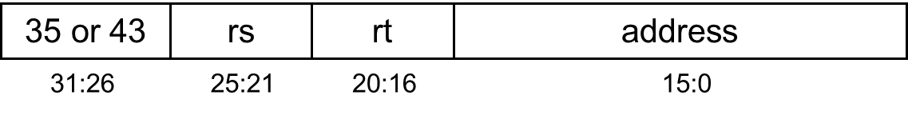
Load Instruction
lw $t1, 100($t2)
What about addi ?

Slide 21
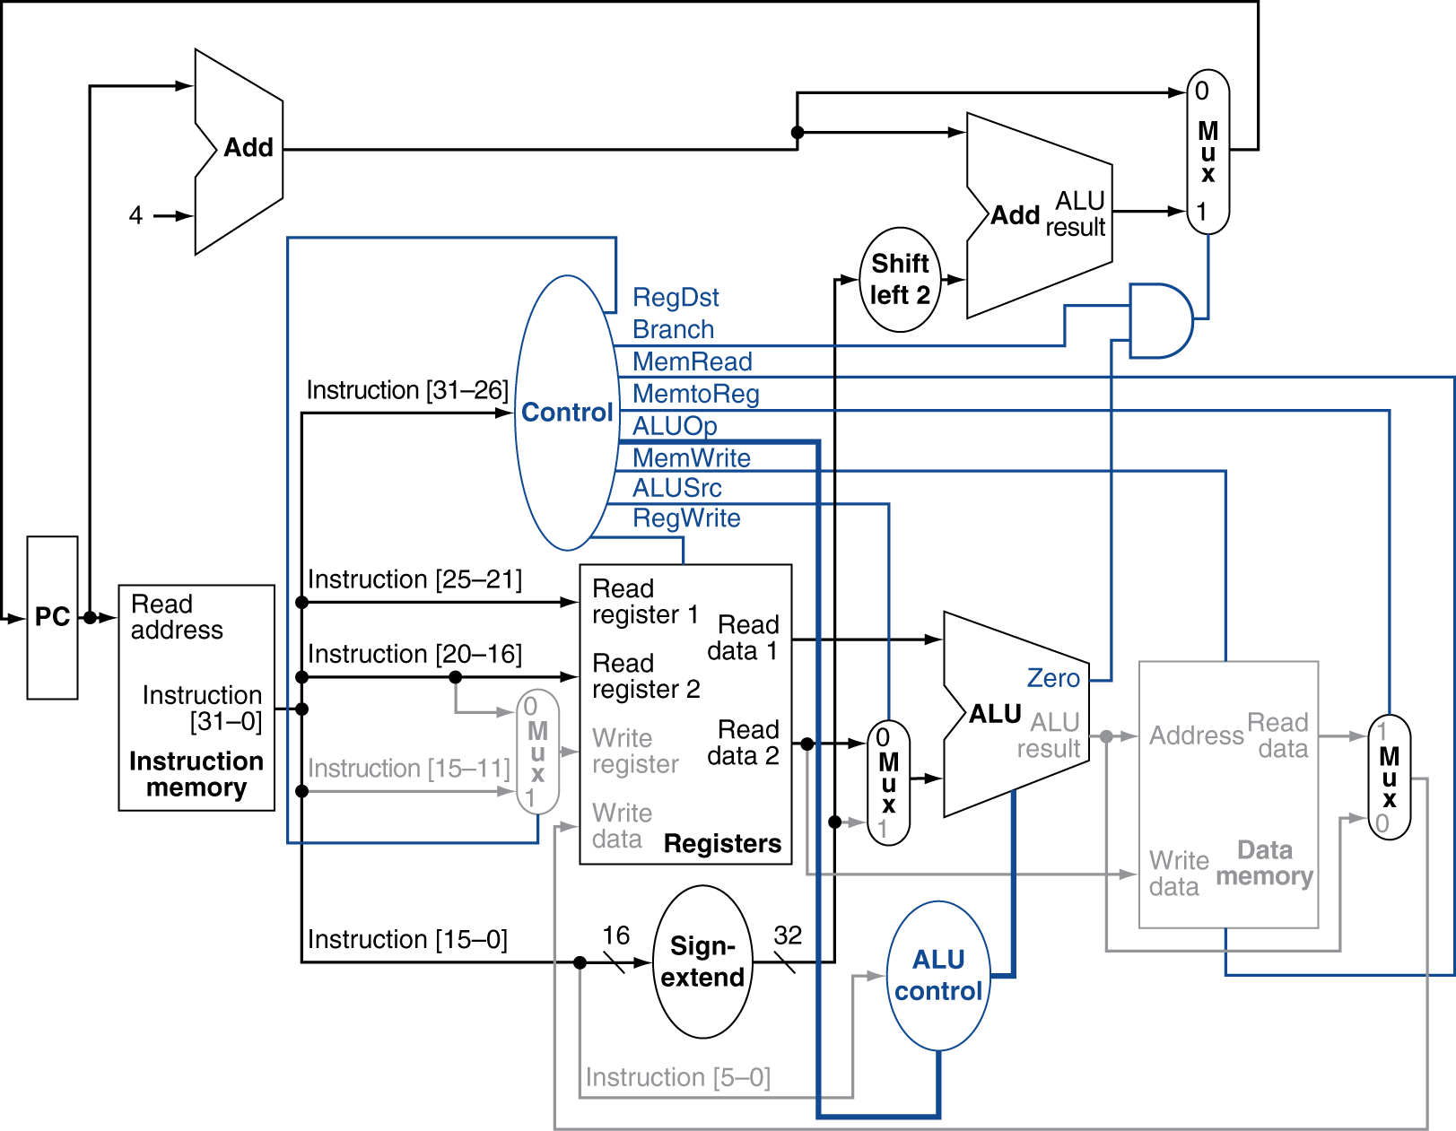
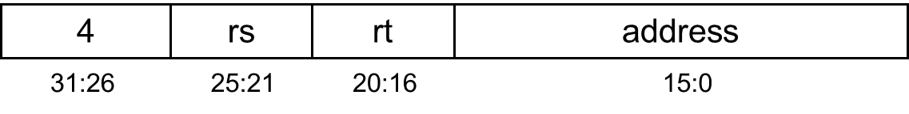
Branch-on-Equal Instruction

Slide 22
Implementing Jumps
Jump
2
address
31:26
25:0
Jump uses word address
Update PC with concatenation of
Top 4 bits of old PC
26-bit jump address
Need an extra control signal decoded from opcode

Slide 23
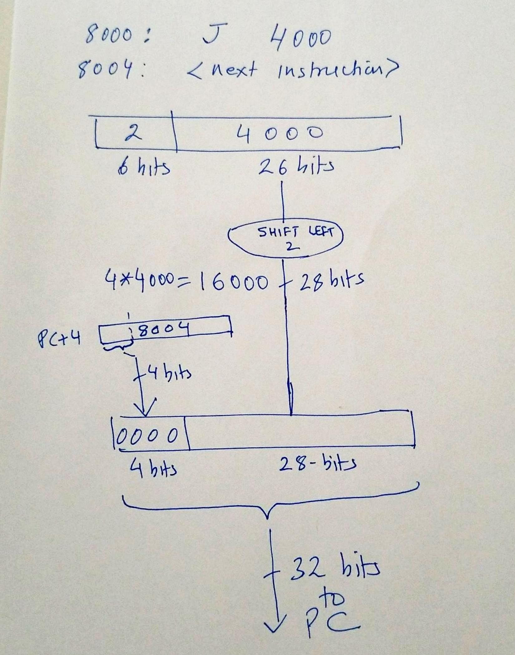
Implementing Jumps

Slide 24
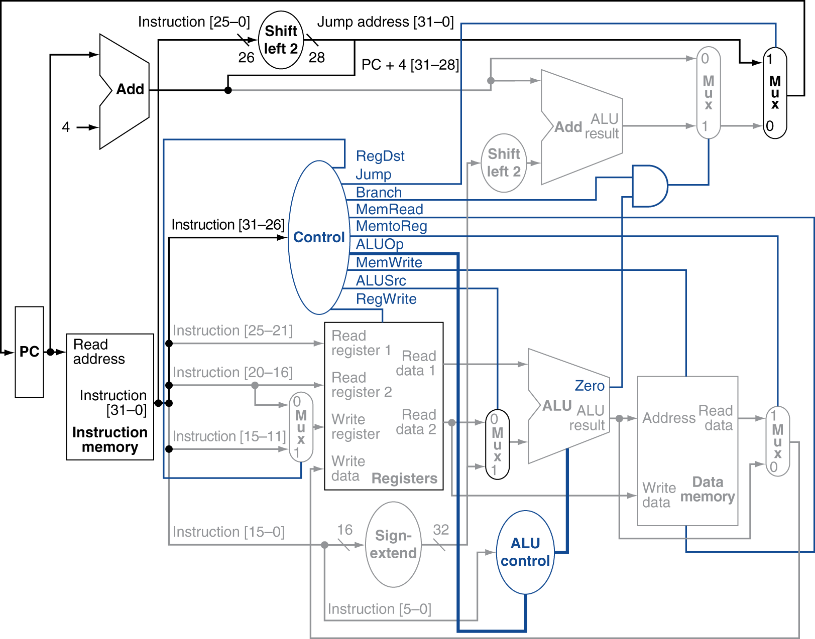
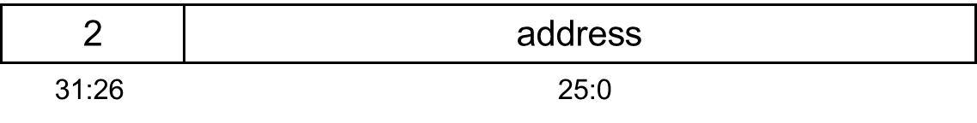
Datapath With Jumps Added

