Slide 1
Chapter 4
Pipelining II
Reference: Section 4.6 and Section 4.7

Slide 2
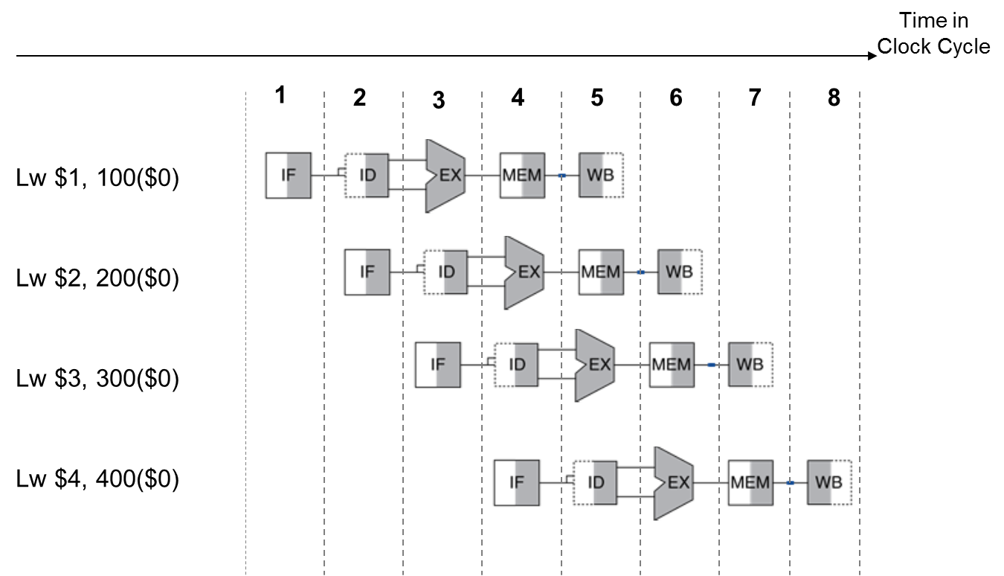
Pipeline Diagrams-Multi Clock Cycle

Slide 3
Pipeline Diagrams-Multi Clock Cycle (with Stalls)

Slide 4
Pipeline Diagrams-Multi Clock Cycle (with Stalls)
Compact Representation

Slide 5
Pipeline Diagrams-Multi Clock Cycle
Compact Representation

Slide 6
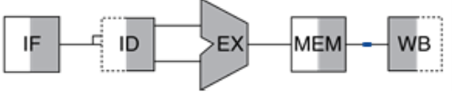
Pipeline Diagrams-Single Clock Cycle
Resources being used in Cycle 4 by different instructions
Take a snapshot of resources being used in a cycle by different instructions:
Lw $4, 400($0)
Lw $3, 300($0)
Lw $2, 200($0)
Lw $1, 100($0)

Slide 7
Pipeline Diagrams-Single Clock Cycle (with Stalls)

Slide 8
Pipeline Diagrams-Single Clock Cycle (with Stalls)

Slide 9
Pipeline Diagrams-Single Clock Cycle (with Stalls)

Slide 10
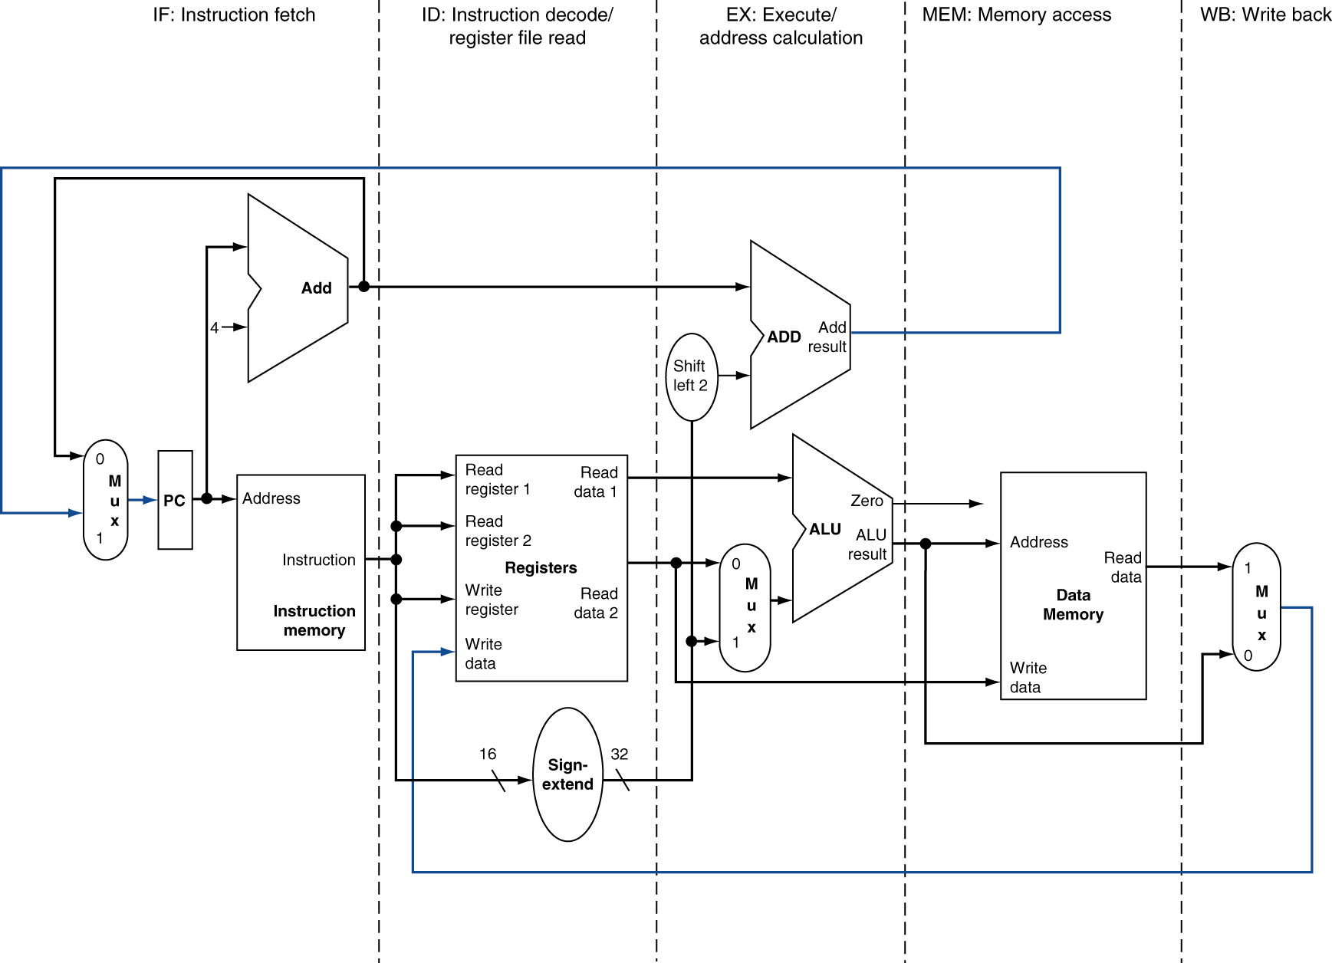
MIPS Pipelined Datapath
§4.6 Pipelined Datapath and Control

Slide 11
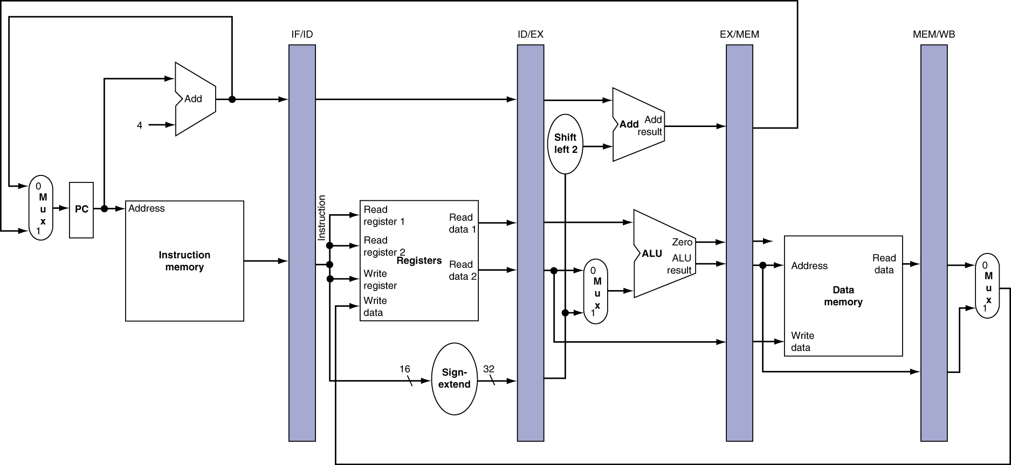
Pipeline registers
Need registers between stages
To hold information produced in previous cycle

Slide 12
Pipeline Operation
Cycle-by-cycle flow of instructions through the pipelined datapath
“Single-clock-cycle” pipeline diagram
Shows pipeline usage in a single cycle
Highlight resources used
c.f. “multi-clock-cycle” diagram
Graph of operation over time
We’ll look at “single-clock-cycle” diagrams for load & store

Slide 13
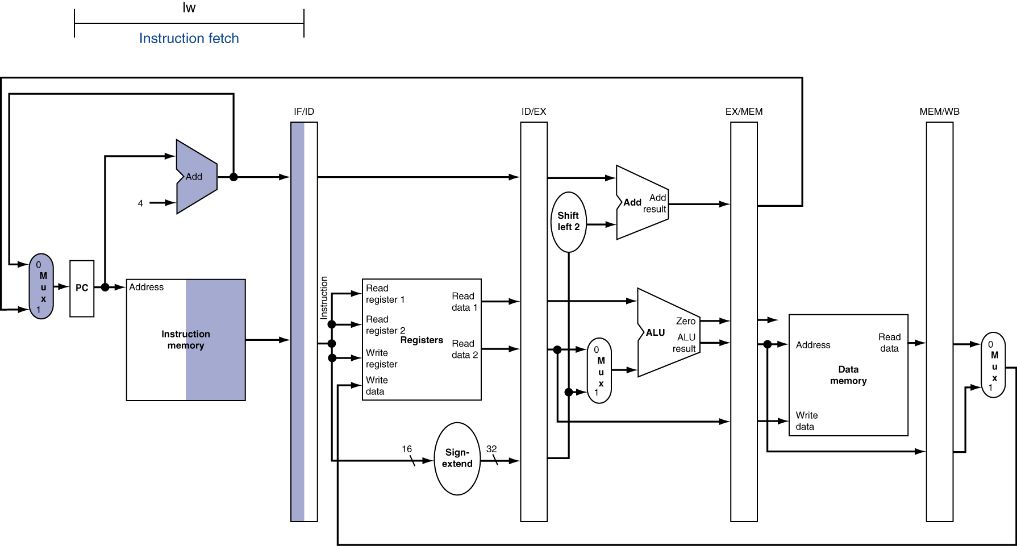
IF for Load, Store, …

Slide 14
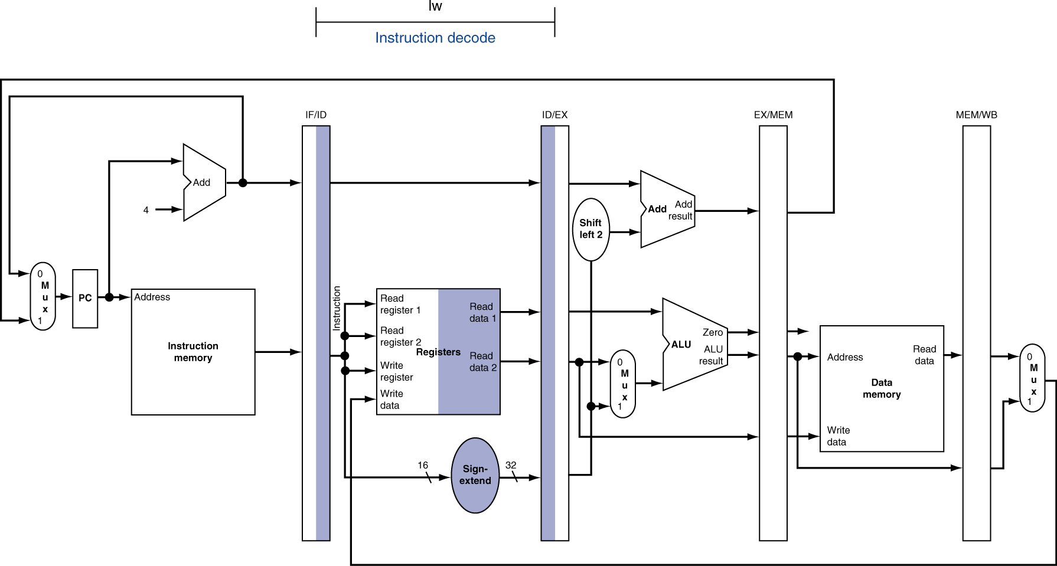
ID for Load, Store, …

Slide 15
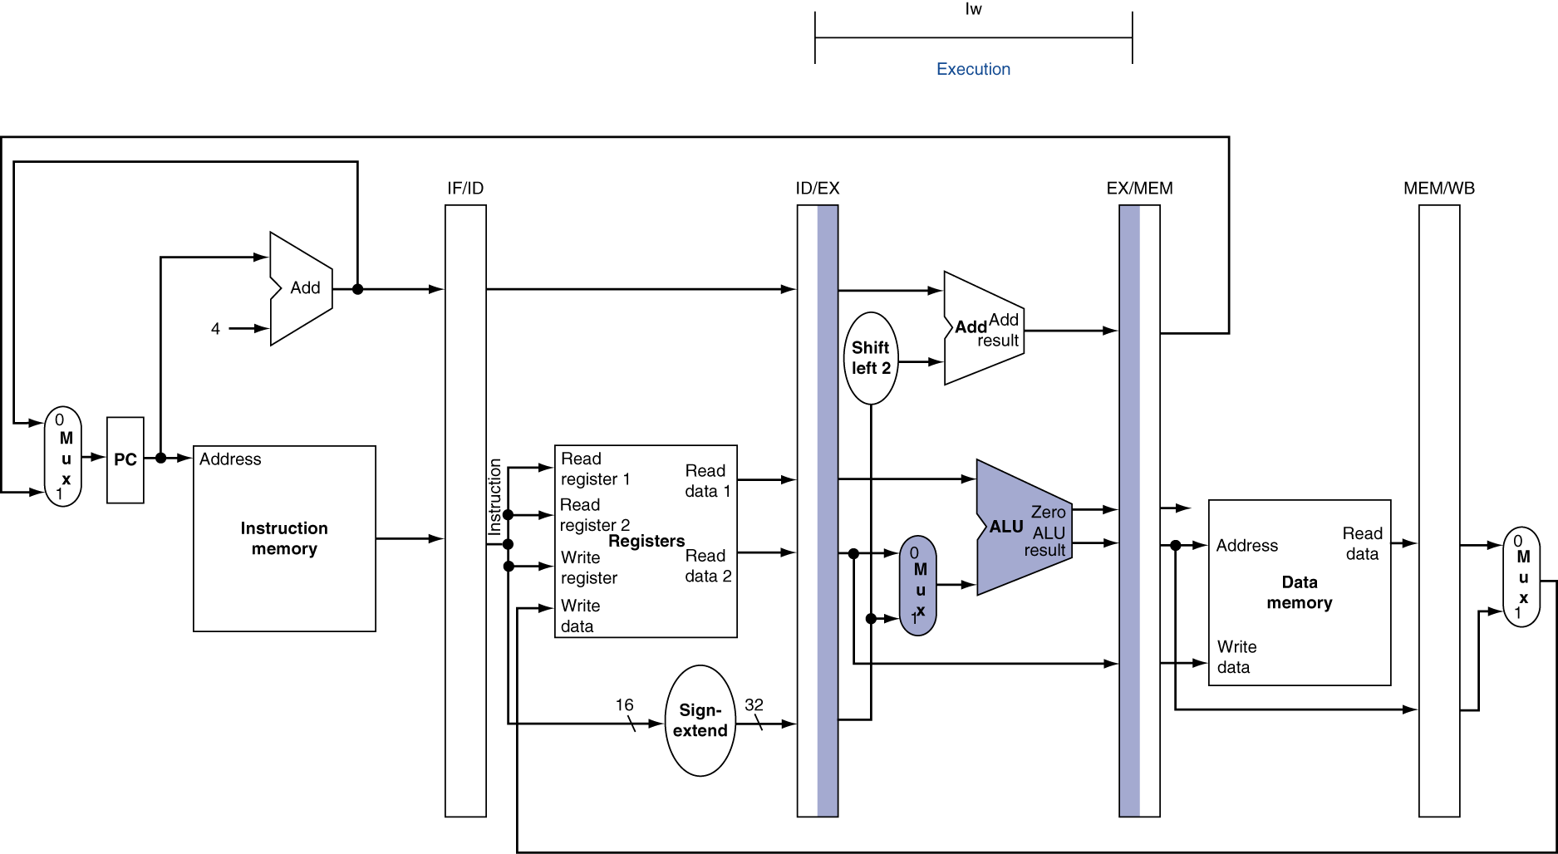
EX for Load

Slide 16
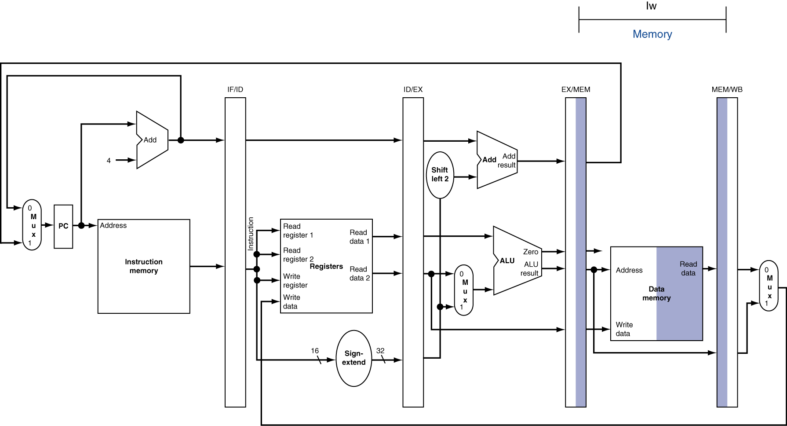
MEM for Load

Slide 17
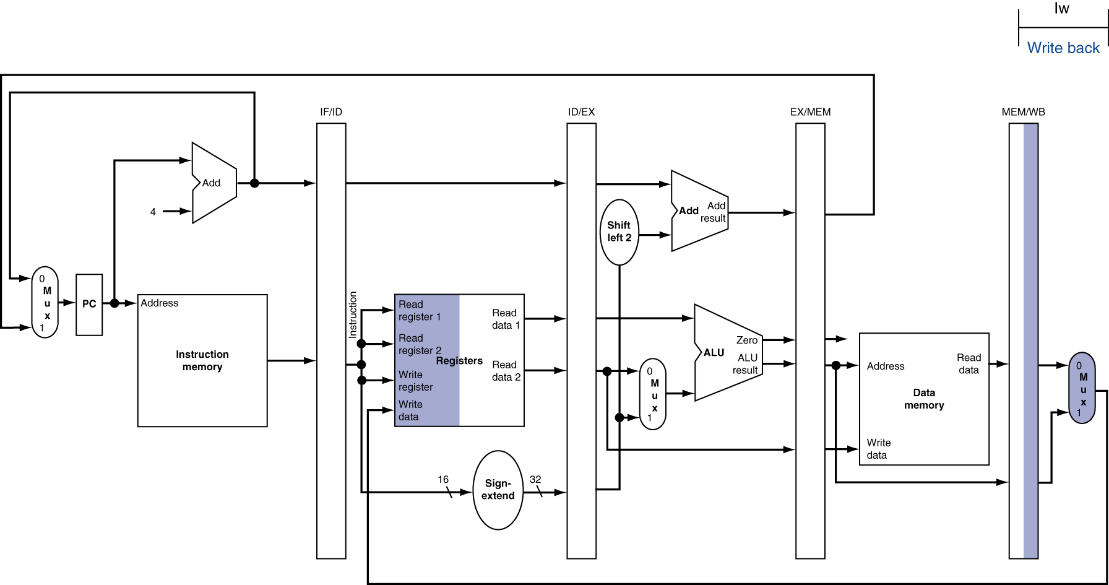
WB for Load
Wrong register number

Slide 18
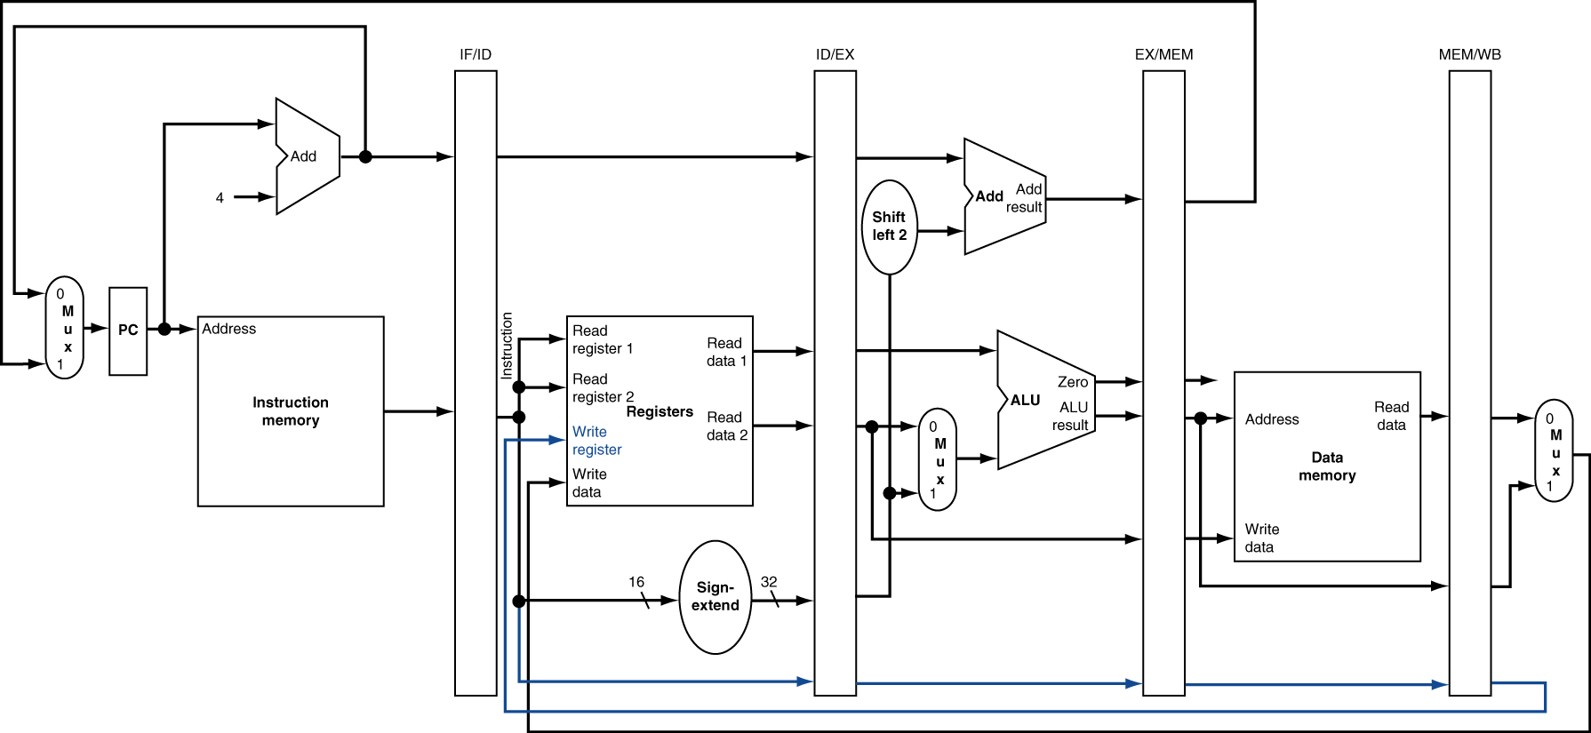
Corrected Datapath for Load

Slide 19

EX for Store

Slide 20
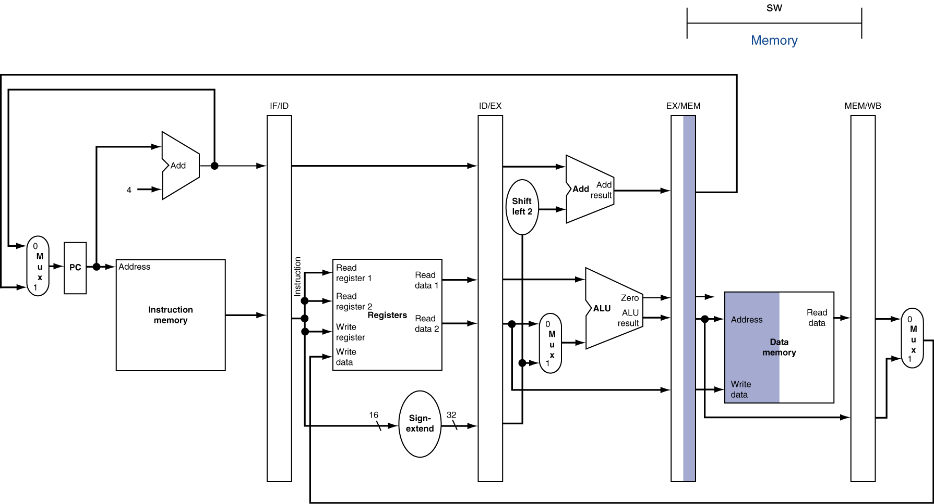
MEM for Store

Slide 21
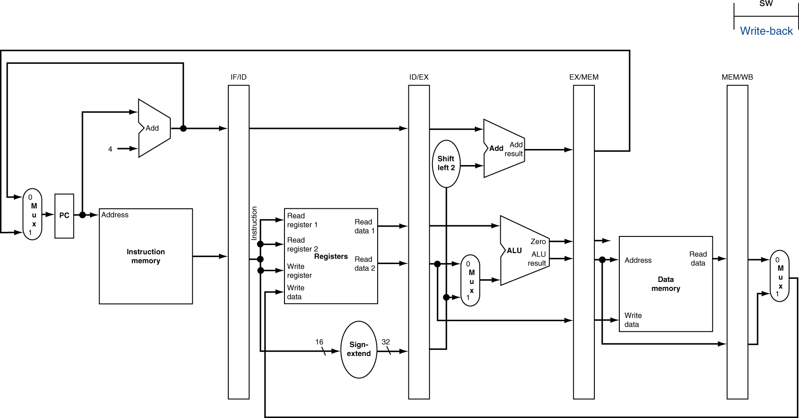
WB for Store

Slide 22
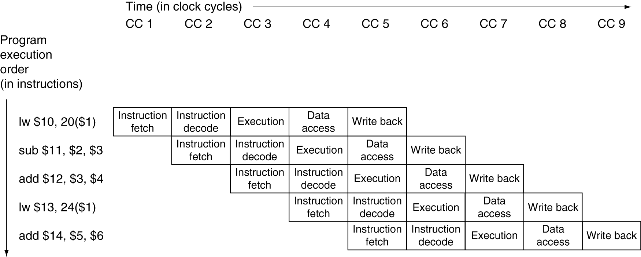
Multi-Cycle Pipeline Diagram
Traditional form

Slide 23
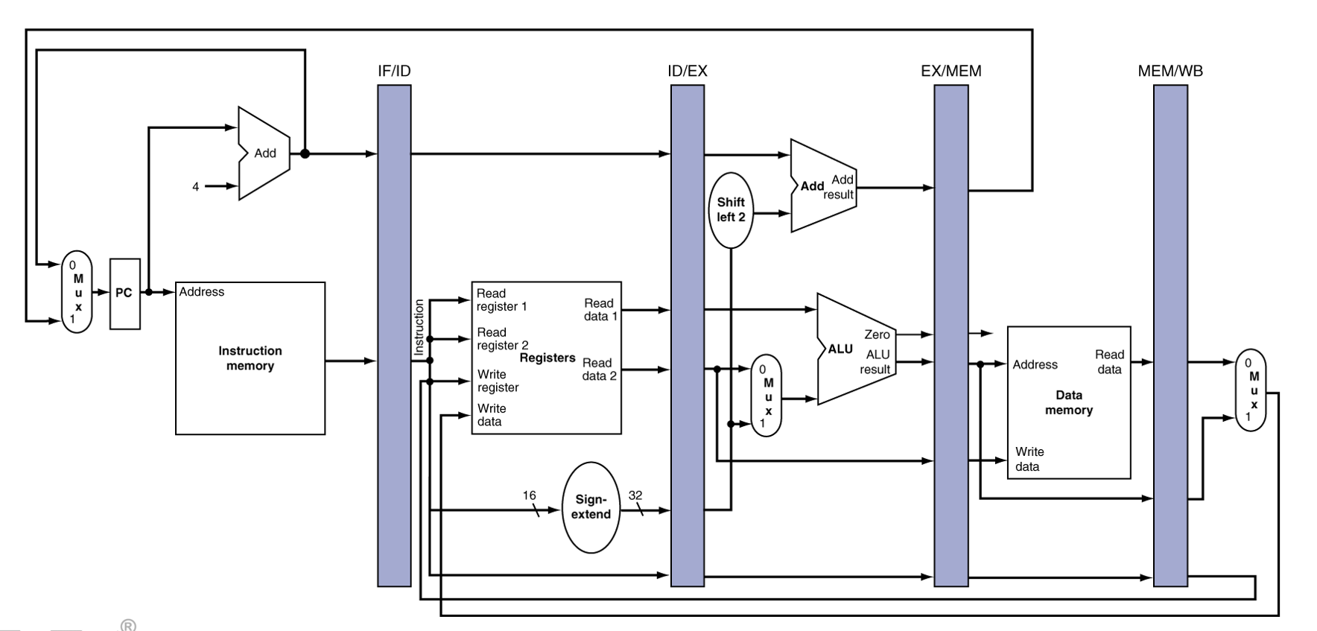
Single-Cycle Pipeline Diagram
State of pipeline in a given cycle

Slide 24
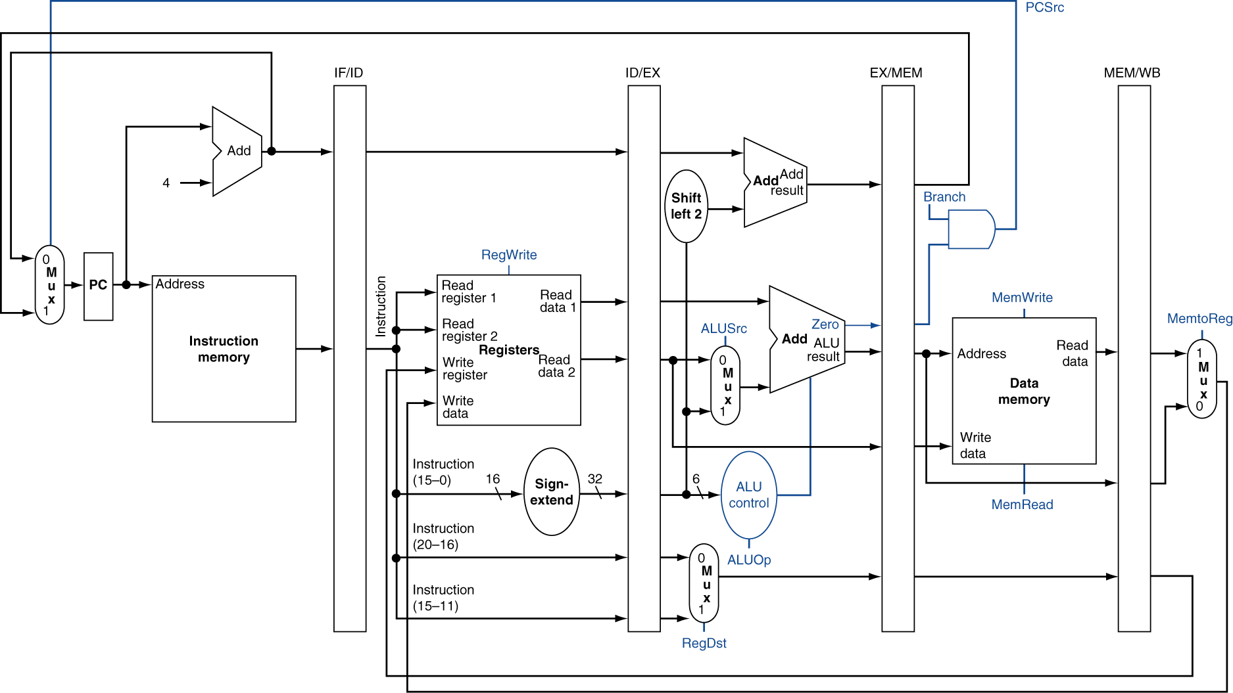
Pipelined Control (Simplified)

Slide 25
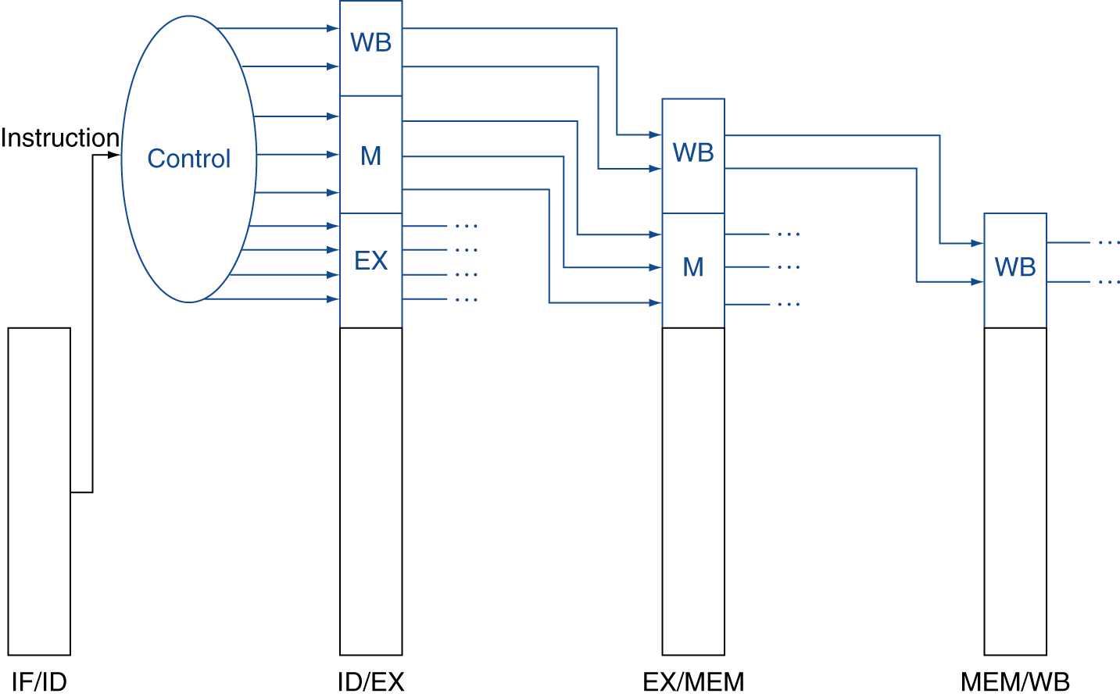
Pipelined Control
Control signals derived from instruction
As in single-cycle implementation

Slide 26
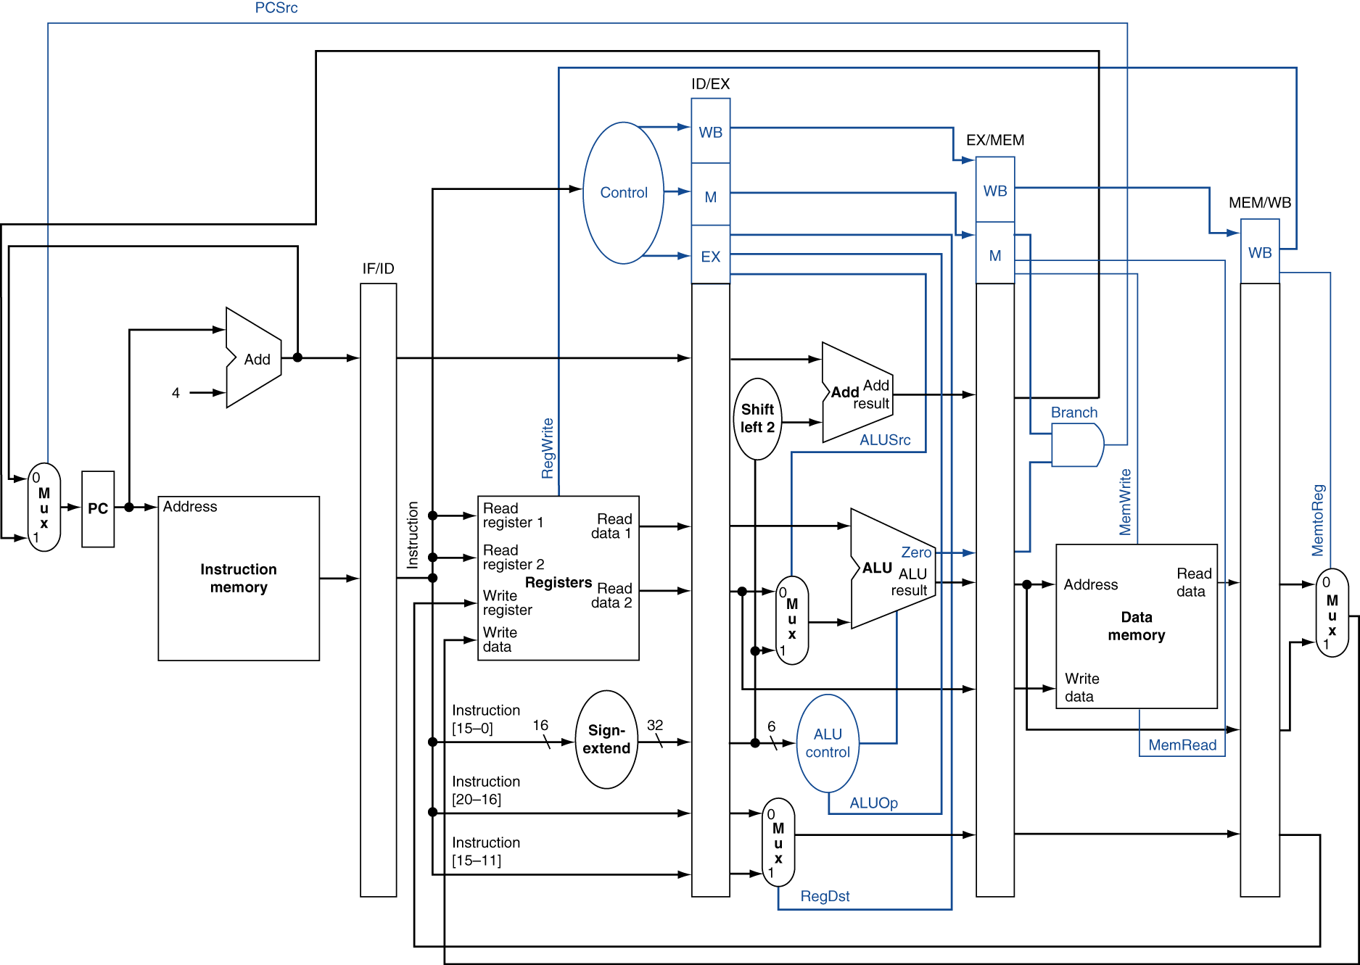
Pipelined Control

Slide 27

Pipelined Control

Slide 28
Pipelined Control
?

Slide 29
Pipelined Control
?
?
?
?

Slide 30
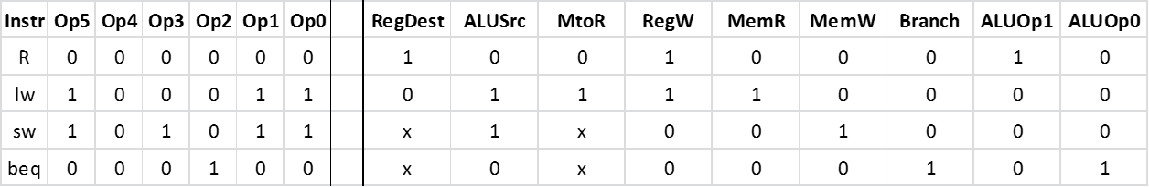
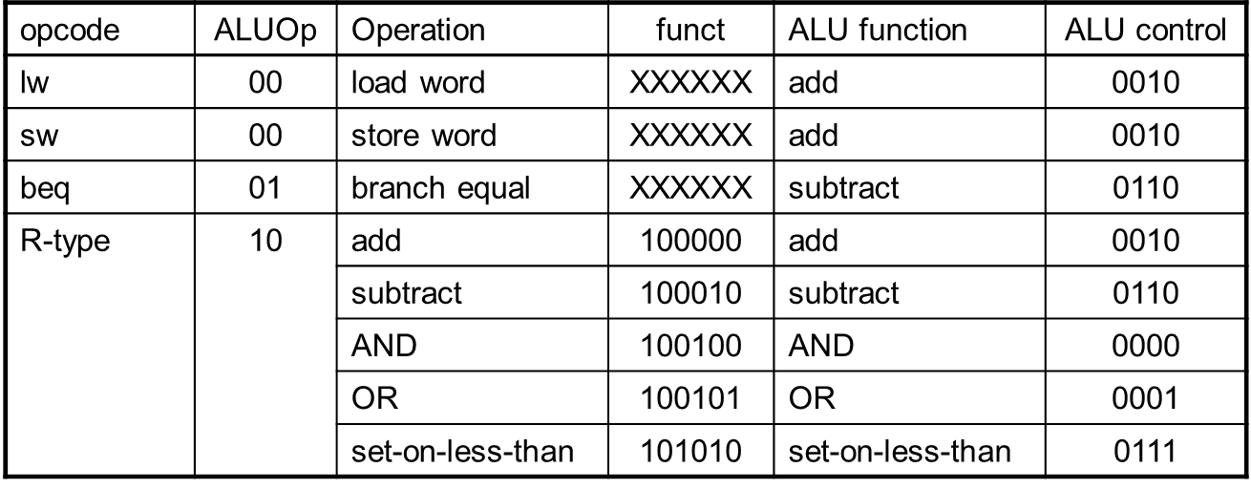
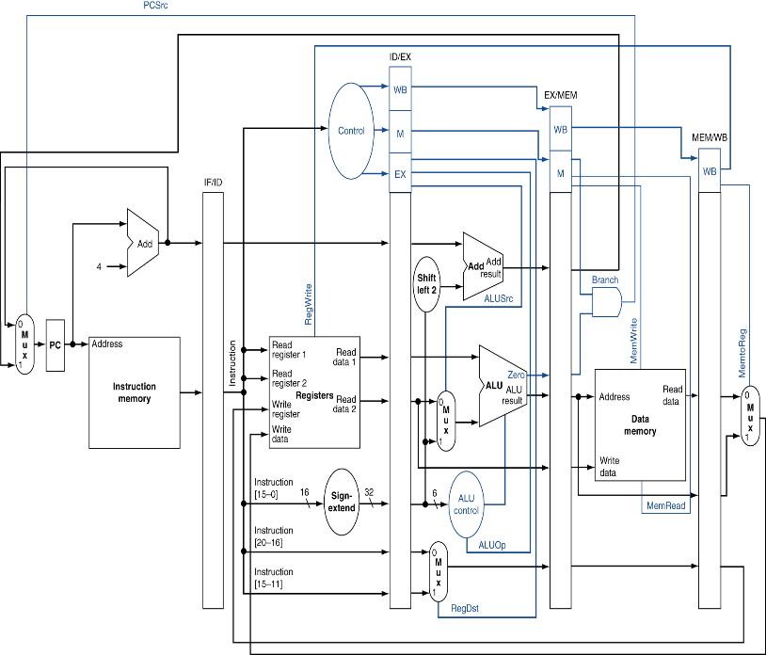
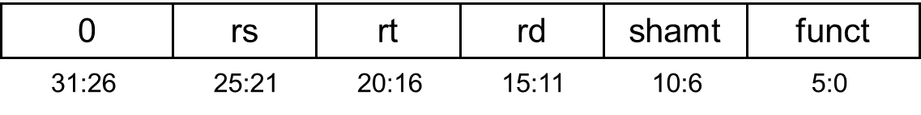
Pipelined Control
?
?
?
?

Slide 31
Pipelined Control
?
?
?

Slide 32
Pipelined Control
?
?

Slide 33

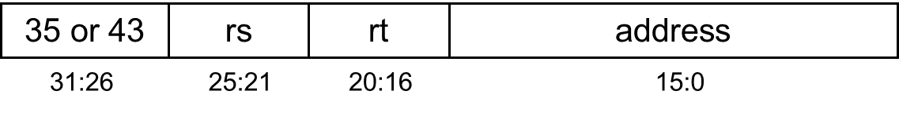
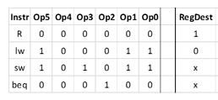
Pipelined Control
?
?

Slide 34
Data Hazards in ALU Instructions
Consider this sequence:
sub $2, $1,$3 and $12,$2,$5 or $13,$6,$2 add $14,$2,$2 sw $15,100($2)
We can resolve hazards with forwarding
How do we detect when to forward?
§4.7 Data Hazards: Forwarding vs. Stalling

Slide 35
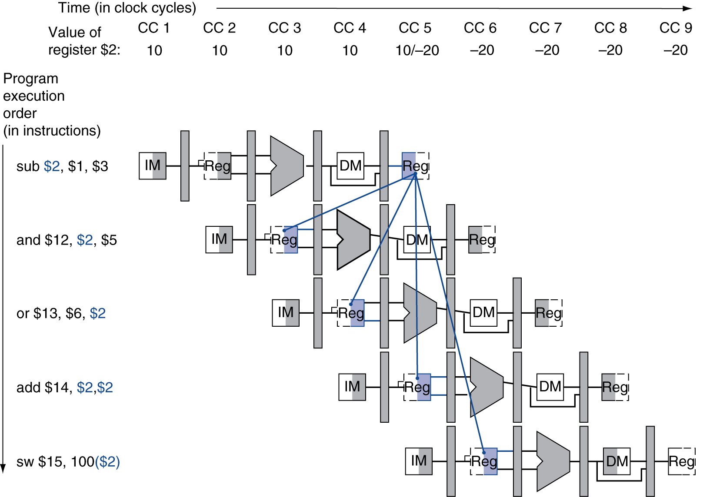
Dependencies & Forwarding

Slide 36
Detecting the Need to Forward
Pass register numbers along pipeline
e.g., ID/EX.RegisterRs = register number for Rs sitting in ID/EX pipeline register

Slide 37
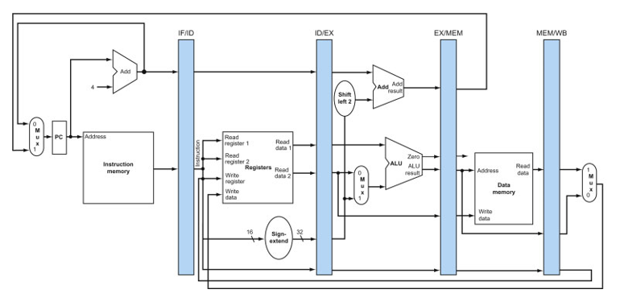
add $14, $2, $2
or $13, $6, $2
and $12, $2, $5
sub $2, $1, $3
Instruction Fetch
Instruction Decode
Execute
Memory
Write Back
ID/EX.RegisterRs = EX/MEM.RegisterRd = $2

Slide 38
add $14, $2, $2
or $13, $6, $2
and $12, $5 ,$2
sub $2, $1, $3
Instruction Fetch
Instruction Decode
Execute
Memory
Write Back
ID/EX.RegisterRt = EX/MEM.RegisterRd = $2

Slide 39
Detecting the Need to Forward
Pass register numbers along pipeline
e.g., ID/EX.RegisterRs = register number for Rs sitting in ID/EX pipeline register
ALU operand register numbers in EX stage are given by
ID/EX.RegisterRs, ID/EX.RegisterRt
Data hazards when
1a. EX/MEM.RegisterRd = ID/EX.RegisterRs
1b. EX/MEM.RegisterRd = ID/EX.RegisterRt
Fwd from EX/MEM pipeline reg

Slide 40
sw $15, 100($2)
add $14, $2, $2
or $13, $6, $2
and $12, $2, $5
sub $2, $1, $3
Instruction Fetch
Instruction Decode
Execute
Memory
Write Back
ID/EX.RegisterRt = MEM/WB.RegisterRd = $2

Slide 41
Detecting the Need to Forward
Pass register numbers along pipeline
e.g., ID/EX.RegisterRs = register number for Rs sitting in ID/EX pipeline register
ALU operand register numbers in EX stage are given by
ID/EX.RegisterRs, ID/EX.RegisterRt
Data hazards when
1a. EX/MEM.RegisterRd = ID/EX.RegisterRs
1b. EX/MEM.RegisterRd = ID/EX.RegisterRt
2a. MEM/WB.RegisterRd = ID/EX.RegisterRs
2b. MEM/WB.RegisterRd = ID/EX.RegisterRt
Fwd from EX/MEM pipeline reg
Fwd from MEM/WB pipeline reg

Slide 42
Detecting the Need to Forward
But only if forwarding instruction will write to a register!
EX/MEM.RegWrite, MEM/WB.RegWrite
And only if Rd for that instruction is not $zero
EX/MEM.RegisterRd ≠ 0, MEM/WB.RegisterRd ≠ 0

Slide 43
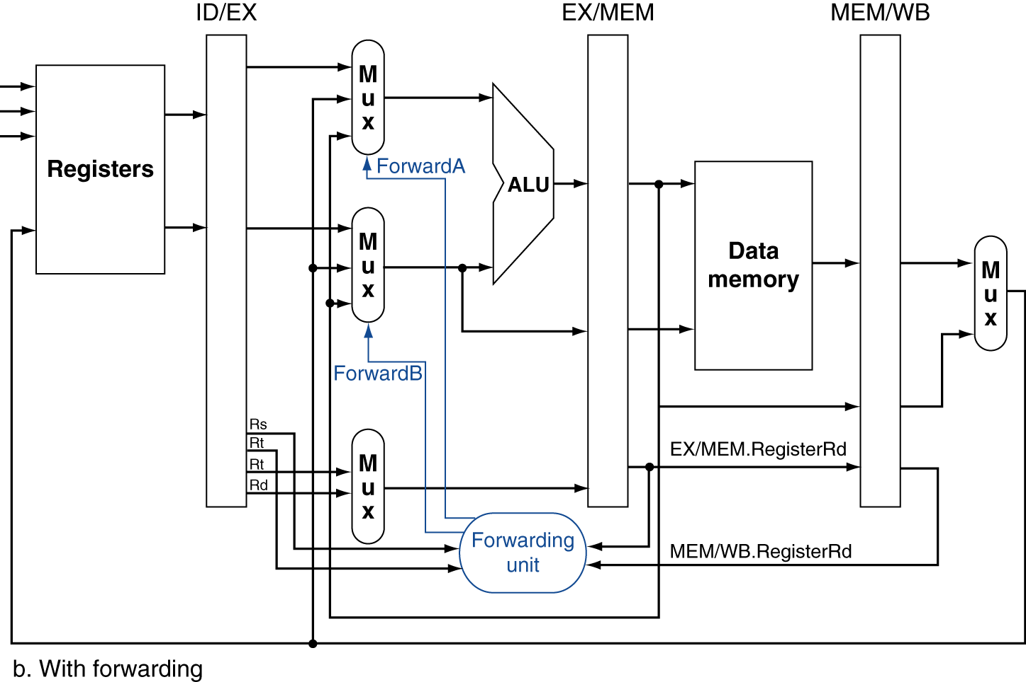
Forwarding Paths
10
10

Slide 44
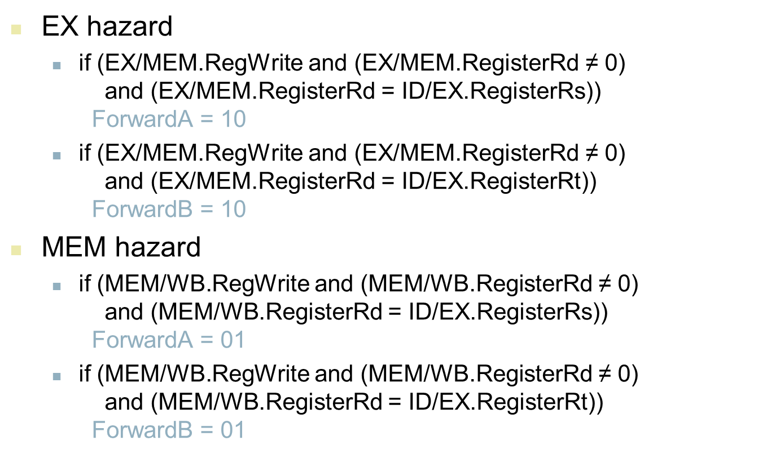
Forwarding Paths
10
10

Slide 45
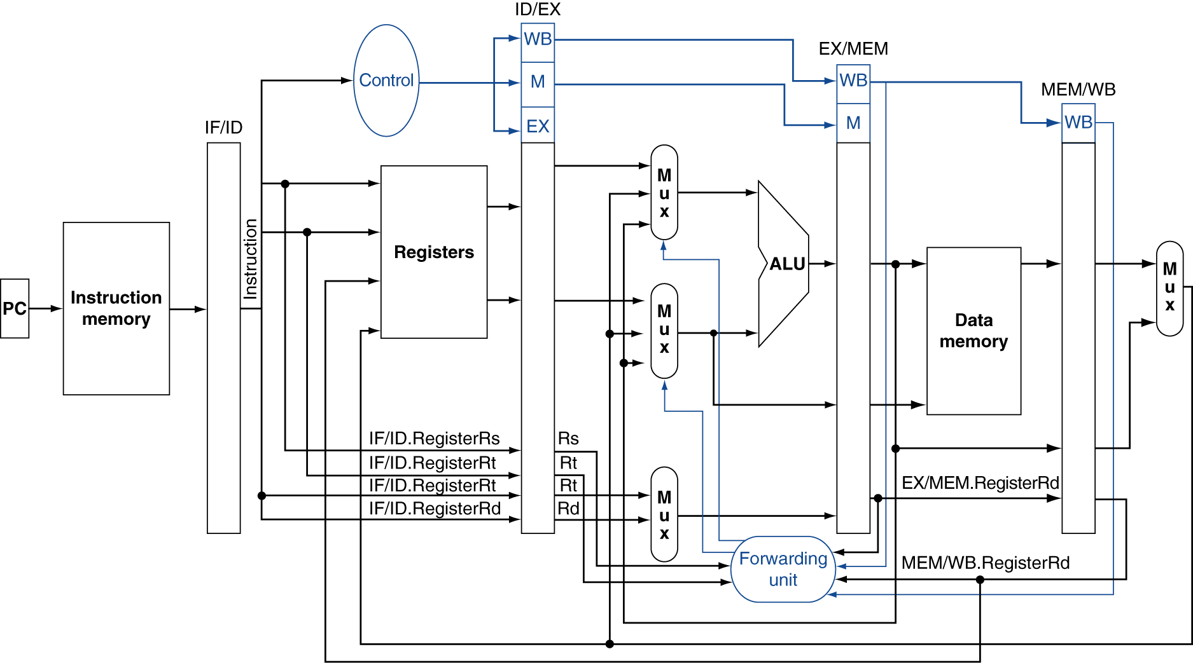
Datapath with Forwarding

Slide 46
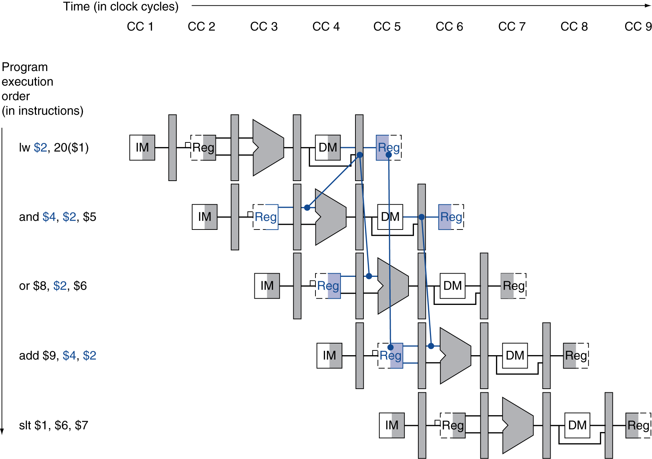
Load-Use Data Hazard
Need to stall for one cycle

Slide 47
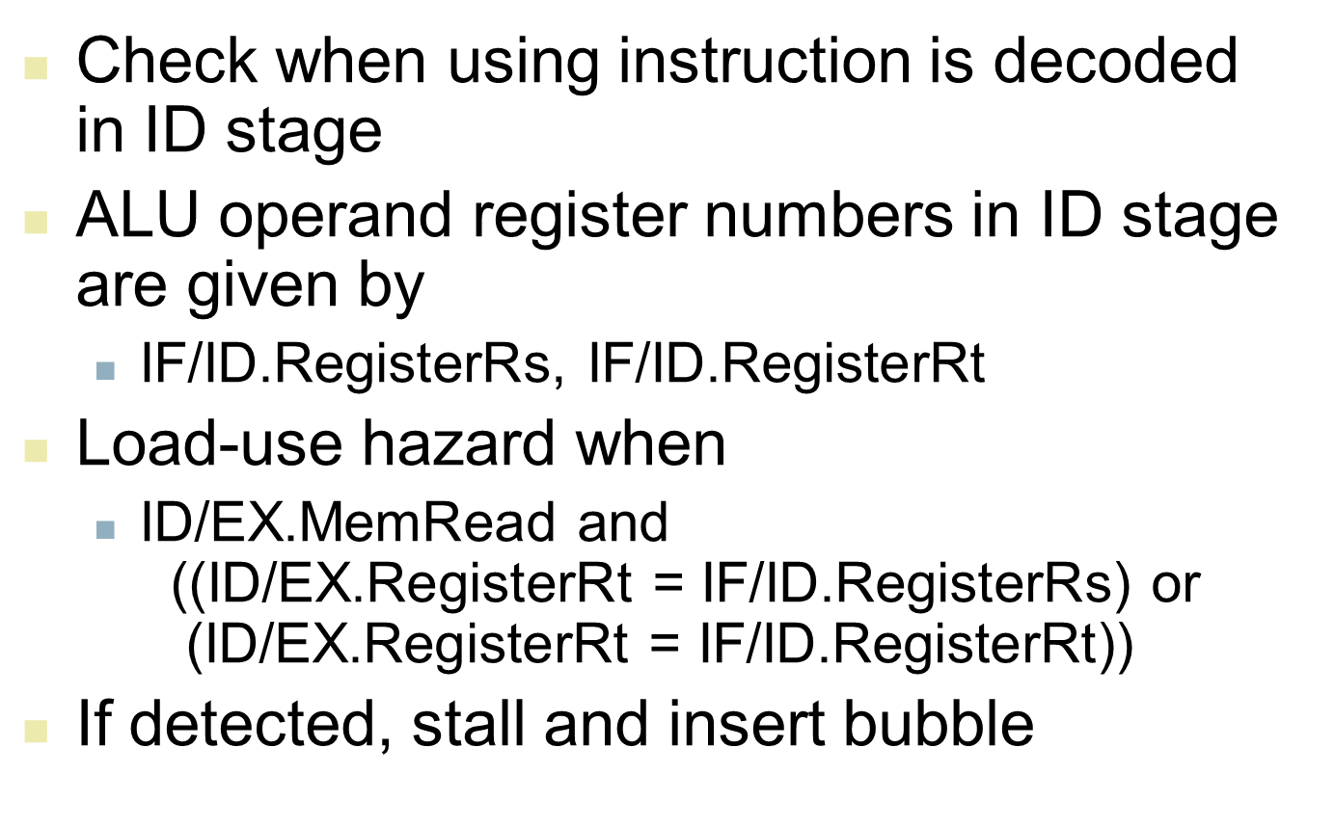
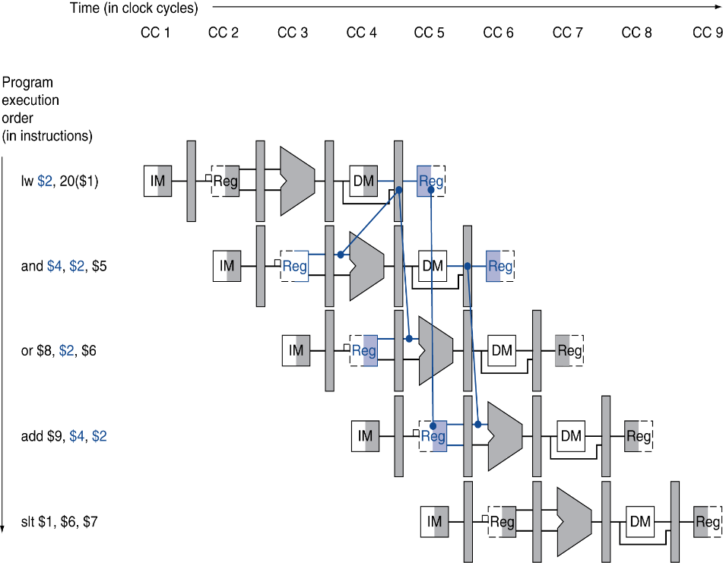
Load-Use Data Hazard

Slide 48
How to Stall the Pipeline
Force control values in ID/EX register to 0
EX, MEM and WB do nop (no-operation)
Prevent update of PC and IF/ID register
Using instruction is decoded again
Following instruction is fetched again
1-cycle stall allows MEM to read data for lw
Can subsequently forward to EX stage

Slide 49
Cycle 3- Data hazard detected between “lw” and “and”
or $8, $2, $5
and $4, $2, $5
lw $2, 20($1)
Instruction Fetch
Instruction Decode
Execute
Memory
Write Back

Slide 50
or instruction is fetched again
continue to stay in ID stage
Cycle 4- Bubble and Freeze
or $8, $2, $5
and $4, $2, $5
NOP
lw $2, 20($1)
Instruction Fetch
Instruction Decode
Execute
Memory
Write Back

Slide 51
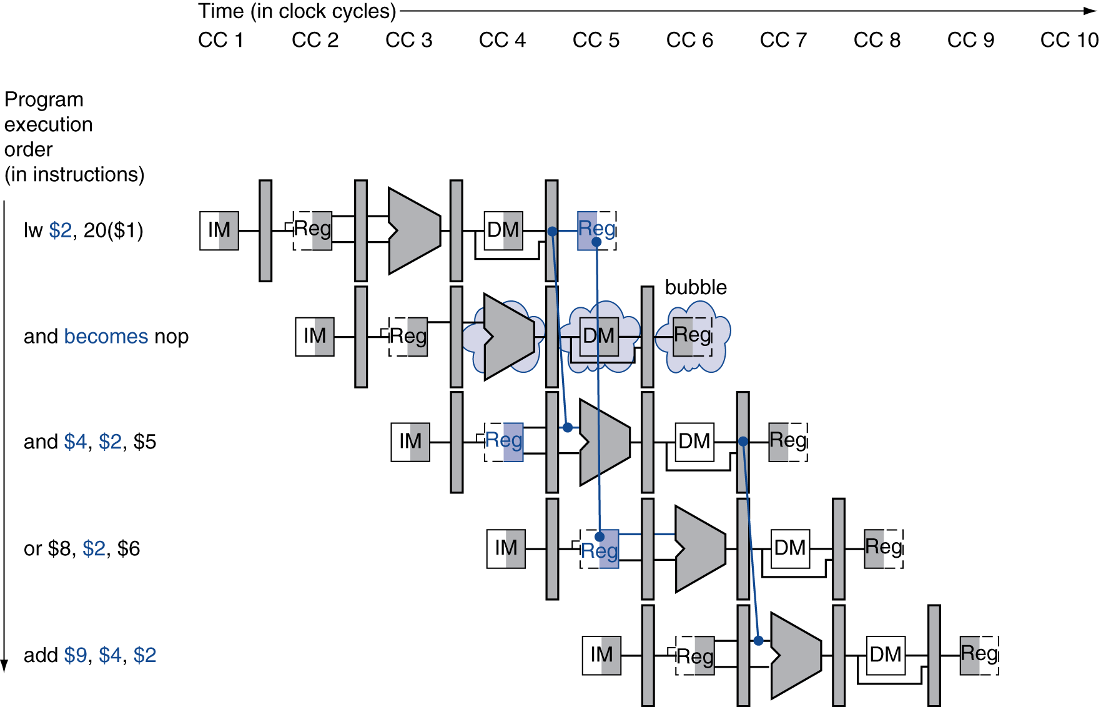
Stall/Bubble in the Pipeline
Stall inserted here

Slide 52
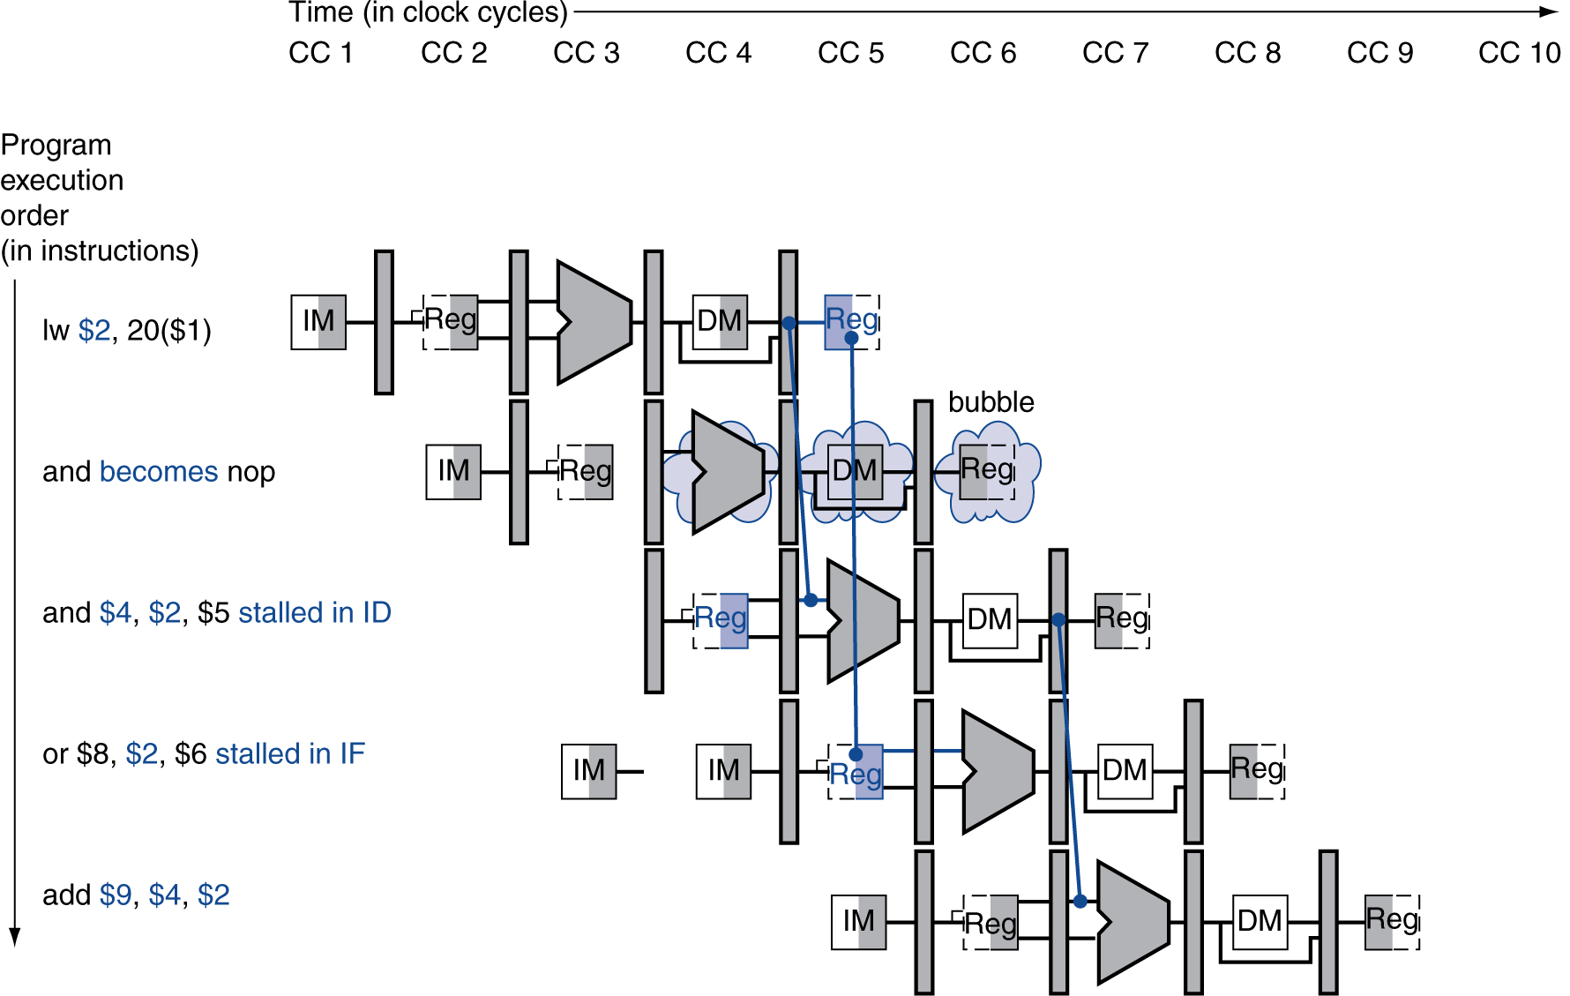
Stall/Bubble in the Pipeline
Or, more accurately…

Slide 53
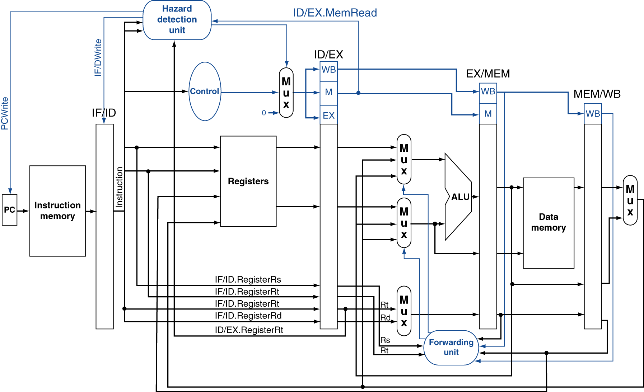
Datapath with Hazard Detection
PCWrite Disabled ensures
same instr (or $8,$2,$5) is
fetched again
IF/IDWrite disabled ensures
instr (add $4,$2,$5) stays in
ID stage

Slide 54
Stalls and Performance
The BIG Picture
Stalls reduce performance
But are required to get correct results
Compiler can arrange code to avoid hazards and stalls
Requires knowledge of the pipeline structure

