Slide 1
Chapter 4
Pipelining III
Reference: Section 4.8 and Section 4.10

Slide 2
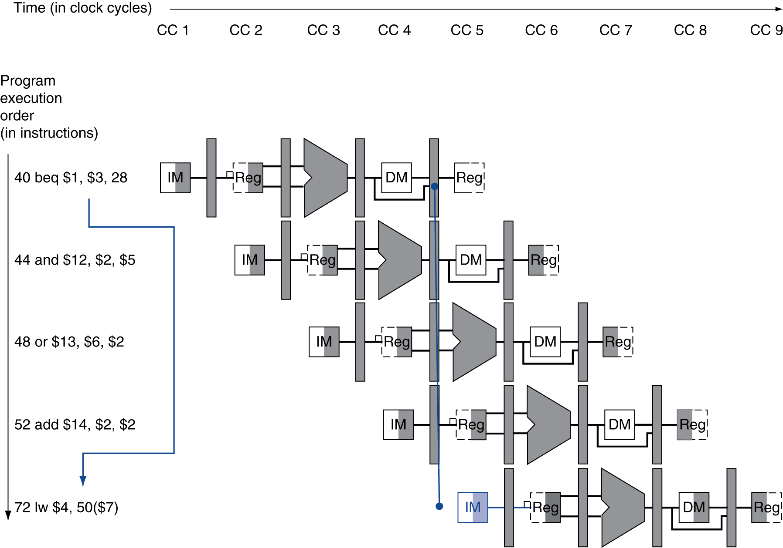
Branch Hazards
§4.8 Control Hazards
If branch outcome determined in MEM
typo (7)
Flush these instructions
(Set control values to 0)
PC

Slide 3
Reducing Branch Delay
Move hardware to determine outcome to ID stage
Target address adder
Register comparator
Issues
Forwarding for the operands of branches were formerly handled by the ALU forwarding logic – now it needs new forwarding logic
In the case where branch needs an operand from a previous instruction in the pipeline
Formerly may not have been a hazard
Now because branch needs the data much earlier (ID stage), there can be a hazard

Slide 4
Hardware Example
Example: branch taken
36: sub $10, $4, $8 40: beq $1, $3, 7 44: and $12, $2, $5 48: or $13, $2, $6 52: add $14, $4, $2 56: slt $15, $6, $7 ... 72: lw $4, 50($7)

Slide 5
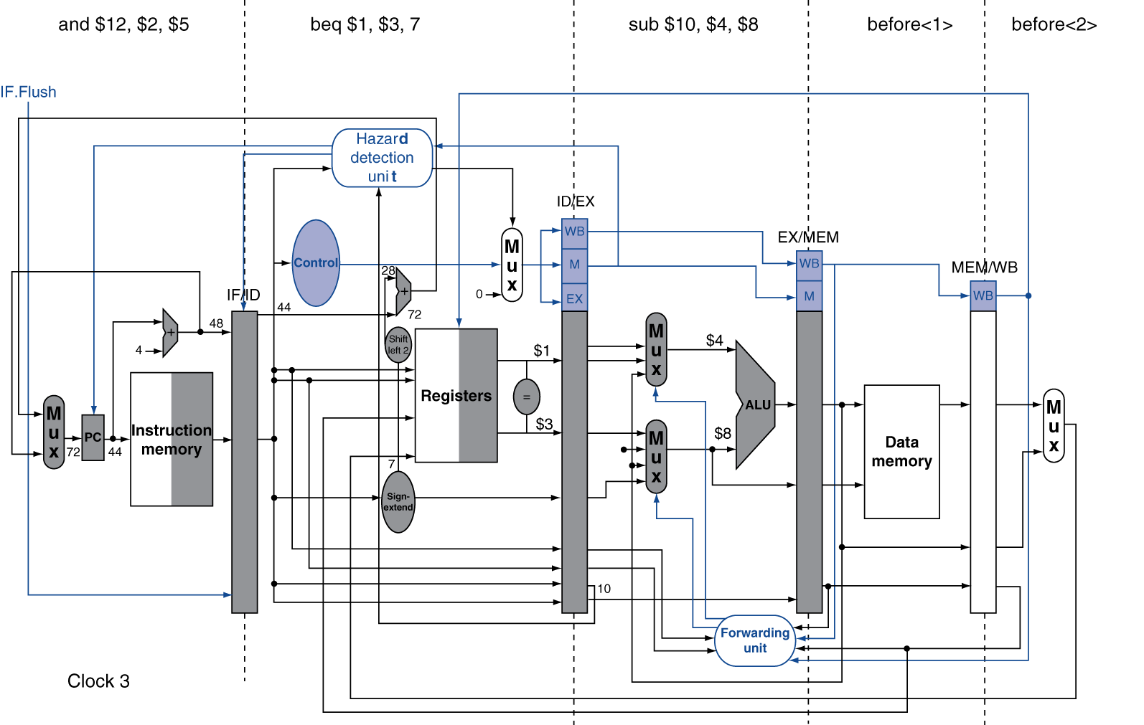
Example: Branch Taken
40 + 4 + 7*4

Slide 6
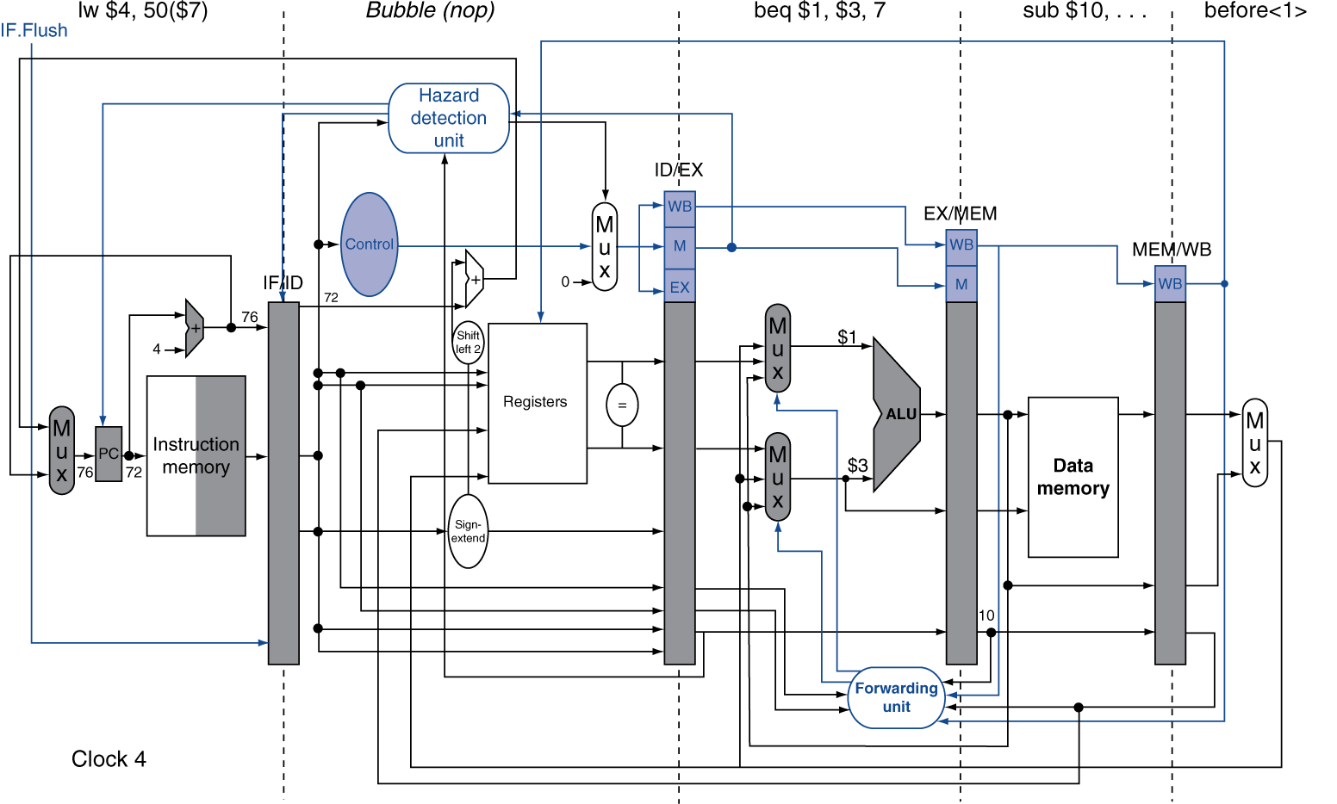
Example: Branch Taken
IF.FLush control line zeros
the instruction
fields of IF/ID Reg

Slide 7
Data Hazards for Branches
If a comparison register is a destination of 2nd or 3rd preceding ALU instruction
add $1, $2, $3
IF
ID
EX
MEM
WB
add $4, $5, $6
IF
ID
EX
MEM
WB
…
IF
ID
EX
MEM
WB
beq $1, $4, target
IF
ID
EX
MEM
WB
Can resolve using forwarding

Slide 8
Data Hazards for Branches
If a comparison register is a destination of immediately preceding load instruction
Need 2 stall cycles
lw $1, addr
IF
ID
EX
MEM
WB
beq stalled
IF
ID
beq stalled
ID
beq $1, $0, target
ID
EX
MEM
WB

Slide 9
Data Hazards for Branches
If a comparison register is a destination of preceding ALU instruction or 2nd preceding load instruction
Need 1 stall cycle
lw $1, addr
IF
ID
EX
MEM
WB
add $4, $5, $6
IF
ID
EX
MEM
WB
beq stalled
IF
ID
beq $1, $4, target
ID
EX
MEM
WB

Slide 10
Dynamic Branch Prediction
In deeper and superscalar pipelines, branch penalty is more significant
Use dynamic prediction
Branch prediction buffer (aka branch history table)
Indexed by recent branch instruction addresses
Stores outcome (taken/not taken)
To execute a branch
Check table, expect the same outcome
Start fetching from fall-through or target
If wrong, flush pipeline and flip prediction

Slide 11
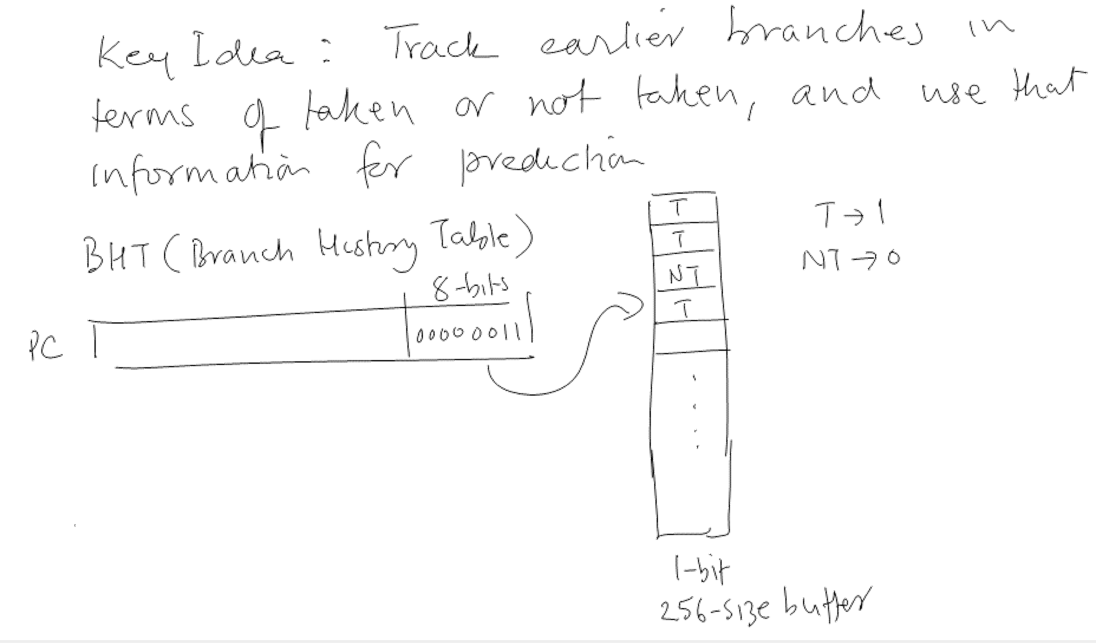
1-Bit Predictor

Slide 12
Accuracy for Different Predictors
Consider the following repeating pattern of branch outcomes:
T, NT, T, T, NT
What is the accuracy of always-taken and always-not-taken predictor
for this sequence of branch outcomes?
always-taken predictor accuracy: 3/5
always-not-taken predictor accuracy: 2/5

Slide 13
Accuracy for Different Predictors
Consider the following repeating pattern of branch outcomes:
T, NT, T, T, NT
What is the accuracy of 1-bit predictor initialized to NT for the first ten branches?
Accuracy: 2/10

Slide 14
Accuracy for Different Predictors
Consider the following repeating pattern of branch outcomes:
T, NT, T, T, NT
If the above pattern repeats forever, what is the accuracy of 1-bit predictor
initialized to NT?
Accuracy: 1/5
Accuracy: 1/5

Slide 15
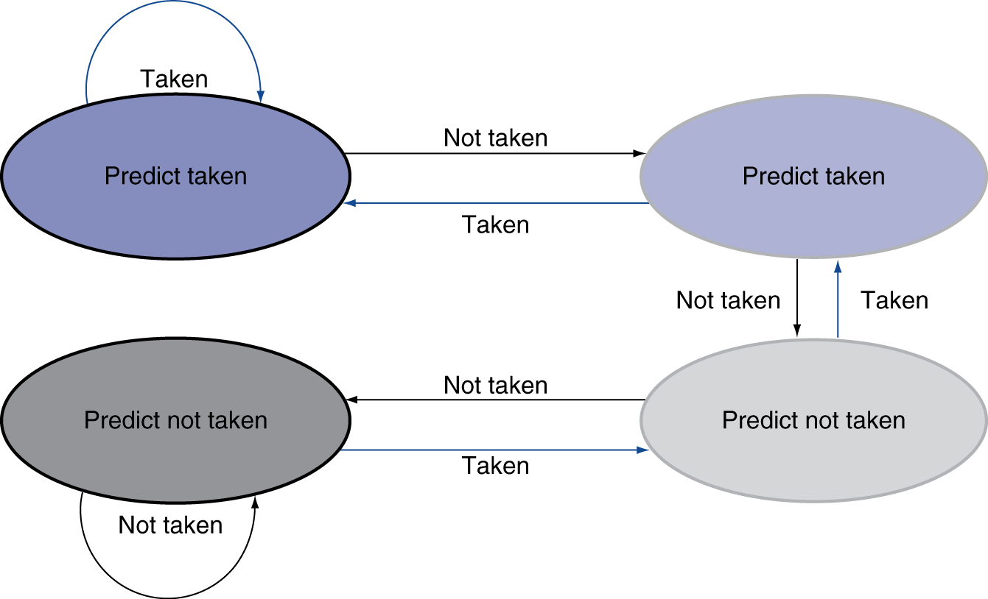
2-Bit Predictor
Only change prediction on two successive mispredictions

Slide 16
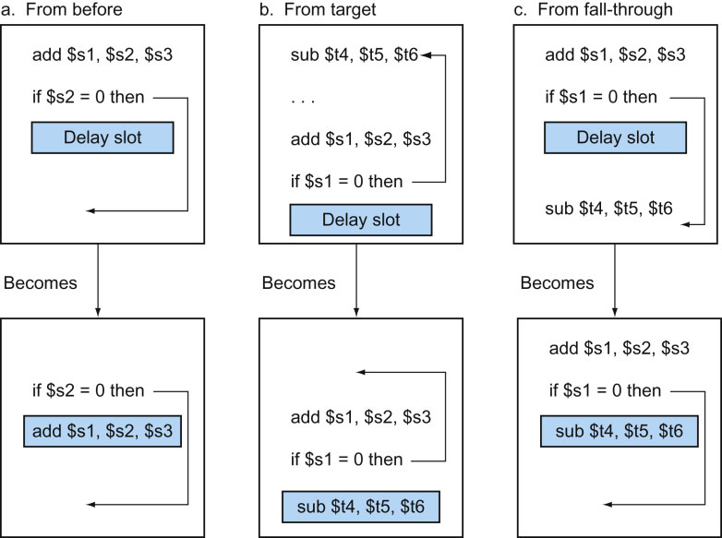
FIGURE 4.64 Scheduling the branch delay slot. The top box in each pair shows the code before scheduling; the bottom box shows the scheduled code. In (a), the delay slot is scheduled with an independent instruction from before the branch. This is the best choice. Strategies (b) and (c) are used when (a) is not possible. In the code sequences for (b) and (c), the use of $s1 in the branch condition prevents the add instruction (whose destination is $s1) from being moved into the branch delay slot. In (b) the branch delay slot is scheduled from the target of the branch; usually the target instruction will need to be copied because it can be reached by another path. Strategy (b) is preferred when the branch is taken with high probability, such as a loop branch. Finally, the branch may be scheduled from the not-taken fall-through as in (c). To make this optimization legal for (b) or (c), it must be OK to execute the sub instruction when the branch goes in the unexpected direction. By “OK” we mean that the work is wasted, but the program will still execute correctly. This is the case, for example, if $t4 were an unused temporary register when the branch goes in the unexpected direction.
16
Copyright © 2014 Elsevier Inc. All rights reserved.

Slide 17
Calculating the Branch Target
Even with predictor, still need to calculate the target address
1-cycle penalty for a taken branch
Branch target buffer
Cache of target addresses
Indexed by PC when instruction fetched
If hit and instruction is branch predicted taken, can fetch target immediately

Slide 19
Instruction-Level Parallelism (ILP)
Pipelining: executing multiple instructions in parallel
To increase ILP
Deeper pipeline
Less work per stage ⇒ shorter clock cycle
Multiple issue
Replicate pipeline stages ⇒ multiple pipelines
Start multiple instructions per clock cycle
CPI < 1, so use Instructions Per Cycle (IPC)
E.g., 4GHz 4-way multiple-issue
16 BIPS, peak CPI = 0.25, peak IPC = 4
But dependencies reduce this in practice
§4.10 Parallelism via Instructions

Slide 20
Multiple Issue
Static multiple issue
Compiler groups instructions to be issued together
Packages them into “issue slots”
Compiler detects and avoids hazards
Dynamic multiple issue
CPU examines instruction stream and chooses instructions to issue each cycle
Compiler can help by reordering instructions
CPU resolves hazards using advanced techniques at runtime

Slide 21
Static Multiple Issue
Compiler groups instructions into “issue packets”
Group of instructions that can be issued on a single cycle
Determined by pipeline resources required
Think of an issue packet as a very long instruction
Specifies multiple concurrent operations
⇒ Very Long Instruction Word (VLIW)

Slide 22
Scheduling Static Multiple Issue
Compiler must remove some/all hazards
Reorder instructions into issue packets
No dependencies with a packet
Possibly some dependencies between packets
Varies between ISAs; compiler must know!
Pad with nop if necessary

Slide 23
MIPS with Static Dual Issue
Two-issue packets
One ALU/branch instruction
One load/store instruction
64-bit aligned
ALU/branch, then load/store
Pad an unused instruction with nop
Address | Instruction type | Pipeline Stages
n | ALU/branch | IF | ID | EX | MEM | WB
n + 4 | Load/store | IF | ID | EX | MEM | WB
n + 8 | ALU/branch |  | IF | ID | EX | MEM | WB
n + 12 | Load/store |  | IF | ID | EX | MEM | WB
n + 16 | ALU/branch |  |  | IF | ID | EX | MEM | WB
n + 20 | Load/store |  |  | IF | ID | EX | MEM | WB

Slide 24
Hazards in the Dual-Issue MIPS
More instructions executing in parallel
EX data hazard
Forwarding avoided stalls with single-issue
Now can’t use ALU result in load/store in same packet
add $t0, $s0, $s1 load $s2, 0($t0)
Split into two packets, effectively a stall
Load-use hazard
Still one cycle use latency, but now two instructions
More aggressive scheduling required

Slide 25
Scheduling Example
Schedule this for dual-issue MIPS
Loop: lw $t0, 0($s1) # $t0=array element addu $t0, $t0, $s2 # add scalar in $s2 sw $t0, 0($s1) # store result addi $s1, $s1,–4 # decrement pointer bne $s1, $zero, Loop # branch $s1!=0
 | ALU/branch | Load/store | cycle
Loop: | nop | lw $t0, 0($s1) | 1
 | addi $s1, $s1,–4 | nop | 2
 | addu $t0, $t0, $s2 | nop | 3
 | bne $s1, $zero, Loop | sw $t0, 4($s1) | 4
IPC = 5/4 = 1.25 (c.f. peak IPC = 2)

Slide 26
Loop Unrolling
Replicate loop body to expose more parallelism
Reduces loop-control overhead
Use different registers per replication
Called “register renaming”
Avoid loop-carried “anti-dependencies”
Store followed by a load of the same register
Aka “name dependence”
Reuse of a register name

Slide 27
Loop: lw $t0, 0($s1) addu $t0, $t0, $s2 sw $t0, 0($s1) addi $s1, $s1,–4
lw $t0, 0($s1) addu $t0, $t0, $s2 sw $t0, 0($s1) addi $s1, $s1,–4
lw $t0, 0($s1) addu $t0, $t0, $s2 sw $t0, 0($s1) addi $s1, $s1,–4
lw $t0, 0($s1) addu $t0, $t0, $s2 sw $t0, 0($s1) addi $s1, $s1,–4
bne $s1, $zero, Loop

Slide 28
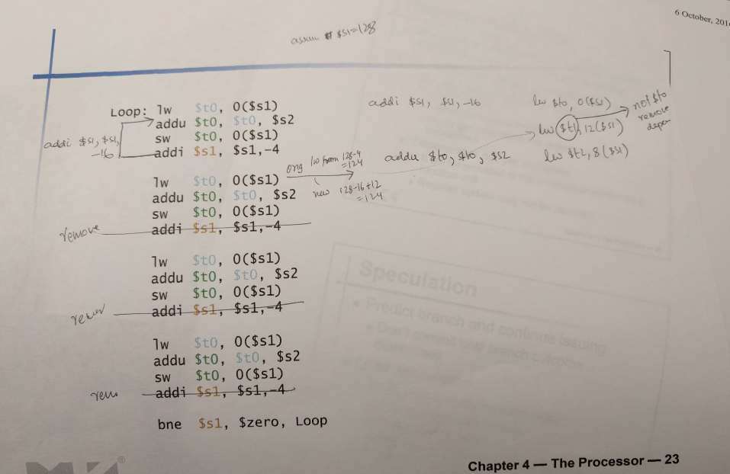

Slide 29
Loop Unrolling Example
 | ALU/branch | Load/store | cycle
Loop: | addi $s1, $s1,–16 | lw $t0, 0($s1) | 1
 | nop | lw $t1, 12($s1) | 2
 | addu $t0, $t0, $s2 | lw $t2, 8($s1) | 3
 | addu $t1, $t1, $s2 | lw $t3, 4($s1) | 4
 | addu $t2, $t2, $s2 | sw $t0, 16($s1) | 5
 | addu $t3, $t3, $s2 | sw $t1, 12($s1) | 6
 | nop | sw $t2, 8($s1) | 7
 | bne $s1, $zero, Loop | sw $t3, 4($s1) | 8
IPC = 14/8 = 1.75
Closer to 2, but at cost of registers and code size

Slide 30
Dynamic Multiple Issue
“Superscalar” processors
CPU decides whether to issue 0, 1, 2, … each cycle
Avoiding structural and data hazards
Avoids the need for compiler scheduling
Though it may still help
Code semantics ensured by the CPU

Slide 31
Dynamic Pipeline Scheduling
Allow the CPU to execute instructions out of order to avoid stalls
But commit result to registers in order
Example
lw $t0, 20($s2) addu $t1, $t0, $t2 sub $s4, $s4, $t3 slti $t5, $s4, 20
Can start sub while addu is waiting for lw

Slide 32
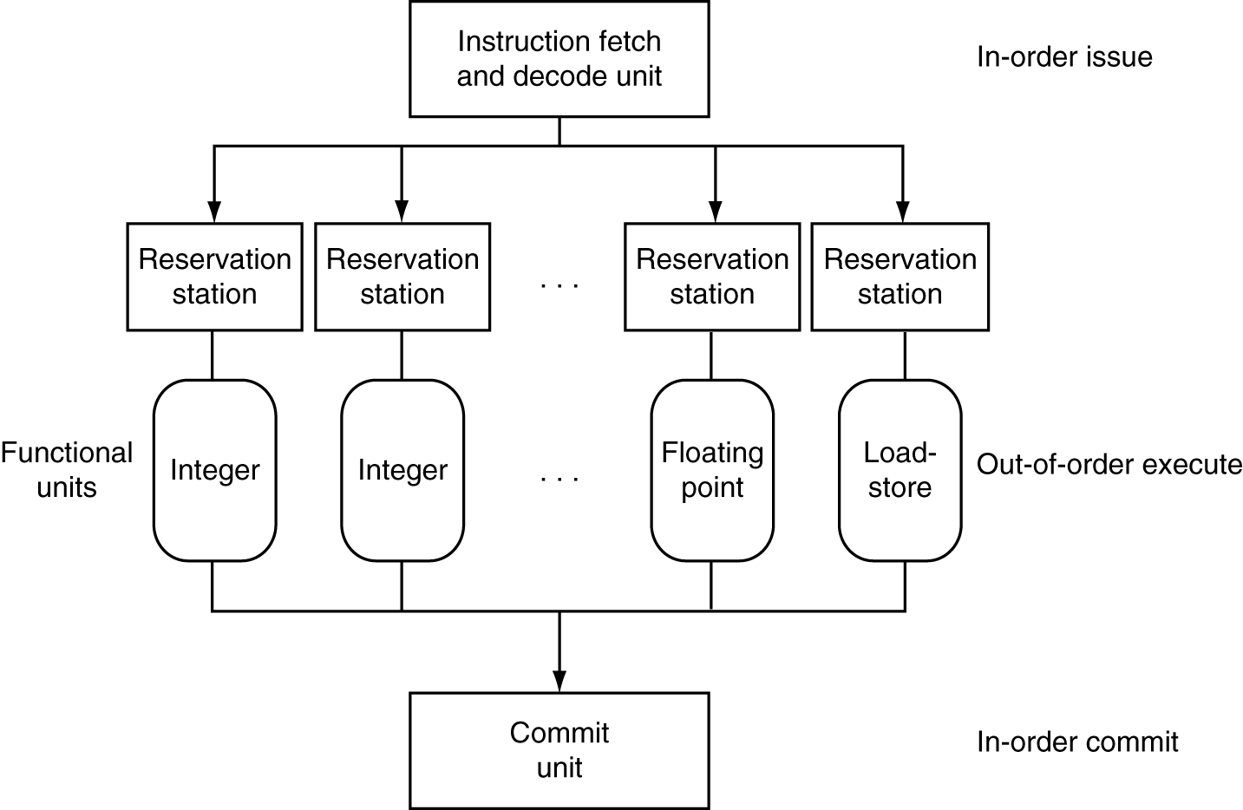
Dynamically Scheduled CPU
Preserves dependencies
Hold pending operands
Results also sent to any waiting reservation stations
Reorders buffer for register writes
Can supply operands for issued instructions

Slide 33
Register Renaming
Reservation stations and reorder buffer effectively provide register renaming
On instruction issue to reservation station
If operand is available in register file or reorder buffer
Copied to reservation station
No longer required in the register; can be overwritten
If operand is not yet available
It will be provided to the reservation station by a function unit
Register update may not be required

Slide 34
Speculation
Predict branch and continue issuing
Don’t commit until branch outcome determined
Load speculation
Avoid load and cache miss delay
Predict the effective address
Predict loaded value
Load before completing outstanding stores
Bypass stored values to load unit
Don’t commit load until speculation cleared

Slide 35
Why Do Dynamic Scheduling?
Why not just let the compiler schedule code?
Not all stalls are predicable
e.g., cache misses
Can’t always schedule around branches
Branch outcome is dynamically determined
Different implementations of an ISA have different latencies and hazards

