Slide 1
Chapter 5
Large and Fast: Exploiting Memory Hierarchy

Slide 2
Principle of Locality
§5.1 Introduction
Programs access a small proportion of their address space at any time
Temporal locality
Items accessed recently are likely to be accessed again soon
e.g., instructions in a loop, induction variables
Spatial locality
Items near those accessed recently are likely to be accessed soon
E.g., sequential instruction access, array data

Slide 3
Taking Advantage of Locality
Memory hierarchy
Store everything on disk
Copy recently accessed (and nearby) items from disk to smaller DRAM memory
Main memory
Copy more recently accessed (and nearby) items from DRAM to smaller SRAM memory
Cache memory attached to CPU

Slide 4
Taking Advantage of Locality
a block of 4 words
CPU
cpu needs word#2 of a block
cache that can accommodate a max of 2 blocks at a time

Slide 5
Taking Advantage of Locality
a block of 4 words
CPU
cache that can accommodate a max of 2 blocks at a time

Slide 6
Temporal Locality
cpu repeatedly access word#2 of the block
a block of 4 words
CPU
cache that can accommodate a max of 2 blocks at a time

Slide 7
Spatial Locality
cpu next time access word#1 of the block
a block of 4 words
CPU
cache that can accommodate a max of 2 blocks at a time

Slide 8
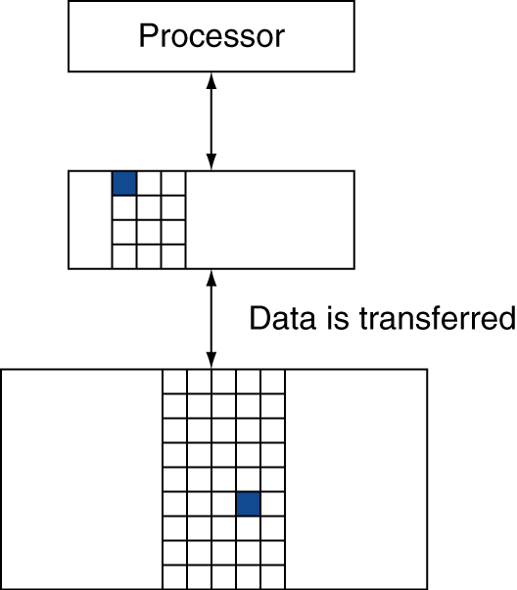
Memory Hierarchy Levels
Block (aka line): unit of copying
May be multiple words
If accessed data is present in upper level
Hit: access satisfied by upper level
Hit ratio: hits/accesses
If accessed data is absent
Miss: block copied from lower level
Time taken: miss penalty
Miss ratio: misses/accesses = 1 – hit ratio
Then accessed data supplied from upper level

Slide 9
Memory Technology
Static RAM (SRAM)
0.5ns – 2.5ns, $2000 – $5000 per GB
Dynamic RAM (DRAM)
50ns – 70ns, $20 – $75 per GB
Magnetic disk
5ms – 20ms, $0.20 – $2 per GB
Ideal memory
Access time of SRAM
Capacity and cost/GB of disk
§5.2 Memory Technologies

Slide 10
Memory Addressing Basics
Byte Addressable
Accessing words and word addresses
Accessing blocks and block addresses
§5.2 Memory Technologies

Slide 11
Byte, Word, Block Addresses
Example:
Total memory 256 bytes
1 Word = 4 bytes, 1 Block = 8 Words
Byte Addressable ?
Word Addressable ?
Block Addressable?
§5.2 Memory Technologies

Slide 12







Byte, Word, Block Addresses
Byte
§5.2 Memory Technologies
1 Word = 4 bytes
1 Block = 8 Words
$$00000000$$
$$00000001$$
Word
$$00000010$$
$$00000011$$
$$00000100$$
Block
$$00011111$$
$$11111111$$

Slide 13








Byte, Word, Block Addresses
Byte
§5.2 Memory Technologies
$$00000000$$
word #0
$$00000001$$
$$00000010$$
$$00000011$$
$$00000100$$
1 Word = 4 bytes
word #1
$$00000111$$
$$11111100$$
word #63
$$11111111$$

Slide 14






Byte, Word, Block Addresses
Byte
§5.2 Memory Technologies
$$00000000$$
block #0
$$00011111$$
1 Block = 8 Words
$$00100000$$
block #1
$$00111111$$
$$11100000$$
block #7
$$11111111$$

Slide 15
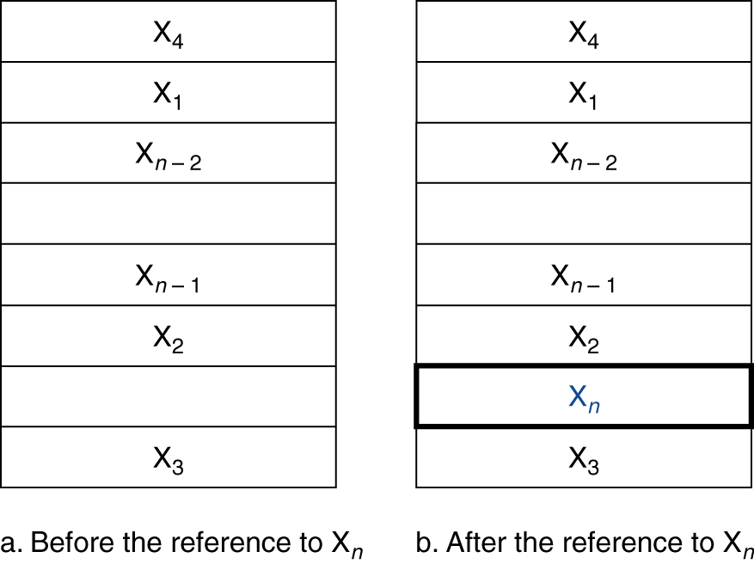
Cache Memory
Cache memory
The level of the memory hierarchy closest to the CPU
Given accesses X₁, …, X_{n–1}, X_{n}
§5.3 The Basics of Caches
How do we know if the data is present?
Where do we look?

Slide 16
Associative Caches
Fully associative
Allow a given block to go in any cache entry
Example: Consider a cache of 4 blocks. What happens if CPU accesses
memory address 32 ?
Initially cache is empty. Access to 32 is a miss!
$$00000000$$
block #0
Tag
Data
$$00011111$$
001
block #1 (M[32:63])
$$00100000$$
block #1
$$00111111$$
$$11100000$$
block #7
$$11111111$$
Notes:
4 blocks = 4 rows -> assuming 8 words per block = 32 bit block size, block #0 = (M[0:31]), block #1 = (M[32:63]), etc. etc. NOTE: Because block size is 32-bits, we know that the index/offset is log(2^5 = 32) = 5

Slide 17
Associative Caches
Fully associative
What happens now if CPU accesses memory address 38 ( 0 0 1 0 0 1 1 0 )? block #1 contains M[38] and is already in the cache, so it is a hit !
How do we know it is in cache?
Search all tag entries and look for a match
$$00000000$$
block #0
Tag
Data
$$00011111$$
001
M[32:63]
$$00100000$$
block #1
$$00111111$$
$$11100000$$
block #7
$$11111111$$

Slide 18
Associative Caches
Fully associative
What happens now if CPU accesses memory address 1 ( 0 0 0 0 0 0 0 1)? block #0 contains M[1] and is not in the cache, so it is a miss !
How do we know it is not in cache?
Search all tag entries and found no match
$$00000000$$
block #0
Tag
Data
$$00011111$$
001
M[32:63]
$$00100000$$
000
M[0:31]
block #1
$$00111111$$
$$11100000$$
block #7
$$11111111$$

Slide 19
Associative Caches
Fully associative
What happens now if CPU accesses memory address 9 ( 0 0 0 0 1 0 0 1)? block #0 contains M[9] and is in the cache, so it is a hit !
$$00000000$$
block #0
Tag
Data
$$00011111$$
001
M[32:63]
$$00100000$$
000
M[0:31]
block #1
$$00111111$$
$$11100000$$
block #7
$$11111111$$

Slide 20
Associative Caches
Fully associative
Allow a given block to go in any cache entry
Requires all entries to be searched at once
Comparator per entry (expensive)

Slide 21
Direct Mapped Caches
Direct Mapped
Allow a given memory block to go to only specific cache entry determined by the memory block address
block #0
block #1
Tag
Data
block #2
block #3
block #4
block #5
block #6
block #7

Slide 22
Direct Mapped Caches
Direct Mapped
Allow a given memory block to go to only specific cache entry determined by the memory block address
block #0
block #1
Tag
Data
block #2
block #3
block #4
block #5
block #6
block #7

Slide 23
Direct Mapped Caches
Direct Mapped
Allow a given memory block to go to only specific cache entry determined by the memory block address
block #0
block #1
Tag
Data
block #2
block #3
block #4
block #5
block #6
block #7

Slide 24
Direct Mapped Caches
Direct Mapped
Allow a given memory block to go to only specific cache entry determined by the memory block address
block #0
block #1
Tag
Data
block #2
block #3
block #4
block #5
block #6
block #7

Slide 25
Direct Mapped Caches
Direct Mapped
Allow a given memory block to go to only specific cache entry determined by the memory block address
block #0
block #1
Tag
Data
block #2
block #3
block #4
block #5
block #6
block #7

Slide 26
Direct Mapped Caches
Direct Mapped
Allow a given memory block to go to only specific cache entry determined by the memory block address
block #0
block #1
Tag
Data
block #2
block #3
block #4
block #5
block #6
block #7

Slide 27
Direct Mapped Caches
Direct Mapped
Allow a given memory block to go to only specific cache entry determined by the memory block address
block #0
block #1
In fully associative a cache block can accommodate any of the eight memory blocks. In case of direct mapped a cache block can accommodate only two ‘specific’ memory blocks (block#0 and block#4)
Tag
Data
block #2
block #3
block #4
block #5
block #6
block #7

Slide 28








Direct Mapped Caches
Direct Mapped
Allow a given memory block to go to only specific cache entry determined by the memory block address
$000$xxxxx
block #0
$001$xxxxx
block #1
$010$xxxxx
Tag
Data
block #2
$011$xxxxx
block #3
$100$xxxxx
block #4
$101$xxxxx
block #5
$110$xxxxx
block #6
$111$xxxxx
block #7

Slide 29


Direct Mapped Caches
Direct Mapped
Which memory block is currently occupying is determined by the tag bit.
$000$xxxxx
block #0
$001$xxxxx
block #1
$010$xxxxx
Tag
Data
block #2
$011$xxxxx
block #3
$100$xxxxx
block #4
$101$xxxxx
block #5
$110$xxxxx
block #6
$111$xxxxx
block #7

Slide 30
Direct Mapped Caches
Direct Mapped
Allow a given memory block to go to only specific cache entry determined by the memory block address
$000$xxxxx
block #0
$001$xxxxx
block #1
$010$xxxxx
Tag
Data
block #2
$011$xxxxx
0
Block #0 (M[0:31])
block #3
$100$xxxxx
block #4
$101$xxxxx
block #5
$110$xxxxx
block #6
$111$xxxxx
block #7

Slide 31
Direct Mapped Caches
Direct Mapped
Allow a given memory block to go to only specific cache entry determined by the memory block address
$000$xxxxx
block #0
$001$xxxxx
block #1
$010$xxxxx
Tag
Data
block #2
$011$xxxxx
1
Block #4 (M[128:159])
block #3
$100$xxxxx
block #4
$101$xxxxx
block #5
$110$xxxxx
block #6
$111$xxxxx
block #7

Slide 32








Direct Mapped Caches
Direct Mapped
How do we know where does a memory block go in the cache (mapping of a memory block to a cache block)
$000$xxxxx
block #0
$001$xxxxx
block #1
$010$xxxxx
Tag
Data
block #2
$011$xxxxx
block #3
$100$xxxxx
block #4
$101$xxxxx
block #5
$110$xxxxx
block #6
$111$xxxxx
block #7

Slide 33
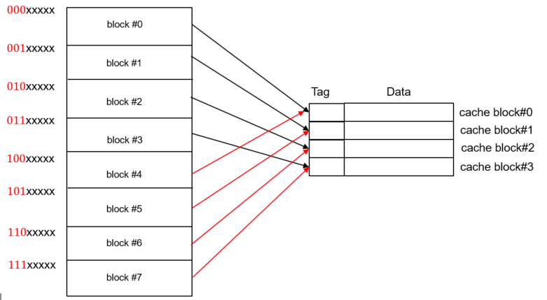
Direct Mapped Caches
Direct Mapped Example
Process access memory byte addresses: 28, 62, 118. Assume cache is initially empty.
28: 0 0 0 1 1 1 0 0 block#0
28: 0 0 0 1 1 1 0 0 cache block#0
When processor access 28, it check the tag for
cache block#0 (00). As there is no tag, it considers a miss, and load the block#0 from memory to cache block #0 (00)

Slide 34
Direct Mapped Caches
Direct Mapped Example
Process access memory byte addresses: 28, 62, 118. Assume cache is initially empty.
28: 0 0 0 1 1 1 0 0 block#0
28: 0 0 0 1 1 1 0 0 cache block#0 (00)
$000$xxxxx
block #0
$001$xxxxx
block #1
$010$xxxxx
Tag
Data
block #2
cache block#0
$011$xxxxx
0
Block#0 (M[0:31])
cache block#1
block #3
cache block#2
$100$xxxxx
cache block#3
block #4
$101$xxxxx
block #5
$110$xxxxx
block #6
$111$xxxxx
block #7

Slide 35
Direct Mapped Caches
Direct Mapped Example
Process access memory byte addresses: 28, 62, 118. Assume cache is initially empty.
62: 0 0 1 1 1 1 1 0 block#1
62: 0 0 1 1 1 1 1 0 cache block#1 (01)
$000$xxxxx
block #0
$001$xxxxx
block #1
$010$xxxxx
Tag
Data
block #2
cache block#0
$011$xxxxx
0
Block#0 (M[0:31])
0
Block#1 (M[32:63])
cache block#1
block #3
cache block#2
$100$xxxxx
cache block#3
block #4
$101$xxxxx
block #5
$110$xxxxx
block #6
$111$xxxxx
block #7

Slide 36
Direct Mapped Caches
Direct Mapped Example
Process access memory byte addresses: 28, 62, 129. Assume cache is initially empty.
129: 1 0 0 0 0 0 0 1 block#4
129: 1 0 0 0 0 0 0 1 cache block#0 (00)
$000$xxxxx
block #0
$001$xxxxx
block #1
$010$xxxxx
Tag
Data
block #2
cache block#0
$011$xxxxx
1
Block#4 (M[128:159])
0
Block#1 (M[32:63])
cache block#1
block #3
cache block#2
$100$xxxxx
cache block#3
block #4
$101$xxxxx
block #5
$110$xxxxx
block #6
$111$xxxxx
block #7

Slide 37
Tags Bits
Direct Mapped
Tag Bit
28: 0 0 0 1 1 1 0 0 cache block#0 (00)
Fully Associative
Tag Bits
28: 0 0 0 1 1 1 0 0 cache block#0 (00)

Slide 38
Valid Bits
Given an address, we identify the tag bits of the address and check whether these bits exist in the tag field of the cache.
For fully associative cache, we look at all cache blocks tag fields
For direct mapped, we only look at a tag field of a specific cache block
What if there is no data in a location?
Valid bit: 1 = present, 0 = not present
Initially 0

Slide 39
Cache Example
8-blocks, 1 word/block, direct mapped
Initial cache state as shown below
Accesses words (word address): 22, 26, 16, 3, 16
Show the state of cache after each access and whether the access is a hit or a miss
Use max word address used (26 in our case) to determine the number of bits you will use for the memory byte address. Closest integer to 26 that is power of 2 is 32. This gives 5 bits for the word address and 2 bits for the byte offset within a word for a total of 7-bits memory byte address.
Index | V | Tag | Data
000 | N
001 | N
010 | N
011 | N
100 | N
101 | N
110 | N
111 | N

Slide 40
Cache Example
Word addr | Binary addr | Hit/miss | Cache block
22 | 10 110 | Miss | 110
Index | V | Tag | Data
000 | N
001 | N
010 | N
011 | N
100 | N
101 | N
110 | Y | 10 | Word #22 (Mem[88:91])
111 | N
1 Word =
4 Bytes

Slide 41
Cache Example
Word addr | Binary addr | Hit/miss | Cache block
26 | 11 010 | Miss | 010
Index | V | Tag | Data
000 | N
001 | N
010 | Y | 11 | Word #26
011 | N
100 | N
101 | N
110 | Y | 10 | Word #22
111 | N

Slide 42
Cache Example
Word addr | Binary addr | Hit/miss | Cache block
22 | 10 110 | Hit | 110
26 | 11 010 | Hit | 010
Index | V | Tag | Data
000 | N
001 | N
010 | Y | 11 | Word #26
011 | N
100 | N
101 | N
110 | Y | 10 | Word #22
111 | N

Slide 43
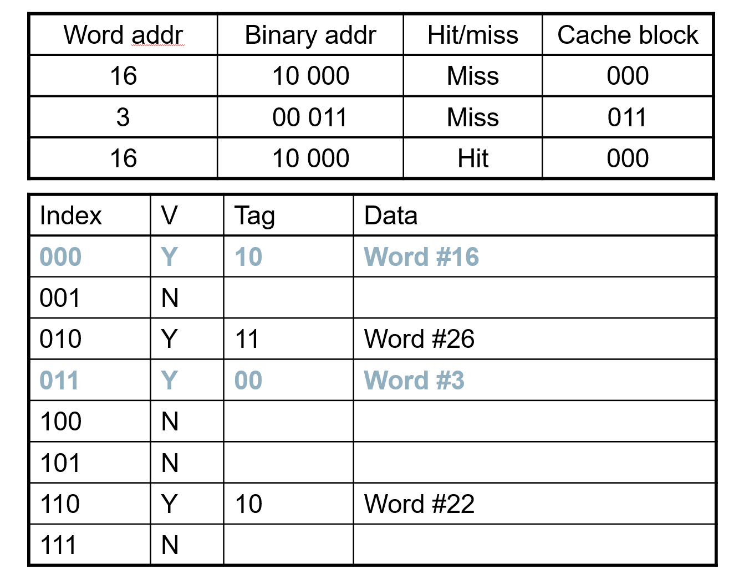
Cache Example
What would have changed if we
had assumed that the memory
address consists of 6 bits and not
5 bits?
Hits and mIsses ratio?
Number of bits in tag?
Both answers are correct!
Can we assume memory address
of 4-bits?

Slide 44
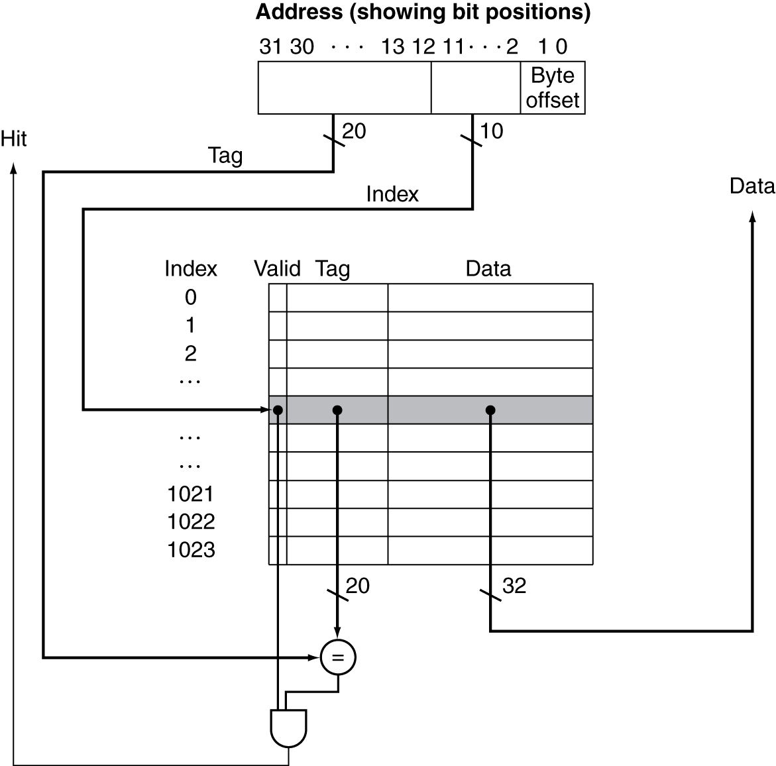
Address Subdivision
32-bit memory address
Direct mapped 1024 blocks
1 block = 1 Word = 4 bytes

Slide 45
Example: Larger Block Size
Total memory as in the previous example: 2^32 Bytes
Direct mapped cache of 64 blocks, 16 bytes/block. Show the partitioning of memory address: tag, cache block index, and byte offset within a block
31
10
9
4
3
0
Tag
Index
Offset
22 bits
6 bits
4 bits
To what cache block number does memory address 1200 map?
First Approach:
Binary representation of 1200 using 32 bits
0000 0000 0000 0000 0000 0100 1011 0000
Second Approach:
Memory block address = ⎣1200/16⎦ = 75
Cache block number = 75 modulo 64 = 11
Block number = 11
Notes:
YELLOW: Wtf? 2^32 bytes?? Where does this come from?
4 bits of offset because each block has 16 bytes -> log(2^4 = 16) = 4
6 bits of index because there are 64 blocks -> log(2^6 = 64) = 6 Tag is 22 because 32 – 6 – 4 = 22

Slide 46
Set Associative Caches
Fully associative
Allows a given memory block to go in any cache entry. Requires all entries to be searched at once
Direct Mapped
Allows a given memory block to go only a specific cache entry (too restrictive). Requires only one entry to be searched
Set Associative
Allows a given memory block to go to one-of-two or one-of-four or one-of-n possible cache blocks

Slide 47
2-Way Set Associative
Example: Total Memory 256 Bytes; 1 Block = 8 Words, 1 Word = 4 Bytes,
Total number of Cache blocks = 4
block #0
block #1
Tag
Data
Tag
Data
block #2
Set 0
block #3
Set 1
Way 0
Way 1
block #4
Number of sets = # of Cache Blocks / # of ways
= 4/2 = 2
A memory block is direct mapped to a set and
within a set it has an option to go to one of the two
cache blocks (2–way)
block #5
block #6
block #7

Slide 48
2-Way Set Associative
Example: Total Memory 256 Bytes; 1 Block = 8 Words, 1 Word = 4 Bytes,
Total number of Cache blocks = 4
Set index (set #0)
28: 0 0 0 1 1 1 0 0
block #0
Tag Bits
block #1
Tag
Data
Tag
Data
block #2
Set 0
00
Block #0 M[0:31]
block #3
Set 1
Way 0
Way 1
block #4
Number of sets = # of Cache Blocks / # of ways
= 4/2 = 2
A memory block is direct mapped to a set and
within a set it has an option to go to one of the two
cache blocks (2–way)
block #5
block #6
block #7

Slide 49
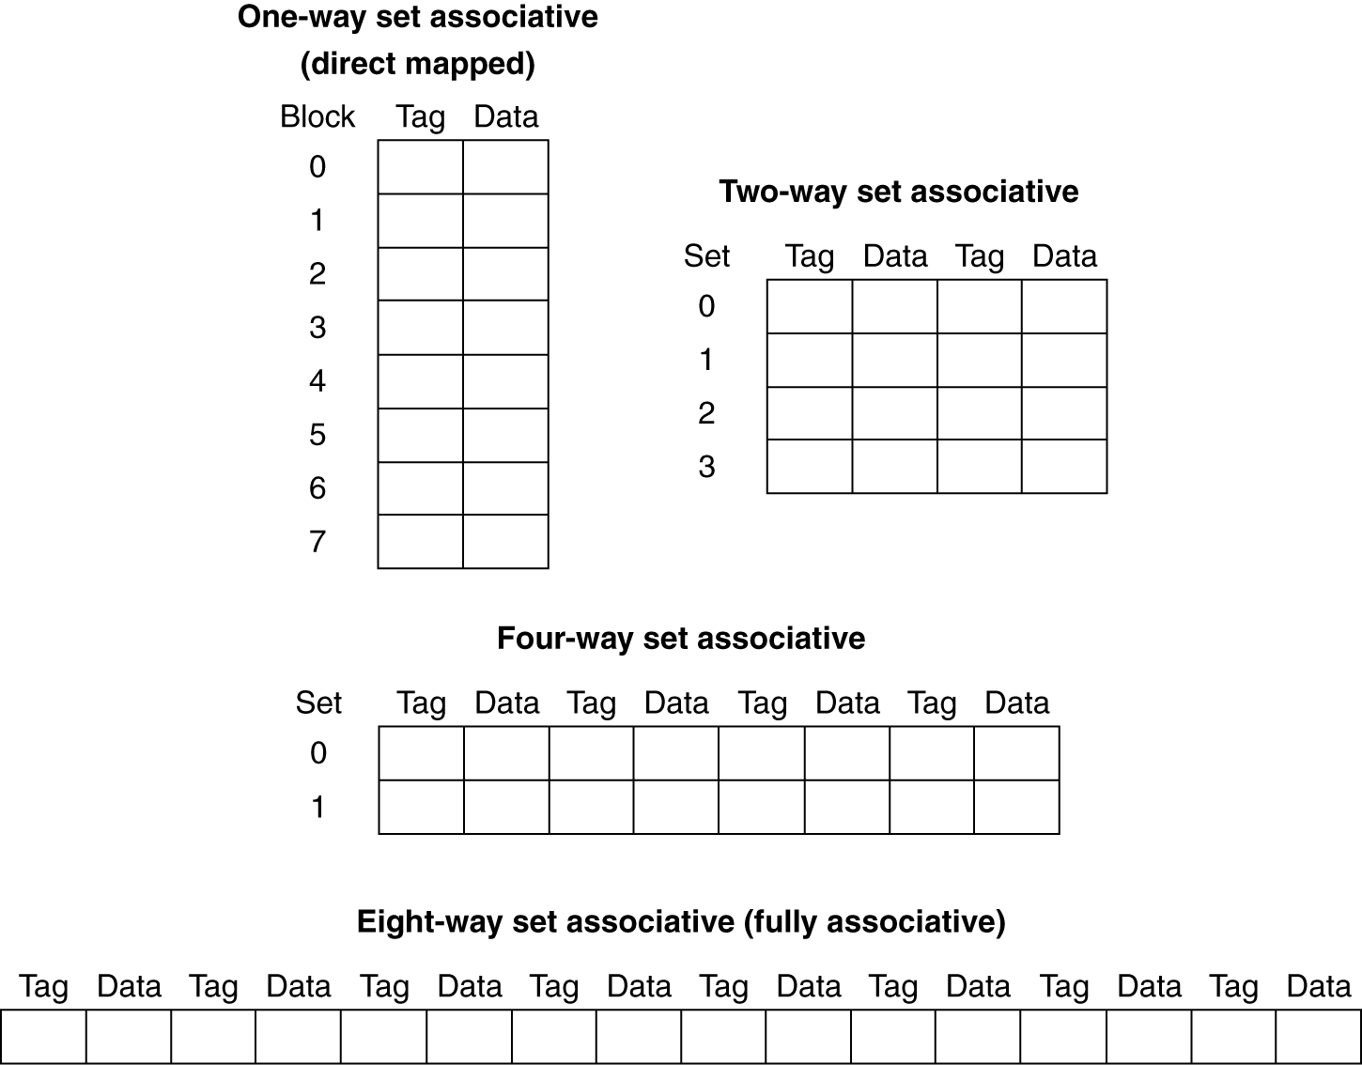
Spectrum of Associativity
For a cache with 8 cache blocks
Number of sets =
# of Cache Blocks / # of ways

Slide 50
Associativity Example
Compare 4-block caches in terms of number of hits/misses
Direct mapped, 2-way set associative, fully associative
Block access sequence: 0, 8, 0, 6, 8
Direct mapped
For computing hit/miss do we need memory size?
Cache
Block #0
Block #8
Block #6
Block access sequence: 0 (miss), 8 (miss), 0 (miss), 6 (miss), 8 (miss)

Slide 51
Associativity Example
2-Way Set Associative
Tag
Data
Tag
Data
Block #0
Set 0
block #0
Block #8
Set 1
Way 0
Way 1
Block #6
Block access sequence: 0 (miss)

Slide 52
Associativity Example
2-Way Set Associative
Tag
Data
Tag
Data
Block #0
Set 0
block #0
block #8
Block #8
Set 1
Way 0
Way 1
Block #6
Block access sequence: 0 (miss), 8 (miss)

Slide 53
Associativity Example
2-Way Set Associative
Tag
Data
Tag
Data
Block #0
Set 0
block #0
block #8
Block #8
Set 1
Way 0
Way 1
Block #6
Block access sequence: 0 (miss), 8 (miss), 0 (hit)

Slide 54
Associativity Example
2-Way Set Associative
replaces least recently
used
Tag
Data
Tag
Data
Block #0
Set 0
block #0
block #6
Block #8
Set 1
Way 0
Way 1
Block #6
Block access sequence: 0 (miss), 8 (miss), 0 (hit), 6 (miss)

Slide 55
Associativity Example
2-Way Set Associative
replaces least recently
used
Tag
Data
Tag
Data
Block #0
Set 0
block #8
block #6
Block #8
Set 1
Way 0
Way 1
Block #6
Block access sequence: 0 (miss), 8 (miss), 0 (hit), 6 (miss), 8(miss)

Slide 56
Associativity Example
Fully Associative
Cache
Block #0
Block #0
Block #8
Block #8
Block #6
Block #6
Block access sequence: 0 (miss), 8 (miss), 0 (hit), 6 (miss), 8 (hit)

Slide 57
How Much Associativity
Increased associativity decreases miss rate
But with diminishing returns
Simulation of a system with 64KB D-cache, 16-word blocks, SPEC2000
1-way: 10.3%
2-way: 8.6%
4-way: 8.3%
8-way: 8.1%

Slide 58
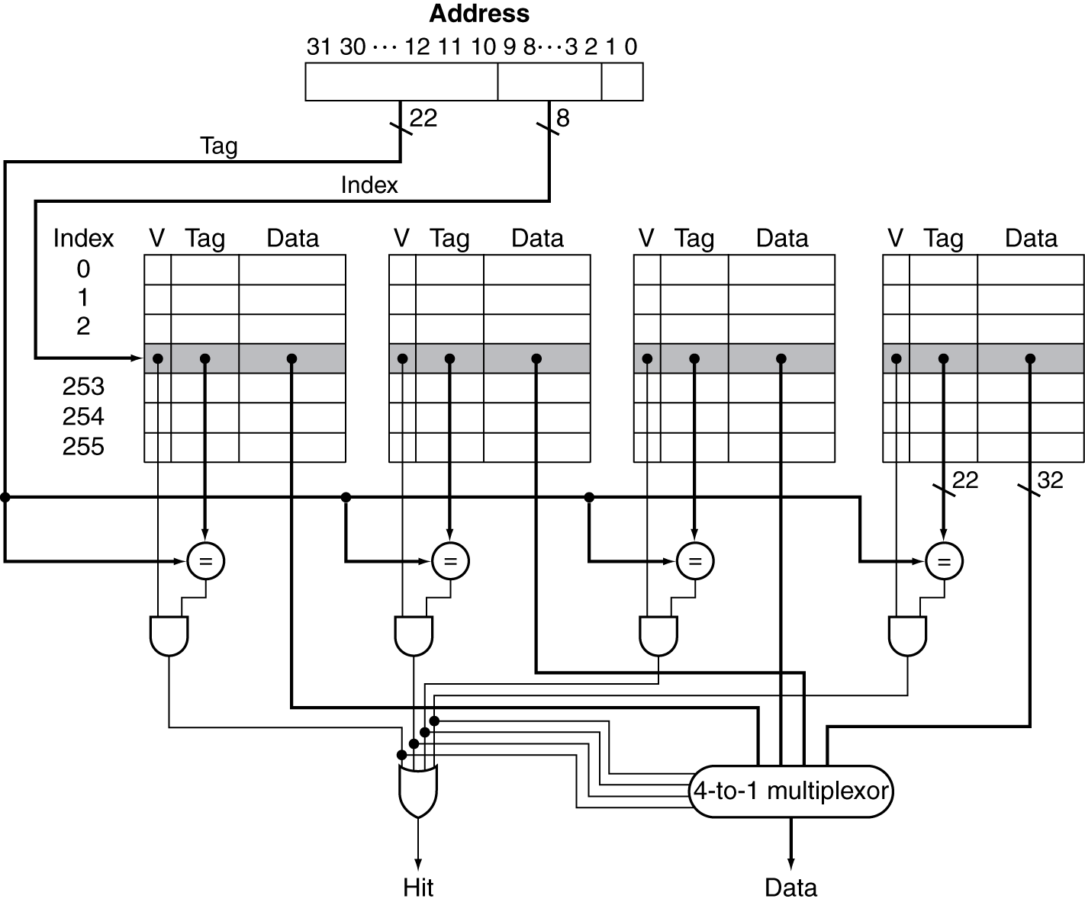
Set Associative Cache Organization
32-bit memory address
4-Way Associative with a total of 1024 blocks
1 block = 1 Word = 4 bytes

Slide 59
Replacement Policy
Direct mapped: no choice
Set associative
Prefer non-valid entry, if there is one
Otherwise, choose among entries in the set
Least-recently used (LRU)
Choose the one unused for the longest time
Simple for 2-way, manageable for 4-way, too hard beyond that
Random
Gives approximately the same performance as LRU for high associativity

Slide 60
Block Size Considerations
Larger blocks should reduce miss rate
Due to spatial locality
But in a fixed-sized cache
Larger blocks ⇒ fewer of them
More competition ⇒ increased miss rate
Larger miss penalty
Can override benefit of reduced miss rate
Early restart and critical-word-first can help

Slide 61
Cache Misses
On cache hit, CPU proceeds normally
On cache miss
Stall the CPU pipeline
Fetch block from next level of hierarchy
Instruction cache miss
Restart instruction fetch
Data cache miss
Complete data access

Slide 62
Write to Memory
Two types of policies exist in current architectures
Write Through
What happens in case of a hit?
What happens in case of a miss?
Write Back
What happens in case of a hit?
What happens in case of a miss?

Slide 63
Hit : Write-Through
On data-write hit, could just update the block in cache
But then cache and memory would be inconsistent
Write through: also update memory
But makes writes take longer
e.g., if base CPI = 1, 10% of instructions are stores, write to memory takes 100 cycles
Effective CPI = 1 + 0.1×100 = 11
Solution: write buffer
Holds data waiting to be written to memory
CPU continues immediately
Only stalls on write if write buffer is already full

Slide 64
Hit: Write-Back
Alternative: On data-write hit, just update the block in cache
Keep track of whether each block is dirty
When a dirty block is replaced
Write it back to memory
Can use a write buffer to allow replacing block to be read first

Slide 65
Miss
Write-Through
Allocate on miss: fetch the block
After the block is fetched and placed into cache , we can overwrite the word that caused the miss into the cache block. We also write the word to the main memory
Write-Back
Fetch the block

