Slide 1
Chapter 5
Large and Fast: Exploiting Memory Hierarchy – Memory Access Pattern

Slide 2
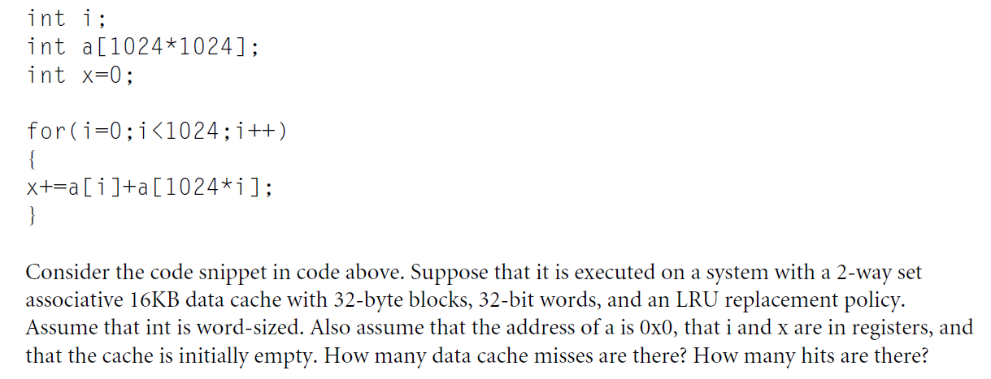
Memory access pattern – hits and misses

Slide 3
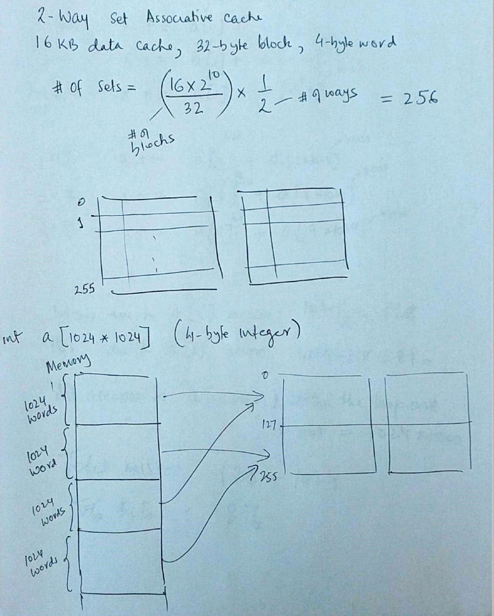

Slide 4
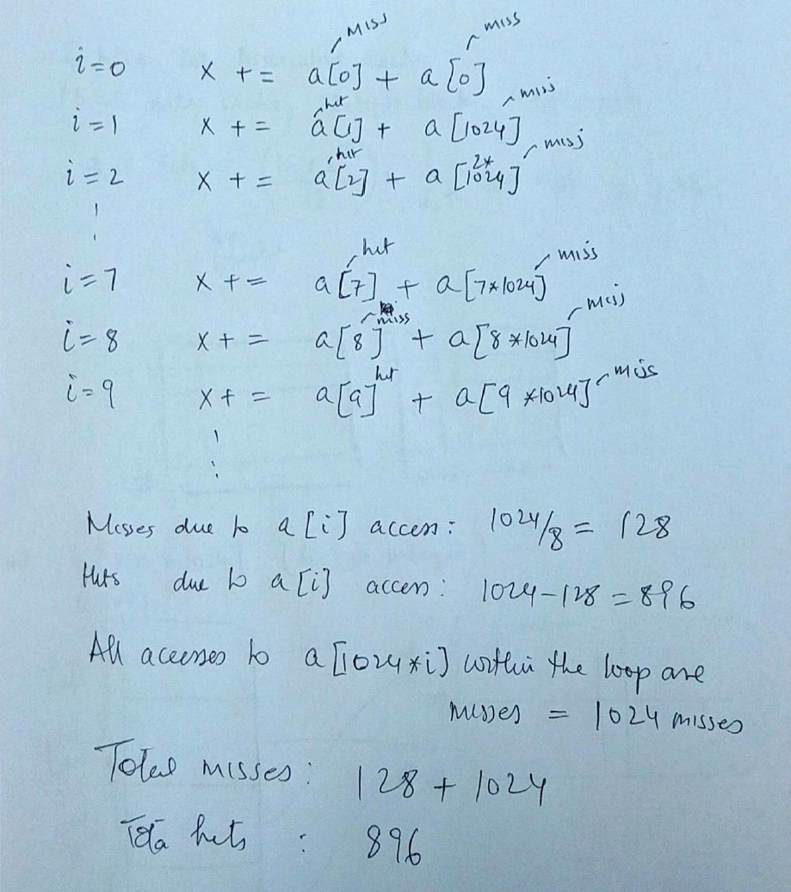

Slide 5
Software Optimization via Blocking
Matrix Multiply - Unoptimized code:
1. void dgemm (int n, double* A, double* B, double* C)
2. {
3. for (int i = 0; i < n; ++i)
4. for (int j = 0; j < n; ++j)
5. {
6. double cij = C[i+j*n]; /* cij = C[i][j] */
7. for(int k = 0; k < n; k++ )
8. cij += A[i+k*n] * B[k+j*n]; /* cij += A[i][k]*B[k][j] */
9. C[i+j*n] = cij; /* C[i][j] = cij */
10. }
11. }

Slide 6
Software Optimization via Blocking
Goal: maximize accesses to data before it is replaced
Consider inner loops of DGEMM:
for (int j = 0; j < n; ++j)
{
double cij = C[i+j*n];
for( int k = 0; k < n; k++ )
cij += A[i+k*n] * B[k+j*n];
C[i+j*n] = cij;
}

Slide 7
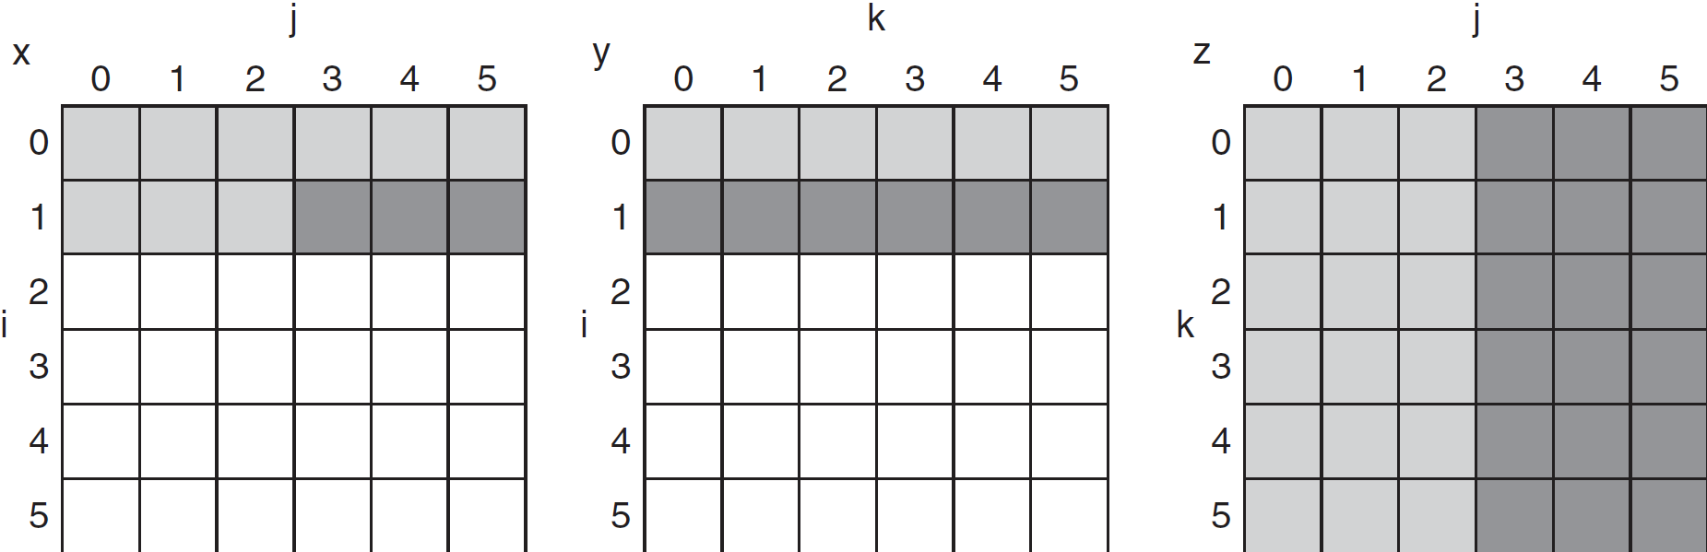
DGEMM Access Pattern
C, A, and B arrays
older accesses
new accesses

Slide 8
Cache Blocked DGEMM
1 #define BLOCKSIZE 32
2 void do_block (int n, int si, int sj, int sk, double *A, double
3 *B, double *C)
4 {
5 for (int i = si; i < si+BLOCKSIZE; ++i)
6 for (int j = sj; j < sj+BLOCKSIZE; ++j)
7 {
8 double cij = C[i+j*n];/* cij = C[i][j] */
9 for( int k = sk; k < sk+BLOCKSIZE; k++ )
10 cij += A[i+k*n] * B[k+j*n];/* cij+=A[i][k]*B[k][j] */
11 C[i+j*n] = cij;/* C[i][j] = cij */
12 }
13 }
14 void dgemm (int n, double* A, double* B, double* C)
15 {
16 for ( int sj = 0; sj < n; sj += BLOCKSIZE )
17 for ( int si = 0; si < n; si += BLOCKSIZE )
18 for ( int sk = 0; sk < n; sk += BLOCKSIZE )
19 do_block(n, si, sj, sk, A, B, C);
20 }

Slide 9
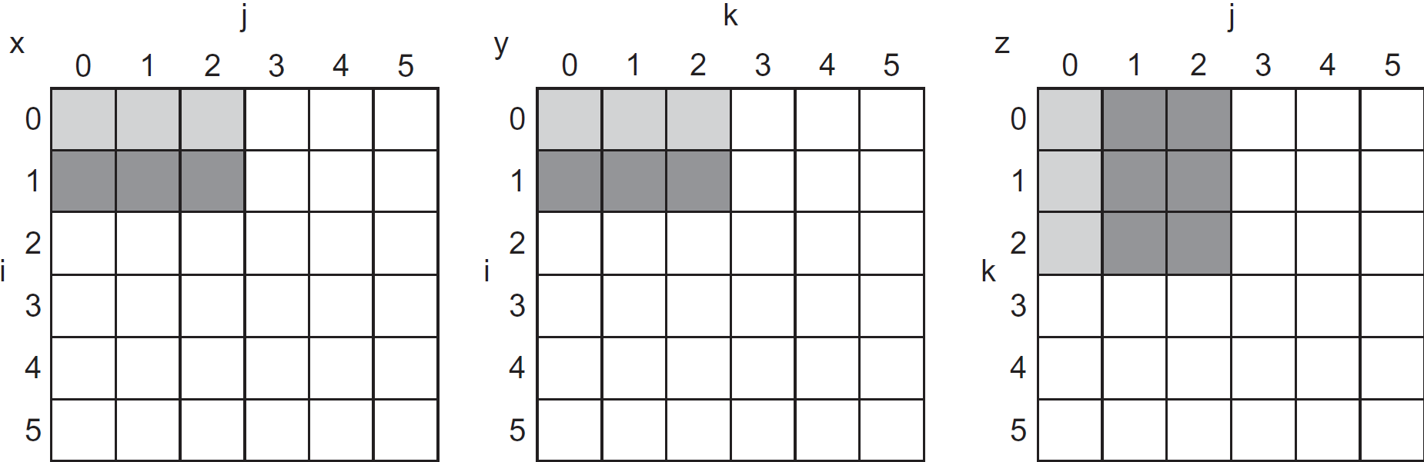
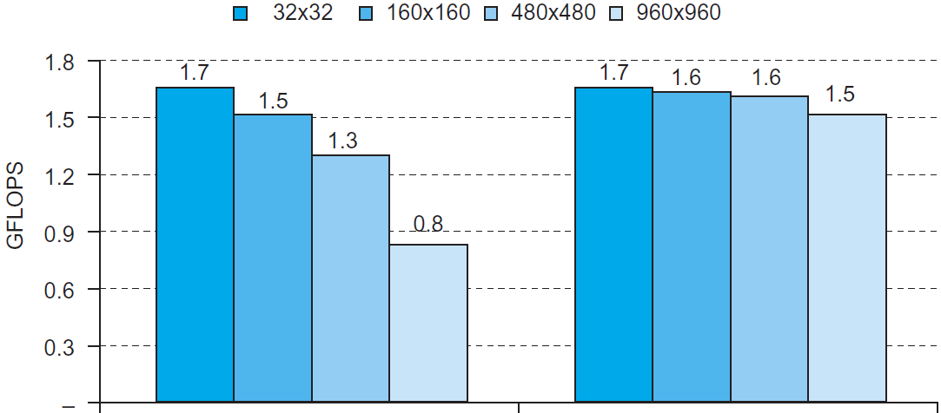
Blocked DGEMM Access Pattern
Unoptimized
Blocked

