Slide 1
Chapter 5
Large and Fast: Exploiting Memory Hierarchy

Slide 2
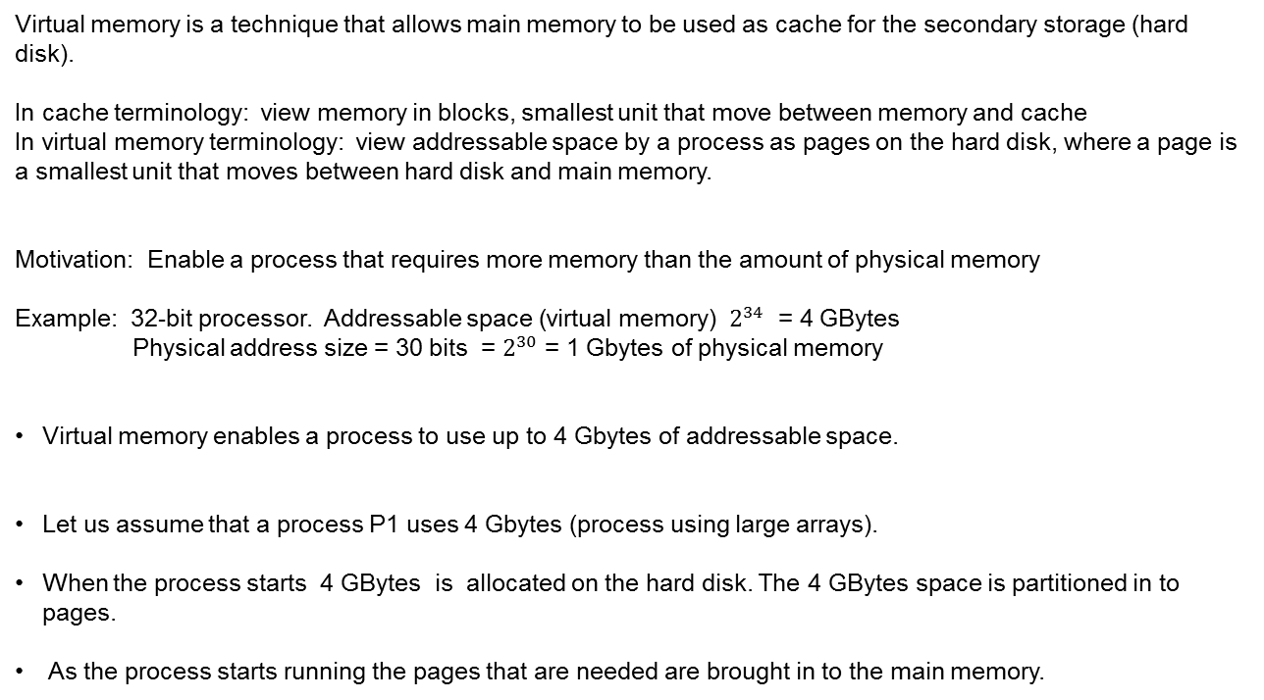
Virtual Memory
Virtual memory is a technique that allows main memory to be used as cache for the secondary storage (hard disk).
In cache terminology: view memory in blocks, smallest unit that move between memory and cache
In virtual memory terminology: view addressable space by a process as pages on the hard disk, where a page is a smallest unit that moves between hard disk and main memory.
Motivation: Enable a process that requires more memory than the amount of physical memory
Example: 32-bit processor. Addressable space (virtual memory) $2^{34}$ = 4 GBytes
Physical address size = 30 bits = $2^{30}$ = 1 Gbytes of physical memory
Virtual memory enables a process to use up to 4 Gbytes of addressable space.
Let us assume that a process P1 uses 4 Gbytes (process using large arrays).
When the process starts 4 GBytes is allocated on the hard disk. The 4 GBytes space is partitioned in to pages.
As the process starts running the pages that are needed are brought in to the main memory.

Slide 3
Motivation: Enable a process that requires more memory than the amount of physical memory
P1 addressable space
Frame 0 (Physical page 0)
Frame 1
Frame 2
Virtual Page 0
Frame 3
Virtual Page 1
Frame 4
Virtual Page 2
Frame 5
Frame 6
Frame 7
Number of virtual page is much greater than the number of frames
OS keeps track of where a virtual page is:
Whether it is in the memory and where?
Whether it is on the disk and where?

Slide 4
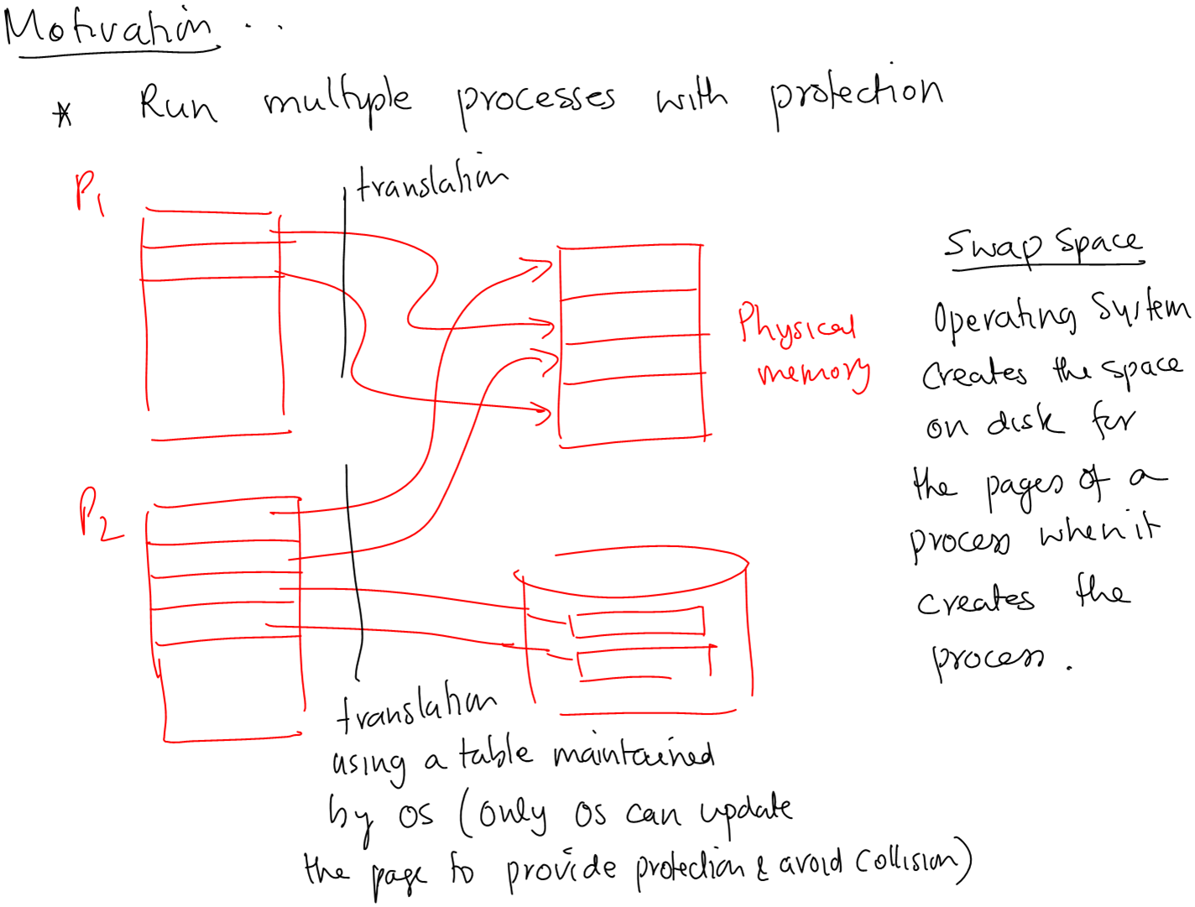
Virtual Memory

Slide 5
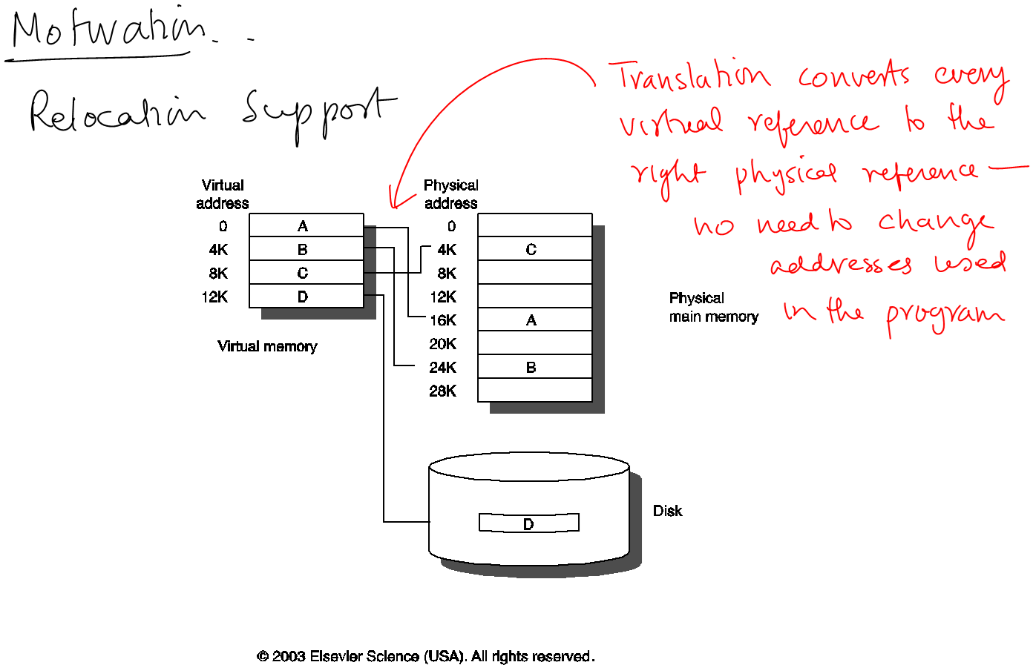
Virtual Memory

Slide 6
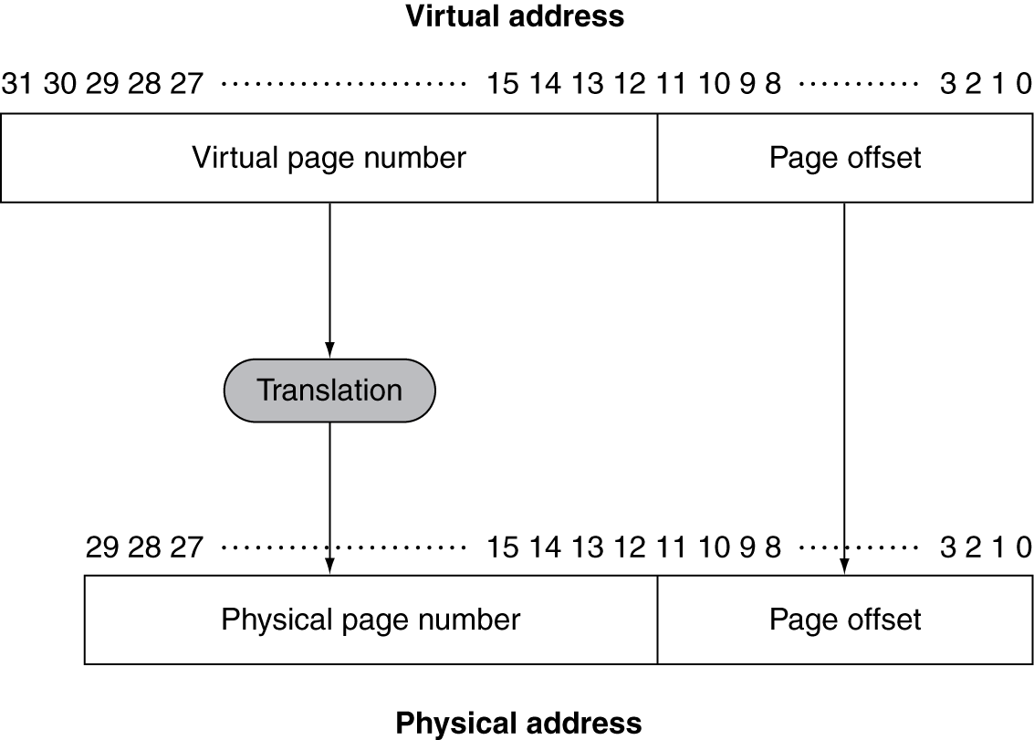
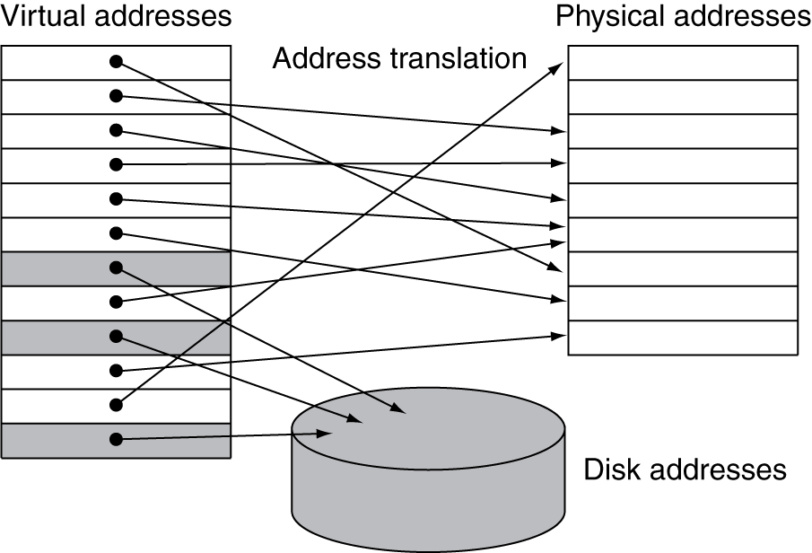
Virtual Address Translation
Fixed-size pages (e.g., 4K)

Slide 7
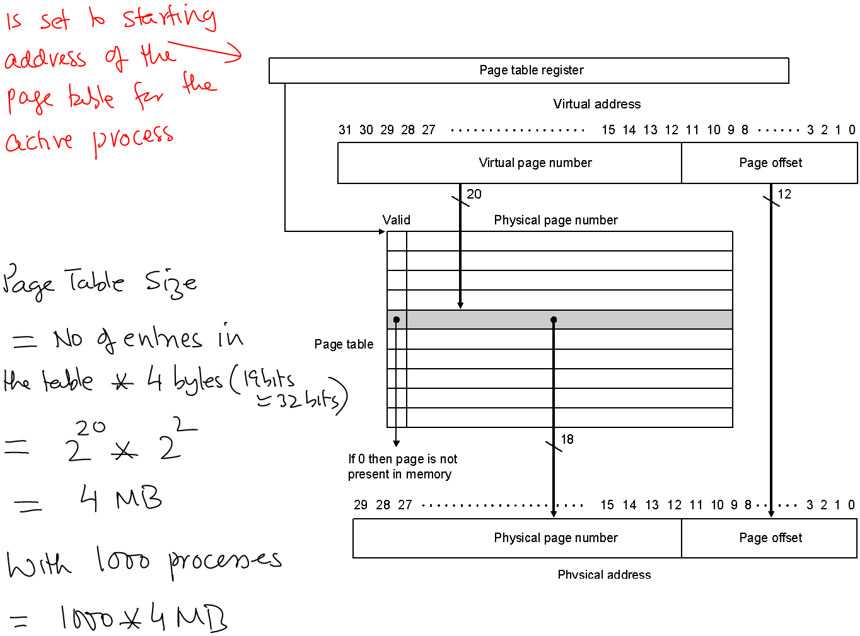
Translation Using a Page Table

Slide 8
Consider a memory system that has the following parameters:
Virtual address: 32 bits
Physical address: 30 bits
Page size: 4 KB
If a processor with above parameters is supporting 100 processes, what is
the maximum memory required by page tables.
The number of entries in a page table for a process is: 2^20
Maximum number of pages in the physical memory for a given process is: 2^18
Assume a page table entry consists of a valid bit and the physical page number,
the exact size in bits of a page table for a process is: 2^20 * 19
Total for all 100 page tables (there are 100 processes): 2^20 * 19 * 100

Slide 9
Page Tables
Stores placement information
Array of page table entries, indexed by virtual page number
Page table register in CPU points to page table in physical memory
If page is present in memory
PTE stores the physical page number
Plus other status bits (referenced, dirty, …)
If page is not present
PTE can refer to location in swap space on disk

Slide 10
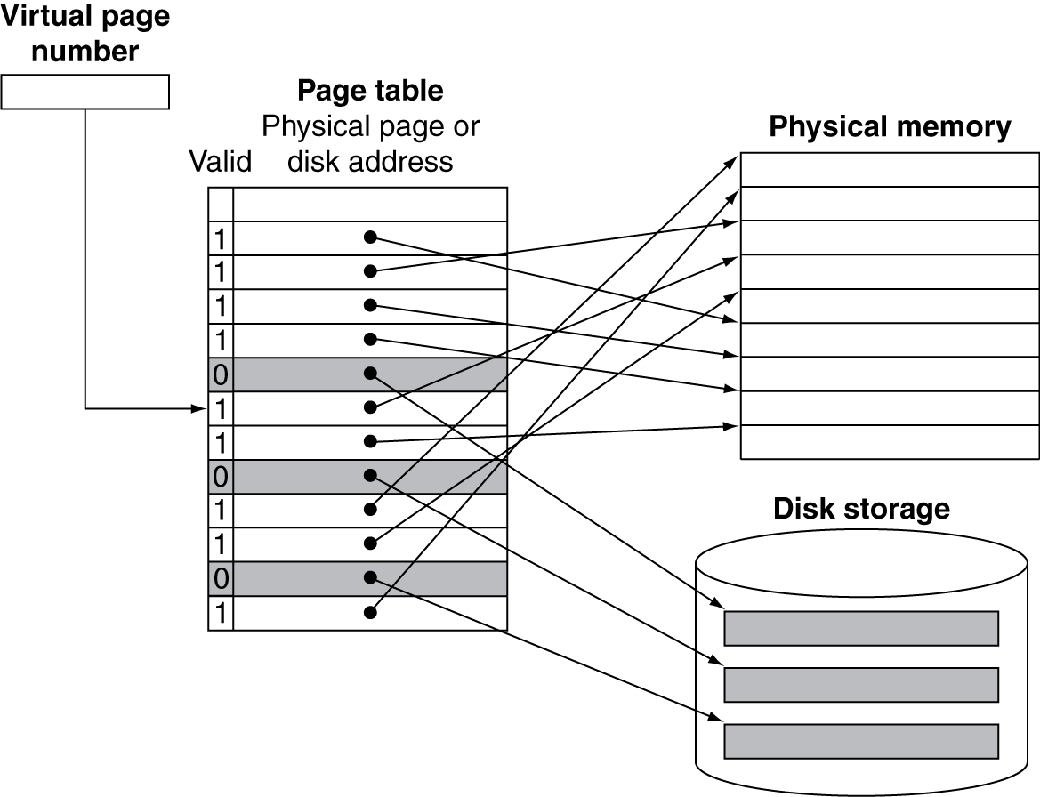
Mapping Pages to Storage

Slide 11
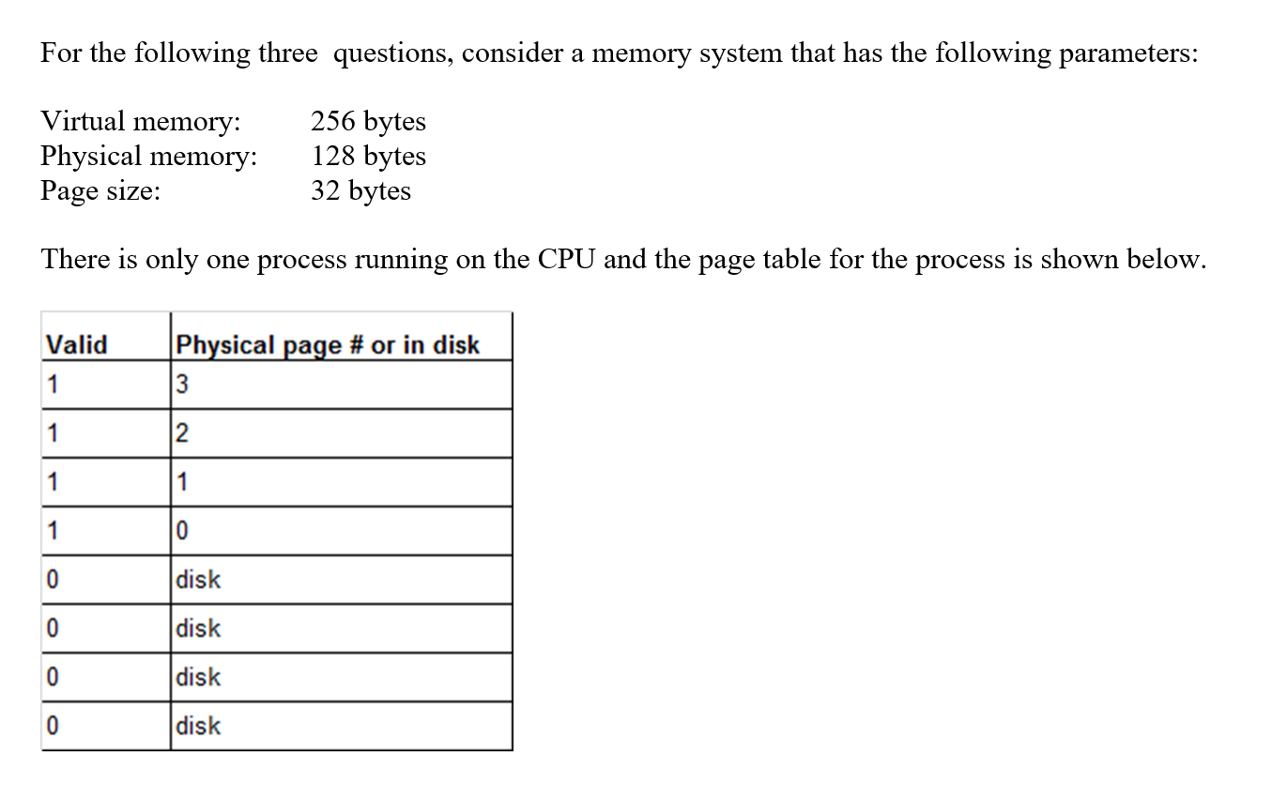

Slide 12
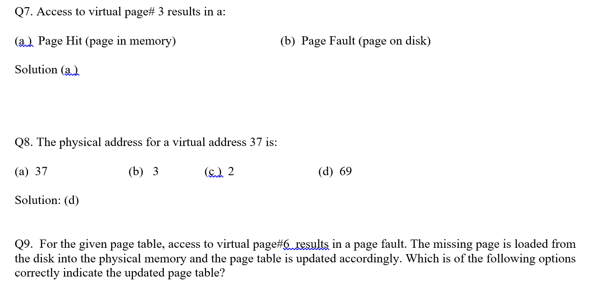

Slide 13
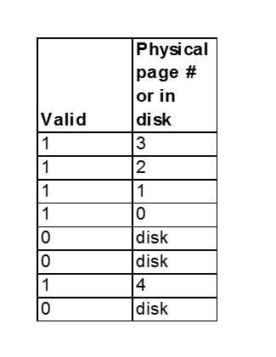
Number of physical pages (frames):
128/32 = 4
So a physical page#4 is not a
correct option.
What if physical memory is 256 Bytes
As replacement policy not mentioned, this is a valid option.
Assumption: Virtual page #1 in frame #2 is replaced by the new page.

Slide 14


Virtual address: 54 bits
Page size: 16 KBytes
Page Table Entry 4 Bytes
(PTE)
( a ) Assume 8-bits of PTE are reserved for operating system. Calculate the largest
physical memory allowed by this PTE format.
8 - bits
24-bits
reserved for OS
physical page number
$$2^{24}$$
number of physical pages
size of physical memory:
$2^{24 }. 2^{14}$
Bytes
page size 16 KB

Slide 15
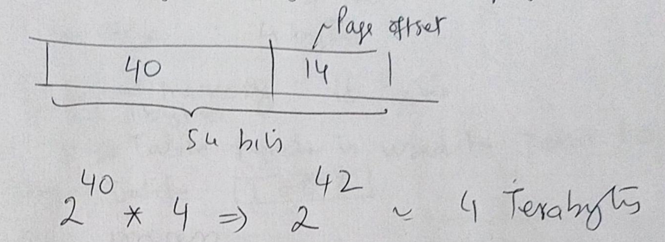
Virtual address: 54 bits
Page size: 16 KBytes
Page Table Entry 4 Bytes
(PTE)
( b ) How large in bytes is the page table?
page size 16 KB

Slide 16
Q. Consider a processor with the following memory specifications:
Virtual address: 5 bits
Physical address: 4 bits
Page size: 4 bytes
PTE Size: 1 byte
Page Table Register: 1000
One process in the system
Show the content of the physical memory after each of the virtual memory access (use LRU policy for replacement):
20 , 8, 3, 11, 11, 15
101 00, 010 00, 000 11, 010 11, 010 11, 111 11
Solution:
Let us first look at the page table.
Table size is 8 bytes.
To accommodate in the memory it needs two
pages of physical memory (one page is 4 bytes)

Slide 17










Now let us first look at the physical memory.
Physical memory consists of 16 bytes or 4 physical pages (frames). Note that the page size is 4 bytes
Byte
$$0000$$
frame #0
$$0001$$
$$0010$$
$$0011$$
available for the
process
$$0100$$
frame #1
$$0111$$
$$1000$$
frame #2
page table register pointing
to this location – starting address
of the page table.
$$1011$$
used by
page table
$$1100$$
frame #3
$$1111$$

Slide 18
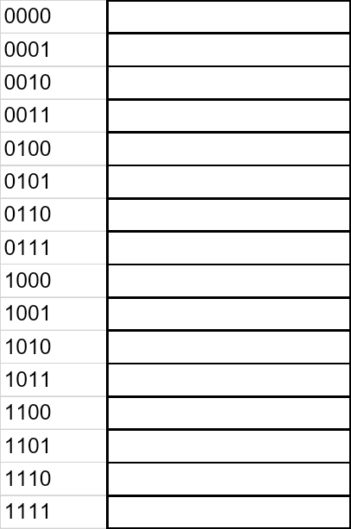
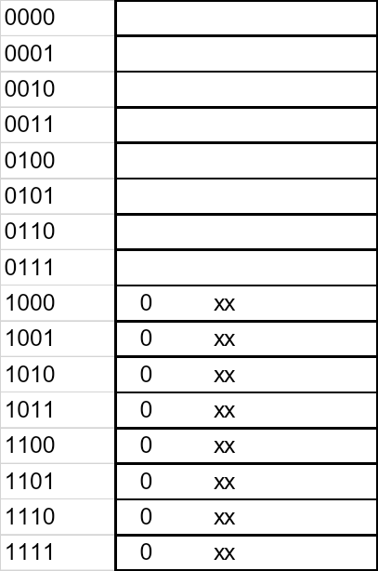
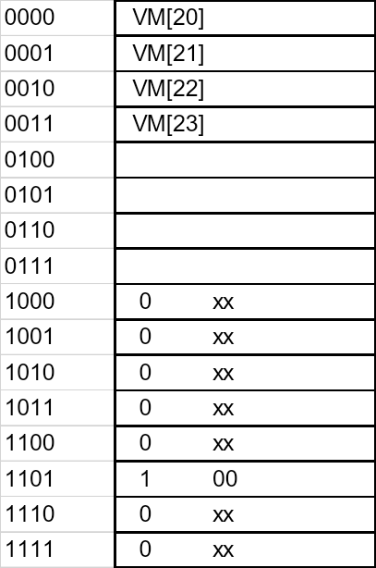
Initial state of the memory
after page table for the
process is initialized
After access of virtual address 20 (101 00)
Page fault
Virtual Address: 20 (101 00)
Virtual Page#: 5 (101)
Go to table entry 5 (101), which is at memory address 13 (1 101)
Note table starts at address 8, and
mem. address 13 (8+5) holds table
entry 5
After the page table entry 5 is updated, virtual page 5 maps to frame 0

Slide 19
After access of virtual address 20 (101 00)
Page fault
After access of virtual address 8 (010 00)
Page fault

Slide 20
After access of virtual address 8 (010 00)
Page fault
After access of virtual address 3 (000 11)
Page fault - replaces virtual page# 5(101) in frame#0 (00)

Slide 21
After access of virtual address 3 (000 11)
Page fault
After access of virtual address 11 (010 11)
No Page fault (Page Hit)

Slide 22
After access of virtual address 11 (010 11)
No Page fault
After repeat access of virtual address 11 (010 11)
No Page fault

Slide 23
After access of virtual address 11 (010 11)
No Page fault
After access of virtual address 31 (111 11)
Page fault - replaces virtual page# 0(000) in frame#0 (00)

Slide 24
Page Fault Penalty
On page fault, the page must be fetched from disk
Takes millions of clock cycles
Handled by OS code
Try to minimize page fault rate
Fully associative placement
Smart replacement algorithms

Slide 25
Replacement and Writes
To reduce page fault rate, prefer least-recently used (LRU) replacement
Reference bit (aka use bit) in PTE set to 1 on access to page
Periodically cleared to 0 by OS
A page with reference bit = 0 has not been used recently
Disk writes take millions of cycles
Block at once, not individual locations
Write through is impractical
Use write-back
Dirty bit in PTE set when page is written

Slide 26
Fast Translation Using a TLB
Address translation would appear to require extra memory references
One to access the PTE
Then the actual memory access
But access to page tables has good locality
So use a fast cache of PTEs within the CPU
Called a Translation Look-aside Buffer (TLB)
Typical: 16–512 PTEs, 0.5–1 cycle for hit, 10–100 cycles for miss, 0.01%–1% miss rate
Misses could be handled by hardware or software

Slide 27
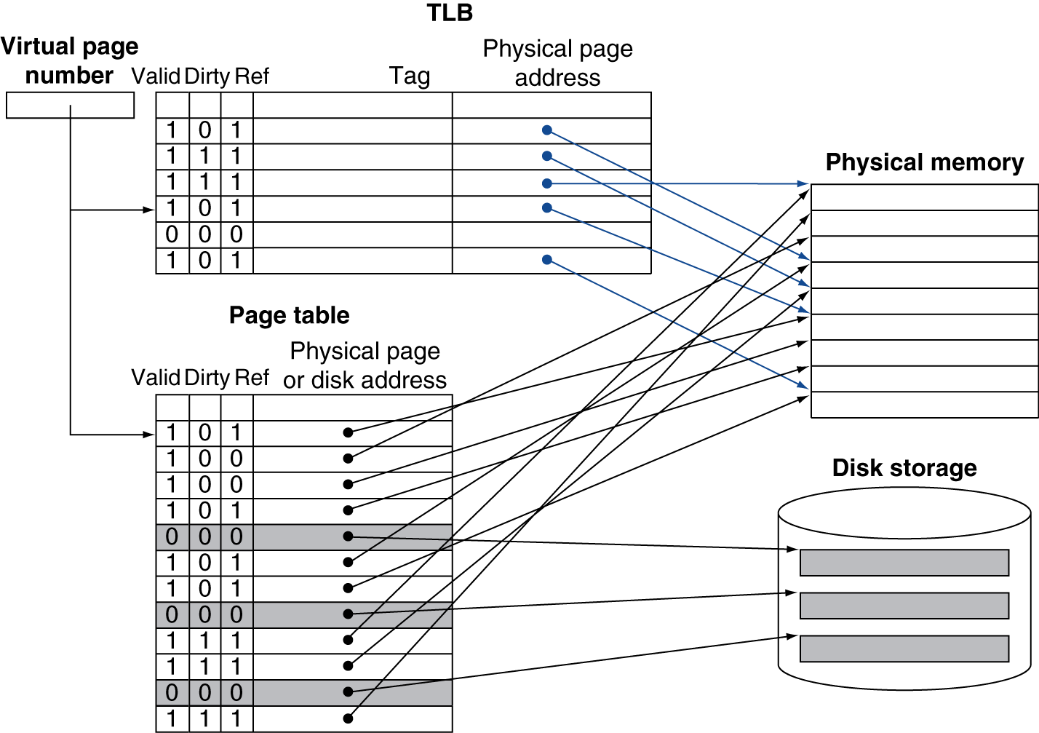
Fast Translation Using a TLB

Slide 28
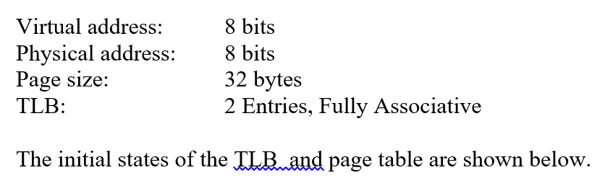
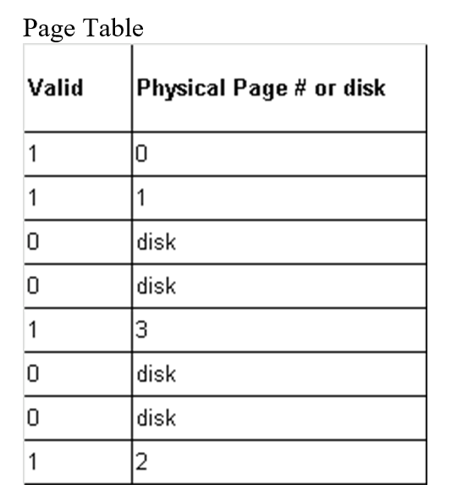
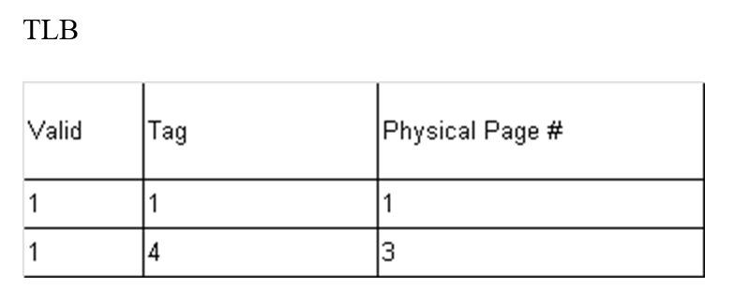
assume last frame (#7) of memory is used for storing the page table.
what happens if the process access virtual address 127?
27 = 011 11111
Virtual Page #3 is on disk so page fault and also TLB miss

Slide 29
TLB Misses
If page is in memory
Load the PTE from memory and retry
Could be handled in hardware
Can get complex for more complicated page table structures
Or in software
Raise a special exception, with optimized handler
If page is not in memory (page fault)
OS handles fetching the page and updating the page table
Then restart the faulting instruction

Slide 30
TLB Miss Handler
TLB miss indicates
Page present, but PTE not in TLB
Page not preset
Must recognize TLB miss before destination register overwritten
Raise exception
Handler copies PTE from memory to TLB
Then restarts instruction
If page not present, page fault will occur

Slide 31
Page Fault Handler
Use faulting virtual address to find PTE
Locate page on disk
Choose page to replace
If dirty, write to disk first
Read page into memory and update page table
Make process runnable again
Restart from faulting instruction

Slide 32
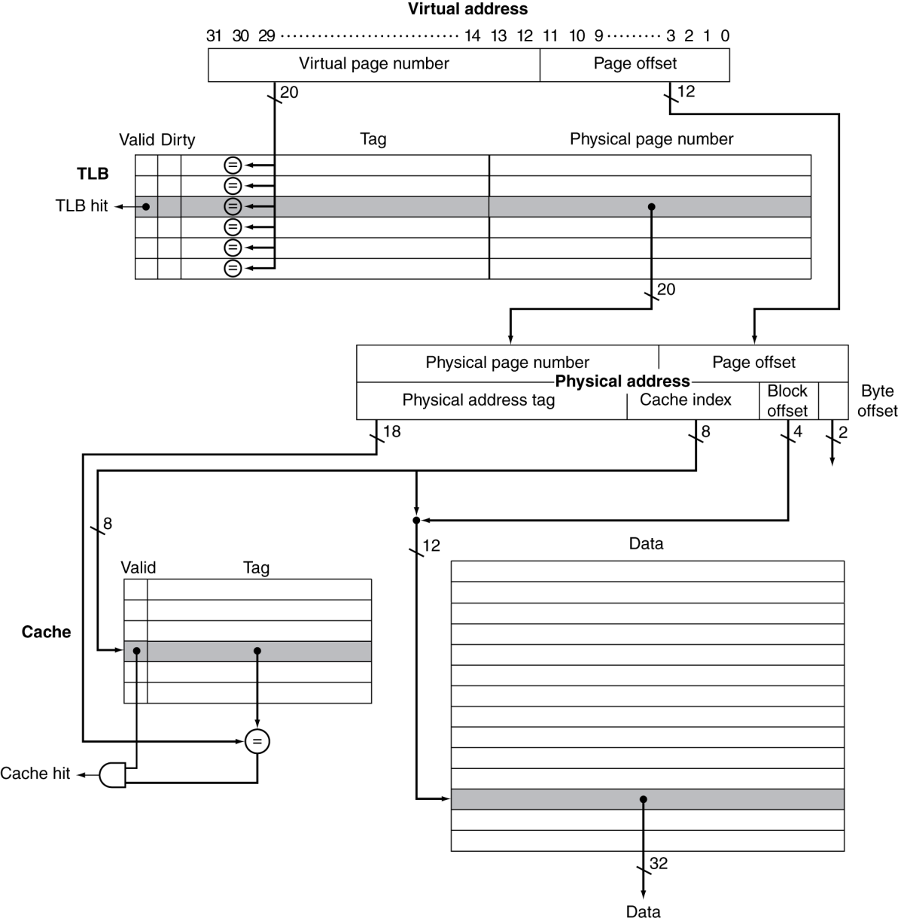
TLB and Cache Interaction

Slide 33
Concluding Remarks
Fast memories are small, large memories are slow
We really want fast, large memories ☹
Caching gives this illusion ☺
Principle of locality
Programs use a small part of their memory space frequently
Memory hierarchy
L1 cache ↔ L2 cache ↔ … ↔ DRAM memory ↔ disk
Memory system design is critical for multiprocessors
§5.16 Concluding Remarks

