Slide 1
Parallel Processors

Slide 2
Hardware and Software
Hardware
Serial: e.g., Pentium 4
Parallel: e.g., quad-core Xeon e5345
Software
Sequential: e.g., matrix multiplication
Concurrent: e.g., operating system
Sequential/concurrent software can run on serial/parallel hardware
Challenge: making effective use of parallel hardware

Slide 3
Parallel Programming
Parallel software is the problem
Need to get significant performance improvement
Otherwise, just use a faster uniprocessor, since it’s easier!
Difficulties
Partitioning
Coordination
Communications overhead
§6.2 The Difficulty of Creating Parallel Processing Programs

Slide 4
Amdahl’s Law
Sequential part can limit speedup
Example: Execution time for a program: 1s
All of the program can be parallelized
With 100 processors, the new execution time is 1/100 s
Speed up = 1s/0.01s = 100
Example: Execution time for a program: 1s
Computation corresponding to time 0.9s (out of 1s) an be parallelized, the other computation cannot be parallelized.
With 100 processors, the new execution time is: 0.9/100s + 0.1s
Speed up = 1s/(0.9/100s + 0.1s) = 9.2
Example: Execution time for a program: 1s
Computation corresponding to time 0.9s (out of 1s) an be parallelized, the other computation cannot be parallelized.
With infinite processors, the new execution time approaches to: 0.1s
Speed up = 1s/(0.1s) = 10

Slide 5
Scaling Example
Workload: sum of 10 scalars, and 10 × 10 matrix sum
Speed up from 10 to 100 processors
Single processor: Time = (10 + 100) × t_{add}
10 processors
Time = 10 × t_{add} + 100/10 × t_{add} = 20 × t_{add}
Speedup = 110/20 = 5.5 (55% of potential)
100 processors
Time = 10 × t_{add} + 100/100 × t_{add} = 11 × t_{add}
Speedup = 110/11 = 10 (10% of potential)
Assumes load can be balanced across processors

Slide 6
Scaling Example
Workload: sum of 10 scalars, and 10 × 10 matrix sum
Single processor: Time = (10 + 100) × t_{add}
10 processors
Time = 10 × t_{add} + 100/10 × t_{add} = 20 × t_{add}
Speedup = 110/20 = 5.5 (55% of potential)

Slide 7
Scaling Example
Workload: sum of 10 scalars, and 10 × 10 matrix sum
Single processor: Time = (10 + 100) × t_{add}
100 processors
Time = 10 × t_{add} + 100/100 × t_{add} = 11 × t_{add}
Speedup = 110/11 = 10 (10% of potential)

Slide 8

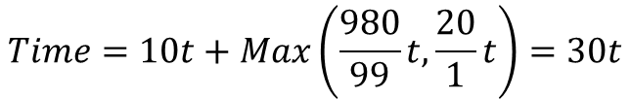

Load Balancing
Sum of 10 scalars, and 32 × 32 matrix sum on 100 processors
$$Time=10t+\frac{1000}{100}t=20t$$
Load Balance: Each processor is adding 10 matrix elements
Speedup = (10+1000)/20 = 50.5
Load Unbalance: One processor adds 20 matrix elements, and the rest 980
additions are distributed uniformly amongst 99 processors
$$Time=10t+Max\left(\frac{980}{99}t,\frac{20}{1}t\right)=30t$$
$$Speedup=\frac{1010}{30}=33$$
What happens if one processor adds 100 elements?

Slide 9
Multithreading
Performing multiple threads of execution in parallel
Replicate registers, PC, etc.
Fast switching between threads
Fine-grain multithreading
Switch threads after each cycle
Interleave instruction execution
If one thread stalls, others are executed
Coarse-grain multithreading
Only switch on long stall (e.g., L2-cache miss)
Simplifies hardware, but doesn’t hide short stalls (eg, data hazards)
§6.4 Hardware Multithreading

Slide 10
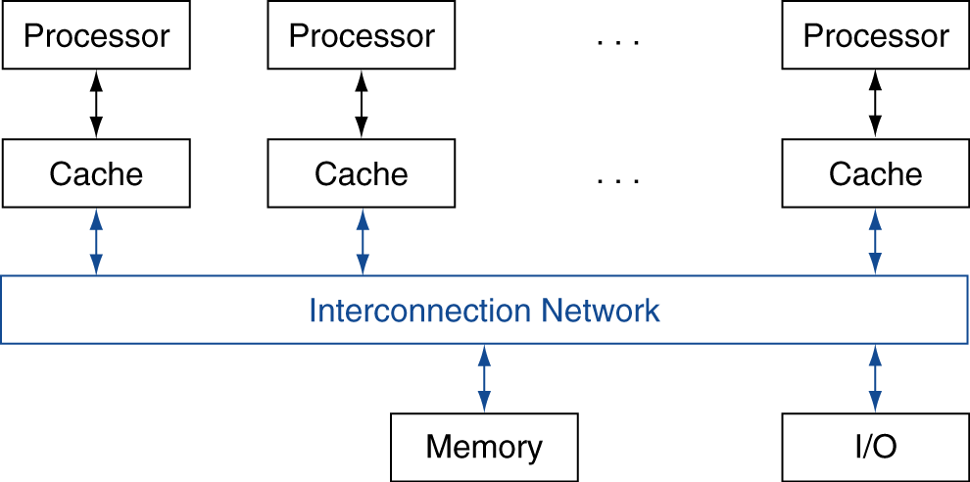
Shared Memory
SMP: shared memory multiprocessor
Hardware provides single physical address space for all processors
Synchronize shared variables using locks
Memory access time
UMA (uniform) vs. NUMA (nonuniform)
§6.5 Multicore and Other Shared Memory Multiprocessors

Slide 11
GPU Architectures
Processing is highly data-parallel
GPUs are highly multithreaded
Use thread switching to hide memory latency
Less reliance on multi-level caches
Graphics memory is wide and high-bandwidth
Trend toward general purpose GPUs
Heterogeneous CPU/GPU systems
CPU for sequential code, GPU for parallel code
Programming languages/APIs
DirectX, OpenGL
C for Graphics (Cg), High Level Shader Language (HLSL)
Compute Unified Device Architecture (CUDA)

Slide 12
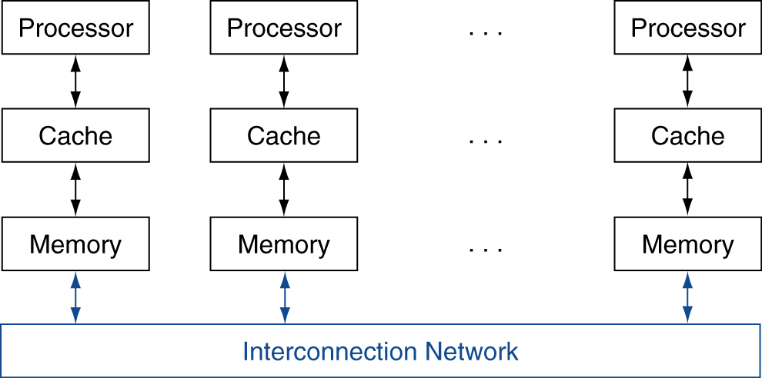
Message Passing
Each processor has private physical address space
Hardware sends/receives messages between processors
§6.7 Clusters, WSC, and Other Message-Passing MPs

Slide 13
Loosely Coupled Clusters
Network of independent computers
Each has private memory and OS
Connected using I/O system
E.g., Ethernet/switch, Internet
Suitable for applications with independent tasks
Web servers, databases, simulations, …
High availability, scalable, affordable
Problems
Administration cost (prefer virtual machines)
Low interconnect bandwidth
c.f. processor/memory bandwidth on an SMP

Slide 14
Parallel Benchmarks
Linpack: matrix linear algebra
SPECrate: parallel run of SPEC CPU programs
Job-level parallelism
SPLASH: Stanford Parallel Applications for Shared Memory
Mix of kernels and applications, strong scaling
NAS (NASA Advanced Supercomputing) suite
computational fluid dynamics kernels
PARSEC (Princeton Application Repository for Shared Memory Computers) suite
Multithreaded applications using Pthreads and OpenMP
§6.10 Multiprocessor Benchmarks and Performance Models

Slide 15
Modeling Performance
Peak Memory Bandwidth
16 GB/s
CPU
MEMORY
CPU can operate at
16 GFLOPS/s
We have a program that on average perform 1/8 FLOPS per byte access of data
What is the maximum performance I can get for this program? 16 GFLOPS/s ?

Slide 16
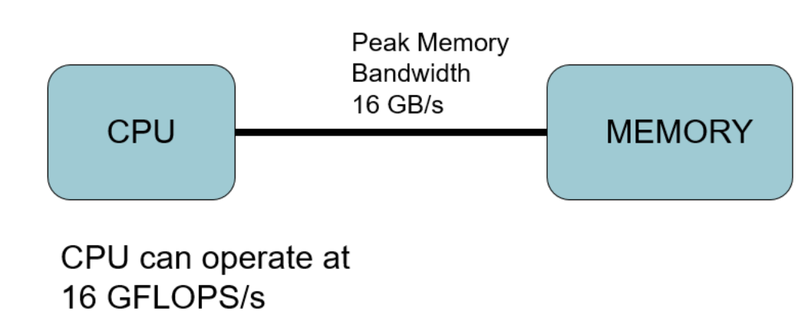
Modeling Performance
We have a program that on average perform 1/8 FLOPS per byte access of data
How much data we can move in 1s to CPU? 16 GB
How many operations CPU can perform in 1s? 16 GB * (1/8 FLOPS/B) = 2 GFLOPS/s

Slide 17
Modeling Performance
We have a program that on average perform 1/4 FLOPS per byte access of data
How much data we can move in 1s to CPU? 16 GB
How many operations CPU can perform in 1s? 16 GB * (1/4 FLOPS/B) = 4 GFLOPS/s

Slide 18
Modeling Performance
We have a program that on average perform 1 FLOPS per byte access of data
How much data we can move in 1s to CPU? 16 GB
How many operations CPU can perform in 1s? 16 GB * (1 FLOPS/B) = 16 GFLOPS/s

Slide 19
Modeling Performance
We have a program that on average perform 2 FLOPS per byte access of data
How much data we can move in 1s to CPU? 16 GB
How many operations CPU can perform in 1s? 16 GB * (2 FLOPS/B) = 32 GFLOPS/s
Is that possible? The maximum CPU can perform is 16 GFLOPS/s
Performance = MIN ( Bandwidth * Arithmetic Intensity, Peak CPU Performance)

Slide 20
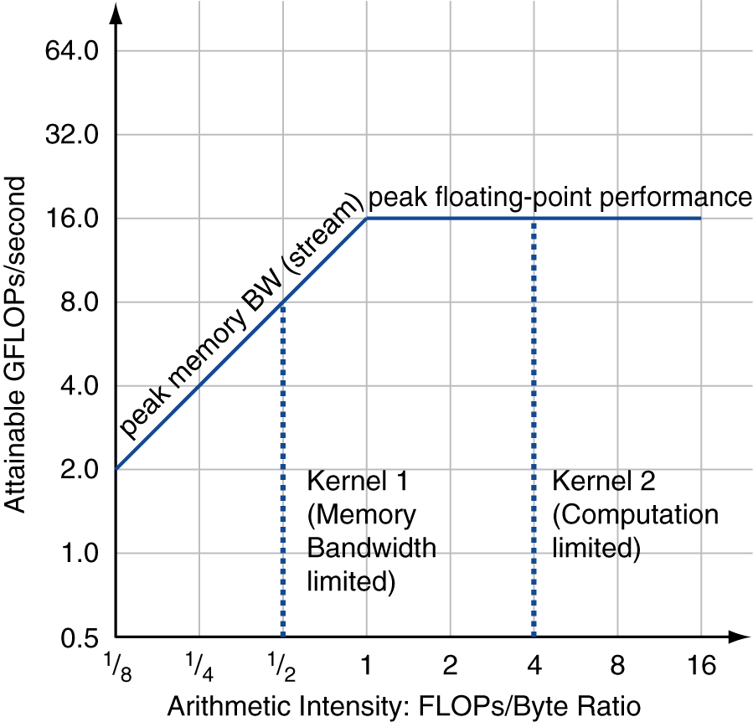
Roofline Diagram
Attainable GPLOPs/sec
= Min ( Peak Memory BW × Arithmetic Intensity, Peak FP Performance )

Slide 21
Concluding Remarks
Goal: higher performance by using multiple processors
Difficulties
Developing parallel software
Devising appropriate architectures
§6.14 Concluding Remarks

