Slide 1
CS 270 – Introduction to Computer Architecture II
§1.1 Introduction

Slide 2
Course Description
CS 270 is a second course in a two semester sequence; CS 170/270. CS 170 is a prerequisite for CS 270.
Focus: Shaded region in the figure below.
COMPUTER
Processor
Memory
Program /Data
Devices
Control
Input
Datapath
Output

Slide 3
Course Description
Design and operation of an ALU (Arithmetic/Logic Unit)
Implementation and control of single and multicycle processors
Processor pipelining
Technology and operation of the memory hierarchy (cache-RAM-disk) as well as virtual memory
Importance of performance and the strong connection between the hardware and software

Slide 4
Text and Topics
Computer Organization and Design, 5th Edition, David A. Patterson and John L. Hennessy
The same text is used in both CS 170 and CS 270. The topics covered in CS 270 are:
Overview of the Course, Review Chapter 1 and Appendix B
Processor - Chapter 4, Controller - Appendix D
Exploiting memory hierarchy - Chapter 5
Parallel computing overview - Chapter 6

Slide 5
Grading
Your grade will be based on a total of 100 points with the following distribution.
Five homework assignments: 15 points
Quizzes (unannounced, closed book and notes): 15 points
Two midterms (open book and notes): 30 points
Final examination (comprehensive, open book and notes): 40 points

Slide 6
Homework Assignments
Homework assignment will be posted on the website.
A homework assignment will be collected in the class on the due date and graded on a range of 0 to 10.
Solutions for the homework will be posted on the website.

Slide 7
Quizzes
Several quizzes will be given throughout the course.
The quiz will be given at the beginning of a class and it will take at most 15 minutes to complete the quiz.
The schedule for these quizzes will NOT be posted.
Quizzes will be based on the material covered in the previous lecture. It is advisable that after each lecture you review the covered material so that you are ready for the quiz.
If you miss a quiz, you will be assigned a score of zero for that quiz.
One quiz with the lowest score will be dropped.
There will be no makeup if you miss a quiz. Computer Organization and

Slide 8
Is Computer Smart?
Hardware only understands electrical signals of the form of high and low voltage (ON/OFF)
Need to code the instruction in low and high voltage electrical signals
Binary System
Ideal for representing machine code as it is based on two symbols (1 and 0) that directly map to high and low voltage electrical signals
For example “10010011” is the machine code for an instruction to add two numbers
§1.2 Below Your Program
Computer Hardware
Electrical signal (ON/OFF)

Slide 9
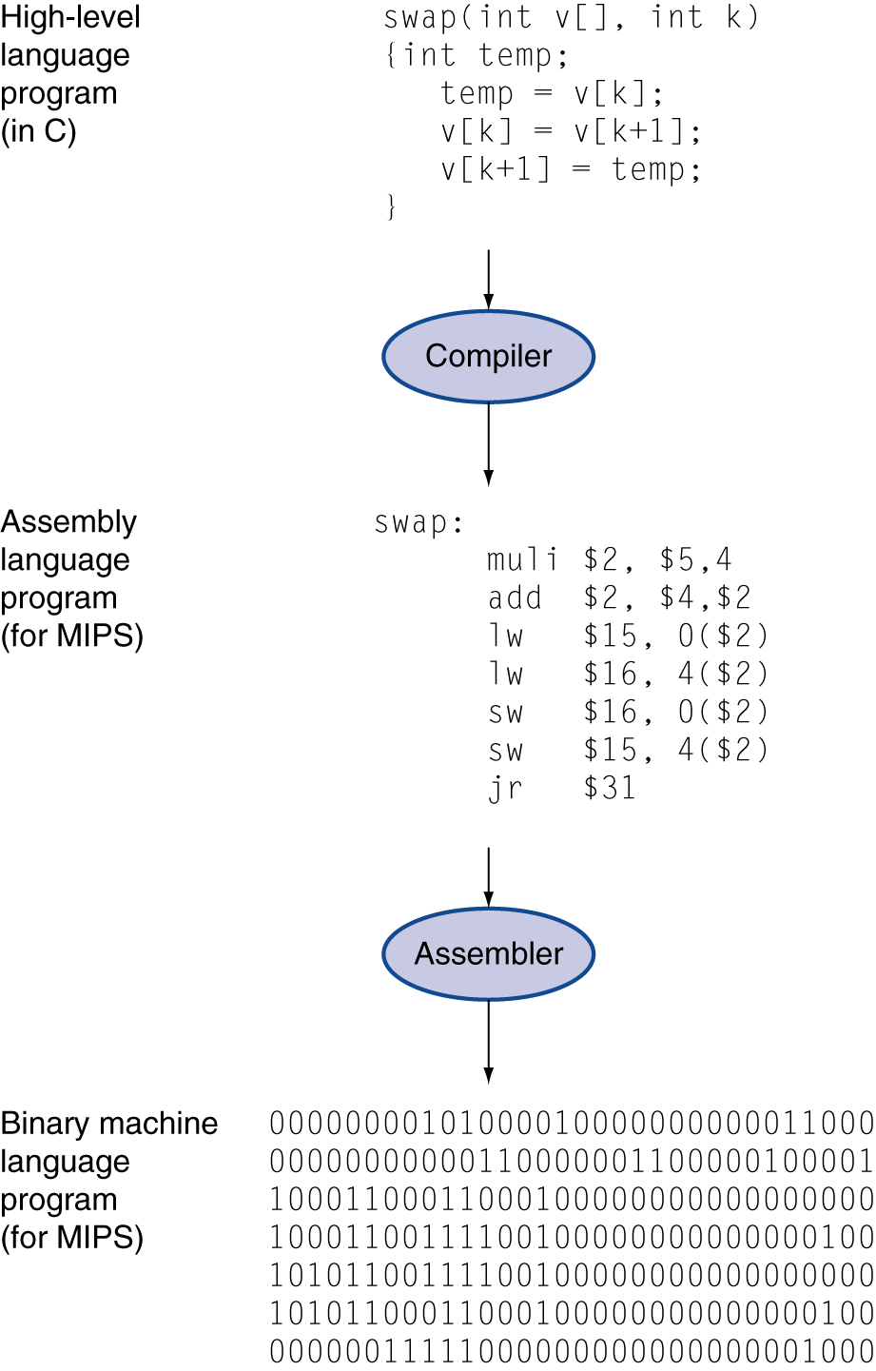
More Layers of Software –Look Smarter
High-level language
Level of abstraction closer to problem domain
Provides for productivity and portability
Assembly language
Textual representation of instructions
Hardware representation
Binary digits (bits)
Encoded instructions and data

Slide 10
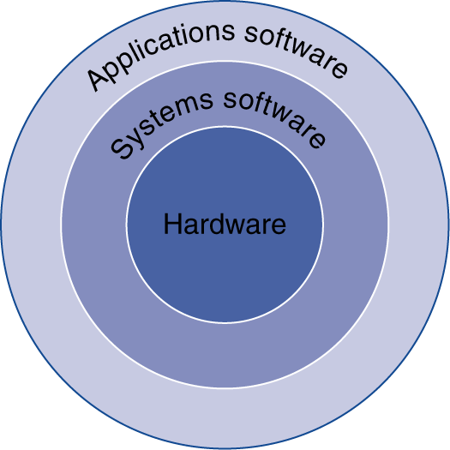
Below Your Program
Application software
Written in high-level language
System software
Compiler: translates HLL code to machine code
Operating System: service code
Handling input/output
Managing memory and storage
Scheduling tasks & sharing resources
Hardware
Processor, memory, I/O controllers
§1.2 Below Your Program

Slide 11
The Computer Revolution
§1.1 Introduction
Progress in computer technology
Underpinned by Moore’s Law
Makes novel applications feasible
Computers in automobiles
Cell phones
Human genome project
World Wide Web
Search Engines
Computers are pervasive

Slide 12
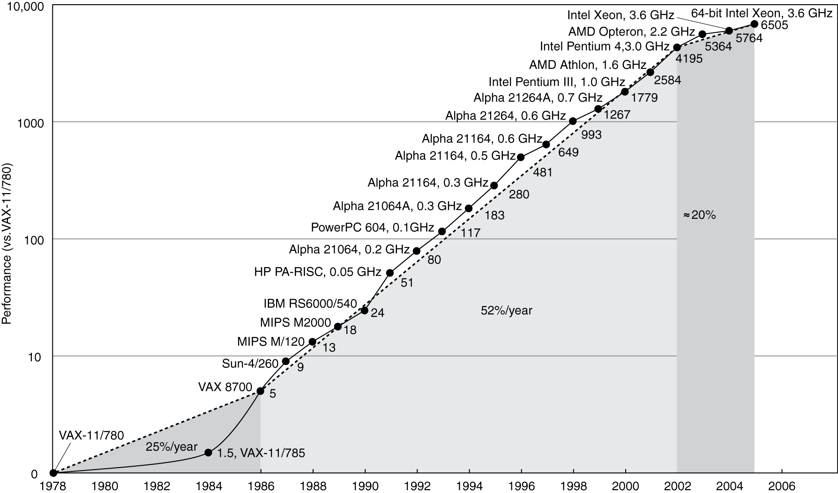
Uniprocessor Performance
§1.6 The Sea Change: The Switch to Multiprocessors
Constrained by power, instruction-level parallelism, memory latency

Slide 13
Multiprocessors
Multicore microprocessors
More than one processor per chip
Requires explicitly parallel programming
Compare with instruction level parallelism
Hardware executes multiple instructions at once
Hidden from the programmer
Hard to do
Programming for performance
Load balancing
Optimizing communication and synchronization

Slide 14
Anatomy of Computer
COMPUTER
Processor
Memory
Program /Data
Devices
Control
Input
Datapath
Output

Slide 15
Inside the Processor (CPU)
Datapath: performs operations on data
Control: sequences datapath, memory, ...
Cache memory
Small fast SRAM memory for immediate access to data

Slide 16
Performance Summary
The BIG Picture
Performance depends on
Algorithm: affects IC, possibly CPI
Programming language: affects IC, CPI
Compiler: affects IC, CPI
Instruction set architecture: affects IC, CPI, T_{c}

Slide 17
Appendix B
Basics of Logic Design

Slide 18
Logic Design Basics
Objective:
To understand how to build a processor
§4.2 Logic Design Conventions
operation
Program in C++
Compiler + Assembler
a
32
ALU
result
32
b
32

Slide 19
Logic Design Basics
Information encoded in binary
Low voltage = 0, High voltage = 1
One wire per bit
Multi-bit data encoded on multi-wire buses
Combinational element
Operate on data
Output is a function of input
State (sequential) elements
Store information
§4.2 Logic Design Conventions

Slide 20
Combinational and Sequential Logic
Combinational logic: A logic system whose blocks do not contain memory and hence compute the same output given the same input.
Sequential logic A group of logic elements that contain memory and hence whose value depends on the inputs as well as the current contents of the memory.
§4.2 Logic Design Conventions

Slide 21
Combinational Elements
AND-gate
Y = A & B
Adder
Y = A + B
A
+
Y
B
A
Y
B
Arithmetic/Logic Unit
Y = F(A, B)
Multiplexer
Y = S ? I1 : I0
A
I0
M u x
Y
Y
ALU
I1
B
S
F

Slide 22
Combinational Elements
Output is completely specified by the input
TRUTH TABLE is a way of describing how an output of a combinational logic depends on the input – completely specifies the logic function
Example: Basic logic function such as AND
INPUT |  | OUTPUT
A | B | Y
1 | 0 | 0
0 | 1 | 0
0 | 0 | 0
1 | 1 | 1
How many entries in a truth table?

Slide 23
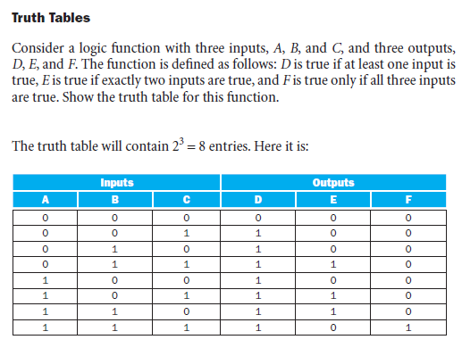
Truth Table

Slide 24
Reminder
§4.2 Logic Design Conventions
Please review what I covered in the class today.
Next class could be a quiz!!

