Slide 1
Chapter 4
Pipelining-I
Reference: Section 4.5

Slide 2
Performance Issues
Longest delay determines clock period resulting in every instruction having the same length (time)
Critical path: load instruction
Instruction memory → register file → ALU → data memory → register file
What happens with more complex instruction set?
Not feasible to vary period for different instructions
Violates design principle
Making the common case fast
We will improve performance by pipelining

Slide 3
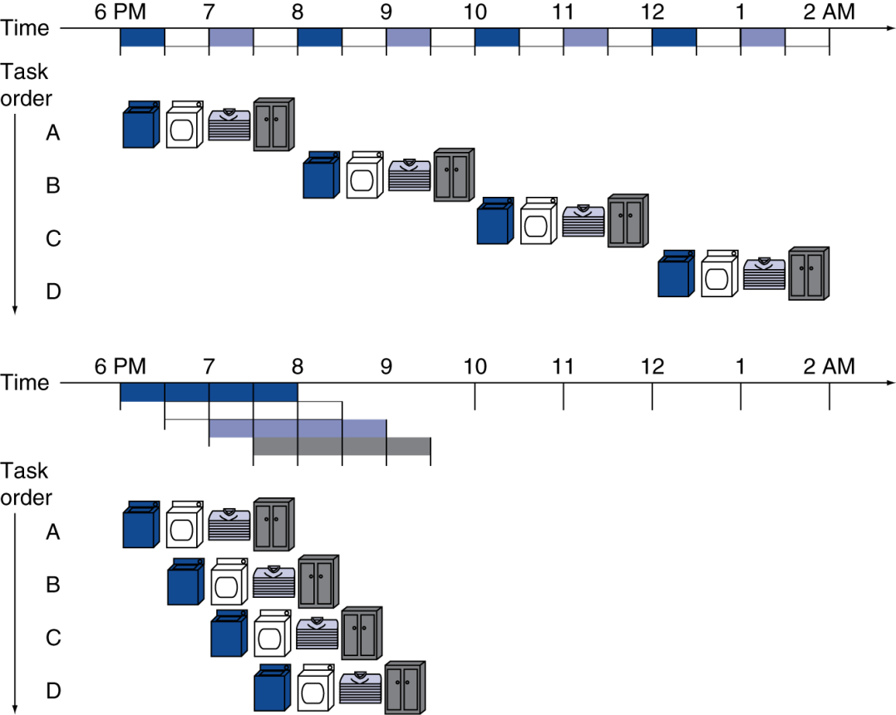
Pipelining Analogy
Pipelined laundry: overlapping execution
Parallelism improves performance
§4.5 An Overview of Pipelining
Four loads:
Speedup = 8/3.5 = 2.3
Non-stop:
Speedup = 2n/(0.5n + 1.5) ≈ 4 = number of stages

Slide 4
MIPS Pipeline
Five stages, one step per stage
IF: Instruction fetch from memory
ID: Instruction decode & register read
EX: Execute operation or calculate address
MEM: Access memory operand
WB: Write result back to register

Slide 5
Pipeline Performance
Assume time for stages is
100ps for register read or write
200ps for other stages
Compare pipelined datapath with single-cycle datapath
Instr | Instr fetch | Register read | ALU op | Memory access | Register write | Total time
lw | 200ps | 100 ps | 200ps | 200ps | 100 ps | 800ps
sw | 200ps | 100 ps | 200ps | 200ps |  | 700ps
R-format | 200ps | 100 ps | 200ps |  | 100 ps | 600ps
beq | 200ps | 100 ps | 200ps |  |  | 500ps

Slide 6
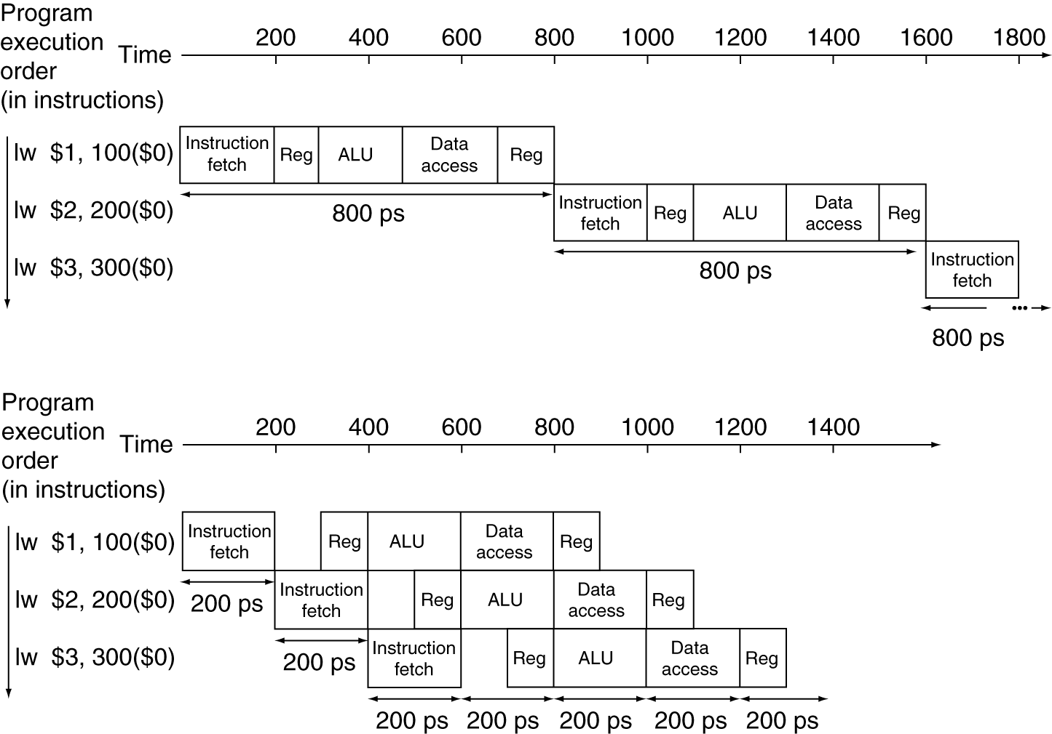
Pipeline Performance
Single-cycle (T_{c}= 800ps)
Pipelined (T_{c}= 200ps)

Slide 7
Pipeline Speedup
If all stages are balanced
i.e., all take the same time
Time between instructions_{pipelined} = Time between instructions_{nonpipelined} Number of stages
If not balanced, speedup is less
Speedup due to increased throughput
Latency (time for each instruction) does not decrease

Slide 8
Pipelining and ISA Design
MIPS ISA designed for pipelining
All instructions are 32-bits
Easier to fetch and decode in one cycle
c.f. x86: 1- to 17-byte instructions
Few and regular instruction formats
Can decode and read registers in one step
Load/store addressing
Can calculate address in 3rd stage, access memory in 4th stage
Alignment of memory operands
Memory access takes only one cycle

Slide 9
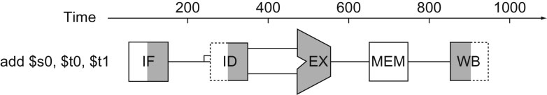
FIGURE 4.28 Graphical representation of the instruction pipeline, similar in spirit to the laundry pipeline in Figure 4.25. Here we use symbols representing the physical resources with the abbreviations for pipeline stages used throughout the chapter. The symbols for the five stages: IF for the instruction fetch stage, with the box representing instruction memory; ID for the instruction decode/register file read stage, with the drawing showing the register file being read; EX for the execution stage, with the drawing representing the ALU; MEM for the memory access stage, with the box representing data memory; and WB for the write-back stage, with the drawing showing the register file being written. The shading indicates the element is used by the instruction. Hence, MEM has a white background because add does not access the data memory. Shading on the right half of the register file or memory means the element is read in that stage, and shading of the left half means it is written in that stage. Hence the right half of ID is shaded in the second stage because the register file is read, and the left half of WB is shaded in the fifth stage because the register file is written.
9
Copyright © 2014 Elsevier Inc. All rights reserved.

Slide 10
Hazards
Situations that prevent starting the next instruction in the next cycle
Structure hazards
A required resource is busy
Data hazard
Need to wait for previous instruction to complete its data read/write
Control hazard
Deciding on control action depends on previous instruction

Slide 11
Structural Hazard
Time in
Clock Cycle
1
2
3
4
5
6
7
8
Lw $1, 100($0)
Lw $2, 200($0)
Lw $3, 300($0)
Lw $4, 400($0)

Slide 12
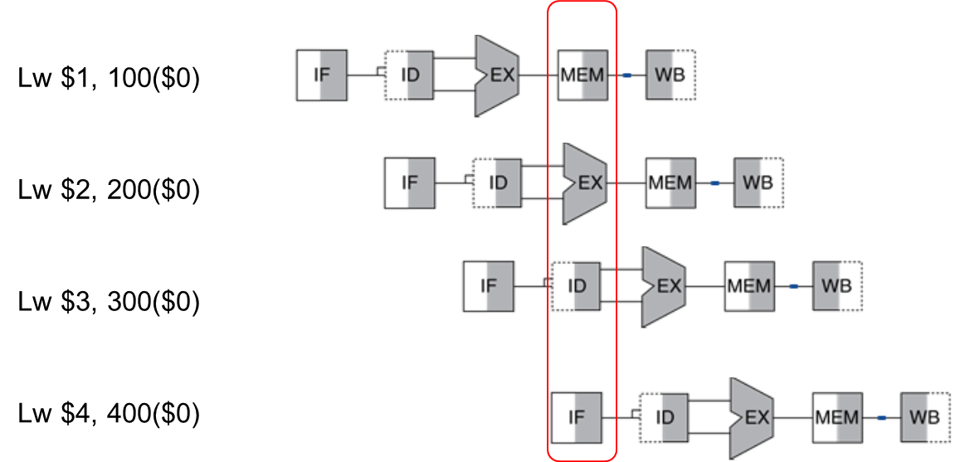
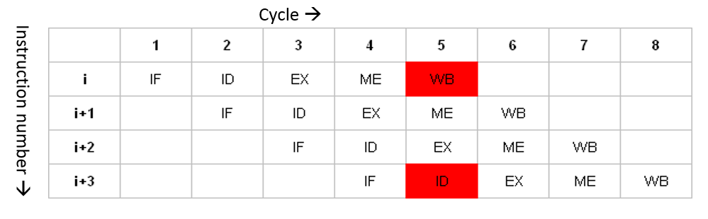
Structural Hazard

Slide 13
Structure Hazards
Conflict for use of a resource
In MIPS pipeline with a single memory
Load/store requires data access
Instruction fetch would have to stall for that cycle
Would cause a pipeline “bubble”
Hence, pipelined datapaths require separate instruction/data memories
Or separate instruction/data caches

Slide 14
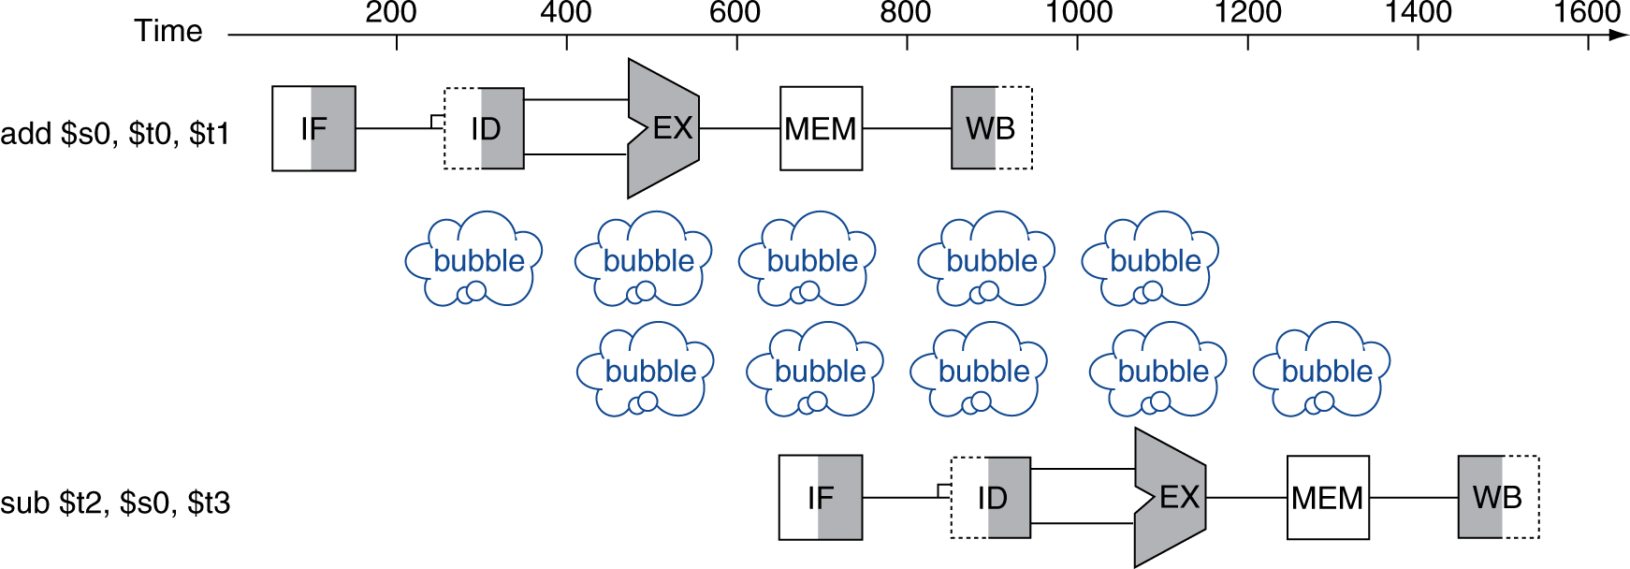
Data Hazards
An instruction depends on completion of data access by a previous instruction
add $s0, $t0, $t1 sub $t2, $s0, $t3

Slide 15
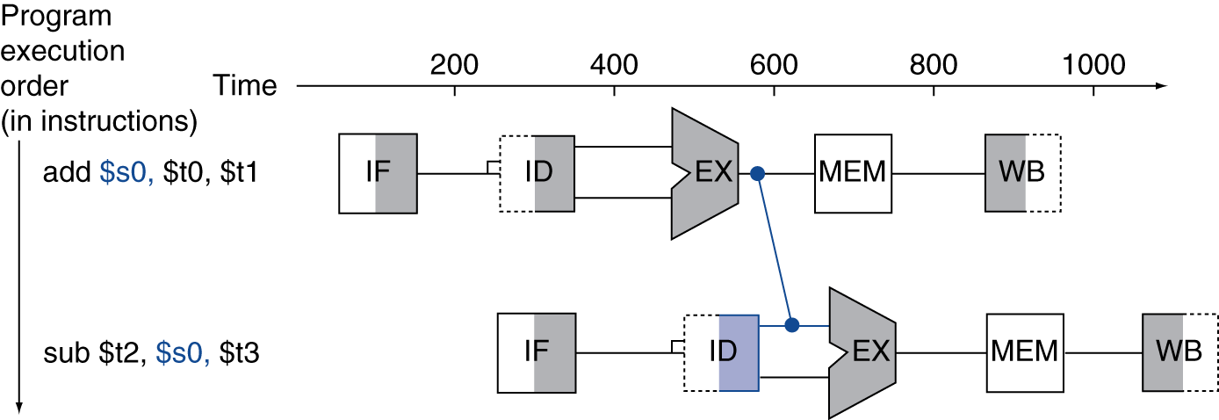
Forwarding (aka Bypassing)
Use result when it is computed
Don’t wait for it to be stored in a register
Requires extra connections in the datapath

Slide 16
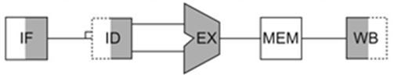
Forwarding
What happens if it is a load followed by a dependent subtract?
Does forwarding help?

Slide 17
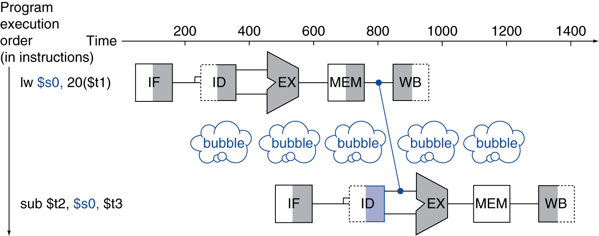
Load-Use Data Hazard
Can’t always avoid stalls by forwarding
If value not computed when needed
Can’t forward backward in time!

Slide 18
Code Scheduling to Avoid Stalls
Reorder code to avoid use of load result in the next instruction
C code for A = B + E; C = B + F;
lw $t1, 0($t0)
lw $t2, 4($t0)
add $t3, $t1, $t2
sw $t3, 12($t0)
lw $t4, 8($t0)
add $t5, $t1, $t4
sw $t5, 16($t0)
lw $t1, 0($t0)
lw $t2, 4($t0)
lw $t4, 8($t0)
add $t3, $t1, $t2
sw $t3, 12($t0)
add $t5, $t1, $t4
sw $t5, 16($t0)
stall
stall
13 cycles
11 cycles

Slide 21
Control Hazards
Branch determines flow of control
Fetching next instruction depends on branch outcome
Pipeline can’t always fetch correct instruction
Still working on ID stage of branch
In MIPS pipeline
Need to compare registers and compute target early in the pipeline
Add hardware to do it in ID stage

Slide 22
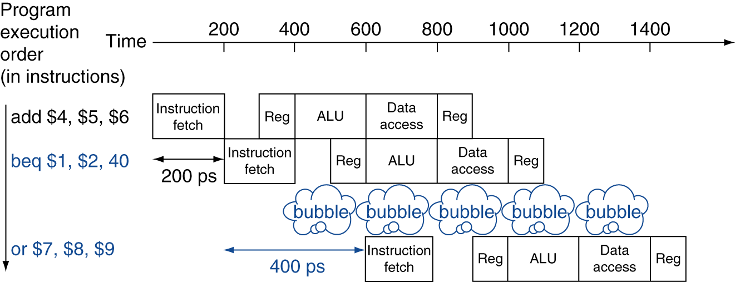
Stall on Branch
Wait until branch outcome determined before fetching next instruction

Slide 23
Branch Prediction
Longer pipelines can’t readily determine branch outcome early
Stall penalty becomes unacceptable
Predict outcome of branch
Only stall if prediction is wrong
In MIPS pipeline
Can predict branches not taken
Fetch instruction after branch, with no delay

Slide 24
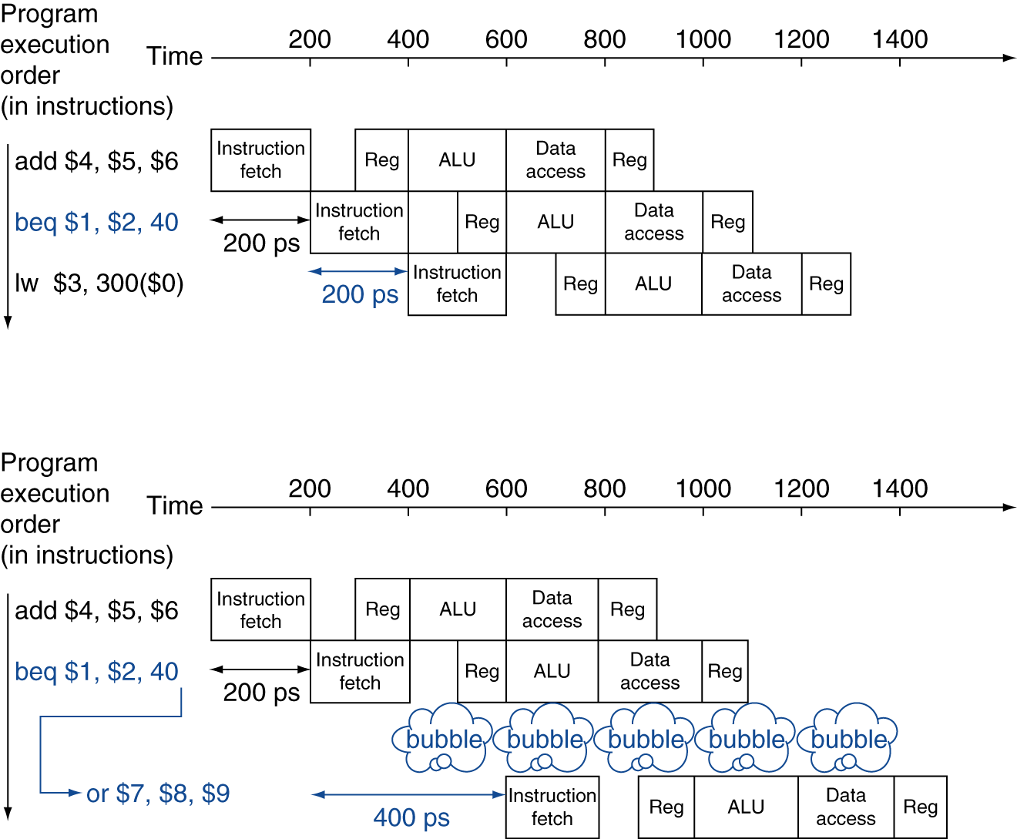
MIPS with Predict Not Taken
Prediction correct
Prediction incorrect

Slide 25
More-Realistic Branch Prediction
Static branch prediction
Based on typical branch behavior
Example: loop and if-statement branches
Predict backward branches taken
Predict forward branches not taken
Dynamic branch prediction
Hardware measures actual branch behavior
e.g., record recent history of each branch
Assume future behavior will continue the trend
When wrong, stall while re-fetching, and update history

Slide 26
Pipeline Summary
The BIG Picture
Pipelining improves performance by increasing instruction throughput
Executes multiple instructions in parallel
Each instruction has the same latency
Subject to hazards
Structure, data, control
Instruction set design affects complexity of pipeline implementation

