Slide 1
CS 495 Lecture 1: Introduction to Software Reverse Engineering
Cong Wang
Center of Cybersecurity Education and Research
Department of Computer Science
http://www.lions.odu.edu/~c1wang/malware_analysis.html

Slide 2
Syllabus
Cyber Center Desktop Logins:
User ID: Your Midas ID
Password: cre-midasid-cre
Or you can bring your own laptop to class – helps save the work

Slide 3
Syllabus
Textbook:
Practical Malware Analysis – Michael Sikorski et. al.
Supplemental Textbook:
Reversing Secrets of Reverse Engineering, Eldad Eilam et. al.
The IDAPro Book, Chris Eagle
Practical Reverse Engineering, Bruce Dang et.al
[More advanced]: Hacker Disassembling Uncovered, Kris Kaspersky et. al.
Notes:
Where to find the textbooks ?

Slide 4
Gradings
Participation and In-Class Homework: 30%
Homework: 40%
Final Project: 30%
Final Project would have some options, or you can propose your own topic, approved by me.
In-Class Homework: you can work in group of max. 2 students
Homework: should be completed independently (no plagiarism – if found, zero for both, lower your final grade as well)

Slide 5
Homework Submission
Email submission: cwang.odu@gmail.com
Homework submission format: docx/pdf file
Timestamp when the email is received
Please do not submit to my odu.edu email
Graded homework will be emailed back in PDF

Slide 6
Policy
Final Project: can be done in group of max 2 students or individually
Late submission: late homework/project (not in-class homework): grade follows an exponential decay regarding late time: S = exp(-(t_1-t_0)/20)*S_0
S_0 is the original grade, t1_, t_0 timestamps in hrs, late for 5 hrs, original 100 -> 78 now
In-class homework should be submitted before 5:00 pm
If cannot complete in class, complete the rest before 12:00AM on Sunday; otherwise, you receive zero for the in-class homework.
Solutions will be posted on Sunday

Slide 7
Prerequisites
Basic understanding how software executes on a system
Windows Assembly Language

Slide 8

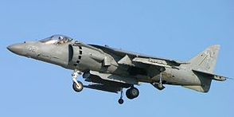


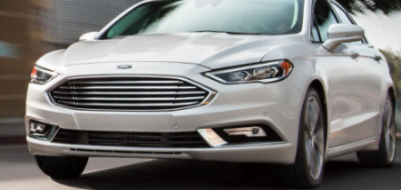
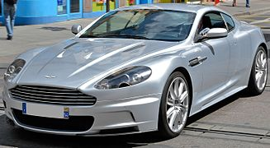
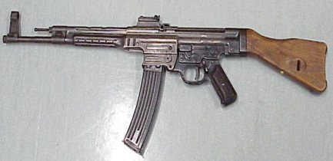
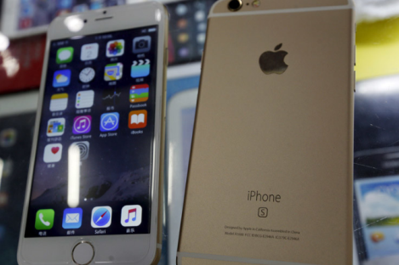
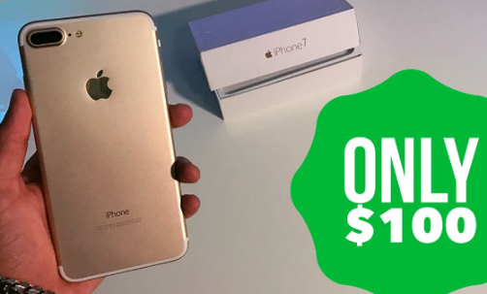
What is Reverse Engineering
Definition: the processes of extracting knowledge or design information from anything man-made and reproducing it.
Soviet: AK-47
Reversed
US: McDonell Douglas AV-8 Harrier
Soviet: Yak 38
Body Design
Ford Fusion
Aston Martin
German: STG44
Clone
Assemble an iPhone in 15 mins Shenzhen, China

Slide 9
Legal
Practice of analyzing a software system, either in whole or in part, to extract design and implementation information.
Business disputes/lawsuit
Is Reversing Legal ? Seek legal counsel.
Copyright Laws (decompilation legal, intermediate copying is illegal)
Copyright Laws: In order to decompile a program, that program must be duplicated at least once, either in memory, on disk, or both
Digital Millenium Copyright Act (applies to Digital Right Management products)
Felten vs. RIAA
US vs. Sklyarov

Slide 10
Felten vs. RIAA
In 2000, SDMI (Secure Digital Music Initiative) announced the Hack SDMI challenge – protect audio recordings
SDMI challenge offered a $10,000 reward in return of giving up ownership
Princeton Prof. Felton’s team found weakness and wrote a paper
[Wu et. al.] ANALYSIS OF ATTACKS ON SDMI AUDIO WATERMARKS, ICASSP, 2001.
[Craver et. al.] Reading Between the Lines: Lessons from the SDMI Challenge, USENIX SP, 2001.
Felten’s team chose to forego this reward and retain ownership of the information to allow them to publish their findings.
They received legal threats from SDMI and the RIAA (the Recording Industry Association of America) claiming liability under the DMCA
They withdraw their original submission, but paper got published later

Slide 11
Felten vs. RIAA
Classic case
DMCA could actually reduce the level of security by preventing security researchers to publish their findings.

Slide 12
US vs. Sklyarov
In 2001, Dmitry Sklyarov, a Russian programmer, was arrested by the FBI for what was claimed to be a violation of the DMCA.
Sklyarov had reverse engineered the Adobe eBook file format while working for ElcomSoft, a software company from Moscow.
The information gathered using reverse engineering was used in the creation of a program called Advanced eBook Processor that could decrypt such eBook files so that they become readable by any PDF reader.
Adobe filed a complaint stating that the creation and distribution of the Advanced eBook Processor is a violation of the DMCA, and both Sklyarov and ElcomSoft were sued by the government.

Slide 13
Why ?
Related to computer security
Used by crackers to defeat copy protection (crack games/software)
Reverse encryption product to assess security levels
Malware analysis (our focus)

Slide 14

Motivation Example 1
FBI uses an exploit in TOR browser, implants a cookie to fingerprint users geographical location via external Firefox Browser.
TOR is anonymous, several layers of encryption – hard to trace
TOR browser based on Firefox
Use the exploit to inject a malware “Magneto”

Slide 15
Cookies
What are Cookies ?
Cookies are small text files stored by your web browser after visiting a web page to personalize your visit in next time, collect demographic information about the visitors to the page or to monitor banner clicks.
Not malicious, but can be used by malicious code to affect user privacy, send user profile to third parties

Slide 16
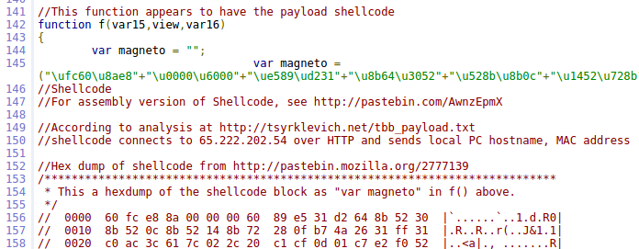
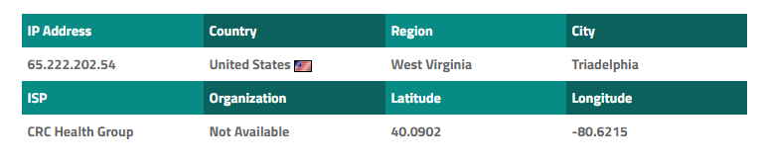
Motivation Example 1
Send user’s hostname/MAC via HTTP request to 65.222.202.54

Slide 17
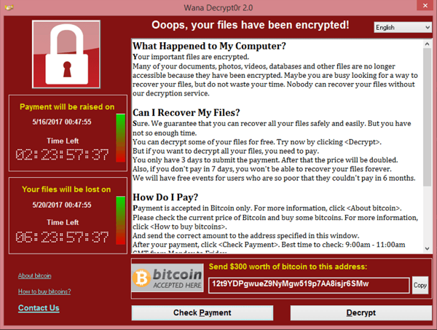
Example 2: Wannacry Ransom

Slide 18
Example 2: Wannacry
Began on May 12, 2017
Infected over 200,000 computers over 150 countries (brought down the entire British hospital system)
Shadow Broker make the exploit public
EternalBlue Exploit Windows SMB (Server Message Block) protocol – zero-day exploit
Malware analysis found a kill switch - http://www.iuqerfsodp9ifjaposdfjhgosurijfaewrwergwea.com , register this domain name
Use Bitcoin to pay ransom – no trace
Disputes, criticisms against government agency/Microsoft

Slide 19
Example 3: IoT Botnet/DDoS
Massive amount of IoT Devices now/in future (Home cameras/Alexa/Fridge/Lamp)
IoT firmware not updated, sold as is
BusyBox system – tiny Unix utilities on IoT devices
Last year, Mirai malware outbreak brought down ISP on the entire eastcoast
Bruteforce BusyBox with a list of deault password
IoT turns into Botnet
Launch DDoS attack (blackmailing)

Slide 20
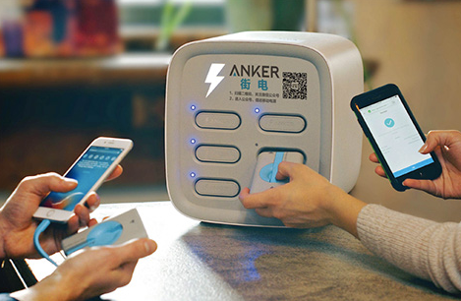
Example 4: Privacy Leaks during PowerBank Sharing
New start-up company to rent Powerbanks
Android system has a USB debugging config
Some smartphone vendors allows installation of software automatically while connecting to desktop
Malware obtains privilege via USB debugging to extract personal photos, contact and install backdoor, adware in Android

Slide 21
Example 5: OPM and Anthem Breach
FBI arrested Yu Pingan, aka GoldSun, a malware broker at LAX (a teacher from Shanghai).
Accused of using Sakula to attack US Office of Personnel Management, over 80M medical records from Anthem; Chinese government also made arrest of two hackers in 2015.
Sakula was only used once – exploits 4 zero-day CVE-2014-0322 (affecting IE10), CVE-2012-4969 (affecting IE6), CVE-2012-4792 (affecting IE6), and an unidentified Flash Player zero-day
Use watering hole attack: infect popular website with malware and wait for prey
Use a typo in DNS spelling of Capstone Turbine in CA to find victim (details unknown)

Slide 22

What is Malware ?
Set of instructions that run on your computer and make your system do something that an attacker wants it to do

Slide 23
Malware Classification
Viruses and worms
Self-replicating code that infects other systems manually or automatically
Botnets
Software that puts your computer under the remote control of an adversary to send spam or attack other systems (DDoS)
Backdoors
Code that bypasses normal security authentications to provide continued, unauthorized access to an adversary
Trojans, launchers
Code that appears legitimate, but performs an unauthorized action

Slide 24
Malware Classification
Rootkits
Tools to hide the presence of an adversary, stay concealed, avoid detection
Information theft
Collects credentials (e.g. keystroke loggers)
Steal files (credit card data exfiltration)
Gather information on you, your habits, web sites you visit (e.g. spyware)
Monitor activity (webcams)
Ransomware
Code that renders your computer or data inaccessable until payment received (Wannacry)

Slide 25
Malware Classification
Resource or identity theft
Store illicit files (copyrighted material)
Stepping stone to launder activity (frame you for a crime)‏
Scareware
Tricks users into buying products they do not need (window pop-up: your system is infected)
Adware
Code that tricks users into clicking illegitimate advertisements
Drive-by downloads
Code automatically downloaded via the web

Slide 26
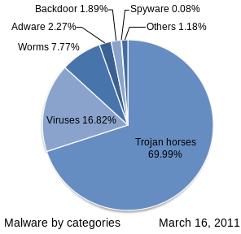
Malware Classification (2011)

Slide 27
Course Objective
Learn tools and techniques to analyze what malicious software does
How to detect malware
Understand the countermeasures from malware authors to evade detection

Slide 28
Ethics
Do not run malware files in the classroom PC locally/or your own computers – only in the VM
Explore only on your own systems/virtual machine you have permission to
Do not break or break into other people's machines

Slide 29
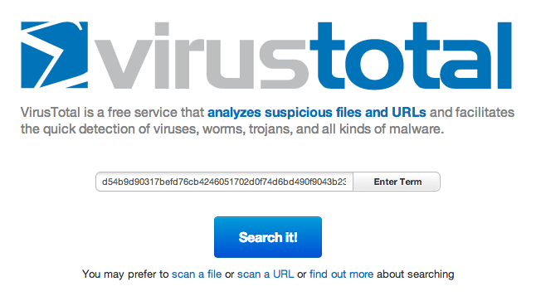
VirtusTotal
Upload a file, website URL, hash for analysis
Pros: Free
Cons: zero-day exploits, it may alert attackers that they’ve been caught
Notes:
Show an example: Upload a file scanned by multiple antivirus engines

Slide 30
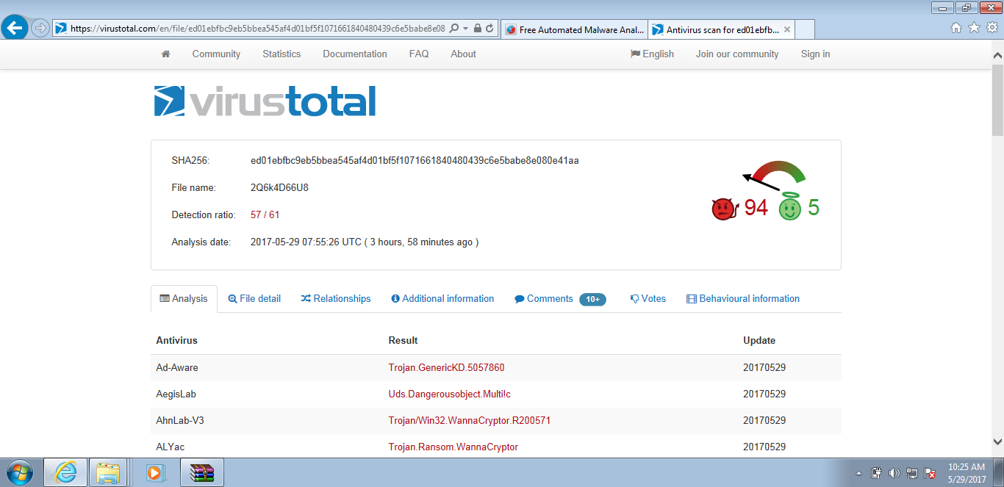
VirusTotal

Slide 31

Sandbox
WinXP
WinXP
WinXP
WinXP
Oracle Virtualbox
Cuckoo framework
Sandbox: special environment allows for logging the behavior of programs
API function calls, their parameters, file created/deleted, websites and ports accessed
Results are saved in a text file

Slide 32
Identify Malware
Identify Signatures:
Host-based signatures:
Malware PE File - Entropy
Malware behavior: changes registry, API calls, file access/creation/modification
Network signatures: monitoring network traffic, understand the propagation of worms – provides high detection rate, less false positives
Port Scanning
Protocols used (e.g. SMB, IRC)
Packet Payload
Finding needle-in-haystack (packet inspection)

Slide 33
Virtual Machine
Download Virtual Box and Install:
https://www.virtualbox.org/wiki/Downloads
You can either:
Load the image file (2+ GB) here: (Box Link – the link will be valid till the end of semester)
https://odu.box.com/s/dayzvwi81rd2mlrpvpm9d58k70bn8cb4

Slide 34
In-class work
Download VM .ova image
Establish VM on either your own laptop or classroom desktops

Slide 35
Tools already install on VM
WinRAR
Sysinternals tools (Process Explorer, Process Monitor) (https://docs.microsoft.com/en-us/sysinternals/downloads/)
PEView (wjradburn.com)
Resource Hacker (angusj.com)
Dependency Walker (dependencywalker.com)
IDA Pro 5.0 Freeware (hex-rays.com) – IDA Pro 6.8
Wireshark (wireshark.org) – v. 1.10 works on XP
Apate DNS (mandiant.com) – Need .NET Framework 3.5 (if you do it by yourself)
OllyDbg 1.10 (ollydbg.de)
WinHex (winhex.com)
PEiD (softpedia.com)
UPX (upx.sourceforge.net)
Regshot (code.google.com/p/regshot/)
Google Chrome
- You can customize your VM, of course

Slide 36
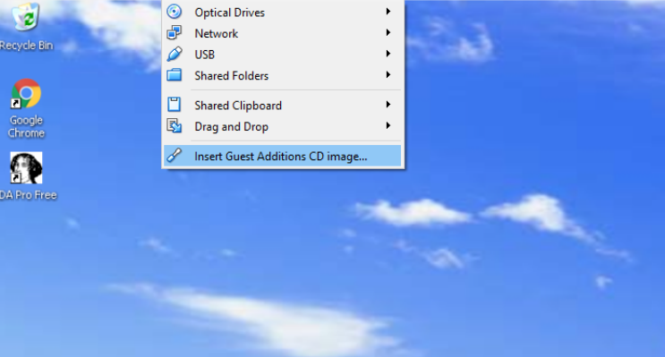
Tools already install on VM
Make sure you “insert guest Additions CD image”
So you can drag files to VM from host

Slide 37
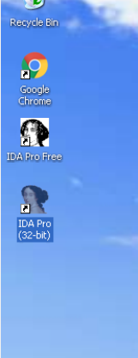
Tools already install on VM
IDAPro 5.0 Freeware does not support plugin
Another IDA Pro 6.8 is provided (unstable)
Can be used once we have plug-in
Some plug-ins are buggy

Slide 38
Advice when analyzing code
Since we are reversing:
Pay attention to the main flow rather than details
Pay attention to the keywords (function calls/names/strings rather than memory operation from the assembly code)
Some code is generated by the compiler – difficult to analyze (avoid the rabbit hole)
Make guesses and use your hunch
Personal experience with IDAPro and Ollydbg
IDAPro is fantastic
Ollydbg gets the job done, but the text is too small (hurt your eyes), cannot trace back only forward – makes analysis time-consuming.

