Slide 1
IT 325 Web site and Web Page Design
Lecture 1: Introduction to Web Design

Slide 2

The Internet and WWW
Internet
  Collection of hardware connected
  together to create a massive
  worldwide network.
WWW（World Wide Web）was developed so that information can be shared regardless of the type of computer connected to the network.
The WWW is most often called the Web.

Slide 3
Development of the WWW
  Tim Berners-Lee
      Computer Specialist
      developed the Web in 1989
  The first Web site was developed at CERN (European Organization for Nuclear Research) and was first put on line on 6 August 1991.

Slide 4
W3C (World Wide Web Consortium)
  Established in 1994 to develop standards and guidelines for the Web
  Tim Berners-Lee has served as the director
  Based at MIT (Massachusetts Institute of Technology)

Slide 5
Browsers
  Software allowing users to view content on the Internet and the Web
  Interact with servers
  View electronic documents HTML/XHTML
  Support Applets or JavaScript controls
  Download and upload info
  Today’s browsers include Internet Explorer, Firefox, Opera, Google Chrome, Mozilla, Safari, etc.
  Market share percentage of web browsers:
  http://en.wikipedia.org/wiki/Usage_share_of_web_browsers

Slide 6
What are Web Pages?
Just Files
Specifically Hypertext Markup Language Files (HTML)
  Files written in special format that web software can interpret and display.
  Creating a web page is simply the act of creating a file of a specific type on your computer and saving them on a server.
Groups of files including images and hyperlinks make up a web site.

Slide 7
Web Site and Web Pages
Technical definitions:
  A webpage is a single HTML/XHTML document
  A website is a collection of related web pages
Designing a good website requires more than just putting together a few pages

Slide 8
Why the Web?
The growing number of web users
Speed of locating information
Cost-effective way to reach people instantly

Slide 9
Why the Web?
Allows people to
  Discover you or your organization
  Understand you or your organization
  Contact you or your organization
  Share articles and other written information
Attract new members or clients
Build an online community

Slide 10
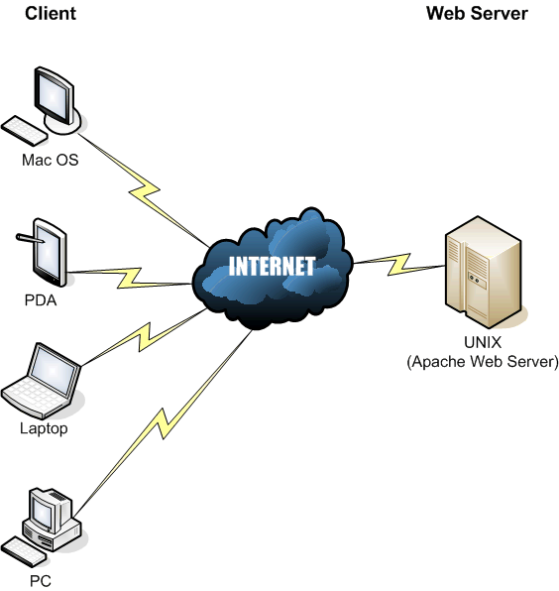
Viewing Web Pages: Client and Server
User uses HTTP client (Web Browser)
User makes a request to the server
Server sends back data (the response)
User clicks on the client side...

Slide 11
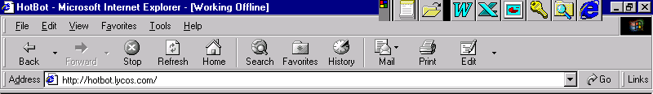
The Internet address (URL)
  Uniform Resource Locator
  Identifies location of server site
  Files are downloaded for viewing

Slide 12
Uniform Resource Locator
http://www.usatoday.com/news/9e/index.html
Domain
Name
Directory
Filename

Slide 13
URL: Top-Level Domains
ID
Affiliation
.com
.edu
.firm
.gov
.int
.mil
.net
.org
Commercial
Education
Businesses
Government
International
Military
Network Resources
Nonprofit Organizations

Slide 14
The History of the Internet
Watch Video: Discovering the Internet
https://www.youtube.com/watch?v=PPZaiSrtk3w
https://www.youtube.com/watch?v=9hIQjrMHTv4

Slide 15
Web Site Design
  Includes 5 Phases:
  Site Planning
  Analyze
  Design
  Implementation
  Test and Refine

Slide 16
Web Site Planning
Clear Vision
  Why are you building a web site?
  Is it for the right reasons?
  Do you really need a web site?
Where to host your web site?
In-house vs. outside development
  In-house
    Be prepared for turnover
    Web design and management should not be dependent on one individual
  Outside - cost, data security, etc

Slide 17
Where to host your web site?
To let others view your web pages, you must publish your web site.
To publish your work, you must copy your site to a web server.
There are three ways to host your web site:
Have your own web server
Host it on commercial web hosting sites for free
Host in on commercial web hosting sites for a fee
Each option has its advantages and disadvantages

Slide 18
Where to host your web site?
Having your own web server gives you greater control over the application programs running on your server and access to your web site, updating, troubleshooting and maintenance
Must meet the hardware and software requirements with adequate bandwidth Internet connection
Personnel must have expertise in setting up, updating, managing and maintaining servers

Slide 19
Where to host your web site?
Free web hosting sites mean that you need not incur the cost of buying the necessary hardware and software, pay for Internet connection bandwidth, or hire personnel
Downside: loaded with advertisements, limited file storage size, and will be restricted to certain applications that will run on your web site
Typically have a slow download capability and weak file security

Slide 20
Where to host your web site?
Commercial web hosting companies usually offer two options:
  file storage space for hosting your web site with support for some application tools like flash or php
  or all these features plus services such as the development and design of your web site

Slide 21
Where to host your web site?
Commercial web hosting:
High cost relative to the amount of services being provided
Weak file security and confidentiality; you must trust an outside organization with full access to your web site, and this can be risky even with a non-disclosure agreement
The risk of becoming overly dependent to the company providing services and its stability and capability to continue doing business

Slide 22
Where to host your web site?
Your choice should be based on the purpose of the web site, the target audience, the information and services to be provided, and your organizations human, material and financial resources

Slide 23
Exercise
Do a Google Search and find some of the web hosting sites offering free or commercial hosting and then compare the cost, file storage space, features and added value services

Slide 24
Analyze Web Site Content (1)
1. Before you can start deciding what content the site is going to contain you need to determine
  Who your target audience is.
  What age group are your users?
  What is their skill level with the Internet?
  How can I communicate effectively?
  You also need to determine the purpose of your site. What is the site for?
Once you have determined these factors you can start to plan the content your site will have. Remember who your target will be when deciding on content:

Slide 25
Analyze Web Site Content (2)
2 - Who is my target audience?
What type of visitors do I want my site to attract? What will be their age, sex and education? Will they search for my site because we share a hobby, like the same television shows or are they looking for specific information?
3 - How can I communicate effectively?
Now that I know who the audience will be, what is the best way to communicate with them?
4 - What information do I need?
Talk to your client if you are designing a web site for a client.
Research other websites. What do similar organizations provide?

Slide 26
Analyze Web Site Content (3)
Research Websites: This is a very important part in the creation of a web site, and usually very useful.
  Spend time looking at other Internet sites, particularly your competitors
  See if you can get any ideas you can use and improve on
  Don't be mistaken that the flashest coolest looking web site is the best.
  Sites with lots of animation are not always the best.
  You must also keep in mind that not everyone has a fast Internet connection.

Slide 27
Analyze Web Site Content (4)
5 - What content (data, graphics, photos, etc.) will be included?
This is the ''big'' job...gathering all the content that you want to include on your web site. Are you going to use photos? What kind of graphics do you want? And what information or data are you putting online?
Make a list of the items you think you will want to have on your website.
Remember that your content has to have a goal!

Slide 28
Web Design
Web page design, or Web design, refers to the visual design and creation of the documents that appear on the World Wide Web

Slide 29
Web Design
Your goal is to create a web site that is:
  useful
  compelling
  attractive
  easy to use
  satisfying

Slide 30
Web Design
Storyboarding
Storyboarding will make the design process easier and more efficient. This will save you time and money.
  Design a navigation system
    Where am I?
    How can I get home?
    Where else can I go?
  Involve the user during design

Slide 31
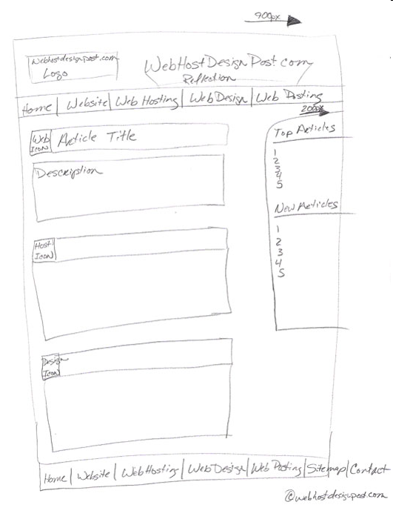
Storyboarding
GO LOOK AT sites and take note of the ones you like
SKETCH out a schematic plan of the website
DRAW on paper a number of interface designs for each unique web page within the plan
Source: http://www.webhostdesignpost.com/website/websitestoryboarding.html

Slide 32
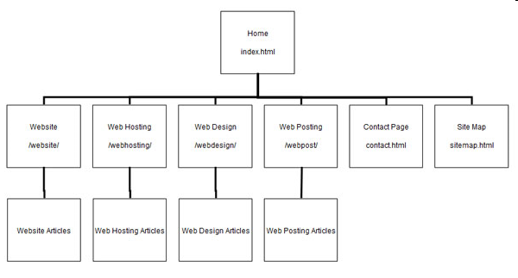
Storyboarding

Slide 33
Top 10 website design tips - checklist
Know your audience
Keep web pages short
Limit the amount of text
Avoid large images
Use web safe colors
Clearly identify all links
Check spelling
Use a site map or directory page
Update and check all links
Include contact information

Slide 34
How to upload your web site
Your web site must be uploaded to a web server connected to the Internet in order to be accessed on the Web, the host for your web site.
Use a FTP client program to connect to your host in order to upload (transfer) your web site (files and other documents) to the server
Test you web site before uploading to the server, then test it again once it has been uploaded

Slide 35
FTP: the file transfer protocol
transfer file to/from remote host
client/server model
  client: side that initiates transfer (either to/from remote)
  server: remote host
An FTP client allows you to upload files to an FTP server as well as download files (but you need an account on the server for this).

Slide 36
Basic steps to use FTP Client
Connect to the FTP server
Navigate the file structure to find the file you want
Transfer the file
The specifics of each step will vary, depending on the client program being used and the type of Internet connection.

Slide 37
Exercise
Read both chapter 23 of the textbook (Publishing Your Pages on the Web) Download an FTP program that will work with your system
Download Ftp Surfer or FileZilla
Connect to the web server of your host and upload a file
Test your web site
Get your free web space at http://www.000webhost.com/

Slide 38
Web Languages Covered in This Course
Client-Side
  HTML/XHTML
  JavaScript
  CSS
Server-Side
  PHP

Slide 39
References
http://www.w3schools.com/
Many Internet Resources such as examples and articles

Slide 40


Who invented the WWW?
a) Al Gore
b) Tim Berners-Lee
c) Lots and lots of people over many years, mostly in California & Massachusetts

Slide 41
Things to Do
Read the textbook
  Introduction
  Chapter 21(Publishing Your Pages on the Web)
Download a FTP tool
Sign up for free web space at
http://www.000webhost.com/
You can also purchase commercial web space at http://www.godaddy.com/ or https://www.ipage.com

