Slide 1
IT 325 Web site and Web Page Design

Slide 2
Learn Good Web Design from Bad Web Design
Excessive Graphics
http://www.webpagesthatsuck.tv/marykay/marykay.html
Lack of Contrast
http://www.youtube.com/watch?v=Wdan6HA6hS0
If there isn't enough contrast between the text and the background, people won't be able to read your content.
Download Color Contrast Analyzer for Web Pages at http://www.visionaustralia.org/digital-access-cca

Slide 3
All The Tags You Need for XHTML
<!DOCTYPE html PUBLIC "-//W3C//DTD XHTML 1.0 Transitional//EN" "http://www.w3.org/TR/xhtml1/DTD/xhtml1-transitional.dtd">
<html xmlns="http://www.w3.org/1999/xhtml">
<head>
<style rel="stylesheet" type="text/css"><!—
--></style>
<meta http-equiv="Content-Type" content="text/html; charset=utf-8" />
<meta name="description" content="this is my website" />
<meta name="keywords“ content="keyword one, keyword two“ />
<title>My website
</title>
</head>
<body>All content goes here.
</body>
</html>
Notes:
CSU Extension

Slide 4
HTML5 markup template
<!doctype html>
<html lang="en">
<head>
<title>Web page title</title>
<meta charset="utf-8" >
</head>
<body>
Web page content
</body>
</html>

Slide 5
Browsers support for HTML5
http://www.html5test.com/
http://www.findmebyip.com/litmus/

Slide 6
Creating an Image Map
An image map consists of an image that is divided into regions
Use the <img>, <map>and <area> tags to create an image map on a Web page
A pixel (short for picture element) represents a single point on a computer screen
A VGA monitor contains 640 columns by 480 rows of pixels; Super VGA contains 1024 columns by 768 rows of pixels
A specific pixel (picture element) is identified by a pair of numbers, giving the horizontal dimension (x) first and the vertical dimension (y) second, separated by a comma.
Pixel numbering starts from 0,0 at the top left of the image.

Slide 7
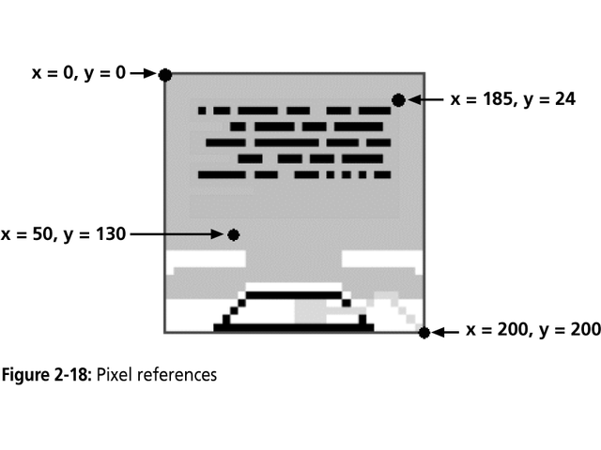
Pixel References

Slide 8
Creating an Image Map
To create an image map, you must include the following tags on your Web page:
  An <img> tag that contains an SRC attribute specifying name of image and a name attribute specifying the name of the <map>…</map> tag pair that contains mapping coordinates
  A <map>…</map> tag pair including name attribute used by <img> tag
  <area> tags within the <map>…</map> tag pair that identify coordinates within image recognized as hot zone

Slide 9
Creating an Image Map
<map name="map-name">
<area href="URL" shape="shape"
coords="x,y,..." alt="alternate text">
<area href="URL" shape="shape"
coords="x,y,..." alt="alternate text">
...
</map>
Use the <area> tag to define a region as a hot zone on an image map, use the shape attribute to specify the shape of region, and coords attribute to specify coordinates of shape’s pixels
<img usemap="#map-name" src="image.jpg" ... >
The map-name is the name defined by the map's name attribute.

Slide 10
Creating an Image Map
The shape attribute of the <area> element can be one of the following:
rect : takes two x,y pairs in the coords list. The first pair is the upper left corner of the rectangle, and the second pair is the lower right corner.
circle : takes three numbers in the coords list. The first two numbers are the x,y location of the center of the circle, and the third is the radius.
poly : takes three or more x,y pairs in the coords list. Each x,y pair is a vertex of the polygon. The first and last pair should be the same to close the polygon, though most browsers will infer a closing point if it is omitted.

Slide 11
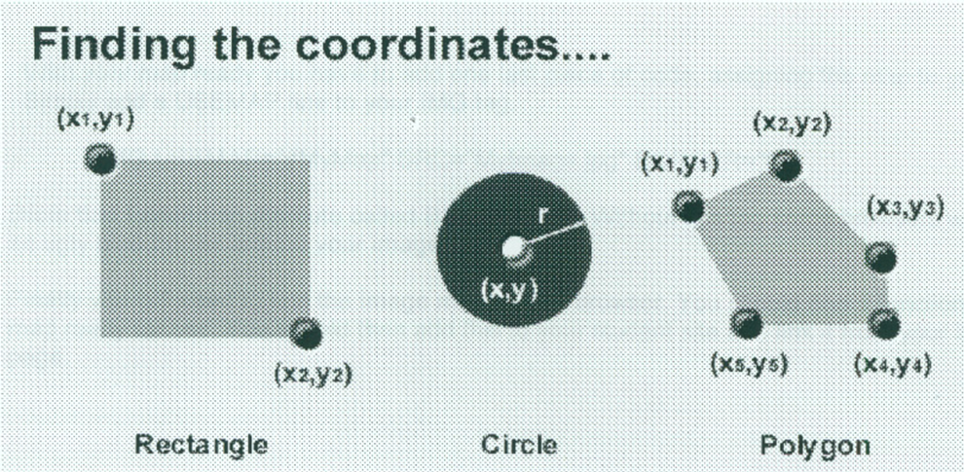

Slide 12
Creating an Image Map
<img src="planets.gif" width="145" height="126" alt="Planets" usemap="#planetmap" />
<map name="planetmap">
<area shape="rect" coords="0,0,82,126" alt="Sun" href="sun.htm" />
<area shape="circle" coords="90,58,3" alt="Mercury" href="mercur.htm" />
<area shape="circle" coords="124,58,8" alt="Venus" href="venus.htm" />
</map>
Example:
http://www.w3schools.com/TAGS/tag_map.asp

Slide 13
What is CSS?
Stands for Cascading Style Sheets
CSS used for presentation only
  Defines how the HTML should be displayed
  Separate content from presentation- change the look of entire site by changing one CSS file
Work with the common visual browsers (Internet Explorer, FireFox, etc)
Used properly, can great simplify visual design, site management and content maintenance

Slide 14
Cascading Style Sheets
Used in conjunction with HTML in several ways
  Inline -- embedded within the HTML element
  Internal -- placed within the header information
  External -- coded in a separate document
    Allows style control of multiple pages all at once
    External Style Sheets can save a lot of work

Slide 15
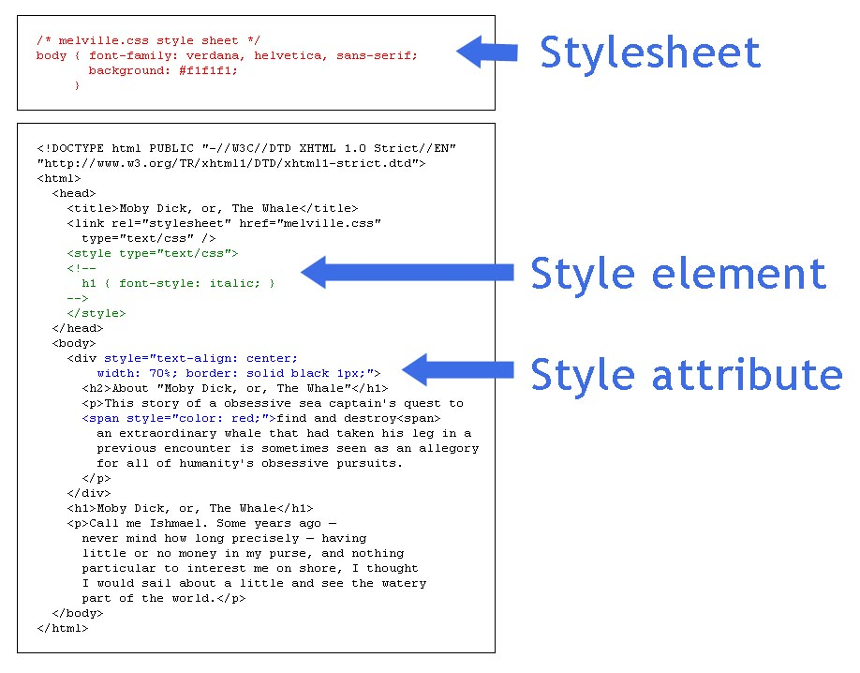
Using CSS
Styles can be set in a stylesheet, in a style element in the head or in a style attribute

Slide 16
Styles
In HTML 4, styles was introduced as the new and preferred way to style HTML elements.
HTML Style Examples
  style="background-color:yellow"
  style="font-size:10px"
  style="font-family:Times"
  style="text-align:center"

Slide 17
Inline Styles
Defined for individual elements
Method:
<tag style=“property:value; property:value ..."> text </tag>
Note the punctuation: The property is followed by a colon (:) and the value is followed by a semicolon(;). If you want to specify more than one property, you must separate each property with a semicolon.

Slide 18
Inline Styles
Selector Property Value
p { font-family: times; }
Example:
<p style="font-family:sans serif; color:red; font-size:20px">
<h1 style="text-align:center"> some text </h1>
  <p style="color : sliver; "> some text </p>

Slide 19
Example
<html>
<head>
<title>Demo of inline style</title>
</head>
<body>
<p>Earth is about to be invaded by
<h2 style="font-size : larger; color : green">
Little Green Men!</h2></p>
</body>
</html>

Slide 20
<div> tag
Divs enclose a set of elements. You can apply CSS between <div> tags
<div id="main" style="text-align: center; ">
<h2> News</h2>
<p><a href="budget.html">Budget</a></p>
<p><a href="invest.html">Investment</a></p>
</div>

Slide 21
Background Color Style
New way:
<body style="background-color:yellow">
Old way:
<body bgcolor="yellow">
Understanding both old way and new way can help you deal with different versions of browsers.

Slide 22
Another way to write styles
To make the style definitions more readable, you can describe one property on each line, like this:
      p
      {
      text-align:center;
      color:black;
      font-family:arial
      }

Slide 23
Grouping
You can group selectors. Separate each selector with a comma. In this example, all header elements will be displayed in green text color.
    h1,h2,h3,h4,h5,h6
    {
    color:green
    }

Slide 24
Style Sheet uses
Internal style sheet
  Single page of content
External style sheet
  Better manage large sites with many pages
  Create separate file with CSS rules
  Add link to CSS in header of document
  <link rel="stylesheet" type="text/css" href="mystylesheet.css">

Slide 25
Internal Style
Placed in the header of the page between the <head>…</head> tags.
Contains styles that are used throughout the whole page rather than on a single tag.
Enclose each “rule” in the <style>…</style> tag.

Slide 26
Internal Style Example
<html>
<head>
<title>HTML Template</title>
<style type="text/css">
h1{
font-family: verdana;
text-align: center;
}
</style>
</head>
<body> ….
</body>
</html>

Slide 27
A Closer Look at the Style
<style type="text/css">
h1{
font-family: verdana;
text-align: center;
}
</style>
selector
value
property
rule

Slide 28
Changing the Font Face
Use the font-family property
Will only display fonts already installed on the end user’s computer
If a font-family is not specified, displays the browser’s default font, usually Times New Roman.
Can give more than one value in the CSS, just in case
To see a list of Web fonts:
http://www.angelfire.com/al4/rcollins/style/fonts.html

Slide 29
Font Example
<html>
<head>
<title>CMSC104 HTML Template</title>
<style type="text/css">
body{
font-family: verdana, helvetica, arial, sans-serif;
}
</style>
</head>
<body>
Do you like this font?
</body>
</html>

Slide 30
Working with Color
background-color -- changes the background color
color -- changes the text color
Can be applied to most selectors. ie: body, p, etc...
black | lime | maroon | purple
white | olive | navy | teal
silver | green | red | fuchsia
gray | yellow | blue | aqua
orange
Chart of possible CSS color values

Slide 31
Color Example
<html>
<head>
<title>HTML Template</title>
<style type="text/css">
body{
background-color: black;
color: orange;
}
</style>
</head>
<body>
Happy Birthday!
</body>
</html>

Slide 32
Changing the Font Size
Sample Usage | Possible values
font-size: 14pt; | Can use number and unit (as in 12pt) or keywords: xx-small, x-small, small, medium, large, x-large, xx-large.

Slide 33
Aligning text
Sample Usage | Possible values
text-align: center; | left, right, center, justify

Slide 34
CSS for Emphasis
Sample Usage | Possible values
font-style: italic; | normal, italic, oblique
font-weight: bold; | normal, bold, bolder, lighter

Slide 35
CSS Comments
You can place a comment in CSS by using the following syntax:
<style type="text/css">
/* body layout */
body{
background-color: black;
color: orange;
}
</style>

Slide 36
Example with Multiple Rules
<html>
<head>
<title>CSS Example</title>
<style type="text/css">
body{
color: blue;
}
h1{
color: red;
}
</style>
</head>
<body>
<h1>What color is this Heading?</h1>
What color am I?
</body>
</html>

Slide 37
External Style Sheets
A style sheet can be placed in a separate file (usually named with suffix .css) and referenced by HTML files that need it.
Useful for centralizing control of style and ensuring uniform appearance across many pages of a web site.
The contents of the file are what would go between <style> ... </style> of an embedded style sheet. Note: this file is not HTML!

Slide 38
Example External CSS
body { backgound:white; color:black;}
a:link {color:blue;}
a:visited {color:black;}
a:active {color:green;}
a:hover {color:red;}
h1,h2, h3 {font-family:arial, sans-serif;}
b {color:maroon;}
The style rules will apply to elements defined by those tags

Slide 39
External CSS
The external css file is referenced using a <link> tag in the HTML document's head portion.
Each page must link to the style sheet using the <link> tag. The <link> tag goes inside the head section:
<head>
<link rel="stylesheet" type="text/css" href="style.css" />
</head>

Slide 40
Style Classes
You can define different styles for the same type of HTML element. For example, if you would like to have two types of paragraphs in your document: one right-aligned paragraph, and one center-aligned paragraph, you can define two classes with styles:
  p.right {text-align:right}
  p.center {text-align:center}
Then you can use the class attribute in your HTML document:
<p class="right">This paragraph will be right-aligned.</p>
<p class="center">This paragraph will be center-aligned.</p>
This method allows you to control which elements of a given type should use a style rule. This method has two parts:
  In the style sheet, the selector defines the class name, which is preceded by a period.
  In the HTML, the tag includes the class attribute and specifies the value of the class name

Slide 41
Style Classes
You can define different styles for the same type of HTML element. For example, if you would like to have two types of paragraphs in your document: one right-aligned paragraph, and one center-aligned paragraph, you can define two classes with styles:
  p.right {text-align:right}
  p.center {text-align:center}
Then you can use the class attribute in your HTML document:
<p class="right">This paragraph will be right-aligned.</p>
<p class="center">This paragraph will be center-aligned.</p>
This method allows you to control which elements of a given type should use a style rule. This method has two parts:
  In the style sheet, the selector defines the class name, which is preceded by a period.
  In the HTML, the tag includes the class attribute and specifies the value of the class name

Slide 42
Example
Define the nodec class for anchor tags:
a.nodec { text-decoration : none }
This suppresses the usual underlining. Use it in HTML like so:
<a class="nodec" href="somepage.html">Link text</a>

Slide 43
Example of using style sheet
  /* This style sheet defines an "excerpt" class
  for paragraphs that is much like blockquote. */
  p.excerpt {
  font-style : italic;
  margin-right : 2em;
  margin-left : 2em;
  }
Save this file as style.css in your text editor.
Note that there is no HTML in this file!

Slide 44
Example of using style sheet
The rel attribute specifies the relationship of the referenced file to this page.
The type attribute must be "text/css".
The href attribute is a URL pointing to the external style sheet.
<html>
<head>
<title>Style Example</title>
<link rel="stylesheet" type="text/css" href="style.css">
</head>
... <p class="excerpt">affected text</p> ...
</html>

Slide 45
Style Classes
Style classes can also be “generic,” i.e. not tied to a specific element type. Example:
.center {text-align:center}
Use this class:
<h1 class="center">This heading will be center-aligned</h1>
<p class="center">This paragraph will also be center-aligned.</p>

Slide 46
Style ID selector
You can also define styles for HTML elements with the id selector. The id selector is defined as a #. Any given id name can only be referenced once within a page or document.
Example: CSS code
    p#exampleID1 { background-color: white; }
    p#exampleID2 { text-transform: uppercase; }
HTML code
<p id="ExampleID1">This paragraph has an ID name of "exampleID1" and has a white CSS defined background</p>
<p id="ExampleID2">This paragraph has an ID name of "exampleID2" and has had its text transformed to uppercase letters. </p>

Slide 47
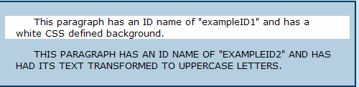
Display

Slide 48
Precedence of Style
What style will be used when there is more than one style specified for an HTML element?
Styles
  Inline
  Internal
  External
  Browser default
An inline style (inside an HTML element) has the highest priority, which means that it will override a style defined inside the <head> tag, or in an external style sheet, or in a browser (a default value).

Slide 49
The importance of Location
If the link to the external style sheet is placed after the internal style sheet in HTML <head>, the external style sheet will override the internal style sheet!
Look at the example on page 135 in the textbook.

Slide 50
CSS Templates
These sites offer many excellent CSS templates and will save
you a lot of time and work. Please check them out, download the code, and
customize your colors and content!
http://www.benmeadowcroft.com/webdev/ – a few of the most basic CSS templates.
http://www.freecsstemplates.org/ – offers a whole directory of designs,
layouts, and templates.

Slide 51
What to do
Read chapter 7 – 11 (with more examples and details)

