Slide 1
Learning from Good web design & bad web design
Usability Testing: Eye Tracking Technology
http://www.youtube.com/watch?v=lo_a2cfBUGc
Bad Web Design
http://www.youtube.com/watch?v=C9JOvlEsfzE
Lesson: don't mix and match multiple colors and text sizes on the same page.

Slide 2
Consistency in Design
Use the same font throughout!
Use consistent graphics in website – do not use ultra modern on one page and calligraphy on another
Use color scheme that is consistent

Slide 3
Good Web Design Tips
Name files consistently and logically
Keep a consistent look and feel
Use colors that are high in contrast
Design for low bandwidth
Design for accessibility

Slide 4
Good Web Design Tips
Don’t overuse media
Don’t make users scroll too much
Don’t flood pages with content
Don’t choose colors or images that make the page hard to read
Don’t assume that your users know where to go

Slide 5
Organizing Information
Decide what info goes on each page
  Friends page
  Family page
  Personal page
  Hobbies page

Slide 6
Get Images
Digital Cameras
Scanners
Image editing software such as Photoshop
Good places for Graphics
  www.clipart.com
  http://free-clip-art.com/
  http://images.google.com/
  www.cooltext.com
Copyright issue: make sure you have the right to use the image(s)

Slide 7
The Font Barrier
Only fonts you can reliably use are Times New Roman (Times) and Arial (Helvetica)
Text in site should be one of these choices
How to overcome this?
  Any font used in graphics is loaded as a graphic, and does not rely upon the font being on the user’s computer
  Make cool font images in Photoshop

Slide 8
Font
To change text size
  <font size="+3">Hello</font>
To change text color
  <font color="red">Hello</font>
To use Arial font
  <font face="arial">Hello</font>
Using multiple
  <font size="+3" color="red" face="arial">Hello</font>

Slide 9
File Name
You will have to refer to your files several times throughout your website.
Follow the following tips to avoid typos and frustrations:
1. Keep file names short.
2. Use lower case letters only instead of both lower and upper case letters.
3. Do not use blank spaces in your file names. Web servers do not recognize blanks and will fill in blanks with a special character.
4. Use the same extension throughout your website. You can use either .htm or .html, but don’t use both.

Slide 10
Organizing your files
All of your webpages should be organized in a folder.
You may want to have subfolders to keep your pictures and media files separate from your html files.
If you were putting your webpage up on a server (so that others can see your page on the web), you would need to upload both the html file plus any images that were added to the webpage.
use relative file path when referring to any webpage within your own website. For example,
<a href = "folder/abc.jpg">picture</a>

Slide 11
Relative File Path
Relative file path: file location relative to the location of the current HTML file
Why Use Relative file path?
If you move your website from one server to a new one, you do not have to change any links you have. They have not moved relative to one another. If you used absolute URLs, you would have to change the links in your website.

Slide 12
Absolute URLs
refer to a specific drive and directory or to the full Web address of an HTML document .
use when referring to any outside webpage
So, if you were using an absolute URL to create a hyperlink the code would be:
<a href = "http://www.google.com">Google</a>

Slide 13
Align attribute
The align attribute allows different alignment. Alignment values are center, right, and left
Examples:
<h1 align="right">
<p align="left "> text </p>
<table align="center"> ….</table>

Slide 14
Alignment
1. To center the image:
<p align = "center"><img src = "image.jpg"></p>
2. To align to the right:
<p align = "right"><img src = "image.jpg"></p>
3. To align to the left:
<p align = "left"><img src = "image.jpg"></p>

Slide 15
Containers
HTML 4 provides two “container” tags:
  <div> ... </div>
  <span> ... </span>
Provide an object to which we can apply style attributes, such as color, size, etc.
Both work the same, except that <div> forces a new line before and after the block that it encloses.
Use one of these tag pairs to enclose the text inside <body> ... </body>

Slide 16
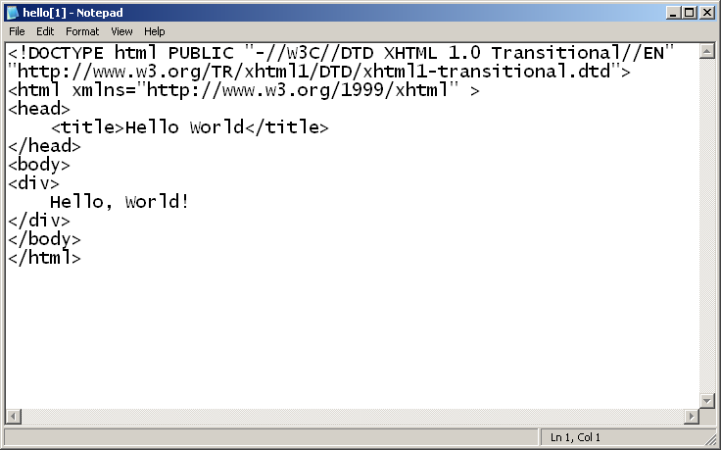

Slide 17
Meta tag
<meta /> Description
The <meta /> element supplies additional information about a document.
<head>
<meta name="…" content="... ">
</head>
Some search engines on the WWW will use the name and content attributes of the meta tag to index your pages.

Slide 18
Implementing Metadata in HTML Documents
Meta tag attributes
  Attribute name
    Type of meta tag
    Name value: keywords
      Search engine identifying words
    Name value: description
      Description for search engine
  Attribute content
    Information for meta tag

Slide 19
META Tag Usage: Example
<html>
<head>
<meta name="keywords" content="intranet, intranets, knowledge management,
knowledge worker, knowledge workers, information professional, information professionals">
<meta name="description" content="Information Science Conference">
<title> Information Science Conference </title>
</head>
<body>
….
</body>
</html>

Slide 20
The Refresh Meta Command
You can tell the browser to reload the same page, or to load a different page, after a certain amount of time.
This is a way to update the users screen without requiring an input from the user.
<meta http-equiv="refresh"
content="1; URL=http://www.clt.odu.edu/bb" />
Where to get next page.
How long to hold page, in seconds

Slide 21
The Refresh Meta Command
<!DOCTYPE html PUBLIC "-//W3C//DTD XHTML 1.0 Transitional//EN" "http://www.w3.org/TR/xhtml1/DTD/xhtml1-transitional.dtd">
<html>
<head>
<title>Flip</title>
<meta http-equiv="refresh"
content="1;URL=http://www.clt.odu.edu/bb" />
</head>
<body>
<div> Redirecting to a New Page<br />
<p>
&nbsp;&nbsp;&nbsp;&nbsp;&nbsp;&nbsp;&nbsp;&nbsp;&nbsp;&nbsp;
Flip
</p>
</div>
</body>
</html>

Slide 22
The <pre> element
<pre> element defines preformatted text. The text inside a <pre> element is displayed in a fixed-width font, and it preserves both spaces and line breaks. Example Code:
<pre>
My Bonnie lies over the ocean.
My Bonnie lies over the sea.
My Bonnie lies over the ocean.
Oh, bring back my Bonnie to me.
</pre>

Slide 23
Table
basic tags
  <table> defines a table in html</table>
  <caption>the title of the table</caption>
  <tr>a row within a table</tr>
  <th>a table header cell</th>
  <td>a table data cell with the text aligned left and centered vertically</td>
attributes
  border - appearing in the table tag
  align - can appear in caption, tr, th, or td
    values: left, center, and right, e.g. align=“center”.
  valign - can appear inside a tr, th, or td
    values: top, middle, bottom.
  width="<value_or_percent>"

Slide 24
A Table Template
    <table border="1"> <!-- start table -->
      <tr> <!-- start first row -->
      <th> first header cell contents </th>
      <th> last header cell contents </th>
      </tr> <!-- end first row -->
      <tr> <!-- Start the second row -->
      <td> second row, first cell contents </td>
      <td> second row, last cell contents </td>
      </tr> <!-- end of second row -->
      <tr> <!-- Start last row -->
      <td> last row, first cell contents </td>
      <td> last row, last cell contents </td>
      </tr>
    </table> <!-- end table -->

Slide 25
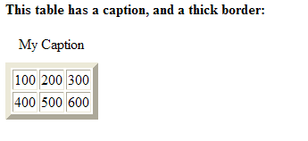
Example 1
<table border="6">
<caption>My Caption</caption>
<tr>
<td>100</td>
<td>200</td>
<td>300</td>
</tr>
<tr>
<td>400</td>
<td>500</td>
<td>600</td>
</tr>
</table>

Slide 26
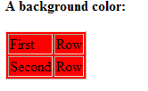
Example 2
<table border="1"
bgcolor="red">
<tr>
<td>First</td>
<td>Row</td>
</tr>
<tr>
<td>Second</td>
<td>Row</td>
</tr>
</table>

Slide 27
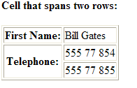
table cells that span more than one row
<td rowspan="2">
<table border="1">
<tr>
<th>First Name:</th>
<td>Bill Gates</td>
</tr>
<tr>
<th rowspan="2">Telephone:</th>
<td>555 77 854</td>
</tr>
<tr>
<td>555 77 855</td>
</tr>
</table>

Slide 28
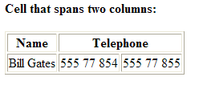
table cells that span more than one column
<td colspan="2">
<table border="1">
<tr>
<th>Name</th>
<th colspan="2">Telephone</th>
</tr>
<tr>
<td>Bill Gates</td>
<td>555 77 854</td>
<td>555 77 855</td>
</tr>
</table>

Slide 29
Examples
Try with different attribute values to get what you want.
<table border="0" width="600" height="200" cellspacing="0" cellpadding="5">
<td width="400" height="40" bgcolor="#B4F864" align="center">

Slide 30
Web Page Layout
Layout of web pages is very important
Poor layout makes for -
  Difficult navigation
  Hard to locate information on page
  Visually unappealing
Use tables to control placement throughout

Slide 31
Using tables to lay out your pages
Make the table borders invisible
A 2x2 table works well

Slide 32
Areas of a Web Page
Logo
Header
Menu
Content

Slide 33
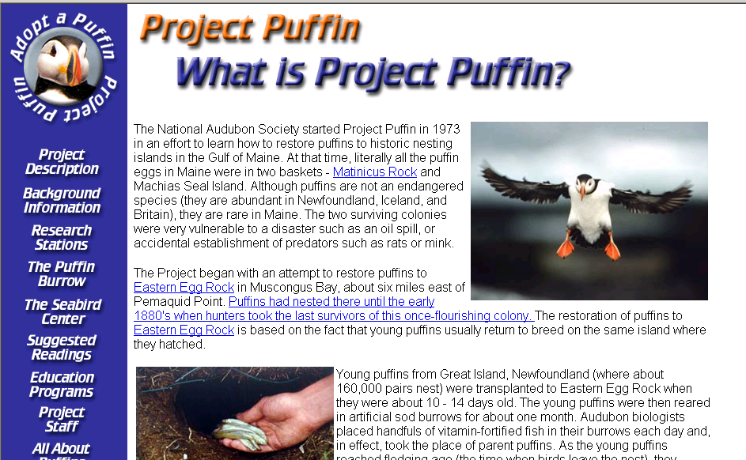
A 2 x 2 Layout

Slide 34
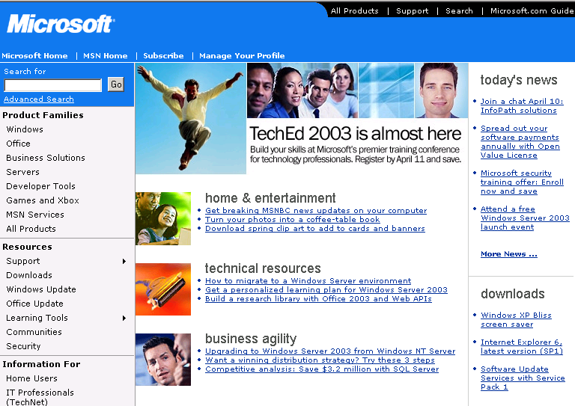
Table within a table

Slide 35
The outer table

Slide 36
The inner table

Slide 37
The inner table

Slide 38
HTML Forms
HTML forms are enhanced HTML documents that look like paper forms
HTML forms are used to create (rather primitive) GUIs on Web pages
  Usually the purpose is to ask the user for information
  The information is then sent back to the server
When a user submits a form to the Web server, the browser
  Submits the value of each form element to the Web server as a parameter
  Submits the form element values in a parameter list, containing the name of every form element and its current value
A form can be created anywhere within an HTML document using the form tag

Slide 39
What are forms?
A form is an area that can contain form elements
  The syntax is: <form parameters> ...form elements... </form>
  Form elements include: buttons, checkboxes, text fields, radio buttons, drop-down menus, etc
    Other kinds of HTML tags can be mixed in with the form elements
  A form usually contains a Submit button to send the information in the form elements to the server
  The form’s parameters tell JavaScript how to send the information to the server (there are two different ways it could be sent)

Slide 40
The <form> tag
The <form arguments> ... </form> tag encloses form elements (and probably other HTML as well)
The arguments to form tell what to do with the user input
  action="url" (required)
    Specifies where to send the data when the Submit button is clicked
  method="get" (default)
    Form data is sent as a URL with form_data info appended to the end
    Can be used only if data is all ASCII and not more than 100 characters
  method="post"
    Form data is sent in the body of the URL request
    Cannot be bookmarked by most browsers

Slide 41
The <input> tag
Most, but not all, form elements use the input tag, with a type="..." argument to tell which kind of element it is
  type can be text, checkbox, radio, password, hidden, submit, reset, button, file, or image
Other common input tag arguments include:
  name: the name of the element
  value: the “value” of the element; used in different ways for different values of type
  readonly: the value cannot be changed
  disabled: the user can’t do anything with this element
  Other arguments are defined for the input tag but have meaning only for certain values of type

Slide 42


Text input
A text field:
<input type="text" name="textfield" value="with an initial value">
A multi-line text field
<textarea name="textarea" cols="24" rows="2">Hello</textarea>

Slide 43

Text input
A password field:
<input type="password" name=“mypassword" value="secret">

Slide 44
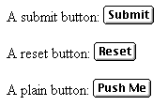
Buttons
A submit button:
<input type="submit" name="Submit" value="Submit">
A reset button:
<input type="reset" name="Submit2" value="Reset">
A plain button:
<input type="button" name="Submit3" value="Push Me">

Slide 45
Buttons
submit: send data
reset: restore all form elements to their initial state
button: take some action as specified by JavaScript

Slide 46
Checkboxes
A checkbox:
<input type="checkbox" name="checkbox” value="checkbox" checked>A checkbox
type: "checkbox"
name: used to reference this form element from JavaScript
value: value to be returned when element is checked
Note that there is no text associated with the checkbox—you have to supply text in the surrounding HTML

Slide 47

Radio buttons
Radio buttons:<br>
<input type="radio" name=“gender" value=“male">
male<br>
<input type="radio" name=“gender" value=“female" checked>female
If two or more radio buttons have the same name, the user can only select one of them at a time
  This is how you make a radio button “group”
If you ask for the value of that name, you will get the value specified for the selected radio button
As with checkboxes, radio buttons do not contain any text

Slide 48
Drop-down menu or list
Drop-down menu or list
  Define a list from which the user can select specified values
  The Web developer can populate the list using static values or from a database

Slide 49

Drop-down menu or list
A menu or list:
<select name="color">
<option value="red">red</option>
<option value="green">green</option>
<option value="blue">blue</option>
</select>
Additional arguments:
  size: the number of items visible in the list (default is "1")
  multiple: if set to "true", any number of items may be selected (default is "false")

Slide 50
Hidden fields
Hidden Form Elements
  A hidden form element is an element that is not visible to the user
<input type="hidden" name="hiddenField" value="yes">
What good is this?
  All input fields are sent back to the server, including hidden fields
  This is a way to include information that the user doesn’t need to see (or that you don’t want her to see)
  The value of a hidden field can be set programmatically (by JavaScript) before the form is submitted

Slide 51
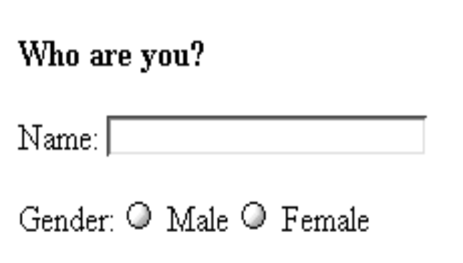
A complete example
<html>
<head>
<title>Get Identity</title>
</head>
<body>
<p><b>Who are you?</b></p>
<form method="post" action="">
<p>Name:
<input type="text" name="textfield">
</p>
<p>Gender:
<input type="radio" name="gender" value="m">Male
<input type="radio" name="gender" value="f">Female</p>
</form>
</body>
</html>

Slide 52
Forms: more examples
Try more examples at
http://www.w3schools.com/html/html_forms.asp

Slide 53
HTML 5
HTML5 – the newest revision of HTML
http://www.w3schools.com/html/html5_intro.asp
HTML5 markup template
<!doctype html>
<html lang="en">
<head>
<title>Web page title</title>
<meta charset="utf-8" >
</head>
<body>
Web page content
</body>
</html>

Slide 54
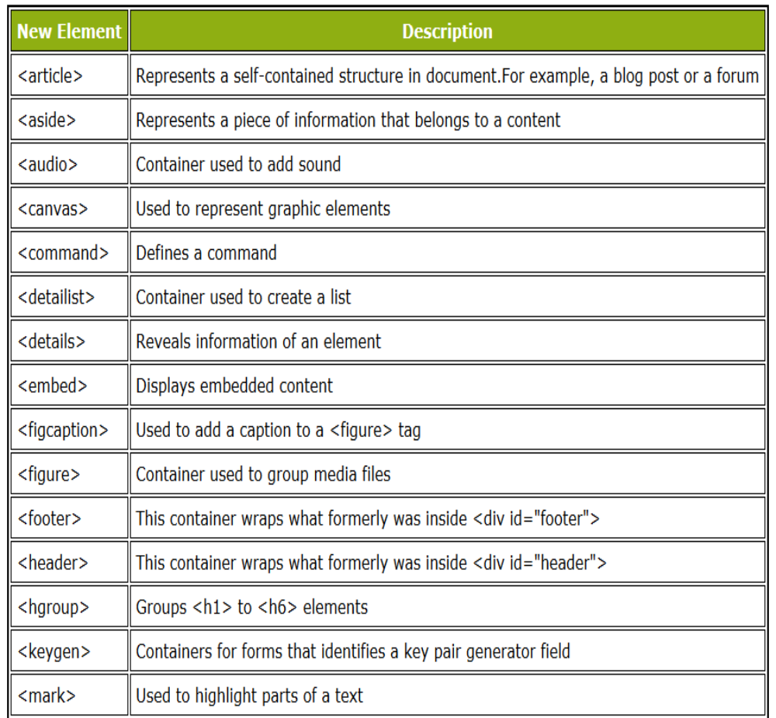
HTML5 brings 28 new elements to help improve the design of your website.

Slide 55
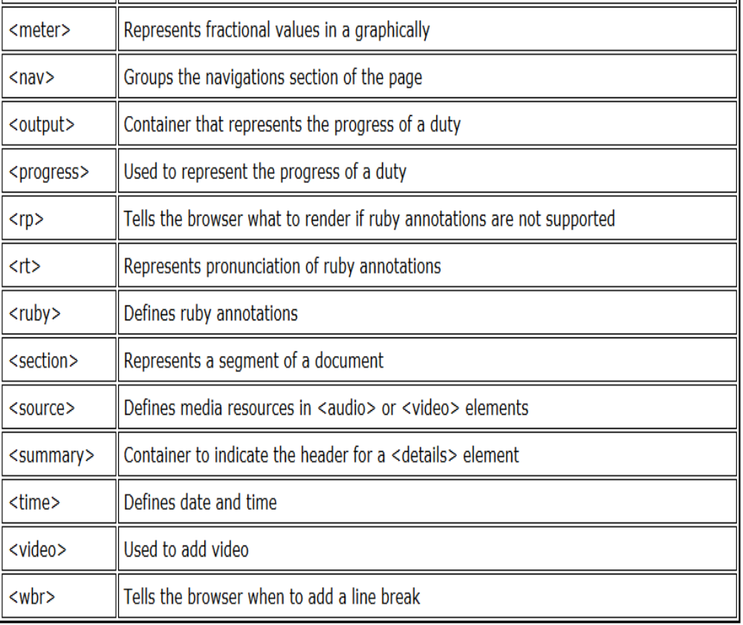

Slide 56
Forms and JavaScript
The JavaScript language can be used to make pages that “do something”
  You can use JavaScript to write complete programs, but...
  Usually you just use snippets of JavaScript here and there throughout your Web page
  JavaScript code snippets can be attached to various form elements
    For example, you might want to check that a zipcode field contains a 5-digit integer before you send that information to the server
HTML forms can be used without JavaScript, and JavaScript can be used without HTML forms, but they work well together
JavaScript for HTML is covered in a separate lecture

Slide 57
Spell it right
Bad spelling and bad grammar can destroy the professional effect of your web site
Use a spell checker
Proofread the texts

Slide 58
Testing
Test your website as you go along.
  If you’re in the computer lab and there’s an empty computer next to you, log into it and check out your web page from there
Make sure it works in Internet Explorer

Slide 59
Tips
What if I want to put some space into my text?
  Ordinarily white space in an HTML document is ignored except for producing a single space.
  To force the browser to leave a space use &nbsp; (nonbreaking space)
<p>&nbsp;&nbsp;&nbsp;&nbsp;&nbsp;
This paragraph is indented five spaces</p>

Slide 60
Web Counters
A web counter displays the number of accesses for a web page
  Keeps track of web page popularity
  Counter usually appears at the bottom of the web page
  Each time the page is uniquely* accessed the value increases
  Counter can be visually configured
Web counters need to have a process running on the web server
  Code also needs to be added to the HTML page
There are a number of websites that will host web counters for free
  http://www.simplehitcounter.com/
  http://www.statcounter.com/

Slide 61
Guestbooks
A Guestbook allows people to type in comments on a webpage/topic
Like a web counter the functionality of a guest book can be configured and entries added & deleted
A guest book requires an application to be run on the web server and a link to the address book from the HTML page
The are a number of websites that offer free guest books:
  http://www.bravenet.com/webtools/guestbook/
  http://www.guestbookcentral.com/

Slide 62
What to do
Read chapter 15,16 and 17

