Slide 1
MIA 5126 • ESSENTIAL CONCEPTS IN DATA SCIENCE
Transaction Intelligence: Customer Segmentation and Behavioral Analytics
A research-oriented analysis of the Berka / PKDD'99 Financial Dataset
Antonio Sosa
University of Ottawa • Professor Dr. Olubisi Runsewe
Notes:
Target: 15 seconds. Introduce the project as a research-oriented banking-behavior analysis. State that the goal is to understand patterns, not to build another fraud-prediction tool.

Slide 2
The project focuses on understanding customer behavior
BEHAVIOR
What activity, cash-flow, balance, and service patterns are present?
How can historical account activity reveal useful customer-behavior patterns?
TIME
How does portfolio-level banking activity change over time?
SERVICES
Which observed services occur together more often than expected?
SEGMENTS
Which account groups and unusual cases emerge from the data?
Project form: research-oriented Finance & Risk Analytics.
2
Notes:
Target: 45 seconds. Explain that the project translates a real-world banking question into four data-science questions. Emphasize that the analytical unit is the account and that observed behavior does not reveal intent.

Slide 3
Combining eight tables to analyze account behavior
Primary and foreign keys preserve the links between customers, accounts, transactions, services, and districts.
district
card
PK district_id demographics A2–A16
PK card_id FK disp_id type, issued
account
disp
PK account_id FK district_id frequency, date
PK disp_id FK client_id FK account_id
client
PK client_id FK district_id gender, birth_date
trans
order
loan
PK trans_id FK account_id amount, balance
PK order_id FK account_id payment details
PK loan_id FK account_id amount, status
4,500 accounts • 1.06M clean transactions • 72 observed months
Dataset: Financial — PKDD'99 Financial Dataset (Berka), CTU Prague.
3
Notes:
Target: 55 seconds. Explain that Berka is a relational dataset rather than one flat file. The account table is the central analytical unit. Transactions, orders, and loans connect through account_id; cards connect through dispositions; clients and accounts connect to district information. Notebook 1 validates these key relationships before any analysis begins.

Slide 4
Four notebooks build the analysis in sequence
NOTEBOOK
WHAT IT DOES
MAIN OUTPUT
01
Data foundation and engineering
Frames the problem; audits tables, keys, and relationships; cleans and joins the data; documents preparation and medallion-layer decisions.
Four clean Silver tables
01_data_foundation_and_engineering.ipynb
Weeks 1, 3, 4 & 5
02
Behavioral and temporal analysis
Runs EDA; studies banking activity over time; forecasts aggregate activity; mines service associations; builds customer behavior features.
Features, monthly activity, and association rules
02_behavioral_and_temporal_analysis.ipynb
Weeks 2, 6 & 7
03
Customer segmentation
Treats skewness and scaling; applies PCA; compares clustering methods; profiles five segments; identifies consensus behavioral outliers.
Segments, profiles, outliers, and saved models
03_customer_segmentation.ipynb
Week 8
04
Validation and insights
Demonstrates supervised learning on completed loans; checks stability, data quality, errors, and limits; prepares dashboard datasets.
Validation figures and dashboard tables
04_validation_and_insights.ipynb
Weeks 9 & 10
Source: notebooks/README.md and the executed project notebooks.
4
Notes:
Target: 75 seconds. Notebook 1 produces transactions_clean.parquet, accounts_clients.parquet, loans_clean.parquet, and account_analytical_base.parquet. Notebook 2 produces customer_behavior_features.parquet, monthly_banking_activity.parquet, and service_association_rules.parquet. Notebook 3 produces customer_segments.parquet, segment_profiles.parquet, behavioral_outliers.parquet, plus the preprocessing, PCA, and clustering model files. Notebook 4 produces validation figures and dashboard_summary.parquet, dashboard_segments.parquet, and dashboard_outliers.parquet.

Slide 5
The repository implements a local medallion architecture
PROJECT STRUCTURE
TRACEABLE DATA FLOW
data/ raw/ Bronze source snapshots interim/ Silver clean relational tables processed/ Gold analytical outputs notebooks/ 01–04 analytical workflow src/.../api/ FastAPI service dashboard/ Angular client models/ Saved transformations reports/ Figures and presentation
SOURCE
External CTU MariaDB
Original Financial / Berka tables
BRONZE
data/raw/
Immutable snapshot, schema, checksums, provenance
SILVER
data/interim/
Clean DuckDB and relational tables · Notebook 1
GOLD
data/processed/
Analytical features and dashboard tables · Notebooks 2–4
API
src/transaction_intelligence/api/
Reusable read-only JSON endpoints served by FastAPI
CLIENTS
dashboard/ and other applications
Angular today; other apps can use the same API
Source: project repository structure and Notebook 1 architecture design.
5
Notes:
Target: 70 seconds. Explain that Bronze, Silver, and Gold describe the quality and purpose of data, not separate cloud services. Bronze preserves the source snapshot. Silver contains validated relational data. Gold contains purpose-built analytical and dashboard datasets. The local folders implement the same separation that could later be deployed to cloud storage, a warehouse, or a lakehouse. FastAPI separates analytical outputs from presentation, so Angular is only one possible client.

Slide 6
Portfolio totals rise with account coverage
Annual transaction records
96 → ~4,480
active accounts across the observation window
4.76 vs 2.60
January versus December withdrawals per active account
Totals combine changing behavior with expanding account coverage.
Source: Notebook 2; monthly activity aggregated by calendar year, 1993–1998.
6
Notes:
Target: 60 seconds. The transaction history grows sharply, but so does the number of observed accounts. That is why the analysis also uses per-account and per-active-account rates. Call out January's withdrawal frequency as evidence of an annual pattern without claiming a cause.

Slide 7
SARIMA reduced error; service rules remain hypotheses
Forecast MAE — fewer is better
2,321
SARIMA holdout MAE
3,858 / 3,942
Last-value / seasonal-naive MAE
Lift 3.60
Household payments + salary-like deposits → loan Support 3.1% • Confidence 54.5%
The service rule is a co-occurrence question—not a personalized recommendation.
Source: Notebook 2; chronological 1998 holdout and filtered Apriori rules.
7
Notes:
Target: 55 seconds. Explain the chronological split: train on 1993 to 1997 and test on 1998. SARIMA had the lowest MAE in this declared comparison. Then distinguish association-rule lift from causation, customer interest, or product suitability.

Slide 8
Five clusters balance separation and interpretation
K-means silhouette score
K = 5
Strongest tested K-means silhouette score with workable group sizes.
0.995–0.998
86%
Adjusted Rand Index across random starts
variance explained by the first four PCs
The matched five-component GMM separated the accounts less clearly.
Source: Notebook 3; 4,500 accounts and nine modeled behavioral features.
8
Notes:
Target: 70 seconds. Summarize the preprocessing rather than listing every feature: Yeo-Johnson transformation, standardization, and PCA for interpretation. K equals five offered the strongest tested K-means silhouette score, stable assignments, workable sizes, and understandable profiles. No single metric proves that the clusters are natural customer types.

Slide 9
Five patterns summarize how accounts were used
Accounts per segment
Largest group
1,519
Established household users 33.8% of accounts
Interpretation boundary
Names summarize observed historical behavior. They are not customer identities, permanent labels, or eligibility categories.
Source: Notebook 3; selected five-segment K-means solution.
9
Notes:
Target: 85 seconds. Give one sentence per group: established household users have higher balances and regular services; pension-associated households show recurring inflows and household payments; high-activity multi-service users have the most activity and variety; low-service cash users show fewer observed services; high-volatility cash users show greater cash use and balance variation. Do not infer intent or value.

Slide 10
Only 16 accounts were unusual by multiple signals
An account was selected only when at least two methods agreed. Each method captures a different kind of unusual behavior.
4
16
0.36%
independent signals
consensus outliers
of all accounts
Centroid distance, low GMM membership, robust within-segment deviation, and Isolation Forest.
A conservative two-signal rule reduced thousands of scores to a small review set.
The selected cases are rare relative to the 4,500-account analytical population.
Unusual behavior is not evidence of fraud, error, distress, or misconduct.
Source: Notebook 3; consensus of four complementary behavioral-outlier signals.
10
Notes:
Target: 45 seconds. Explain that no single outlier score was accepted on its own. The consensus rule selected 16 cases for interpretation. The purpose is to understand why an account differs from its segment, not to accuse or automatically intervene.

Slide 11
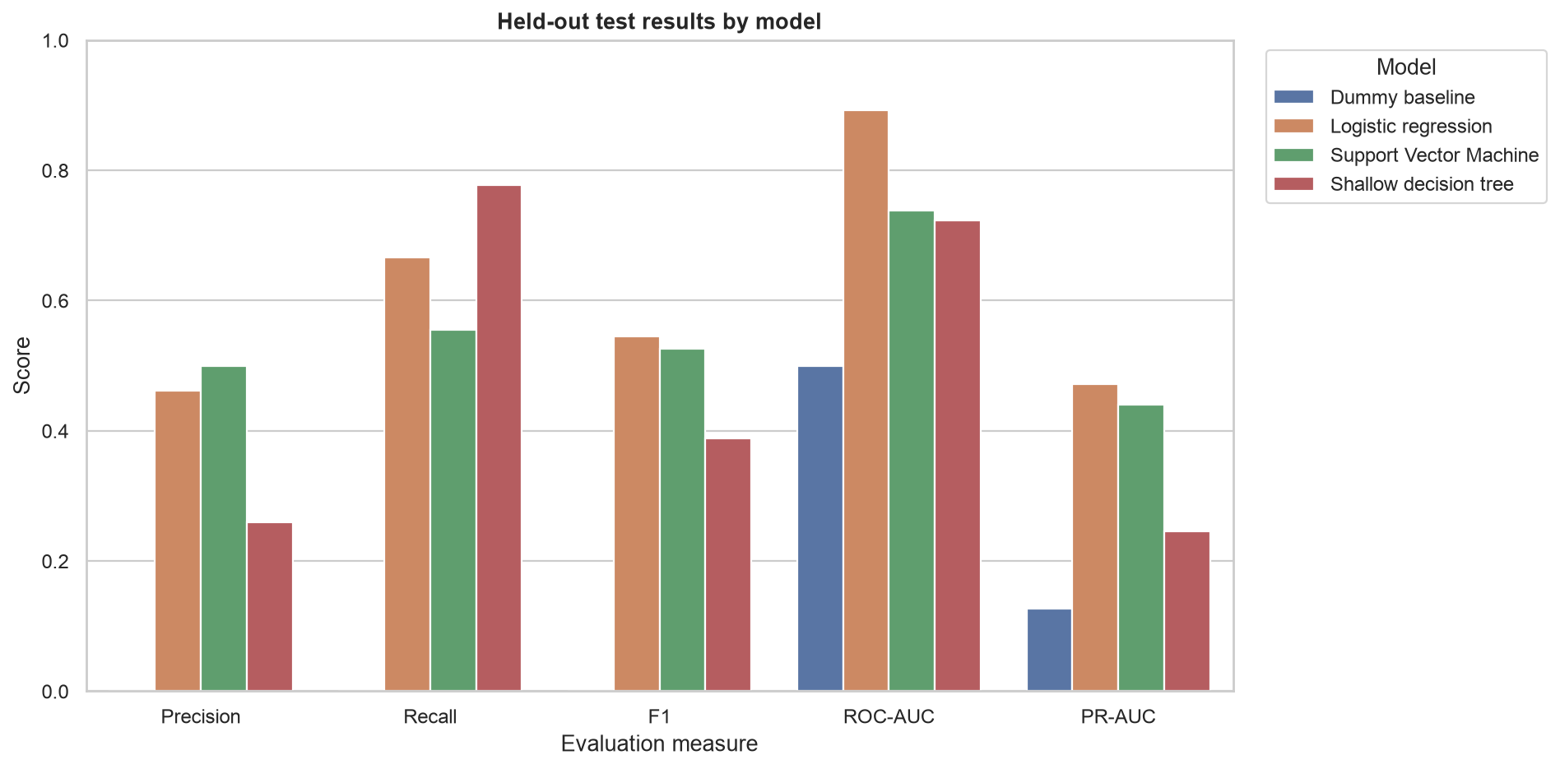
The loan case improved on the baseline—but evidence is limited
234 completed loans
31 recorded problem loans
LOGISTIC REGRESSION
F1 0.55 PR-AUC 0.47 Recall 0.67
On 71 test loans, the model identified 6 of 9 problem cases, produced 7 false alarms, and missed 3.
Course-method demonstration only—not a production lending model.
Source: Notebook 4; completed loans only and a fixed historical train/test split.
11
Notes:
Target: 65 seconds. The target includes only completed loans and uses only information available before loan start. Accuracy alone was misleading because the dummy model predicted no problem loans. Logistic regression gave the clearest balance of recall, F1, ranking performance, and explanation, but the sample is too small for production claims.

Slide 12
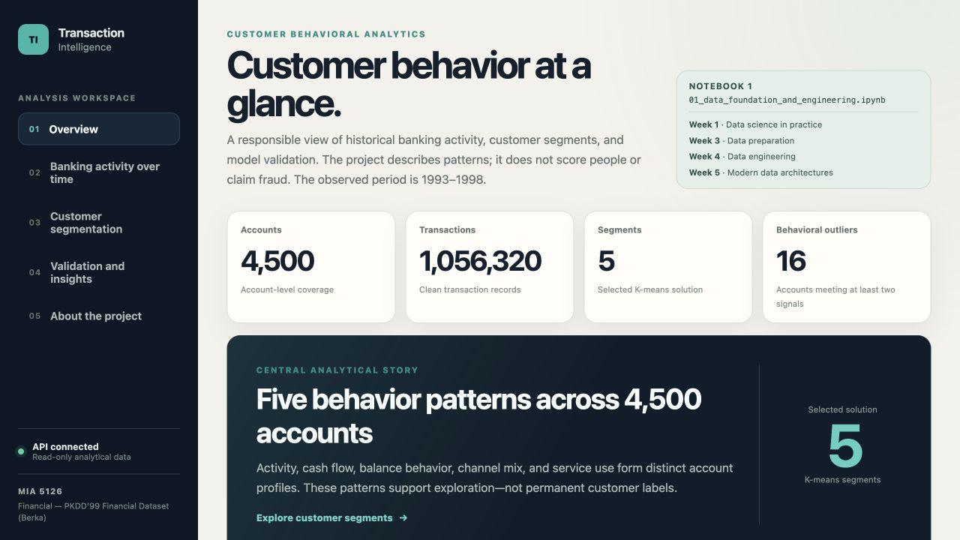
Angular is one client of the FastAPI endpoints
CURRENT READ-ONLY GET ENDPOINTS
/api/v1/health /api/v1/summary /api/v1/activity /api/v1/segments /api/v1/segments/points /api/v1/segments/{segment_id} /api/v1/outliers /api/v1/service-rules /api/v1/validation /api/v1/figures/{filename}
Any other application can consume the same JSON endpoints when the API is deployed and reachable.
Examples: another web app, mobile app, BI tool, notebook, or internal service.
Source: live local application and FastAPI OpenAPI schema.
12
Notes:
Target: 60 seconds. Explain the separation between analysis, API, and presentation. FastAPI reads curated Gold-layer outputs and returns JSON. Angular is the current client, but it is not coupled to the notebooks. Another application can call the same endpoints. Read the endpoint list as examples only; do not read every path aloud unless asked.

Slide 13
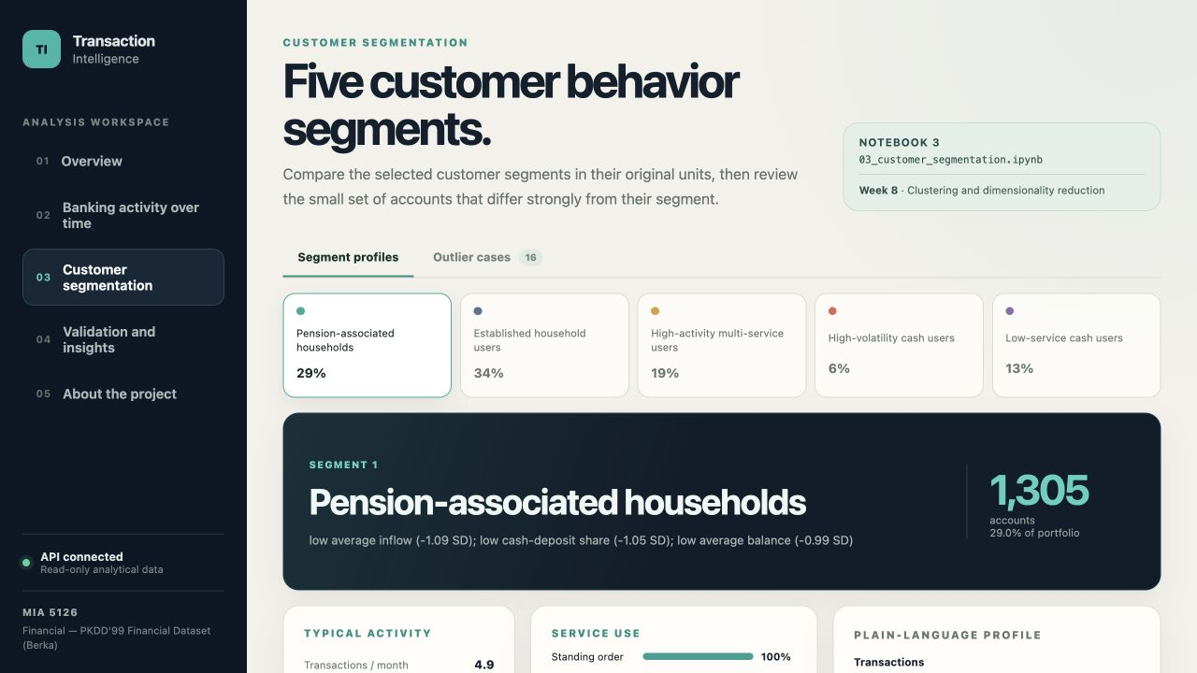
The dashboard makes segment results easier to interpret
THE PAGE COMBINES
• Segment population shares • Original-unit activity metrics • Service-use rates • Plain-language profiles • Interpretation limits
DATA ENDPOINTS
/api/v1/segments /api/v1/segments/{segment_id} /api/v1/segments/points
The page explains patterns; it does not assign risk scores.
Source: live Angular segment explorer backed by Notebook 3 outputs.
13
Notes:
Target: 50 seconds. Explain that the dashboard translates Notebook 3 outputs into original-unit measures and plain-language profiles. The segment labels summarize observed historical behavior. They are not permanent customer identities or risk categories.

Slide 14
CONCLUSION
Useful patterns, bounded claims
Five stable behavioral segments
Historical evidence supports investigation and planning—not automated customer treatment.
Aggregate forecasts and service hypotheses
Curated results through FastAPI and Angular
Notes:
Target: 50 seconds. Return to the opening question. The project found meaningful and repeatable account-behavior patterns. Forecasts may support aggregate planning, while service rules and outlier cases create questions for further study. The dataset is historical, account-based, and non-causal, so the results should not automate lending, fraud, or customer-treatment decisions.

Slide 15
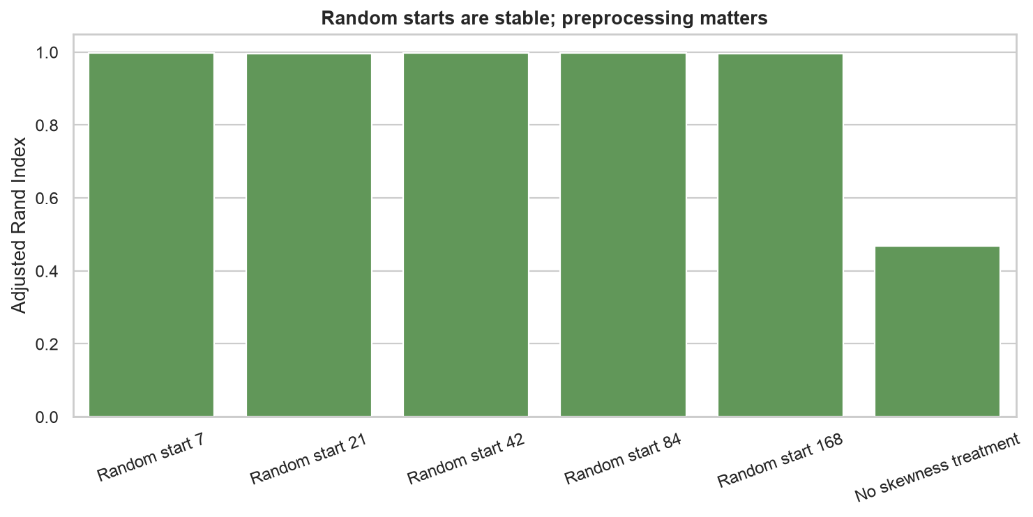
Backup — preprocessing mattered
Random-start ARI stayed near 1.0, while removing skewness treatment reduced ARI to 0.469 and produced a two-account cluster.
Source: Notebook 4; repeated K-means fits and preprocessing sensitivity check.
15
Notes:
Use only if asked about robustness. Explain that random initialization did not materially change assignments, but preprocessing choices did. Stability is necessary evidence, not proof that the segments are permanent or naturally occurring.

Slide 16
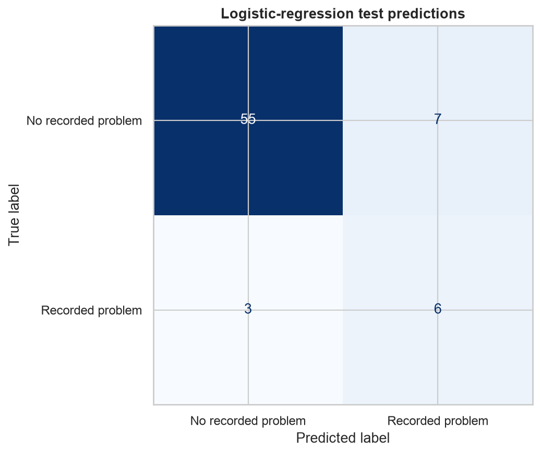
Backup — test errors and coefficients clarify the loan model
TEST OUTCOMES
55 correct non-problem 6 correct problem 7 false alarms 3 missed problems
LARGEST ABSOLUTE COEFFICIENTS
Negative-balance share +1.861 Operation diversity −1.481 Average balance −0.956
Coefficients describe the fitted model; they do not establish cause.
Source: Notebook 4; 71-loan historical test set.
16
Notes:
Use only if asked about errors or explainability. Describe false alarms and missed cases directly. Coefficient signs show how standardized inputs move the fitted score, but small-sample instability and correlation prevent causal interpretation.

Slide 17
References and disclosure
DATA AND CLUSTER VALIDATION CTU Prague. Financial — PKDD'99 Financial Dataset. relational.fel.cvut.cz/dataset/Financial Rousseeuw, P. J. (1987). Silhouettes: A graphical aid to the interpretation and validation of cluster analysis. Journal of Computational and Applied Mathematics, 20, 53–65. DOI: 10.1016/0377-0427(87)90125-7 Davies, D. L., & Bouldin, D. W. (1979). A Cluster Separation Measure. IEEE TPAMI, 1(2), 224–227. DOI: 10.1109/TPAMI.1979.4766909
FORECASTING AND ASSOCIATION RULES Hyndman, R. J., & Athanasopoulos, G. (2021). Forecasting: Principles and Practice, 3rd ed. otexts.com/fpp3/ Agrawal, R., & Srikant, R. (1994). Fast Algorithms for Mining Association Rules in Large Databases. VLDB, 487–499. PROJECT REPOSITORY github.com/antonsoss/transaction-intelligence-customer-analytics
AI assistance disclosure: AI was used as an engineering productivity tool for brainstorming, troubleshooting, and documentation. The author remains responsible for all technical decisions, implementation, validation, and conclusions.
17
Notes:
Reference slide. Keep available during questions. The analytical evidence comes from the four project notebooks and the Berka dataset. The listed sources support the forecasting, association-rule, and clustering-validation methods.

