Slide 1
Free Slot Identification in Vehicle Booking Systems
Level 0 · Car Parking
A-01
A-02
A-03
A-04
A-05
A-06
A-07
A-08
A-09
A-10
A-11
A-12
SlotFinder: find a free parking slot before you arrive
Free slots found
5 of 12 available
Done by
Antony Berezin J
Notes:
Introduce the project: SlotFinder identifies which parking slots are free for a chosen vehicle type and time window, lets users book them, and prevents double booking.

Slide 2




The problem: drivers can't see free slots in advance
Circling for a spot
Drivers arrive without knowing whether a slot is free, wasting fuel and time searching.
PROJECT GOAL
Show exactly which slots are free for my vehicle and my time, then book one safely, with no clashes.
Double booking
Simple systems only count slots, so two users can book the same slot for overlapping times.
No idea when a slot frees up
When everything is full, users get a "sorry, full" message with no next available time.
A-01
A-02
A-03
Manual slot management
Operators track slots, prices and bookings by hand or in spreadsheets.
Notes:
Explain the everyday problems that motivated the project.

Slide 3
Project objectives
01
02
03
04
Identify free slots
Prevent double booking
Show live occupancy
Secure access
For any vehicle type and time window, using a time-overlap check.
Re-check availability at booking time, and stop one vehicle from holding two slots.
A colour-coded slot map and a 24-hour timeline for each slot.
JWT login, user and admin roles, and validation on both client and server.
Notes:
Four objectives guided the design.

Slide 4




Technology stack
Frontend
Backend
Database
Security
HTML5, CSS3
Vanilla JavaScript
Responsive design
Live validation
Node.js
Express.js REST API
express-validator
Central error handler
MongoDB
Mongoose ODM
Schema validation
Compound index
JWT authentication
bcrypt password hashing
Role-based access
CORS
Notes:
The full JavaScript stack: the same language on both client and server.

Slide 5


Architecture model: 3-tier client–server (MVC)
PRESENTATION TIER
APPLICATION TIER
DATA TIER
Browser pages
Express REST API
MongoDB + Mongoose
index · login · register
dashboard · timeline
bookings · admin
Routes (controllers)
Middleware: JWT, validation
freeSlots.js algorithm
Models: User, Slot, Booking
Indexes for overlap queries
Local or Atlas cloud
Request flow: Browser → fetch + JWT → Express route → validation → algorithm → Mongoose → JSON → UI
Notes:
Model used: a three-tier client-server architecture following the MVC pattern. Models are Mongoose schemas, the views are the HTML pages, and the controllers are the Express routes.

Slide 6



Data models (MongoDB / Mongoose)
User
Booking
Slot
name (3–50 letters)
email (unique)
phone (10 digits, 6–9)
password (bcrypt hash)
role: user | admin
user → User
slot → Slot
vehicleNumber (TN01AB1234)
vehicleType
startTime · endTime
amount (₹)
status: booked | cancelled
slotNumber (A-01, unique)
vehicleType: car | bike | ev | truck
floor (0–10)
pricePerHour (₹1–1000)
isActive
Index { slot, status, startTime, endTime } on Booking makes the overlap query fast.
Notes:
Three collections. A Booking references one User and one Slot.

Slide 7
How free slots are identified
Overlap when existing.start < requested.end AND existing.end > requested.start
1
Fetch all active slots of the requested vehicle type
Example: request 11:00 – 13:00
2
Find bookings (not cancelled) on those slots that overlap the window
A-01
A-02
3
Free slots = all slots − slots with an overlapping booking
A-03
4
Return free slots with estimated cost = price/hr × hours
A-01 overlaps → busy A-02 → FREE A-03 overlaps → busy
Notes:
The core of the project is in utils/freeSlots.js. A single MongoDB query finds every booking that collides with the requested time window.

Slide 8


Smart suggestions and zero double bookings
Next-free suggestion
Double-booking prevention
When every slot is full, SlotFinder doesn't just say "full".
For each slot, walk its future bookings in time order
Push the candidate start past each colliding booking
Stop at the first gap long enough for the same duration
Suggest the earliest result across all slots
Re-check at booking time
Availability is checked again on POST, so a slot taken seconds ago returns 409 Conflict.
One vehicle, one slot
The same vehicle number can't hold two overlapping bookings.
Right slot for the vehicle
A bike can't be booked into a car or EV slot.
Notes:
These two features are what set the system apart from a simple slot counter.

Slide 9







Website features at a glance
Free slot search
Live slot map
Day view timeline
Next-free suggestion
By vehicle type and time window, with estimated cost
Colour-coded free / occupied / inactive grid, refreshes every 30 s
24-hour bar per slot with a current-time marker
Earliest time a slot frees up for the same duration
Booking
My bookings
Admin panel
Responsive UI
Booking summary with amount and no double booking
Filter Upcoming / Active / Completed / Cancelled, cancel
Manage slots and bookings, view revenue stats
Works on mobile, tablet and desktop
Notes:
Overview of the eight main features of the website.

Slide 10
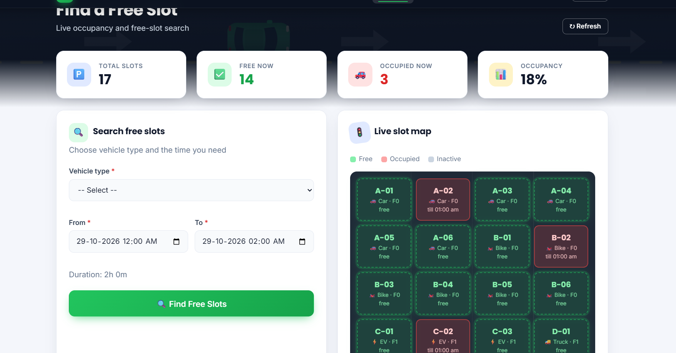
Find a Free Slot: live occupancy and search
1
Stat cards
Total slots, free now, occupied now and occupancy %
2
Search form
Vehicle type, From / To and live duration
3
Live slot map
Green = free, red = occupied, showing "till" time
Notes:
The dashboard page combines live statistics, the search form and the slot map.

Slide 11
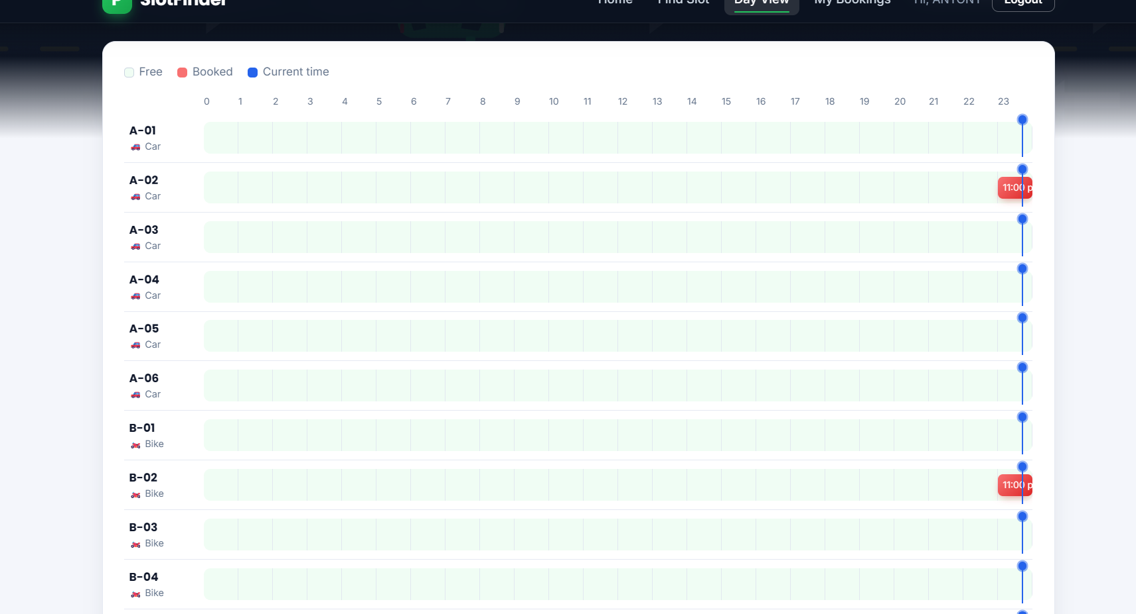



Day view: 24-hour timeline per slot
Free
Light green track = slot is available
Booked
Red block = existing booking with its time
Current time
Blue marker moves across every slot
Users spot free windows at a glance, before they search.
Notes:
The day view shows every slot's bookings on a 24-hour axis.

Slide 12
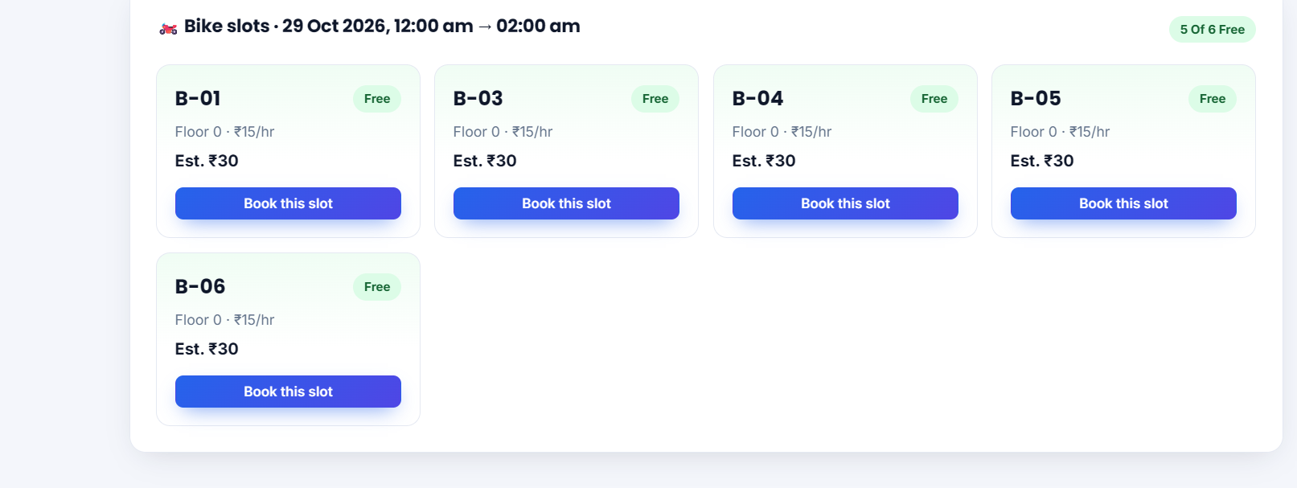
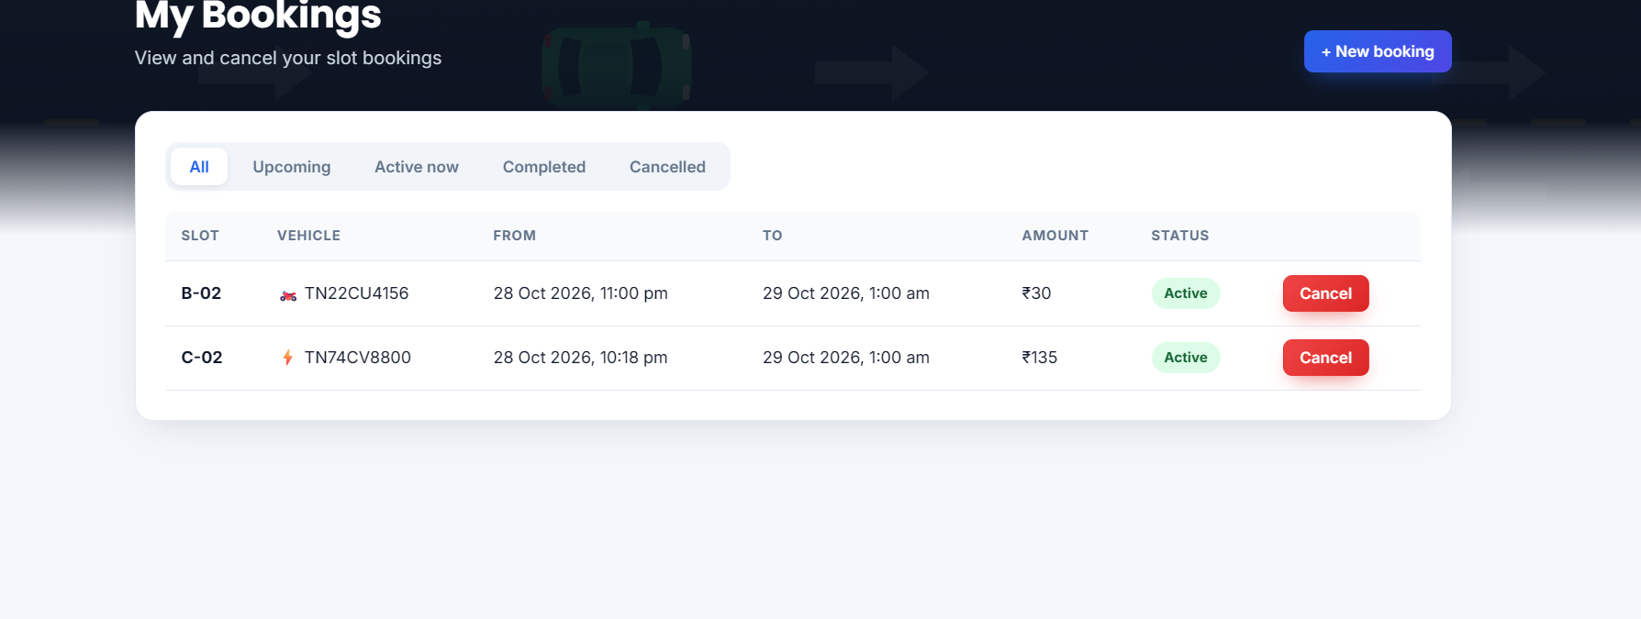
Booking a slot and managing bookings
Search results: free bike slots with price and estimated cost
My Bookings: filter by status and cancel
Search
Pick a free slot
Enter vehicle no.
Confirm amount
Booked ✓
Notes:
The booking flow from search to confirmation, and the My Bookings page.

Slide 13



Validation and security
Field | Rule (checked in browser and on server)
Name | 3–50 characters, letters and spaces only
Mobile | Exactly 10 digits, starts with 6–9
Password | 8+ chars: upper, lower, number, special
Vehicle no. | Indian format, e.g. TN01AB1234
Time window | Not in past, ≤ 30 days ahead, 30 min – 24 h
Slot | Format A-01, unique; price ₹1–1000
JWT authentication
Token sent as Bearer header on every API call
bcrypt hashing
Passwords never stored in plain text
Role-based access
Admin-only routes for slots and stats
Notes:
Every rule is enforced twice: live in the browser for user feedback and again on the server with express-validator and Mongoose schema rules.

Slide 14
Key differences from other booking websites
Aspect | Typical parking / booking sites | SlotFinder
Availability | Total count of spaces, or a static list | Per-slot check against bookings for your exact time window
When full | "No slots available" | Suggests the next free time for the same duration
Double booking | Possible when two users book at once | Re-check at booking + vehicle clash check
Visibility | Plain list of slots | Live colour-coded map + 24-hour day timeline
Vehicle types | Usually cars only | Car, bike, EV and truck slots with own prices
Cost | Known only at the counter | Estimated cost shown before booking
Notes:
These are the main ways SlotFinder goes beyond a typical slot-counting booking website.

Slide 15





Conclusion and future scope
FUTURE SCOPE
Online payment gateway
IoT sensors for real occupancy
QR code entry and exit
SlotFinder identifies truly free slots, prevents double booking, and gives drivers and admins a live view of the parking.
Mobile app with notifications
Map of multiple parking sites
Tested with 24 automated API tests
Thank you · Antony Berezin J
Notes:
Summarise and thank the audience. Mention planned improvements.

