Slide 1
✦ AI-POWERED JOB MATCHING
Fortune
Jobs AI
Find Your Dream Job in Seconds
Built by Franklin Antony · fortunejobsai.framer.ai · Zero Coding Experience

Slide 2
THE PROBLEM
Job hunting is
broken.
😩
🤷
⏳
Endless Scrolling
No Context
Time Lost
Sifting through hundreds of irrelevant listings wastes hours every day.
Job boards show salary ranges and titles — but not WHY a job fits you.
Average job seeker spends 11 hours/week just searching — not applying.

Slide 3
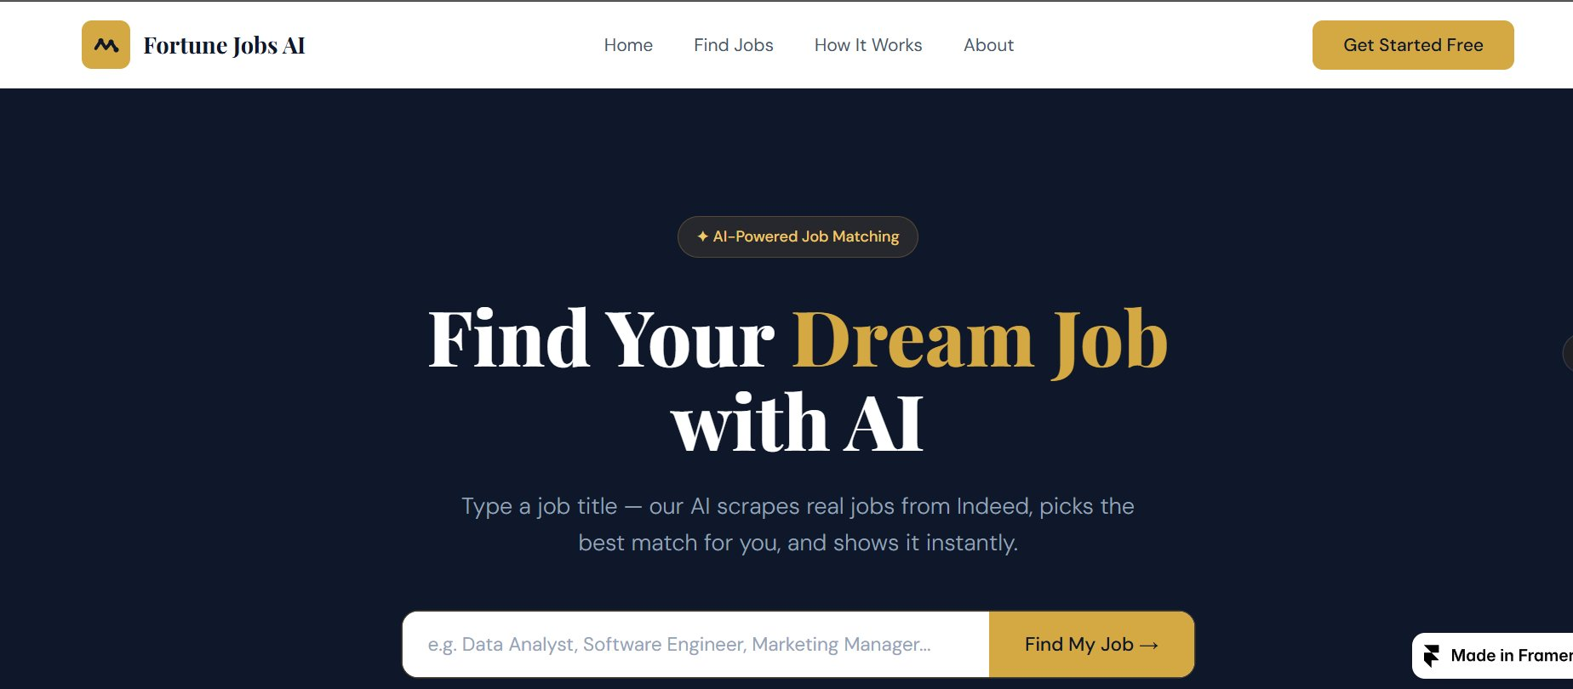
THE SOLUTION
One search.
Perfect match.
Instantly.
1000+
< 30s
97%
Jobs Scraped
Result Time
Best Match Score
Type any job title. Our AI scrapes thousands of real jobs from Indeed, evaluates each one, and delivers your best match — with salary, location, match score, and a direct Apply Now link.

Slide 4
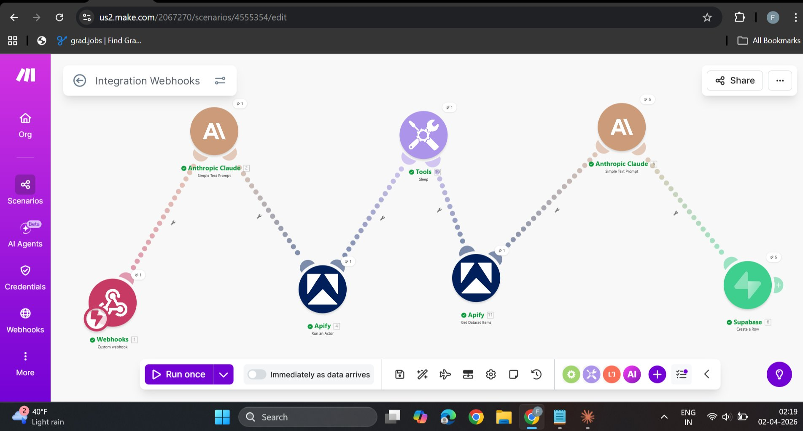
HOW IT WORKS
7-Step AI Pipeline
1 Webhook receives job search
2 Claude AI extracts clean title
3 Apify scrapes Indeed (real-time)
4 Sleep 10s — data loads
5 1000 job listings retrieved
6 JSON Parser splits fields
7 Claude picks best match → Supabase

Slide 5
TECH STACK
Built with the
best AI tools.
Claude AI
Supabase
Job title extraction + best match selection
PostgreSQL database for job_matches
Apify
Framer
Real-time Indeed scraping (1000 jobs)
Beautiful navy + gold frontend
Make.com
GitHub Pages
7-step automation pipeline
Hosts search webhook logic

Slide 6
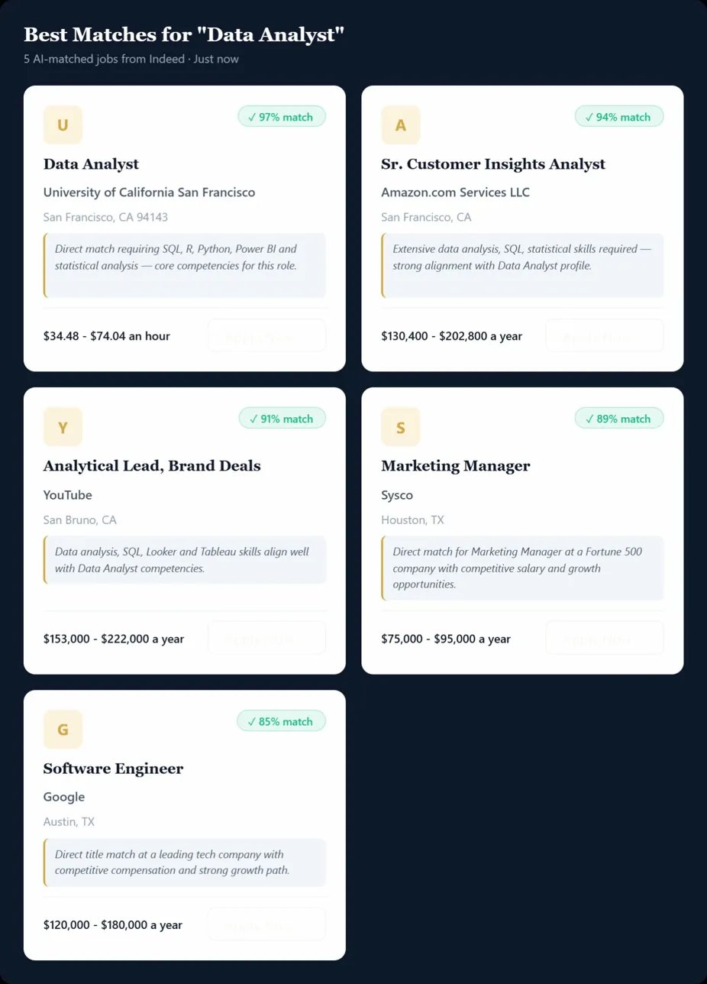
LIVE RESULTS
Real jobs. Real companies.
Real AI matching.
97%
Data Analyst
UC San Francisco · $34–$74/hr
94%
Sr. Customer Insights Analyst
Amazon · $130K–$202K
91%
Analytical Lead
YouTube · $153K–$222K
89%
Marketing Manager
Sysco · $75K–$95K
85%
Software Engineer
Google · $120K–$180K

Slide 7
SMART FEATURES
Designed for speed.
Built for precision.
🔄
🎯
📊
Auto-Polling
Smart Filtering
Score Sorted
Checks Supabase every 20 seconds — no refresh needed
Only shows results from your current search
Highest match scores appear first, always
⚡
🏢
🔗
Zero Login
Real Companies
Direct Apply
Free to use instantly — no account required
Live scraping from Indeed — not a cached database
One-click Apply Now links straight to Indeed

Slide 8
PROBLEMS SOLVED
Every bug crushed.
Every blocker cleared.
✗ NULL values in database
✗ Claude returning JSON with backticks
✓ Added JSON Parser step to pipeline
✓ Prompt engineered to return raw JSON only
✗ Apify returning no results
✗ Website showing 'Still Processing'
✓ Switched to defaultDatasetId from Step 4
✓ Built smart auto-polling every 20 seconds
✗ Make.com not triggering
✗ Apify sync error
✓ Enabled 'Immediately as data arrives' toggle
✓ Changed Run synchronously to Yes

Slide 9
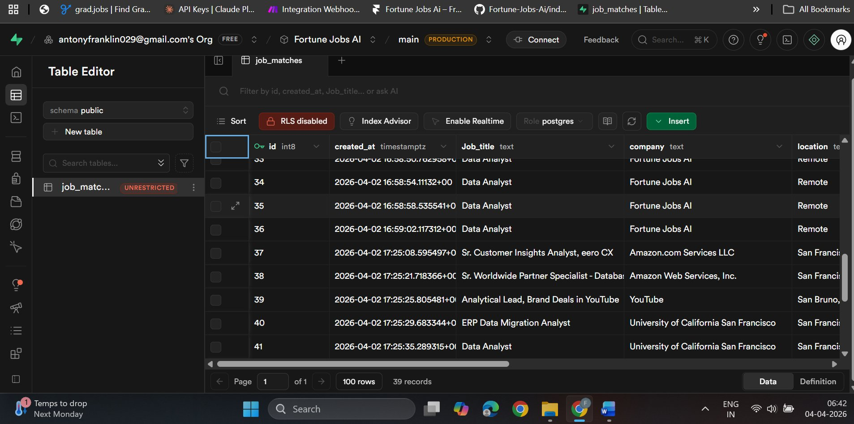
LIVE DATABASE
39 records. Real matches.
Production database.
39
8
100%
Job Records
Data Fields
Real Company Data
Fields stored per job:
job_title · company · location · salary · apply_url · match_reason · match_score · created_at

Slide 10
CURRENT STATUS
Everything is
live. Now.
Live Website
LIVE
GitHub Repository
PUBLISHED
Make.com Pipeline
LIVE
LinkedIn Post
PUBLISHED
Claude AI Matching
LIVE
Auto-polling
LIVE
Apify Scraping
LIVE
Make.com Credits
NEEDS $9/mo
Supabase Database
LIVE

Slide 11
FUTURE VISION
This is just
the beginning.
PHASE 1
PHASE 2
PHASE 3
Custom domain: fortunejobsai.com
Resume PDF upload + Claude parsing
Mobile app launch
Upgrade Make.com ($9/mo)
Multiple matches per search
Premium subscriptions
User login via Supabase Auth
Email job alerts
Company partnerships

Slide 12
A solo founder. Zero coding experience.
One powerful AI platform.
Fortune Jobs AI
is live, real, and growing.
fortunejobsai.framer.ai · github.com/antonyfranklin29/Fortune-Jobs-Ai · Built by Franklin Antony

