Slide 1
Sentiment analysis on movie reviews
By
Jisha Karthik

Slide 2

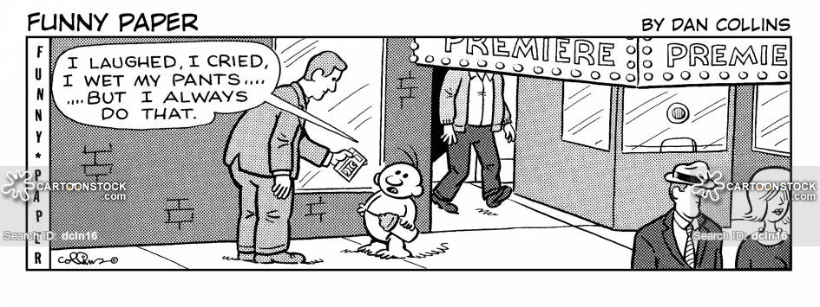

Slide 3
Dataset & Approach
Movie reviews from IMDb(Internet movie database)
The data set contains 50,000 movie reviews labeled whether they are positive or negative based on the content
The task is to predict the sentiment of movie reviews whether the sentiment positive or negative

Slide 4

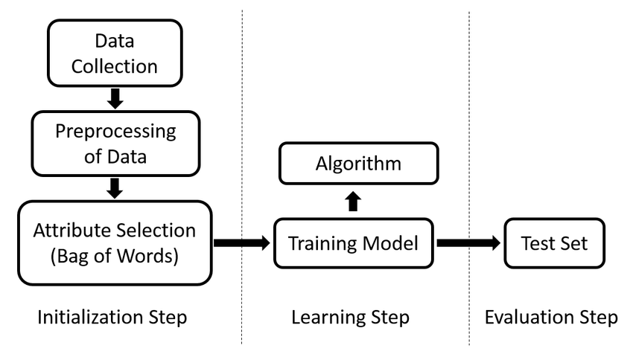
Sentiment analysis steps
Prepare train and test datasets
The data is split in to train and test .The train set contains 35,000 reviews (70% of data) intended for training and the test set has 15,000 reviews (30% of data) for testing the classifier.
Text pre-processing
Remove HTML tags,accented characters, expanding contractions,removing special characters,lemmatization to get the root word and removing stopwords
Feature engineering
Bag of words model, TF-IDF model, word2vec model, GloVe model
Train model
Model prediction and evaluation

Slide 5
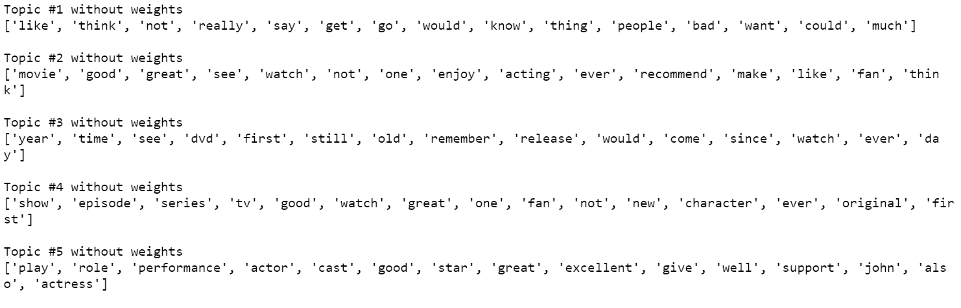
Positive reviews

Slide 6
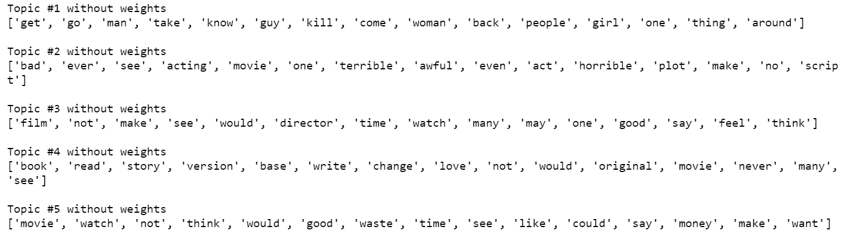
Negative Reviews

Slide 7
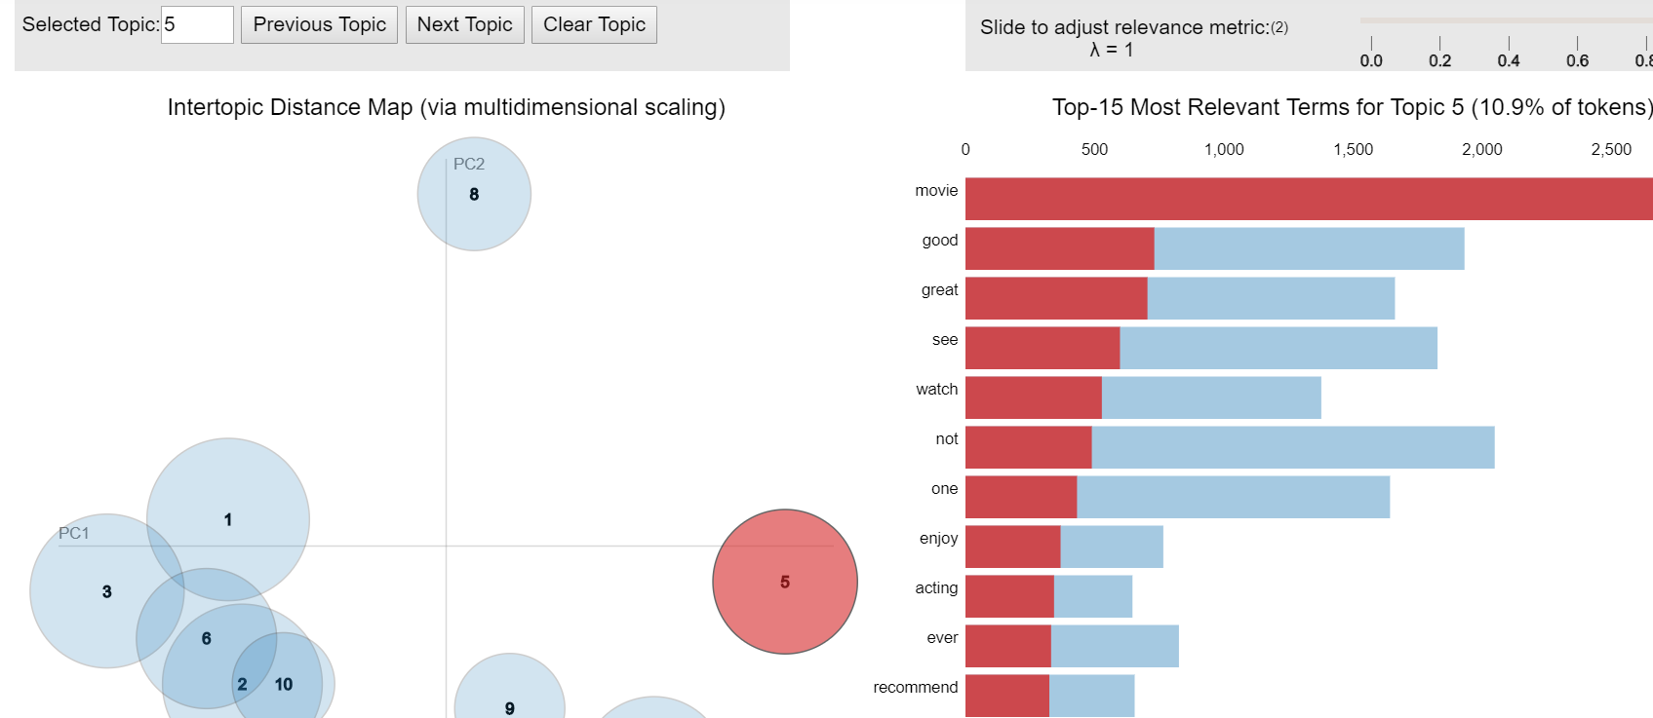
Topic modeling
Visualization on positive reviews

Slide 8
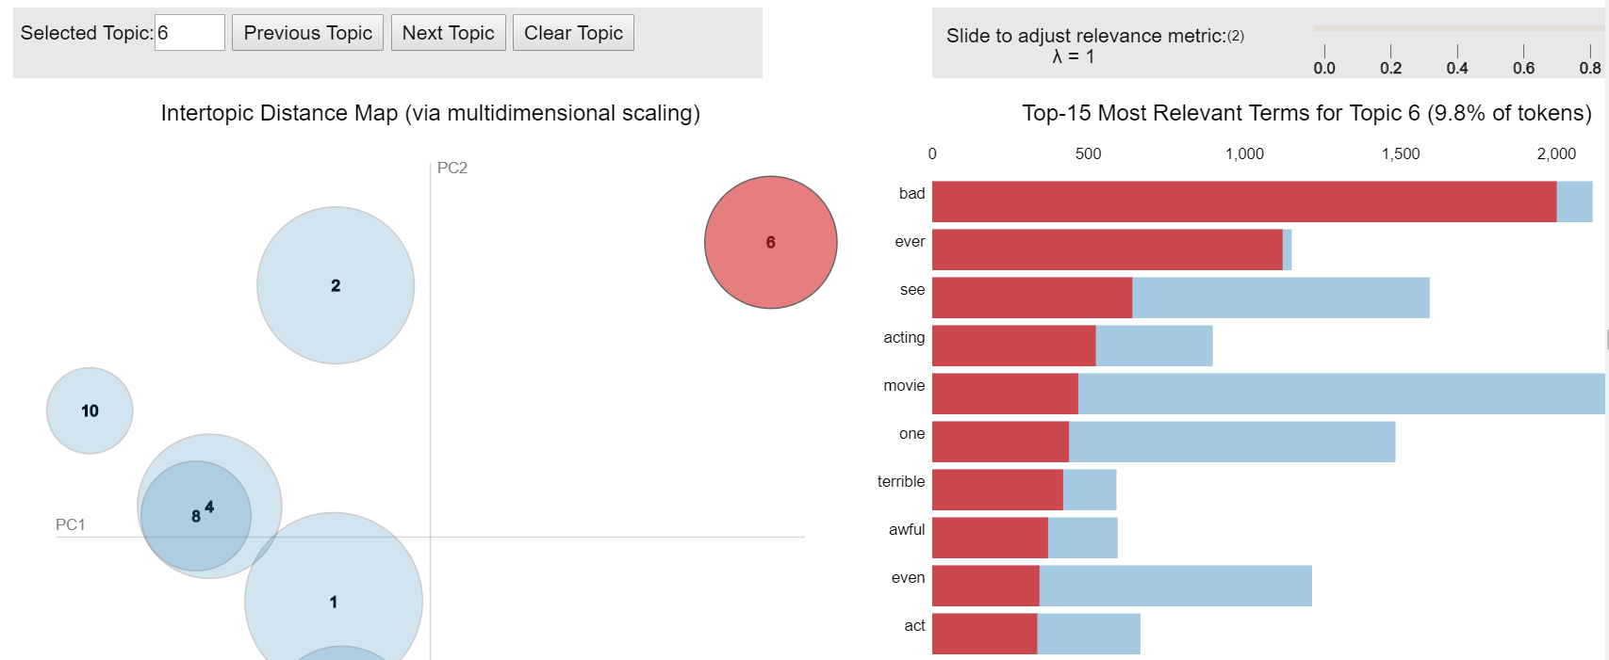
Topic modeling
Visualization on negative reviews

Slide 9
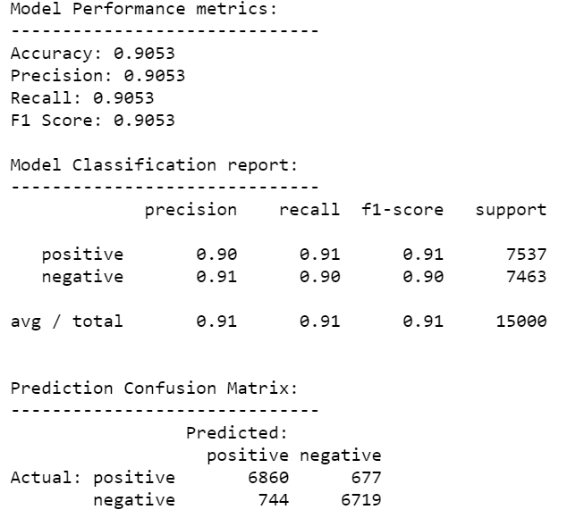
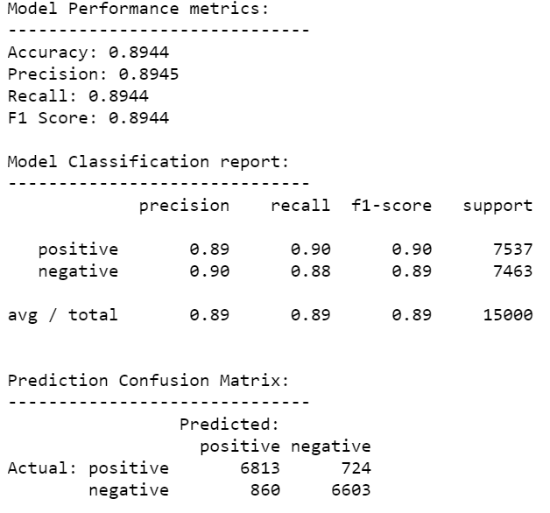
Machine Learning Models & evaluation
Logistic regression on BOW features
Logistic regression on TF-IDF features

Slide 10
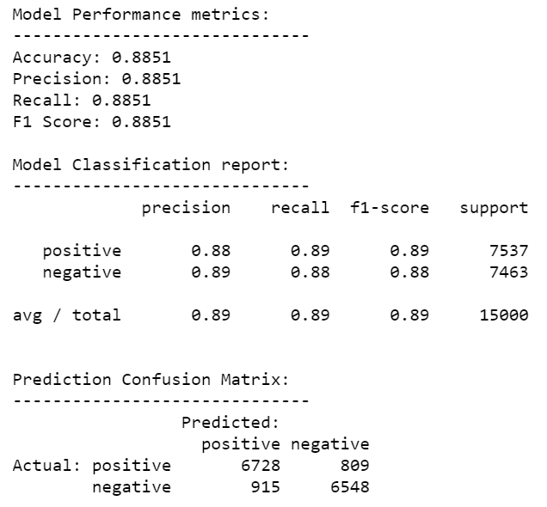
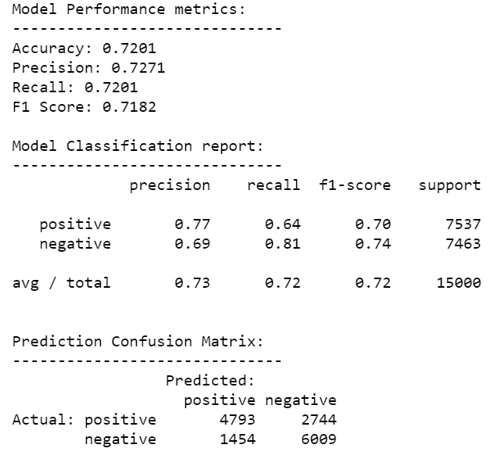
Deep learning models
DNN model on word2vec features
DNN model on GloVe features

Slide 11
Model Evaluation
Logistic regression on BOW features
Accuracy : 90%
F1 Score : 91%
Logistic regression on TF-IDF features
Accuracy : 89%
F1 Score : 89%
DNN Model on word2vec features
Accuracy : 89%
F1 Score : 89%
DNN Model on GloVe features
Accuracy :72 %
F1 Score :72 %

Slide 12
Conclusion
The Linear regression on BOW features got the highest accuracy and F1-score 91%
DNN model on GloVe features got the lowest accuracy and F1-score 72%

