Slide 1
Application Delivery Fundamentals 2.0 B: Java
Introduction to Maven

Slide 2
Course Goals / Objectives
At the end of this module, participants will be able to understand:
The Physical Overview of Maven2
The Maven repositories
Maven Archetypes
Maven 2 life cycle phases
How to set the environment for Maven 2

Slide 3
Course Goals / Objectives
At the end of this module, participants will be able to understand:
The pom.xml file
How to customize the pom.xml file
How to create Eclipse related files using Maven
How to create a WAR file

Slide 4
Java Application Build Steps
Compiling all source files
Compiling unit test codes
Configuring all the dependent files
Managing the project structure
Building war files
Java Application Build
Notes:
Faculty Notes:
Building a Java web application is very hard and can be a very tedious task. Typical build steps are as follows:
* Compiling all source files. Copying all class files to a temporary directory.
* Compiling unit test source codes and then run unit tests. Stopping the build process if a unit test fails.
* Transferring other required files (xml, properties, etc) to the temporary directory.
* Copying all the web content files.
* Building the war file.
Participant Notes:
We have created several Java applications till now in the course. We managed the build steps manually till now. However, when we deal large enterprise applications building the application and taking care of the dependencies could become very tedious
Transition:
Let’s have a look at some of the common issues

Slide 5
Issues
Common Issues
Configuring multiple jars
Managing Dependencies
Managing Project structure
Deploying
Building and testing modules
Notes:
Faculty Notes:
Imagine a large application with different modules eg: order, inventory etc and for some reason we want to create a separate war file for each of the modules. And then there is a common module which all of these depend on which has to be created as a jar and included in all war files.
While building a real time application we should take care of multiple modules, sequence in which modules need to be built and deploy it to various servers/environments like testing, production etc. Performing this manually would be difficult. Thus, in scenarios like this we use a build tool which helps us automate the process.

Slide 6

What is Maven ?
Build tool
A software project management and comprehension tool.
It can manage the build of project, documentation and reporting from a central piece of information
Maven is hosted by Apache Software Foundation
Notes:
Faculty Notes:
You can download Maven 2 from http://maven.apache.org/download.html.

Slide 7
What is Maven ?
Maven is a project management tool which encompasses a project object model.
a set of standards, a project lifecycle, a dependency management system, and logic for executing plugin goals at defined phases in a lifecycle.
Notes:
Faculty Notes:
You can download Maven 2 from http://maven.apache.org/download.html.

Slide 8
What is Maven ?
Maven uses POM (Project Object Model) in order to describe the software project which is being built, it’s dependencies on other external modules and build order.
Notes:
Faculty Notes:
You can download Maven 2 from http://maven.apache.org/download.html.

Slide 9
What is Maven ?
Maven comes with predefined targets for performing certain tasks like compilation of code and it’s packaging.
Maven is network-ready. The core engine can dynamically download plug-ins from a repository.
Notes:
Faculty Notes:
You can download Maven 2 from http://maven.apache.org/download.html.

Slide 10
Apache Ant vs Maven
Apache Ant
Ant doesn’t have formal conventions like a common project directory structure or default behaviour.
You have to tell Ant exactly where to find the source and where to put the output.
Informal conventions have emerged over time, but they haven’t been codified into the product.
Ant is procedural. You have to tell Ant exactly what to do and when to do it.
You have to tell it to compile, then copy, then compress.
Ant doesn’t have a lifecycle. You have to define goals and goal dependencies.
You have to attach a sequence of tasks to each goal manually.

Slide 11
Apache Ant vs Maven
Apache Maven
Maven has conventions. It knows where your source code is because you followed the convention.
Maven’s Compiler plugin put the bytecode in target/classes, and it produces a JAR file in target.
Maven is declarative. All you had to do was create a pom.xml file and put your source in the default directory. Maven took care of the rest.
Maven has a lifecycle which was invoked when you executed mvn install.
This command tells Maven to execute a series of sequential lifecycle phases until it reached the install lifecycle phase.
As a side effect of this journey through the lifecycle, Maven executed a number of default plugin goals which did things like compile and create a JAR.

Slide 12
Setting the environment for Maven 2
Download Maven2 from http://maven.apache.org/download.html
Unzip the installation archive to c:/
Set the M2_HOME and Path environment variables in the following way:
M2_HOME=C:\apache-maven-2.2.1
Path=%M2_HOME%\bin

Slide 13

Setting the environment for Maven 2
If installed correctly, you should be able to test it by opening a command prompt and typing :
The output should be like this:

Slide 14
User-Specific Configuration and Repository
~/.m2/settings.xml
A file containing user-specific configuration for authentication, repositories, and other information to customize the behaviour of Maven.
~/.m2/repository/
This directory contains your local Maven repository. When you download a dependency from a remote Maven repository, Maven stores a copy of the dependency in your local repository.

Slide 15
Maven Key terms
Archetype - is a template of a project which is combined with some user input to produce a working Maven project that has been tailored to the user's requirements
POM - The pom.xml file is the core of a project's configuration in Maven. It is a single configuration file that contains the majority of information required to build a project.
Dependencies - Maven allows projects to declare what dependencies they have, and will automatically materialize those dependencies
Notes:
http://maven.apache.org/guides/getting-started/index.html

Slide 16
Physical Overview of Maven 2
pom.xml
Local & Remote
Repositories
Project Object
Model
Dependency
Management
Model
Project Life cycle and phases
Plug-in
Plug-in
Plug-in
Source files
Generated
Files
Resources
Binaries
Packaged Binaries
Notes:
Faculty Notes:
POM is Maven’s understanding of your particular project.
Dependencies are specified as a part of pom.xml file. Maven resolves project dependencies according to it’s dependency management model. Maven 2 looks for dependent components in local and global repositories. In Maven terminology, the dependent components are known as artifacts. Artifacts resolved in remote repositories are download to the local repository.
Maven 2 can deal with transitive dependencies also. That is, Maven 2 works perfectly when resolving dependencies that your dependencies depend on.
All file handling tasks are performed by the Maven engine through plug-ins. Plug-ins are configured and described in the pom.xml file. The plug-ins are handled as artifacts by the dependency management model and are downloaded on demand. Each plug-in can be associated with various phases of a life cycle.

Slide 18
POM
General project information
This includes a project’s name, the URL for a project, the sponsoring organization, and a list of developers and contributors along with the license for a project.
Build settings
In this section, we customize the behaviour of the default Maven build.
We can change the location of source and tests, we can add new plugins, we can attach plugin goals to the lifecycle, and we can customize the site generation parameters.

Slide 19
POM
Build environment
The build environment consists of profiles that can be activated for use in different environments.
For example, during development you may want to deploy to a development server, whereas in production you want to deploy to a production server.
The build environment customizes the build settings for specific environments and is often supplemented by a custom settings.xml in ~/.m2.
POM relationships
A project rarely stands alone; it depends on other projects, inherits POM settings from parent projects, defines its own coordinates, and may include submodules.

Slide 20
The Super POM
All Maven project
POMs extend the Super POM, which defines a set of defaults shared by all projects.
This Super POM is a part of the Maven installation.
Depending on the Maven version it can be found in the maven-x.y.z-uber.jar or maven-model-builder-xy.z.jar file in ${M2_HOME}/lib.
Effective POM
$ mvn help:effective-pom

Slide 21
Project Dependency Scope
compile
compile is the default scope;
provided
provided dependencies are used when you expect the JDK or a container to provide them.
For example, if you were developing a web application, you would need the Servlet API available on the compile classpath to compile a servlet, but you wouldn’t want to include the Servlet API in the packaged WAR; provided dependencies are available on the compilation classpath (not runtime). They are not transitive, nor are they packaged.

Slide 22
Project Dependency Scope
runtime
runtime dependencies are required to execute and test the system, but they are not required for compilation.
For example, you may need a JDBC API JAR at compile time and the JDBC driver implementation only at runtime.
test
test-scoped dependencies are not required during the normal operation of an application, and they are available only during test compilation and execution phases.
system
The system scope is similar to provided except that you have to provide an explicit path to the JAR on the local file system. This is intended to allow compilation against native objects that may be part of the system libraries.

Slide 23
Maven Plugins and Goals
To execute a single Maven plugin goal, we used the syntax mvn archetype:generate, where archetype is the identifier of a plugin and generate is the identifier of a goal.
$ mvn archetype:generate -DgroupId=org.sonatype.mavenbook.simple
A Maven Plugin is a collection of one or more goals.
Examples of Maven plugins can be simple core plugins like the Jar plugin, which contains goals for creating JAR files, Compiler plugin, which contains goals for compiling source code and unit tests, or the Surefire plugin, which contains goals for executing unit tests and generating reports.

Slide 24
Maven Plugins and Goals
A goal is a specific task that may be executed as a standalone goal or along with other goals as part of a larger build.
A goal is a “unit of work” in Maven.

Slide 25
Maven Repositories
Maven repositories store a set of artifacts which are used by Maven during dependency resolution for a project.
Local repositories can be accessed on the local hard disk.
Remote repositories can be accessed through the network.
An artifact is bundled as a JAR file which contains the binary library or executable.
An artifact can also be a war or an ear.
Notes:
Faculty Notes:
Resolving Project Dependencies
During the build process, the project dependencies are resolved with the help of Maven 2 dependency management engine. Dependencies are specified in <dependencies> elements within a pom.xml file. Project dependencies are stored on repository servers. The dependencies resolver attempts to resolve the dependencies in the following order:
Your local repository is checked for the dependency.
A list of remote repositories is checked for the dependency.
In case, 1 and 2 fail, an error is reported.
By default, the first remote repository contacted in step 2 is a worldwide-accessible centralized Maven 2 repository containing artifacts for most popular open source projects.
Local Repository
Your Maven 2 local repository is a directory on your disk, located at HomeDirectory/.m2/repository. This repository acts as a high-performance local cache, storing any artifacts downloaded as a result of dependency resolution.
Remote Repository
Remote repositories are accessed over the network. You can maintain a list of remote repositories to use in your settings.xml configuration file. The settings.xml file is present in the conf folder of apache-maven-2.2.1.

Slide 26
Maven 2 Archetypes
An archetype is a complete project template
Using an archetype, a project template can be created with a simple command
Following is a list of archetypes and their purposes.
Notes:
Maven provides command line utilities using which we can create project template, similar to the project creation options in Eclipse

Slide 27
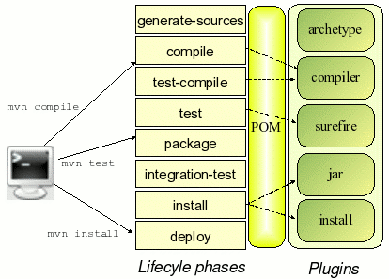
Maven Life Cycle

Slide 28
Maven Life Cycle
Maven is based around the central concept of a build lifecycle. There are three built-in build lifecycles: (Goals)
Default (Build)
clean
site

Slide 29
Clean Life Cycle
When we execute mvn post-clean command, Maven invokes the clean lifecycle consisting of the following phases.
pre-clean
clean
post-clean
Its clean:cleangoal deletes the output of a build by deleting the build directory. Thus, when mvn clean command executes, Maven deletes the build directory.

Slide 30
Site Lifecycle
Maven Site plugin is generally used to create fresh documentation to create reports, deploy site, etc. It has the following phases −
pre-site
site
post-site
site-deploy

Slide 31
Maven Life Cycle (Default)

Slide 32
Maven Life Cycle (Default)

Slide 33
Maven 2 Life cycle phases
Plug-ins are software modules which are written to fit into the plug-in framework of Maven.
Each task within a plugin is called a mojo.
A mojo is executed when the Maven engine executes the corresponding phase on the build life cycle.
The association between the phase of a life cycle and a mojo is called as a binding.

Slide 34
Maven 2 Life cycle phases (Continued…)
Few phases of the build life cycle are described below:
compile
Compiles the source code and the classes are placed in the target directory tree.
test-compile
Compiles the source code of the unit tests.
test
package
install
deploy
Adds the archive to the remote Maven directory. Thus making the artifact available to a larger audience.
Adds the archive to the local Maven directory. Thus making it available for any other module dependent on it.
Bundles the executable binaries into a distribution archive such as jar or war
Runs the compiled unit tests and verifies the results

Slide 35
Package-specific Lifecycles
JAR

Slide 36
Package-specific Lifecycles
WAR

Slide 37
First Maven 2 project
Create the archetype
Create the source files
Create the test files
Open pom.xml and review the plugins
Execute build
Notes:
Faculty Notes:
Discuss how Maven2 works

Slide 38
First Maven 2 project
In order to create everything which is needed for a simple Java project that can be built using Maven, you can use Archetype plug-in.
Archetype is a standard plug-in which comes with Maven 2.
The Archetype plug-in runs outside of a Maven project build life cycle and is used for creating Maven projects.
Notes:
Now lets see how maven works. Here are the steps
Create the archetype
Create the source files
Create the test files
Open pom.xml and review the plugins
Execute build

Slide 39
First Maven 2 project
Issue the following command from the directory that you want to contain SampleProject:
The above command provides the archetype plug-in with the coordinates of your module.
The command also creates a starter pom.xml file for the project along with the conventional Maven 2 directory structure.
mvn archetype:generate -DgroupId=com.cgi.banking -DartifactId=BankingAppln -DarchetypeArtifactId=maven-archetype-quickstart -DinteractiveMode=false

Slide 40
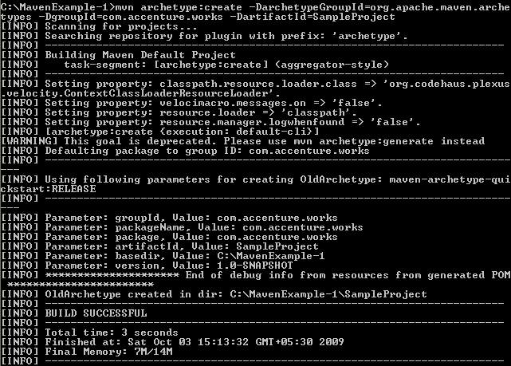
First Maven 2 project (Continued…)
The output should be similar to the following:
Notes:
Sumaiya – This is fine

Slide 41
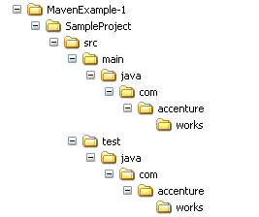
First Maven 2 project (Continued…)
The Archetype plug-in creates a directory tree, a pom.xml file and a placeholder App.java application.
It also creates a directory tree for unit test source code and a placeholder AppTest.java unit test.
The following figures shows the directory structure created:
Notes:
This is fine. Reference the steps

Slide 42
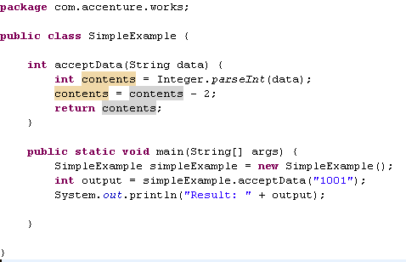
First Maven 2 project (Continued…)
Remove App.java and place the following SimpleExample.java :
Notes:
This is fine. Reference the steps

Slide 43
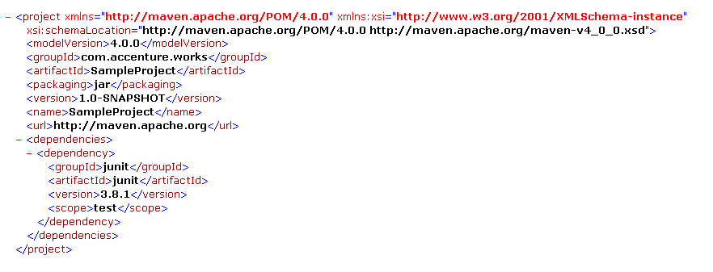
Sample pom.xml file
The file generated by the Archetype plug-in for SampleProject is shown below:
Notes:
Faculty notes:
Maven Coordinates
The group ID: The entity or organization responsible for producing the artifact. For example, com.accenture.works can be a group ID. The artifact ID: The name of the actual artifact. For example, a project with a main class. The version: A version number of the artifact.
Note how the Archetype has defined the module's coordinates, defined the type as a JAR archive, and also specified JUnit as a dependency during the test phase (via the <scope> tag).

Slide 44
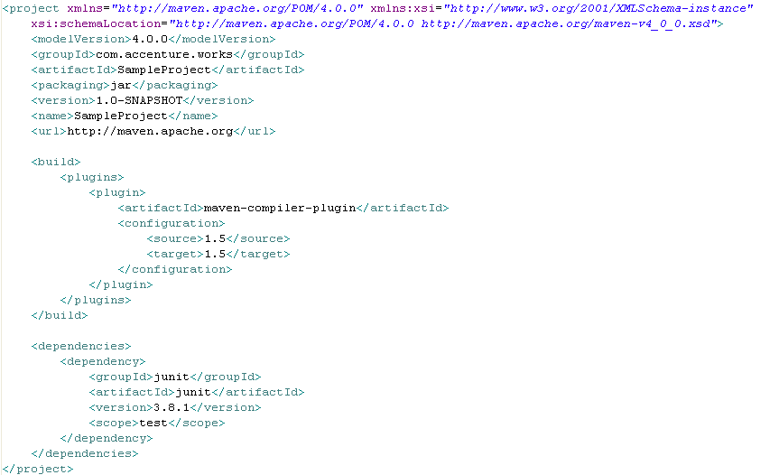

Customizing the generated pom.xml file

Slide 45
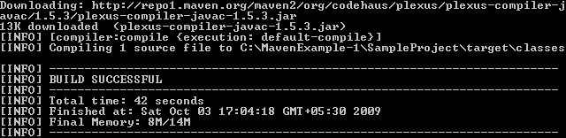
Compiling the customized Project
You can now compile the SampleProject using mvn compile command.
You should see the report of a successful build, creating one class file in the target tree.
This can take a little while if it is the first time you run it because some dependencies might need to be downloaded from the central repository over the Internet.

Slide 46
Test jar
java -cp target/my-app-1.0-SNAPSHOT.jar com.mycompany.app.App

Slide 47
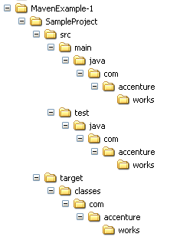
Directory structure after compilation
After compilation, the .class files (SimpleExample.class) file is created in the target folder shown below:

Slide 48
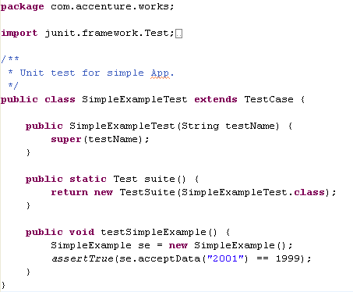
Adding a Unit test
It is a development best practice to provide unit tests for all code modules.
Maven 2 created a placeholder AppTest.java unit test for you. Remove the file and place the following SimpleExampleTest.java :

Slide 49
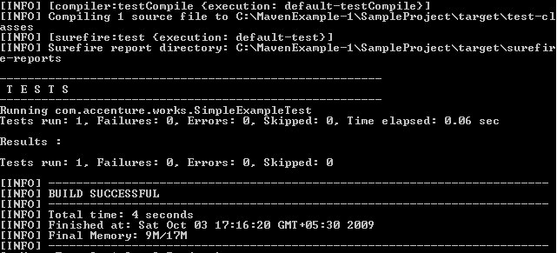
Running a unit test
You can use mvn test command.
Maven 2 compiles the source and the unit test. It then runs the tests, reporting on the number of successes, failures, and errors, as shown in the following figure:

Slide 50
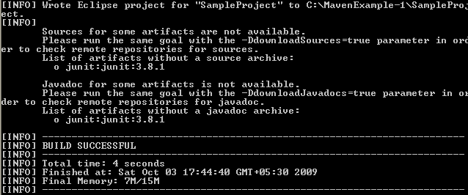
Creating eclipse specific files
It is easier for developers to work with Eclipse, hence Maven supports creation of eclipse specific files
To generate the eclipse metadata files from your pom.xml you execute the following command:
The above command generates eclipse related files like .project and .classpath .
Notes:
Participant Notes:
Eclipse IDE makes the java development easier for the developer. Thus, Maven supports creation of eclipse specific files. There is someone in the project(May be a application build engineer) who creates the Maven stuff and we developers can use it in Eclipse by importing.

Slide 51
Importing the project in Eclipse
After generating the Eclipse Classpath and Project files for your project, import the project into Eclipse with the following steps:
From the Eclipse workspace menu select File > Import
2. Expand General and select Existing Projects into Workspace
3. Mark Select root directory and hit Browse. Browse for the directory in which your POM file is in. Press OK.
4. You should now see your project checked under the Projects: box. Press Finish.
5. You should now see your project in Eclipse.

Slide 52
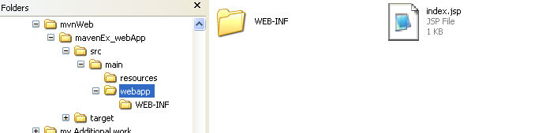
Creating a WAR file
Now let’s see how to create a simple Web application:
Execute the following command in the directory where you want the web application to be created.
The following directory structure will be created

Slide 53
Web Project Create
mvn archetype:generate -DarchetypeArtifactId=Maven-archetype-webapp -DgroupId=com.citi.fundtransfer -DartifactId=CITIMAVENFT

Slide 54

Creating a WAR file (Continued…)
The directory structure created will be as per WAR file.
Maven provides us the required directory structure and template files.
We have to create web pages and place them in the proper locations.
For our application, lets use index.jsp file which is created by default.
Add your contents to index.jsp and save it.
Give following command in the command prompt.
Notes:
Faculty notes:
-Explain to the participants that Maven just creates a web directory structure and template files like web.xml.
-We have to create the web pages and place them in the proper locations

Slide 55
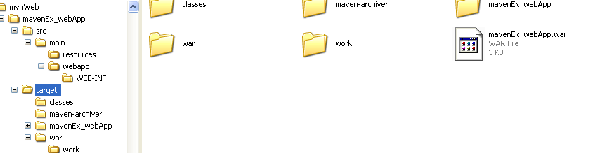
Creating a WAR file (Continued…)
Notice a war file created in the target folder
Deploy the same in a web server and request for index.jsp to see the output

Slide 56
Maven site
Mvn site

Slide 57
Custom library
mvn install:install-file -Dfile=c:\kaptcha-2.3..2.jar -DgroupId=com.google.code
-DartifactId=kaptcha -Dversion=2.3 -Dpackaging=jar
In POM.xml
<dependency>
<groupId>com.google.code</groupId>
<artifactId>kaptcha</artifactId>
<version>2.3.2</version>
</dependency>

Slide 58
Local Repository
{M2_HOME}\conf\setting.xml
<settings>
<!-- localRepository
| The path to the local repository maven will use to store artifacts.
|
| Default: ~/.m2/repository
<localRepository>/path/to/local/repo</localRepository>
-->
<localRepository>D:/maven_repo</localRepository>
<interactiveMode>true</interactiveMode>
<usePluginRegistry>false</usePluginRegistry>
<offline>false</offline>

Slide 59
What is Build Profile?
A Build profile is a set of configuration values, which can be used to set or override default values of Maven build.
Using a build profile, you can customize build for different environments such as Production v/s Development environments.

Slide 60
Types of Build Profile
Type | Where it is defined
Per Project | Defined in the project POM file, pom.xml
Per User | Defined in Maven settings xml file (%USER_HOME%/.m2/settings.xml)
Global | Defined in Maven global settings xml file (%M2_HOME%/conf/settings.xml)

Slide 61
Profile Activation
Explicitly using command console input.
Through maven settings.
Based on environment variables (User/System variables).
OS Settings (for example, Windows family).

Slide 62
Maven: See It
Demonstration:
Faculty will demonstrate how to create a simple Java program using Maven and the Eclipse IDE
Time Allocated: 10 minutes
Environment or File : Eclipse
Steps:
Open Eclipse
Create a new Maven project without using any archetype
Expand the source tree and target tree and provide a walk through.
Open pom.xml and provide a walkthrough
Create a new package com.accenture.adfx.module1.sample
Create a new Java file with a main method printing “Hello World” to the console
Build and Run the file using Maven
Notes:
Faculty Notes:
The objective of this demo is to show how to use Eclipse to create a simple Maven project.
Demonstrate how to create a simple Java project using Maven and Eclipse.
This demo requires Eclipse with Maven Plugin and Maven installed on the laptop.
Open Eclipse
Create a new Maven project without using any archetype.
Expand the source tree and target tree and provide a walk through.
Open pom.xml and provide a walkthrough
Create a new package com.accenture.adfx.module1.sample1
Create a new Java file with a main method printing “Hello World” to the console
Build and Run the file using Maven.
Participant Notes:
Pay attention as your faculty member creates the simple Java project using Maven. You will be asked to create one after this demonstration.

Slide 63
Maven: Try - It
Now Try It:
Create a simple Java project using Maven
Time Allocated: 15 minutes
Environment or File : Eclipse
Steps:
Open Eclipse
Create a new Maven project without using any archetype
Expand and view the source tree and target tree
Open and observe the generated pom.xml
Create a new Java file in the com.accenture.adfx.module1.sample package with a main method printing “Hello World” to the console
Build and Run the file using Maven
Notes:
Faculty Notes:
The fully annotated solution code is found in the Faculty Guide.
Present the task that participants must try themselves.
Walk around the room in case anyone needs assistance.
Participant Notes:
Create a Simple Java project
Open Eclipse
Create a new Maven project without using any archetype.
Expand and observe the source tree and target tree.
Open and observe the generated pom.xml
Create a new package com.accenture.adfx.module1.sample1
Create a new Java file with a main method printing “Hello World” to the console.
Build and Run the file using Maven.

Slide 64

Maven: Activity
Objective:
Create a Maven project using maven-archetype-webapp and learn how to build and package the web application into a war
Time Allocated: 30 min
Environment or File: Eclipse
Instructions:
Open Eclipse
Create a Maven using maven-archetype-webap archetype.
Expand and observe the source tree and target tree.
Open and observe the generated pom.xml
Open index.jsp and modify the default message.
Build the project using Maven.
Package into a war file using Maven.
Deploy and run on tomcat.

Slide 65
Questions

Slide 66
Module Summary
In this module we discussed
Overview of Maven
Maven archetypes
Maven life cycle phases
The pom.xml file
Creation of Java projects using Maven
Creation of war files

