Slide 1
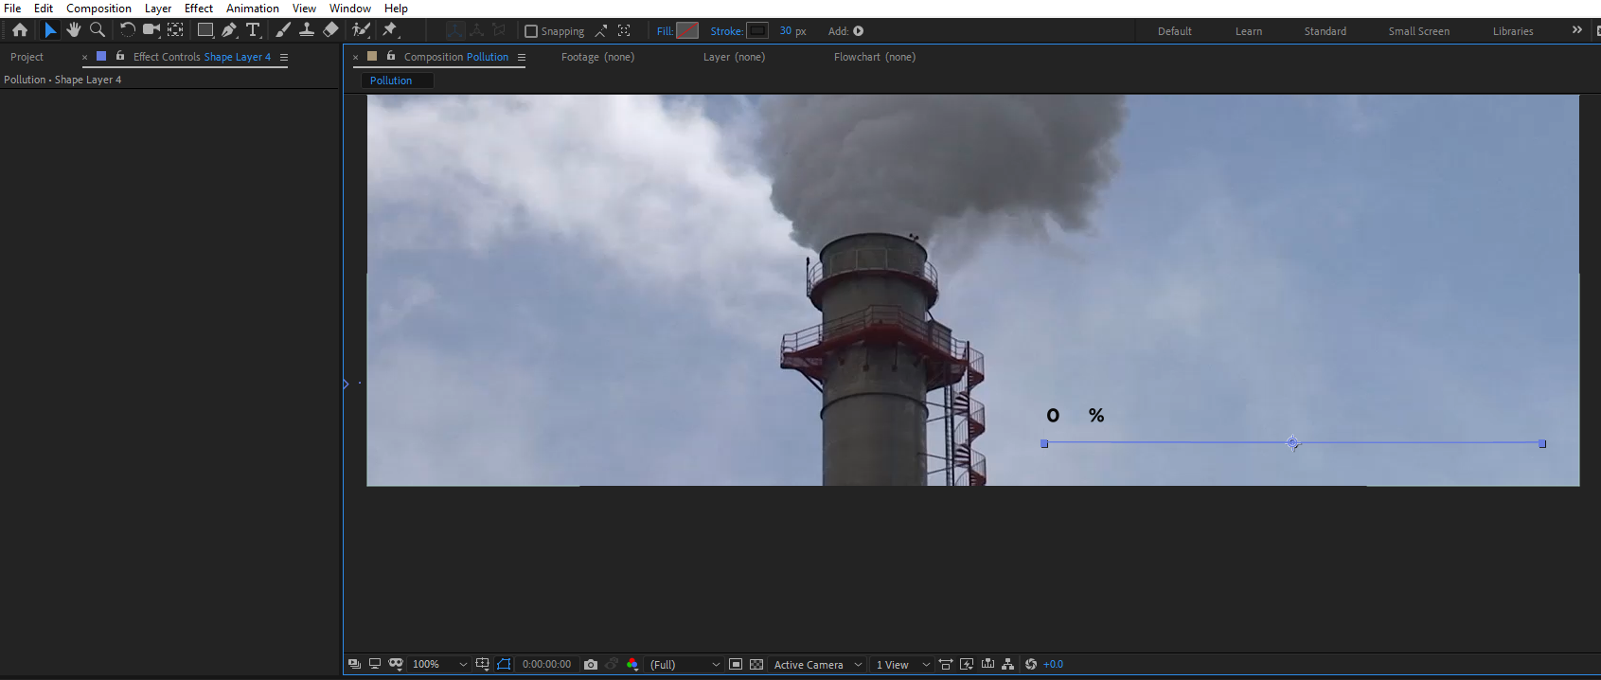
After Effects loader
1. Create new shape layer
2. Draw a line with a pen tool
Set the stroke width as desired 40px/50px...
Select pen tool
and draw a line
First put a single point,by pressing the mouse button (once)
Then put another point in different place on the screen
This process will physically draw a line.

Slide 2
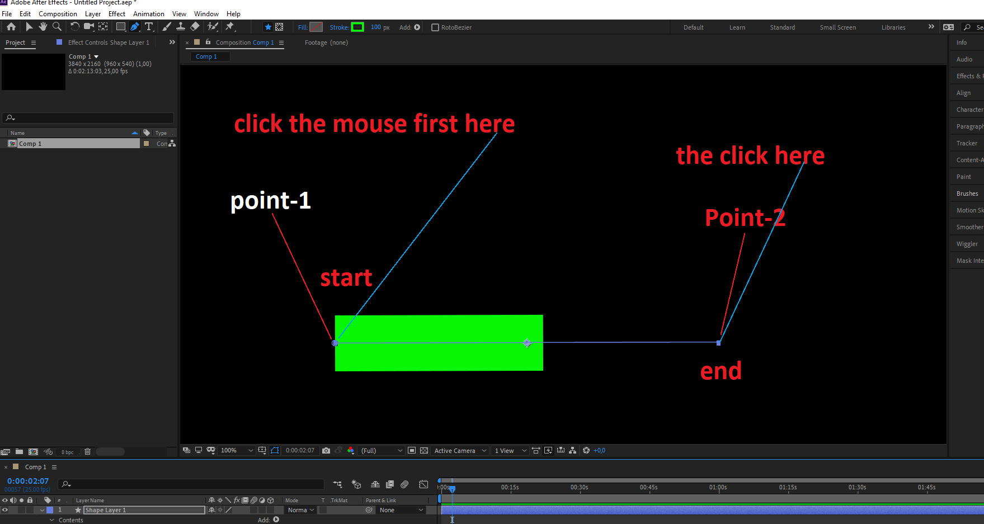
Draw a line: example
n

Slide 3
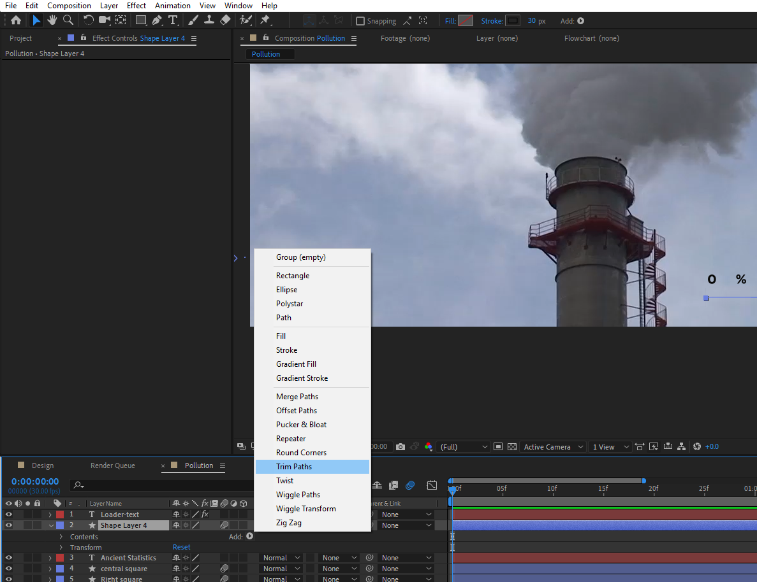
Select the line, expand the dropdown menu
Select trim path from the Add menu
Sep -2

Slide 4
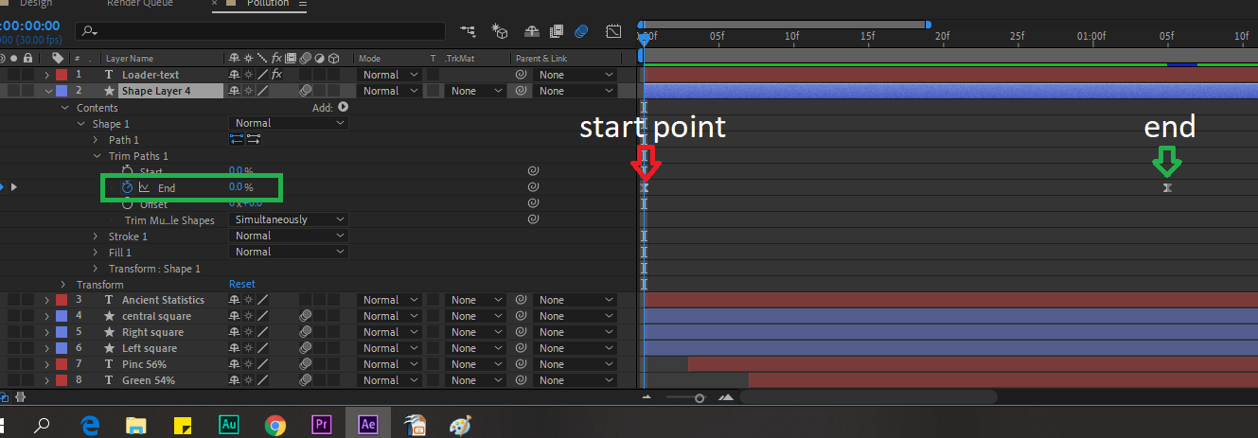
Step 3
Select start, and end keyframes by settting them up on the timeline
Use TrimPath property to set zero on start point
Use TrimPath property to set 100% on the end point
This will animate the line, as simple progress bar being filled from left to right
You can select the keyframes right click and select easy ease from keyframe assistant
for smoothness

Slide 5
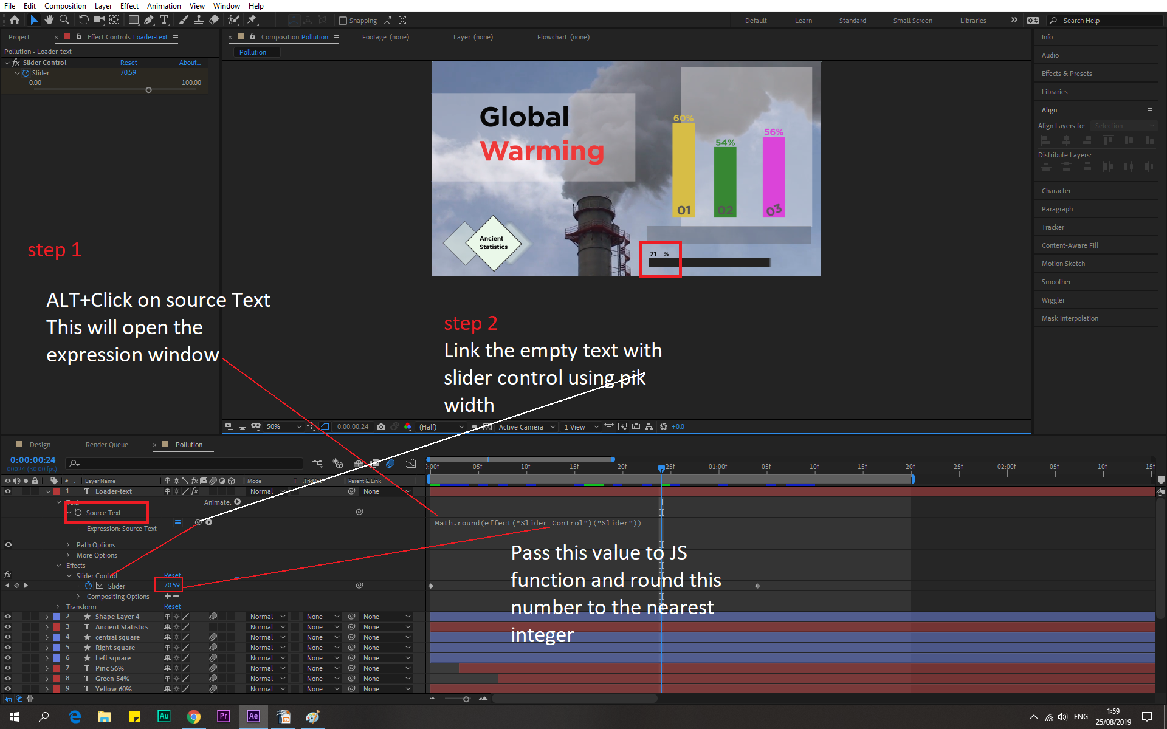
Step 4
Don't forget to create a keyframe on first frame on slider!!!!
Create empty text
2. Apply a slider effect to empty text
3.Add Javascript expression to slider
4.Link empty text with slider effect
5.Apply math.random() JS function to get the right effect
6. Add start+ end keyframes on slider property 0-100%
7.this slider effect will pass the value to empty text via math random function
Math.round(effect("Slider Control")("Slider"))+"%";

