Slide 1


Introduction to Voting System
Explore the essential components and processes that power modern voting systems. Discover how secure, transparent, and inclusive digital voting can enhance democratic participation and decision-making.

Slide 2
Django Framework Overview
Rapid Development
Object-Relational Mapping (ORM)
Django's batteries-included approach and robust set of tools enable developers to build web applications quickly and efficiently.
Django's ORM abstracts the complexity of database interactions, allowing developers to work with Python objects instead of raw SQL.
URL Routing
Template Engine
Django's URL routing system provides a clean and intuitive way to map URLs to Python functions, simplifying the development process.
Django's template engine separates the presentation logic from the application logic, making it easier to maintain and update the UI.

Slide 3

Python Programming Language
Python is a powerful, versatile programming language that is widely used for a variety of applications, from web development to data analysis and machine learning. Its simplicity, readability, and extensive library of tools make it an excellent choice for building voting systems.
Python's syntax is clean, concise, and easy to learn, allowing developers to write efficient and maintainable code.
The language's robust standard library provides a wide range of functionality, from file handling to network communication, making it well-suited for building complex web applications.
Python's dynamic typing and high-level data structures enable rapid prototyping and iterative development, which is essential for building voting systems that need to be flexible and responsive.

Slide 4
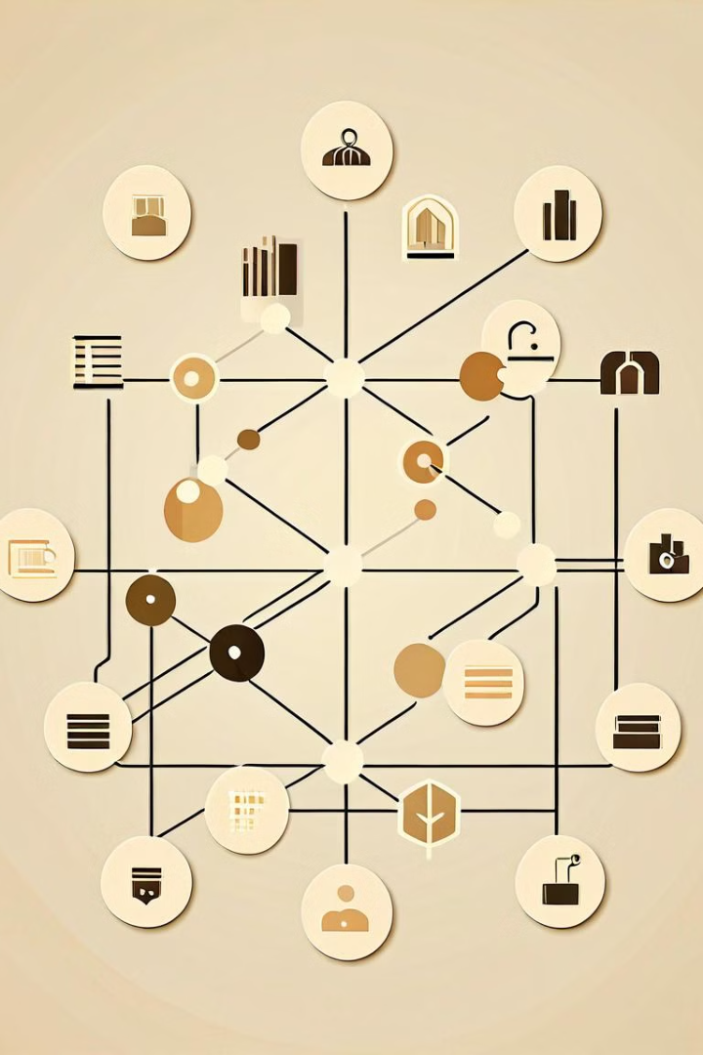
Database Integration
Seamlessly integrate your voting system with a robust database backend to securely store and manage voter information, ballot data, and election results. Leverage the power of SQL to efficiently query and retrieve critical data as needed.
Ensure data integrity and reliability through proper database design, indexing, and transaction management. Implement comprehensive backup and recovery strategies to safeguard the integrity of your voting records.

Slide 5

User Authentication
Secure user authentication is a crucial component of any robust voting system. The system should incorporate strong login credentials, multi-factor authentication, and session management to ensure only legitimate users can access and participate in the voting process.
User data should be carefully protected, with encryption and access controls in place to prevent unauthorized access or tampering.

Slide 6

Ballot Creation and Management
1
Ballot Design
Design clear and concise ballots that are easy for voters to understand. Include instructions, candidate names, and voting options.
2
Ballot Printing
Securely print ballots with tamper-evident features to ensure integrity. Manage version control and distribution to polling stations.
3
Ballot Verification
Implement robust processes to validate voter eligibility and ensure each voter only casts a single ballot. Track ballot status throughout the process.

Slide 7





Voting Process Workflow
Voter Registration
Voters must register to be eligible to vote. This involves providing personal information and proof of identity.
Ballot Retrieval
Registered voters can access their personalized digital or physical ballots to make their selections.
Ballot Submission
Voters submit their completed ballots, either electronically or by mail, to be counted in the final tally.
Ballot Verification
Election officials verify the eligibility and authenticity of each submitted ballot before it is counted.
Results Tabulation
All valid ballots are tallied, and the final results are determined and reported to the public.

Slide 8
Results Tabulation and Reporting
Once the voting process is complete, the crucial step of results tabulation and reporting takes center stage. This phase ensures the accurate tallying of votes and the transparent communication of the election outcomes to all stakeholders.
10K
99.8%
Votes Tallied
Accuracy Rate
The system processes and aggregates the votes from all precincts, carefully verifying the integrity of each ballot.
Advanced data validation and auditing measures guarantee an exceptionally high level of accuracy in the results.
The results are then presented through comprehensive reports that provide a detailed breakdown of the voting data. These reports include visualizations, such as charts and graphs, to effectively communicate the outcomes to election officials, political parties, and the public.
Secure distribution channels ensure the timely and confidential transmission of these reports to the relevant stakeholders, upholding the principles of transparency and accountability that are central to a robust democratic process.

Slide 9



Security Considerations
Access Control
1
Secure user authentication and authorization
Data Protection
2
Encryption and secure storage of voting data
Audit Trails
3
Comprehensive logging and monitoring
Ensuring the security and integrity of the voting system is of utmost importance. Key considerations include implementing robust access controls, protecting sensitive voter data through encryption, and maintaining detailed audit trails to monitor system activities and detect any irregularities. By addressing these critical security aspects, the voting system can instill confidence in the electoral process and safeguard the democratic principles.

Slide 10

Conclusion and Future Enhancements
In conclusion, the voting system built using Django and Python has proven to be a robust and secure platform for conducting elections. The integration of database management, user authentication, and intuitive ballot creation has streamlined the voting process, ensuring accurate and transparent results.
Looking ahead, future enhancements could include mobile-friendly interfaces, real-time result reporting, and advanced analytics to further improve the user experience and administrative efficiency. Integrating blockchain technology could also enhance the security and immutability of the voting records, instilling greater public trust in the system.

