Slide 1
Model Selection

Slide 2
Data Set

Slide 3
Data Set
Train/Test Split
Training Set
Test Set
70%
30%

Slide 4
Data Set
Training Set
70%

Slide 5
Training Set

Slide 6
K-fold Cross Validation
Training Set

Slide 7
10-fold Cross Validation
1 | 2 | 3 | 4 | 5 | 6 | 7 | 8 | 9 | 10

Slide 8
10-fold Cross Validation
1 | 2 | 3 | 4 | 5 | 6 | 7 | 8 | 9 | 10
validation set

Slide 9
10-fold Cross Validation
1 | 2 | 3 | 4 | 5 | 6 | 7 | 8 | 9 | 10
1 | 2 | 3 | 4 | 5 | 6 | 7 | 8 | 9 | 10
validation set

Slide 10
10-fold Cross Validation
1 | 2 | 3 | 4 | 5 | 6 | 7 | 8 | 9 | 10
1 | 2 | 3 | 4 | 5 | 6 | 7 | 8 | 9 | 10
1 | 2 | 3 | 4 | 5 | 6 | 7 | 8 | 9 | 10
validation set

Slide 11
10-fold Cross Validation
1 | 2 | 3 | 4 | 5 | 6 | 7 | 8 | 9 | 10
1 | 2 | 3 | 4 | 5 | 6 | 7 | 8 | 9 | 10
1 | 2 | 3 | 4 | 5 | 6 | 7 | 8 | 9 | 10
1 | 2 | 3 | 4 | 5 | 6 | 7 | 8 | 9 | 10
1 | 2 | 3 | 4 | 5 | 6 | 7 | 8 | 9 | 10
1 | 2 | 3 | 4 | 5 | 6 | 7 | 8 | 9 | 10
1 | 2 | 3 | 4 | 5 | 6 | 7 | 8 | 9 | 10
1 | 2 | 3 | 4 | 5 | 6 | 7 | 8 | 9 | 10
1 | 2 | 3 | 4 | 5 | 6 | 7 | 8 | 9 | 10
1 | 2 | 3 | 4 | 5 | 6 | 7 | 8 | 9 | 10

Slide 12
10-fold Cross Validation
1 | 2 | 3 | 4 | 5 | 6 | 7 | 8 | 9 | 10
.69
1 | 2 | 3 | 4 | 5 | 6 | 7 | 8 | 9 | 10
.64
1 | 2 | 3 | 4 | 5 | 6 | 7 | 8 | 9 | 10
.73
1 | 2 | 3 | 4 | 5 | 6 | 7 | 8 | 9 | 10
.82
1 | 2 | 3 | 4 | 5 | 6 | 7 | 8 | 9 | 10
.64
1 | 2 | 3 | 4 | 5 | 6 | 7 | 8 | 9 | 10
.70
1 | 2 | 3 | 4 | 5 | 6 | 7 | 8 | 9 | 10
.68
1 | 2 | 3 | 4 | 5 | 6 | 7 | 8 | 9 | 10
.71
1 | 2 | 3 | 4 | 5 | 6 | 7 | 8 | 9 | 10
.70
1 | 2 | 3 | 4 | 5 | 6 | 7 | 8 | 9 | 10
.69

Slide 13
10-fold Cross Validation
1 | 2 | 3 | 4 | 5 | 6 | 7 | 8 | 9 | 10
.69
1 | 2 | 3 | 4 | 5 | 6 | 7 | 8 | 9 | 10
.64
1 | 2 | 3 | 4 | 5 | 6 | 7 | 8 | 9 | 10
.73
1 | 2 | 3 | 4 | 5 | 6 | 7 | 8 | 9 | 10
.82
1 | 2 | 3 | 4 | 5 | 6 | 7 | 8 | 9 | 10
.64
1 | 2 | 3 | 4 | 5 | 6 | 7 | 8 | 9 | 10
.70
1 | 2 | 3 | 4 | 5 | 6 | 7 | 8 | 9 | 10
.68
1 | 2 | 3 | 4 | 5 | 6 | 7 | 8 | 9 | 10
.71
1 | 2 | 3 | 4 | 5 | 6 | 7 | 8 | 9 | 10
.70
1 | 2 | 3 | 4 | 5 | 6 | 7 | 8 | 9 | 10
.69

Slide 14
Logistic Regression
Fold 1 | Fold 2 | Fold 3 | Fold 4 | Fold 5 | Fold 6 | Fold 7 | Fold 8 | Fold 9 | Fold 10 | Mean
.69 | .64 | .73 | .82 | .64 | .70 | .68 | .71 | .70 | .69 | .70

Slide 15
Logistic Regression
Fold 1 | Fold 2 | Fold 3 | Fold 4 | Fold 5 | Fold 6 | Fold 7 | Fold 8 | Fold 9 | Fold 10 | Mean
.69 | .64 | .73 | .82 | .64 | .70 | .68 | .71 | .70 | .69 | .70

Slide 16
Logistic Regression
Fold 1 | Fold 2 | Fold 3 | Fold 4 | Fold 5 | Fold 6 | Fold 7 | Fold 8 | Fold 9 | Fold 10 | Mean
.69 | .64 | .73 | .82 | .64 | .70 | .68 | .71 | .70 | .69 | .70

Slide 17
Logistic Regression
Fold 1 | Fold 2 | Fold 3 | Fold 4 | Fold 5 | Fold 6 | Fold 7 | Fold 8 | Fold 9 | Fold 10 | Mean
.69 | .64 | .73 | .82 | .64 | .70 | .68 | .71 | .70 | .69 | .70

Slide 18






















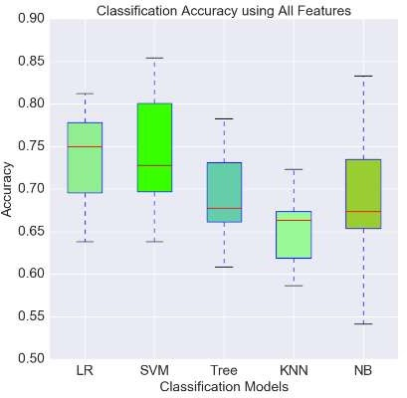

0.705

Slide 19
Model Evaluation Metrics

Slide 20


































Slide 21
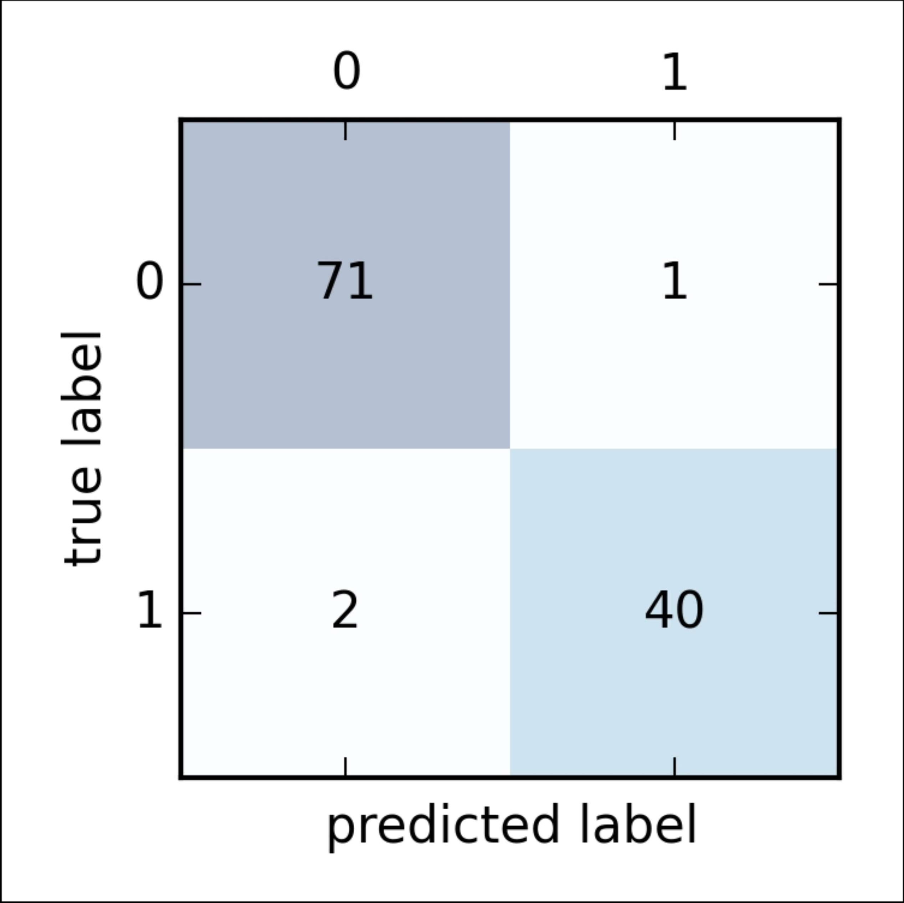
true class

Slide 22










true class

Slide 23









true class

Slide 24
Accuracy
true class

Slide 25
Precision
true class

Slide 26
Recall
true class

Slide 27








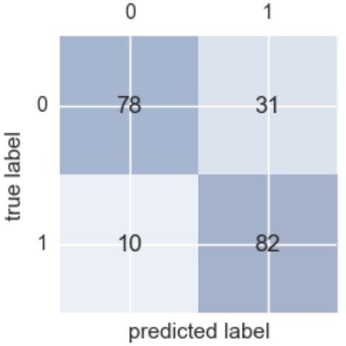




Slide 28




Slide 29




Slide 30
















Slide 31
Fraudulent Transactions

Slide 32
Fraudulent Transactions
The average merchant experiences 156 successful fraudulent transactions per month.
The average value of a fraudulent transaction is $114

Slide 33

Fraudulent Transactions

Slide 34

Fraudulent Transactions

Slide 38
Accuracy

Slide 39
Accuracy
99%

Slide 41
Precision

Slide 42
Precision
20%

Slide 43
Precision
20%
Recall

Slide 44
Precision
20%
Recall
100%

Slide 45
Precision
20%
Recall
100%

Slide 46
Online Dating

Slide 47
Online Dating
1 in 5 relationships (20%) begins online
17% of marriages in the U.S. begin online
The most popular online dating site is match.com with 23.5 million users
eHarmony is responsible for 4% of all marriages in the U.S.

Slide 48


Slide 49


Slide 51
Precision

Slide 52
Precision
50%

Slide 53
Precision
50%
Recall

Slide 54
Precision
50%
Recall
33%

Slide 55
Precision
50%
Recall
33%

Slide 56
Full Training Set
1 | 2 | 3 | 4 | 5 | 6 | 7 | 8 | 9 | 10

Slide 57
Data Set
Training Set
Test Set
70%
30%

Slide 58
Data Set
Training Set
Test Set
30%

Slide 59
Full Data Set
Training Set
Test Set
100%

