Slide 1
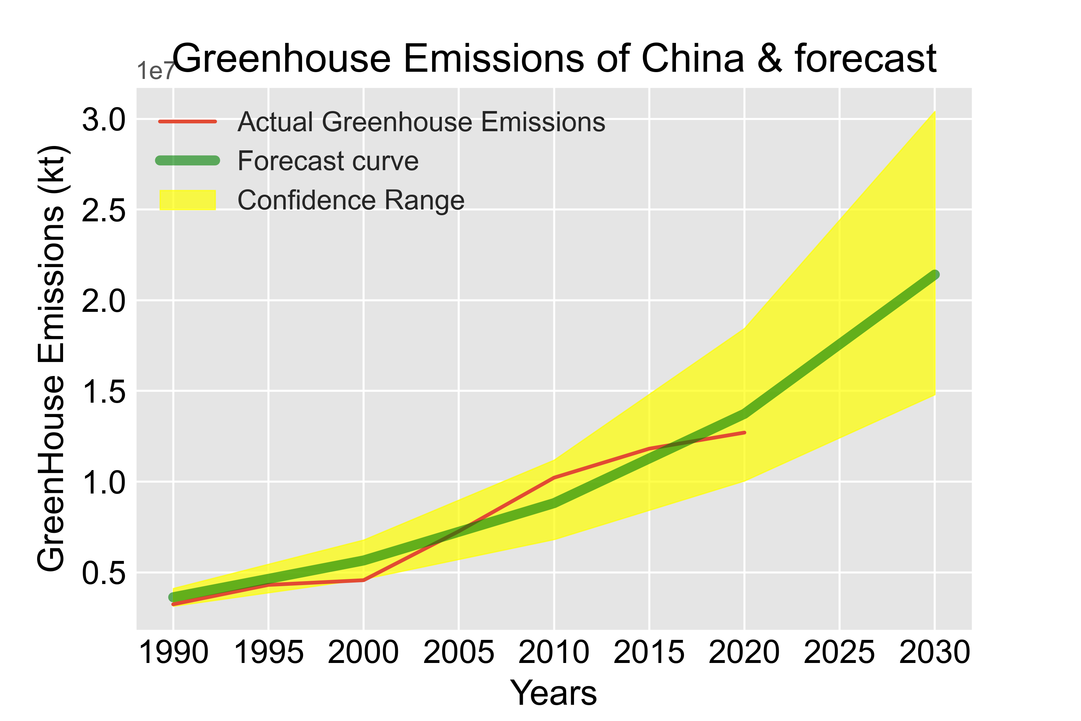
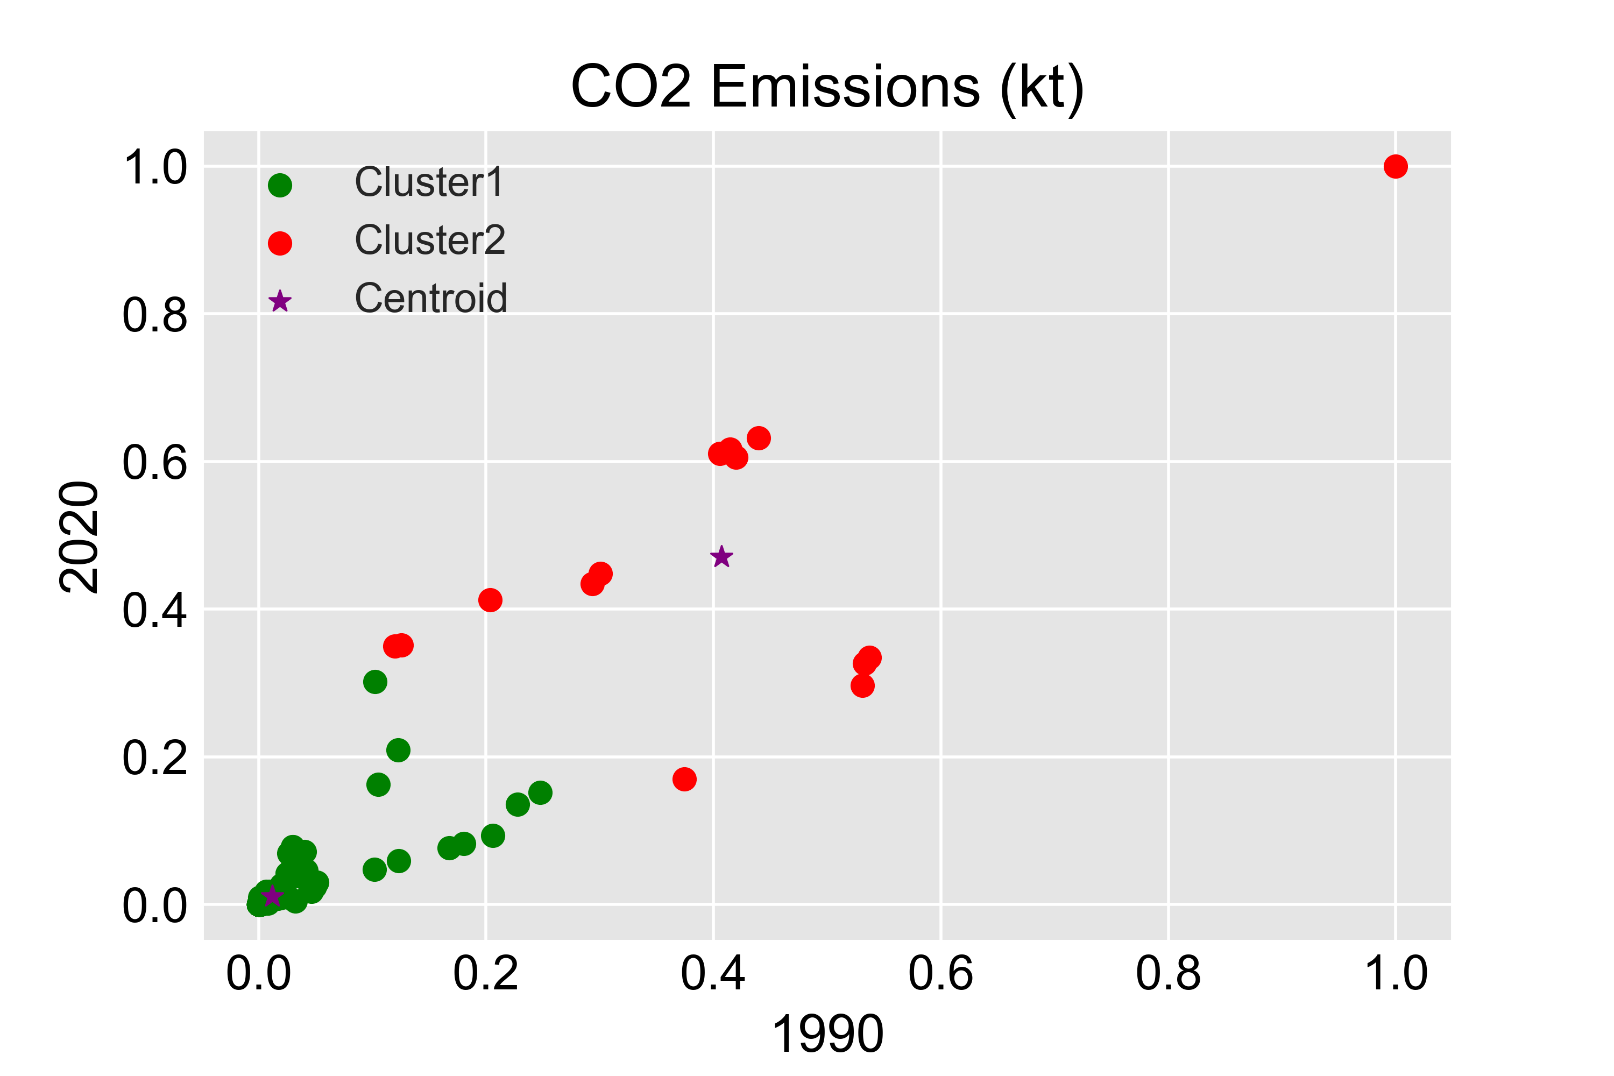
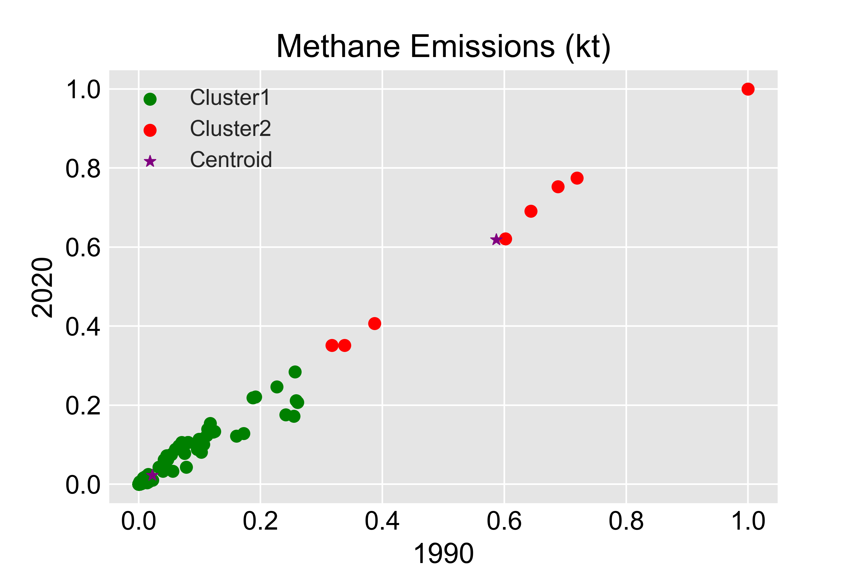
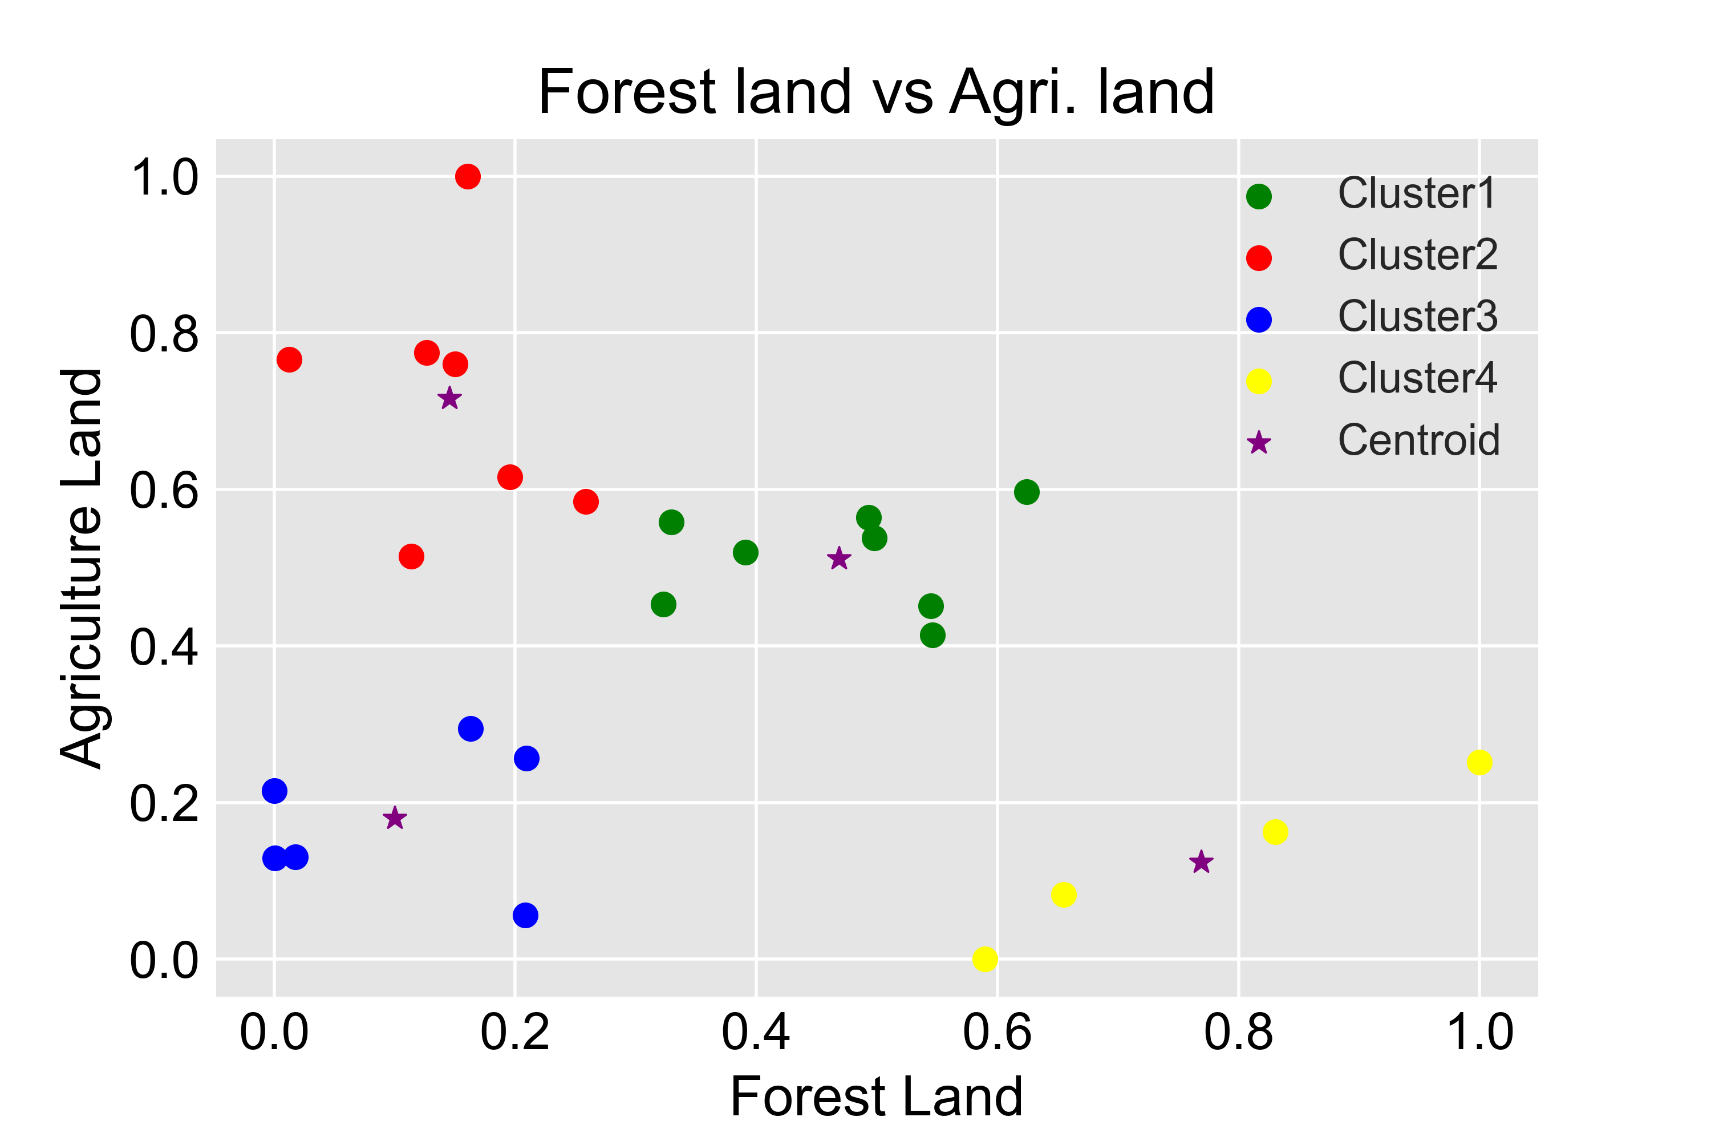
Analysis on climate change
Antony Roy Nellangara, (GITHUB LINK)
Abstract
Climate change is one of the most dangerous issues that threatens this planet’s existence. The main aim of this analysis is to investigate different factors that causes climate change and also forecast the future performance of certain factors. The aim is also to figure out how and what factors have to be considered to prevent or stop climate change.
Introduction
The factors selected for analysis are Total Greenhouse gasses emission, Carbon dioxide emissions, Methane emissions and percentage of forest land and agricultural land. Countries will be grouped into different clusters to analyze the clusters and understand the clusters. Forecast of China’s greenhouse gasses emission will be calculated and analyzed and methods to prevent the greenhouse gas emissions for China will also be suggested.
Forecast of China’s Greenhouse Emission
China is one of the biggest manufacturing superpowers in the world and as a result has very high greenhouse gasses emission. The values for the greenhouse gasses emission for China have risen drastically from the year 1990 to 2020. This shows that China has taken very poor measures against climate change and is contributing majorly to it. The forecast for the same for China shows that China will continue to emit more greenhouse gasses over the next 10 years. Heavy industrialization and dependency of China on fossil fuels are some of the major reasons why China has failed miserably to work against climate change and as a result China has some of the most polluted and populated cities in the world. The forecast indicates that China will not be slowing down. Forecast here has been calculated using an exponential function and curve_fit.
Factor 1 : CO2 Emissions (kt)
Factor 2 : Methane Emissions (kt)
Factor 3 : Forest vs Agri. Land
CO2 Emissions can be due to the use of fossil fuels and also as a result of deforestation. It can be observed that some countries in the green cluster had a low CO2 emission in 2020 and in 1990 and almost all the countries in the red cluster have a very high CO2 emission in 1990 and 2020 which is very bad.
Methane Emissions can be due to the use and transport of coal, natural gas and oil. It can be observed that for the countries in the green cluster, methane emission was very low in 1990 and 2020. For the countries in the red cluster, it can be observed that the methane emission is very high in both 1990 and 2020 compared to the countries in green cluster. .
Forest Land and agricultural land play a very important role in climate change. Deforestation of forest land and conversion of forest land into agricultural land can lead to increase in the greenhouse gasses emission. Countries in the red cluster has a large amount of agricultural land compared to countries in the blue cluster.
Conclusion
From the above visualizations, it can be concluded that most of the world countries still have to work really hard to bring down the Greenhouse gasses emission levels, CO2 emissions levels and Methane emission levels. Forecast for greenhouse gas emissions for China also conveys that China should immediately take preventive measures to bring it down. Switching to cleaner energy, afforestation, reducing the dependency on fossil fuels are some of the measures that can prevent climate change.

