Slide 2
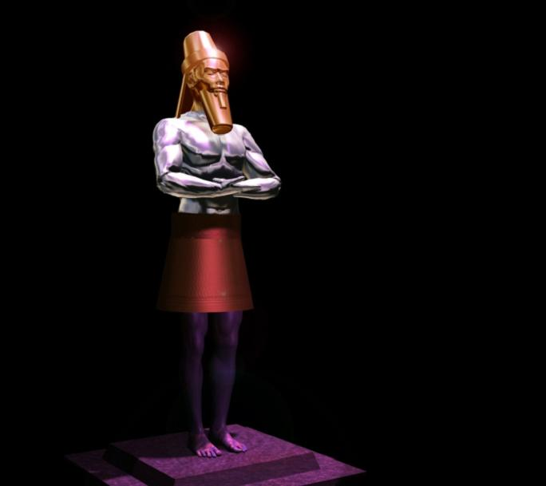
Daniel & The King!
A Mysterious Dream
Part 2

Slide 3
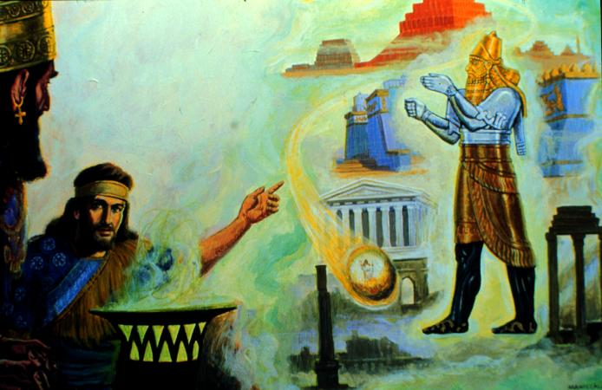
Daniel and his friends prayed and God showed Daniel the dream. He went before the king and told him the dream.
“Thou, O king, sawest, and behold a great image. This great image, whose brightness was excellent, stood before thee; and the form thereof was terrible. This image's head was of fine gold, his breast and his arms of silver, his belly and his thighs of brass, His legs of iron, his feet part of iron and part of clay.” Daniel 2:31-33

Slide 4
“Thou sawest till that a stone was cut out without hands, which smote the image upon his feet that were of iron and clay, and brake them to pieces. Then was the iron, the clay, the brass, the silver, and the gold, broken to pieces together, and became like the chaff of the summer threshingfloors; and the wind carried them away, that no place was found for them: and the stone that smote the image became a great mountain, and filled the whole earth.” Daniel 2:34, 35

Slide 5
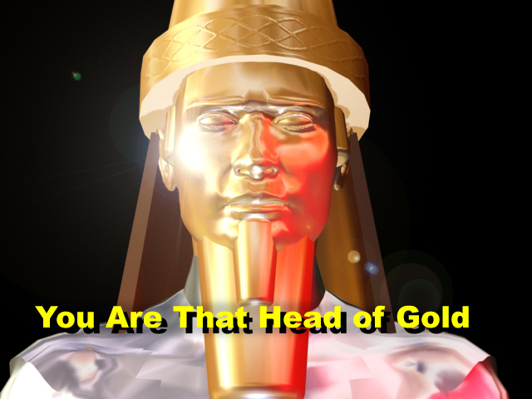
“This is the dream; and we will tell the interpretation thereof before the king. Thou, O king, art a king of kings: for the God of heaven hath given thee a kingdom, power, and strength, and glory. And wheresoever the children of men dwell, the beasts of the field and the fowls of the heaven hath he given into thine hand, and hath made thee ruler over them all. Thou art this head of gold. And after thee shall arise another kingdom inferior to thee, and another third kingdom of brass, which shall bear rule over all the earth.” Daniel 2:36 - 39

Slide 6
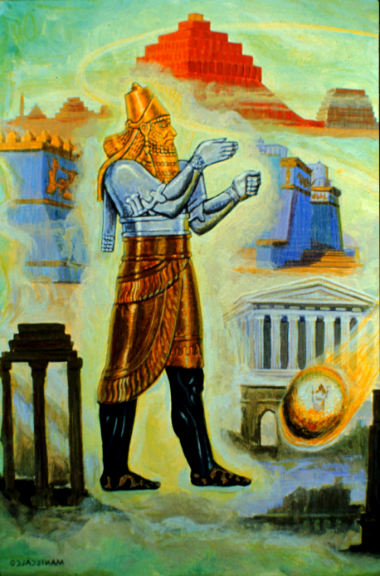
“And the fourth kingdom shall be strong as iron: forasmuch as iron breaketh in pieces and subdueth all things: and as iron that breaketh all these, shall it break in pieces and bruise. And whereas thou sawest the feet and toes, part of potters' clay, and part of iron, the kingdom shall be divided; but there shall be in it of the strength of the iron, forasmuch as thou sawest the iron mixed with miry clay.” Daniel 2:40 - 41

Slide 7
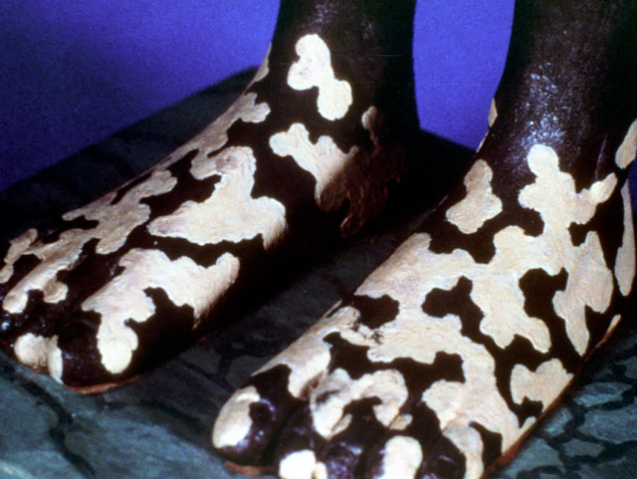
“And as the toes of the feet were part of iron, and part of clay, so the kingdom shall be partly strong, and partly broken. And whereas thou sawest iron mixed with miry clay, they shall mingle themselves with the seed of men: but they shall not cleave one to another, even as iron is not mixed with clay.” Daniel 2:42 - 43

Slide 8
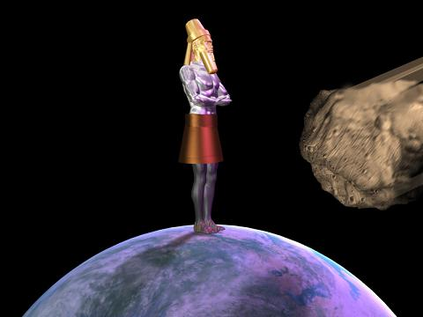
“And in the days of these kings shall the God of heaven set up a kingdom, which shall never be destroyed: and the kingdom shall not be left to other people, but it shall break in pieces and consume all these kingdoms, and it shall stand for ever.” Daniel 2:44

Slide 9
“Forasmuch as thou sawest that the stone was cut out of the mountain without hands, and that it brake in pieces the iron, the brass, the clay, the silver, and the gold; the great God hath made known to the king what shall come to pass hereafter: and the dream is certain, and the interpretation thereof sure.” Daniel 2:45

Slide 10
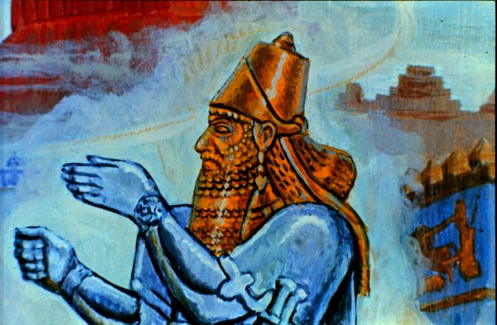
The head of gold represented Nebuchadnezzar's kingdom, Babylon. He was the head of gold.

Slide 11
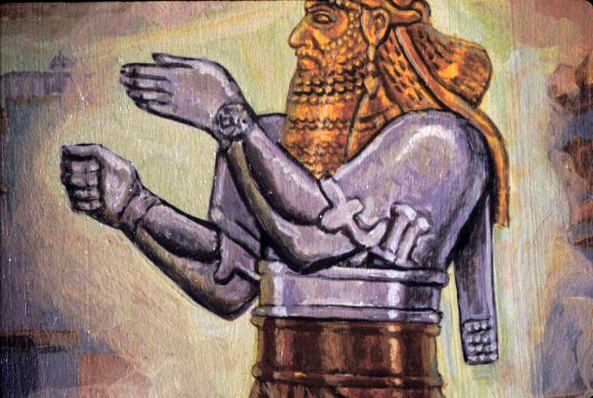
The silver chest and arms was the Medo-Pesian empire. It was to be inferior to Babylon and would rise up after it.

Slide 12
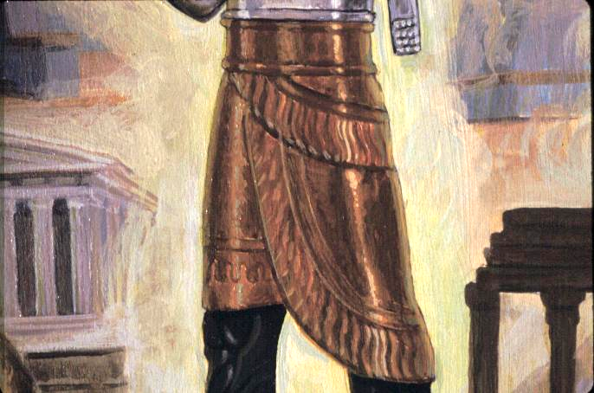
The third kingdom, Greece, was represented by the brass waist and thighs. It would bear rule over all the earth.

Slide 13
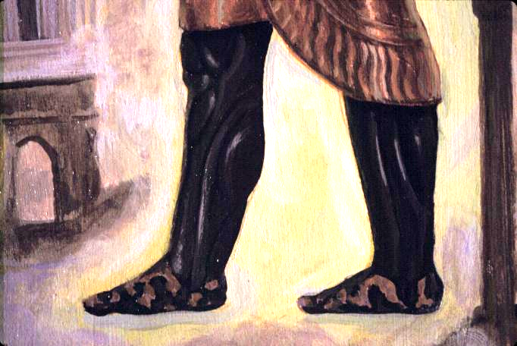
The fourth kingdom, Rome, was to be as strong as iron and would damage and destroy everything. It would then be divided, which is represented by the feet and toes made of part of potters' clay and part of iron. These two can’t be mixed together as one, just like the world today.

Slide 14
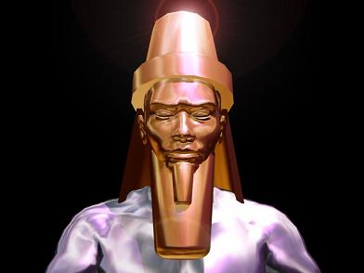
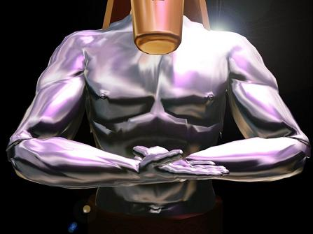
Each of the four empires of this prophecy, was to fall, and be succeeded by another ruling power.
1. The gold kingdom of Babylon: 606 - 538BC
No other nation was as rich in gold as was Babylon, gold was used everywhere. Also Babylon was ruled over by a strong leader, or head, and it was the first of what history knows as the Four Great Monarchies.
2. The silver kingdom of Persia: 538 - 331BC
Medo-Persia used silver almost exclusively and held it in higher esteem than even gold. They used silver in their ornaments, house-hold items and as a medium of exchange. The two arms and body represents the two kingdoms of the Medes and Persians joined together into one body to take over Babylon.

Slide 15
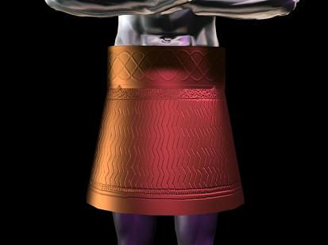
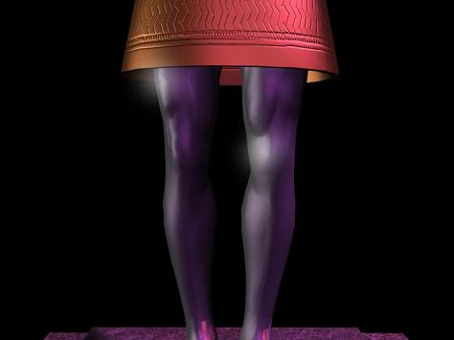
3. The brass kingdom of Greece: 331 – 168BC
The brazen armour and brass breastplates worn by the Grecian soldiers are reflected in the brass thighs of the image. The Greeks widely used brass in the construction of their buildings, temples, and statues as well.
4. The iron kingdom of Rome: 168BC - 476AD
The Romans mastered iron forging; they used it to make their swords, shields and other implements of war. Rome ruled like iron as well, braking in pieces, bruising, and subduing kingdoms for nearly six hundred years. Jesus was born in this era and was crucified under Rome's authority. The legs are also representative of both the way Rome trampled over all nations and the distance they covered.

Slide 16
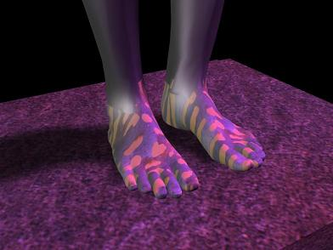
The divided kingdoms of clay and iron: 476AD -
Rome was divided into ten separate kingdoms; some were weak and some were strong, just like iron and clay. These kingdoms have been taken over and have over taken each other, but they have never been able to mix together into one strong nation. The feet are also a good visual representation, showing us that the balance of the weight of earth’s history is being held up by the feet, which are weakened through corruption.

Slide 17
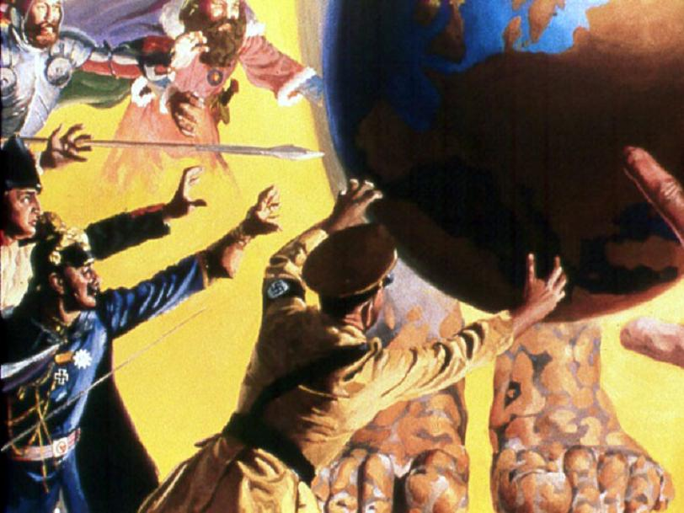
"They shall not cleave one to another."

Slide 18
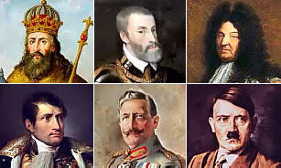
Since the division of Rome, there has been conquest after conquest to unit the ten kingdoms under one rule. The efforts of rulers such as Charlemagne, Charles V, Louis XIV, Napoleon, Kaiser Wilhelm, and Hitler to unite these European nations under one head have all ultimately failed. The prophecy says that these countries will never be permanently united: “They shall not cleave one to another.” Even when the ruling monarchs tried marriage to unite their interests; it still did not work.

Slide 19
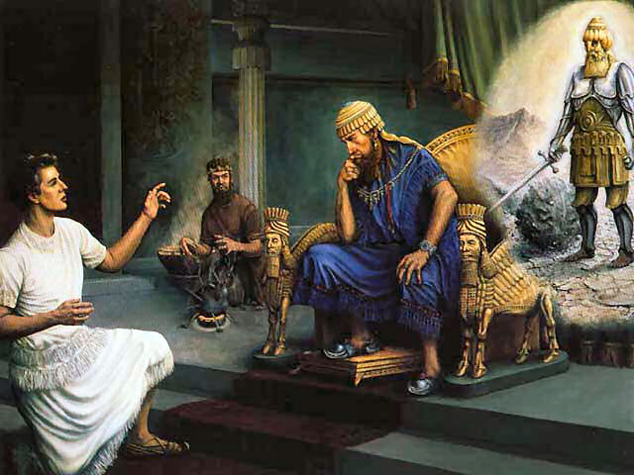
“Then the king Nebuchadnezzar fell upon his face, and worshipped Daniel, and commanded that they should offer an oblation and sweet odours unto him. The king answered unto Daniel, and said, Of a truth it is, that your God is a God of gods, and a Lord of kings, and a revealer of secrets, seeing thou couldest reveal this secret.” Daniel 2:46,47

Slide 20
“Then the king made Daniel a great man, and gave him many great gifts, and made him ruler over the whole province of Babylon, and chief of the governors over all the wise men of Babylon. Then Daniel requested of the king, and he set Shadrach, Meshach, and Abednego, over the affairs of the province of Babylon: but Daniel sat in the gate of the king..” Daniel 2:48,49

Slide 21
This is one of the most ancient prophecies in the history of man upon the earth. It is astonishing in its simplicity and startling in its accuracy. No man could have formulated it. It is one of the evidences we have that there is a GOD, and that the Bible is truly inspired by the Spirit of God!

Slide 22
Three World Kingdoms followed Babylon: No more, and no less. Medo-Persia, Greece, then Rome. Each of them was inferior in splendor to the one before it. Then Rome was divided - not followed by another world empire. And to this day it remains divided. "They shall not cleave one to another", says the scriptures and they don’t!

Slide 23
Iron and Clay
In this mixture of metal and mud we see a very unnatural situation, the strength of the iron is undermined by the brittleness of clay and the fact that they do not even stick together makes it even worse. But there is a deeper meaning in this symbol and we learn much by looking into it.
Iron is used in the Bible as a symbol of ruling power. (see: Psalms 2:9; Revelation 2:27) It stands for Civil or State power.

Slide 24
Iron and Clay
Clay is used in a figurative way in describing God’s people or church.
Isaiah 64:8; “But now, O LORD, thou art our father; we are the clay, and thou our potter; and we all are the work of thy hand.” (Also see: Jeremiah 18:1-6)
But here we do not see just clay; we are told it is miry or dirty clay. Miry clay denotes filthy or corrupted churches.

Slide 25
Iron and Clay
The combination of the iron and miry clay represents the mingling of State-craft and Priest-craft which is an abomination to God. The feet come into history at the time of the beginning of the Papal supremacy of the 1260 years where the church ruled the secular governments and used them for her own corrupt ends.

Slide 26
Ten Kingdoms; Ten Toes??
The ten toes are also of this same material and our attention is called to them by the explicit mention of them in the prophecy. The Roman kingdom was finally divided into ten parts. However the ten toes of the image do not represent the ten divisions of the Roman Empire. We know this because in the division of the Roman Empire, three kingdoms were removed leaving only seven. This we do not see in the ten toes.

Slide 27
Daniel & Revelation: One Book
Daniel and Revelation are actually one prophetic book with the first part having been given by Christ to Daniel and the second part having been given by Christ to John on Patmos. Any attempts to truly understand these prophetic books separately will yield poor results. In Revelation 17 we see a beast with seven heads and ten horns. The seven heads correspond with the seven kingdoms of the earth and the ten horns here are described:

Slide 28
Ten Kings: One Kingdom
“And the ten horns which thou sawest are ten kings, which have received no kingdom as yet; but receive power as kings one hour with the beast.” Revelation 17:12
At the end of time there will be a confederacy of ruling powers that will have one mind and will give their power to the Beast for a short time. These correspond with the ten toes on the Image of Daniel 2. They are not ten kingdoms, but one kingdom with ten kings.

Slide 29
This dream has been fulfilled exactly so far!

Slide 30
Christ’s Kingdom
The stone is ‘cut out without hands’. His kingdom is not earthly, not set up by man's power. The kingdoms of man are swept out of existence ‘like the chaff from the summer threshing-floor’. This 'Stone' is 'cut out of the 'Mountain' --what is this 'Mountain'? In Daniel 11:45 we read of a 'Glorious Holy Mountain'--this represents God's people. From them a final group will be 'cut out' by the guidance and power of the Holy Spirit. In Revelation we see them called 'the 144,000'.

Slide 31
Christ’s Kingdom
The ‘Stone, cut out without Hands’ represents this final generation of God’s faithful who will be prepared by God to carry forth an important work in the final hours of earth’s history. They carry forth the final message of mercy and warning that leads quickly to the Second Coming of Christ to take His faithful home. We need to be making the choices that will allow us to be among this group that Christ will use to finally bring this earth's sordid history to a close.

Slide 32
Christ’s Kingdom
Do you choose to be among them? God promises: “If ye be Christ’s, then are ye Abraham’s seed, and heirs according to the promise.” Galatians 3:29. Do you have a covenant relationship with Christ, the coming King? Do you love His character which is described in His Law? Are you choosing to walk humbly in His footsteps, and, by His enabling grace, obey His laws and His teachings?

Slide 33
Christ’s Kingdom
There is to be no rival kingdom where you can go if you remain an enemy to Jesus, for God’s kingdom is to occupy all the territory ever possessed by any and all of the kingdoms of this world, past or present. It is to fill the whole earth. Happy are they to whom the rightful Sovereign, the all-conquering King, at last can say, “Come, ye blessed of My Father, inherit the kingdom prepared for you from the foundation of the world.” Matthew 25:34.

Slide 34
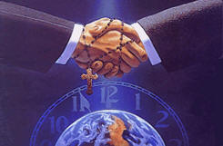
There are world-wide plans for a "One World Government“ uniting the civil and religious powers. It is in the process now of being implemented, and it will be like the Dark Ages all over again!! As the Bible Says in Isaiah 3:5:
“And the people shall be oppressed, every one by another, and every one by his neighbour: the child shall behave himself proudly against the ancient, and the base against the honourable.”

Slide 35
There will be no safety anywhere because everyone will spy on his neighbor. IT WILL CLAIM TO BE SUCCESSFUL FOR A SHORT WHILE, BUT it will fail. "They shall not cleave one to another," says God’s word. The ‘Stone cut out without hands’, will soon put an end to man’s cruel and proud tyranny over his fellow man.

Slide 36
This Final Generation of God's Faithful ones will be a people who have turned from sin and rebellion to totally love, honor and obey God. They will stand in the last generation as a wonder to behold—a small group of faithful people showing the character of Jesus in a world gone crazy with pride and rebellion. We must choose to be among them--because when Jesus comes, only they, with the resurrected righteous dead, will go home with Jesus!

Slide 37
Jesus will come for His children who have obeyed His word and accepted His salvation. We must be ready for this coming! All signs foretold indicate it must be soon! Now is the time to seek the Lord with all our hearts and He promises to be found of us--as we study His Word and practice obeying what we learn, He will lead us to be ready to meet Him in peace on that day!

Slide 38
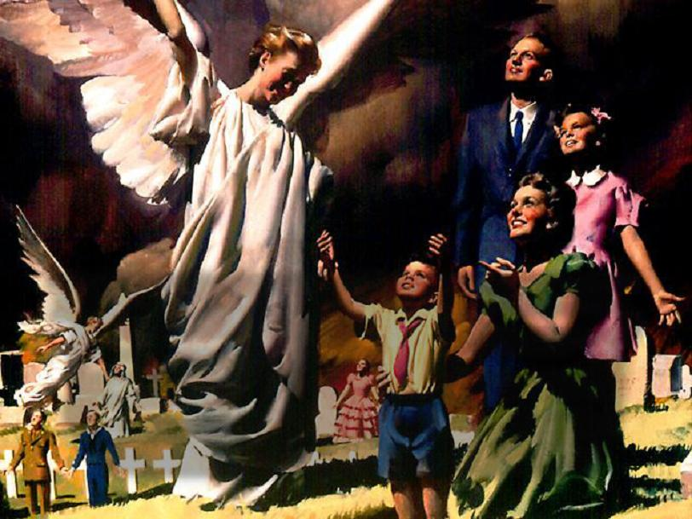
These faithful ones will meet Jesus in the air.
The wicked will perish.
The righteous dead will rise.
They will all go Home together with Jesus!

Slide 39
Jesus will take His people to Heaven.
Will you be there?

Slide 40
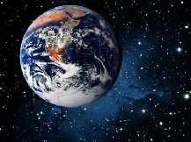
No human will be left alive on this earth!
Where will you be?

Slide 41
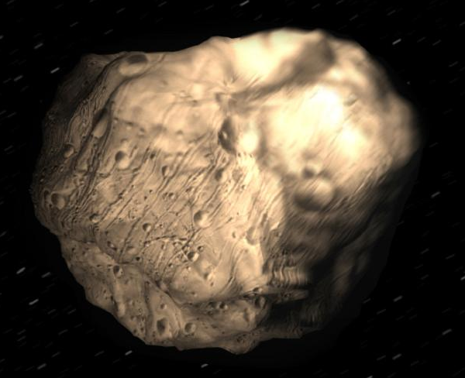
Now is the time to decide!

