Slide 2


Daniel & The Lion’s Den !
Is Your God Able?

Slide 3
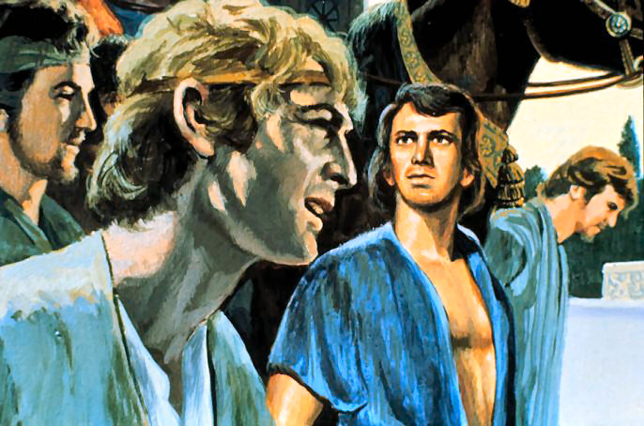
It had been a long time since the boy Daniel was brought to Babylon as a slave by Prince Nebuchadnezzar. He had served long and faithfully and was now well up in years. Having just been made chief ruler in the kingdom just before Belshazzar's death had brought him to the attention of the conquering ruler Darius, placed over the city by Cyrus.

Slide 4
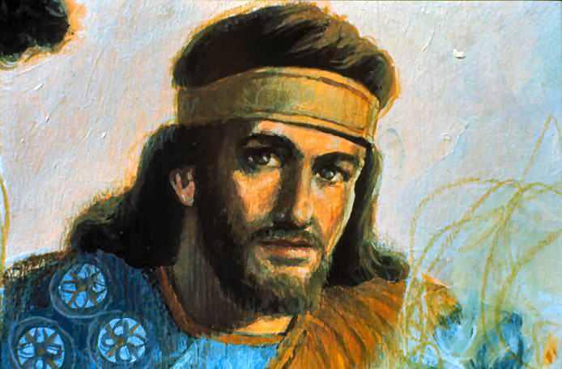
Darius took a liking to Daniel, and felt he could trust him. He too was an older man being 62 when Babylon fell and he valued the experience and godly wisdom of the faithful Hebrew captive. Quickly Daniel found himself once again as first ruler next to the King.
“It pleased Darius to set over the kingdom an hundred and twenty princes, which should be over the whole kingdom; And over these three presidents; of whom Daniel was first: that the princes might give accounts unto them, and the king should have no damage. Then this Daniel was preferred above the presidents and princes, because an excellent spirit was in him; and the king thought to set him over the whole realm.” Daniel 6:1-3

Slide 5
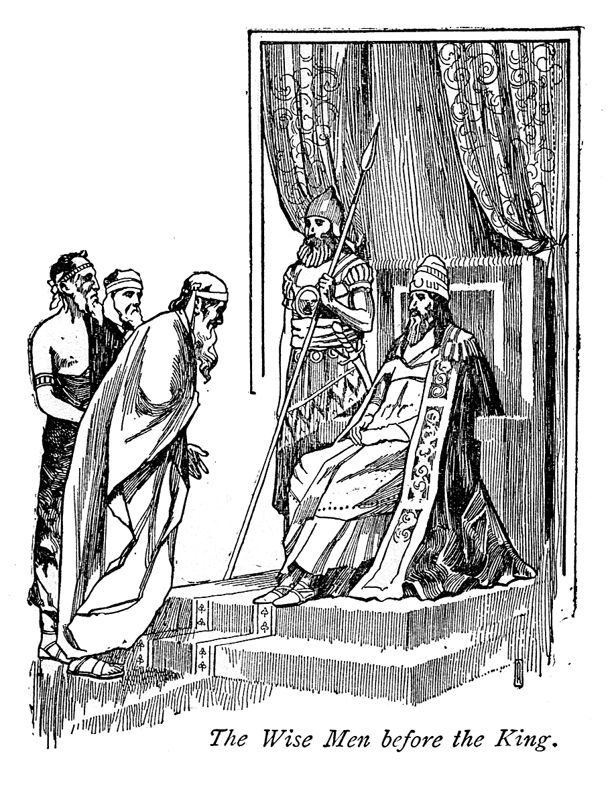
He set up 120 Princes and over them was to be three presidents. Daniel was the chief of the three. Daniel was the one they all had to answer to.
”Then the presidents and princes sought to find occasion against Daniel concerning the kingdom; but they could find none occasion nor fault; forasmuch as he was faithful, neither was there any error or fault found in him.” Daniel 6:4
So now we see him again in a position where heathen rulers were forced to have a worshipper of the True God as head over them. Satan didn’t like it. The heathen rulers didn’t like it. But they were stuck with it. Darius was very pleased with his new friend, Daniel.

Slide 6
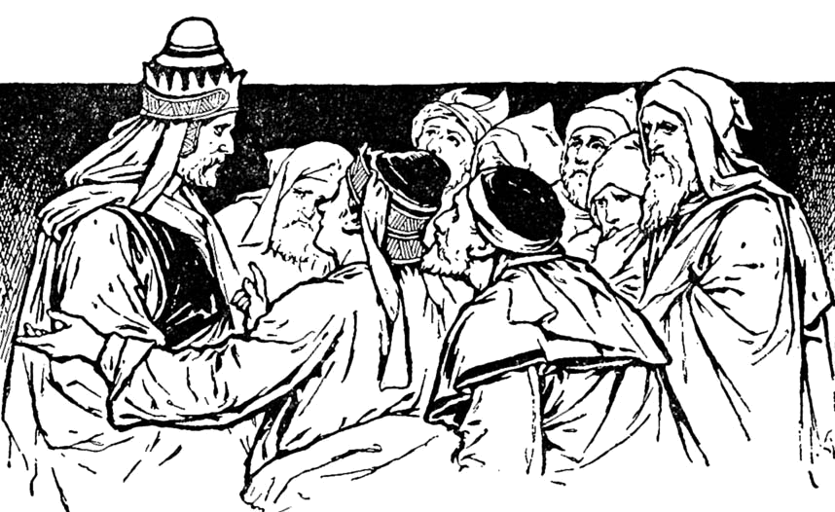
Then they got a nasty idea. They decided to watch him very closely and surely they would be able to catch him making a mistake or being dishonest. They watched him in everything he did. They wanted to catch him in something that they could use to get him fired or better yet, executed. But they couldn’t get anything to report that was bad about Daniel.
“Then said these men, We shall not find any occasion against this Daniel, except we find it against him concerning the law of his God.” Daniel 6:5

Slide 7
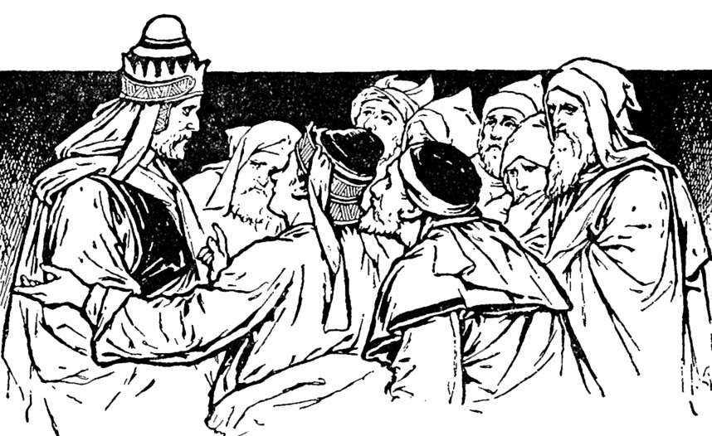
Now you would think that they would have been ashamed to try to harm this dear old man who did his work so well and faithfully; but they were jealous and determined to get rid of him. They realized that the only way they could trap him would have to be “concerning the law of his God”.

Slide 8
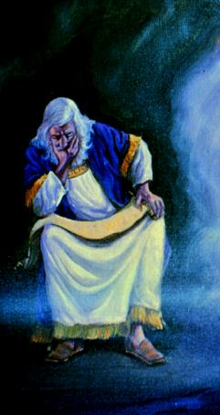
The keen eyes of jealousy were fixed upon Daniel day after day; their watchings were sharpened by hatred; yet not a word or act of his life could they make appear wrong…The more blameless the conduct of Daniel, the greater was the hatred excited against him by his enemies. They were filled with madness, because they could find nothing in his moral character or in the discharge of his duties upon which to base a complaint against him.

Slide 9
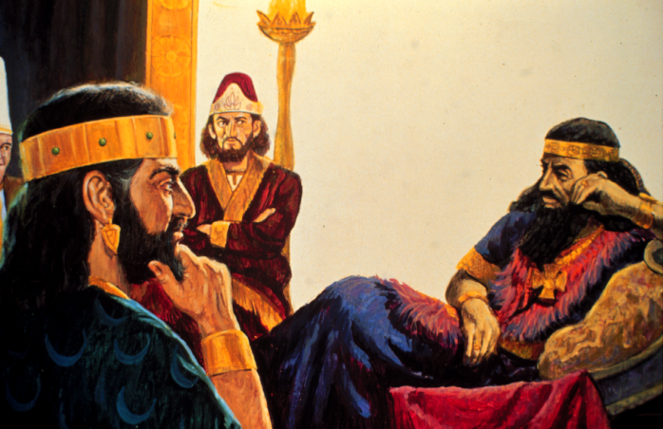
“Then these presidents and princes assembled together to the king, and said thus unto him, King Darius, live for ever. All the presidents of the kingdom, the governors, and the princes, the counsellors, and the captains, have consulted together to establish a royal statute, and to make a firm decree, that whosoever shall ask a petition of any God or man for thirty days, save of thee, O king, he shall be cast into the den of lions.” Daniel 6:6,7

Slide 10
So they got their heads together and they started to flatter king Darius. They told him what a great king he was and what he could do to make himself even greater. “Why don’t you make a law that says for 30 days nobody can ask anything from any man or even any god except you; and if they do, they will be thrown into the lion’s den.”

Slide 11
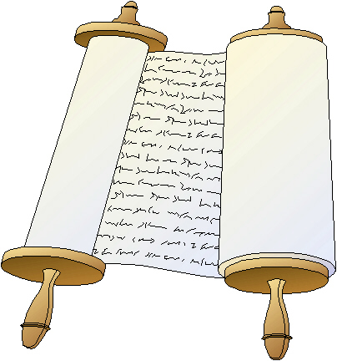
“Now, O king, establish the decree, and sign the writing, that it be not changed, according to the law of the Medes and Persians, which altereth not. Wherefore king Darius signed the writing and the decree.” Daniel 6:8, 9

Slide 12
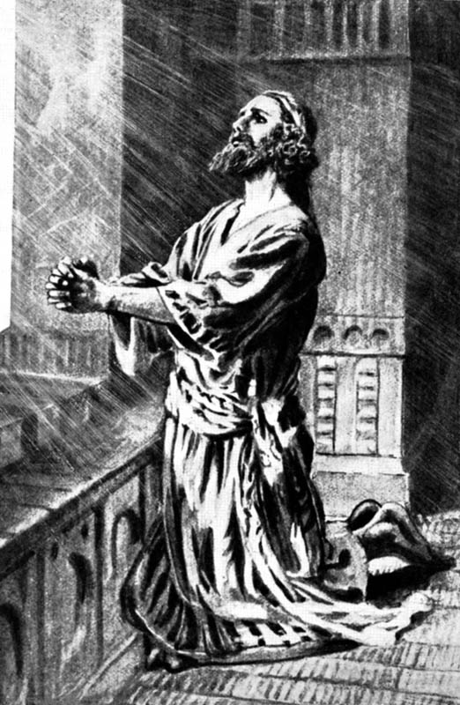
That was really silly, don’t you think? But they had flattered him so much and made him feel so proud of himself that he just fell for it. Quickly they put the ‘law’ before him and he signed it and sealed it. He never dreamed it was just a plot to get rid of his best friend.
Daniel 6:10 “Now when Daniel knew that the writing was signed, he went into his house; and his windows being open in his chamber toward Jerusalem, he kneeled upon his knees three times a day, and prayed, and gave thanks before his God, as he did aforetime.”

Slide 13
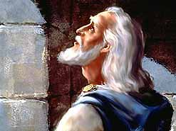
Daniel was a man of prayer. Three times a day he knelt before the Lord; and Satan told his enemies that they could use this to destroy him. Daniel knew about the decree, he knew it was designed for one reason only - to get him.
Now Daniel could have just prayed secretly for a month. He could have just prayed in his head in the bathroom or something. But he would not dishonour his God like that. He knew also that no man has any right to tell another man how he is to worship his God. To even pretend to go along with it would deny and insult God.

Slide 14
So he opened his windows just like always towards Jerusalem and he prayed. Not once, not twice but three times a day, just like always. And hiding where they could watch the whole thing were those wicked, jealous rulers. Daniel knew it; but he committed himself to the Lord and went about his business anyway. He was no different in this time of danger than when all was well with him. Just like his three friends had years before, he trusted God and left the problem in His hands.
That law seemed silly, but it was meant to destroy God’s faithful one; the Sunday Law in the last days will be silly also; but it is Satan’s plan to get rid of God’s true children.

Slide 15
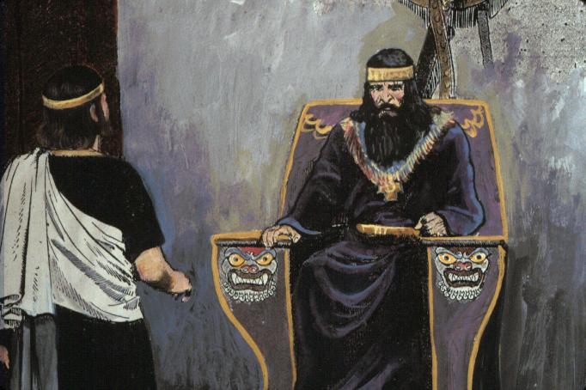
Daniel 6:11-13 "Then these men assembled, and found Daniel praying and making supplication before his God. Then they came near, and spake before the king concerning the king's decree; Hast thou not signed a decree, that every man that shall ask a petition of any God or man within thirty days, save of thee, O king, shall be cast into the den of lions? The king answered and said, The thing is true, according to the law of the Medes and Persians, which altereth not. Then answered they and said before the king, That Daniel, which is of the children of the captivity of Judah, regardeth not thee, O king, nor the decree that thou hast signed, but maketh his petition three times a day.”

Slide 16
As soon as they said it, the king saw his mistake. King Darius realized that all along it had been just a plot to get rid of Daniel. He knew they were jealous of him and now they had their weapon to use against Daniel and he foolishly had given to them.
14 “Then the king, when he heard these words, was sore displeased with himself, and set his heart on Daniel to deliver him: and he laboured till the going down of the sun to deliver him.”

Slide 17
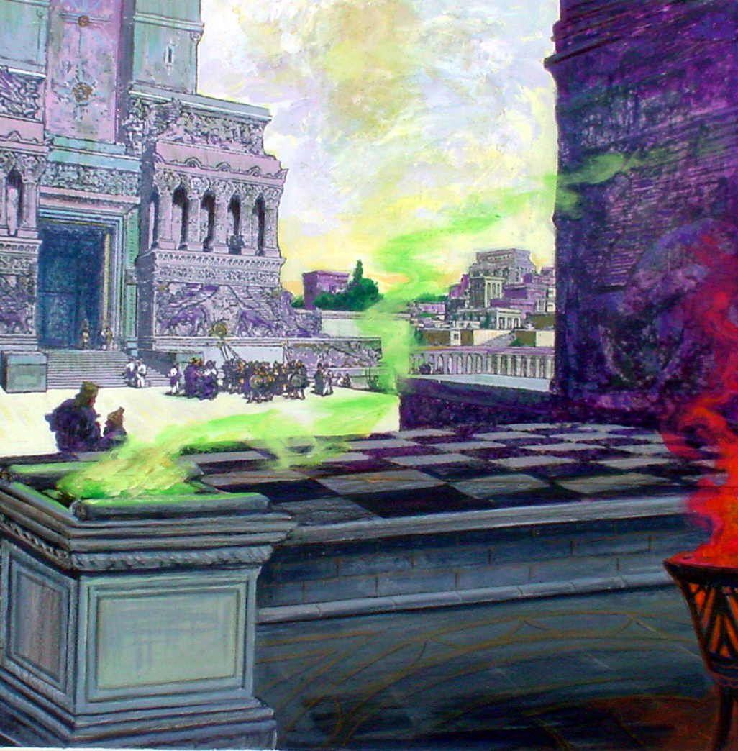
Now there was a very interesting law that the Medo-Persian Empire had made for themselves. It was that no law that they made could be changed. In other words, they felt they could never make any mistakes. They thought they were infallible - like God Himself! So the king couldn’t just pass another law and not put Daniel in with the lions. Those rulers would have made big trouble for him if he did that.

Slide 18
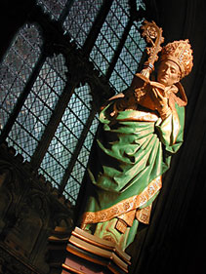
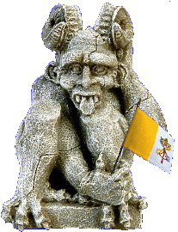
There is another power today that claims to be infallible. Do you know who it is? Yes, it is the Pope of Rome. He thinks he is like God also. But was Darius really infallible? Hadn’t he just made a terrible mistake? Yes indeed! And so will the popes of Rome find out someday that they have made a terrible mistake by persecuting God’s people.

Slide 19

Daniel 6:15,16 “Then these men assembled unto the king, and said unto the king, Know, O king, that the law of the Medes and Persians is, That no decree nor statute which the king establisheth may be changed. Then the king commanded, and they brought Daniel, and cast him into the den of lions. Now the king spake and said unto Daniel, Thy God whom thou servest continually, he will deliver thee.”

Slide 20
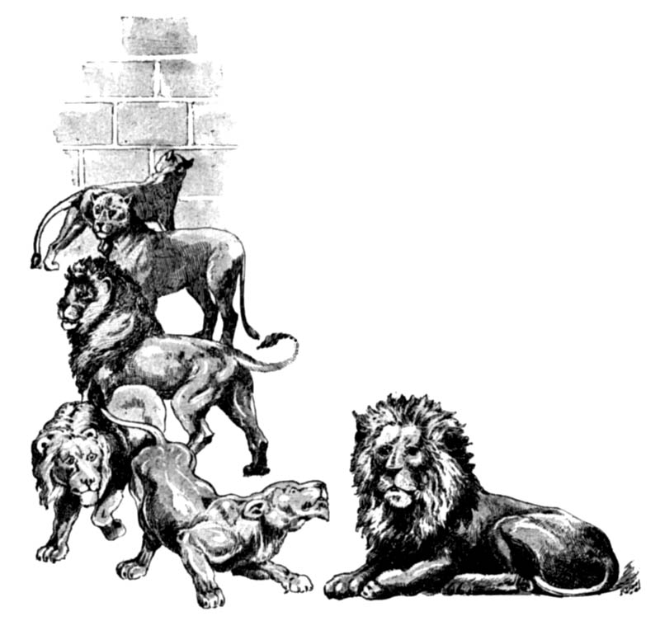
King Darius gave the order and went with Daniel to the lions’ den. In those days kings like to have caged lions and throwing people to them was a good way to get rid of people they didn’t like, and help to feed the hungry lions. But the king had learned something about Daniel and his God, and he assured him that his God would protect him.
17 And a stone was brought, and laid upon the mouth of the den; and the king sealed it with his own signet, and with the signet of his lords; that the purpose might not be changed concerning Daniel.

Slide 21
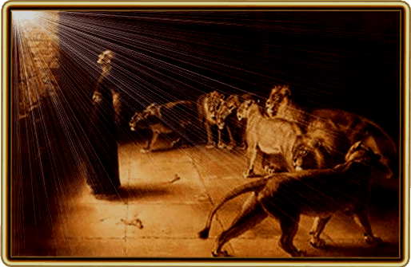
Daniel was thrown into the den and a stone was brought and placed on the mouth of the den and the king sealed it with his own seal. It seems King Darius was not as worried about the lions as he was about the wicked rulers coming and stealing Daniel out of the den and perhaps killing him or taking him away; and everybody would think he was eaten up. So he made sure the den could not be opened without breaking that seal.

Slide 22
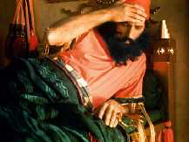
18, 19 Then the king went to his palace, and passed the night fasting: neither were instruments of musick brought before him: and his sleep went from him. Then the king arose very early in the morning, and went in haste unto the den of lions.
Then he went back to his palace and spent a sad, miserable night. He felt very ashamed of himself that he had allowed the rulers to trick him like they did. He kept thinking about his dear old friend out there in the den of nasty lions. He would not eat or listen to music and just counted the hours till morning.

Slide 23
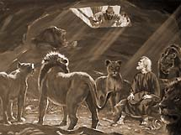
Daniel 6:20 “And when he came to the den, he cried with a lamentable voice unto Daniel: and the king spake and said to Daniel, O Daniel, servant of the living God, is thy God, whom thou servest continually, able to deliver thee from the lions?”
The first rays of dawn saw the worried king hurrying out to the lions’ den. He called out to his old friend and was overjoyed to hear the polite reply of the faithful servant of God.

Slide 24
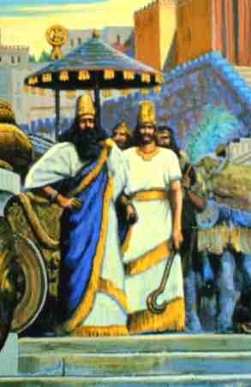
“Then said Daniel unto the king, O king, live for ever. My God hath sent his angel, and hath shut the lions' mouths, that they have not hurt me: forasmuch as before him innocency was found in me; and also before thee, O king, have I done no hurt.” Daniel 6:21,22
Quickly the king orders the stone removed and Daniel taken up out of the den. He was examined carefully and there was no hurt on him. Not even a scratch or a bite.

Slide 25
“Then was the king exceeding glad for him, and commanded that they should take Daniel up out of the den. So Daniel was taken up out of the den, and no manner of hurt was found upon him, because he believed in his God.
24 And the king commanded, and they brought those men which had accused Daniel, and they cast them into the den of lions, them, their children, and their wives; and the lions had the mastery of them, and brake all their bones in pieces or ever they came at the bottom of the den..” Daniel 6:23,24

Slide 26
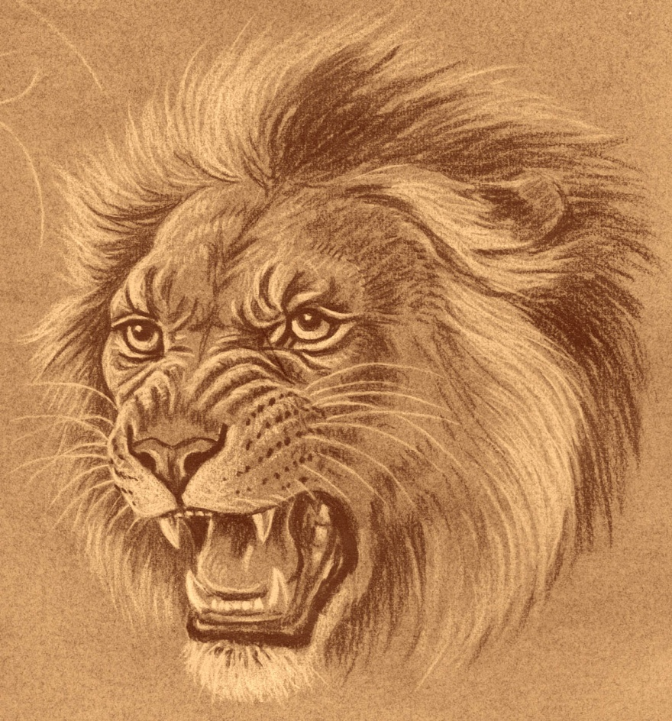
Now Darius ordered the wicked rulers who had tricked him to be thrown into the lions’ den. People had been saying that the lions just weren’t hungry—but those big cats just crunched them up like CRACKERS. So their evil plan came back on their own heads.
The king then sent around a decree telling the story of the great God of heaven. . .

Slide 27

25 Then king Darius wrote unto all people, nations, and languages, that dwell in all the earth; Peace be multiplied unto you.
26, 27 I make a decree, That in every dominion of my kingdom men tremble and fear before the God of Daniel: for he is the living God, and stedfast for ever, and his kingdom that which shall not be destroyed, and his dominion shall be even unto the end. He delivereth and rescueth, and he worketh signs and wonders in heaven and in earth, who hath delivered Daniel from the power of the lions.
Because of this, the message of the true God went around the world again.

