Slide 1
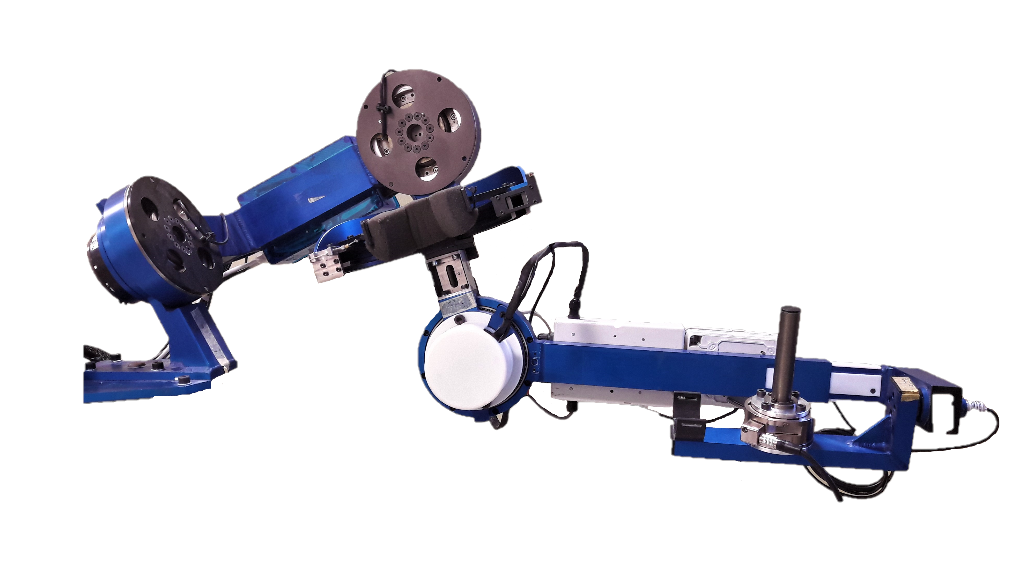
JOINT 2
JOINT 1
JOINT 3
JOINT 5
JOINT 4
F/T SENSOR

