Slide 1
Langton’s Ant
The ant lives in a grid, and knows a sequence of possible colors for grid cells:
Each color “means” one of two things:
TURN
LEFT
TURN
RIGHT
TURN
LEFT
Each turn, the ant does the following:
Turn 90° according to the color of the current cell
Paint the cell with the next color in the sequence
Advance one cell in its
current direction

Slide 2
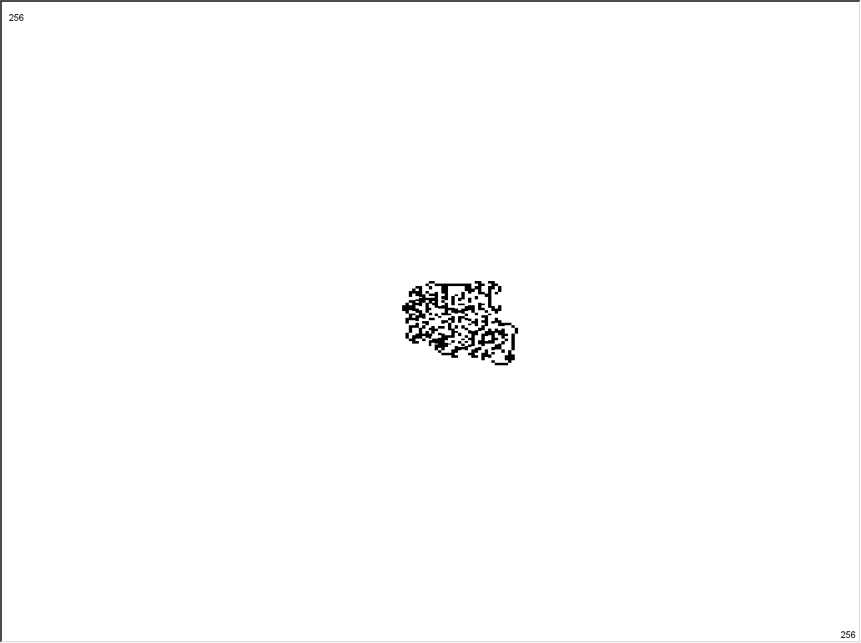
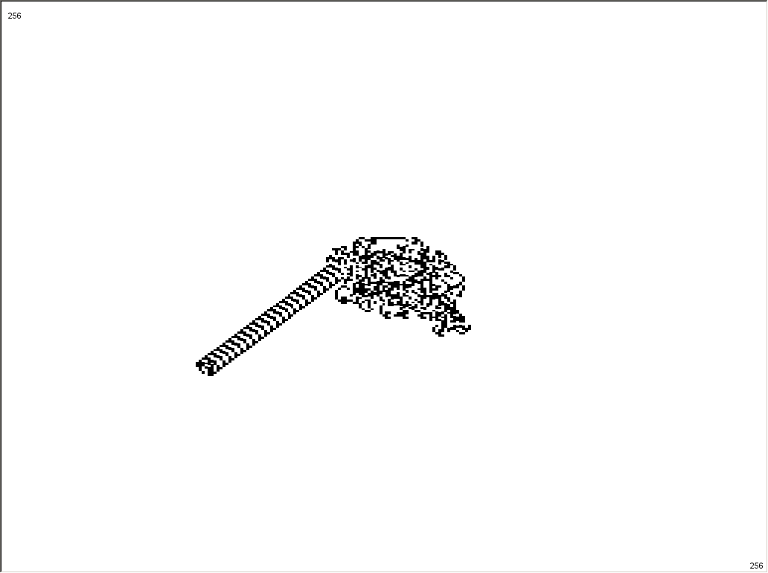
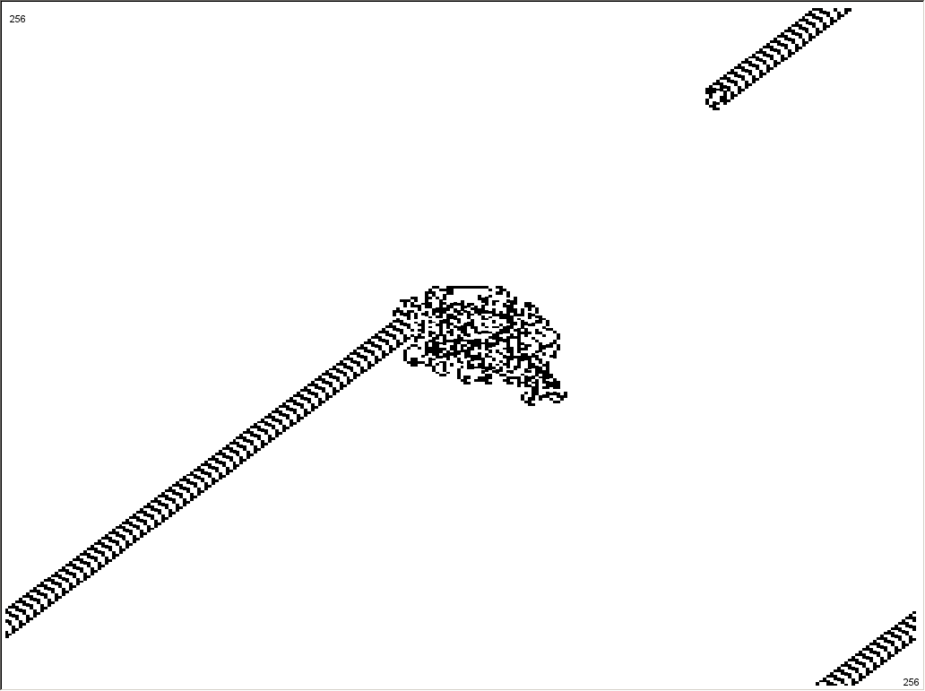
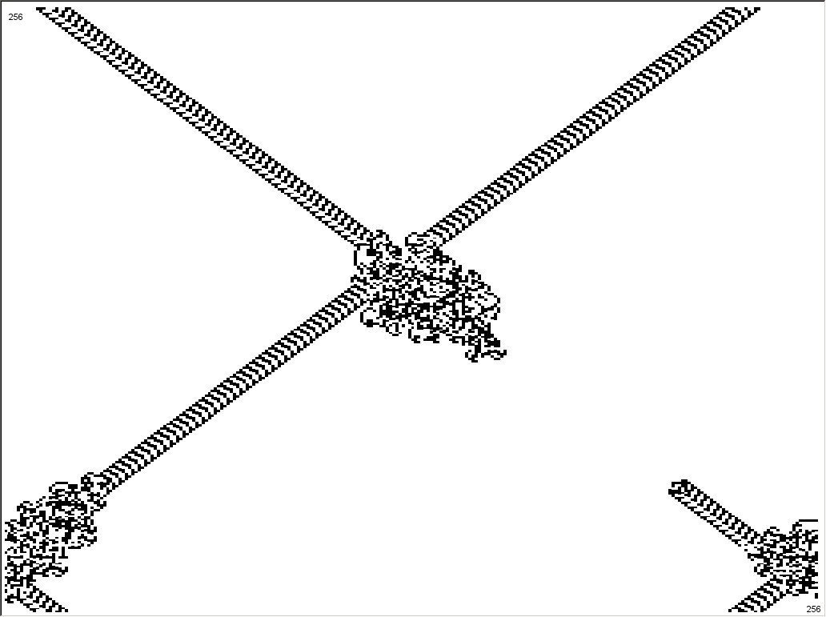
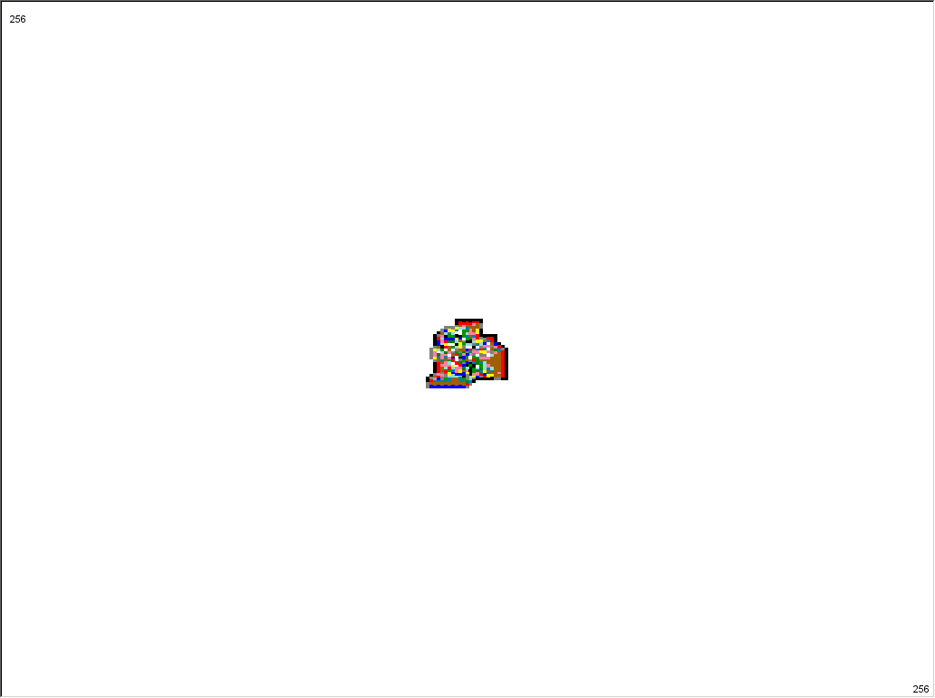
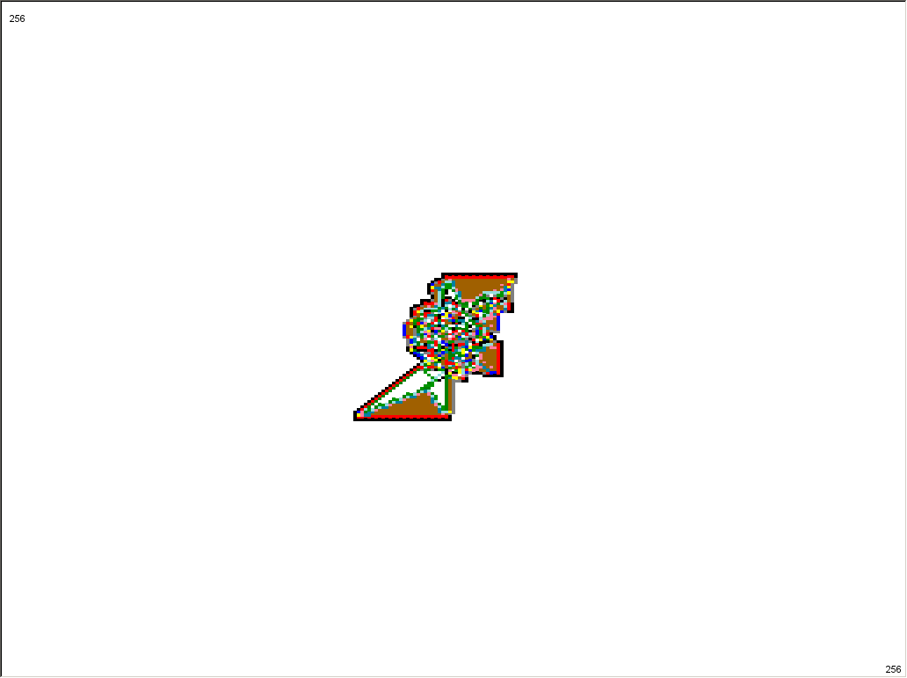
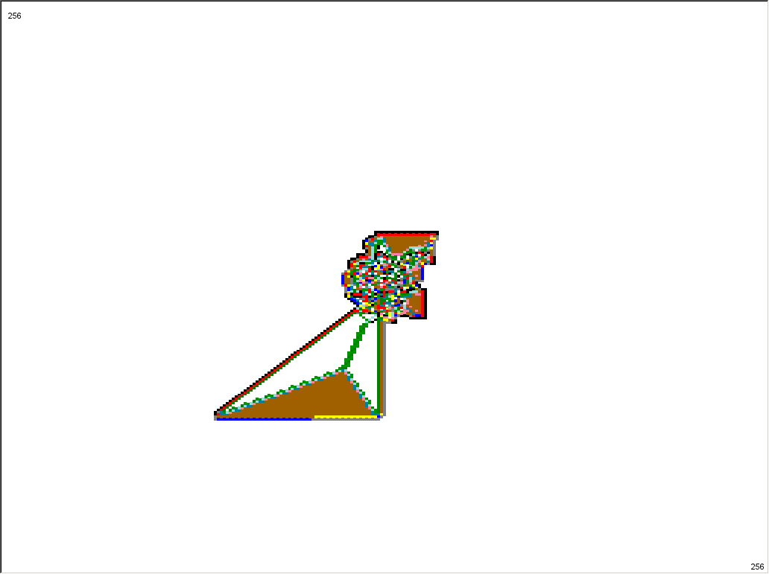
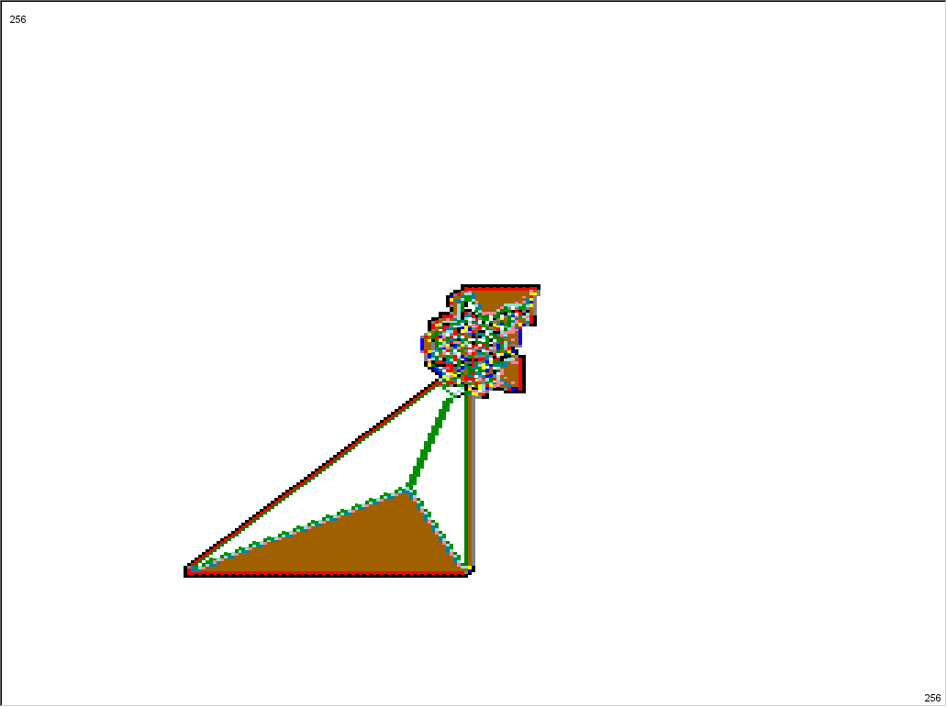
In Evolife
Set number of colors and the corresponding turning direction of each to create, for instance:
Ex 1) “Highways’’ (2 colors - RL)
Ex 2) A growing triangular structure (12 colors - RRLLLRLLLRRR)

Slide 3
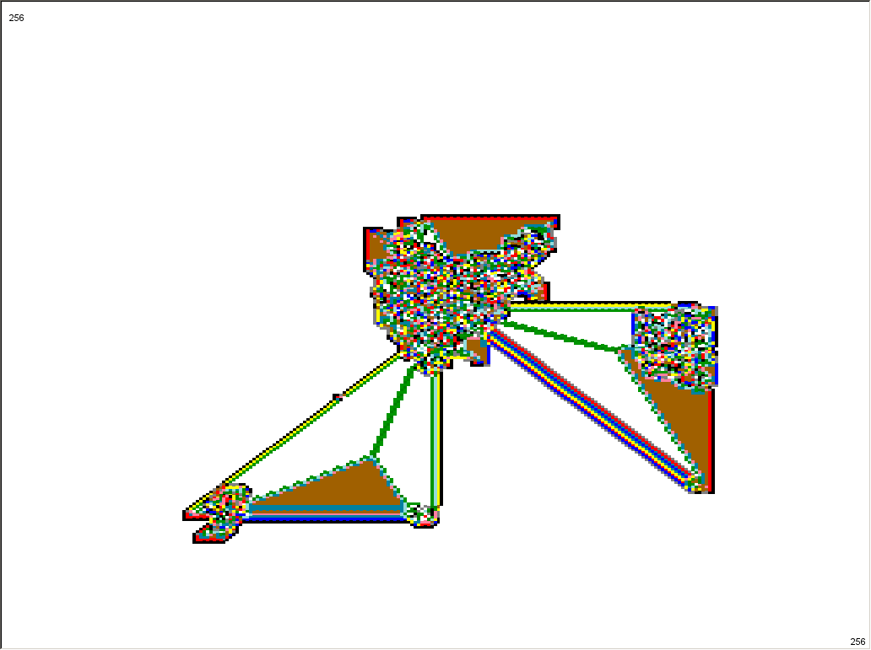
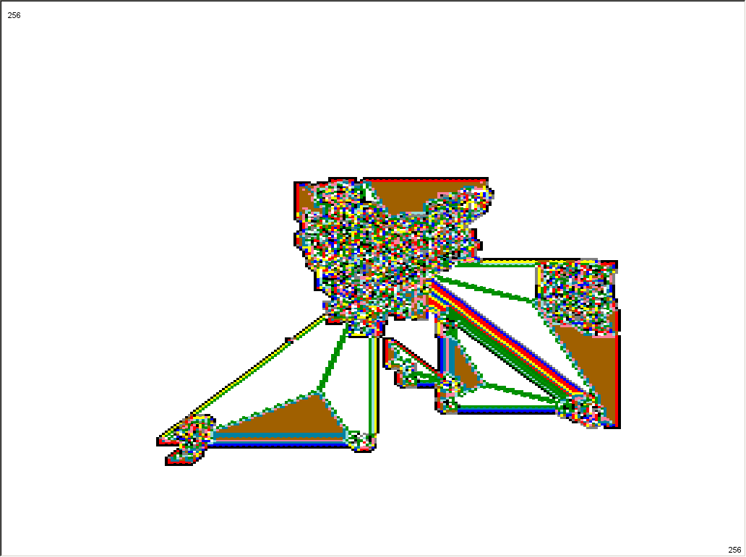
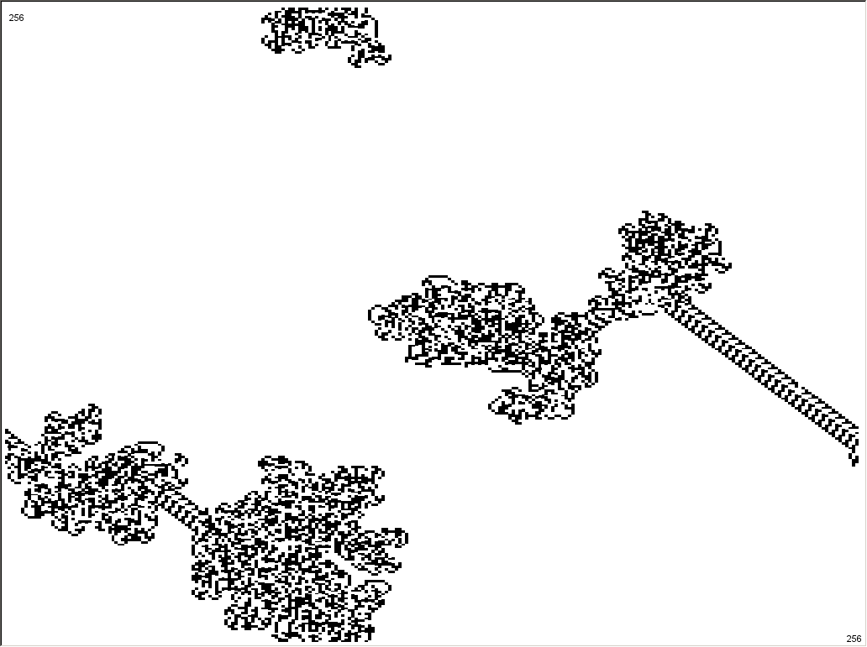
An experiment
A parameter “Noise” was added: the likelihood (per million turns) that the ant takes a turn in the other direction instead. Some interesting effects:
Ex 2) With Noise ~ 75, many triangles may be formed instead of one
Ex 1) Stretches of “Highway” still appear for Noise as large as 1500

