Slide 1
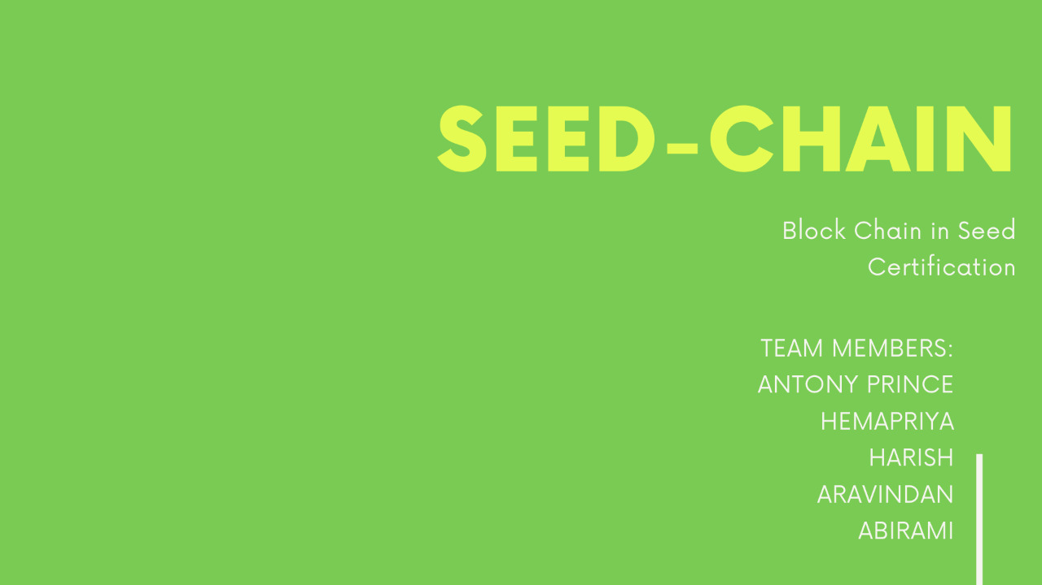

Slide 2
Abstract
SEED- CHAIN is a Blockchain based platform that facilitates creation and formatting of seed certificate that are accessed by the access domains of the
proposed system. The proposed system aims at issuing and tracking well-formed, in quality and secured seed certificate to be stored
and rendered when requested.

Slide 3
Proposed System
S E E D - C H A I N a l l o w s d o m a i n b a s e d a c c e s s t o v i e w , u p d a t e , r e n d e r , a n a l y s e a n d r e v i e w t h e s e e d
c e r t i f i c a t e i s s u e d a s p e r n o r m s . b l o c k c h a i n e n a b l e s t o s t o r e t h e r e c o r d i n t h e h i g h l y s e c u r e d s e c u r e d c l o u d t h a t e n s u r e s
t r a c e a b i l i t y a n d t h e s t a b i l i t y o f c e r t i f i c a t e o v e r
t h e a c c e s s d o m a i n s . t r u m p c a r d s i n c l u d e f u l l o n t r a c e a b i l i t y o f o f t h e s e e d f r o m f a r m t o f a r m , v a l i d c h e c k p o i n t s ,
p r o m o t e m u t a b l e t h e r e b y a u g m e n t s t h e e x i s t i n g
s u p p l y c h a i n .

Slide 4
A C C E S S D O M A I N S O F T H E P R O P O S E D
S Y S T E M

Slide 5
Process Flow

Slide 6
What happens in the Processing phase?
E X T E N D E D P R OC E S S F L O W
S P P
Aids the farmer in issuing and viewing seed certificate
S P A
Initiates the block and governs the overall process of certification.
Issues unique identification such as the LotNumber
S C A
Update the processing & sampling information against the Seed Lotno
S T L
Updates only the Seed Testing Results against the sample secrete code
P R O V I D E R / P R O D U C E R
Can view certificate by lot number or sgName.
.
Issues Sample Secret Code

Slide 7


SEED-CHAIN
A I M S A T O F F E R I N G
F A R M - F A R M T R A C E A B I L I T Y
S T A N D A R D A N D V A L I D C E R T I F I C A T I O N
S T A B L E / F L E X I B L E D A T A V I A B L O C K C H A I N
A U G M E N T S E X I S T I N G S U P P L Y C H A I N

Slide 8
