Slide 1

Turkish Legends
By « Les vils juifs de Villejuif »
Dorian ANTOINET, Victor DELENCLOS and Aymeric DAVIAS

Slide 2
On the Menu
Introduction as appetizer
Use Case Diagram Salad
Sequence Diagram Kebab served with
Class Diagram french fries
Creational Patterns sweet medley for dessert
All this accompanied by a delicious demonstration

Slide 3
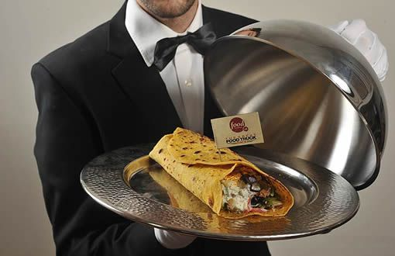
Introduction
Villejuif is known for its famous kebabs

Slide 4
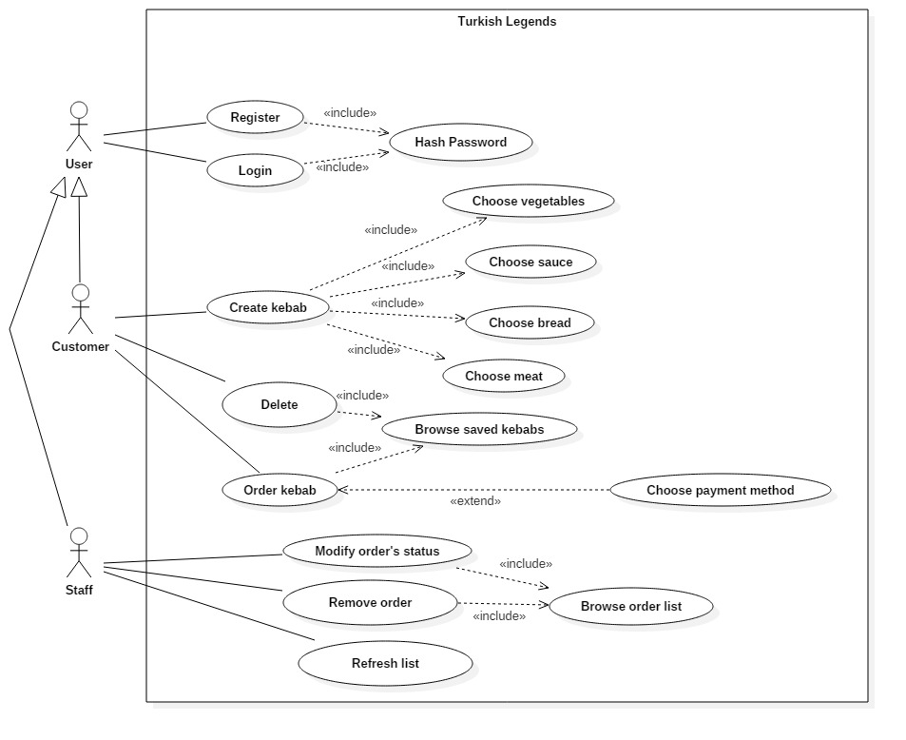
Use Case Diagram

Slide 5
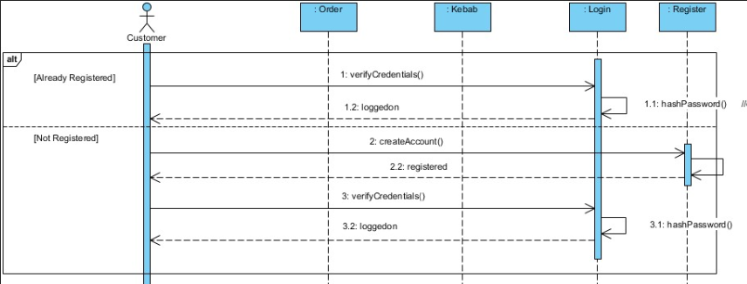
Sequence Diagram (Top)

Slide 6
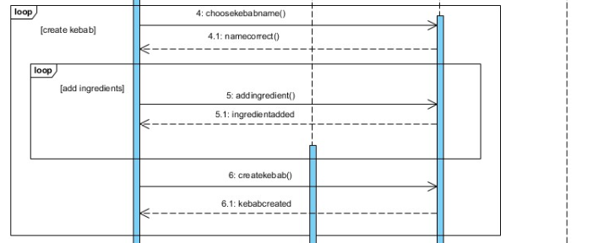
Sequence Diagram (Middle)

Slide 7
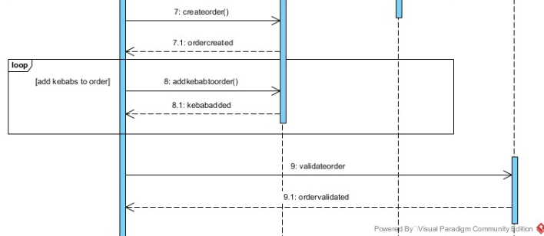
Sequence Diagram (Bottom)

Slide 8
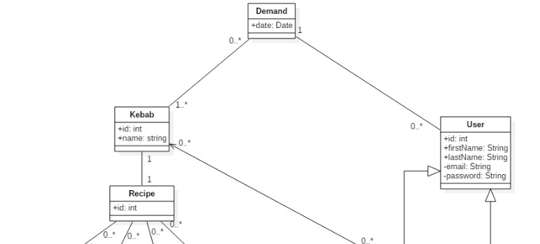
Class Diagram (Database Top)

Slide 9
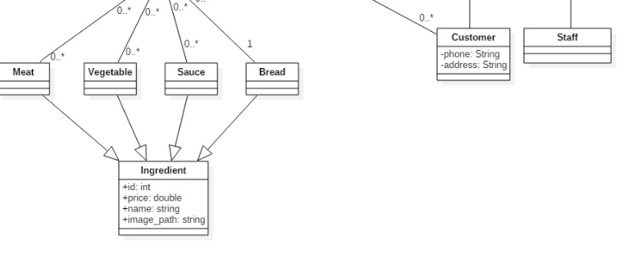
Class Diagram (Database Bottom)

Slide 10
Class Diagram (System)
Model / View / Controller pattern used.

Slide 11
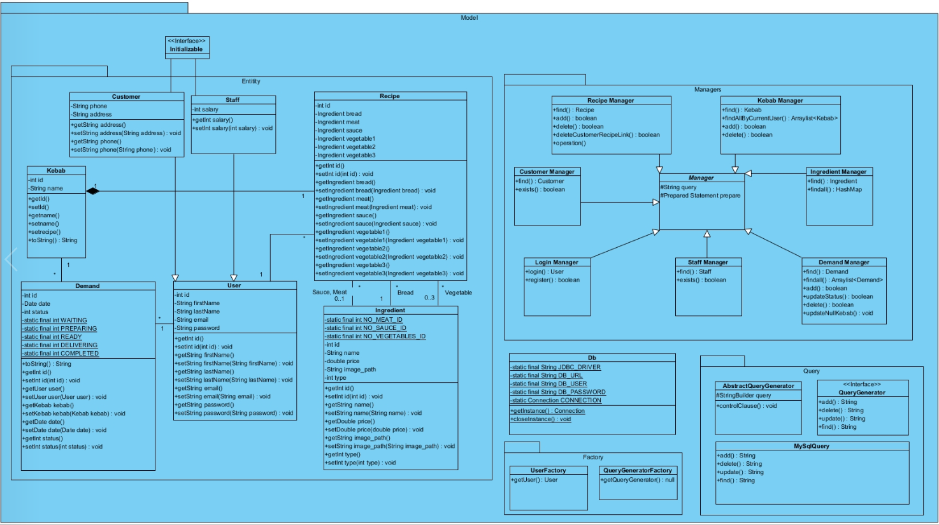

Slide 12
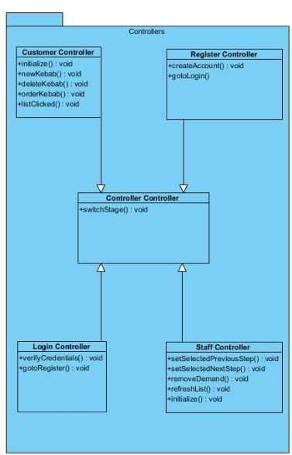
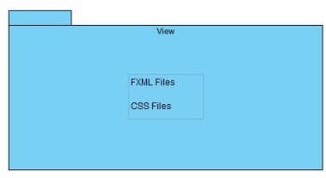

Slide 13
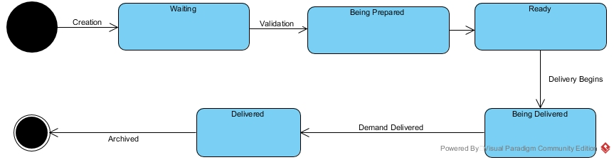
Demand State Diagram

Slide 14
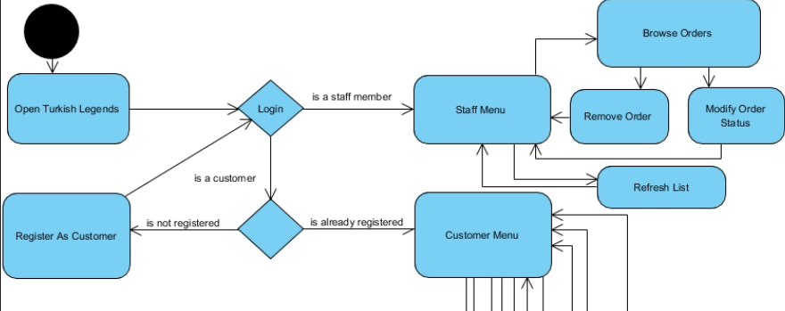
Activity Diagram (Top)

Slide 15
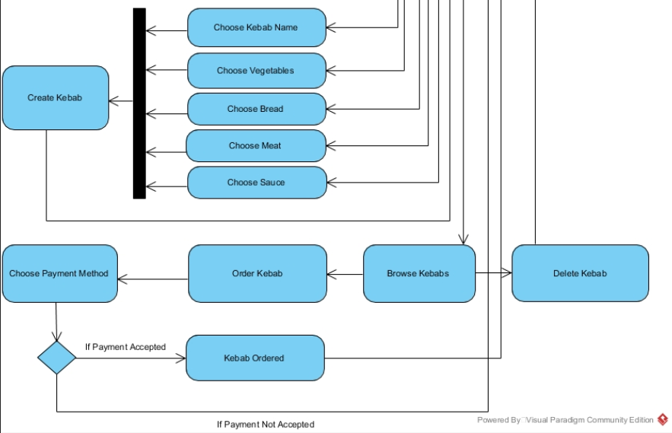
Activity Diagram (Bot)

Slide 16
Creational Patterns Used
Builder Pattern
Factory Pattern
Strategy Pattern

Slide 17
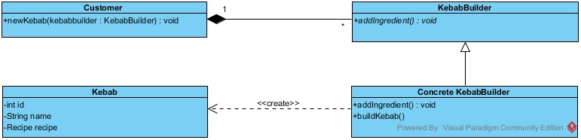
Builder Pattern

Slide 18
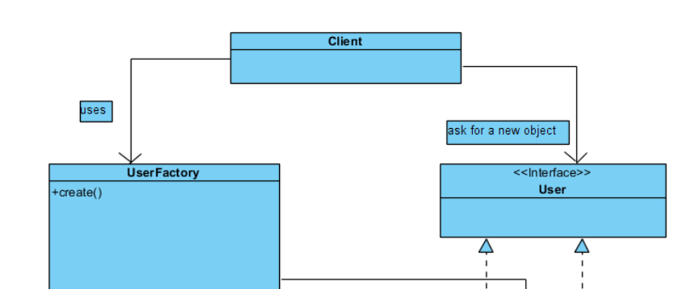
Factory Pattern (Top)

Slide 19
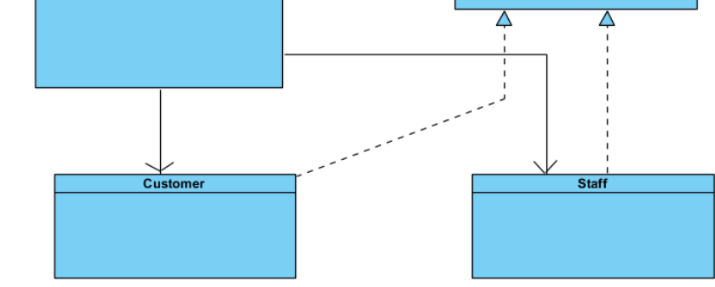
Factory Pattern (Bot)

Slide 20
Strategy Pattern
QueryGeneratorFactory
QueryGenerator
AbstractQueryGenerator
MysqlQuery

Slide 21
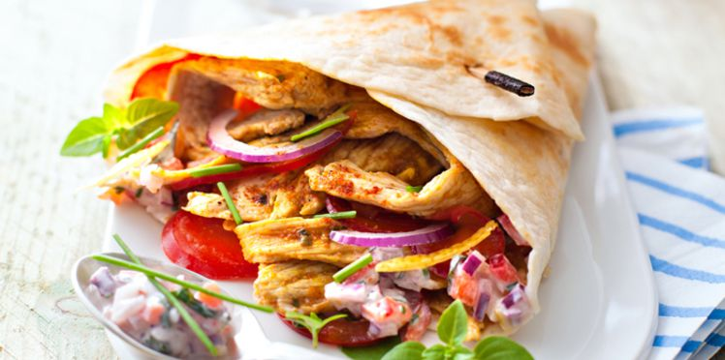
Demonstration time

Slide 22
Conclusion

