Slide 1



Lab work
Computational analysis
Protein extraction & digestion
Mass Spectrometry analysis
.RAW files
Open format conversion (MGF)
Peptide to Spectrum matching (PSM)
Biological interpretation & data visualization
Quality control, validation and filtering
Protein inference
Protein quantification

Slide 2
Lab work
Computational analysis
Protein extraction & digestion
Mass Spectrometry analysis
.RAW files
Open format conversion (MGF)
Peptide to Spectrum matching (PSM)
Biological interpretation & data visualization
Quality control, validation and filtering
Protein inference
Protein quantification

Slide 3

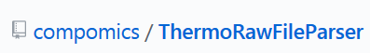

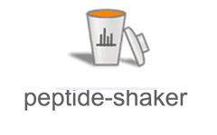


Computational analysis
.RAW files
Open format conversion (MGF)
Peptide to Spectrum matching (PSM)
Quality control, validation and filtering
Protein inference
Protein quantification

