Slide 1
Seasonal Prediction System SPS4
ThisM ThisY Outlook

Slide 2
Outline
1. Last month highlights:
observed climate conditions for MM1STR MM1Y
2. Last lead 1 month evaluation:
MM1STR MM1Y issued in MM2STR MM2Y
3. Last season forecast evaluation:
SeAM1 issued in SM1ForeM SM1ForeY
4. Outlook for ThisM ThisY lead 1 season (SEA)
  Global outlook
  Focus over Europe
  Summary

Slide 3
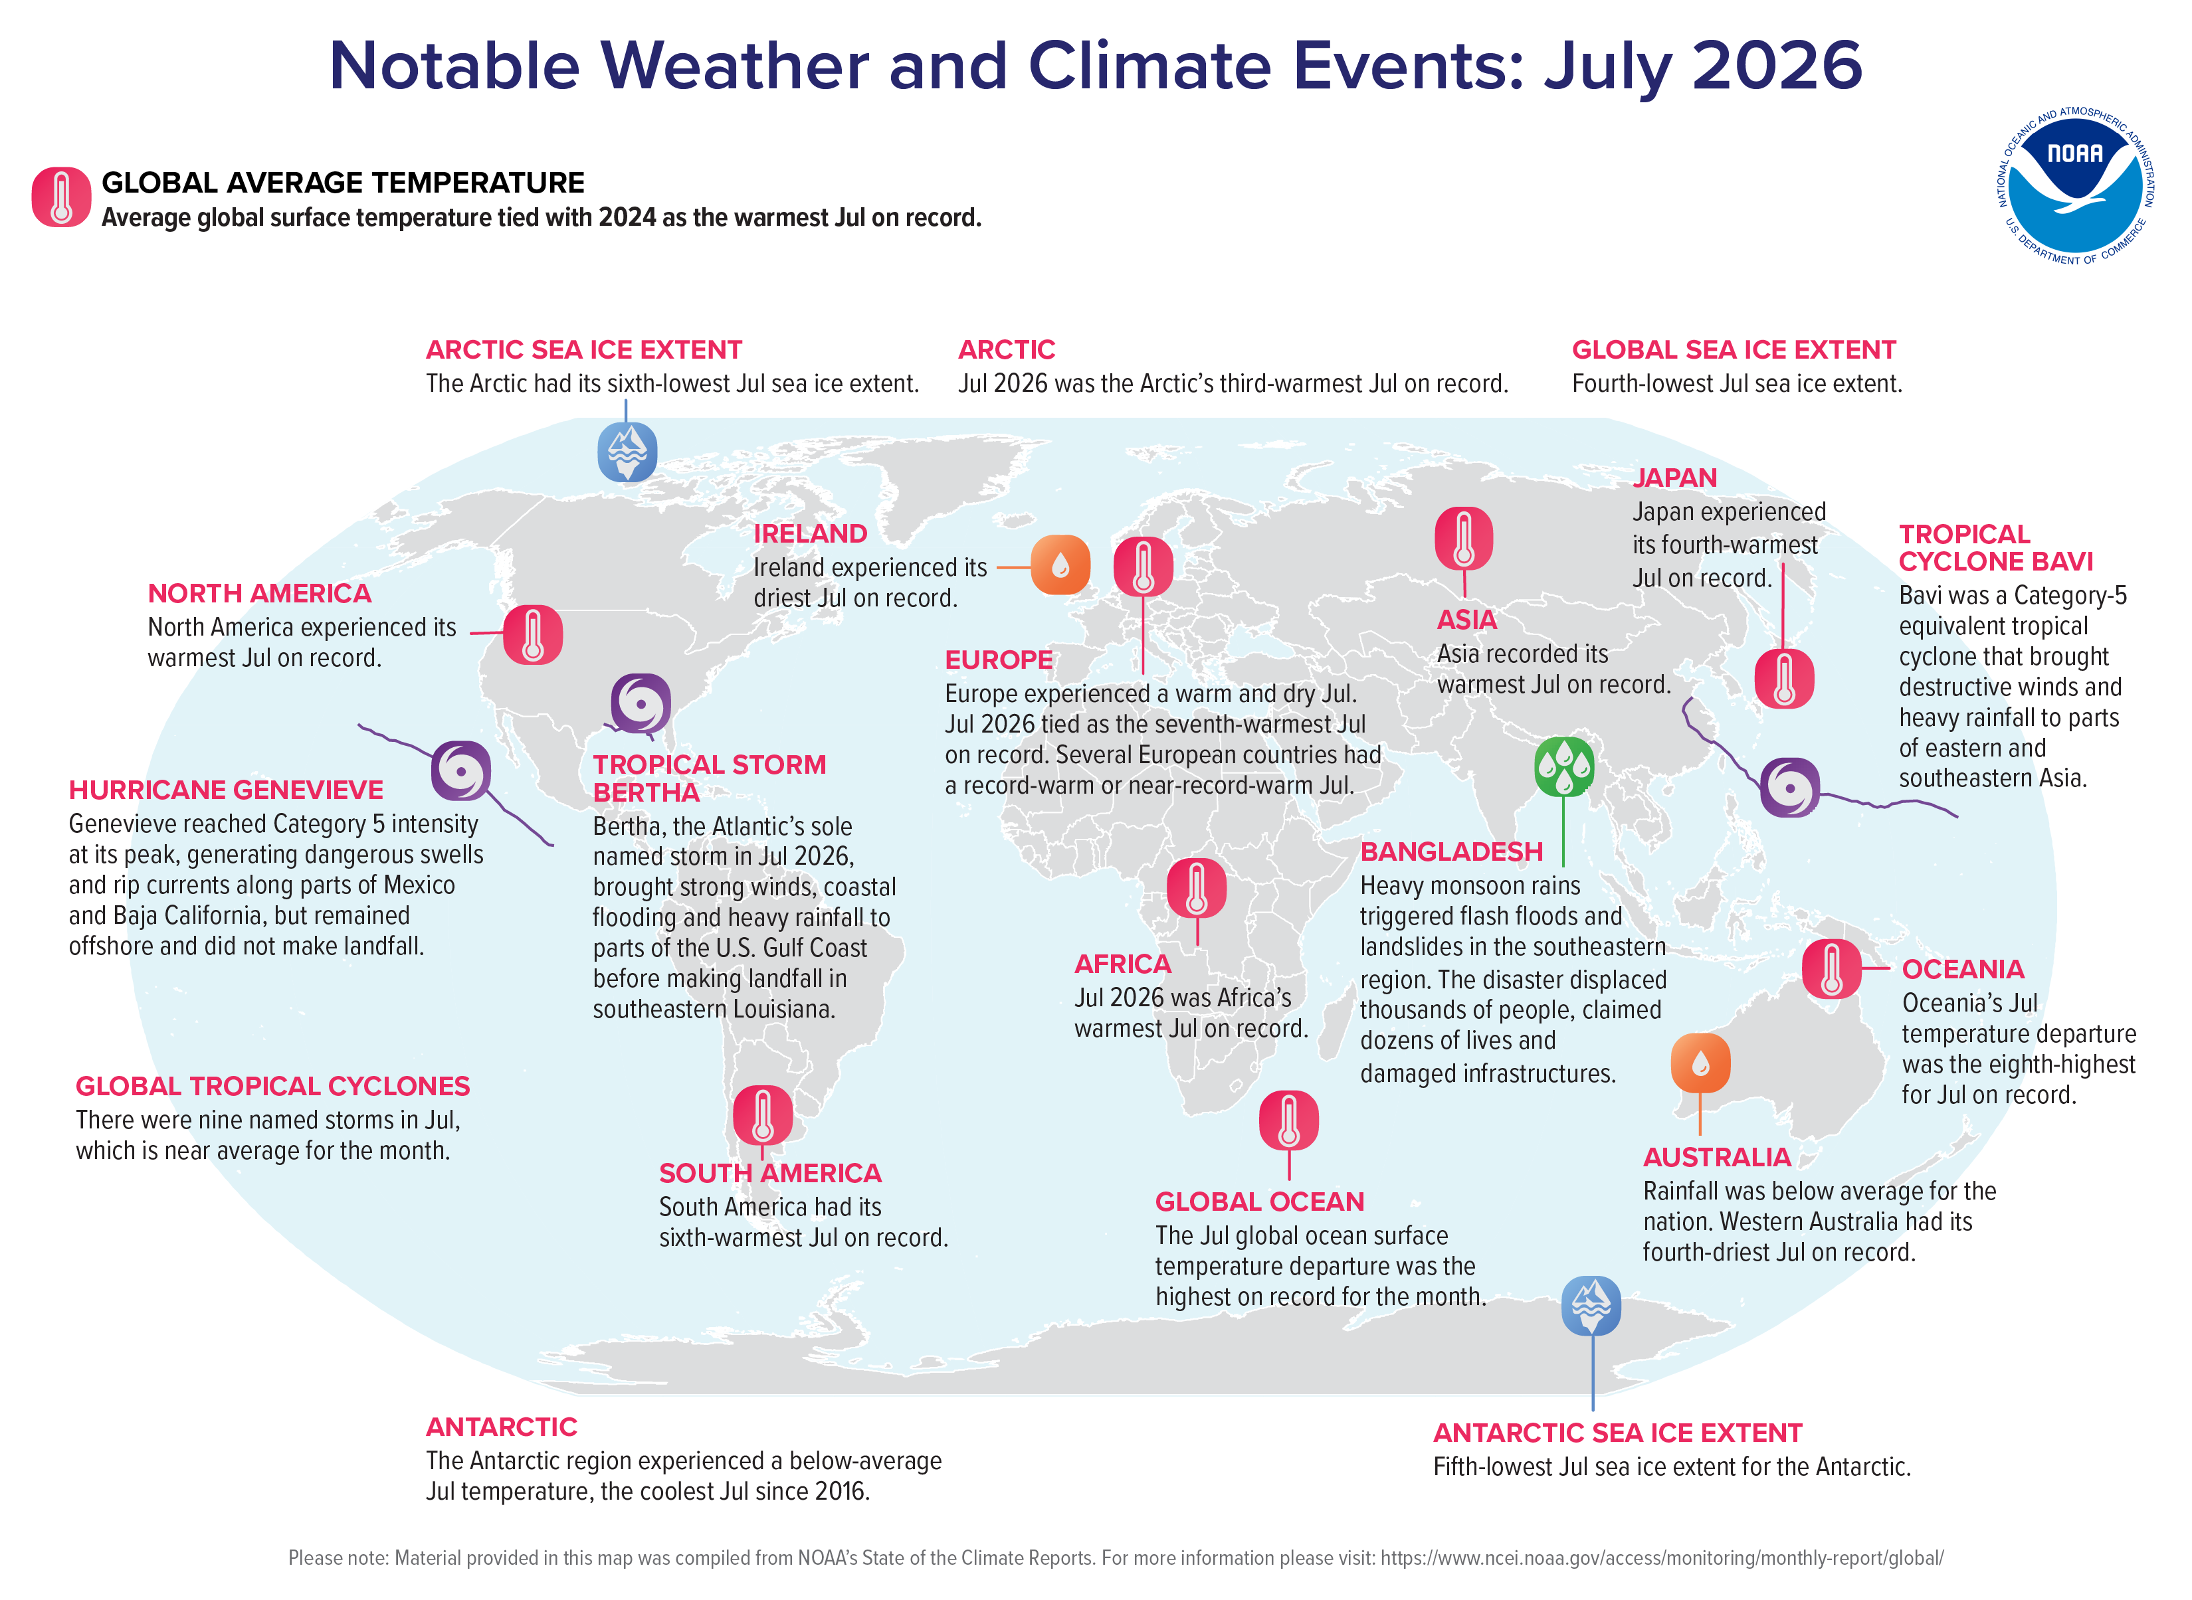
Significant Events
IMG_SIGNIF_EVENTS

Slide 4
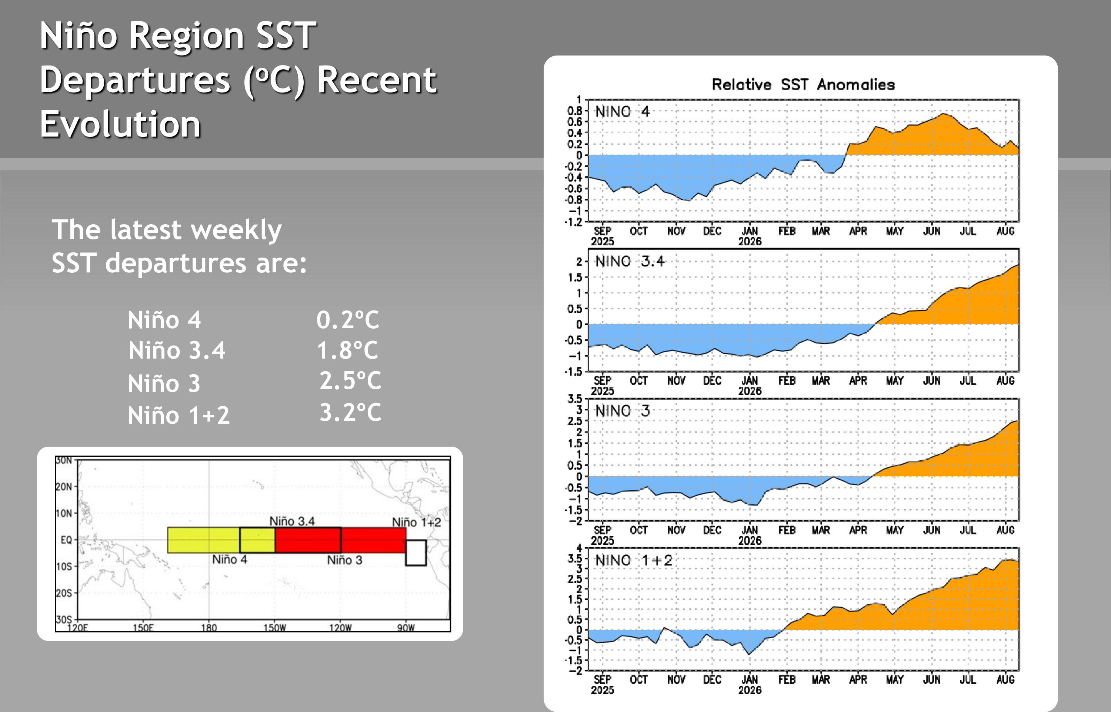
SST anomalies MM1STR MM1Y: ENSO
IMG_NINO_TS

Slide 5
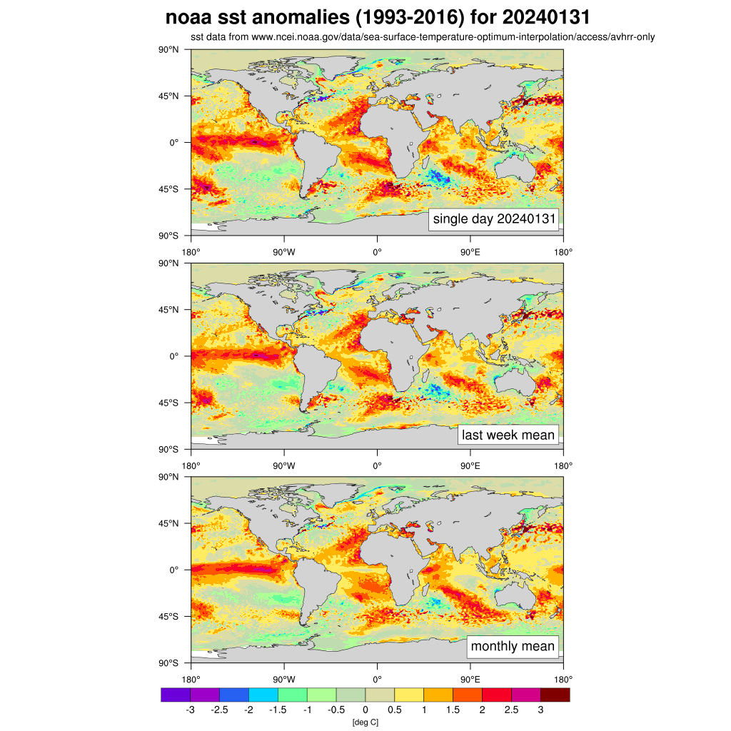
SST anomalies MM1STR MM1Y: Global
ESA-CCI-OSTIA SST anomalies (1991-2020) for MM1YMM1NDDM1
SST data from ESA CCI/OSTIA SST
IMG_SST_TOP
IMG_SST_BOTTOM
Positive anomalies across the tropical Pacific, with the characteristic warm tongue on the Western coast of South America
Warm pattern the Atlantic
warm pattern across the North Pacific slightly Decreased compared to previous month.

Slide 6
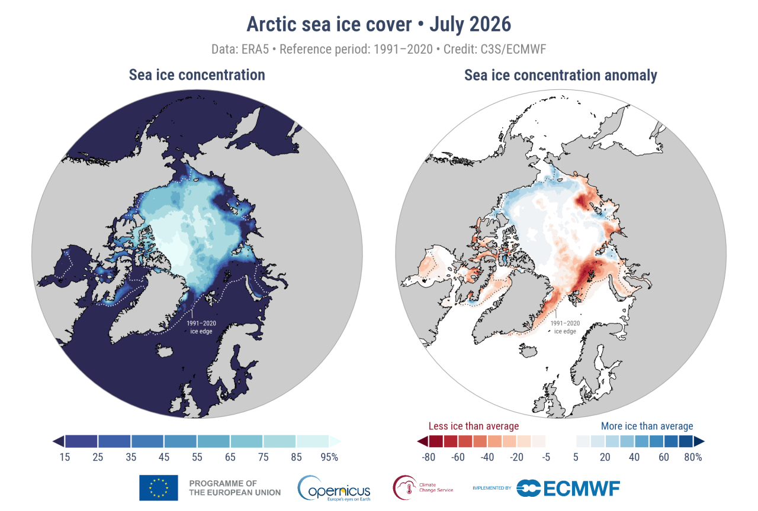
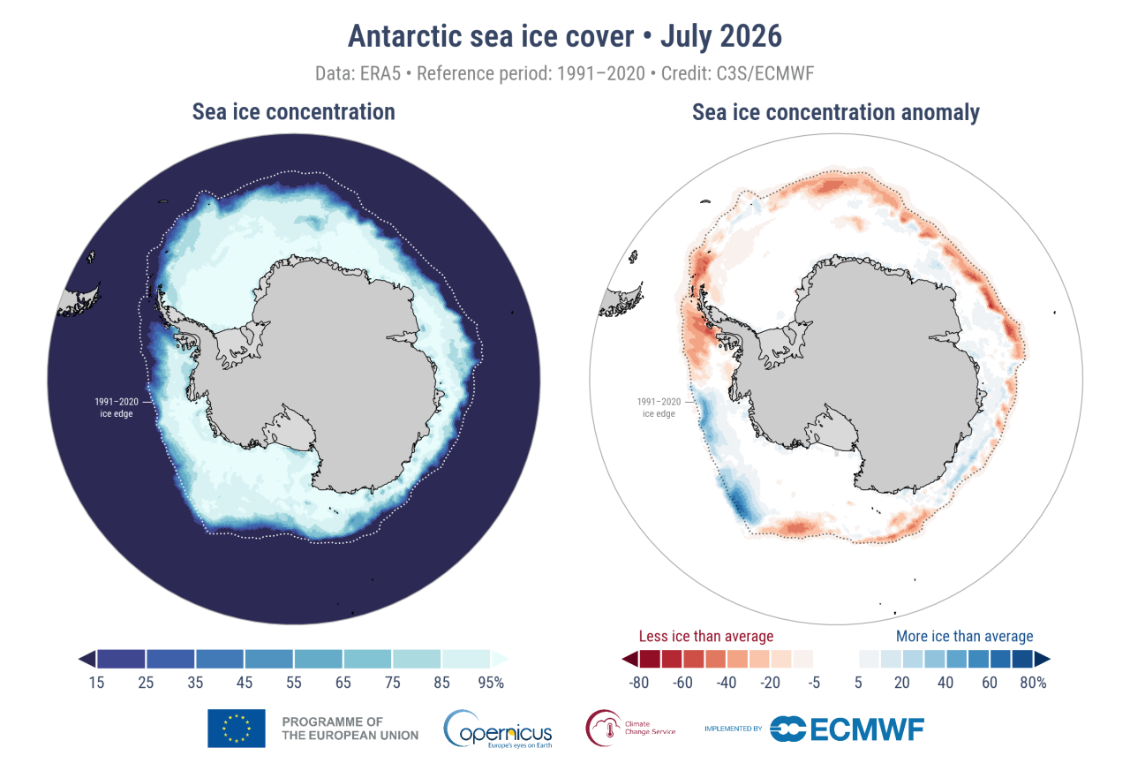
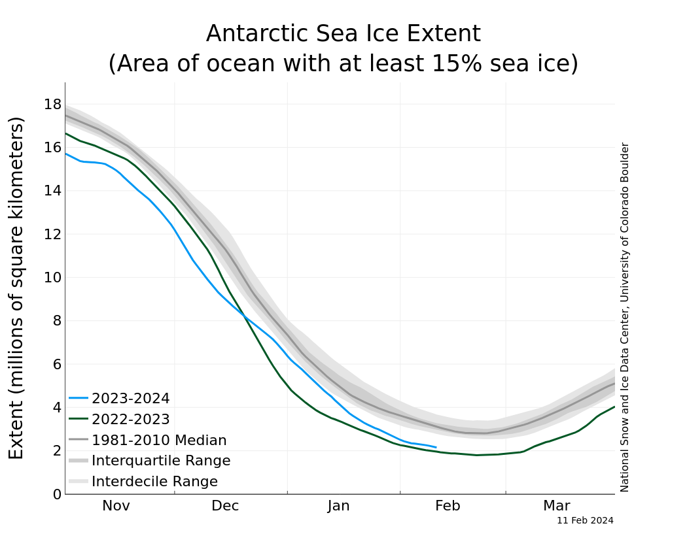
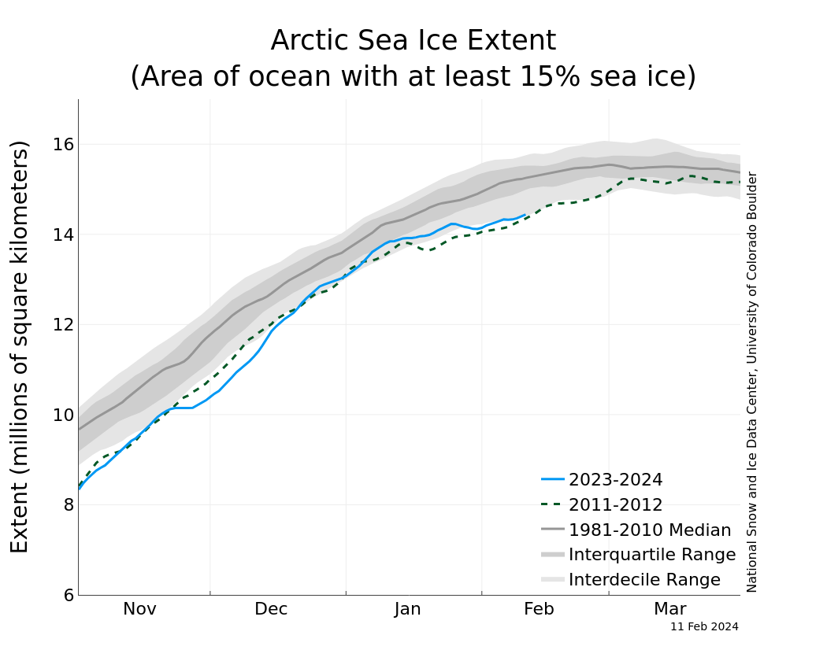
Sea-ice anomalies MM1STR MM1Y
ARCTIC
ANTARCTIC
IMG_ARCTIC_MAP
IMG_ANTARCTIC_MAP
IMG_ARCTIC_TS
IMG_ANTARCTIC_TS

Slide 7
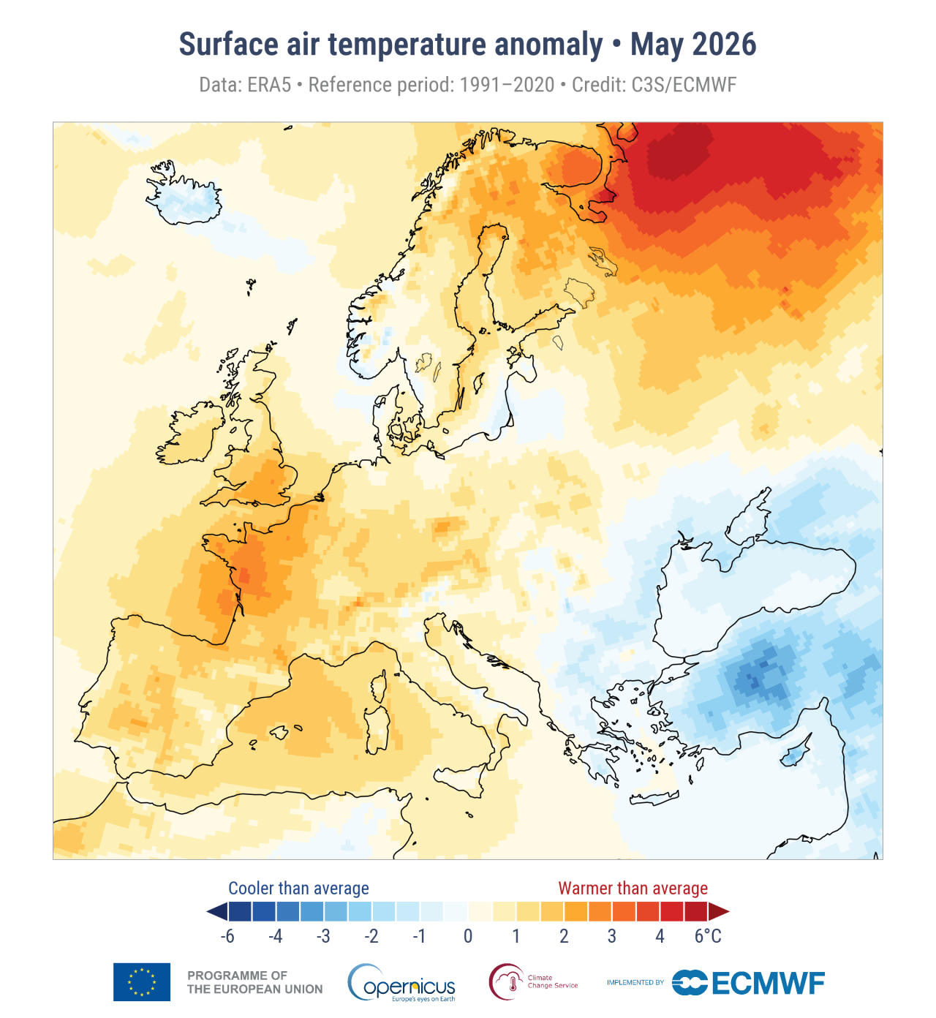
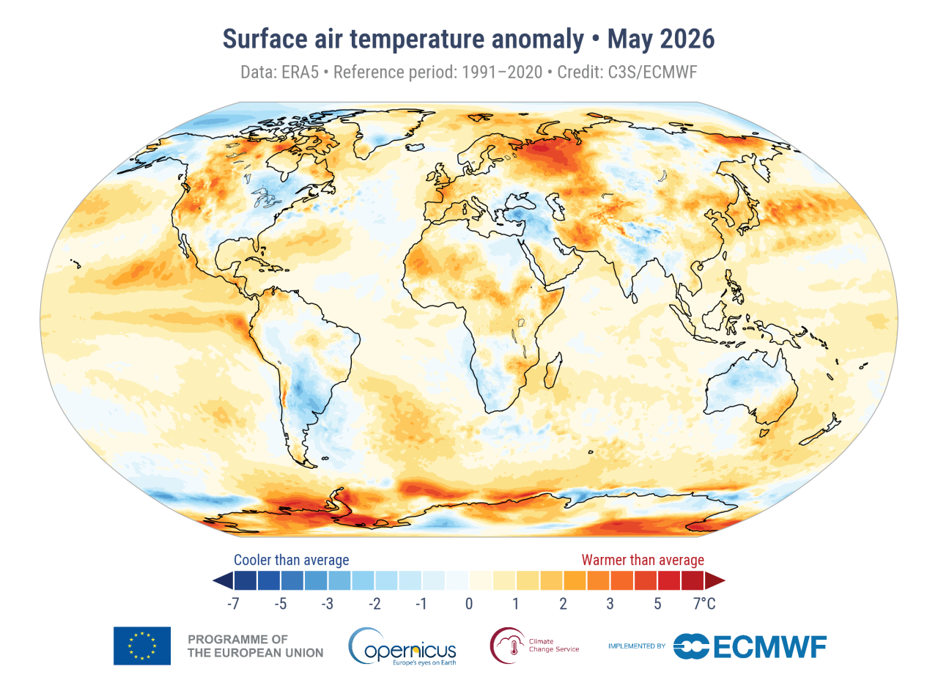
T2M anomalies MM1STR MM1Y
IMG_T2M_GLO
IMG_T2M_EU
GLOBAL: t2m
EUROPE: t2m

Slide 8
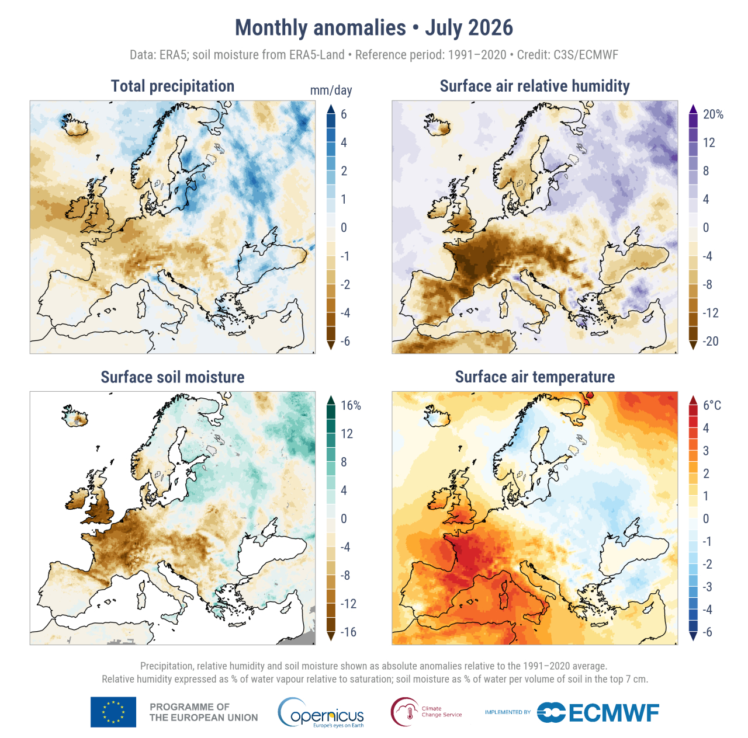
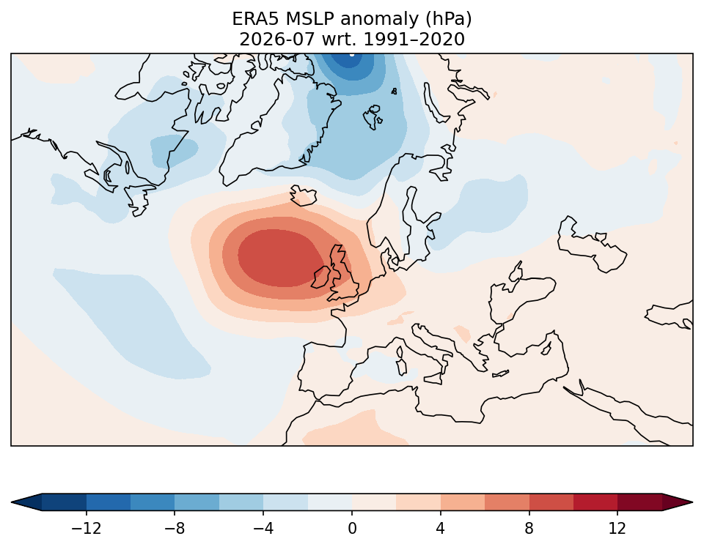
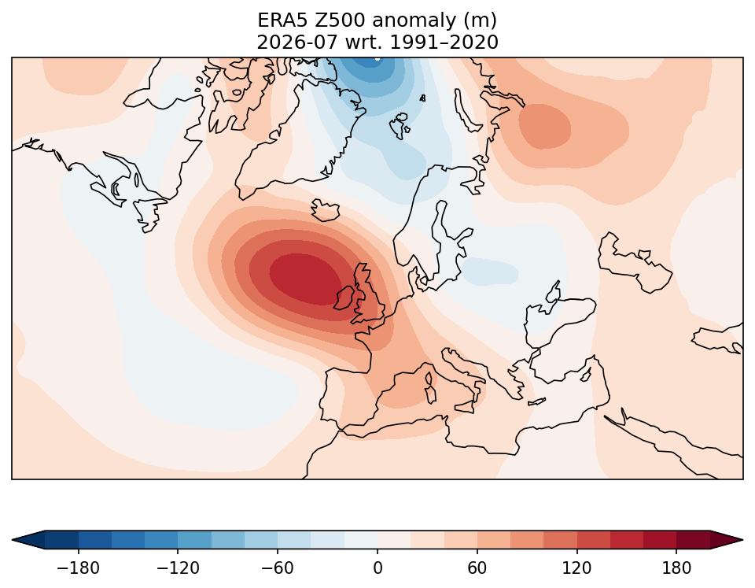
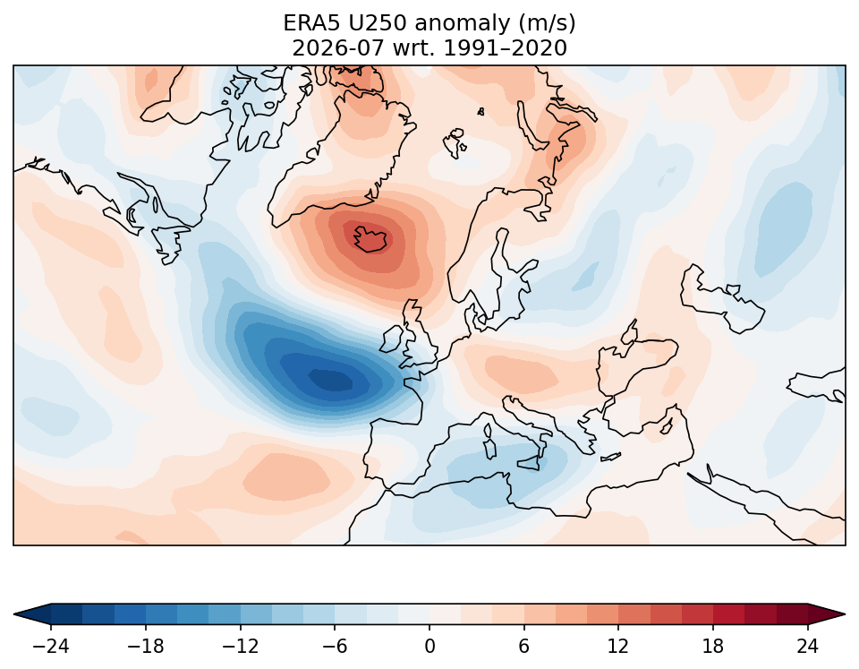
Hydrological and synoptic parameter anomalies
MM1STR MM1Y
IMG_HYDRO_C3S
IMG_MSLP_ANOM
IMG_Z500_ANOM
Mean Sea Level Pressure (hPa)
500 hPa Geopotential Height (m)
IMG_U250_ANOM
250 hPa Zonal Wind (m/s)

Slide 9
Lead 1 month forecast evaluation issued in MM2STR MM2Y

Slide 10
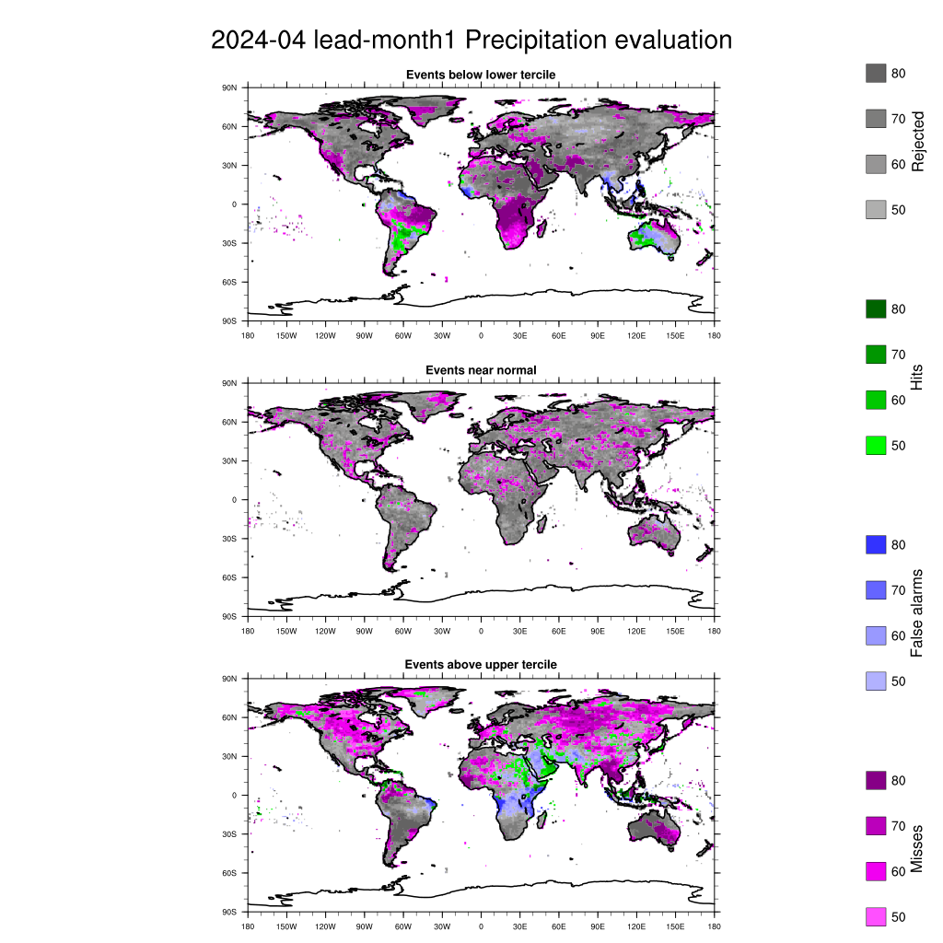
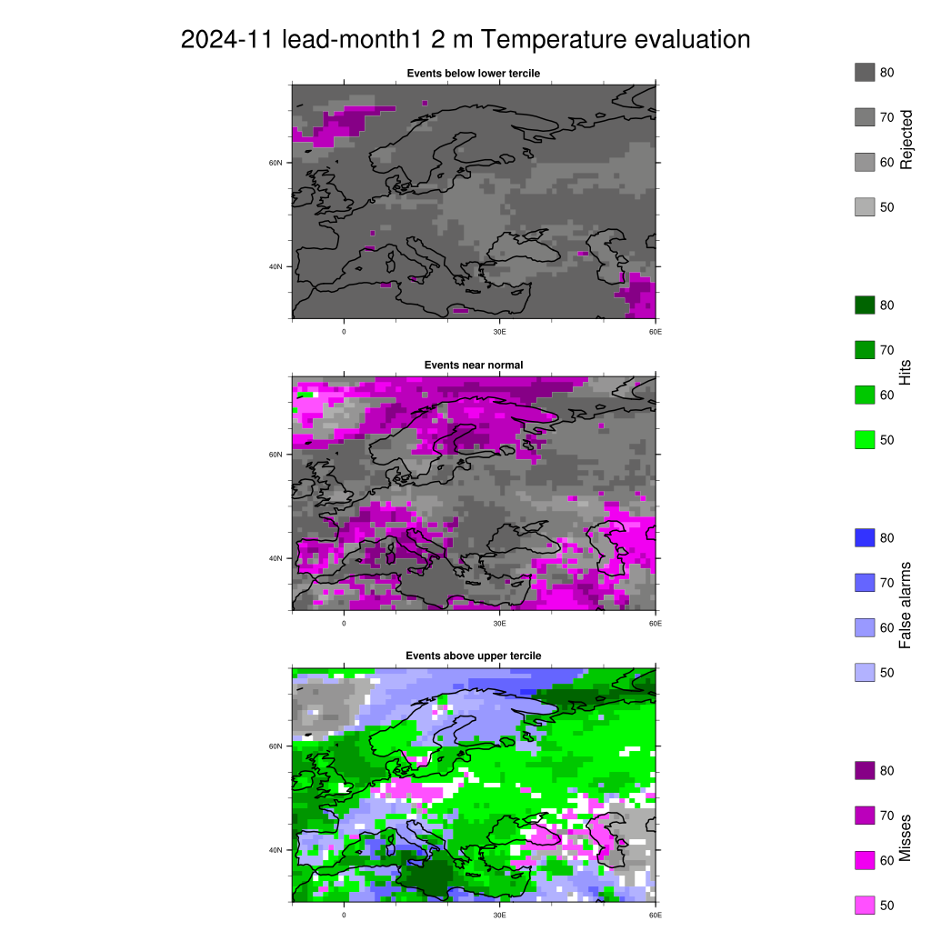
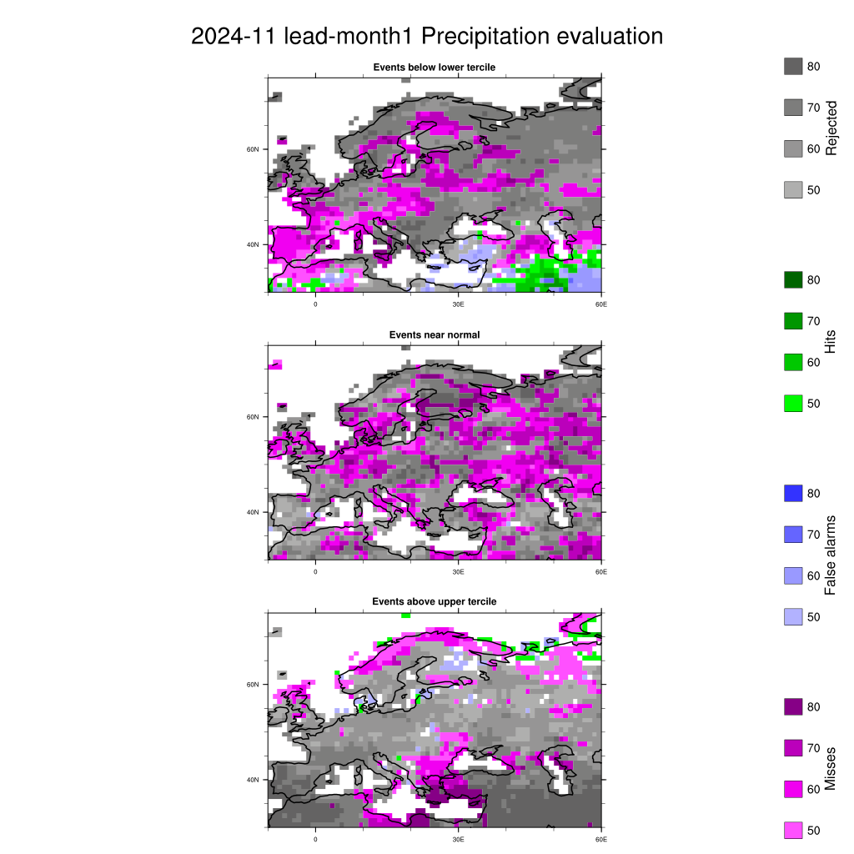
Evaluation: lead 1 month issued in MM2STR MM2Y
IMG_PRECIP_EVAL_EU
IMG_T2M_EVAL_EU
IMG_COLORBAR

Slide 11
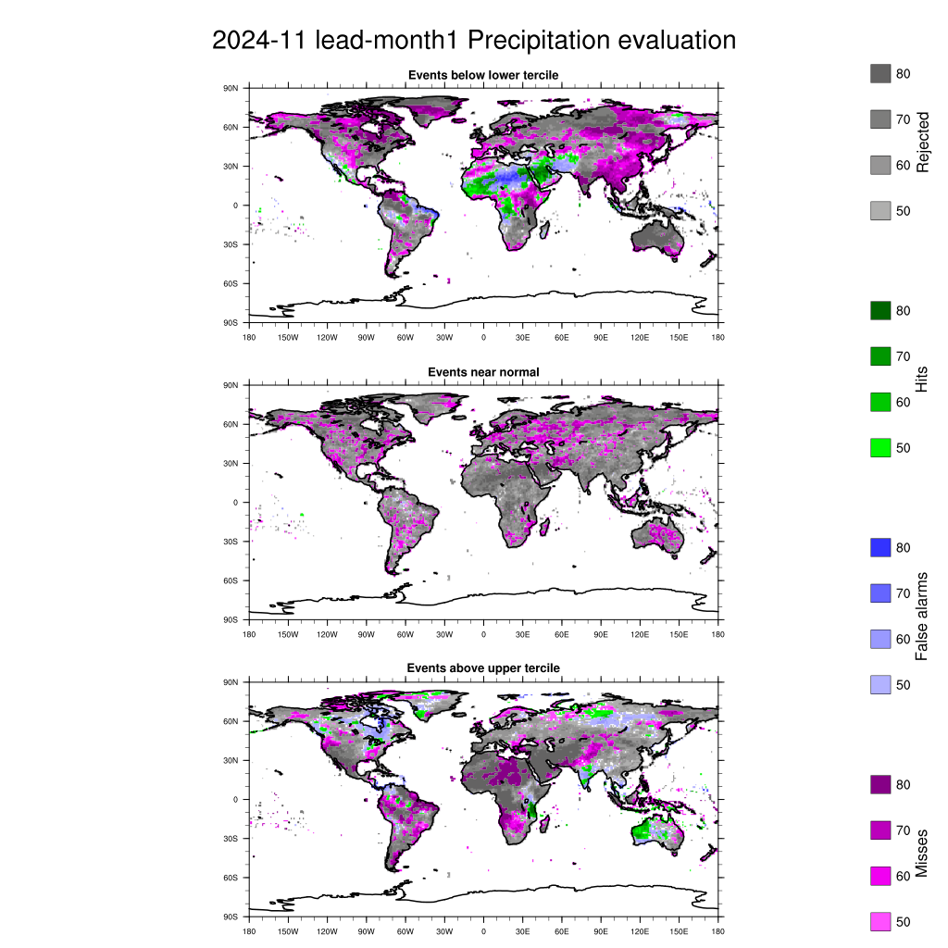
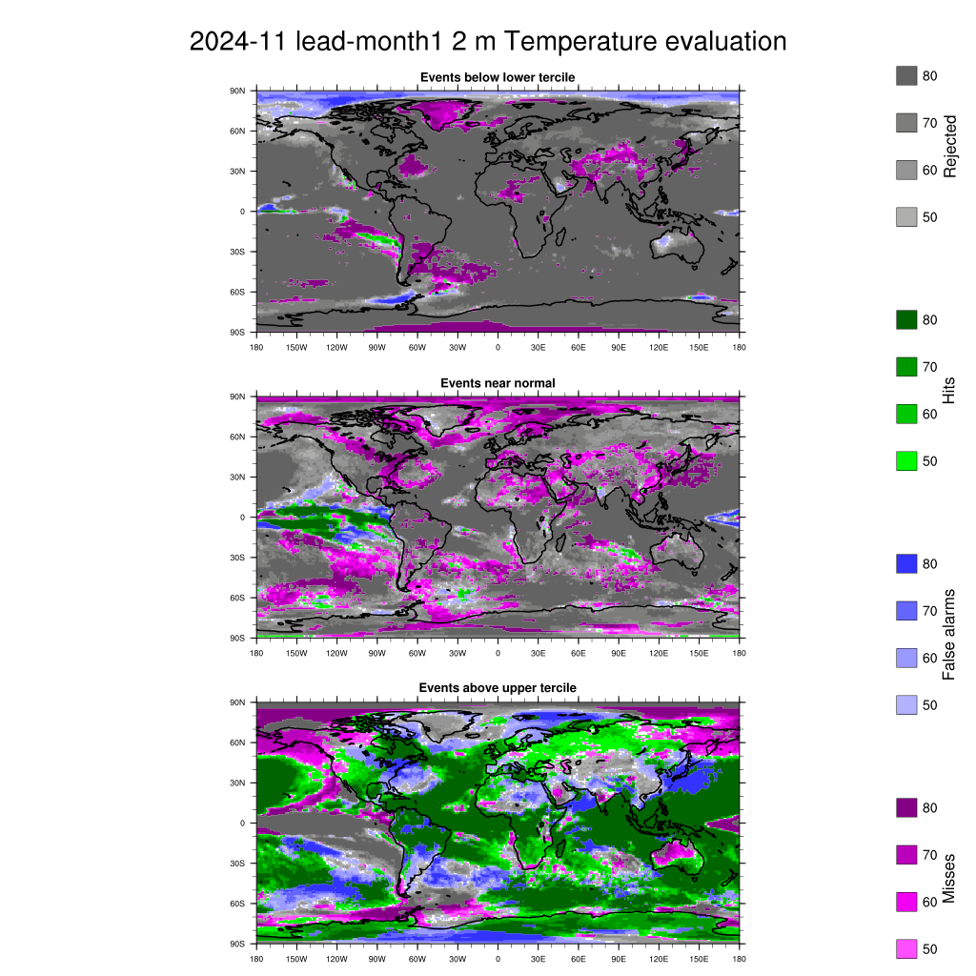
Evaluation: lead 1 month issued in MM2STR MM2Y
IMG_PRECIP_EVAL_GLOB
IMG_T2M_EVAL_GLOB
IMG_COLORBAR

Slide 12
SeAM1 forecast evaluation
issued in SM1ForeM SM1ForeY

Slide 13
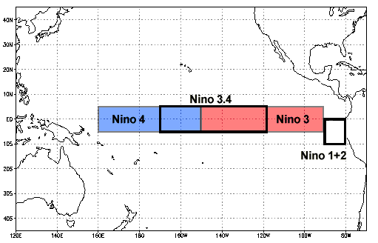
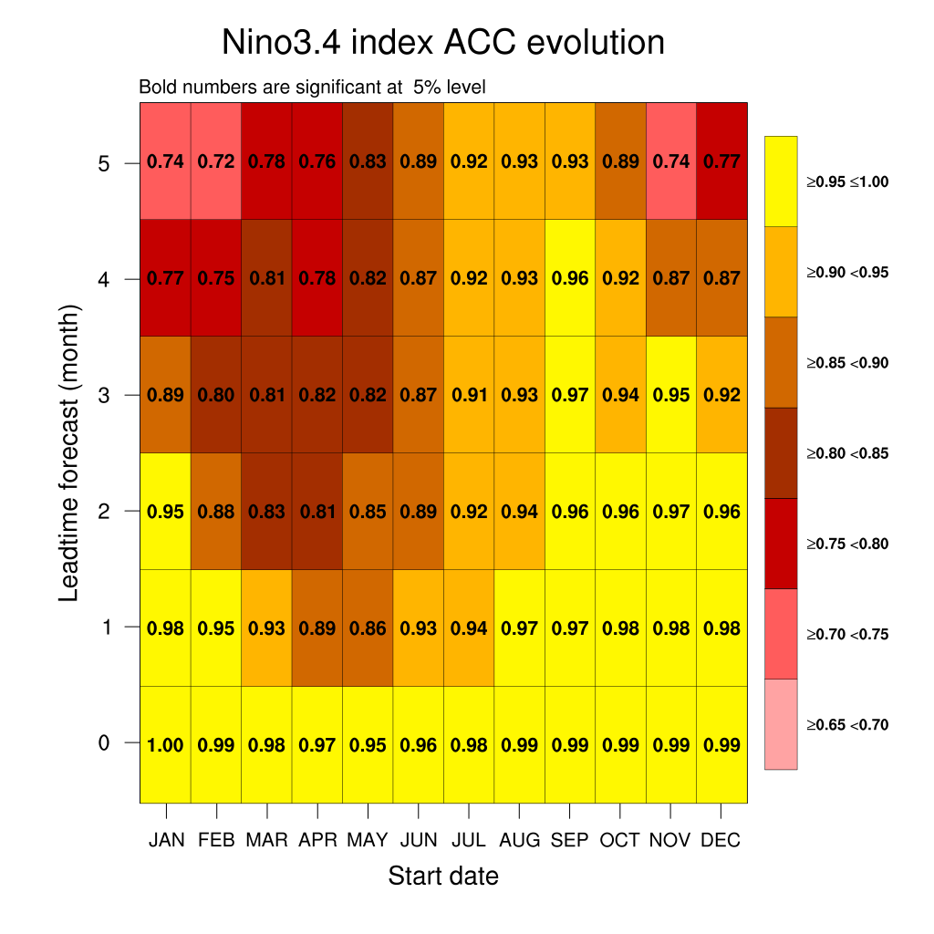
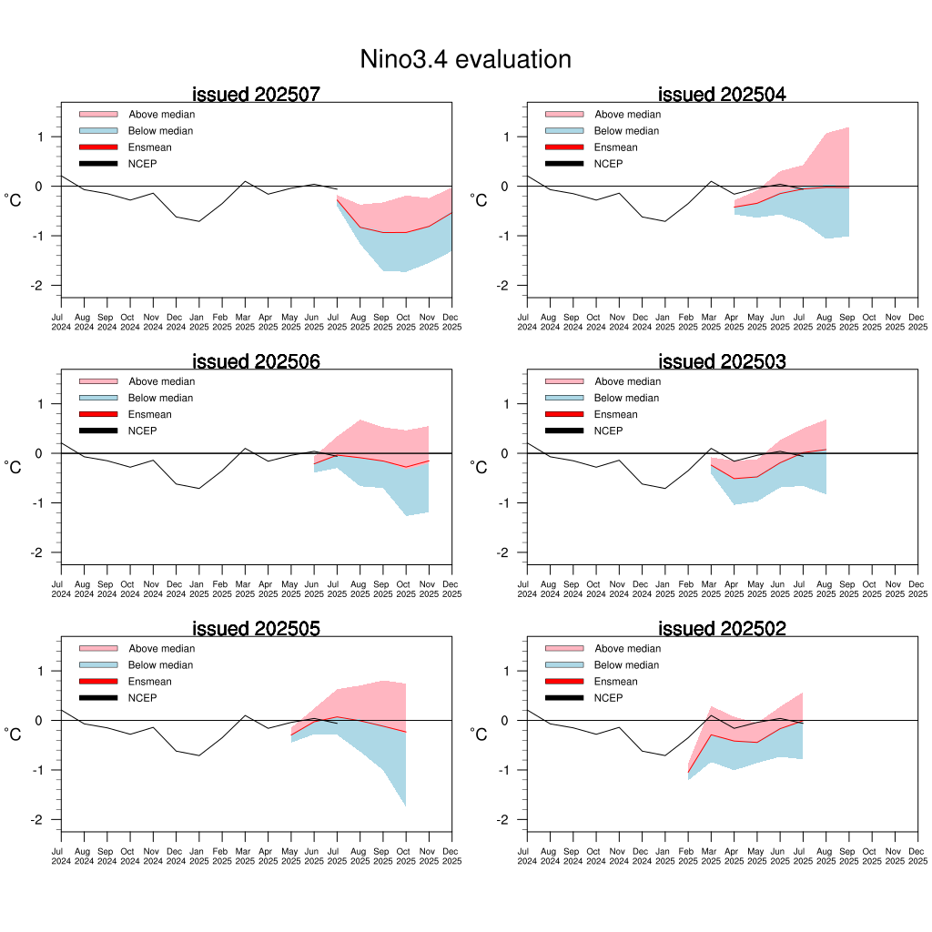
Evaluation: Nino3.4 (from MM6STR MM6Y to MM1STR MM1Y)
IMG_NINO_EVAL

Slide 14
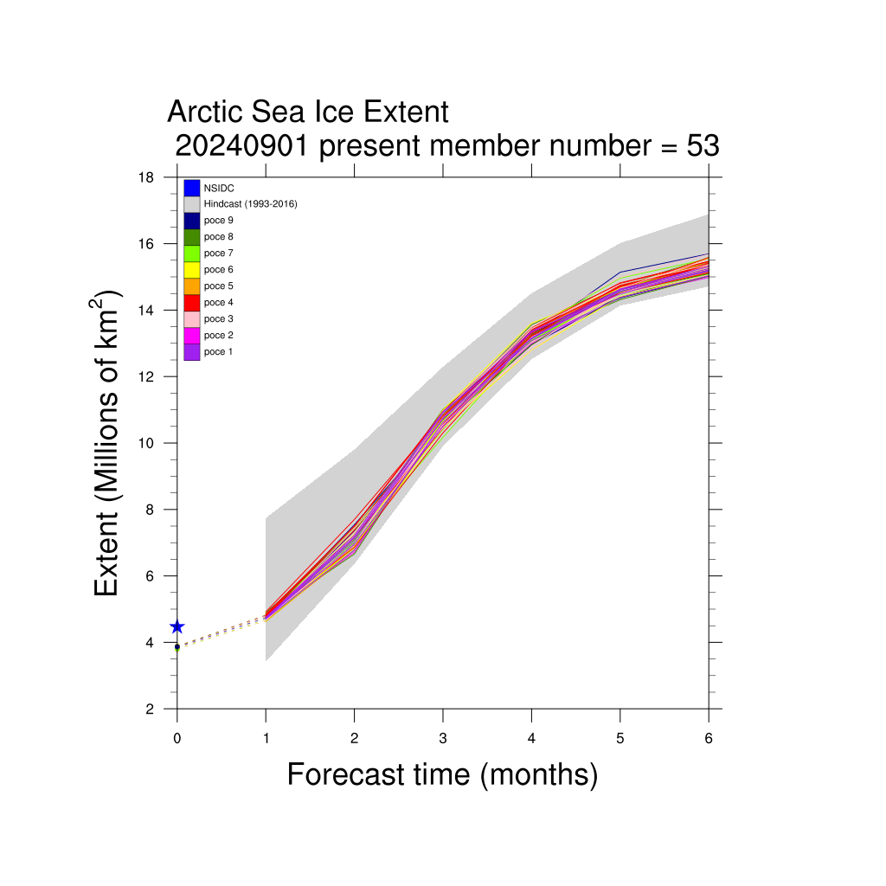
Sea-ice verification forecast SM1ForeM SM1ForeY
IMG_SIE_EVAL

Slide 15
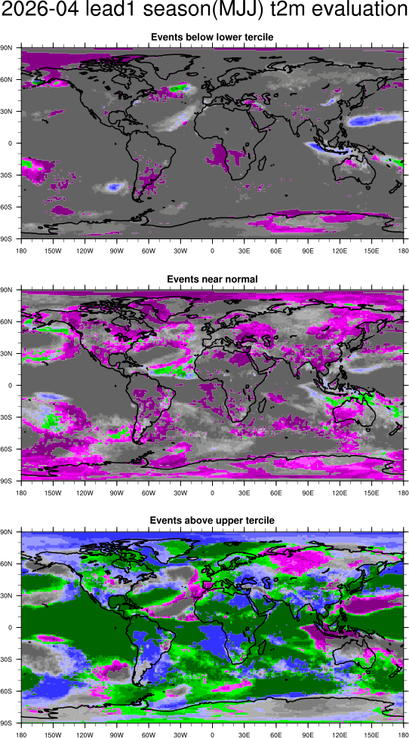
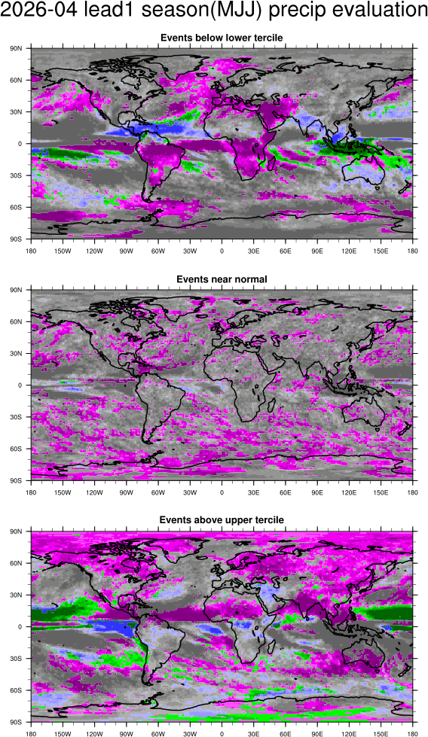
Evaluation maps SeAM1 issued in SM1ForeM SM1ForeY
IMG_PRECIP_EVAL_GLOB_SEASON
IMG_T2M_EVAL_GLOB_SEASON
IMG_COLORBAR

Slide 16
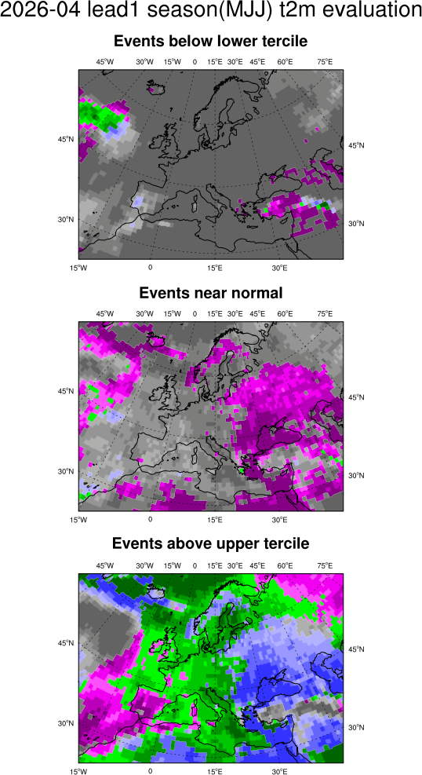
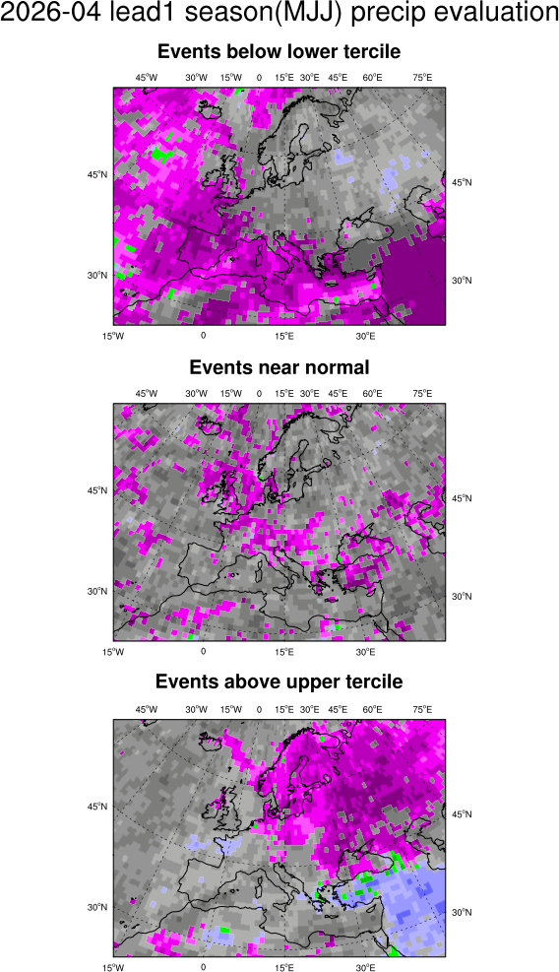
Evaluation maps SeAM1 issued in SM1ForeM SM1ForeY
IMG_PRECIP_EVAL_EU_SEASON
IMG_T2M_EVAL_EU_SEASON
IMG_COLORBAR

Slide 17
FORECAST
issued in ThisM ThisY

Slide 18
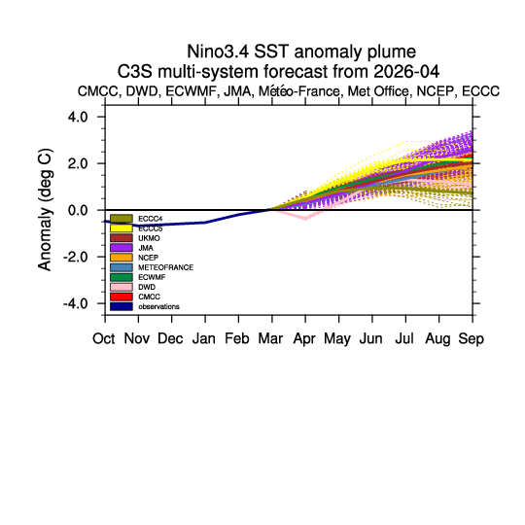
Nino3.4 issued in ThisM ThisY – C3S Multi-model
IMG_C3S_MME_NINO

Slide 19
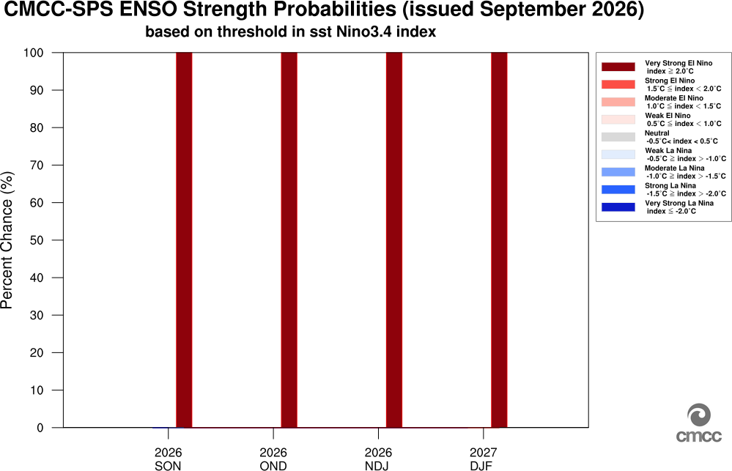
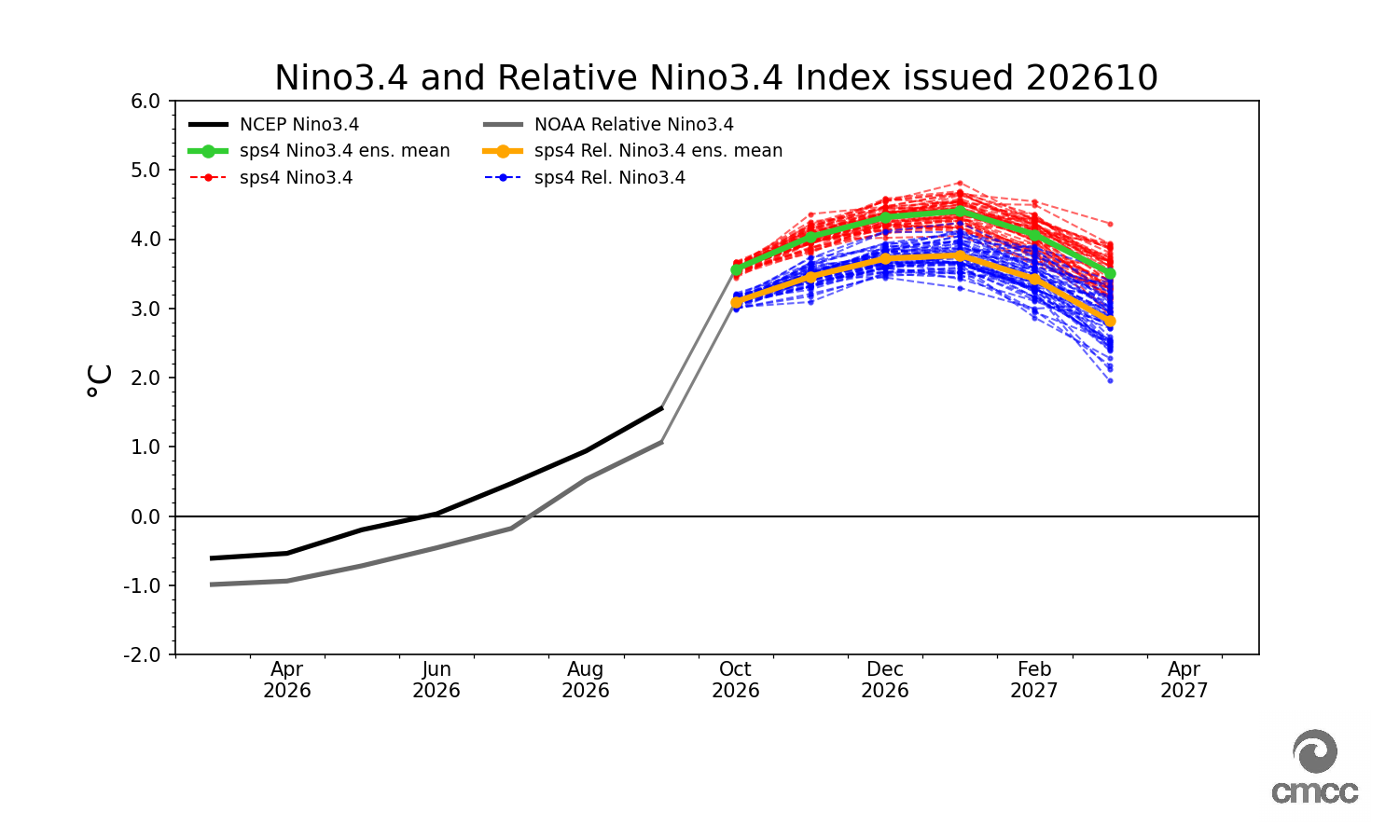
Nino3.4 issued in ThisM ThisY – CMCC SPS4
IMG_SST_NINO_PROB
IMG_SST_NINO_MEM

Slide 20
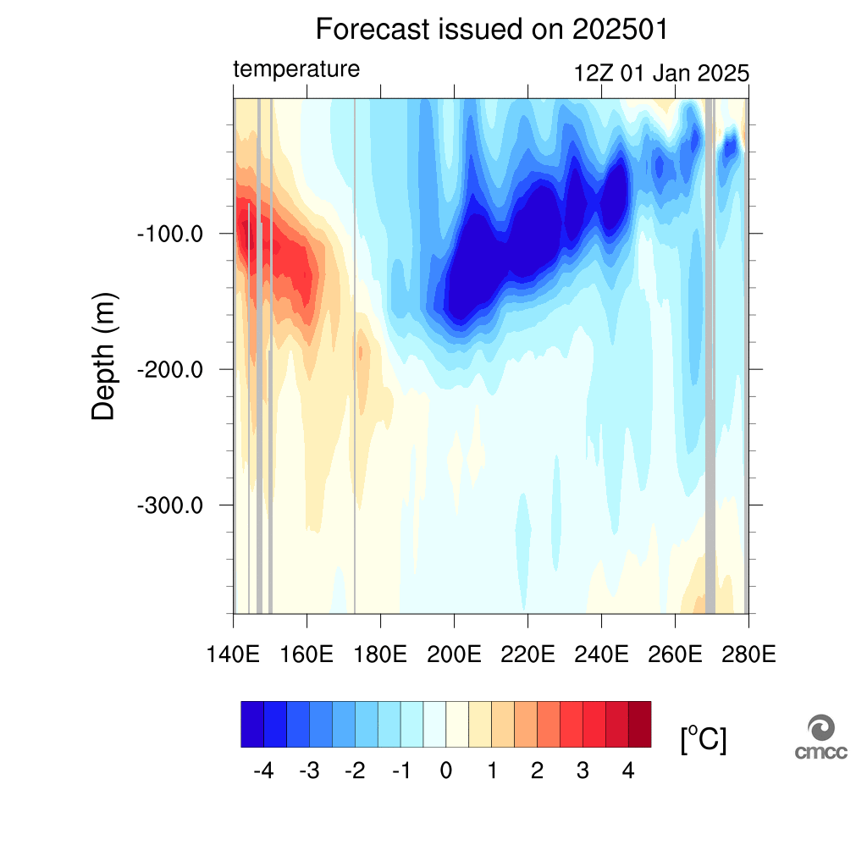
Potential temperature (meridional average 2.5S: 2.5N) vertical section issued in ThisM ThisY
IMG_TPROF_PAC_TROP

Slide 21
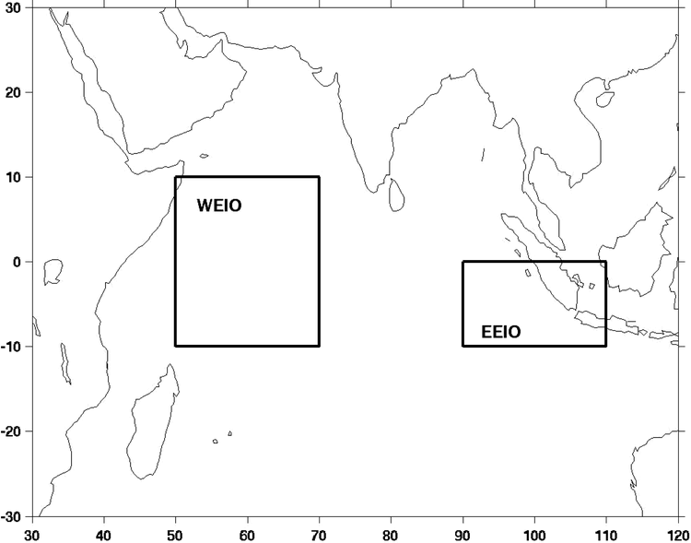
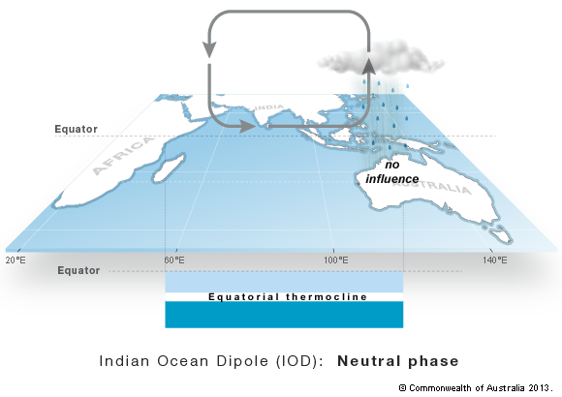
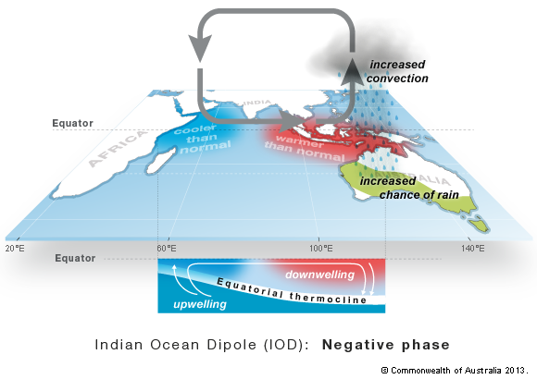
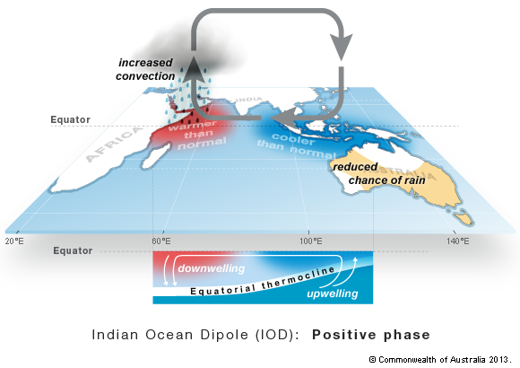
Indian Ocean Dipole – ThisM ThisY

Slide 22
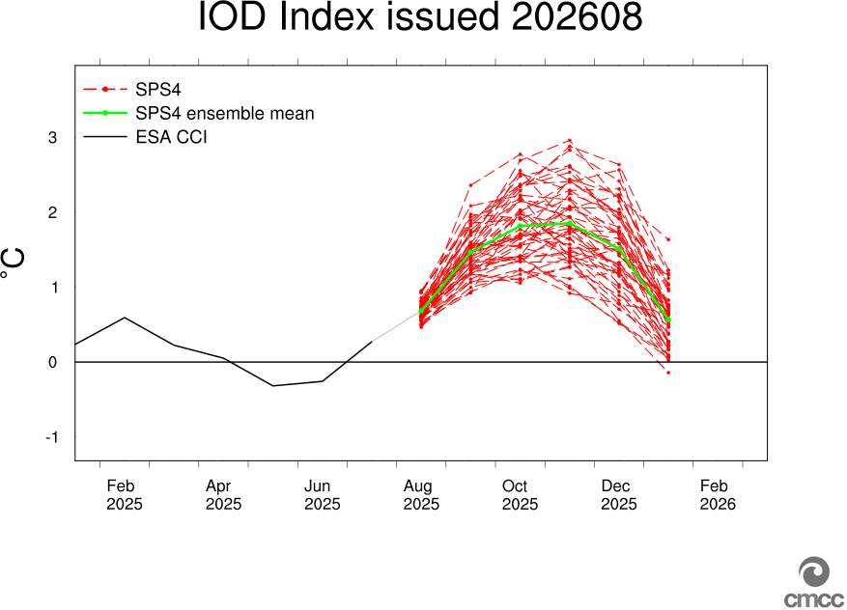
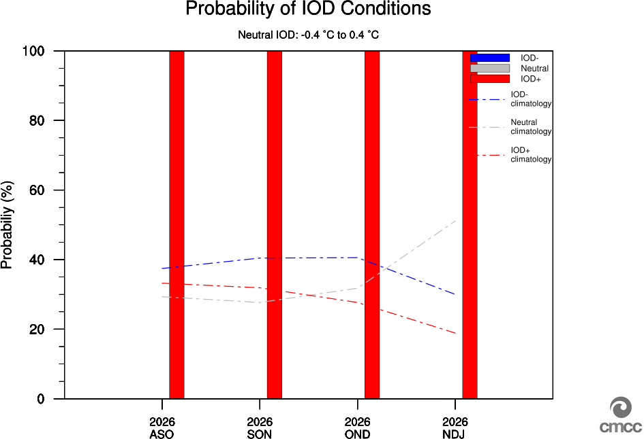
Indian Ocean Dipole – ThisM ThisY
IMG_IOD_MEM
IMG_IOD_PROB

Slide 23
FORECAST
Lead1 season (SEA)
issued in ThisM ThisY

Slide 24
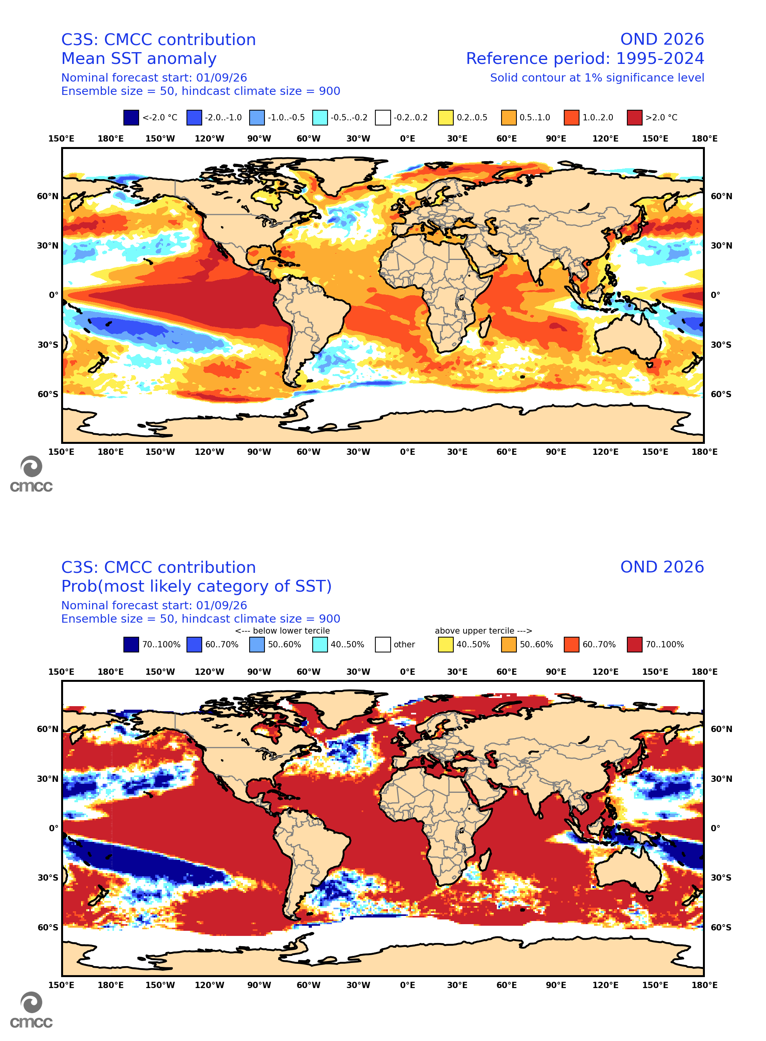
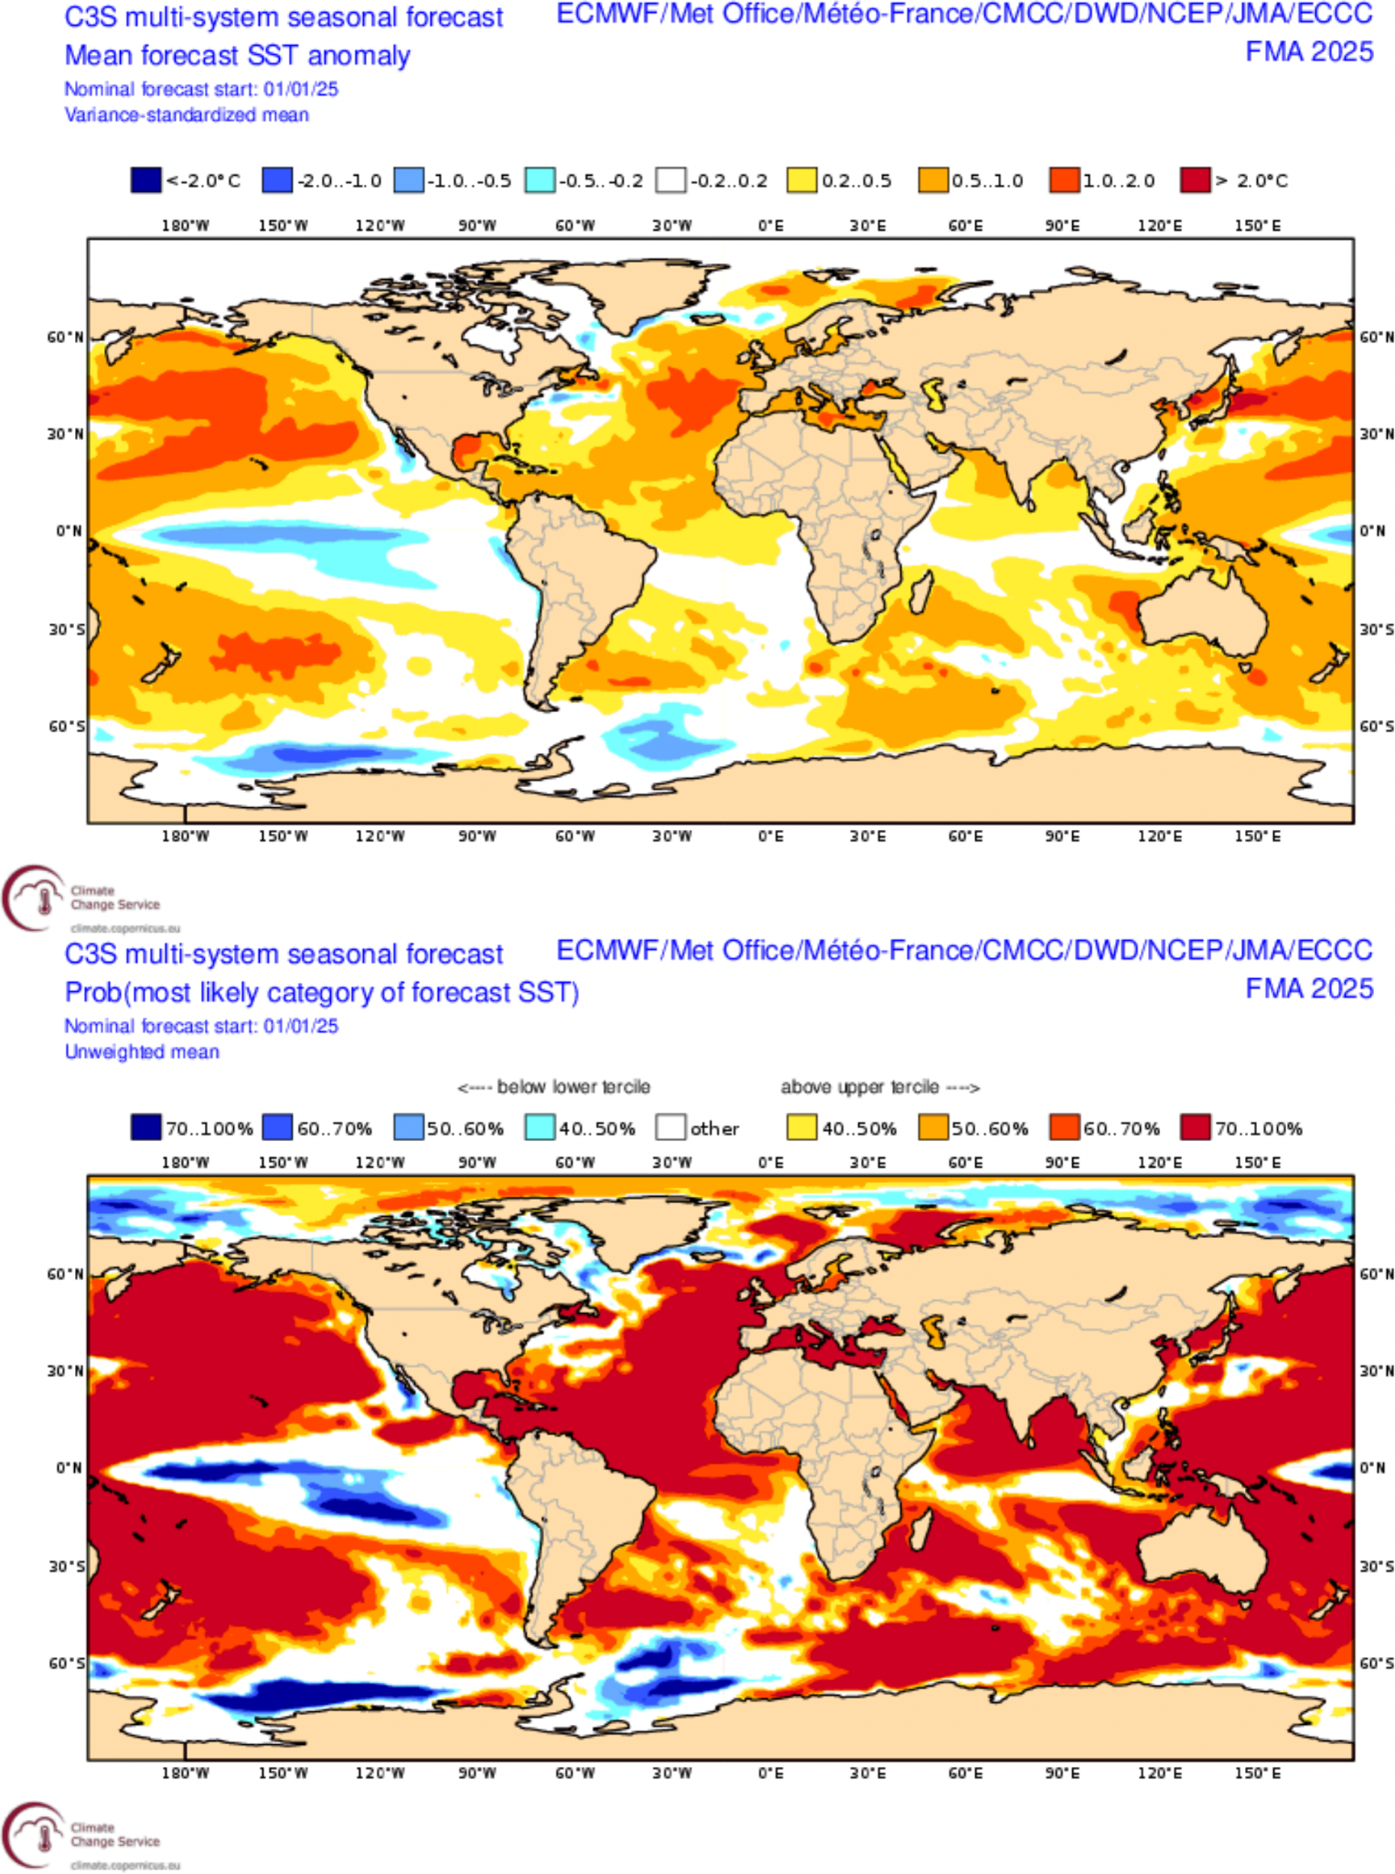
SEA SST issued in ThisM ThisY
CMCC
C3S multi-model
IMG_SSTO_FORE_CMCC
IMG_SSTO_FORE_MM
Ensemble mean anomaly
Ensemble mean anomaly
Tercile summary
Tercile summary

Slide 25
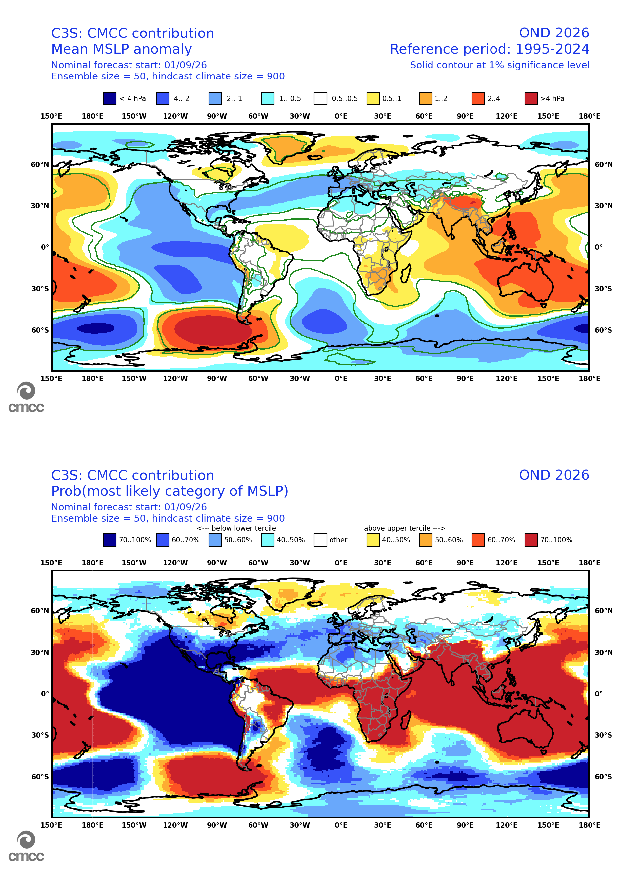
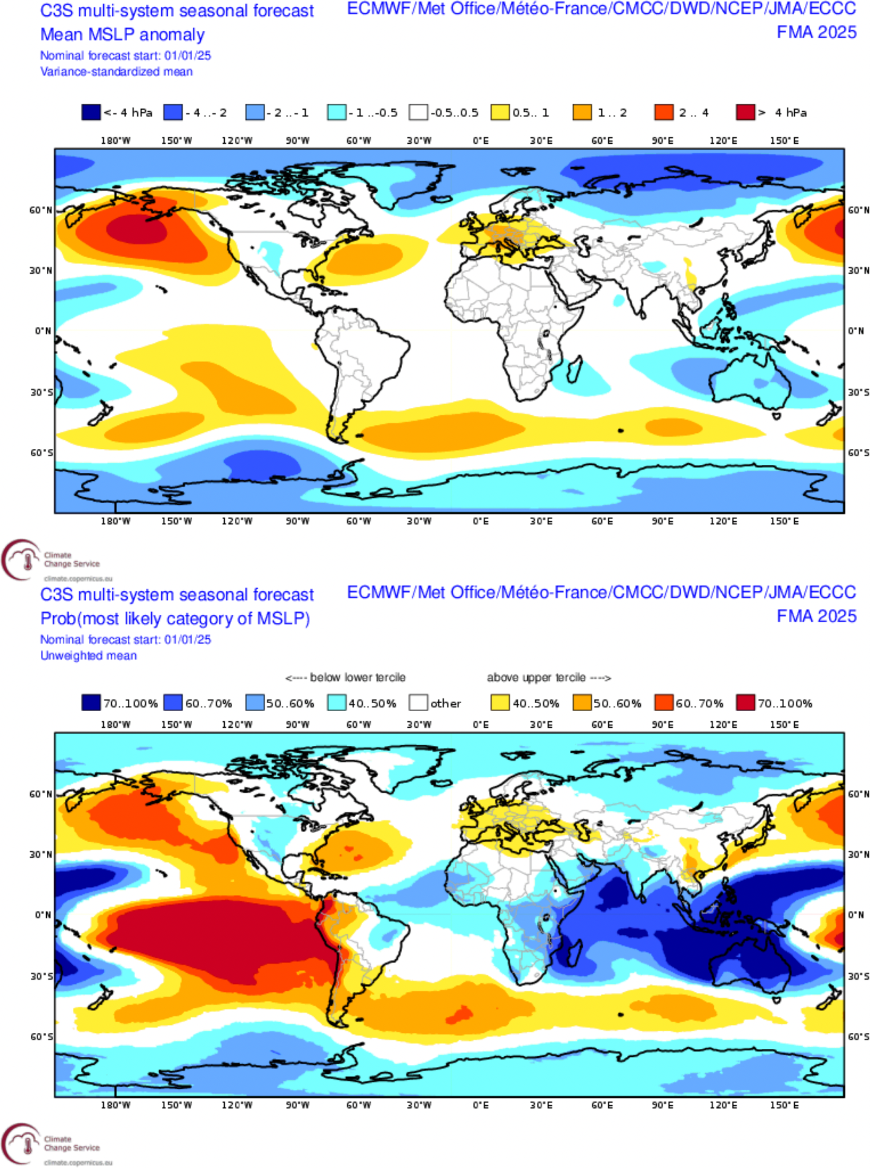
SEA MSLP issued in ThisM ThisY
CMCC
C3S multi-model
IMG_MSLP_FORE_CMCC
IMG_MSLP_FORE_MM
Ensemble mean anomaly
Ensemble mean anomaly
Tercile summary
Tercile summary

Slide 26
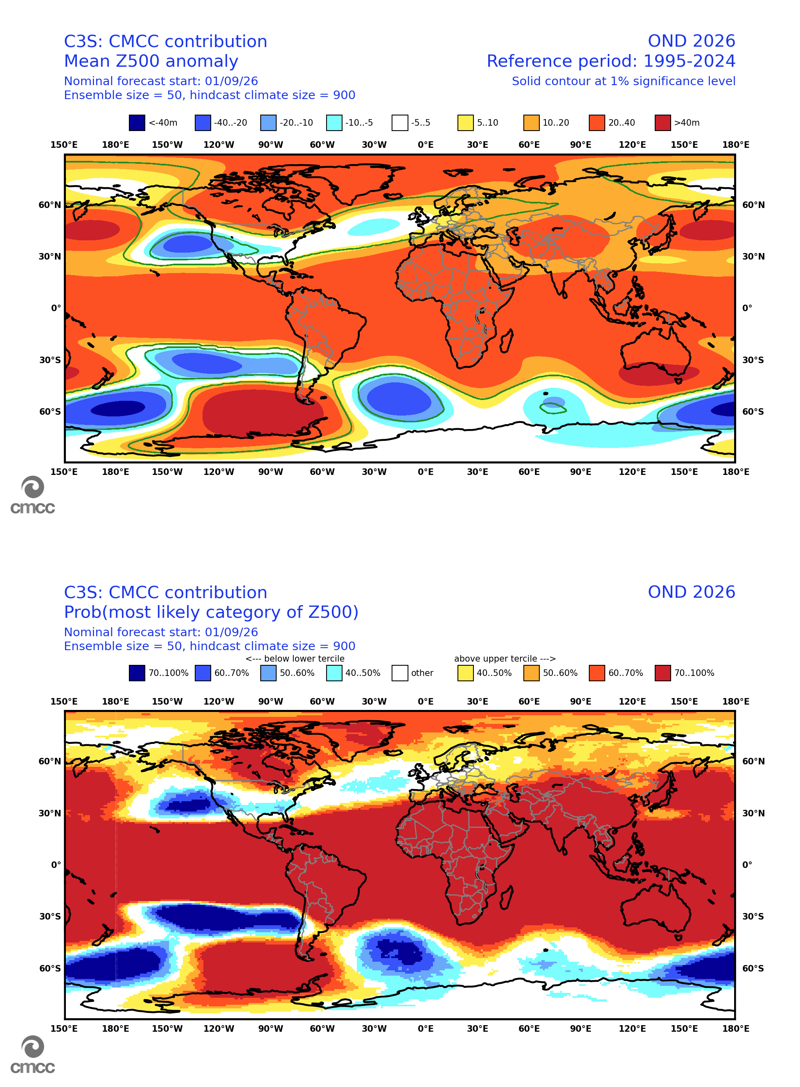
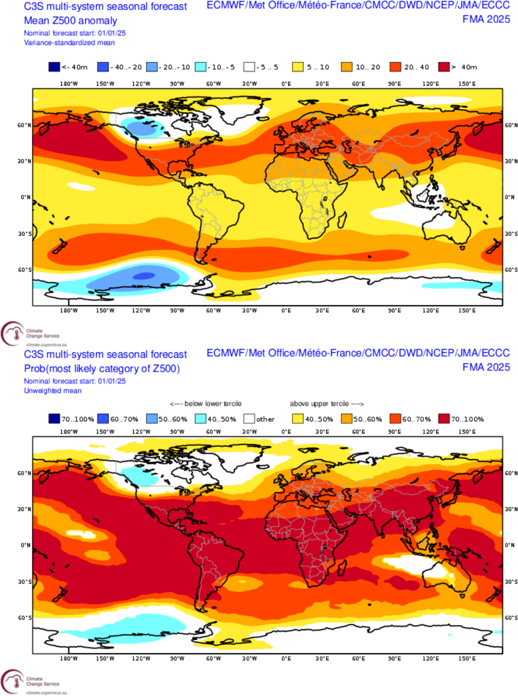
SEA Z500 issued in ThisM ThisY
CMCC
C3S multi-model
IMG_Z500_FORE_CMCC
IMG_Z500_FORE_MM
Ensemble mean anomaly
Ensemble mean anomaly
Tercile summary
Tercile summary

Slide 27
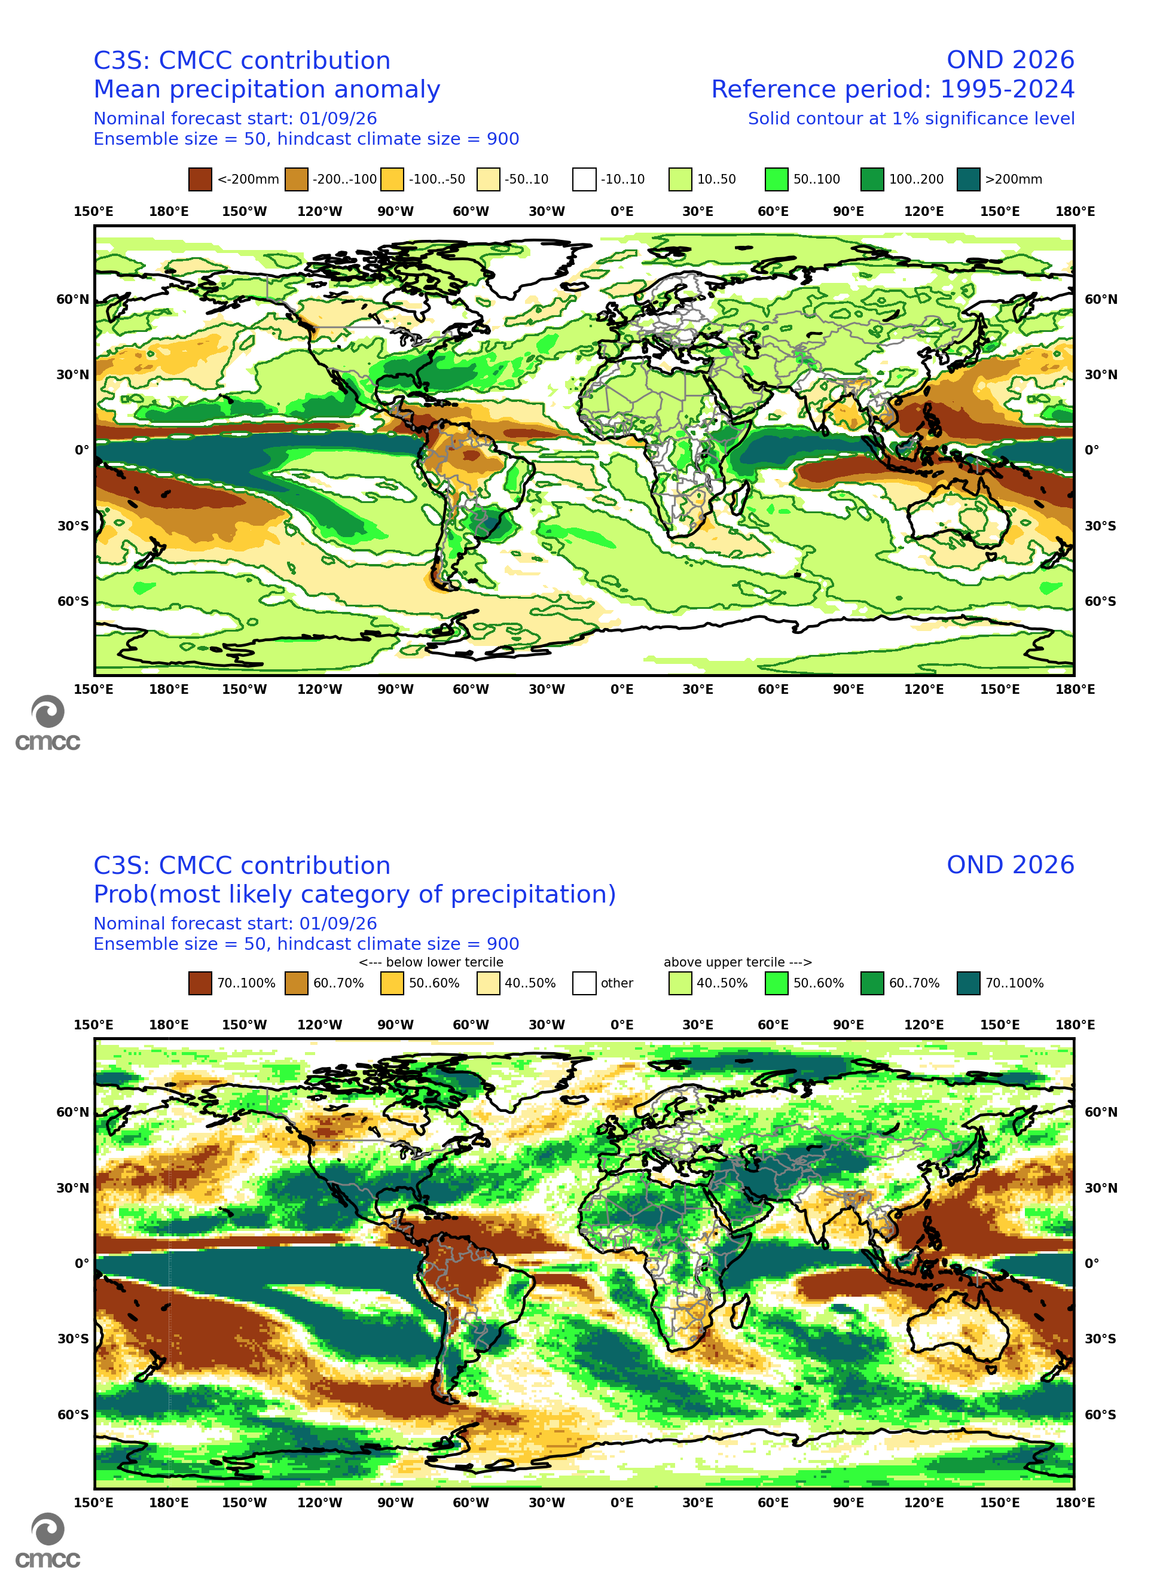
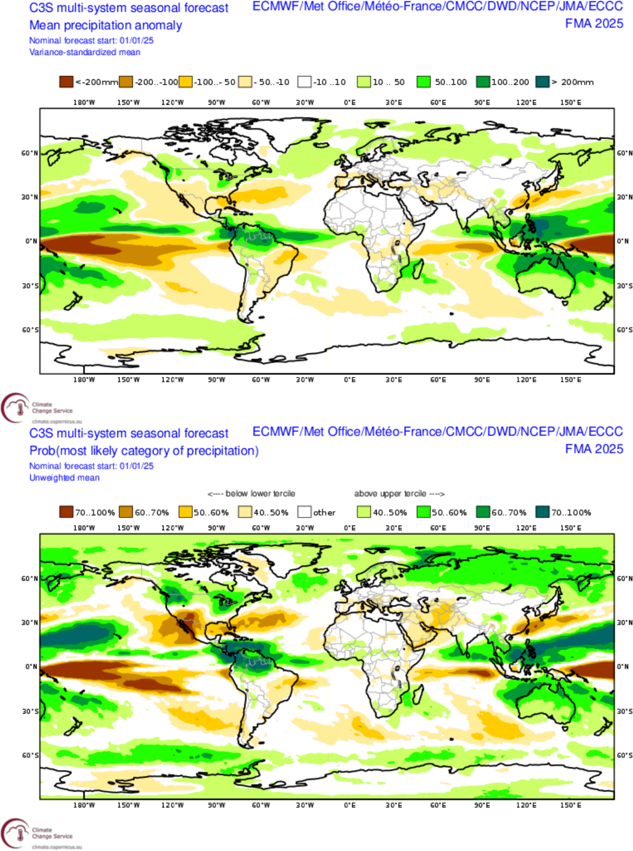
SEA PREC issued in ThisM ThisY
CMCC
C3S multi-model
IMG_RAIN_FORE_CMCC
IMG_RAIN_FORE_MM
Ensemble mean anomaly
Ensemble mean anomaly
Tercile summary
Tercile summary

Slide 28
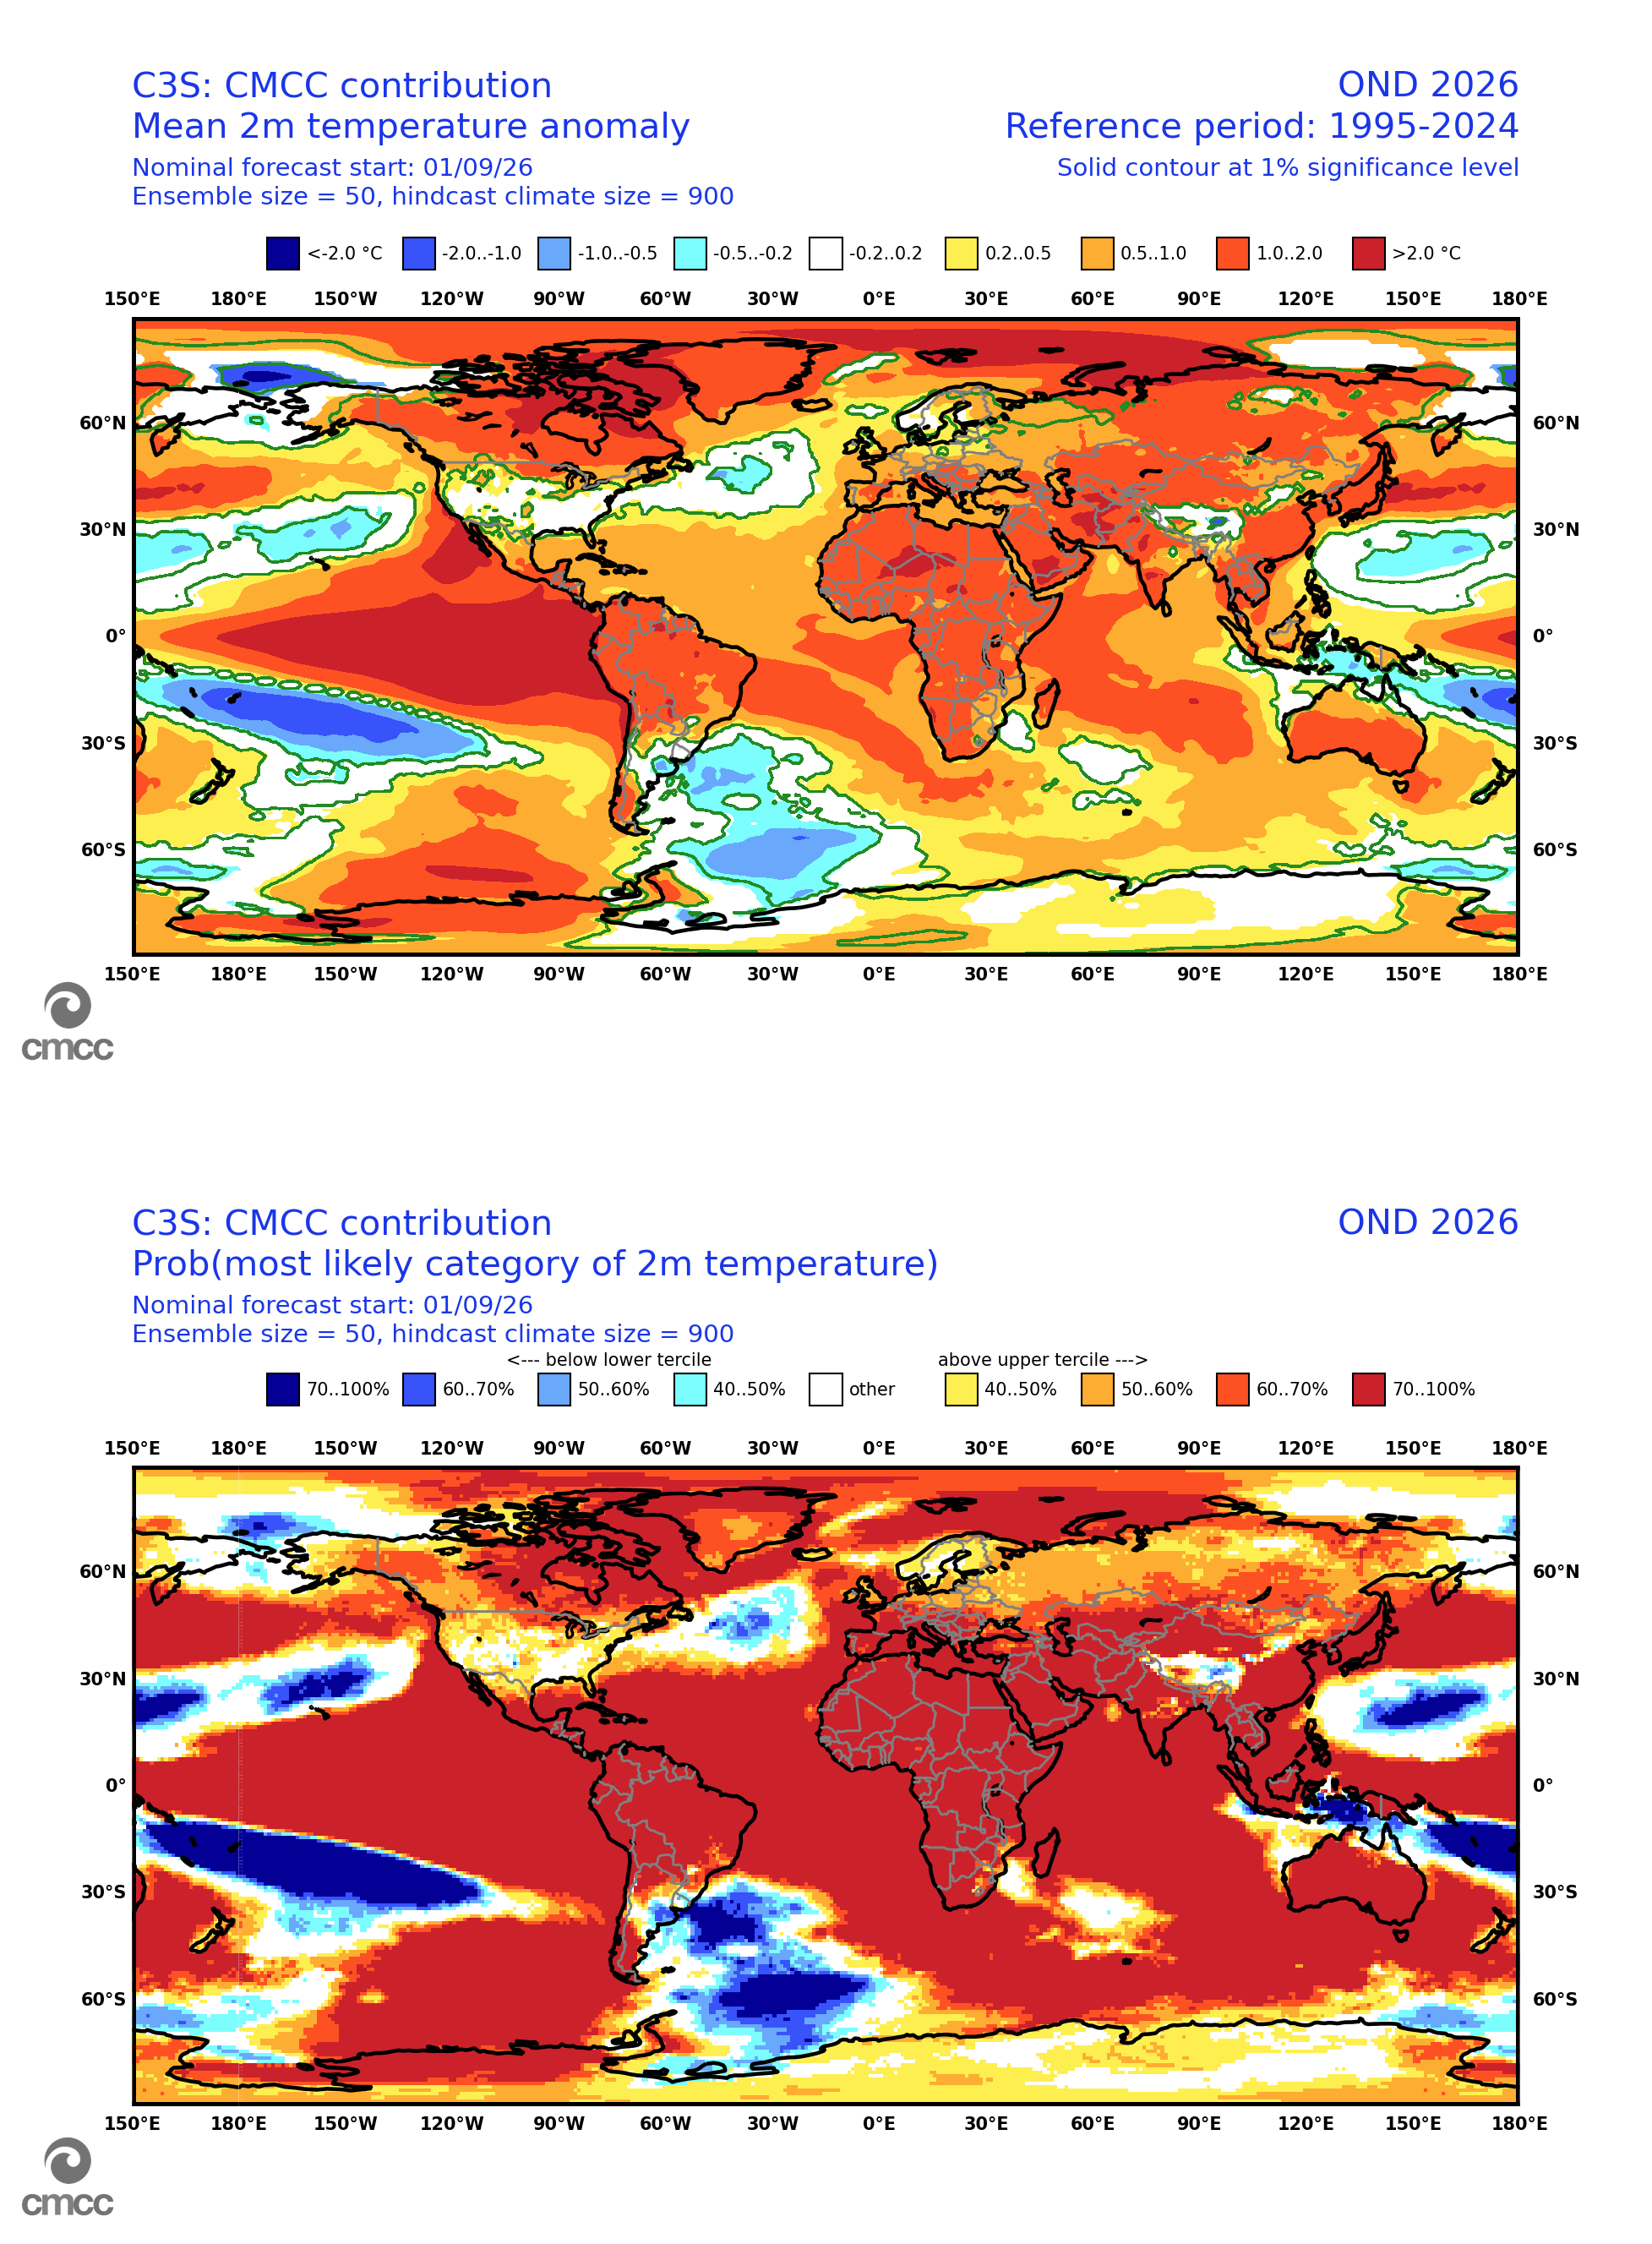
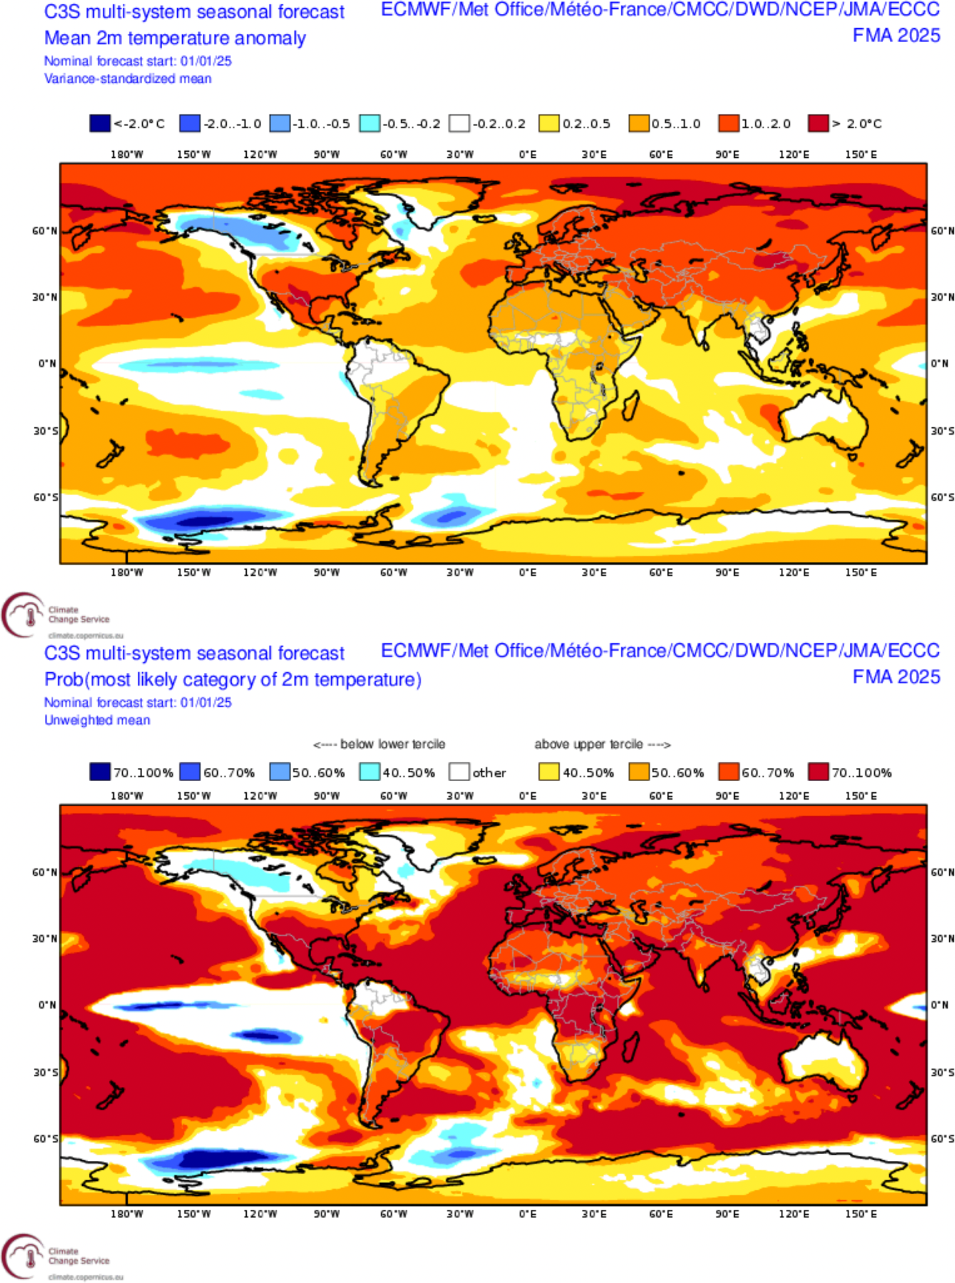
SEA T2M issued in ThisM ThisY
CMCC
C3S multi-model
IMG_2MTM_FORE_CMCC
IMG_2MTM_FORE_MM
Ensemble mean anomaly
Ensemble mean anomaly
Tercile summary
Tercile summary

Slide 29
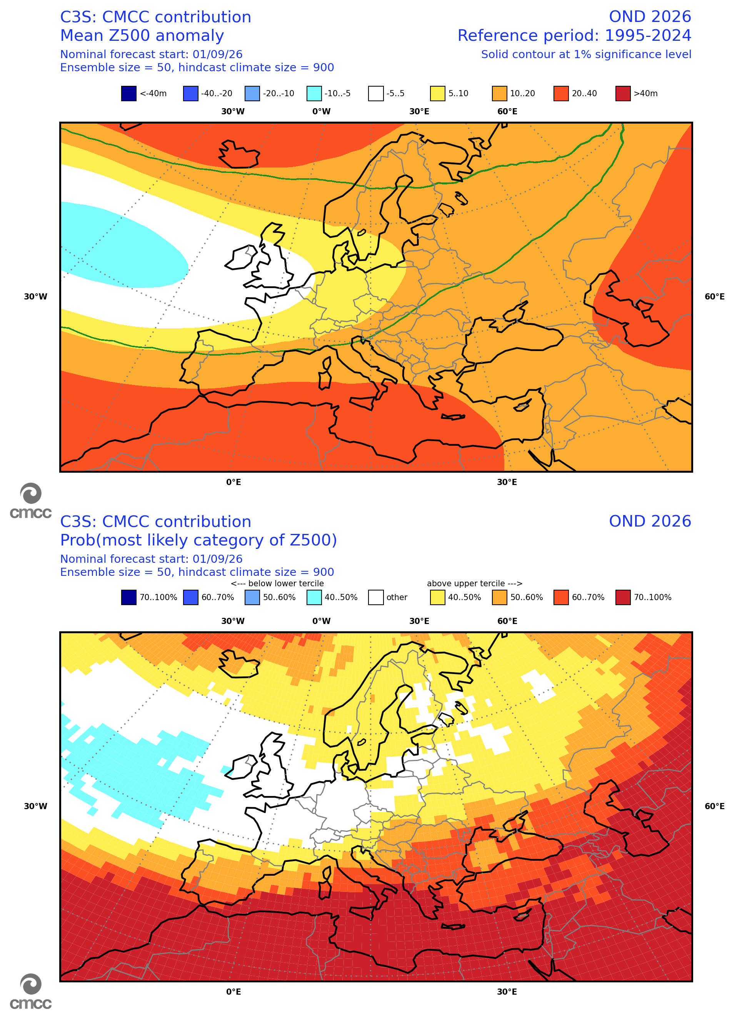
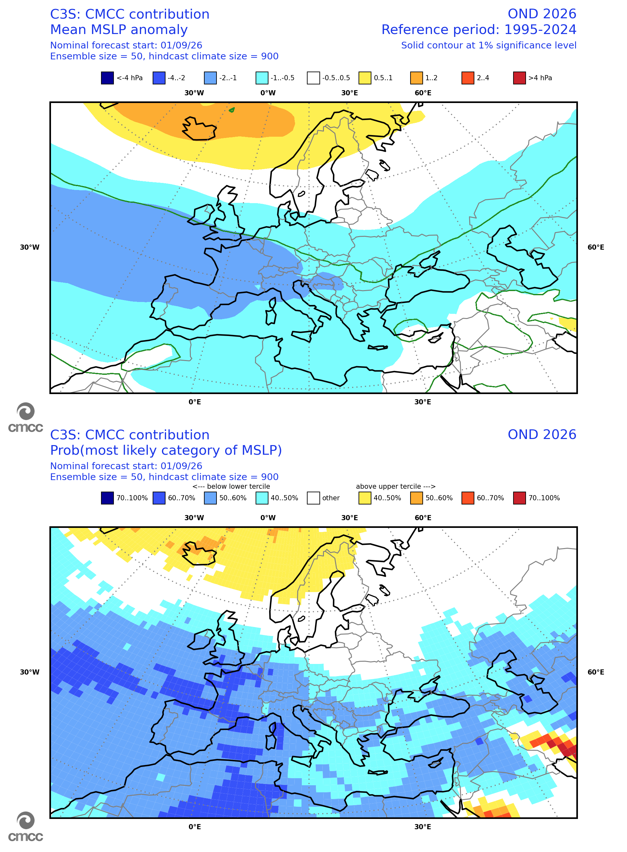
CMCC SEA over Europe: Z500 and MSLP
Z500
MSLP
IMG_Z500_EURO_CMCC
IMG_MSLP_EURO_CMCC
Ensemble mean anomaly
Ensemble mean anomaly
Tercile summary
Tercile summary

Slide 30
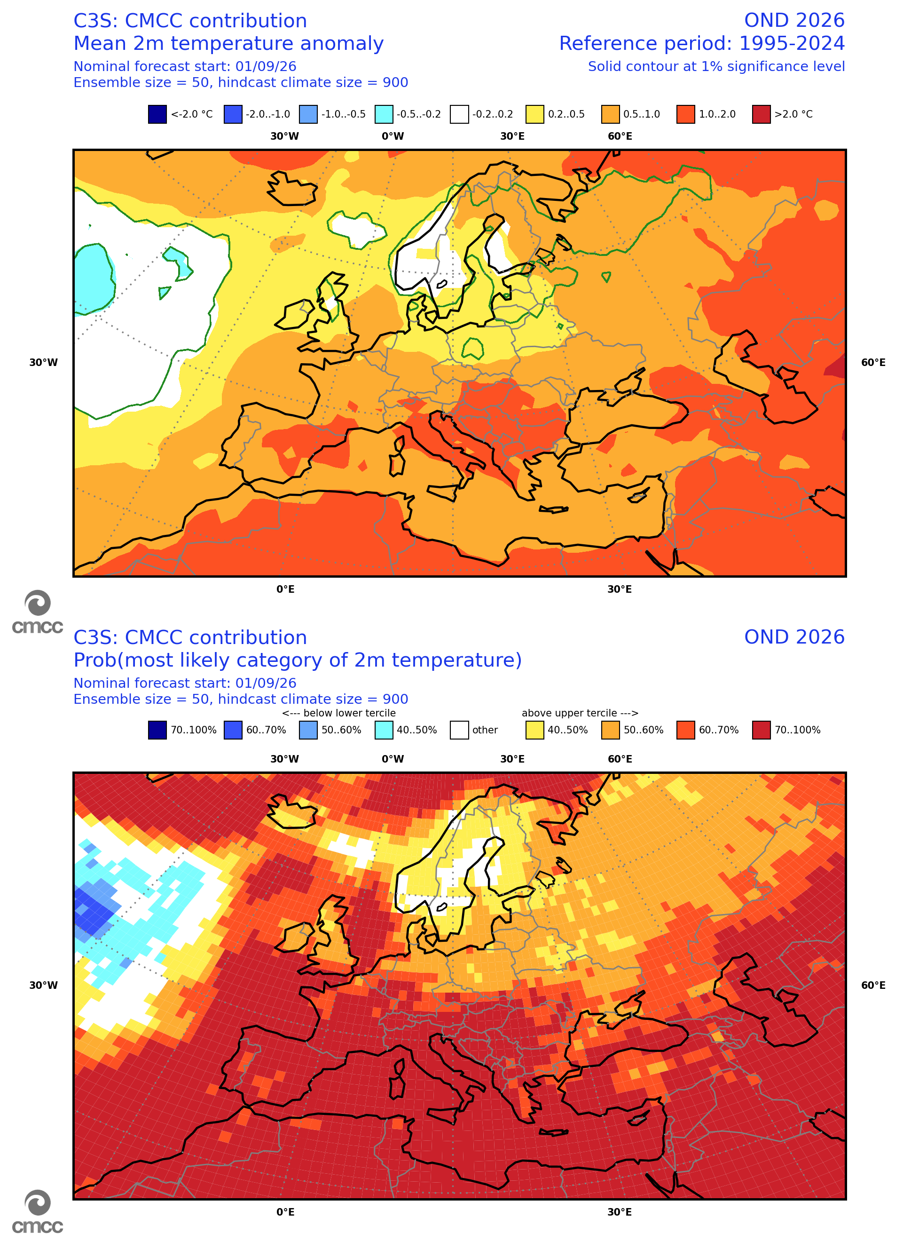
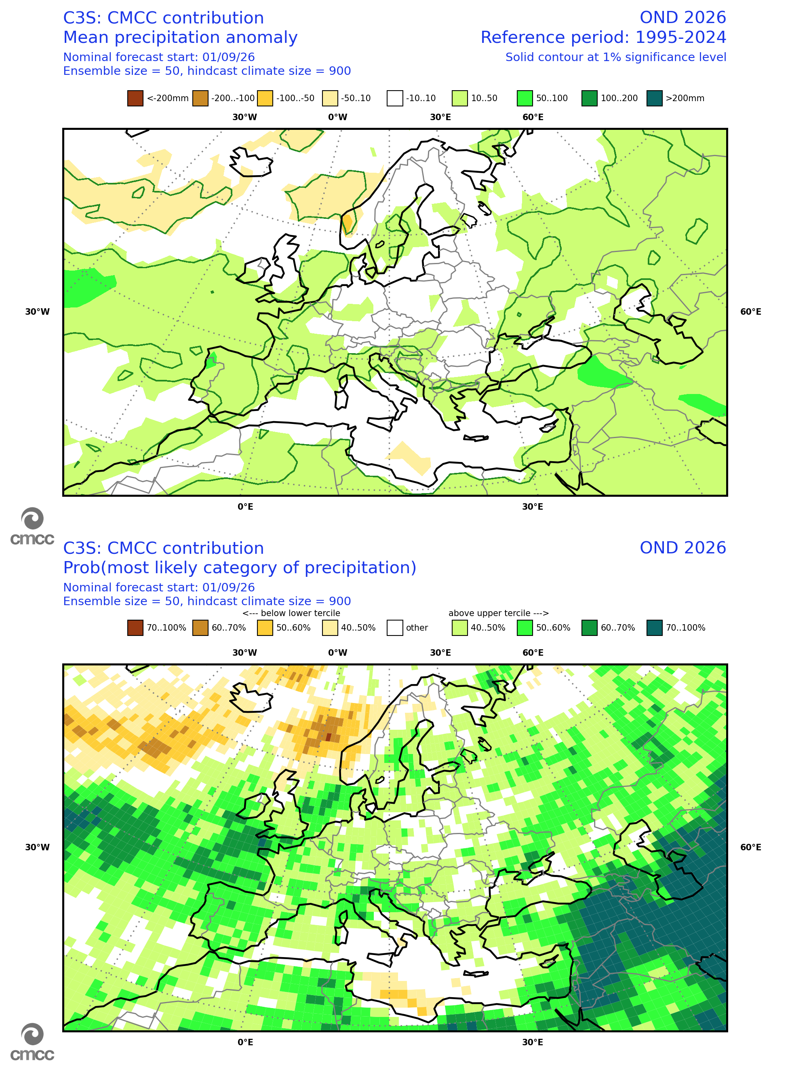
CMCC SEA over Europe: T2M and PREC
T2M
PREC
IMG_2MTM_EURO_CMCC
IMG_RAIN_EURO_CMCC
Ensemble mean anomaly
Ensemble mean anomaly
Tercile summary
Tercile summary

Slide 31

CMCC SEA over Euro-Mediterranean area
IMG_FORECAST_SUMMARY
WET
DRY
HOT
COLD

Slide 32



www.cmcc.it

Slide 33



West Indian Monsoon Index – ThisM ThisY
IMG_FORECAST_WAMI
IMG_FORECAST_WAMI_PROB

