Slide 1
Seasonal Prediction System SPS4
ThisM ThisY Outlook

Slide 2
Outline
1. Last month highlights:
observed climate conditions for MM1STR MM1Y
2. Last lead 1 month evaluation:
MM1STR MM1Y issued in MM2STR MM2Y
3. Last season forecast evaluation:
SeAM1 issued in SM1ForeM SM1ForeY
4. Outlook for ThisM ThisY lead 1 season (SEA)
  Global outlook
  Focus over Europe
  Summary

Slide 3
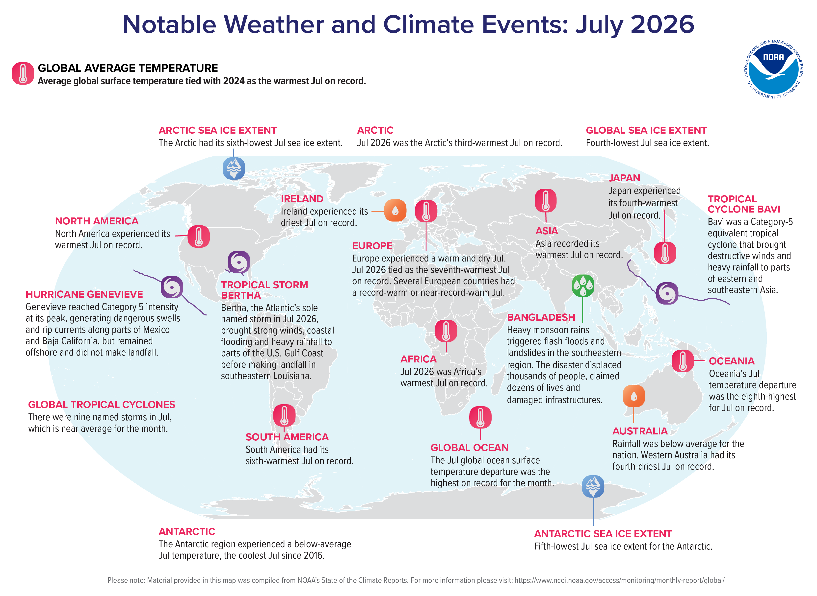
Significant Events

Slide 4
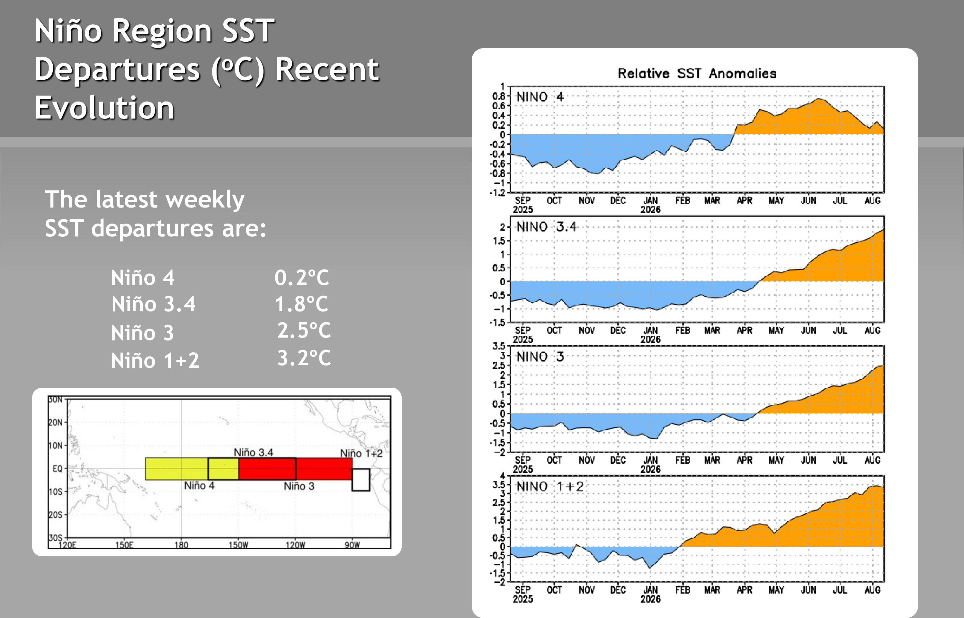
SST anomalies MM1STR MM1Y: ENSO

Slide 5
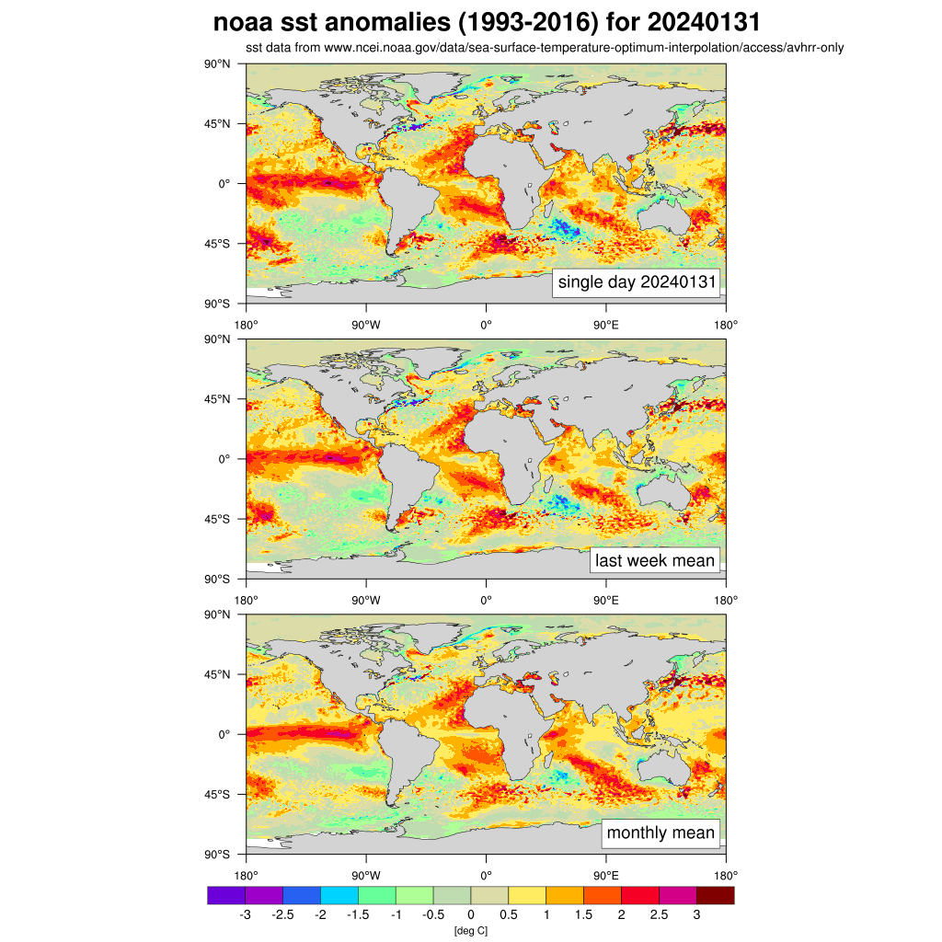
SST anomalies MM1STR MM1Y: Global
ESA-CCI-OSTIA SST anomalies (1991-2020) for MM1YMM1NDDM1
SST data from ESA CCI/OSTIA SST
Positive anomalies across the tropical Pacific, with the characteristic warm tongue on the Western coast of South America
Warm pattern the Atlantic
warm pattern across the North Pacific slightly Decreased compared to previous month.

Slide 6
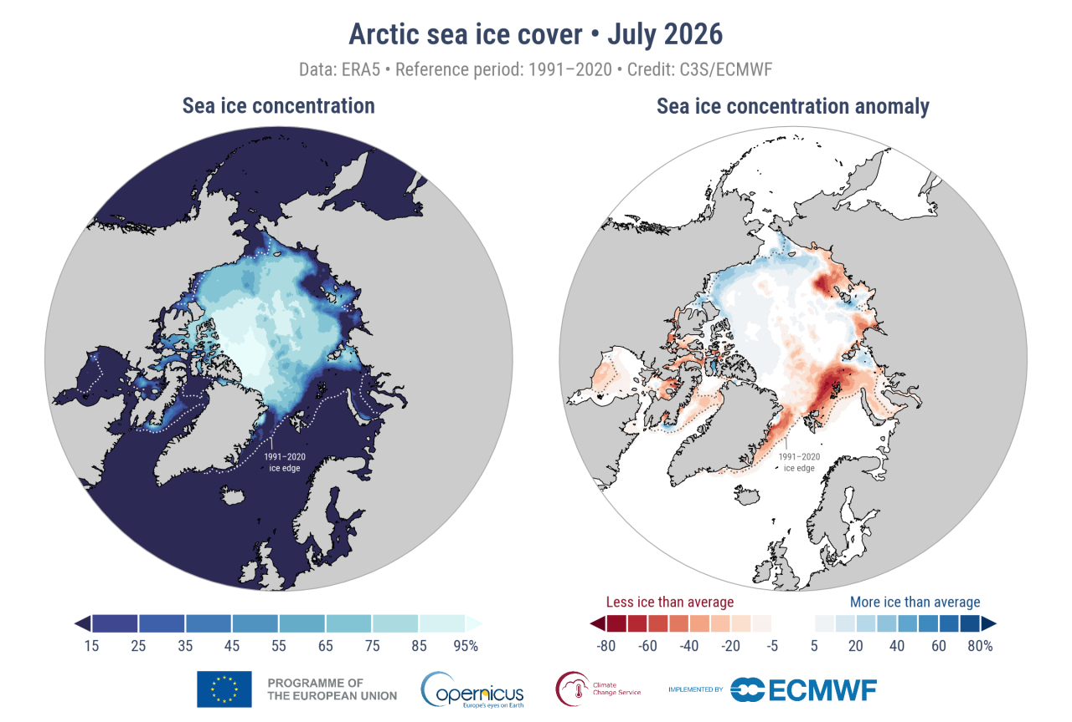
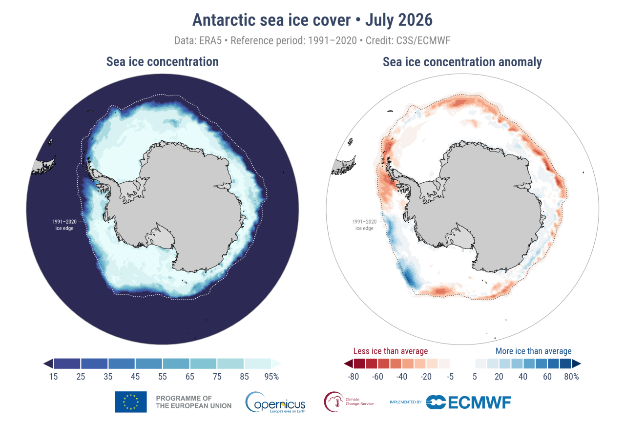
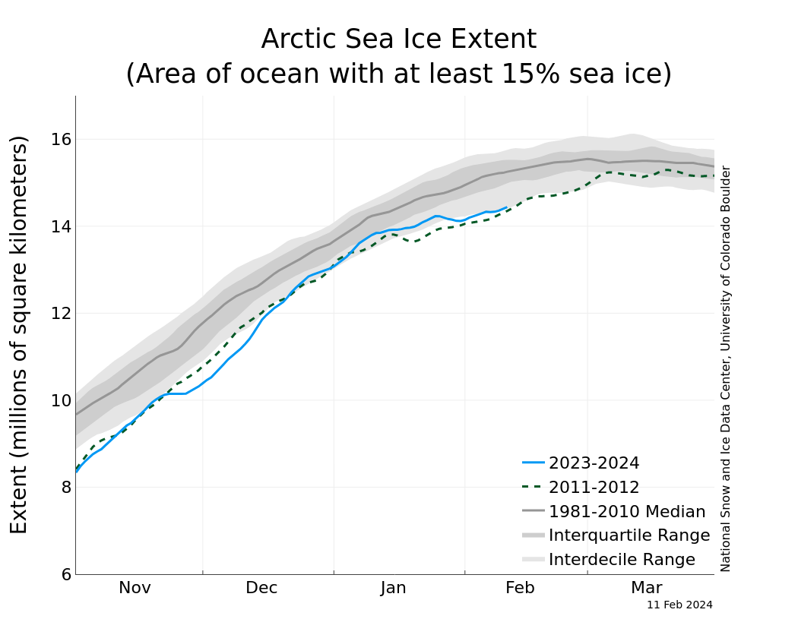
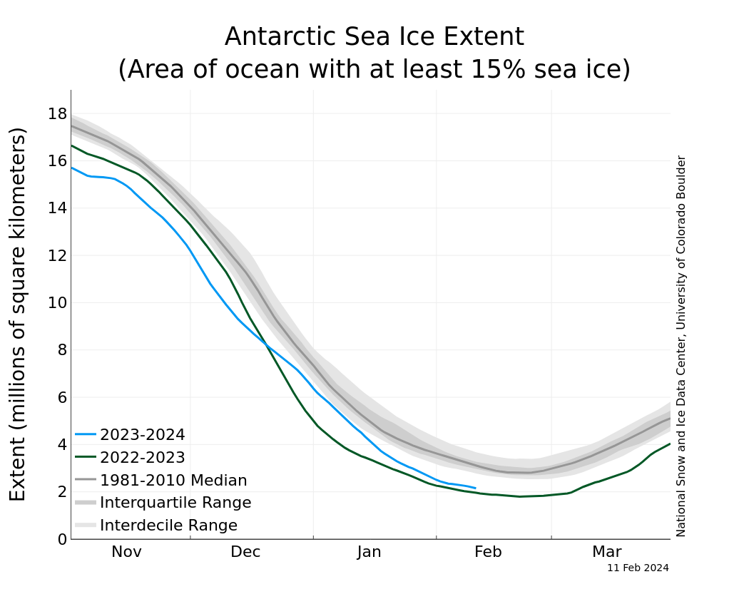
Sea-ice anomalies MM1STR MM1Y
ARCTIC
ANTARCTIC

Slide 7
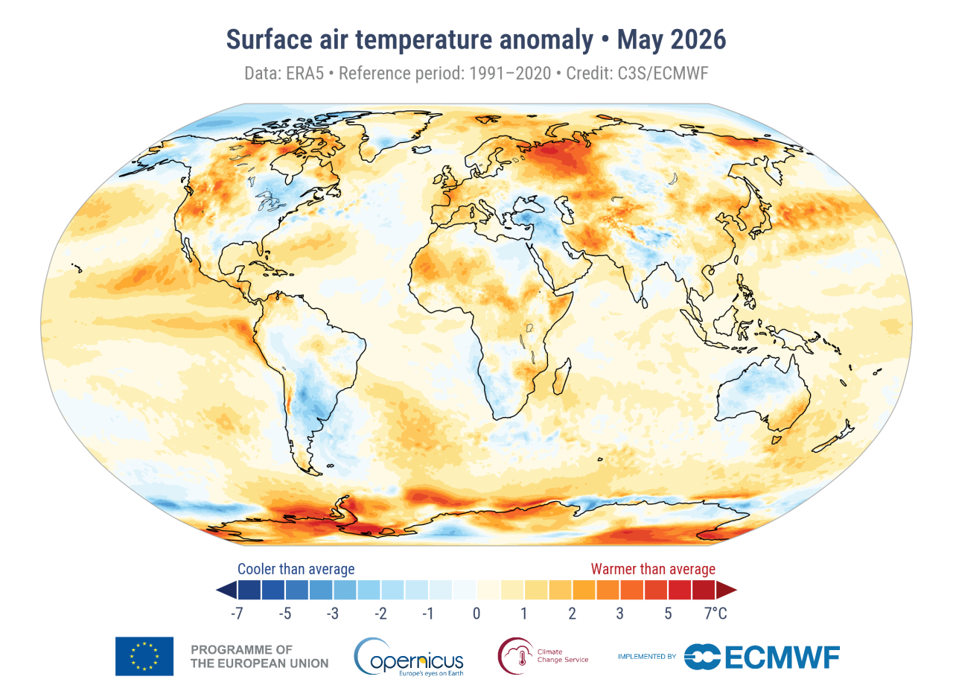
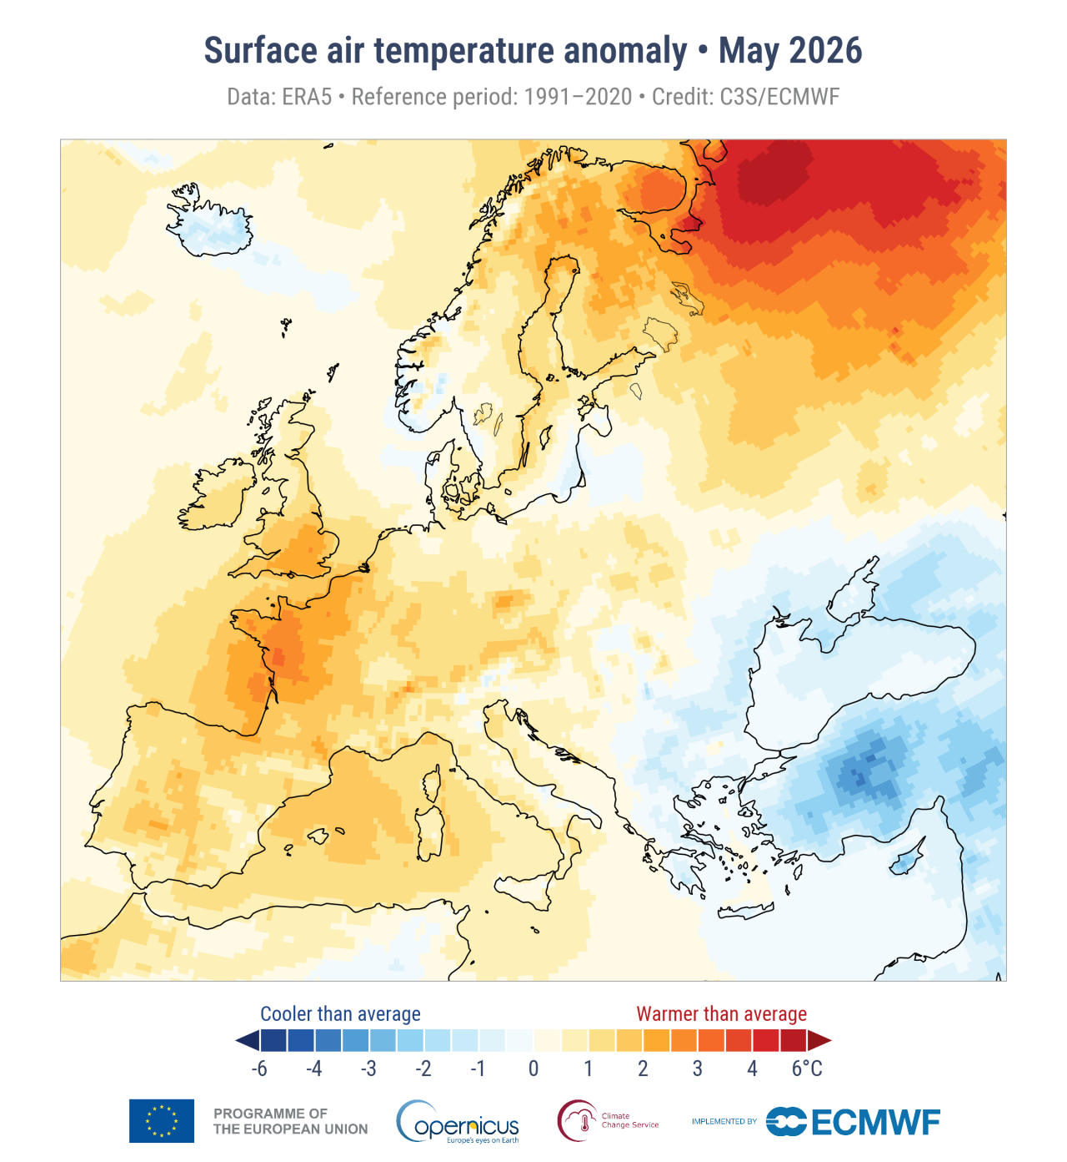
T2M anomalies MM1STR MM1Y
GLOBAL: t2m
EUROPE: t2m

Slide 8
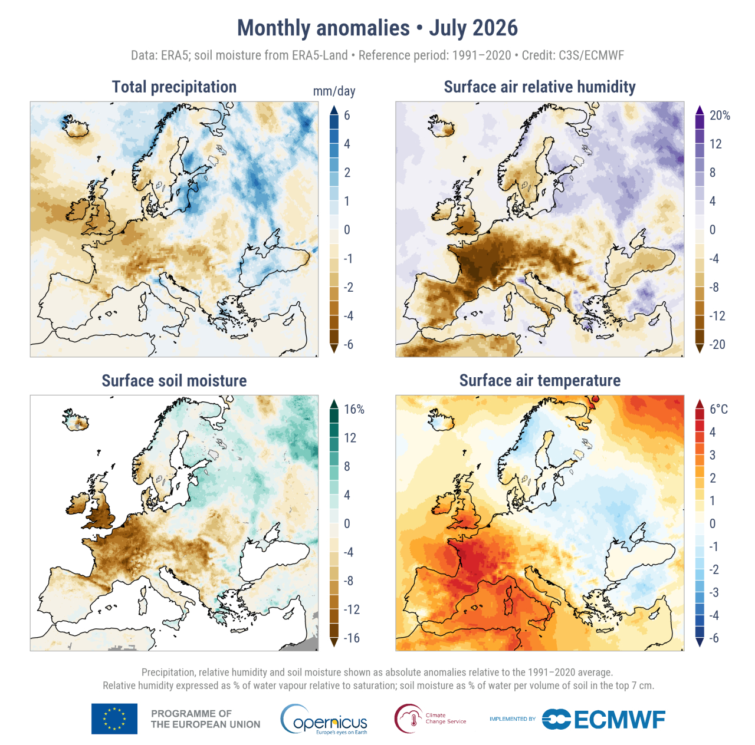
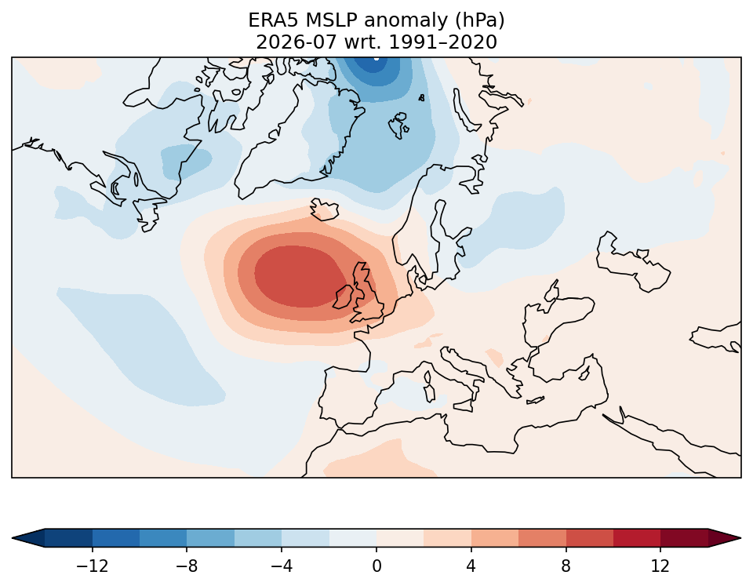
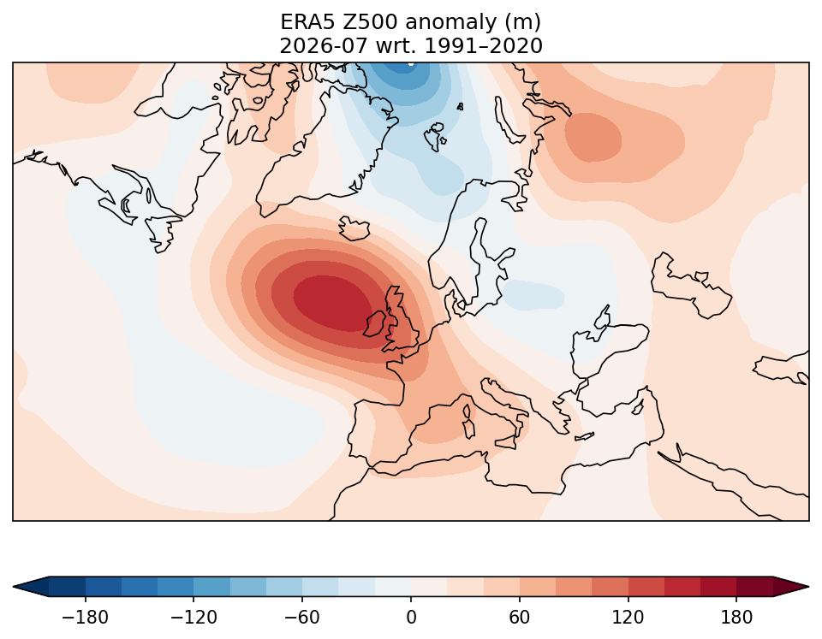
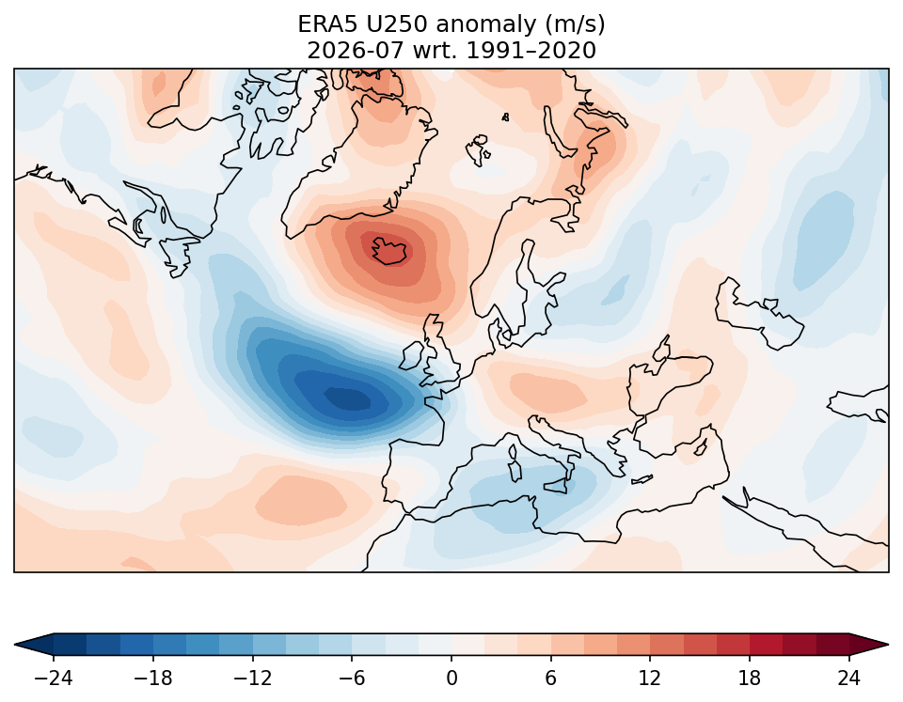
Hydrological and synoptic parameter anomalies
MM1STR MM1Y
Mean Sea Level Pressure (hPa)
500 hPa Geopotential Height (m)
250 hPa Zonal Wind (m/s)

Slide 9
Lead 1 month forecast evaluation issued in MM2STR MM2Y

Slide 10
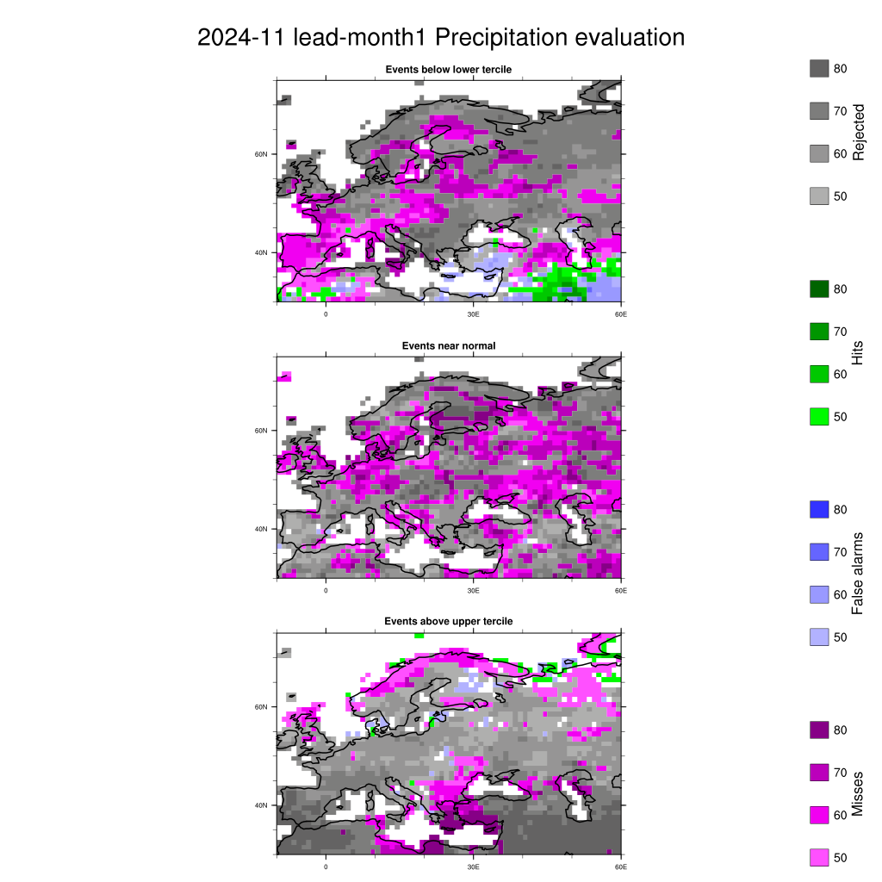
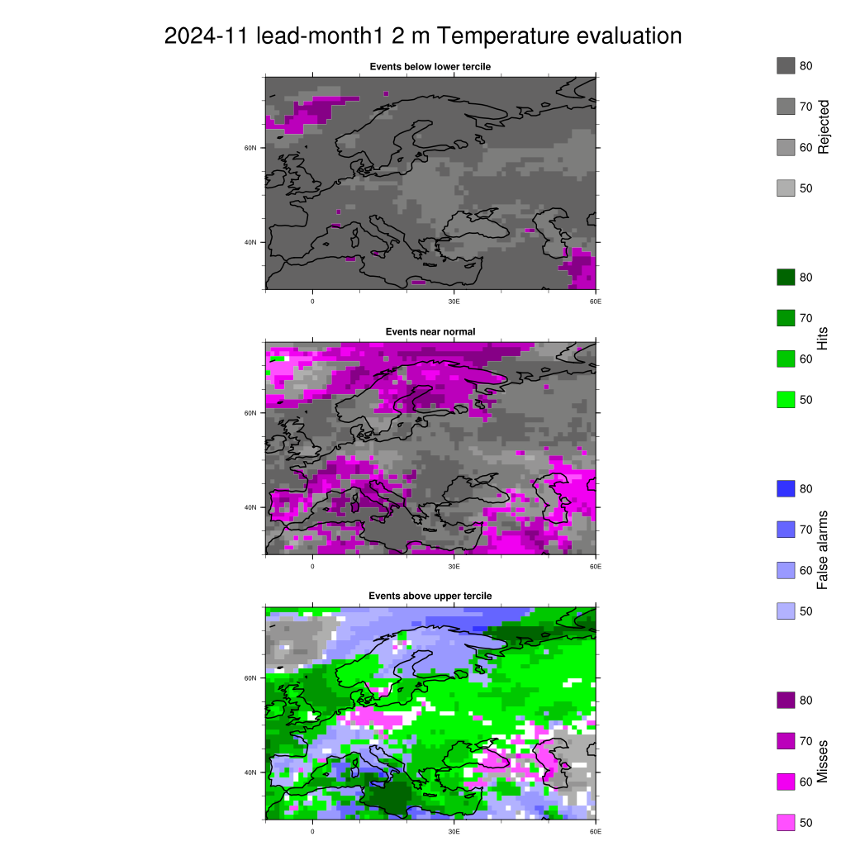
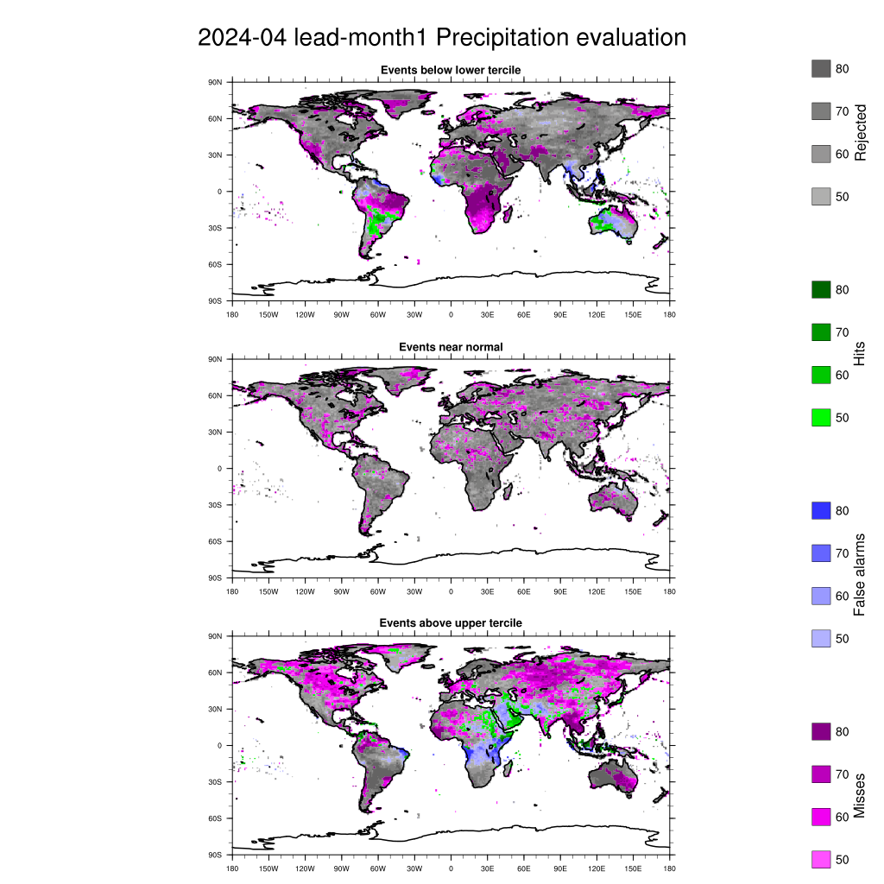
Evaluation: lead 1 month issued in MM2STR MM2Y

Slide 11
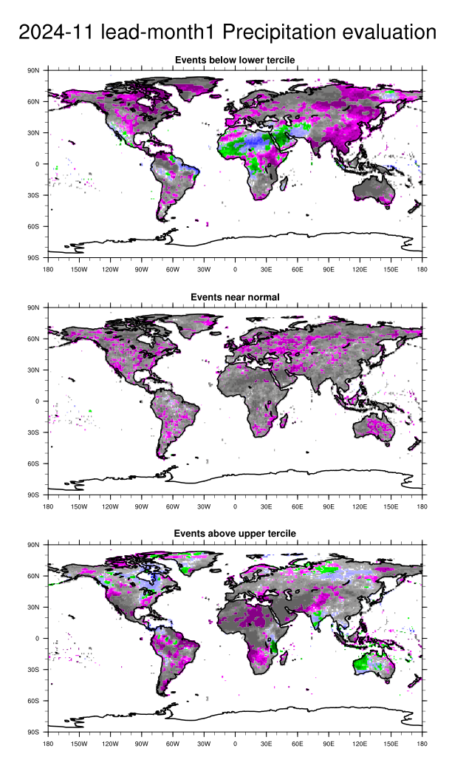
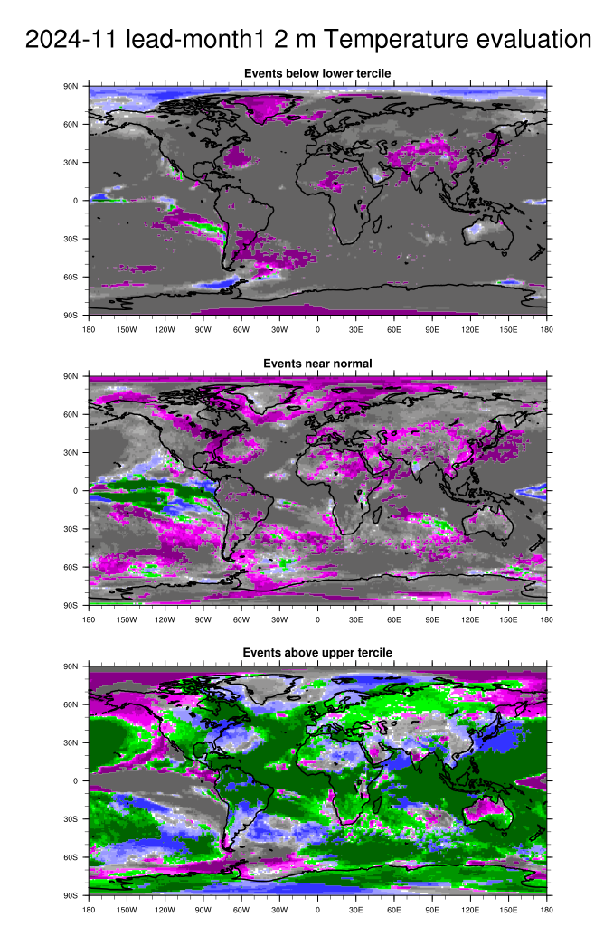
Evaluation: lead 1 month issued in MM2STR MM2Y

Slide 12
SeAM1 forecast evaluation
issued in SM1ForeM SM1ForeY

Slide 13
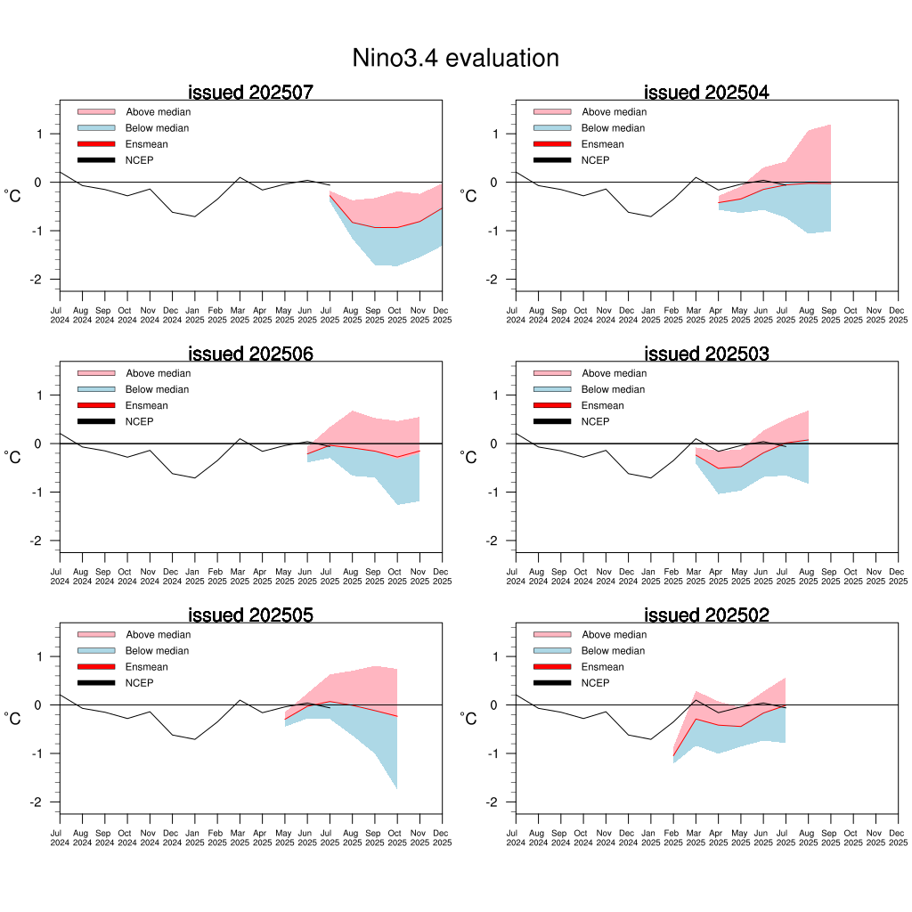
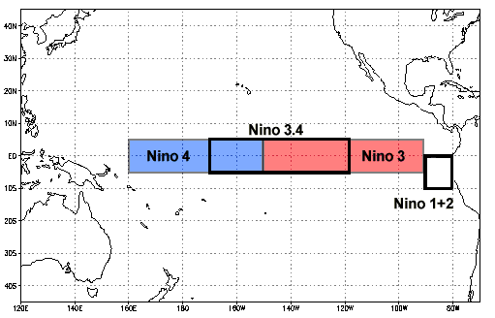
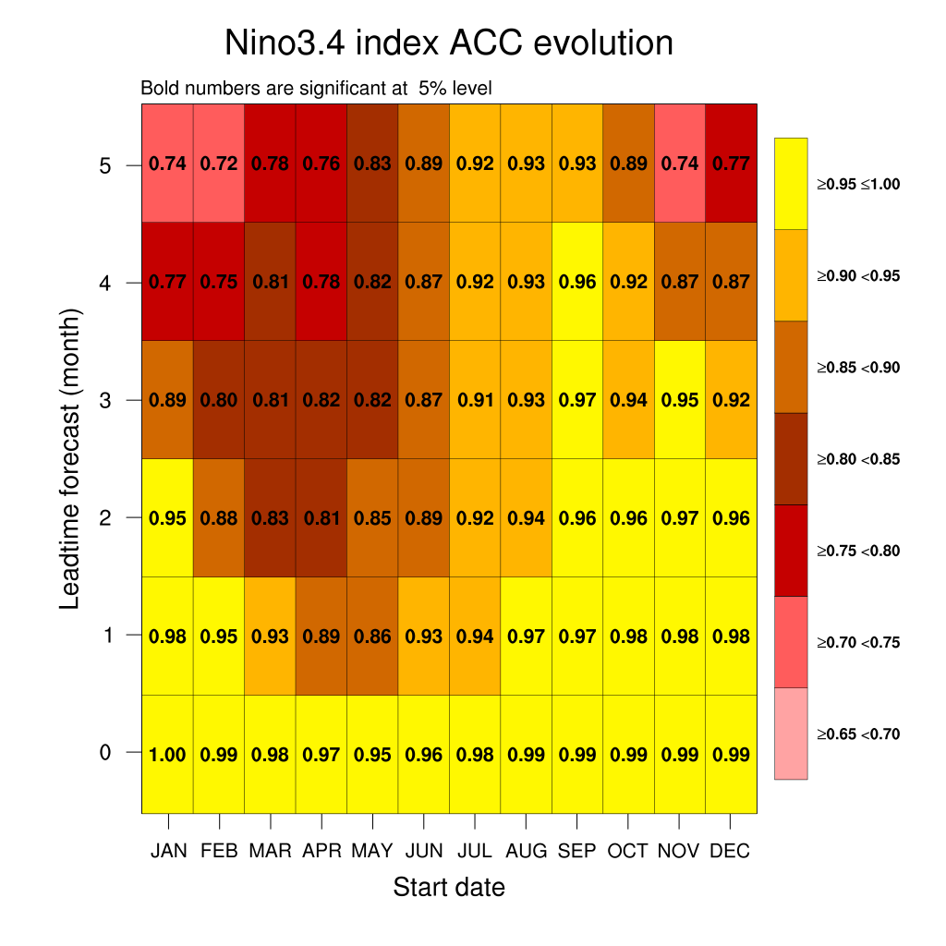
Evaluation: Nino3.4 (from MM6STR MM6Y to MM1STR MM1Y)

Slide 14
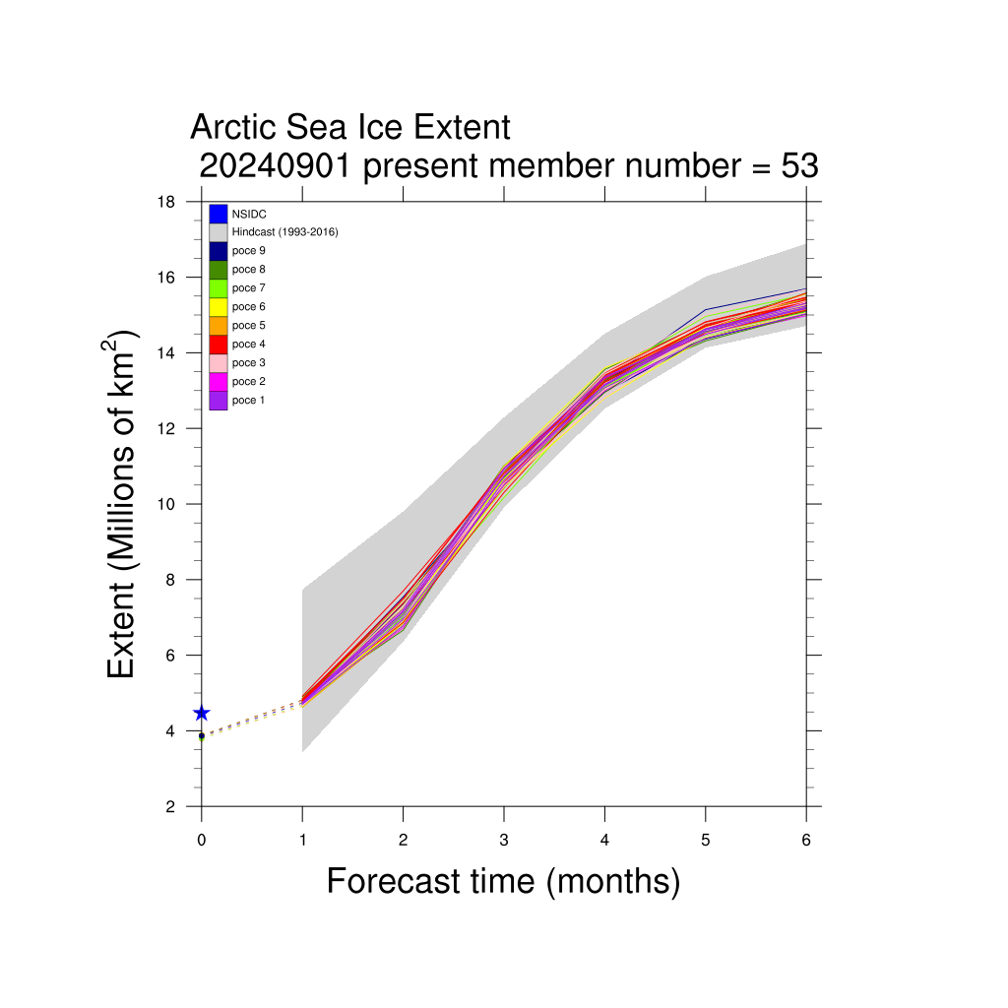
Sea-ice verification forecast SM1ForeM SM1ForeY

Slide 15
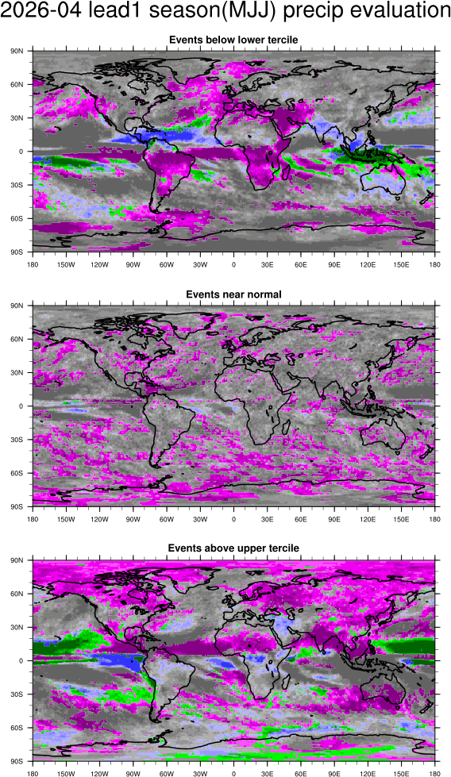
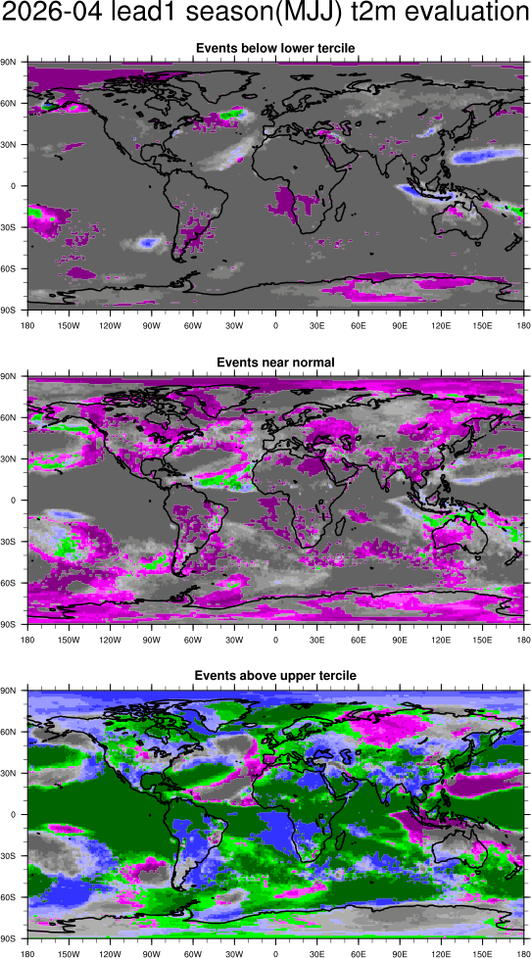
Evaluation maps SeAM1 issued in SM1ForeM SM1ForeY

Slide 16
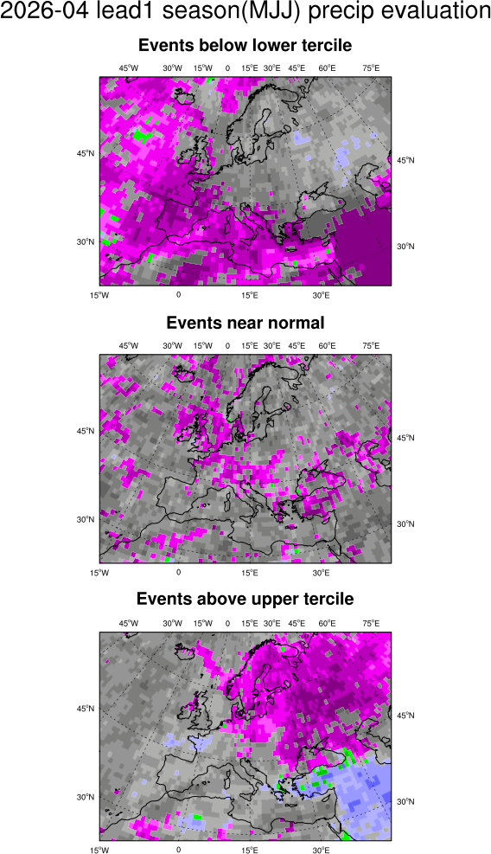
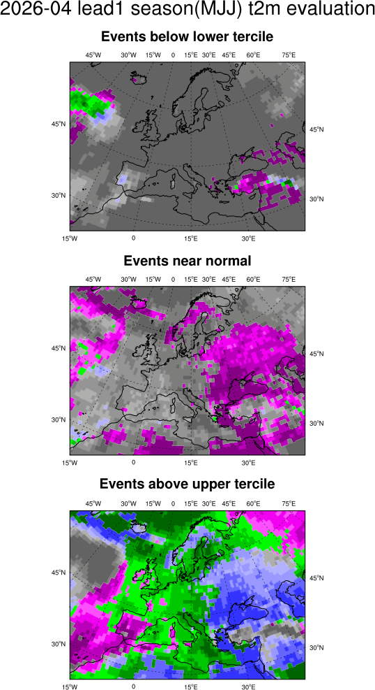
Evaluation maps SeAM1 issued in SM1ForeM SM1ForeY

Slide 17
FORECAST
issued in ThisM ThisY

Slide 18
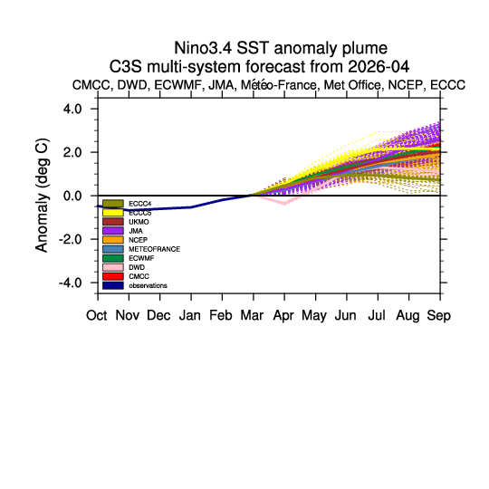
Nino3.4 issued in ThisM ThisY – C3S Multi-model

Slide 19
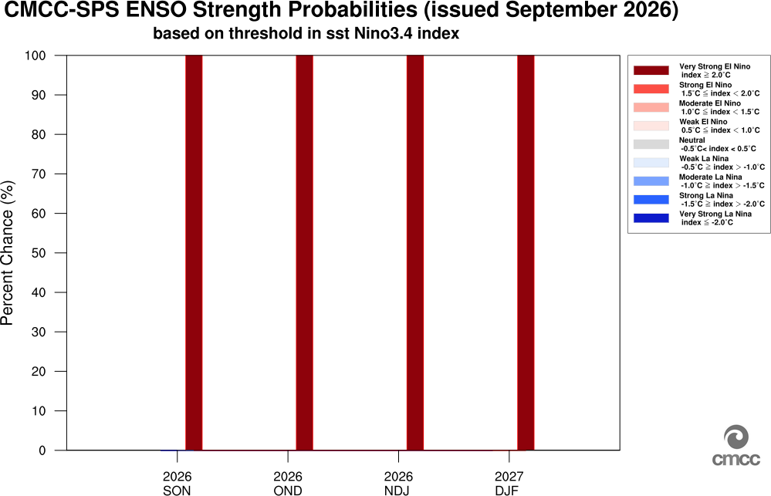
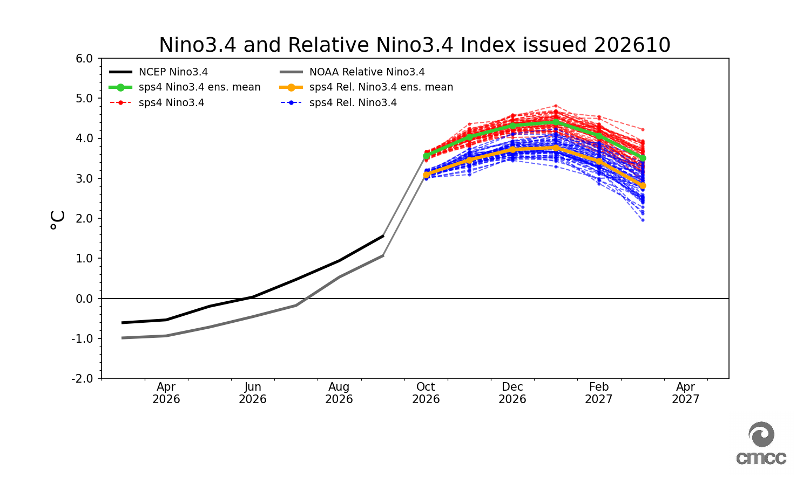
Nino3.4 issued in ThisM ThisY – CMCC SPS4

Slide 20
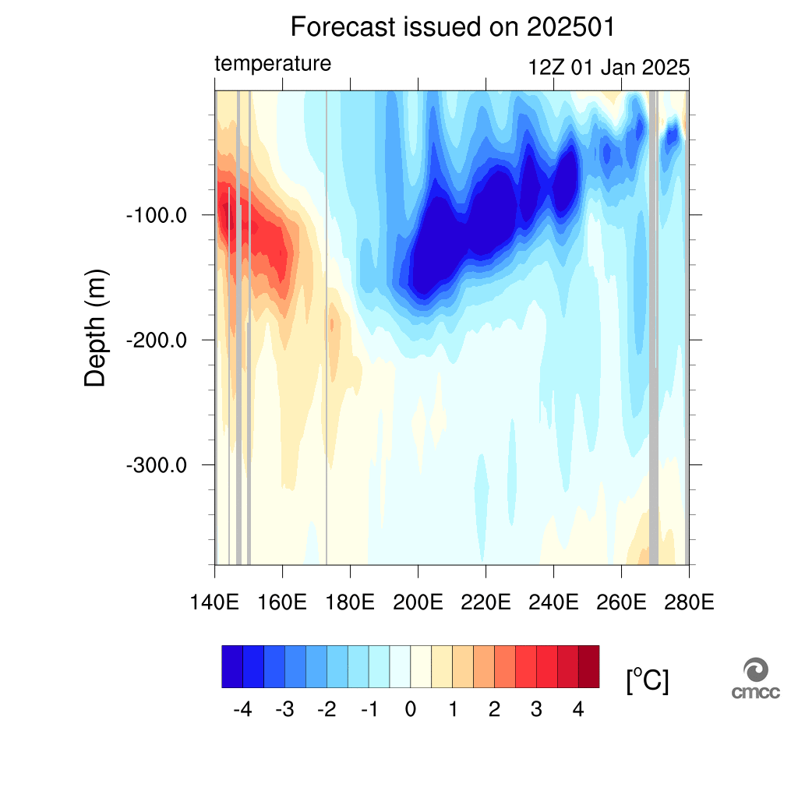
Potential temperature (meridional average 2.5S: 2.5N) vertical section issued in ThisM ThisY

Slide 21
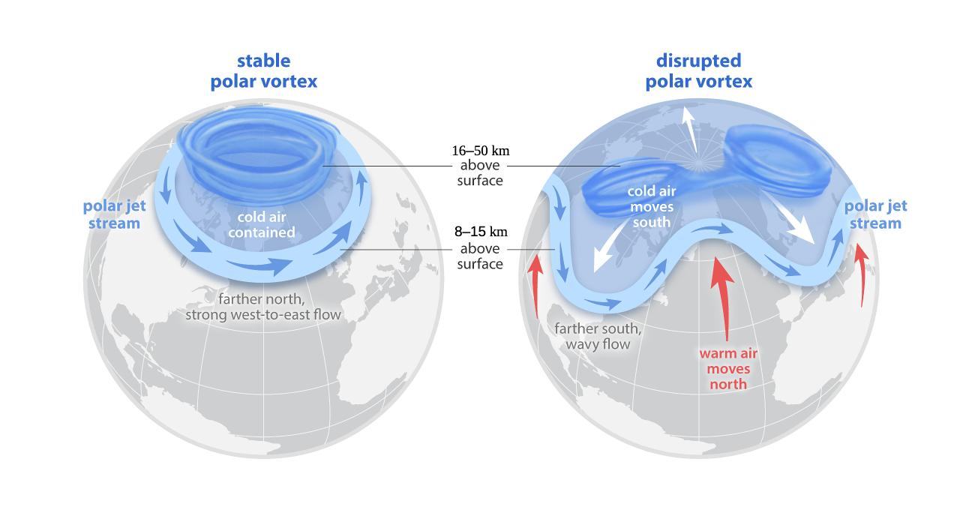
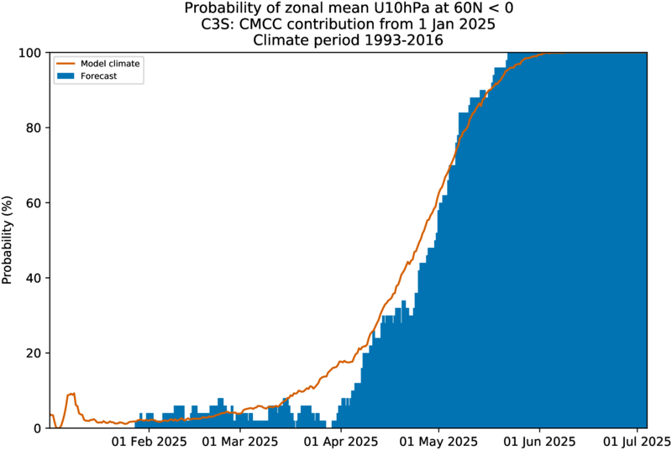
Polar Vortex Activity – ThisM ThisY
Generally, a strong polar vortex is linked to a more zonal circulation, inhibiting cold air intrusion at mid latitude; on the contrary a weak polar vortex leads to a wavy flow, more prone to meridional exchange

Slide 22
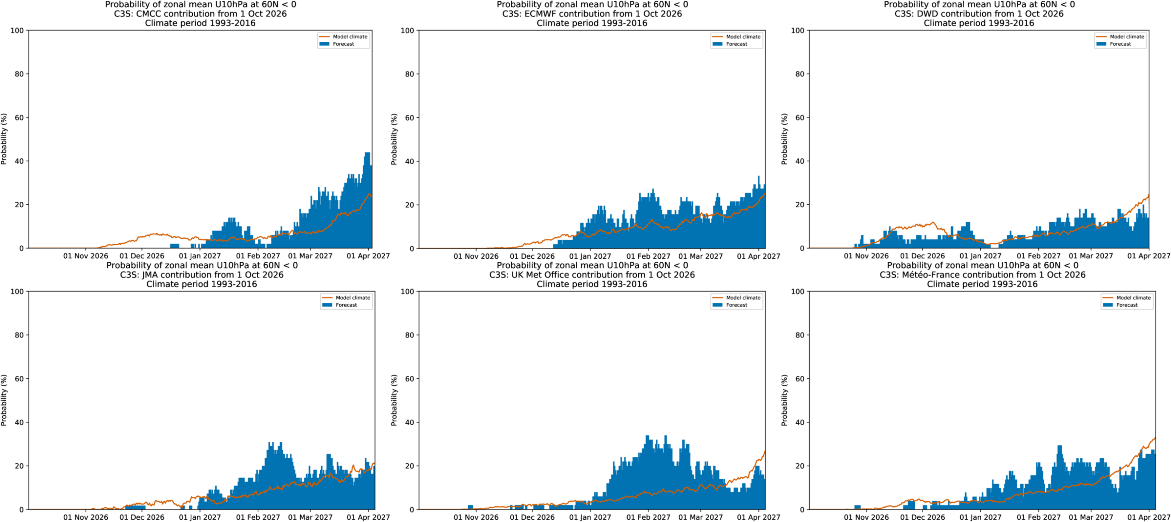
Polar Vortex Activity – ThisM ThisY
SPSs​ | DATE​
CMCC​ | -
ECMWF​ | -
DWD​ | -
JMA​ | -
UK​ Met-Office​ | -​
Meteo-France​ | -
CMCC
ECMWF
DWD
JMA
Met-Office
Meteo-France

Slide 23
FORECAST
Lead1 season (SEA)
issued in ThisM ThisY

Slide 24
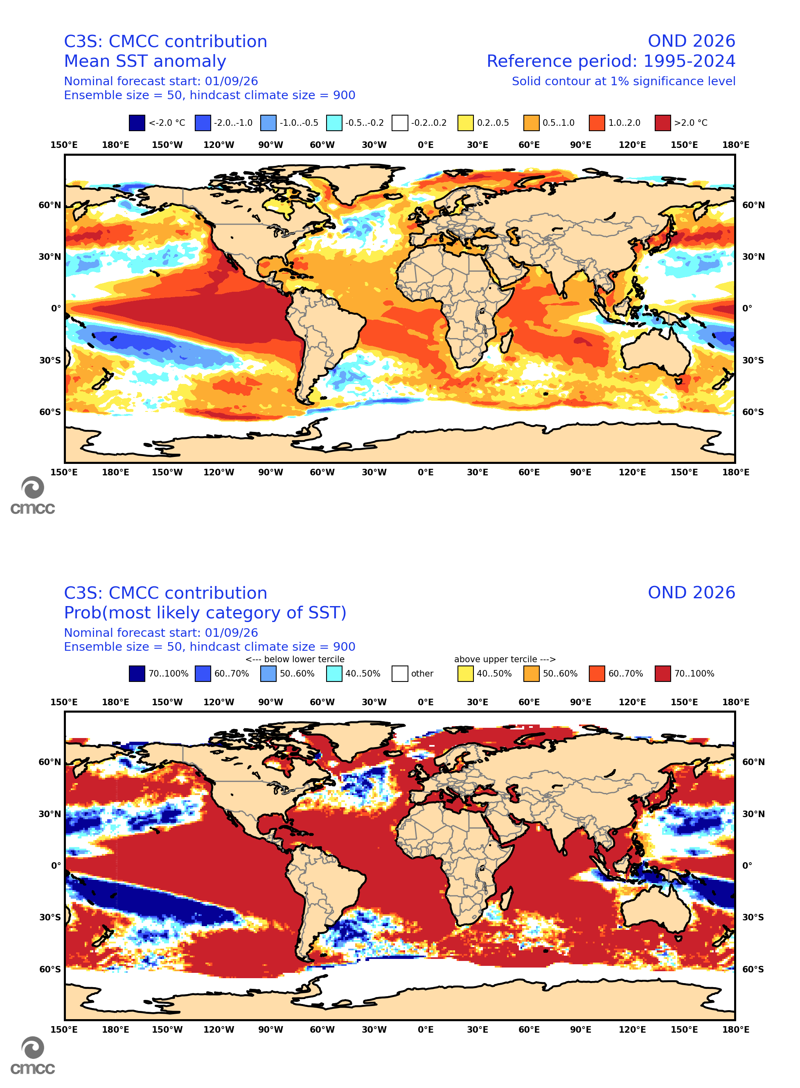
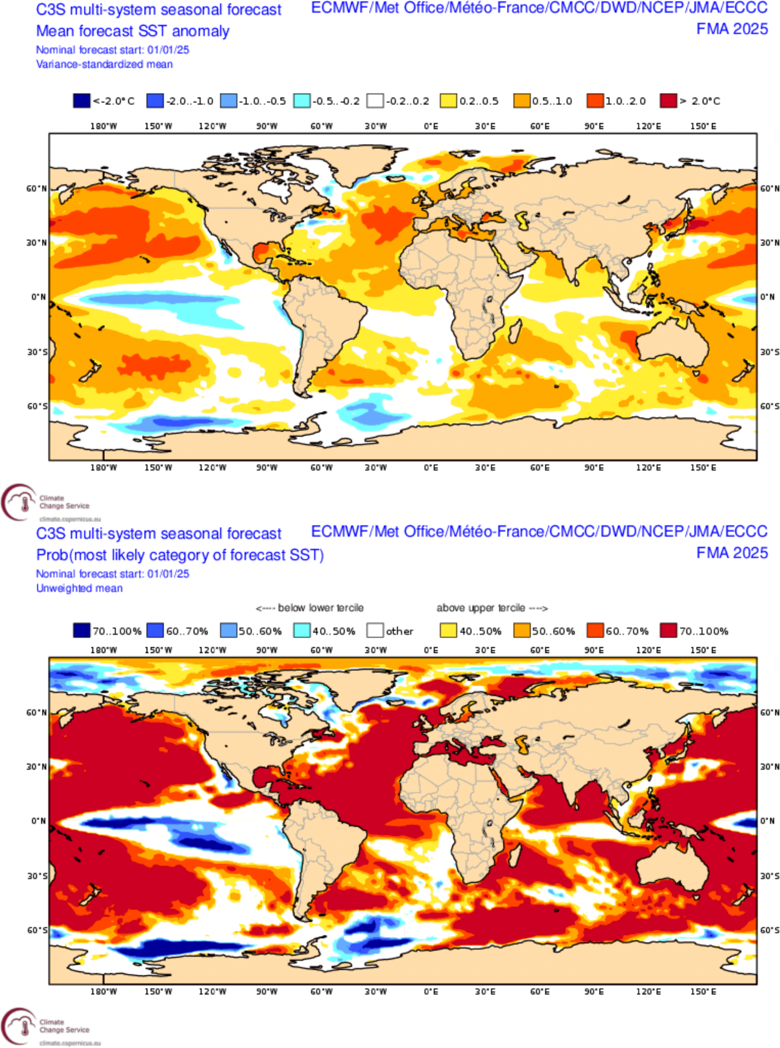
SEA SST issued in ThisM ThisY
CMCC
C3S multi-model
Ensemble mean anomaly
Ensemble mean anomaly
Tercile summary
Tercile summary

Slide 25
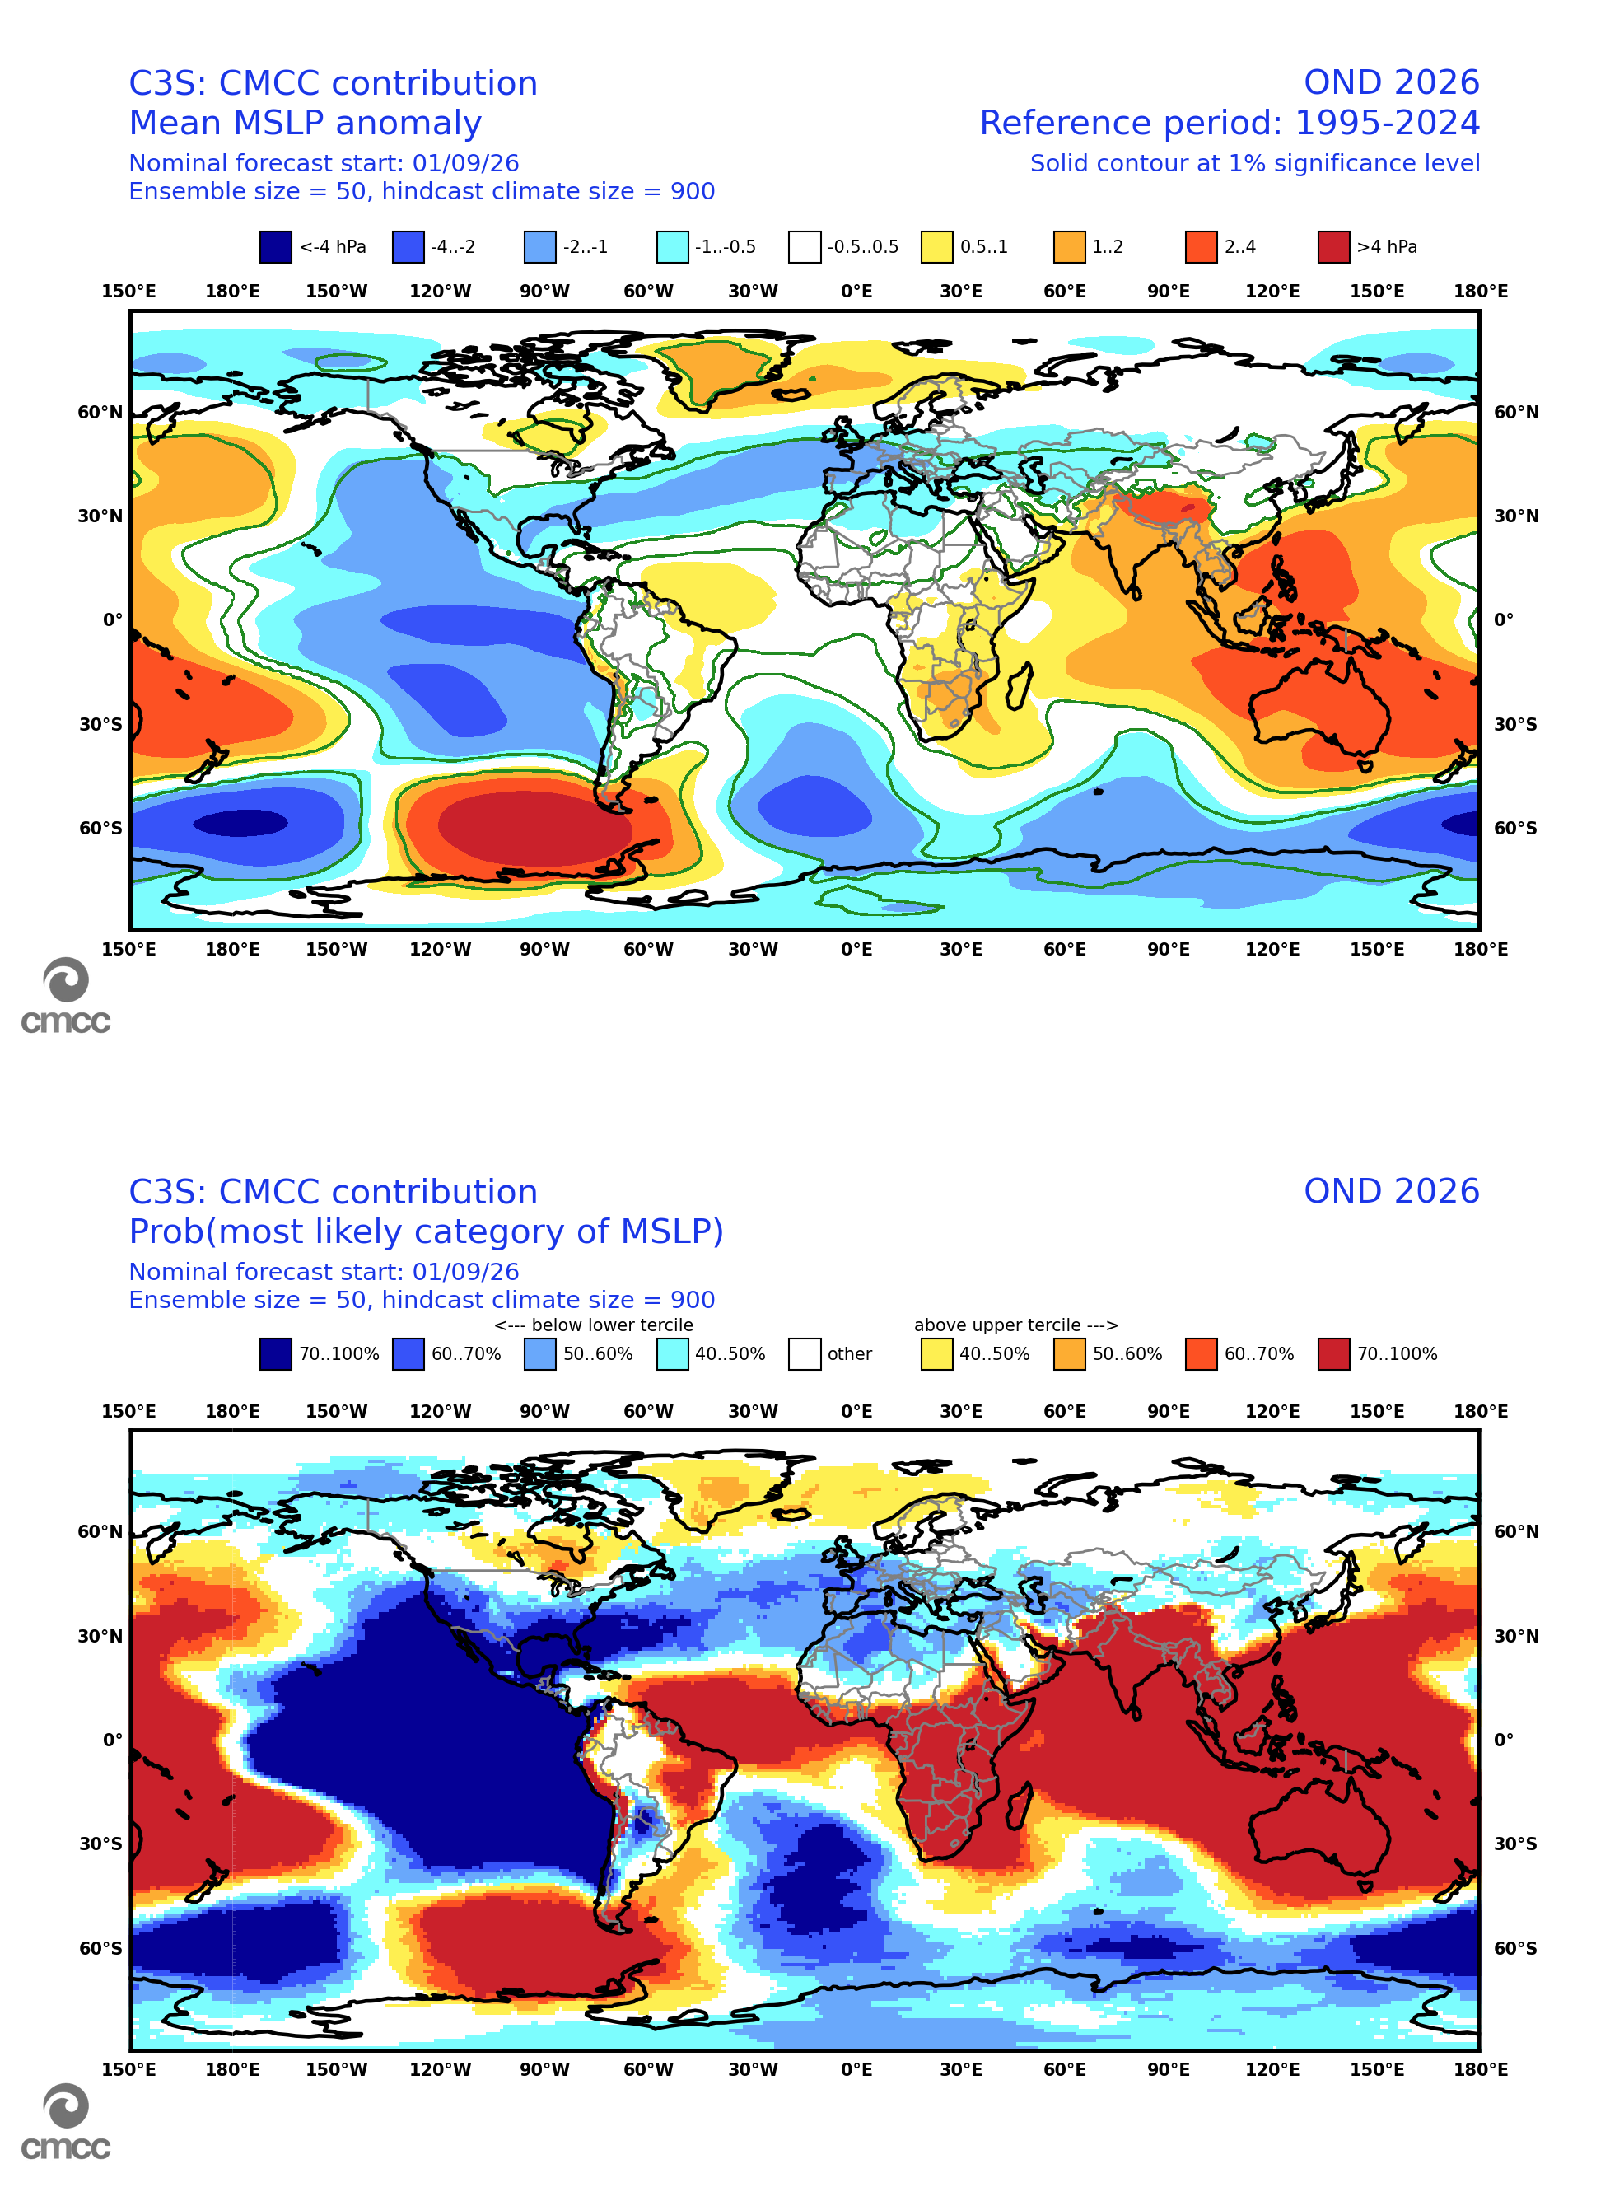
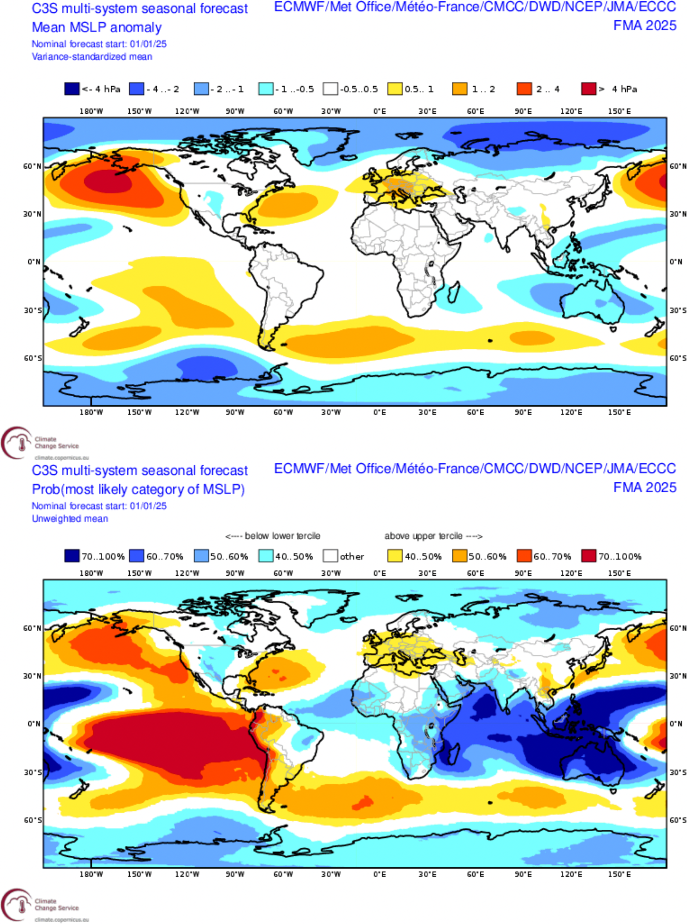
SEA MSLP issued in ThisM ThisY
CMCC
C3S multi-model
Ensemble mean anomaly
Ensemble mean anomaly
Tercile summary
Tercile summary

Slide 26
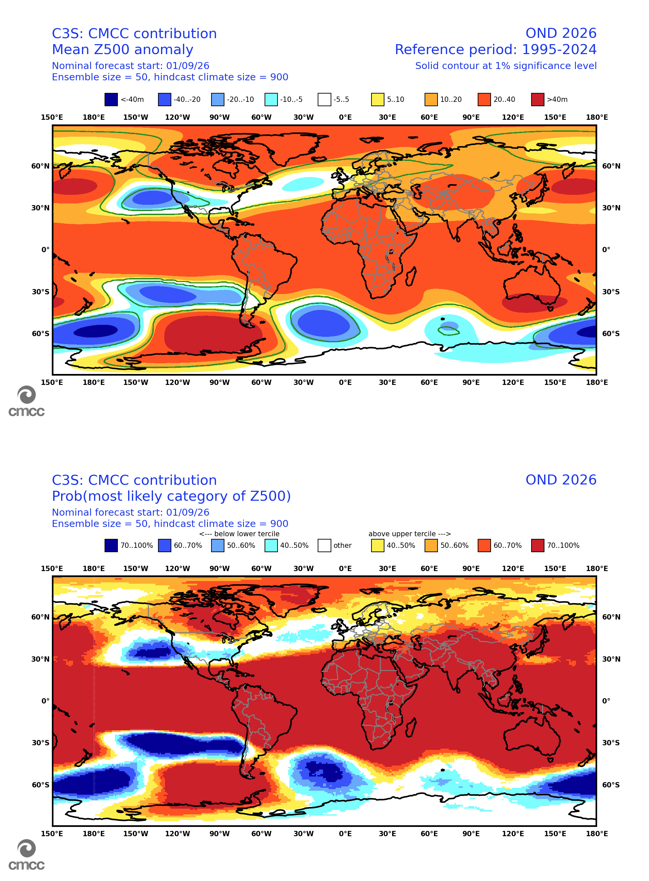
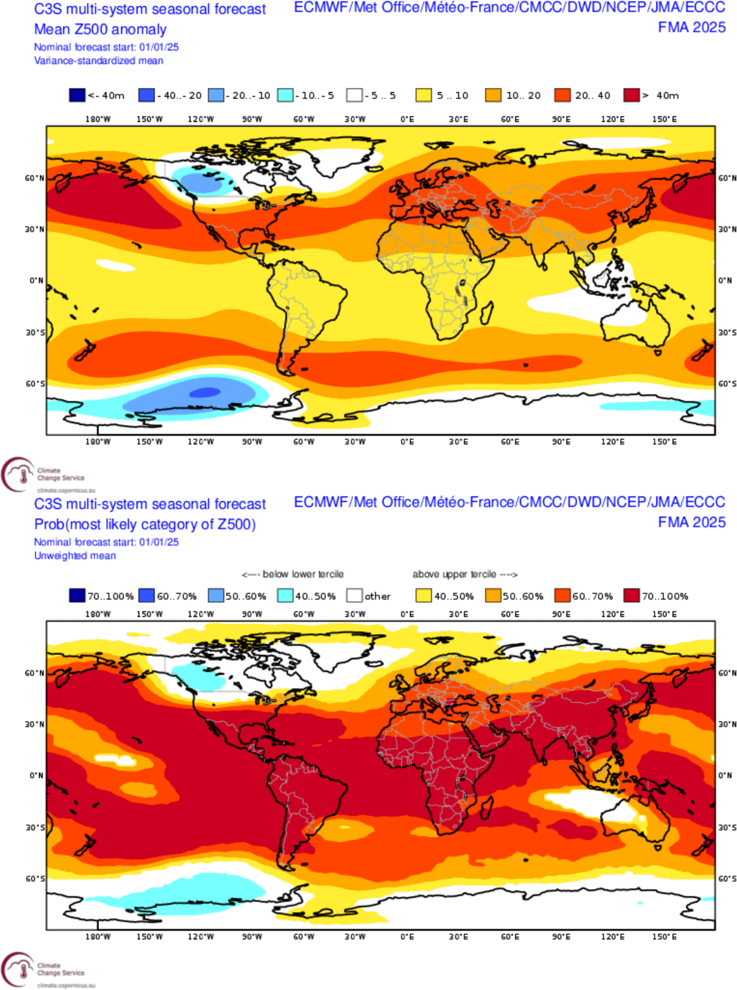
SEA Z500 issued in ThisM ThisY
CMCC
C3S multi-model
Ensemble mean anomaly
Ensemble mean anomaly
Tercile summary
Tercile summary

Slide 27
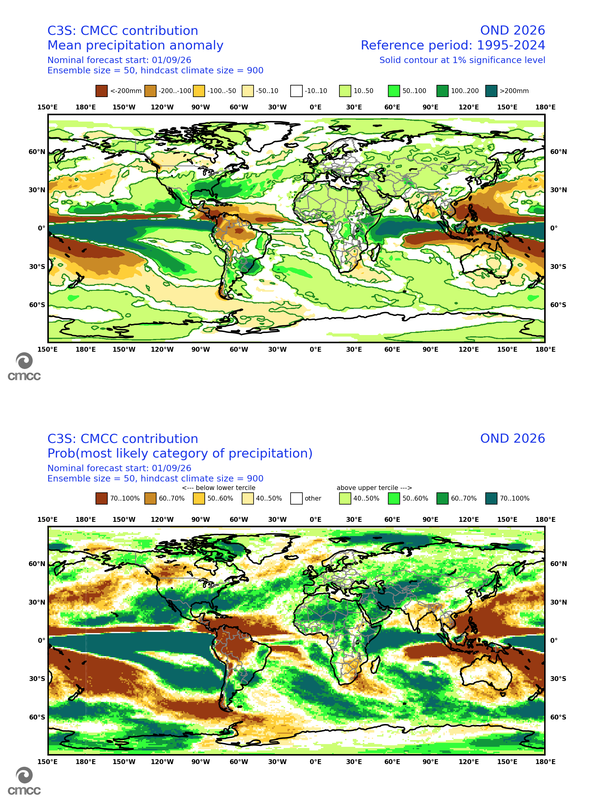
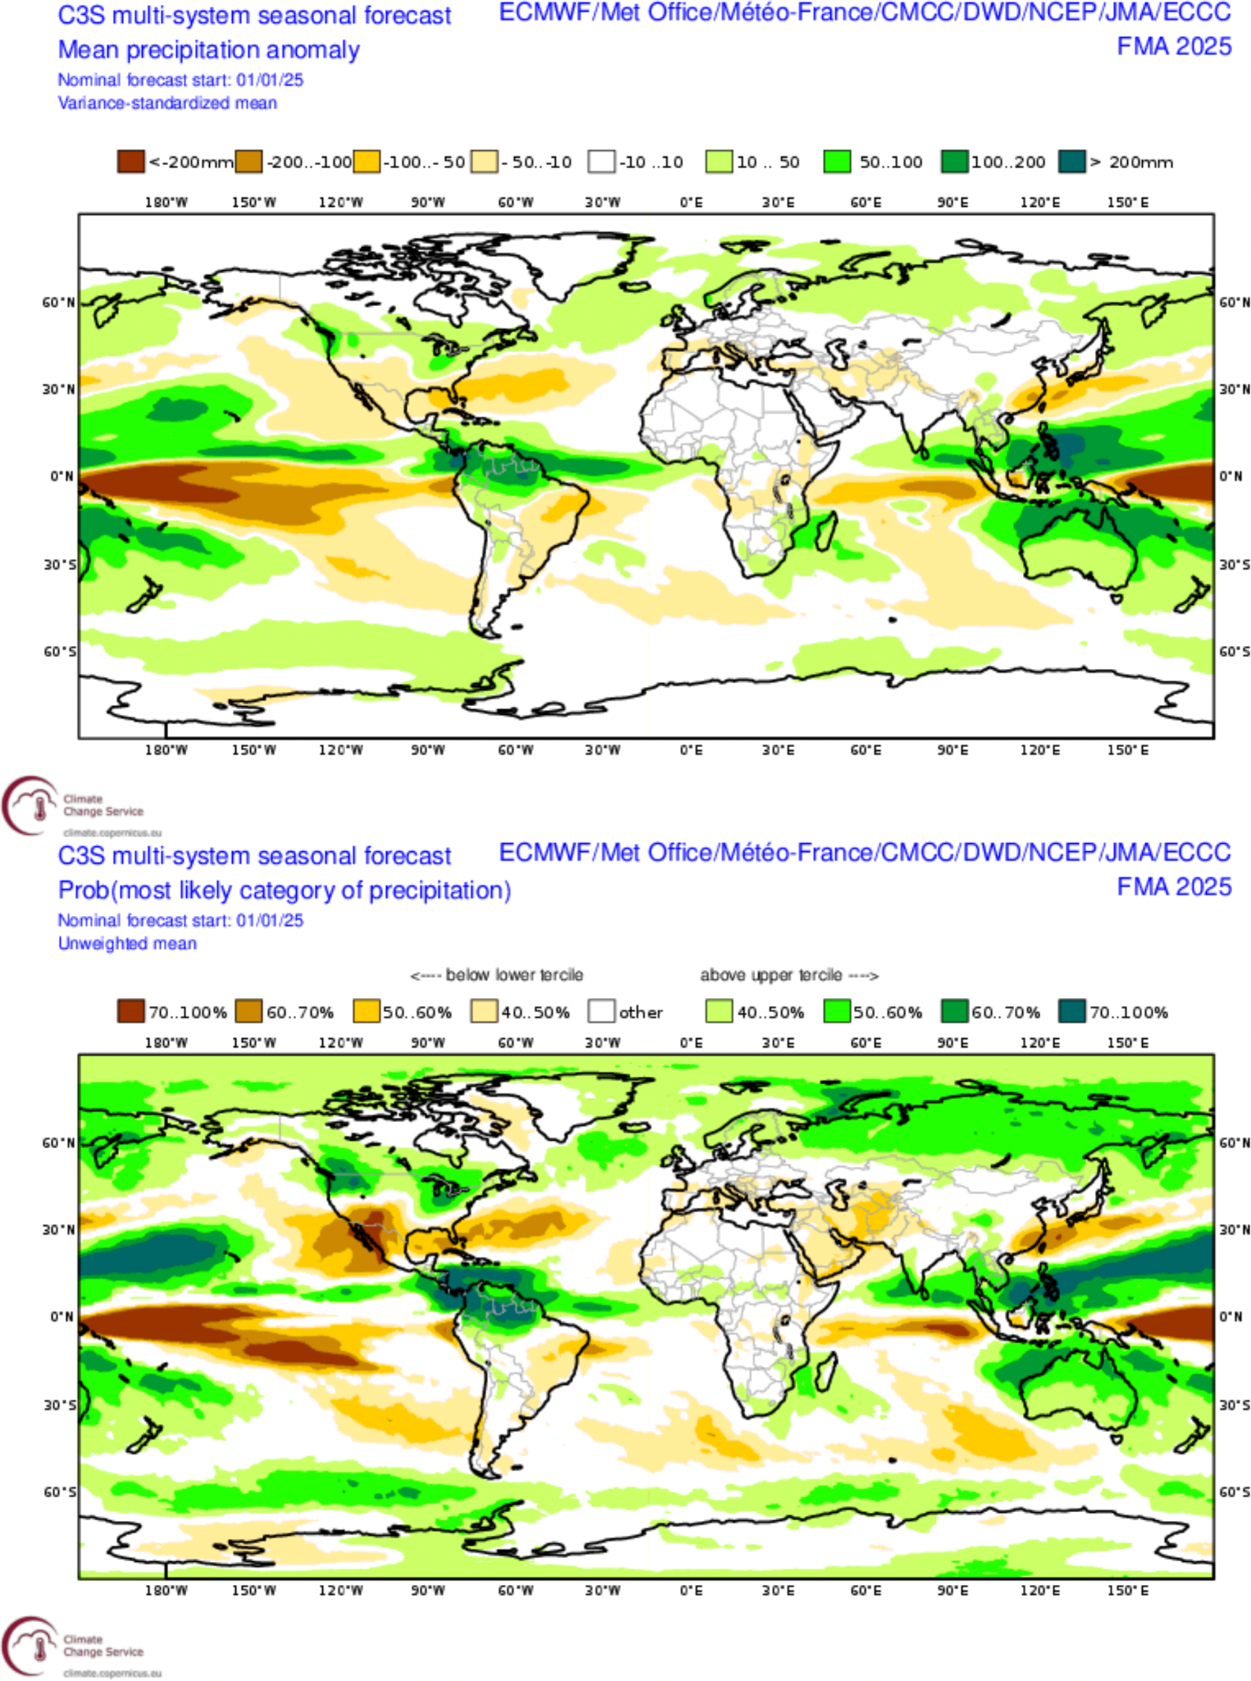
SEA PREC issued in ThisM ThisY
CMCC
C3S multi-model
Ensemble mean anomaly
Ensemble mean anomaly
Tercile summary
Tercile summary

Slide 28
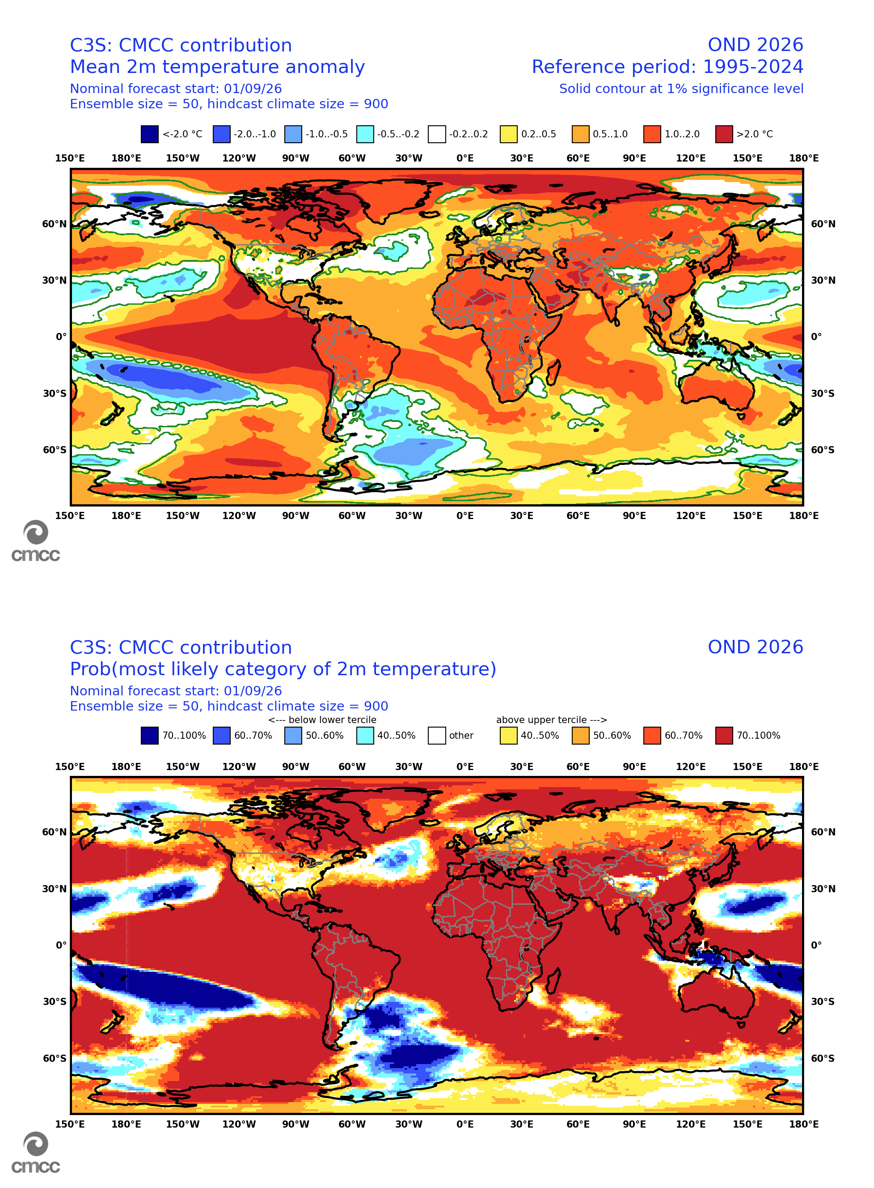
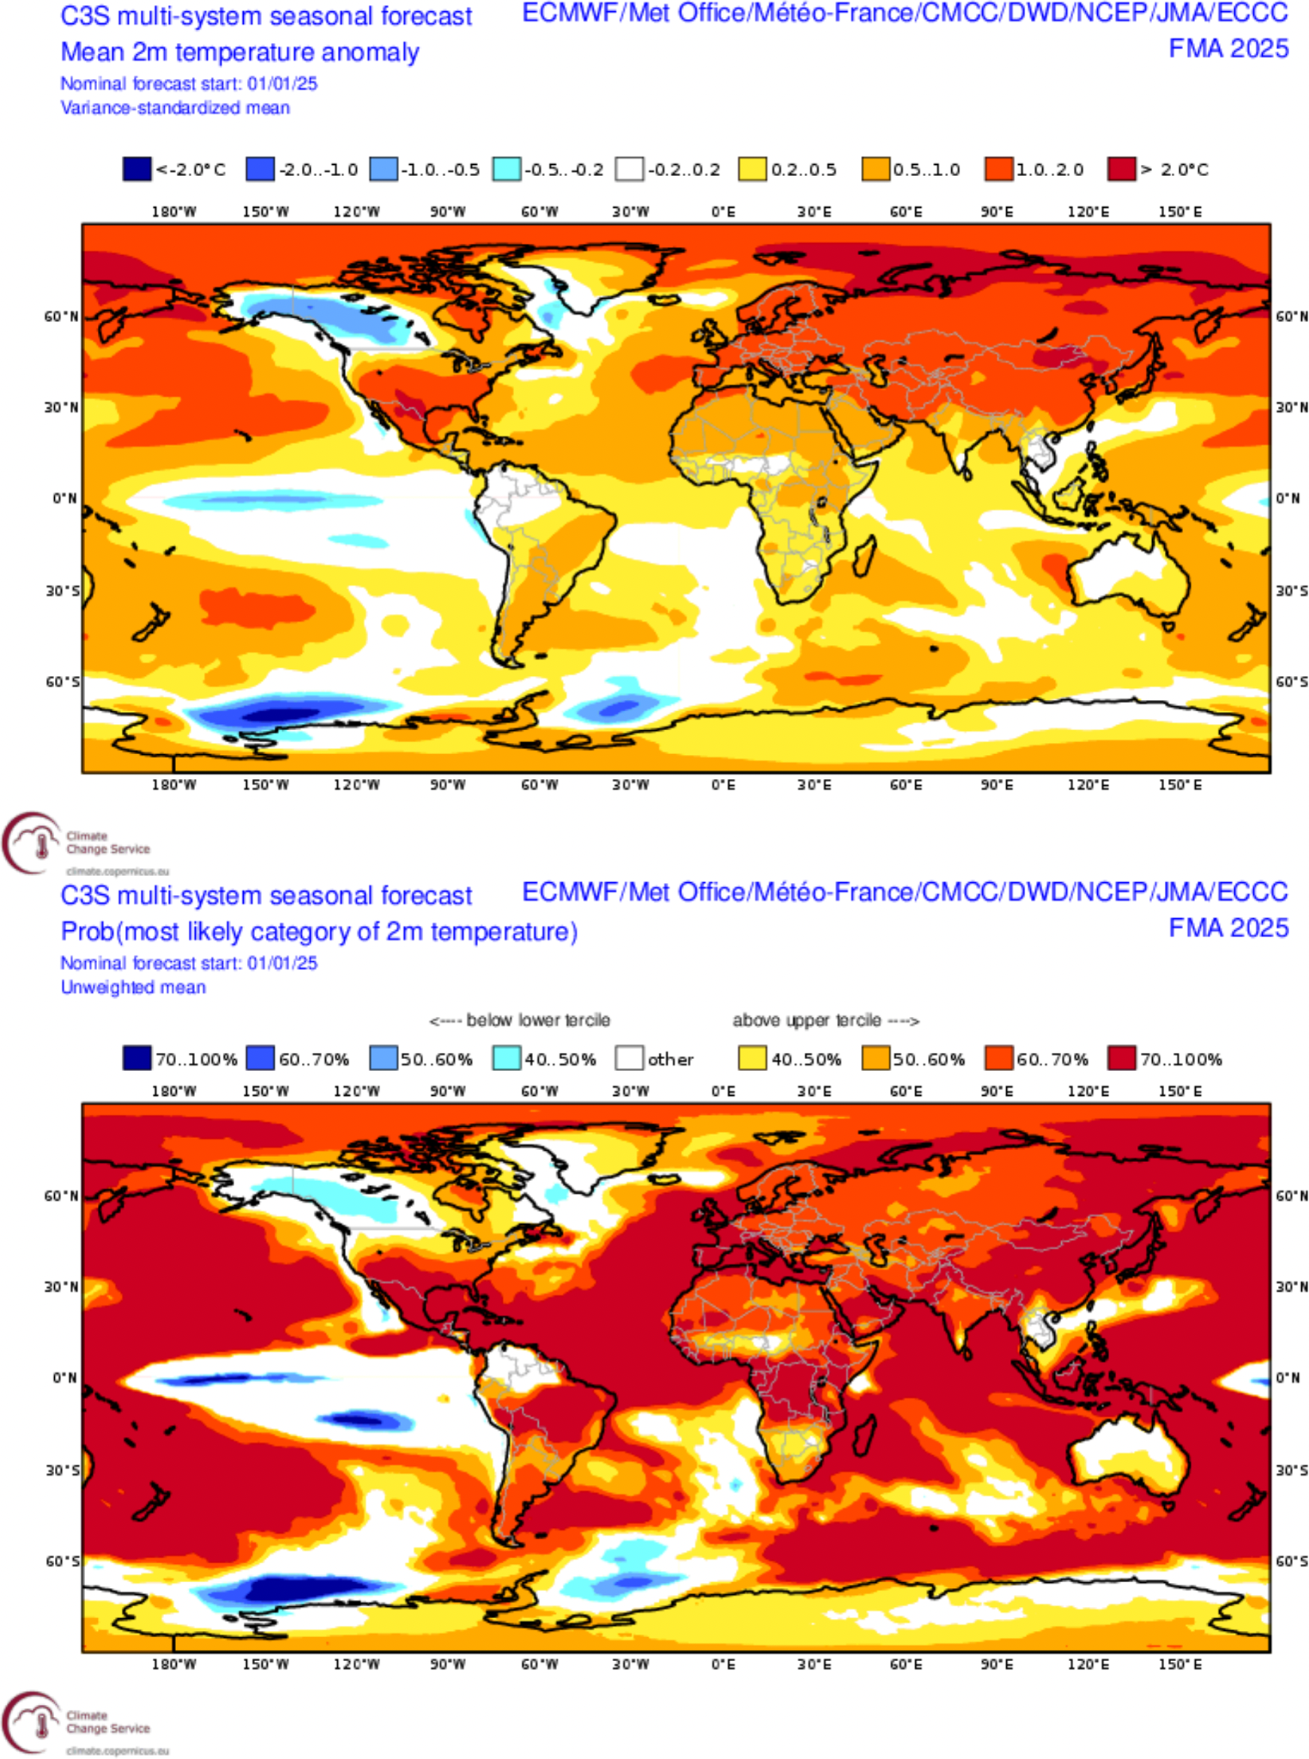
SEA T2M issued in ThisM ThisY
CMCC
C3S multi-model
Ensemble mean anomaly
Ensemble mean anomaly
Tercile summary
Tercile summary

Slide 29
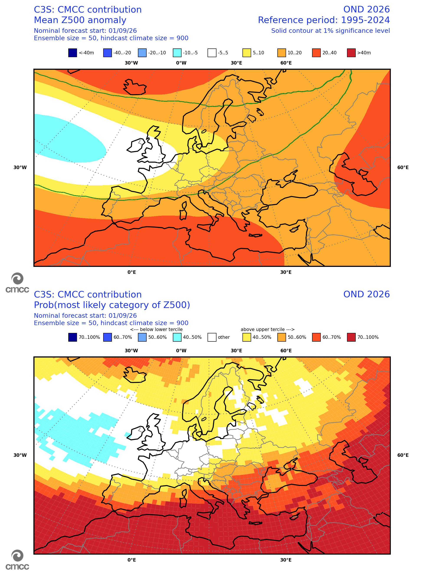
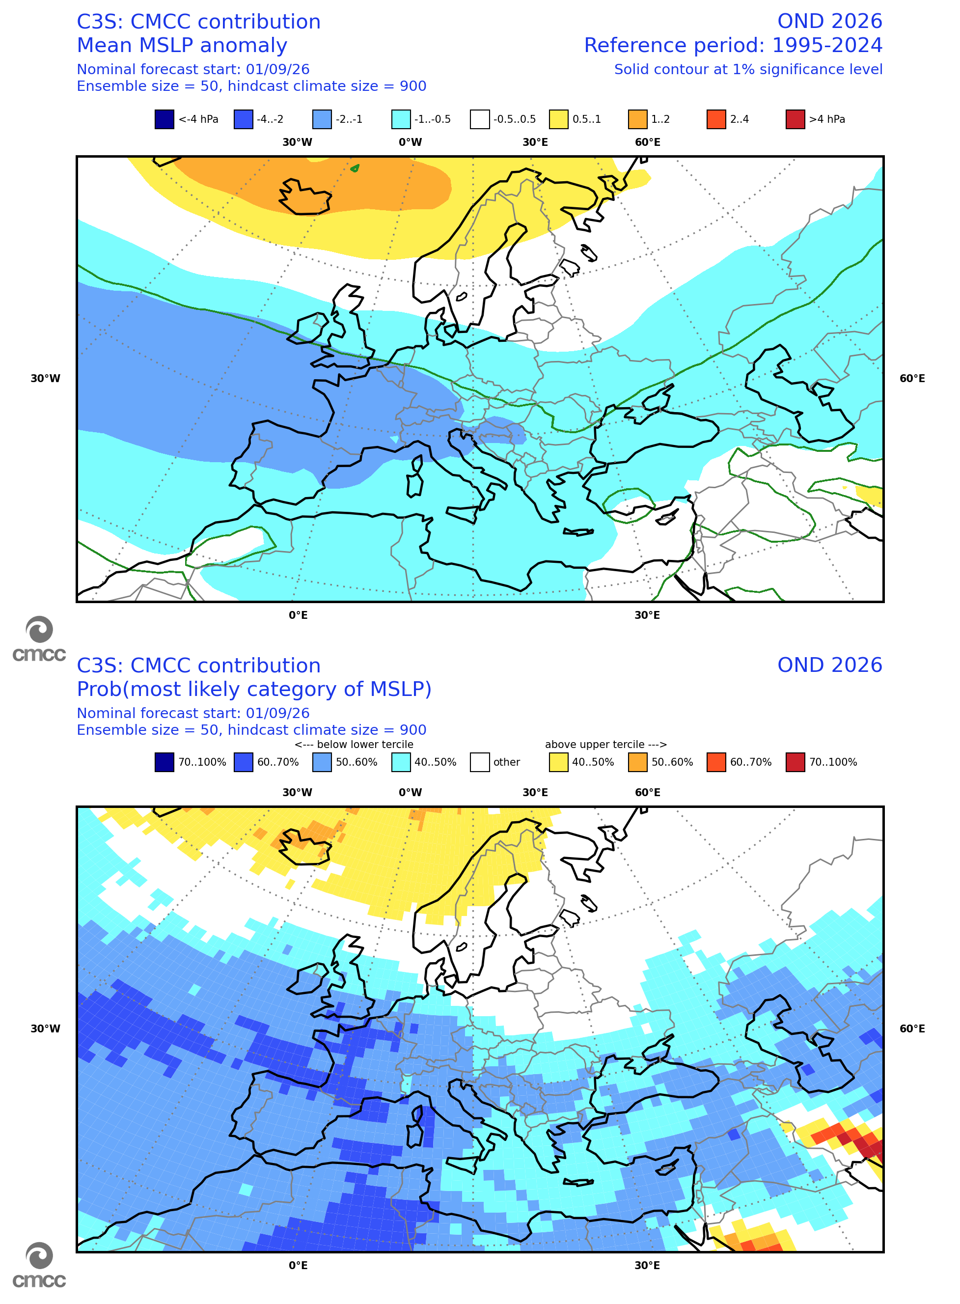
CMCC SEA over Europe: Z500 and MSLP
Z500
MSLP
Ensemble mean anomaly
Ensemble mean anomaly
Tercile summary
Tercile summary

Slide 30
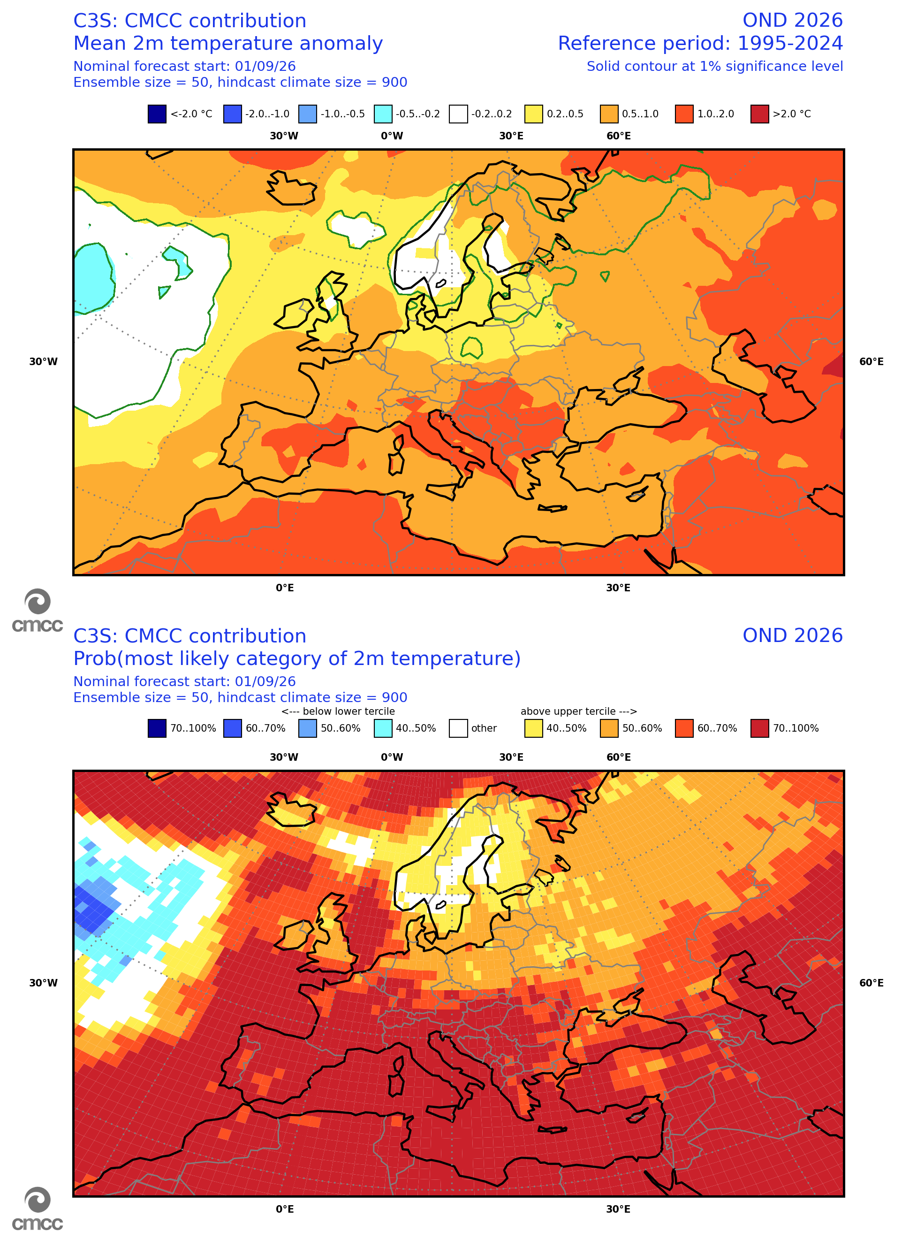
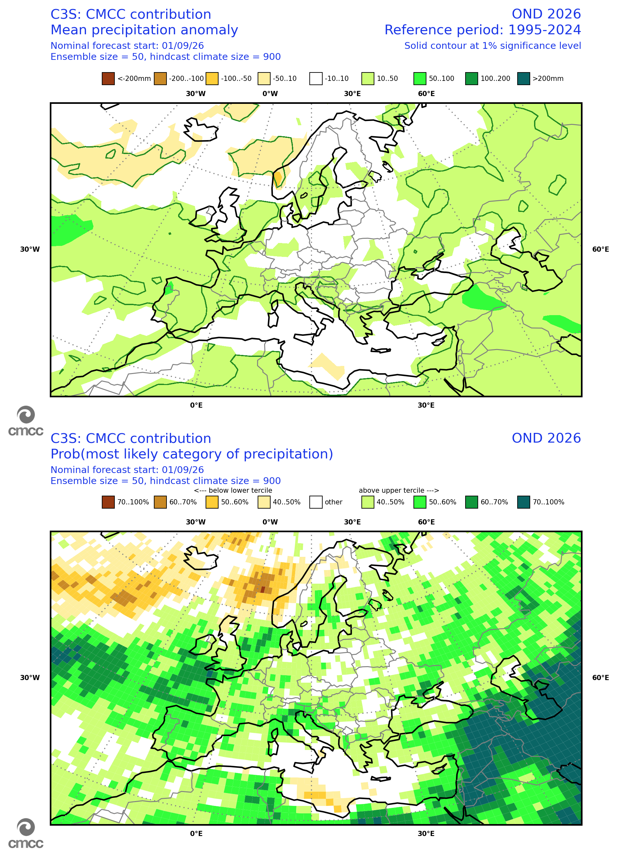
CMCC SEA over Europe: T2M and PREC
T2M
PREC
Ensemble mean anomaly
Ensemble mean anomaly
Tercile summary
Tercile summary

Slide 31
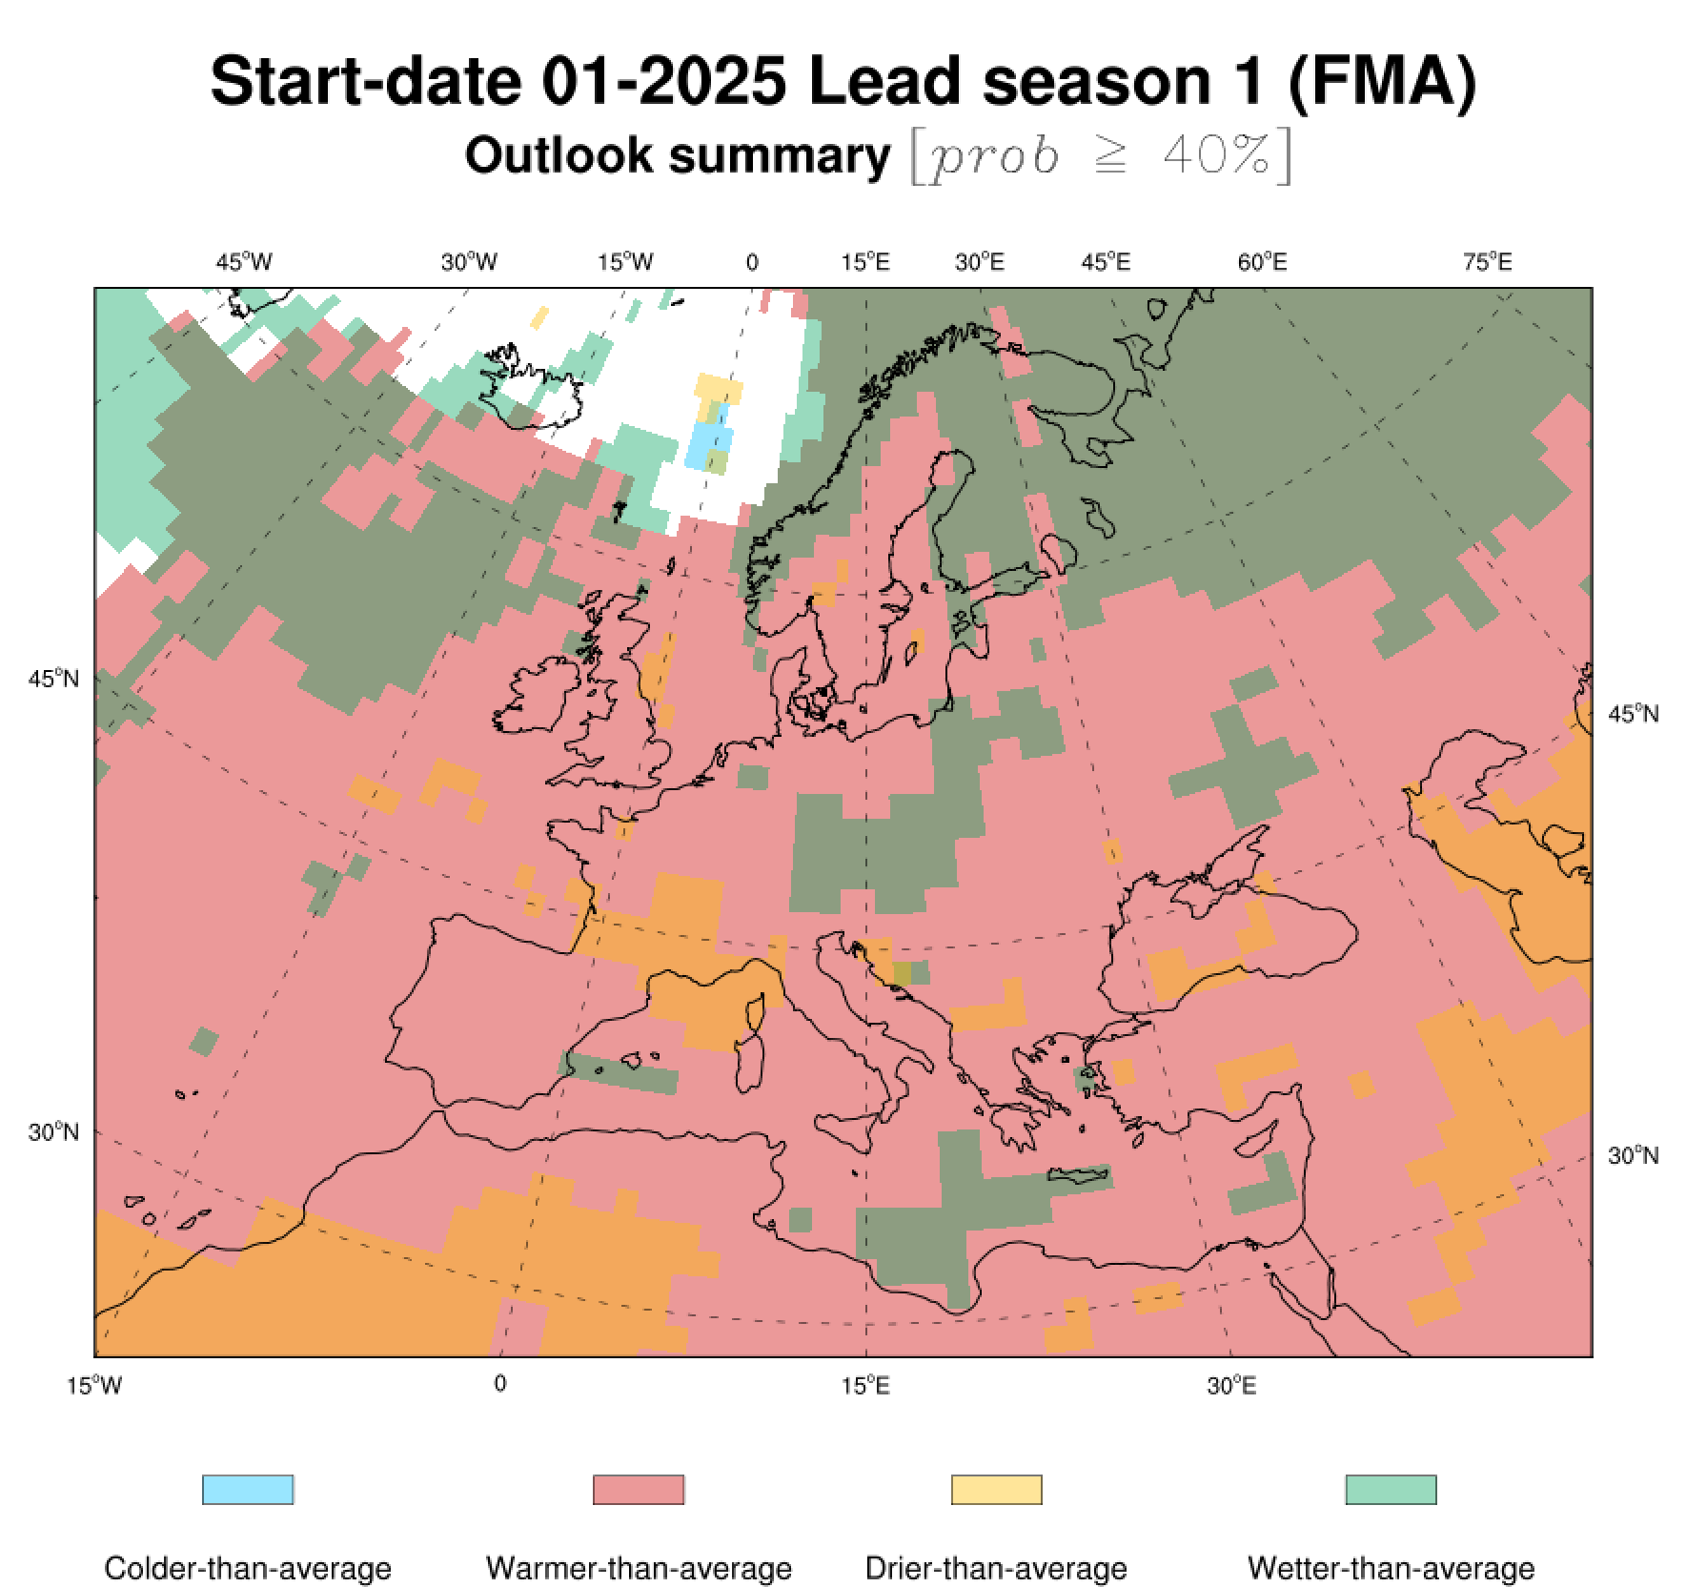
CMCC SEA over Euro-Mediterranean area
WET
DRY
HOT
COLD

Slide 32



www.cmcc.it

