Slide 1

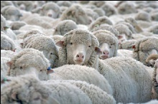

Herd Behaviour and Keeping up with the Joneses
Andrew Oswald
University of Warwick and IZA Bonn

Slide 2
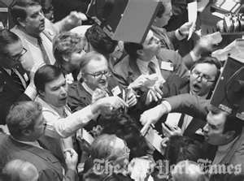
I would like to understand ‘herd behaviour’ in humans.

Slide 3
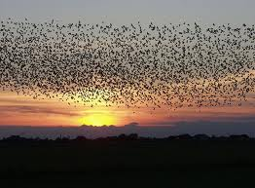
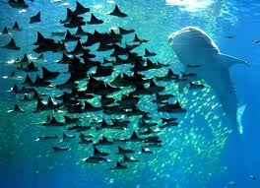

Slide 4
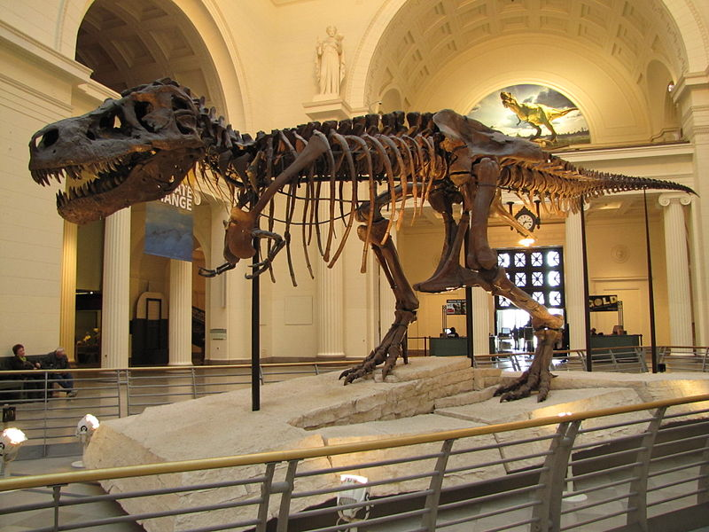

Slide 5
"Men … think in herds; they go mad in herds, … they only recover their senses slowly, and one by one."
C. Mackay

Slide 6
Extraordinary Popular Delusions and the Madness of Crowds, by Charles MacKay, published in 1841.

Slide 7
Extraordinary Popular Delusions and the Madness of Crowds, by Charles MacKay, published in 1841.
Far from the Madding Crowd, by Thomas Hardy, published in 1874.

Slide 8
Herd behaviour is very often natural and individually rational.

Slide 9
Herd behaviour is very often natural and individually rational. But it has the potential to be dangerous for the group.

Slide 10

Herd behaviour is very often natural and individually rational. But it has the potential to be dangerous for the group.

Slide 11
Today we’ll look at:

Slide 12
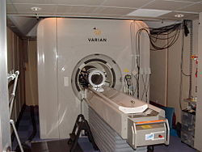
Today we’ll look at:
Brain scan evidence

Slide 13
Today we’ll look at:
Brain scan evidence
Statistical evidence

Slide 14
Today we’ll look at:
Brain scan evidence
Statistical evidence
The mathematics of herd behaviour

Slide 15

I’ll propose a number of other ideas.

Slide 16
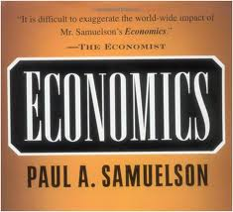
#1
‘Happiness’ data offer us interesting potential as proxy-utility data.
u = u(y, z, ..)

Slide 17
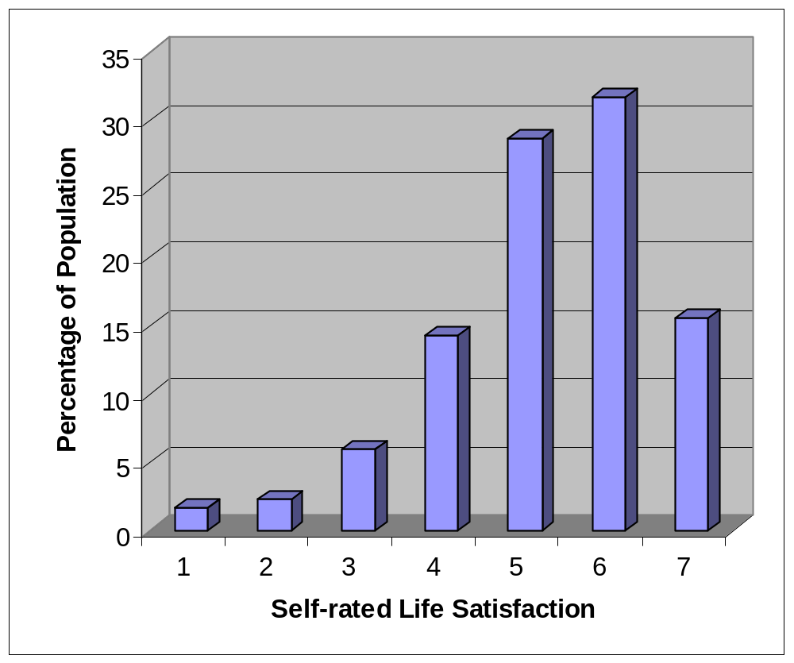
The distribution of life-satisfaction levels among British people
N = 74,481

Slide 18
#2
Empirically, there are strong relative effects on utility:

Slide 19
#2
Empirically, there are strong relative effects on utility:
u = u(y, y*)
eg. if y* is others’ incomes.

Slide 20
#3
A crucial role in social-science behaviour is played by the second derivative, v″, of the function
utility = v(relative status)+ ..

Slide 21
In humans (I shall argue)
Concavity of v(.) leads to imitation and herd behaviour
Convexity of v(.) leads to deviance.

Slide 22
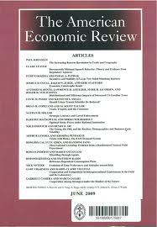


#4
The next 20 years are likely to see economists work more and more with physiological and hard-science data.

Slide 23
The classic article on real herd behaviour:

Slide 24

Hamilton, W. D. (1971). "Geometry for the Selfish Herd". Journal of Theoretical Biology 31 (2): 295–311.

Slide 25
So why does herding happen?

Slide 26

So why does herding happen?

Slide 27
When a T Rex dinosaur comes in the room, it is your relative position that matters.

Slide 28
So suggested:
Hamilton, W. D. (1971). "Geometry for the Selfish Herd". Journal of Theoretical Biology 31 (2): 295–311.

Slide 29
The standard theory in biology had been that herds had an inexplicable communitarian instinct.

Slide 30
Instead, Hamilton argued:

Slide 31
Instead, Hamilton argued:
A rational animal clusters with the others –

Slide 32

Instead, Hamilton argued:
A rational animal clusters with the others – because its relative position is what matters.

Slide 33
For biologists and zoologists, Hamilton’s is now the dominant theoretical explanation for herd behaviour.

Slide 34
By contrast

Slide 35

By contrast
Most economists who study herd behaviour prefer to view it as ‘informational learning’.
Banerjee in the QJE, etc.

Slide 36

Yet fashion is ‘pure’ imitation

Slide 37

Yet fashion is ‘pure’ imitation

Slide 38
So I reckon we need to think about human imitation caused by sheer keeping-up desires*.
*even if heavily subconscious

Slide 39
Before getting to equations, let’s start with everyday empirical evidence.

Slide 40
Consider your wrist.

Slide 41


Slide 42
5 euros

Slide 43


Slide 44
500000 euros

Slide 45
5 euros

Slide 46
500000 euros

Slide 47
“A watch defines a man's look and tone.” Rolex advert.

Slide 48

“A watch defines a man's look and tone.” Rolex advert.

Slide 49
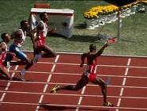
Subconsciously, humans seem frightened of falling behind.

Slide 50
So let us hypothesise that human beings care about their relative position.

Slide 51
So let us hypothesise that human beings care about their relative position.
Duesenbery, Easterlin, Frank, Hirsch, Layard, Runciman, Veblen, ...

Slide 52
There are now results
From fMRI scans
From statistical work on well-being

Slide 53
This includes new empirical work:
Armin Falk and colleagues on relative-income images in the brain (Science, Journal of Public Economics)
Peter Kuhn and colleagues on car purchasing by neighbours of lottery winners (AER forthcoming)
Ori Heffetz on visible goods (REStats forthcoming).
David Card, Alexandre Mas, Enrico Moretti, Emmanuel Saez on peers and satisfaction.

Slide 54
Two papers I would greatly recommend.

Slide 55
Title: Social comparison affects reward-related brain activity in the human ventral striatum
Author(s): Fliessbach K, Weber B, Trautner P, et al.
Source: SCIENCE Volume: 318 Issue: 5854 Pages: 1305-1308 Published: NOV 23 2007

Slide 56
Title: Relative versus absolute income, joy of winning, and gender: Brain imaging evidence
Author(s): Dohmen T, Falk A, Fliessbach K, et al.
Source: JOURNAL OF PUBLIC ECONOMICS Volume: 95 Issue: 3-4 Special Issue: Sp. Iss. SI Pages: 279-285 Published: APR 2011

Slide 57
We are now able to look inside the brain.

Slide 58
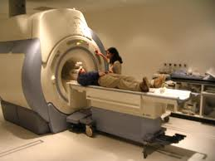
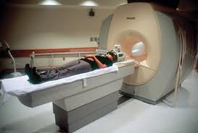
Armin Falk et al

Slide 59
Armin Falk et al
While being scanned in adjacent MRI scanners, pairs of subjects had to perform a task with monetary rewards for correct answers.

Slide 60
Variation in the comparison subject's payment affected blood oxygenation level-dependent (BOLD) responses in the ventral striatum.

Slide 61
Variation in the comparison subject's payment affected blood oxygenation level-dependent (BOLD) responses in the ventral striatum. This brain region is engaged in the registration of primary rewards.

Slide 62
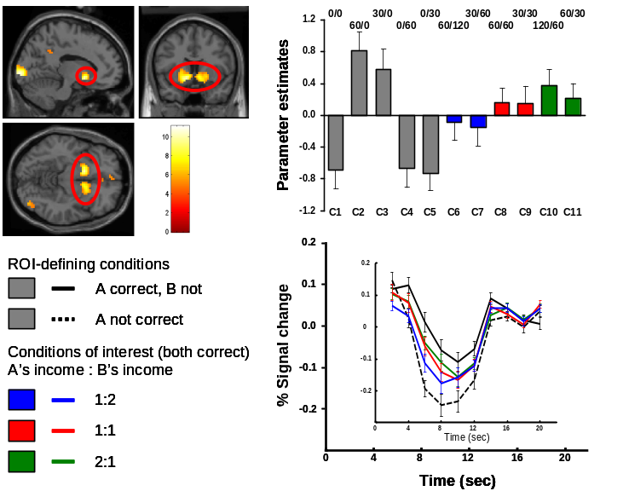
Falk et al in Science and JPubEcon

Slide 63
Falk et al in Science and JPubEcon
“The mere fact of outperforming the other subject positively affected reward-related brain areas.”

Slide 64
The next slide -- very briefly -- is for specialists.

Slide 65
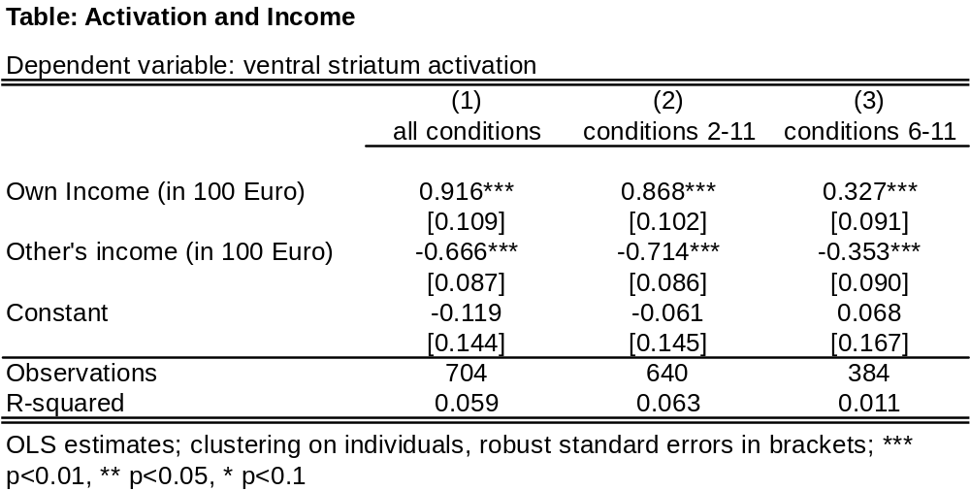
Blood-oxygenation equations
(similar with fixed effects, main variation across Ss)

Slide 66
So, inside your brain

Slide 67
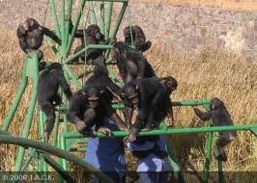
So, inside your brain
You simply want to be high up the monkey pack

Slide 68
Here is a different kind of data and evidence.

Slide 69
It has been found that

Slide 70
It has been found that
Relative-income variables show up consistently in well-being equations.

Slide 71
It has been found that
Relative-income variables show up consistently in well-being equations.
E. Luttmer, Quarterly Journal of Economics 2005
A. E.Clark et al, JPubEcon 1996, JELit 2008
GDA Brown et al, Industrial Relations 2008 and Psychological Science 2010
D. Card et al, NBER paper, 2011.

Slide 72

A person’s happiness and mental health = f(their relative income). Andrew E Clark

Slide 73
Why would we care about these things?

Slide 74
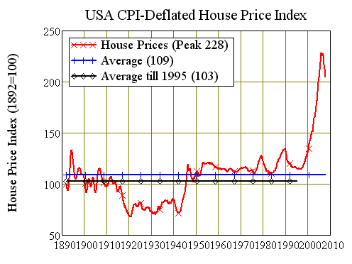
Real house prices in the United States over the century

Slide 75
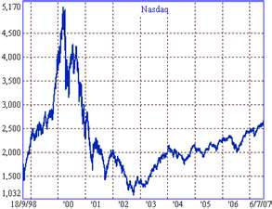
The dotcom bubble: 2000-1

Slide 76
But potentially this issue goes far beyond economics.

Slide 77
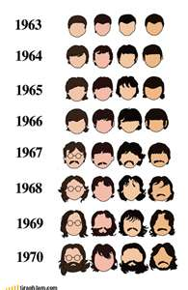
The hair ‘bubble’

Slide 78
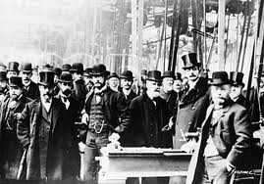
Hat mania

Slide 79

Peers and health choices

Slide 80
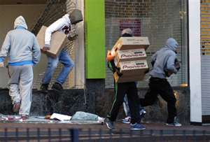
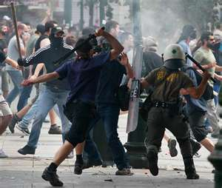

Perhaps even 2011 in the UK

Slide 81
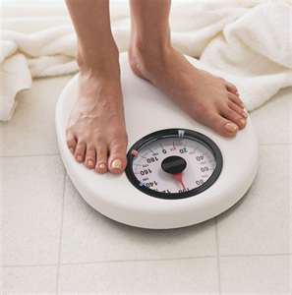
Social norms in other ways

Slide 82
Now let’s think of the likely mathematics.

Slide 83
Much in the next few slides will rest on whether the happiness from status is accelerating or decelerating.

Slide 84
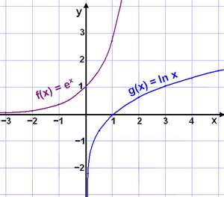

Slide 85
Which of them is true of you, do you think?

Slide 86
Does your happiness from status accelerate as you go up in status?

Slide 87
Does your happiness from status accelerate as you go up in status? [convex]

Slide 88
Does your happiness from status accelerate as you go up in status? [convex]
Or do you get diminishing marginal returns?

Slide 89
Does your happiness from status accelerate as you go up in status? [convex]
Or do you get diminishing marginal returns? [concave]

Slide 90
Imagine a person is choosing an action a to get the greatest utility:
where a* is what everyone else is doing.

Slide 91
Imagine a person is choosing an action a to get the greatest utility:
Maximize u(a) + v(a – a*) – c(a)
where a* is what everyone else is doing.

Slide 92
u(a) is the direct bit of utility

Slide 93
u(a) is the direct bit of utility (if my car can go fast I really can get to Oxford more quickly)

Slide 94

u(a) is the direct bit of utility (if my car can go fast I really can get to Oxford more quickly)

Slide 95
u(a) is the direct bit of utility (if my car can go fast I really can get to Oxford more quickly)

Slide 96
u(a) is the direct bit of utility (if my car can go fast I really can get to Oxford more quickly)

Slide 97
u(a) is the direct bit of utility (if my car can go fast I really can get to Oxford more quickly)

Slide 98
v(a – a*) is the indirect bit of utility

Slide 99
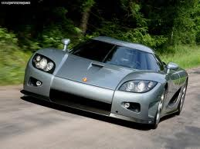
v(a – a*) is the indirect bit of utility (if my car can go fast then subconsciously I feel superior to others as I drive to Oxford)

Slide 100
Putting these together

Slide 101
Putting these together
Maximize u(a) + v(a – a*) – c(a)
a* is what other people are doing
a is my action

Slide 102

Let’s think back to watches. What is your rational choice of action, a?

Slide 103
Do I buy a better watch when you do?

Slide 104
Do I buy a better watch when you do?
Well the sign of
da/da*
is given by the sign of the second derivative of v(a-a*).

Slide 105
Concavity of v(.) leads to emulation
Convexity of v(.) leads to the opposite.
Joint work with Andrew Clark

Slide 106
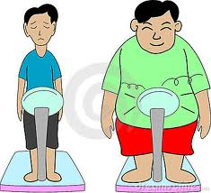
This matters because, for example, we need to have an explanation for the simultaneous occurrence of obesity and anorexia.

Slide 107
When might v(.) be convex?

Slide 108
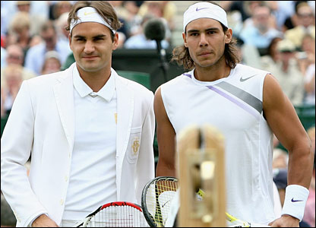
When might v(.) be convex?

Slide 109
The utility increment going from 3rd in the world to 2nd in the world is going to be much bigger than going from 8th to 7th.

Slide 110
So maybe v(a –a*) goes convex at the extreme end of a status distribution.

Slide 111
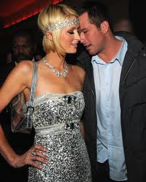
So maybe v(a –a*) goes convex at the extreme end of a status distribution.

Slide 112
Overall, in my judgment:

Slide 113
Overall, in my judgment:
This parameter v″(a - a*) is one of the most fundamental in all of social science.

Slide 114
Overall, in my judgment:
This parameter v″(a - a*) is one of the most fundamental in all of social science.
Yet we have little idea of its size or even often what sign it takes.

Slide 115
So what?
Why might it matter to social scientists if utility depends on relative things?

Slide 116


Slide 117
A second possibility: excessive herding.

Slide 118
The importance of relative things to well-being may provide an important clue about what has driven the Credit Crunch.

Slide 119
When rewards depend on your relative position
it will routinely be
dangerous to question whether the whole group’s activity is flawed
rational simply to compete hard within the rules that govern success.

Slide 120
When rewards depend on your relative position
it will routinely be
dangerous to question whether the whole group’s activity is flawed
rational simply to compete hard within the rules that govern success.
Correct dotcom analysts were fired.

Slide 121
In financial markets, people are now routinely rewarded in a way that depends on their relative performance. Top quartile, second quartile, etc.

Slide 122
That’s dangerous:

Slide 123
To conclude

Slide 124
The main ideas
1. Imitation is central to human life.
2. It is often driven by relative feelings; this links it to biology and real herds.
3. The crucial parameter is v″(a – a*) .
4. We need to understand herd behaviour better in social science.
5. The madness of crowds will be back.

Slide 125
The main ideas
1. Imitation is central to human life.
2. It is often driven by relative feelings; this links it to biology and real herds.
3. The crucial parameter is v″(a – a*) .
4. We need to understand herd behaviour better in social science.
5. The madness of crowds will be back.

Slide 126
Herd Behaviour and Keeping Up with the Joneses
Andrew Oswald
University of Warwick and IZA Bonn

