Slide 1

Discretion is the better part of secrecy: international trade negotiations, open government, and bureaucratic culture
Nicholas Gruen
Government 2.0 Taskforce Australia
E ngruen@gmail.com
T @nicholasgruen

Slide 2


Caveats

Slide 3
Outline
What is Web 2.0 and why does it matter?
The value of openness
Trade negotiations
  from hard secrecy to soft
Performing government
  Soft secrecy becomes the default
Groupthink and Openness as a cultural value
Notes:
http://www.opendemocracy.net/ourkingdom/simon-burall/when-local-can%E2%80%99t-happen-locally
Web 2.0
Ideas that work
Mass Transit, Fix my street, Kaggle
Ideas that don’t
Obama’s brainstorming
Budget challenge
What’s the difference?
Recipe(s) for success
Structure
All the failures are by governments

Slide 4
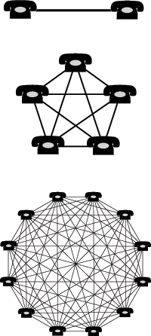

Metcalfe’s Law
2 => 1
5 => 10
12 => 66

Slide 5
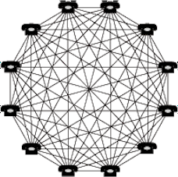
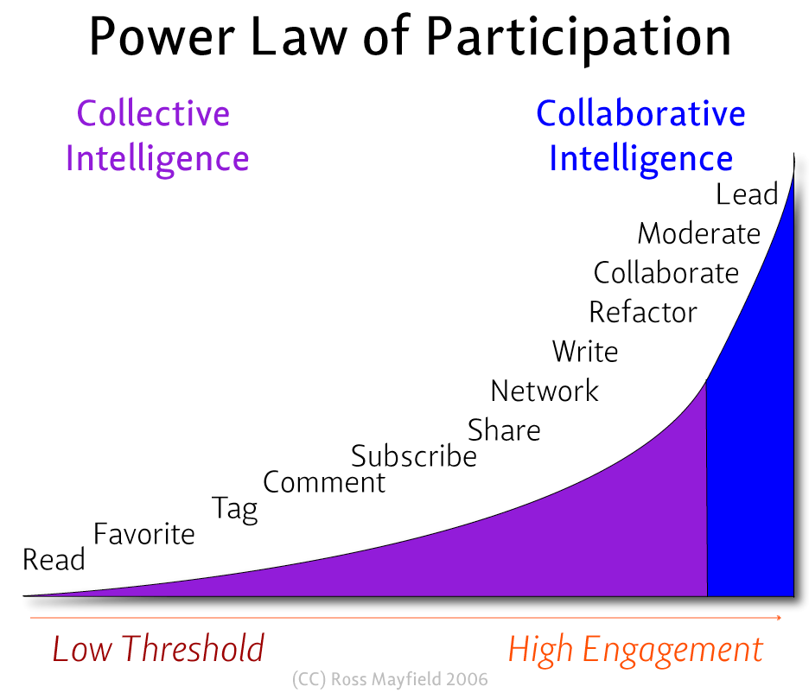
Social policy
#
Mortgage
Securitisation
Poodles

Slide 6

Where’s Wally?
Finding Wally?
Notes:
There are countless models that can be applied to solve any one predictive analytics problem. It is impossible to know at the outset which technique will be most effective.

Slide 7
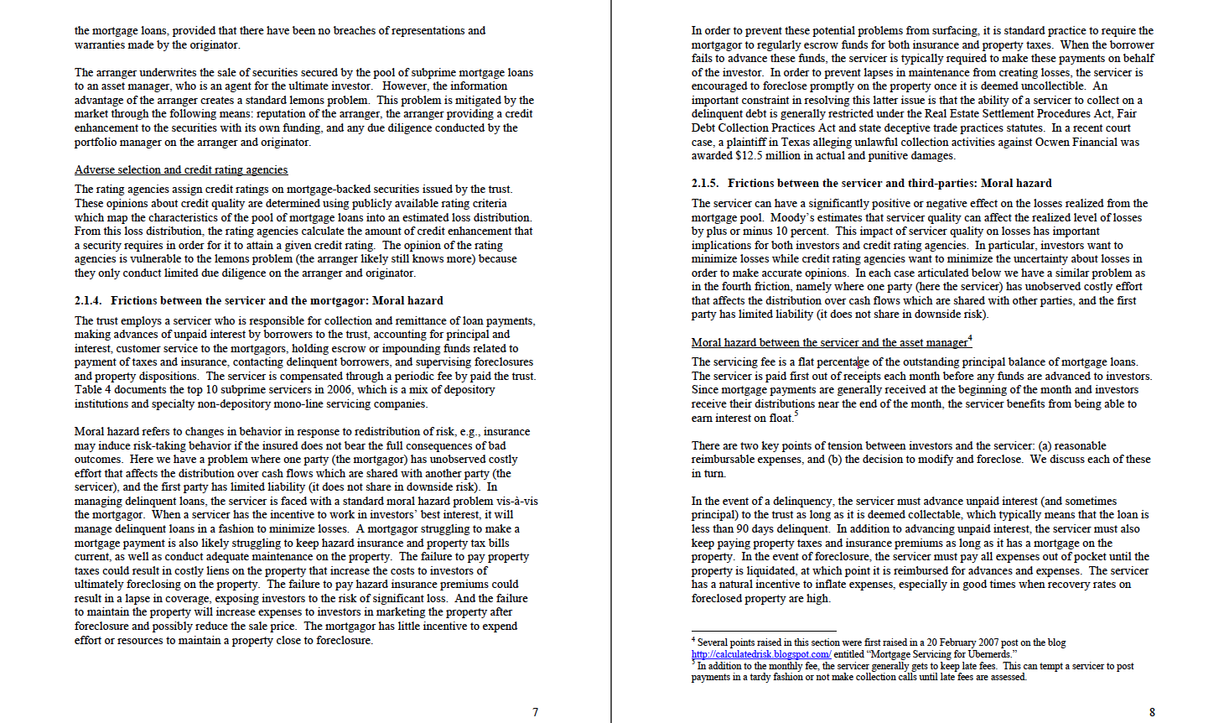
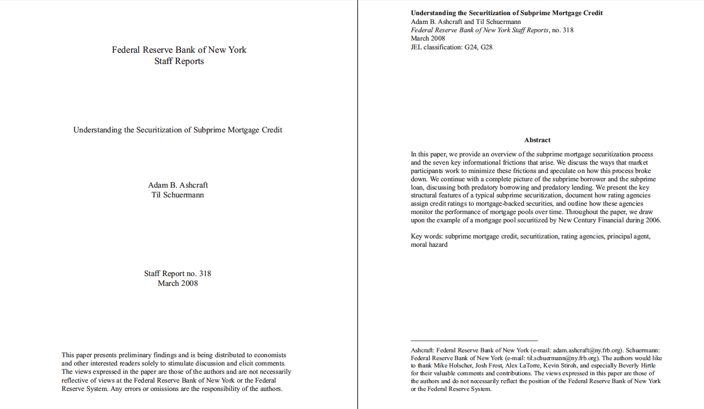
Tanta

Slide 8


Tanta
Steve Randy Waldman

Slide 9
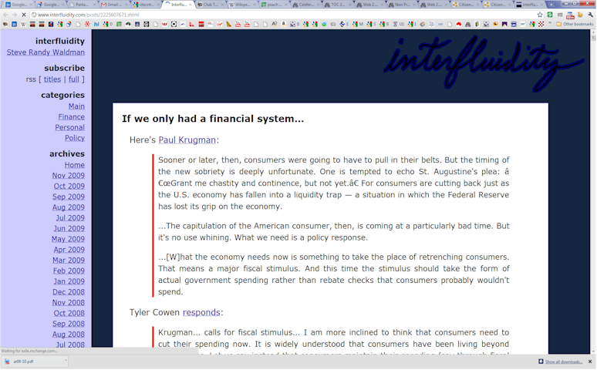

Slide 10
The turbocharged ecology of
Web 2.0 authority
Authority
Contribution
Reputation
Identity

Slide 11
Engaging Wally?
Where’s Wally?
Notes:
There are countless models that can be applied to solve any one predictive analytics problem. It is impossible to know at the outset which technique will be most effective.

Slide 12
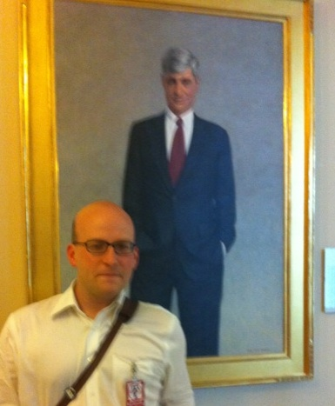
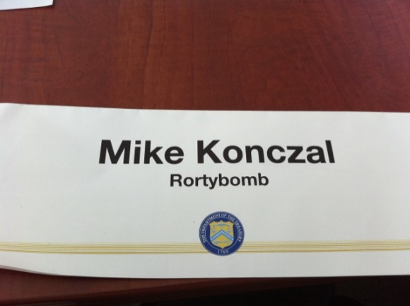

Takeouts:
  The smartest guys are always outside the room
  Find and engage them
  To do so we need more
    Humility
    Gregariousness
  Organisations find this surprisingly hard
  Web 2.0 has massively increased the gains from openness

Slide 13
Trade Negotiation
No information out of the strict course of official duty shall be given, directly or indirectly, by any officer without the express direction or permission of the responsible Minister
Civil Service Act 1862 (Vic)
Trade negotiation should be open
But trade negotiation is exercise of executive sovereignty
Ratification is for Parliament
So trade negotiation is closed by default

Slide 14
Trade Negotiation
Closed doesn’t work
  So WTO, WIPO and others have protocols for communicating text as it emerges from negotiating rounds.
Recent plurilateral agreements have seen a reassertion of secrecy
Anti-Counterfeiting Trade Agreement.
Trans Pacific Partnership Agreement.
Negotiated for years in secret
some interests have inside information
others nurse conspiracy theories

Slide 15
TPP
  Who here is not embarrassed to be negotiating in secret?
    Computerworld attended the lunch, on an undertaking not to report what was said in detail, lest this jeopardise future relations between the negotiators and their critics.
    Secrecy feeds on itself
    Hard secrecy surrounds itself with a penumbra of soft secrecy

Slide 16
Lowy Institute Blog on Secrecy
  I know it is difficult for our many readers in Canberra's national security bureaucracy to participate, but requests for anonymity will be respected.
  While secrecy may need to be respected, why should talking about secrecy be secret?

Slide 17
Performing control
A career limiting statement
  Your guess is as good as mine
A nation saving initiative
  Treasury’s ‘war-gaming’ the GFC
A nation risking silence
  Our mining boom: This time it’s different

Slide 18
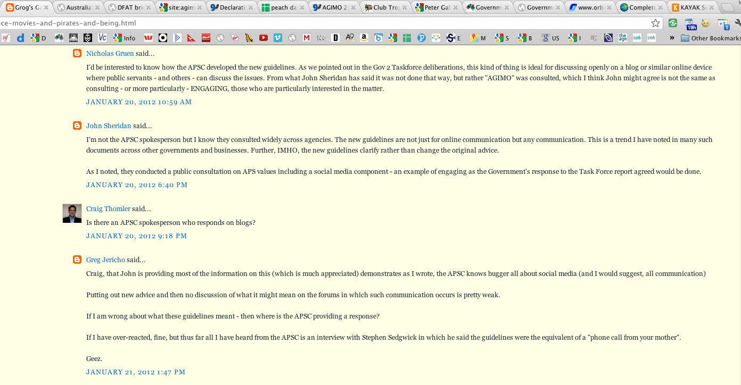
APSC

Slide 19
Openness as . . .
Human right
  right to one’s file
Political and constitutional hygiene
Micro-economic reform
  Where’s Wally
    Finding the right person
    Connecting people and information
  Bug fixing
    Government 2.0 mashup
    Fighting the tyranny of serial veto

Slide 20
Openness as . . .
Instrumental value (Managerialism)
  “Our mission is to . . . “
  The agency uses the tools
  captures the newly available benefits
Cultural or deliberative value (Professionalism)
  Collectively and individually lived cultural value
  Capturing the value of dissent
    Resisting complacency
    Openness to improvement
    Resistance to error and hubris from the top

Slide 21
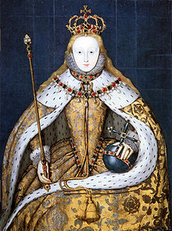
The pull of groupthink
Hayek’s ideas about tribal and liberal man
  Whistleblowers
The balm of ‘discretion’
  Team players
The power of top down

Slide 22
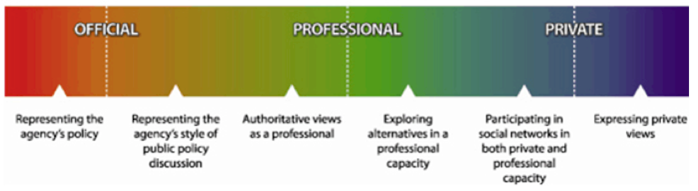
Public engagement
Our challenge has been to avoid the gimmickry of the latest fad in favour of outlining how the new approaches might reinvigorate the time-honoured and hard-won traditions of modern democratic government.
Government 2.0 Taskforce

Slide 23
A Declaration on Open Government
Online engagement by public servants should be enabled and encouraged.
  Robust professional discussion benefits their agencies, their professional development, and the Australian public;
Public sector information is a national resource
  releasing as much of it on as permissive terms as possible maximises its value and reinforces democracy;
Open engagement at all levels of government is integral to promoting an informed, connected and democratic community, to public sector reform, innovation and best use of the national investment in broadband.

Slide 24

Reaction to our report
The Australian Government 2.0 Taskforce Teaches Us A Lesson
Their report is the best piece of work I have seen by a government-driven initiative around government 2.0. But I would also like to praise the way members of the taskforce worked over the last few months.
Their blog was a constant source of thoughtful considerations, and their debate went on in the open, being as informative as the report itself. They participated in external debates, by reading other people’s blogs, reaching out and commenting. For what I have seen, as I had a few chances to interact with them, the level of engagement and openness they have achieved was truly exemplary, with a level of humility that made their excellent skills even stronger.
2nd of top ten things
A truly excellent report in a remarkably short period of time, reaching out to experts inside and outside government worldwide, and showing a rare attitude to listening to other people’s opinions.
Australia is the place where the government 2.0 taskforce has recognized the centrality of employees and the federal government has bought into that idea.
Andrea Di Maio
Gartner Government 2.0 Principal

Slide 25
The Declaration of Open Government: 16th July 2010
Citizen collaboration in policy and service delivery design will enhance the processes of government and improve the outcomes sought. Collaboration with citizens is to be enabled and encouraged. Agencies are to reduce barriers to online engagement, undertake social networking, crowd sourcing and online collaboration projects and support online engagement by employees, in accordance with the Australian Public Service Commission Guidelines.
The possibilities for open government depend on the innovative use of new internet-based technologies. Agencies are to develop policies that support employee-initiated, innovative Government 2.0-based proposals.

Slide 26
Conclusion
No silver bullets
  There will be important trade-offs with national security
Big changes require political leadership
  With executive or legislative action
The benefits of openness
  to Data, Discussion and Disagreement are indirect and serendipitous
  Just like the benefits of opening markets
The norms of openness are a great cultural labour the infrastructure
Freedom
Prosperity and
Prudence or the avoidance of mistakes (and so national security)

Slide 27


Slide 28
Government 2.0 Taskforce two years on
Stroke of the pen reforms
  going slowly but well
    CC-BY default
    FOI and the new Information Commissioner structure
Initiatives that can be absorbed into comms
  Agency Twitter accounts now abound
Reforms requiring cultural change and engagement
  Not so well

Slide 29
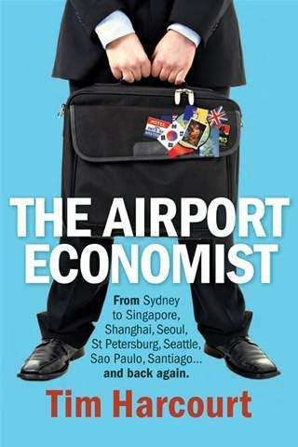

Slide 30

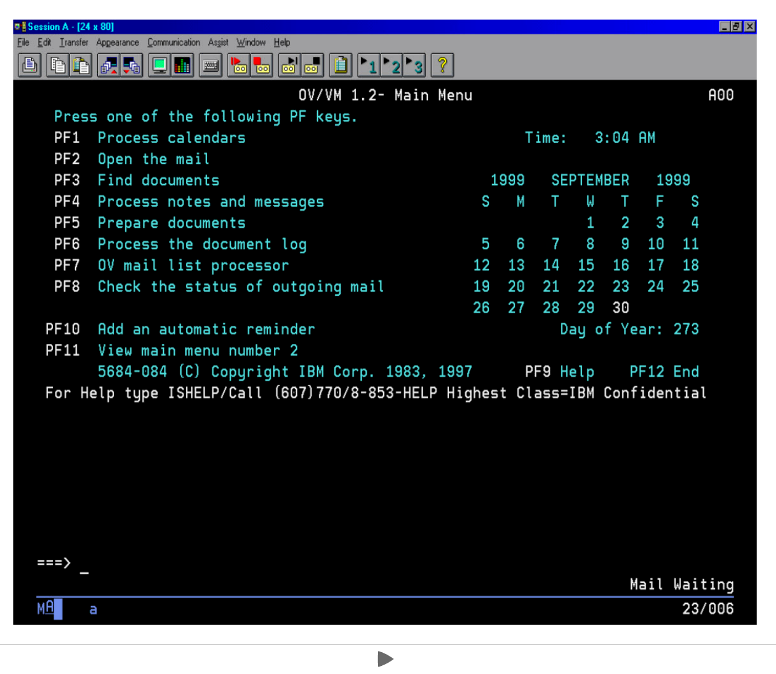
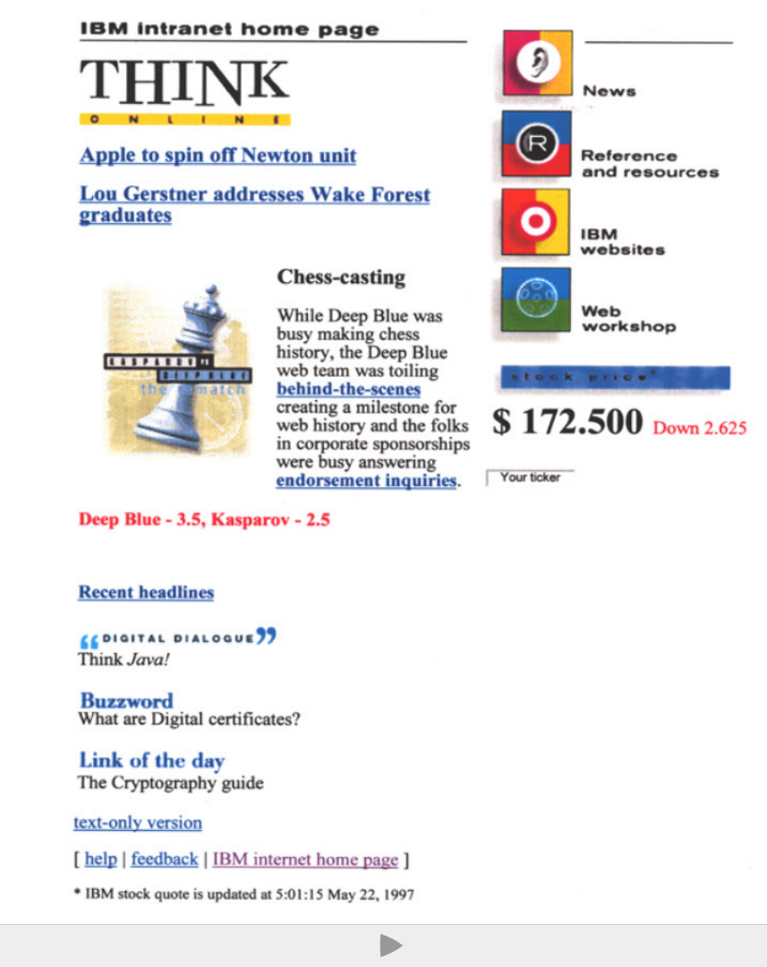
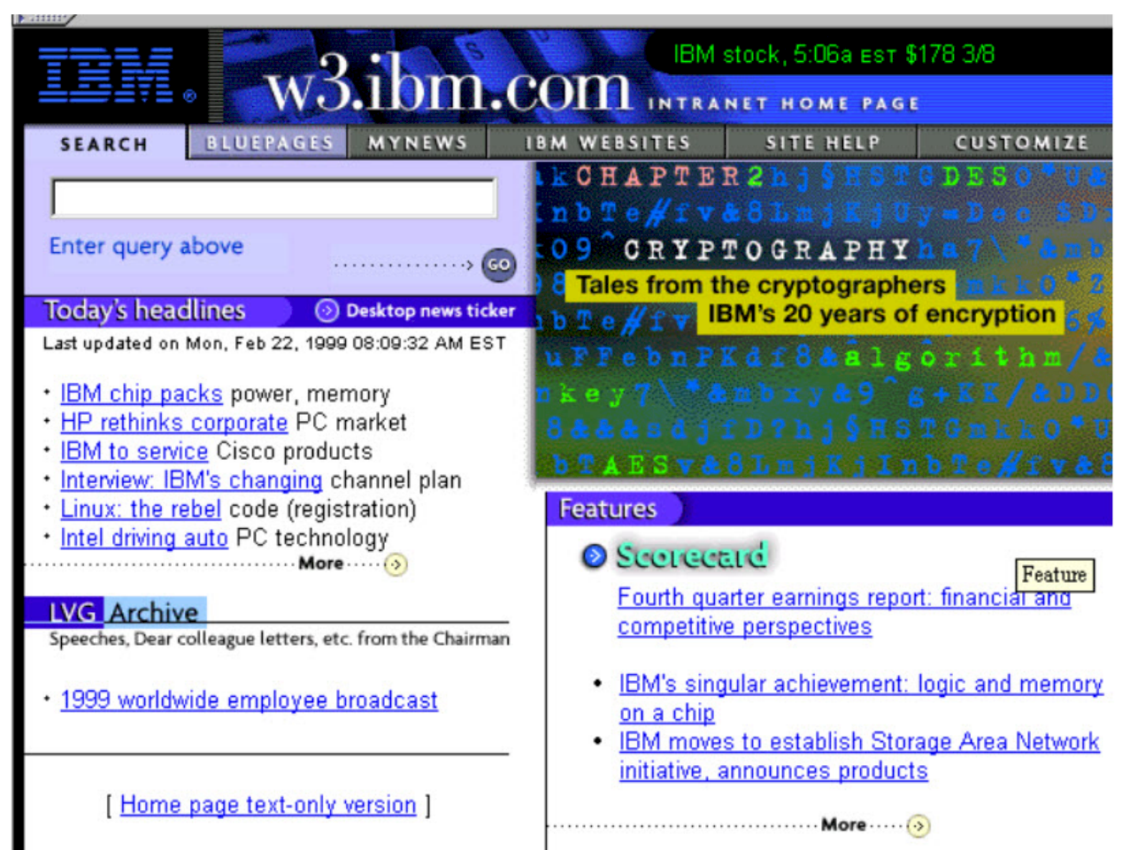
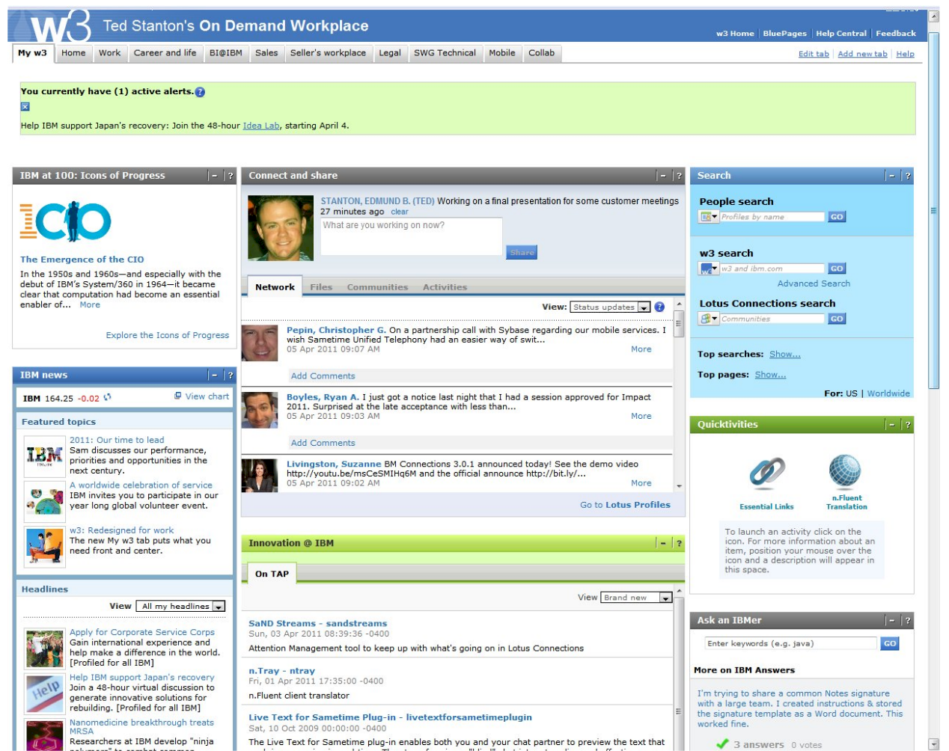
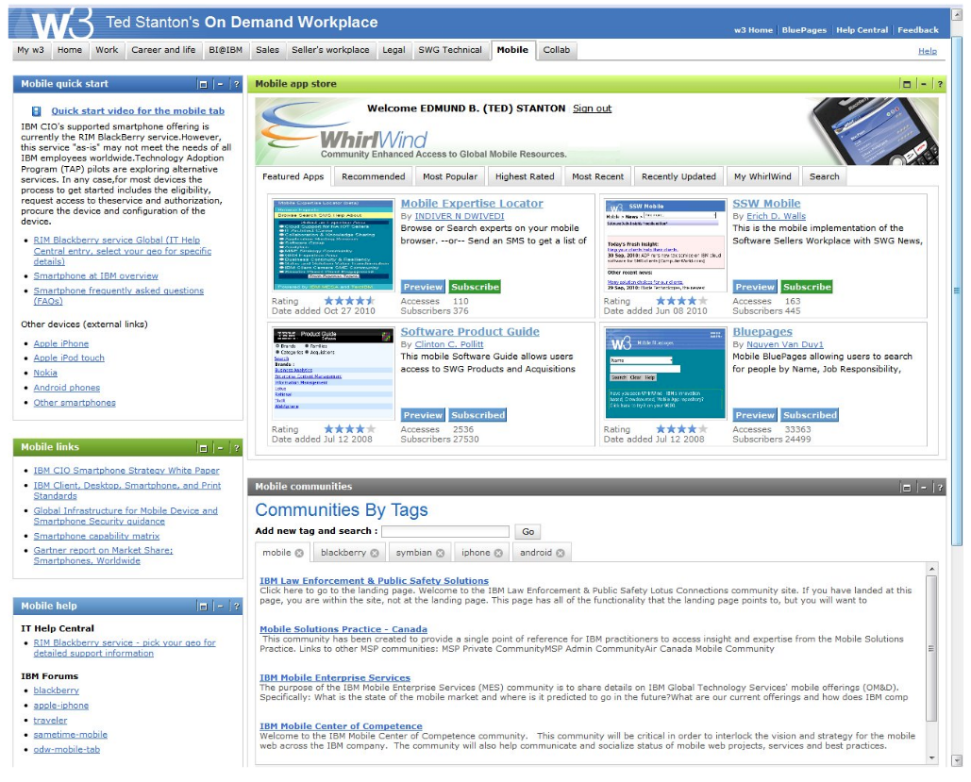
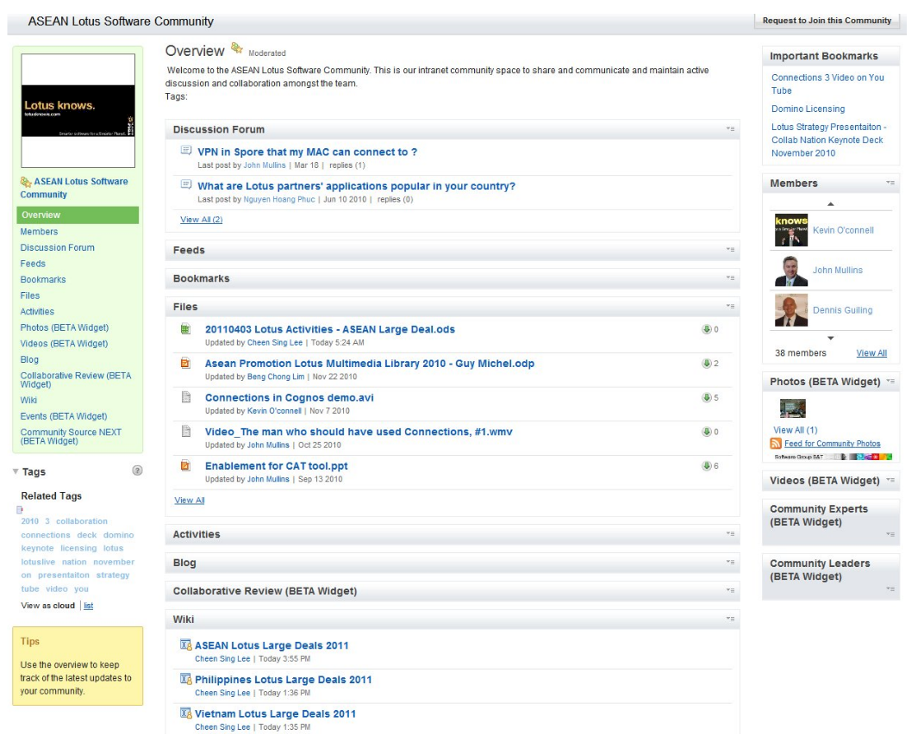

Slide 31
Noinformationoutofthestrictcourseofofficialdutyshallbegiven,directlyorindirectly,byanyofficerwithouttheexpressdirectionorpermissionoftheresponsibleMinister”CivilServiceAct1862(Vic)

Slide 32
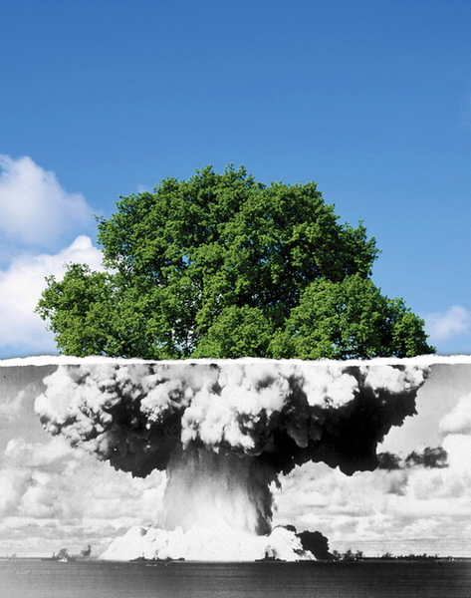

Caveats

