Slide 1
Parental Leave
Introduction by Paul Frijters

Slide 2
50 Countries around the world currently have paid maternity leave.
Australia remains one of only two OECD countries that do not have paid maternity leave (the other is the US).
Democrats senator Natasha Stott Despoja .

Slide 3
On Thursday September 13, 2007 the Australian Democrats introduced federal legislation to establish a paid maternity leave scheme that would provide all working women with 14 weeks Government-funded leave at the minimum wage on the birth or adoption of a child.
Democrats senator Natasha Stott Despoja .http://natashastottdespoja.deadline.net.au/aspx/campaigns_maternity_leave.aspx

Slide 4
The Australian Greens has called for 18 weeks parental leave.
http://www.goldcoast.com.au/article/2007/10/09/3601_gold-coast-top-story.html

Slide 5
According to the Equal Opportunity for Women in the Workplace Agency, provisions for paid maternity leave should be seen as a financial edge for businesses not a burden, with those currently offering it experiencing a 19% higher return rate from maternity leave than those businesses which do not offer it.
‘Leading the way: EOWA Employers of Choice fro Women’ Equal Opportunity for Women in the Workplace Agency 23 May 2007

Slide 6
It is illegal to discriminate on the basis of gender or pregnancy when recruiting, dismissing or promoting employees.
Currently, Australian birth mothers have a right to up to a year’s unpaid maternity leave.
“who pays for parenthood”, http://www.acci.asn.au/text_files/issues_papers/Labour_Relations/LR35.pdf

Slide 7
“Whether it is better for the parents of young children to work or to stay at home is not the point. In a free society such decisions should properly be left to families without undue interference from government.”
“who pays for parenthood”, http://www.acci.asn.au/text_files/issues_papers/Labour_Relations/LR35.pdf

Slide 8
Costs of Maternity Leave
Paid maternity leave will cost between $415m and $780m per annum depending on the rate of pay and eligibility.
2004, Senator the Hon. Nick Minchin , http://www.aph.gov.au/library/intguide/ECON/maternity_leave.htm

Slide 9
250,200 births and 514 adoptions (250,714 maternity events) x .72 participation rate = 180,514 x .781 in non-government employment ( = 140,981) x .754 for those in current job for more than a year = 106,300.
Of these, assume 36.3 per cent (or 38,587) earn less than minimum wage at an average of$229/week (these are mainly part-timers).
Net of the Maternity Allowance and the Maternity Immunisation Allowance, these are eligible for an average Maternity Payment of ($229 x 14 weeks) less $1007 = $2199. Estimated cost for those earning less than minimum wage is $2199 x 38,587 = $84.85 million.
For those earning above minimum wage, or 63.7 percent of 106,300 = 67,713, net of the Maternity Allowance and the Maternity Immunisation Allowance, ($431.40 x 14 weeks) less $1007 = $5033. Estimated cost for those earning more than minimum wage is $5033 x 67,713 = $340.80 million
Total approximate cost, before tax = ($342.09m + $85.58m) = $425.65 million, after tax = $352.14 million.
http://www.aph.gov.au/library/intguide/ECON/maternity_leave.htm

Slide 10
Cost of Parental Leave
Providing favourable tax arrangements to encourage employees to salary sacrifice a portion of income that can be used to fund parental leave – estimated cost of $155M for 14 weeks; $287M for 26 weeks and $575M for 52 weeks leave.
Introducing arrangements that allow employees who invest more in superannuation to be able to draw down on this investment (at a favourable tax rate) prior to the current retirement age to fund parental leave – estimated cost of $141M for 14 weeks; $262M for 26 weeks and $524M for 52 weeks leave.
http://www.acs.org.au/index.cfm?action=show&conID=200502011319287231

Slide 11
How big is this?
On the side of the receivers: $5033
What do you think the total life-time cost of a kid is these days?
So how much is this going to help fertility and who is going to react most?
If government pays, employers will noly object if they don’t want their employees to have kids, which might be the case if long-run mutual investments are made. If employers pay, then $5033 is going to be around 15% of annual salary, or about 3% additional wage cost per kid per employee (assuming a 5 year average tenure and median wage job). That’s a good reason not to want to hire someone who might get a kid.

Slide 12
Is there any obvious market failure?
Offering maternity leave is simply a business decision and whether it makes good business sense is something a market can determine pretty well. Hence the argument by ‘Equal Opportunity for Women in the Workplace Agency’ that business should do this out of self-interest is bogus.
However, individual employers are not going to care about the benefit of society from having more kids. Hence the debate boils down to whether kids and families bestow positive externalities on others. If they do, the childless should compensate those with kids up to the full amount of the externality. If they don’t, the childless should not be burdened by subsidising those with kids. In either case, forcing paid maternity leave on kids will mean employers start to pay women less or discriminate them in hiring decisions unless men too are made to take compulsory child leave (such as in some Scandinavian country).

Slide 13
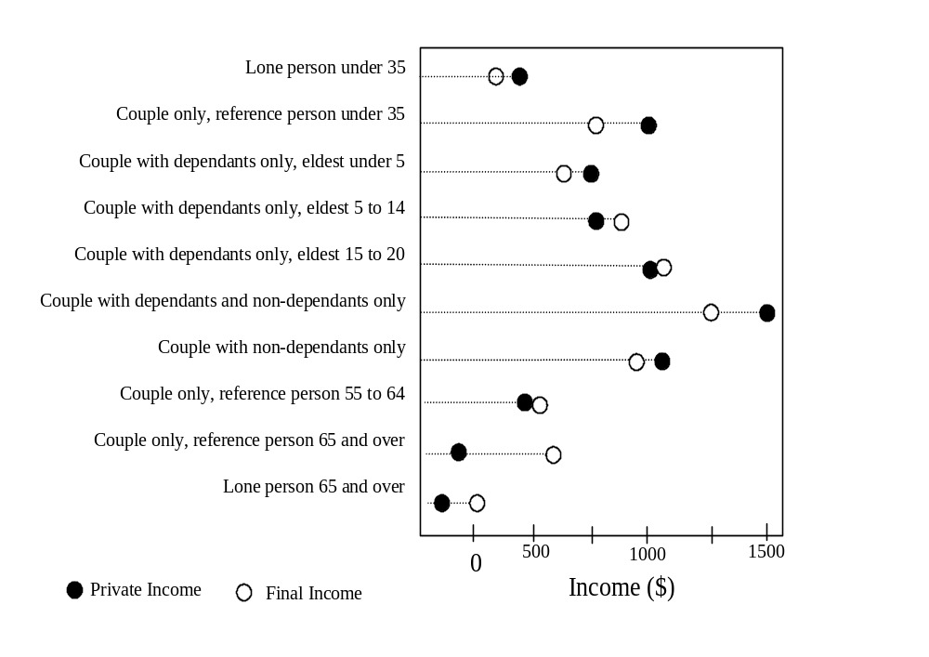
Do the childless already subsidise kids?
Not much: look at 1999 state transfers. It’s the old and those with school kids who get the transfers

Slide 14
What is the likely long-run effect?
Slightly more kids, especially amongst low-paid for whom the subsidy is relatively bigger.
If employers pay and there’s no paternity leave: more discrimination against women.
If government pays: somewhat higher taxes.

Slide 15
Should we do this?

Slide 16
Why the government should subsidise and support Paid Parental Leave
Alison Macintyre

Slide 17
The current situation does not make economic sense
Accounting = cutting costs of production (ie wages etc)
Economics = consider all types of costs, including monetary, opportunity costs, social costs, externalities.

Slide 18
There are of course arguments that neither Australia nor businesses
can afford such a scheme
Except the US, all of Australia's major trading partners and all
members of OECD provide paid maternity leave.

Slide 19
Current Paid Parental leave in other countries
1) Sweden - 68 weeks
2) Norway - 53 weeks
3) Denmark - 52 weeks
4) Camada - 50 weeks
5) Italy - 47 weeks
6) UK - 39 weeks
7) Czech Rep.- 28 weeks
8) Hungary - 24 weeks
9) Finland- 21 weeks
10) Ireland - 18 weeks
11) Vietnam/Greece - 17 weeks
12) Turkey, France, Poland, Spain, Netherlands - 16 weeks
13) Belgium - 15 weeks
14) Germany, Japan, Switzerland - 14 weeks
15) Pakistan, Israel, Mexico - 53 weeks
http://www.gatago.org/aus/politics/51568411.html

Slide 20
Why don’t we already have paid leave?
Political parties unwilling to commit government to paying for it
Unwilling to put the burden of payment on employers – and suffer the political pain
“a deep ambivalence about working mothers and the workforce, despite the fact that we know we desperately need to enlarge the workforce given the current skill shortage and ageing of the population in the long term”

Slide 21
SME
Are less able to afford paid leave
But their main concern is finding and keeping skilled staff (August Sensis Business Index)
Ability to offer paid leave can attract workers, so big business enjoys an advantage
A govt funded minimum leave entitlement would help SMEs compete with big business for staff

Slide 22
Costs too much?
Baby bonus currently costs almost $1 billion per year
Stott Despoja’s proposal would only cost about $500 million
Just in case you are interested, Access Economics puts the total cost of domestic violence JUST IN AUSTRALIA at over $8 billion per year. That’s cost to government and business of financial cost, social cost, lost productivity, increased dependence on welfare, problem children

Slide 23
Renumeration for services rendered
People who care for children are rendering a service to society for which they deserve renumeration
It is not redistribution but payment for performance – taking care of children, education and upbringing
The amount should be identical to the price consumers are willing to pay in a marketplace
“A new study puts that cost at almost four hundred and fifty thousand dollars for the average family to raise two children from birth to the age of twenty”.

Slide 24
Productive forces for society: land, capital, and labour
Soil cannot be produced but can be exploited, capital is generated by investment which requires people, labour is produced by the birth of children who must be educated and socialised by parents who have to shoulder the burden

Slide 25
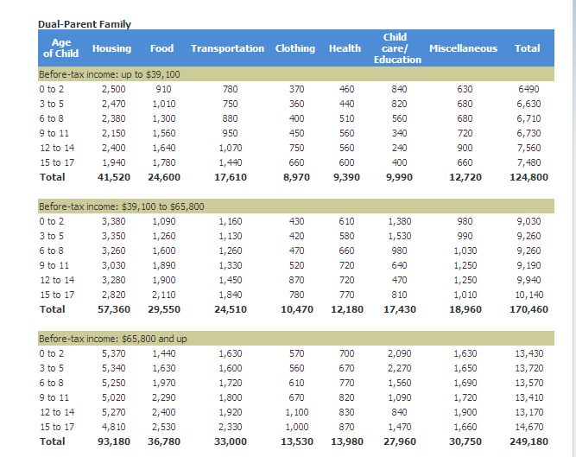

Slide 26
Children as public goods
Public good is one that exhibits non-divisibility and non-rivalry
No-one is prepared to pay for the benefit of public goods from their own pocket due to the non-excludability characteristic
Can become a free rider and enjoy the benefits without contributing to production
Common practice where voluntary contribution is relied on
It can be argued the state should meet this challenge if there is an interest in producing these goods
Nachtkamp, H. H. http://www.familie-und-gesellschaft.org/htm/downloads/engl/SOZIALNachtkampenglFass6.DOC

Slide 27
“Restrictions on women’s ability to support themselves outside of marriage lowered the opportunity cost of children and limited women’s ability to exercise choice”
Parents used to have leverage over adult children and raise them for working on the family farm or were responsible only for vocational training as a blacksmith
Increased geographical mobility, compulsory education, laws restricting child labour, weakened patriarchal property rights, women’s economic independence… all increases both the future productivity of children and the cost of raising children
“Growth of transfer payments and taxation of future generations socialises the benefits of having children”
Folbre, N. 1994. "Children as Public Goods" . American Economic Review

Slide 28
Is bearing children merely personal choice?
It must be more than this otherwise we wouldn’t have been urged to have one for ourselves, one for our husband and one for the country
Certainly weren’t talking about new cars – we can exclude other people from enjoying the benefit of those

Slide 29
In a family environment, children are socialised and learn the skills for existing in a pluralist society
Any deficiencies will be taken care of at some other point and at far greater cost
Positive and negative externalities

Slide 30


Slide 31


Slide 32
Having children still governed by norms etc
If they think like a rational egoist “homo economicus” it could end
The same geographical mobility and changes to labour that socialises benefits of children makes it easier to renege on contracts of family life – ie care for elderly parents - a cost that is being borne by the state, or taxpayers
It’s time for paid parental leave to catch up

Slide 33
The arguments against common Parental Leave policies.
Ben Ives

Slide 34
Obligations of Employment
Conditions of employment will outline a employee’s obligations to their employer, as well as the leave entitlements for the employee. Both parties are bound by these conditions, which can be regulated.

Slide 35
Obligations of Employment
Parental leave for extended periods can effect an employer's operations. However, the dismissal of an employee has social welfare implications.
Due to this situation, an area of policy that has become the centre of debate has been the issue of Parental Leave.

Slide 36
Questions to be addressed
Should Policy be developed aimed at the provision of Parental Leave?
If so, what are the realisms that need to be noted that will occur due to this policy?
What are the specifics of the Leave provided?
Who should be providing this Parental Leave?

Slide 37
Types of Leave
Paid Leave involves Parents receiving payments during leave.
Unpaid leave involves a system where an employer is required to ensure that a parent can take leave and return to a position of employment when they return to the workforce.
Aside from the difference caused by continuing payments, the two situations have similar repercussions for both employers and employees.

Slide 38
Parental Leave for Extended Periods
Parental leave for extended periods has massive impacts for an employer because:
  it loses this expertise for the period of the leave,
  is required to find another employee to fill the position, or increase workload of others, or decrease workload of the business
  at the end of the leave period, if another employee was employed, there is the possibility the interim employee (and the training given to this employee) will not be able to remain with the employer due to funding considerations.
  due to changing business operations (due to technological changes, business task changes), the returning employee may be less able to fulfill the position when they return than the interim employee.

Slide 39
Unpaid leave for Extended Periods
The realism is unpaid leave will hinder the labor market because:
There will be an added cost to a business associated with the risk of the employee taking Parental Leave in the Future.
Employees who take Parental Leave when they return may have become less capable in the positions then other alternative (potential) employees. The returning employee may require additional training (at the cost to the business) to be able to fulfill the requirements of the position.
There will be less incentive for the employer to employ interim employees due the loss of training costs when the employee on leave returns.

Slide 40
"If Parents don't have access to extended parental leave it will hinder their career progression"
The realism is when a parent spends an extended amount of time out of the work force, when they return to the workforce their employment value to an employer will still be a function of their current ability.

Slide 41
Economic Realisms - Hypothetical Number 1
A Parent who has three children and takes 2 years Parental Leave for each child will have 6 years less work experience compared to their otherwise equivalent counterpart. Assume 2 parents, both have three children, one who worked whilst raising their children (and thus paying a higher value of taxes during this period), the other received leave payments.
Due to the extra experience (relevant to their employment occupation) obtained by the parent who remained in the workforce, should this employee receive higher pay/better career prospects? Is policy aimed at removing wage inequality and ensuring equal levels of career progression in this context rational?

Slide 42
"If Parents don't have access to extended parental leave it will hinder their career progression"
If parental leave is not required, then either:
1. The employer will employ someone else for the duration of leave. When the employee returns from leave to the workforce, the employer will employ the individual of greatest employment utility, and the other will find another position according to their abilities.
or
2. The company won't replace the employee going on parental leave, and either develop systems that make the position redundant, cease projects relating to the position, or phase back related projects, possibly rehiring the employee when they return form leave.

Slide 43
"If Parents don't have access to extended parental leave it will hinder their career progression"
Thus, when the employee is ready to return to the workforce, if the employer still has value in them, they will be rehired anyway, possibly displacing an interim employee if they are a better option. The reason the employer would not employ them again would be if they had a better option. Requiring the business to rehire the individual given the business has better options is a massive economic efficiency. If the individual is the best person for the job, they will be rehired. If not, they will obtain a different position in the labor market according to their current level of ability.
This is equivalent to any employment position. A business should always have the ability to fill any position with the best person for the job.

Slide 44
"If Parents don't have access to extended parental leave it will hinder their career progression"
When parents reenter the workforce, the labor market will place them in a position equal to their employment prospects. This new employment position will encapsulate the employees abilities and the point they are at on their career path. There is no reason to suggest that labor markets are inefficient at valuing employees (unless policies are implemented that cause these inefficiencies), as employees should be able to equally shift between jobs to accommodate their ability as employers should have the flexibility to employ the staff with the attributes they are after.
In actuality, the provision of parental leave is hampering others career progressions, as it stops them being able to obtain higher positions when they become available due to employers being required to hold the positions for others.

Slide 45
Economic Realisms - Hypothetical Number 2
Two employment applicants, one aged 26 with no children, another aged 40 with 4 teenage children, apply for the same job. Both have equivalent qualifications, experience and ability for the position. If an employer knows the details about these applicants and is required to provide up to 2 years unpaid leave for the birth of child, it faces a higher risk of lesser returns to its wage payments to the younger applicant, who is more likely to take extended parental leave in the future. Thus, the employer has several options:

Slide 46
Economic Realisms - Hypothetical Number 2
1. If it has the ability to set wages, the higher risk means it will offer to pay a (greatly) lower wage to the younger applicant, thus promoting wage inequality. This decreased wage will offset the costs of losing the employee and holding their position for the interim period.
2. If discrimination laws requires these factors to not be considered and wages to be set equal with no discrimination due to these reasons, the business will have an economic incentive to employ the older applicant.
3. If there are no requirements for the business to provide paid parental leave or extended unpaid leave, the business will still favor the older worker (as their is a greater possibility of long term uninterrupted employment over the medium horizon), however will not attribute the same level of risk to the younger worker as in the previous situations, and will be willing to offer a wage higher than that in the first situation (and in general improve employment prospects).

Slide 47
Economic Realisms - Hypothetical Number 2
Thus, whilst Parental leave is focused on reducing employment discrimination and increasing employment prospects for parents, in actuality it is decreasing wages of prospective parents depending on their likeliness to take parental leave (and this also promoting wage inequality) and reducing employment prospects.
Potential future parents thus face improved employment prospects and wages if employers are allowed to be more flexible and there are no regulations placed on employers requiring them to provide parental leave.

Slide 48
The Interim Employee
Another social implication for society if Parental leave is enforced upon business is the effects on employing an interim employee.
1. If paid leave is required, the employer will have less funds for employing an interim replacement.
2. If unpaid leave is required, the business will still place less emphasis on employing an interim replacement, and as it will be seen as only being a temporary employment, will focus less on training this employee. Thus, the unpaid leave will come at the cost of the career development of the interim worker.
3. If no leave is required, a new individual will be employed if chosen by the employer, and an optimal level of training and continuous business flow will occur. When the parent returns to the workforce, they may be rehired by the business. This is still the optimal scenario, as at the end of the leave period, all three parties are correctly valued by the market and employees are placed in positions according to their ability.

Slide 49
Business's role in Parental Leave
Often it is suggested that the duty of the provision of Parental leave should be undertaken by business.
However, this raises the question why must business both be the nations economic engine room while also have the added burden of implementing social policy initiatives?
Why should business be responsible for providing a Parental Leave system?
If policy regarding Parental Leave is to be implemented, it should managed by Government through redistribution.

Slide 50
Big vs small business
Why discriminate between big and small business? Requiring big business to undertake policies not required for small business is purely discriminating by size. Large business is responsible for the majority of employment, productivity, output and R&D and contains most of the superannuation/investment funds in this nation.

Slide 51
"Parental Leave paid Should be equivalent to employed payment rates"
An argument often given is that if parental leave consisted of payments that were set at an amount to maintain a certain standard of living, set equal across all recipitants, this amount could be much lower than many of the high income proponent of the populace receive for paid work. Thus, there is a monetary disincentive to move from paid work to parental leave, and thus also a disincentives not to have children.
It is also argued that only “poor” people who earn less than the value of parental leave payments are not greatly negatively financially affected by this sort of policy. A standard level of parental leave payments would result in greater incentive to take leave for lower income groups.

Slide 52
"Parental Leave paid Should be equivalent to employed payment rates"
There is much conflicting information regarding the overall benefits of parental leave on child development, and as this argument seems to fall the way of personal opinion, it is hard to make an argument either way for this issue.
However, most would agree that basic social welfare is optimized when parents and children are living sustainably and healthily. Any additional payments above this amount could act as deterrents to returning to work, and elongate leave and distort the labor market.

Slide 53
Parental Leave will improve population growth
Will the nations quality of life be better if Australia has a population of 20 million, 40 million, 60 million, or something else? How do we calculate what the optimal population number is? There is arguements that to fund an aging population we need an increasing young demographic and thus increased birth rates, but if each generation is slightly bigger than the last, when will this policy stop? How much is the requirement of increased birth rates effected by the increasing age expectancy and stagnant retirement age?

Slide 54
Policy Recommendations
Employers should in no way be responsible for being a vehicle for carrying out social policy goals in this situation. No Business, big or small, should be required to incorporate Parental Leave policies.
However, if business does choose to offer parental leave to certain employees, then they should be allowed to do that.
If Policy concerning Parental Leave is to be implemented, it should be funded by tax revenues and managed by government. No additional requirements should be made on employers to fund parental leave or for any extended unpaid leave. Thus, this leave will be similar to any government redistribution welfare system. Governments Parental leave could coincide with Parental-leave job training and job-search assistance to improve career flow.

