Slide 1
Wellbeing Economics and Tradeoffs During the Covid-19 Pandemic.
Paul Frijters LSE- Social Policy

Slide 2
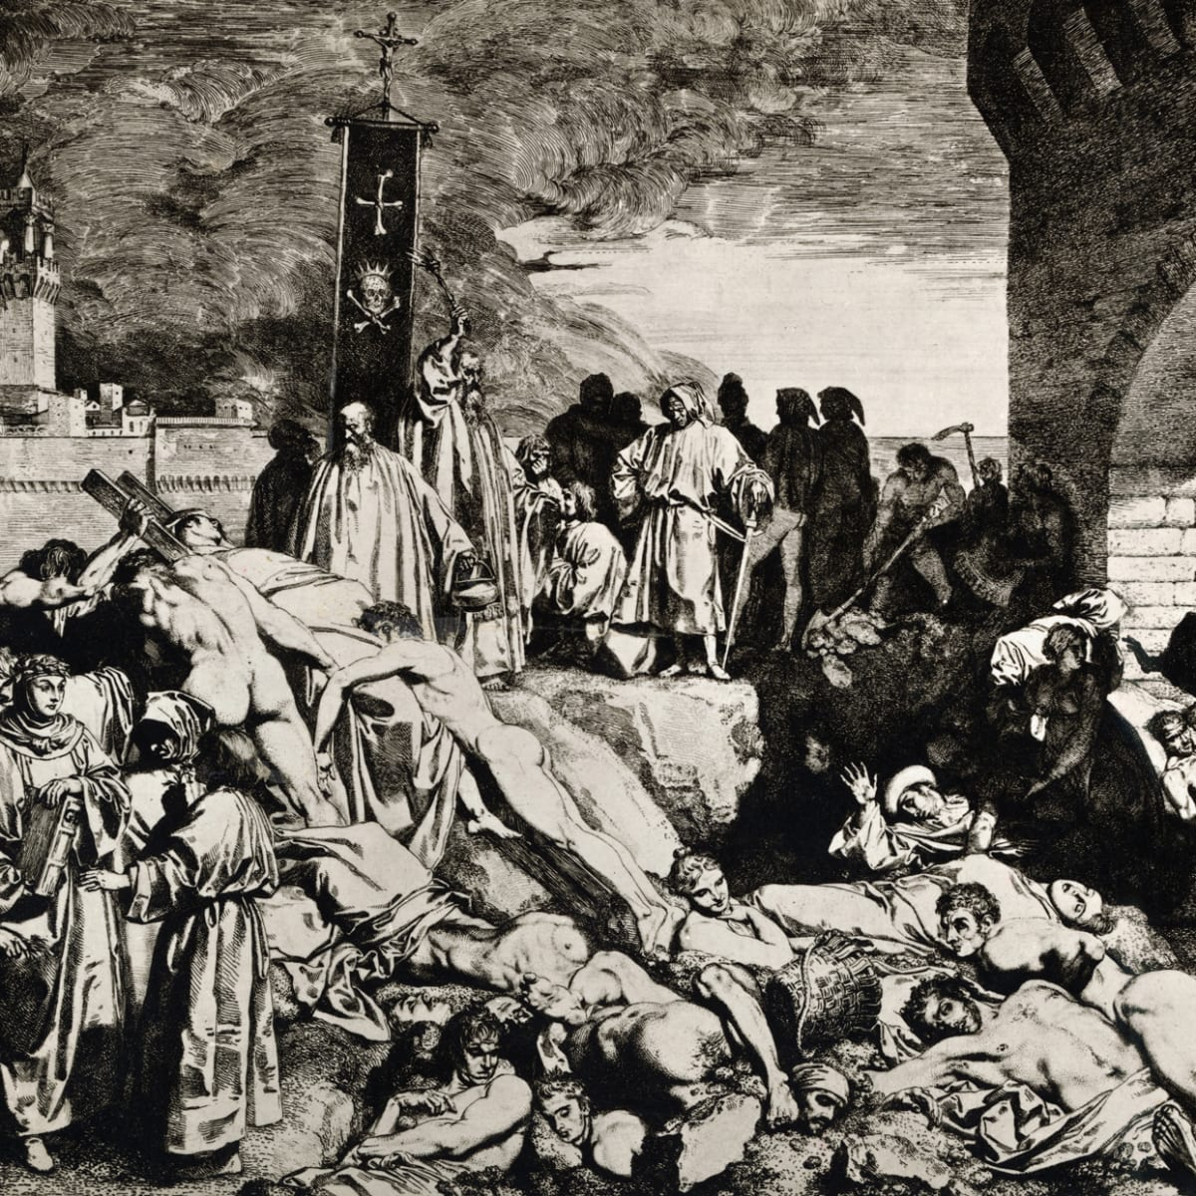
Pandemics that were Terrible
The plague: the black death that killed half of Europe in the 14th century. Lock downs didn’t help much as rats spread it.

Slide 3
Pandemics that weren’t
UK “mad cow diseases” of the 1990s. In 1999, European Union scientists suggested up to 500,000 people could die from the UK mad cow disease. By October 2013, 177 deaths were recorded from the disease.
“Avian Flu” of 2000s. In 2005, the UN’s coordinator David Nabarro warned between 5 to 150 million people could die from avian flu. The World Health Organization’s official estimates were 2–7.4 million. Only 455 people died of bird flu from 2003–2019.
Swine flu 2009. The feared 1.3% fatality rate turned into an actual rate of 0.02%, In the UK, against the “reasonable worst-case scenario” of 65,000 deaths, there were only 457.
Hat tip Ramesh Thakur: https://www.lowyinstitute.org/the-interpreter/flattening-economy-costs-lives-livelihoods-and-freedoms-too

Slide 4
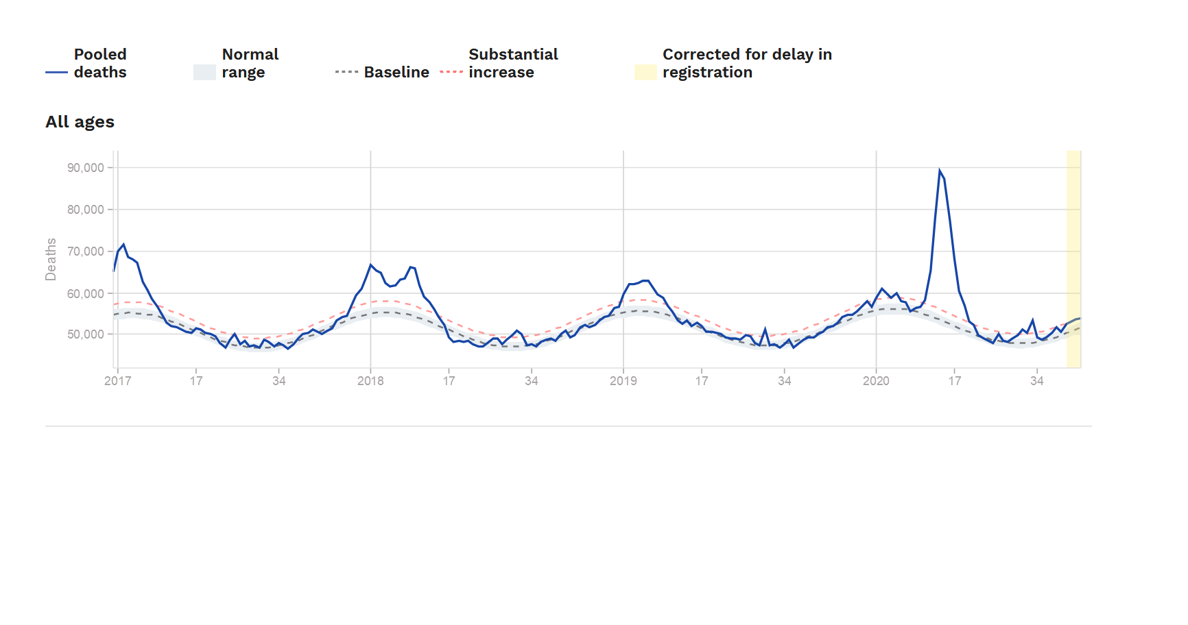
Excess mortality deaths in 24 European countries
Note 1: the 2020 excess mortality was 225,000 higher than baseline and 105,000 higher than 2018. Its an excess mortality of about 0.07% of the population, or 4 weeks normal mortality.
Note 2: UK, Sweden. have been back to baseline mortality for over a month now.
Source: https://www.euromomo.eu fed by official national death statistics.

Slide 5
Quick look at UK covid death tolls
Estimated UK fatality estimates for Covid-19 were scaled down dramatically by Imperial College London within two weeks, from 510,000 to 20,000 Current is 47,000, or 0.07%.
On average, each person dying with covid-19 probably had about 3-5 more happy years left.
The WHO in February put out “case based fatality estimates” of 3-5%. My estimate in March of the infection fatality rate (IFR) was 0.2%
At present, the total recorded world death toll stands at around 1.3 million, 0.02% of the world. That is the normal world birth rate of four days.

Slide 6
Current relevance for the UK
The worst recorded death toll is the State of New York (0.18%). The Ioaninidis estimate at the WHO in Oktober is that the IFR for the world is 0.2%. That was also my March estimate. The WHO estimate that 10% of the world has now been infected would mean an IFR of 0.15%
Note that many ‘official’ IFR estimates do not count the asymptomatic as ‘infections’ (which in the UK are 86% of all infections).
Someone infected is now believed to have some persistent immunity for years (via T-cells and B-cells). Only very few get reinfected.
Long-covid exists but is a rare occurrence: Adams (2020) estimates less than 50,000 people with neurological damage.
This means the UK maximally had 140,000 (=0.2%) it could possibly save from covid.

Slide 7
Some sense of scale of other effects.
More than 100 million new unemployed in the West. 400 million worldwide.
A quarterly GDP drop of 20% in the West and elsewhere.
Hundreds of millions threatened by famines. Tens of millions projected to die unnecessarily from TB, malaria, cholera, etc.
Civil strife brewing in Lebanon, India (with the Muslims blamed), and parts of Africa.
Mass loneliness in lock down territories.
20,000 prevented IVF babies per month in the West. The same again elsewhere.
Reduced usage of health services in the West due to fear.
Disrupted education of over a billion children.

Slide 8
Which of these are also in marginal effects (ie due to local policies)? And which are largely global?
More than 100 million new unemployed in the West. Business bankruptcy.
A GDP drop of 20% in the West. Sectoral collapse.
A feared famine and loss of innoculations in poor countries costing many millions.
Civil wars brewing in Lebanon, India (with the Muslims blamed), and parts of Africa.
Mass loneliness in lock down territories.
20,000 prevented IVF babies per month in the West (2,000 in the UK). The same again elsewhere.
Reduced usage of health services in the West due to fear.
Disrupted education of over a billion children.

Slide 10
Basic covid-scenarios
If we as a country/world lock down, we get
Some deaths, some economic and social disruption, some loneliness, some suicides, etc.
If we as a country/world treat covid as another flu and don’t do much different from before, we get…
A different number of deaths, different disruption, different social outcomes, etc.
Getting estimates of actual outcomes in the two scenarios is always difficult. We never know either what happened or could have happened. That is true for all choices.
How would you like “us” to choose? Why was what choice made?

Slide 11
So to save us from one form of misery via lock downs, we are getting another….

Slide 12
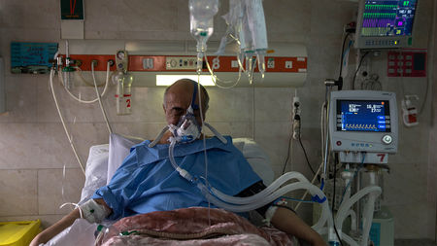
To prevent more of these

Slide 13
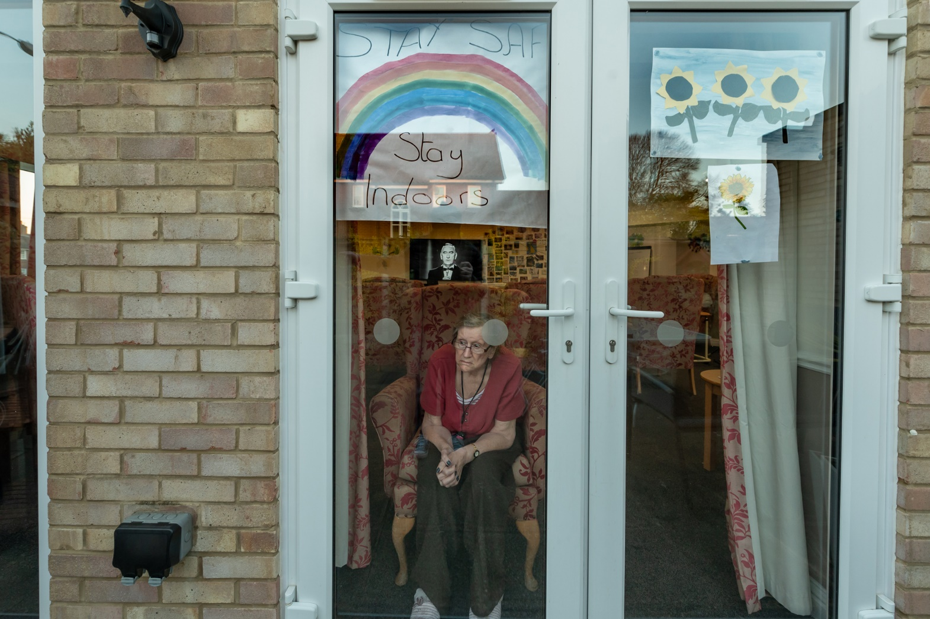
We are creating many more of these

Slide 14
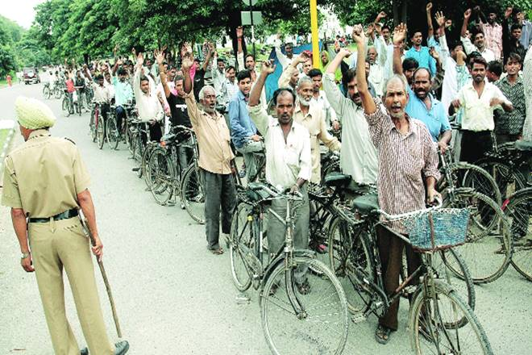
And these

Slide 15
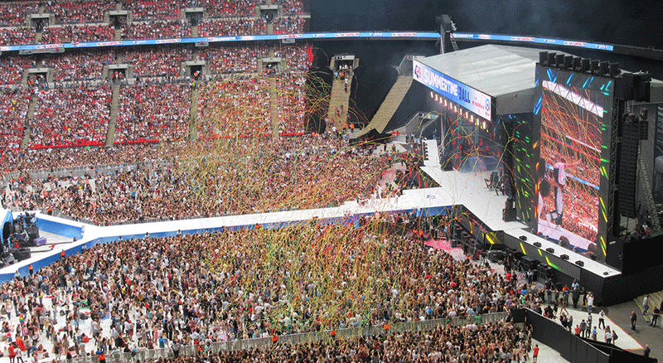

And these

Slide 16

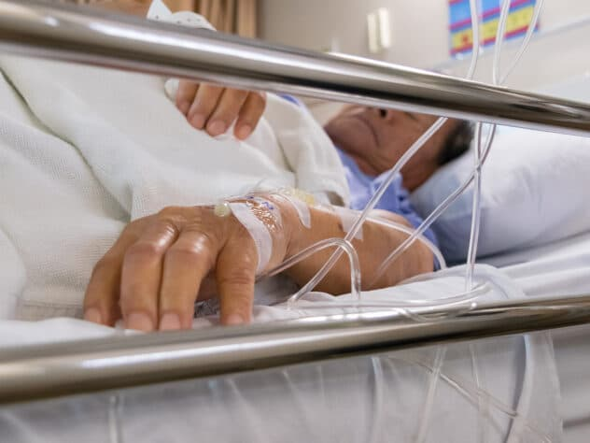
And these
Uneducated fearful dysfunctional children
The old dying alone.

Slide 17
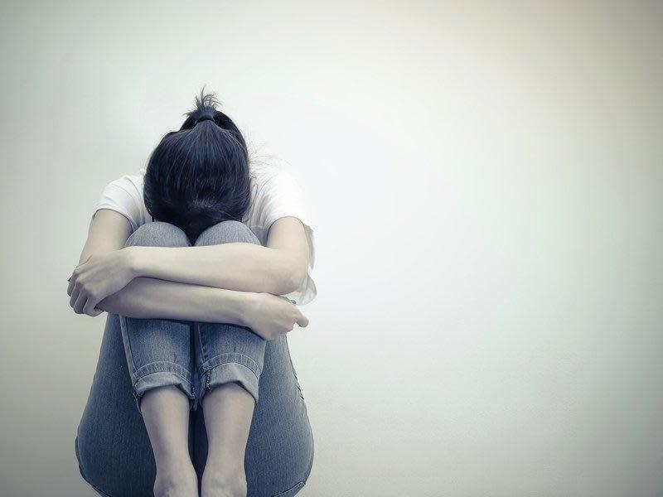
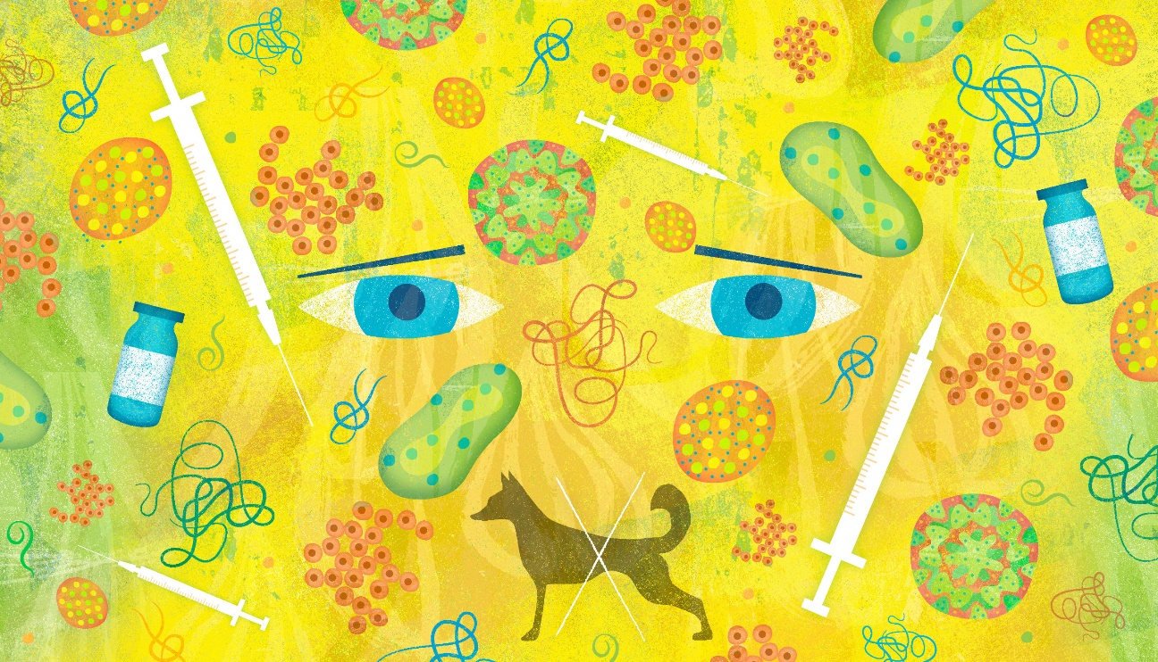
And these
Malaria, Cancer, childhood innoculations: less attention, delayed treatments millions of postponed operations in the UK
Last IVF chance cancelled.

Slide 18
The point?
There are costs of the choice made (lock downs and social distancing) and benefits. They are in different domains. Different people are affected at different times. All relevant effects evoke strong emotions. We would like not to have to choose at all……
But we need to make choices and we want to “do the right thing”.

Slide 19
How to line up the costs and benefits in these different domains?
We need a single metric to put them together.
Note that every decision maker, explicitly or implicitly, makes tradeoffs all the time.
The burden of an economist is never to shy away from tradeoffs by arbitrarily calling one thing “safe” or “vital”, thereby marginalising the importance of what is lost.
All jobs are essential to those whose livelihoods depend on them. No course of action is ever entirely safe. One must consider the likely tradeoffs.

Slide 20
What common metric to use in Cost-Benefit?
The “old” common metric was economic surplus. Used by most governments and large organisations. Economic surplus does not fully value life, loneliness, unemployment, lost fertility, and bad health though. So we need a richer measure.
A new metric is the WELLBY: “happy years lived”. You can then value anything that makes life enjoyable.
My co-author Gigi Foster presented this method to the UK parliamentary committee on covid at the end of October.

Slide 21
The UK life-satisfaction question (“ONS4”)
Overall, how satisfied are you with your life nowadays? 0 is “not at all” and 10 is “completely”
1 WELLBY is one unit of life-satisfaction on a 0-10 scale for one person for one year.
Essentially, a normal level for someone who is very healthy is an 8.
The level at which people are indifferent between living on or not at all is around 2.
So a normal year of life is worth 6 WELLBY.
So 1 year of good health is worth 6 WELLBY is 1 regular year of happy life.
The WELLBY captures (almost) everything that is important to people. Health measures miss joy, status, and things that give fulfilment.

Slide 22
The WELLBY
The government then maximises the
The Discounted Sum of the WELLBYs lived by the population.
In calculations you use predicted changes in life satisfaction, using the best causal estimates you can find.

Slide 23
Two cost-benefit questions
Costs versus benefits of all largescale human reactions. Relatively easy to do.
The economic collapse versus what was expected in January 2020.
The social and emotional damage versus “no change” from January 2020.
The death tolls of many events (like famines) versus “no change” from Jan 2020.
Costs versus benefits of UK government choices. Much harder and less certain.
Additional economic costs of another month of lock downs.
Emotional costs of social distancing and lock downs versus “focussed protection”.
Such things need models and strong scenario assumptions. Some elements are easier to judge (like IVF babies) than others (like added unemployment).

Slide 24
To do these calculations we need several numbers:
1. How many WELLBYs are lost from loneliness, unemployment, and other items relevant to global and local policies?
2. How many WELLBYs are lost from the GDP collapse in the world and in the UK?
3. How many WELLBYs are lost when someone dies of Covid-19?
4. What is reasonable to assume about how many more covid-deaths, employed, lonely, etc., are caused by various policies?

Slide 26
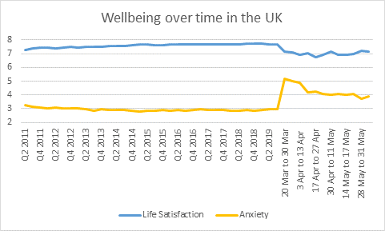
In early April I predicted the drop in Life Sat to be 0.5 Turns out to be 0.7. This is the biggest drop ever seen in the UK.
Note how Anxiety ie returning to normal, but life-satisfaction is not: people do not get used to loneliness and unemployment.

Slide 27
Humorous notes
The July 2020 update, unlike those for the previous years, starts the data it shows at the end of march, so you cant see the big drop.
The 2020 September wellbeing updates, which th eONS website claims were released September 10, are in fact all not yet published.
The Oktober 30th Coronavirus roundup by the ONS does not show wellbeing.
Somebody doesn’t want us to know….

Slide 28
Imperial college data…
https://ichpanalytics.imperialcollegehealthpartners.com/t/BDAU/views/YougovCovid-19TrackerLifeSatisfaction-20200622_15961947288210/LifeSatisfaction?:iid=4&:isGuestRedirectFromVizportal=y&:embed=y
Shows a complete flatline: life-satisfaction at the end of October is as low as it has been from the start of the March lockdowns (with a different baseline due to different set-up of the survey and a slightly different version of the question)

Slide 29
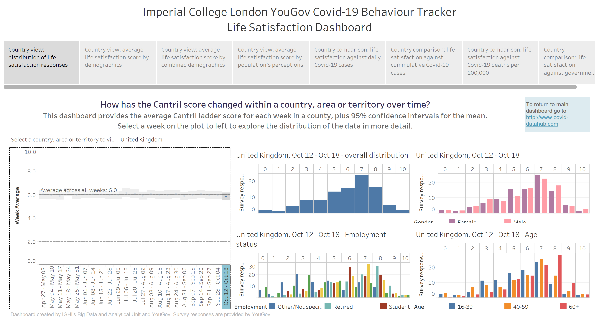

Slide 30
Meaning
Constant post-march wellbeing levels. So 0.7 down the whole period.
Huge loneliness and mental health problems in the UK. The misery is enormous. Its like 12% of all wellbeing is taken from everyone every day since March.
We thus now see about 30% of the population with depression or anxiety (up from 16% or so before).
Particularly the young (16-39) are miserable to an unprecedented degree.
The UK is much more miserable than many other countries. The Netherlands had only 0.05 to 0.1 less wellbeing during lockdowns than before march or after may. Similar small number pertain to Germany and Scandinavia. The UK lockdowns are particularly socially damaging.

Slide 31
Quick calculation
The UK has a population of about 70 million. A 0.7 drop in life-satisfaction is 49 million WELLBY per year. That is equivalent to a loss of 8.1 million healthy years of life. So per month this drop is over 680,000 healthy years of life.
So if you generously take the average covid-19 victim to have 5 more healthy years of life, the damage to life-satisfaction alone is equivalent to over 136,000 covid-19 deaths per month. This has gone on for 7 months.
In total the UK now has about 47,000 recorded covid-19 deaths.
So just via mental health and loneliness, the UK policies are doing more damage every 11 days than all the covid-deaths so far.
Per month, the wellbeing loss is higher than could possibly have been saved.

Slide 32
Length of life of covid-death
Note the average age of a covid-death is about 82.
More than 50% was in nursing homes and retirement homes where people on average have about 1-2 happy year of life left.
Well over 90% of the rest also had sever health conditions.

Slide 33
Andrew Briggs on covid in the UK.
 |  | 3372 | Total deaths from ONS
 |  |  |  | SMR=1 | qCM=100% |  |  |  | SMR=2 | qCM = 90% |  |  |  | SMR=3 | qCM=80%
Age |  | dist |  | LE | QALE | dQALY |  | LE | QALE | dQALY |  | LE | QALE | dQALY
0-9 |  | 0% |  | 76.45 | 66.41 | 27.65 |  | 69.56 | 55.16 | 24.23 |  | 65.34 | 46.38 | 21.07
10-19 |  | 0% |  | 66.51 | 56.46 | 25.54 |  | 59.66 | 46.24 | 22.16 |  | 55.49 | 38.48 | 19.10
20-29 |  | 0% |  | 56.69 | 47.07 | 23.29 |  | 49.99 | 37.87 | 19.89 |  | 45.94 | 31.13 | 16.96
30-39 |  | 1% |  | 46.98 | 38.05 | 20.68 |  | 40.50 | 29.90 | 17.30 |  | 36.63 | 24.18 | 14.51
40-49 |  | 2% |  | 37.49 | 29.38 | 17.51 |  | 31.35 | 22.33 | 14.17 |  | 27.78 | 17.64 | 11.61
50-59 |  | 5% |  | 28.36 | 21.61 | 14.21 |  | 22.78 | 15.71 | 10.99 |  | 19.64 | 12.04 | 8.72
60-69 |  | 11% |  | 19.86 | 14.76 | 10.75 |  | 15.11 | 10.12 | 7.82 |  | 12.59 | 7.46 | 5.94
70-79 |  | 27% |  | 12.30 | 8.79 | 7.04 |  | 8.65 | 5.48 | 4.62 |  | 6.88 | 3.79 | 3.27
80-90 |  | 39% |  | 6.42 | 4.52 | 3.95 |  | 4.05 | 2.48 | 2.25 |  | 3.05 | 1.56 | 1.44
90-100 |  | 16% |  | 3.03 | 2.06 | 1.91 |  | 1.72 | 0.95 | 0.90 |  | 1.24 | 0.51 | 0.49
weighted mean |  |  |  | 11.04 | 8.08 | 6.15 |  | 7.96 | 5.20 | 4.10 |  | 6.48 | 3.70 | 2.97
Bottom line: those who die with covid in the UK probably had 3-5 healthy years left to live on average. 3-5 QALY. 18-30 WELLBY. Until someone analyses the patient data though (which is not trivial to get), we wont know for sure.
Note, in Italy and the Netherlands, the covid deaths had less lost QALY.

Slide 34
Second Crucial tradeoff number
How many years of life and WELLBYs will be lost in the longer run when GDP drops?
There are two basic types of evidence. Fortunately they give almost the same answer.
Consumer willingness to pay for a WELLBY puts the value of a regular year of life around 60,000 Pounds. That is also what the UK government counts as the statistical value of a year of life, ie how much government and personal expenses are presumed to be worth.
Note that the claimed costs of saving a year of life via the NHS are four times lower, which would make the implicit damage of GDP reductions four times higher.

Slide 35
Implication for the UK
UK GDP was 2.21 trillion pounds in 2019.
In 2020 GDP is now expected to drop at least 10% over the whole year, more during lock down.
Returning to previous levels is now expected to take years, so very conservatively, the UK will lose 3 times more than the loss of 2020 before it is back to baseline.
So one should expect a drop of 0.66 trillion GDP in the UK due to the crisis as a whole. That is thus the same as 11 million lost years of life if one applies the official Statistical Value of Life number. If we’d only calculate the expected loss via expected reduced government health services, this would be
0.25*0.4*660,000,000,000/15,000 = fraction government spends on health * fraction of government to GDP * lost GDP / cost per year of life via the NHS = 4.4 million years of life

Slide 36
And for the world?
For each 10 trillion USD, the world loses at least 40 million regular life years, ie 40 million QALY and 240 million WELLBY. With rational government (other expenses have the same marginal benefit as health expenses), its 960 million WELLBY.
The initial and still current estimate is that in 2020-2021 alone the world economy will shrink by 12 trillion USD. Discounted over the next 10 years, the total loss of all reactions is easily 50 trillion.
50 trillion USD is thus at least 200 million regular life years, or between 40 and 67 million “covid deaths”. More realistically, it is 10 times higher than that for the world as a whole.

Slide 37
Third tradeoff number: costs of social isolation.
The lock downs induce a loneliness/anxiety effect of around 0.5-0.7 WELLBY per individual. We saw the ONS evidence. The cleanest new evidence comes from “State of life” data in the UK that found that individuals who kept on working had no wellbeing loss, but the rest lost so much that the average loss was over 0.4. Other studies put this number higher (up to 0.8), hence let us take 0.5 as realistic.
Note that a 0.5 WELLBY effect means for the UK:
You lose 30 million WELLBY per year.
Per 1 billion inhabitants (“the West”), this cost is equivalent to between 1 and 2 million coronavirus deaths. Per Month.

Slide 38
Fourth tradeoff number: cost of unemployment
The unemployed lose at least 0.7 WELLBY per year of unemployment (Clark et al. 2019). The total effect on the whole community might be as high as 2 WELLBY.
So 1 million unemployed for 1 year is equivalent to….
You lose at least 700,000 WELLBY per year.
That is about 116,700 regular years of life lost per year.
That is equivalent to between 40,000 and 20,000 “corona victim deaths” per year.
That is between 1700 and 3400 corona deaths per month.
This effect can be proportionately attributed to lock downs or other measures to the degree they cause more or extended unemployment years.
So 400 million additional unemployment years are equivalent to 8-16 million corona victim deaths. Minimally. More likely 3 times higher than that.

Slide 39
On unemployment:
400 mil
200 mil
200 mil
ΔUnem
ΔUnem
March 2020
March 2021
March 2022
March 2020
March 2021
March 2022
March 2023
March 2024
More usual recession scenario reflecting actual loss of productive things to do and usual time till normality in a depression. Would mean additional roughly 800 million net unemployment years in the whole world.
Optimistic quick recovery scenario, only an additional 200 million net unemployment years in the whole world.

Slide 40
Previously projected GDP and later projected GDP: one-year loss versus cumulative loss
Quarterly world GDP
Previously expected 3% annual growth
23 trillion
40 trillion loss more till catch up
20.5 trillion
18 trillion
8 trillion loss
Expected after Q1 and Q2 of 2020: 7% GDP drop 2020, catch up after.
Q1 2020
Q1 2021
Q1 2022
Q1 2028

Slide 41
Other tradeoff numbers
There are many we can mention, including suicides, air pollution, disrupted schooling, and postponed hospital operations.
Let me simply give just one example: IVF treatments, which were cancelled all over the world during lock downs.

Slide 42
Effect of loss of IVF babies
The lock downs and suspensions of health services cost an additional 2,000 IVF babies per month in the UK. They live on average 80 years. Their potential mothers and fathers also have a combined 80 years further to live, now without a child.
Because they live 80 years and not 3-5, each baby is worth between 16 and 27 corona virus deaths. One should probably add around 10% to that via the loss to the parents.
There is the question whether you want to count lost IVF babies at all, but since we regard the forced sterilisation of gypsies and others by the Nazis as genocide, we cannot pretend these “lock down forced infertilities” are a form a damage we can discount. Maybe these lost lives don’t count 100%, but not 0% either.
Note that one could have lock downs without stopping IVF treatment, but this has not happened widely and is difficult (fear makes this hard: unless you address the fear, IVF operations remain viewed as a liability).

Slide 43
Bringing it together: scenarios
CBA analysis 1: All of humanity’s reactions to covid versus “focussed protection” for the vulnerable on a voluntary basis.
CBA analysis 2: An additional month of “half lock downs” in the UK versus “ focussed protection: regular economic and social life”
Note that if you believe there is a transition path between lock downs and regular life, then that does not alter the basic calculation: a month sooner one eases the lock down, a month sooner one starts the transition, so a month sooner one is back to normal.

Slide 44
CBA1: All of humanitys’ reaction
Potential benefits: lock downs saved between 0% and 1% of the world population, where the victims would live 3 to 5 regular years. Say 0.2%
Huge differences by country. Australia probably had a “rho<1” anyway so never faced a serious threat. New York might have saved 0.2% of its population if they had dispersed that population immediately at the outset of the pandemic.
Sweden is showing some degree of herd immunity can be achieved with total mortality rates of around 0.07%. Some other European countries might have even less high costs for the same degree of herd immunity.
0.2% world mortality is 15 million covid deaths is around 75 million years of regular life (valuing them at 5 regular years of life each).
So lets count 75 million years of regular life saved, ie 450 million WELLBY as the “maximum benefits” of humanity’s reaction.
Note this is 10 times the current world mortality, so very generous to the benefits of lock downs.

Slide 45
Costs of all the reactions
Costs from economic collapse via government expenditure: 1.2 billion WELLBY at least, probably around 5 billion WELLBY.
Cost via the mental anguish of unemployment: minimum 120 million WELLBY lost, probably more like 1.5 billion WELLBY lost.
Cost via loneliness/stress if lock downs on average applied for 2 months to 4 billion people: 333 million WELLBY.
In total, a minimum loss of 1.5 billion WELLBY, probably closer to 7 billion WELLBY, equivalent to 1.16 billion regular years, or 250 to 400 million corona virus deaths.
If we compare the maximum benefits with the minimum costs, the costs outweigh the benefits by a minimum of a factor of 3.
If we take my best-guess numbers (benefits = 0.02% so 45 million WELLBY; Costs 7 billion WELLBY), the cost-benefit ratio is over 150.
On top of this come IVF baby costs, health costs due to reduced services, disruption of education, etc.

Slide 46
CBA2: policies in the UK?
Let us calculate something quite simple:
Costs per month of “no recovery and minimal lock downs”, meaning no reduction in unemployment, recovery of GDP, end of only half the social isolation.
One can see this as the “costs” of ongoing but not complete lock downs. One can compare that with what one believes the “benefits” would be.

Slide 47
Costs per month of delayed recovery with relatively light restrictions
Costs 1: loneliness/stress of 30 million British = 0.5*30/12 = 1,250,000 WELLBY
Cost 2: continued unemployment of three million workers = 3*0.7/12 = 175,000 WELLBY
Cost 3: 2000 IVF babies prevented = 2,000*80*6= 960,000 WELLBY.
Cost 4: reduced government expenses proportional to GDP loss = 14.7 billion per month = 1.6 million WELLBY per month at the minimum.
So costs of postponing recovery and continuing 50% social isolation is at least 4 million WELLBY per month, equivalent to 133,333 covid-19 lives lost per month.

Slide 48
Benefits of continued lock downs.
Hard to know how many lives would be saved. As a low number, maybe 100. As a high number, maybe 10,000 (based on the experience of other European countries).
Benefits 100 prevented covid deaths per month = 100*30 WELLBY = 3000 WELLBY (thus assuming 5 good years per prevented death).
Benefits 10,000 prevented deaths per month = 300,000 WELLBY.
So costs versus benefits ranges from 13.3 to 1,333.

Slide 49
Important to note
The marginal costs of unemployment, loneliness, and loss of GDP are so enormous compared to any reasonable assessment of the covid-19 threat, that it hardly matters what policy scenario or model assumptions one puts in.
Various authors have now noted a high cost-benefit ratio of 30 to 1 or 50 to 1 for the UK.
Frijters (March 21th) https://clubtroppo.com.au/2020/03/21/the-corona-dilemma/
Layard et al. (April 25th) http://cep.lse.ac.uk/pubs/download/occasional/op049.pdf
Miles et al (June, Imperial College) https://journal.sketchingscience.org/users/333926/articles/460021-living-with-covid-19-balancing-costs-against-benefits-in-the-face-of-the-virus

Slide 50
Conclusion
The WELLBY cost-benefit approach allows one to add up apples and pears: loneliness and death, government expenditure and IVF babies.
There is a huge literature to draw on as to the “rough effects” of circumstances on wellbeing. So it’s a powerful tool for getting a reasonable ball-park figure when there are many conflicting effects.
Implied costs of humanity’s reactions to covid outweigh the benefits in any metric (healthy lives lived, happy lives lived), no matter how skewed the assumptions put in. In all the more reasonable scenarios, costs outweigh the benefits by at least a factor of 50.
By any metric (lives/heath/WELLBY), delaying recovery in the UK with continued lock downs has far higher costs than benefits.

Slide 51
Reflections
It was already clear in March 2020 that the likely costs of trying to prevent the virus spreading throughout the population was going to be a huge multiple of the most optimistic scenario of the benefits.
Avoiding the spread already seemed futile in March 2020: this thing is in the world human population and cant be kept away indefinitely. Vaccines are very seldom 100% effective and usually take many years to appear. So herd immunity was and is the logical end-game. Besides which, coronaviruses tend to mutate fast (which is why there is no vaccine for the cold).
In March 2020 one could still maintain there was some huge risk of hundreds of millions dying so suppression had to be tried. Now that can no longer be reasonably said.
And yet, lockdowns remain hugely popular, in the UK and elsewhere. What is going on? What strange group phenomenon are we actually watching here? Why are scientists not taking their responsibility to guide their populations more seriously?

Slide 53
Suggested selected reading:
Adam, D. (2020), Special report: The simulations driving the world’s response to COVID-19, Nature News Feature, https://www.nature.com/articles/d41586-020-01003-6
Clark et al. (2019). Origins of Happiness. https://press.princeton.edu/books/hardcover/9780691177892/the-origins-of-happiness
http://clubtroppo.com.au/2020/03/21/the-corona-dilemma
https://clubtroppo.com.au/2020/06/17/what-kind-of-crowd-are-we-now-seeing-the-5-surprises-in-this-pandemic/
https://clubtroppo.com.au/2020/06/29/from-being-to-seeming-why-empirical-scientists-failed-in-times-of-covid/
Frijters, P., Krekel, C. (2021). Handbook for Wellbeing Policy. Oxford University Press forthcoming. Current version available on request.
Frijters et al. The WELLBY, BPP. https://doi.org/10.1017/bpp.2019.39
Ioannidis, J. P. (2020) Global perspective of COVID‐19 epidemiology for a full‐cycle pandemic. European Journal of Clinical Investigation, e13421.

Slide 54
Additional slides to aid discussions
Details on the presumed UK scenario
Additional calculation on UK children: the loss of disrupted education.
Some background information on wellbeing cost-effectiveness.

Slide 55
C-B on a month of lock downs in UK?
Here one must make a stand on how many corona virus deaths are saved by continued lock downs in UK for another month versus a counterfactual in which the borders are fully opened and the virus can spread.
This is an epidemiological questions on which honest opinions differ. Some say lock downs made no difference and so the answer would be “a few hundred”. Others say 0.2% of the population could be saved so the answer would be “120,000 if we have full open borders”. Yet others say “something else would have few deaths as well” (apps, targeted isolation, quarantines, etc.).
Since the social and economic effects are large of most forms of inhibited movement and continued fear, the most relevant options are “continued fear and thus continued isolation policies for at least half the population” versus “shrug shoulders”.

Slide 56
Continued Lockdown equals
Continued fear, half the population locked up (over and above the number of unemployed), no economic recovery but a flatlined number of unemployment equal to 3 million above normal rates. [note one can use several numbers for the added unemployed]
Why flatlined economy? Tourism, students, property markets, hands-on services, international business, etc., continues to be very difficult and impaired. So no return of hospitality jobs, etc.
GDP down 20% during lock down = 440 billion pounds per year = 176 billion less government expenditure per year = 14.7 billion less per month.
Focussed protection equals
Between a 100 and 10,000 additional covid deaths per month (so maximum costs smeared out over 12 months).
No social isolation costs. 2,000 IVF babies per month. Economic recovery starts so we get back to normal GDP and normal unemployment one month sooner than under continued lockdown.
So the comparison here is between “continued repression that involves ongoing but not increasing misery” versus “recovery to normality but with more covid death”.
You may want to think of other scenarios. The point here is illustration of how to do these calculations using a semi-realistic scenario.

Slide 57
The cost to children from disrupted schooling?
If we accept that the returns to a year of education are 6% (basically the mainstream estimate), and that human capital earns about 50% of GDP, and that the at-school cohort is 14% of the population, then one loses 6*0.5*0.14/12=0.035% of discounted GDP for the next 40 years. Per month of school disruption.
With an economy of 2.2. trillion pounds and a net real discount rate of 2.5%, that is a loss of 20 Billion pounds future GDP.
One month of lock down does not mean 100% no schooling in that month though. The loss should thus be the proportion of schooling lost due to lock downs times 20 billion.
Note that the misery of the children from being locked down is part of the 0.5 WELLBY loss from the lock downs.
This assumes no knock-on loss (such as via scarring and mental health problems that prevent future learning), but also no catch-up.

Slide 59
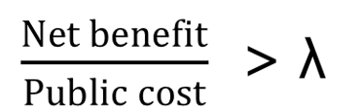
Wellbeing Cost-Effectiveness
Public cost – the whole of government net costs
Net Benefit – benefit in terms of a WELLBY: an additional unit of Life Satisfaction for one person for one year

Slide 60
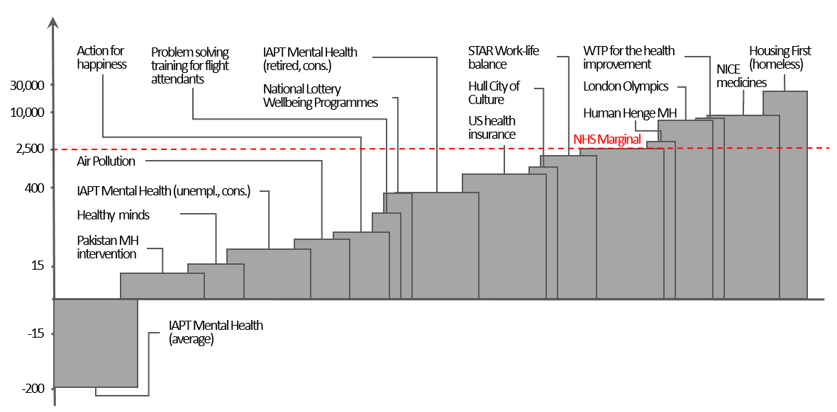
Cost-effectiveness of some low-hanging fruit…
Figure 1: Cost per WELLBY of interventions at work, in the environment, and government services.

Slide 61
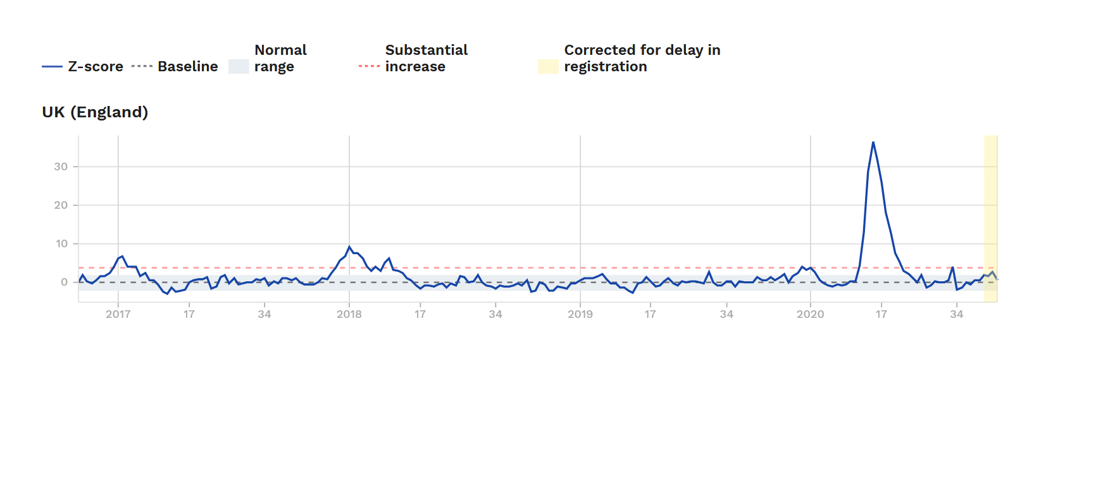
Excess deaths UK till end week 44 of 2020 (euromomo.eu)

