Slide 1
Health, Information and Economics: some fresh ideas.
  Nicholas Gruen
  CEO
  Lateral Economics
  A presentation to the VHA
  Friday, 14th Nov 2003

Slide 2
Outline
  1 The lucky country starts making its own luck:
  Australia as leader in economic reform
  2 Improving information, a new field of reform
  3 Relevance to Health care
  4 Pitfalls
  5 Responses
  6 Prognostic auctions
  7 Concluding remarks

Slide 3
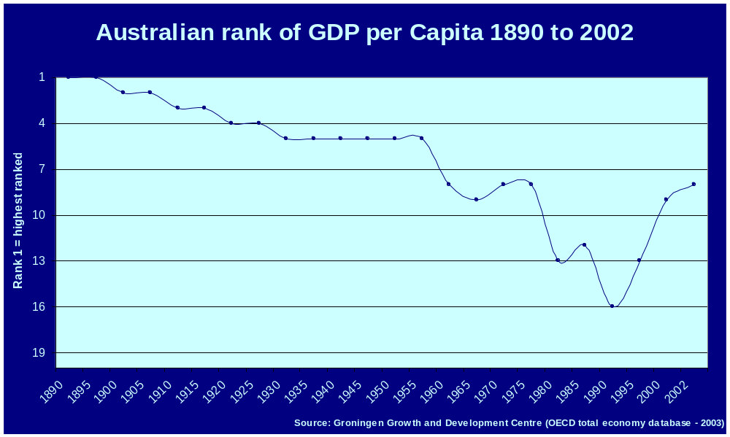
The lucky country - making its own luck

Slide 4
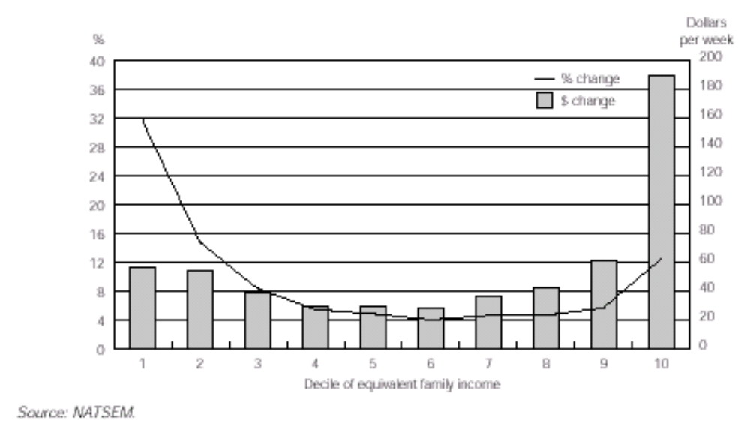
Distribution of Gains 1982–97

Slide 5
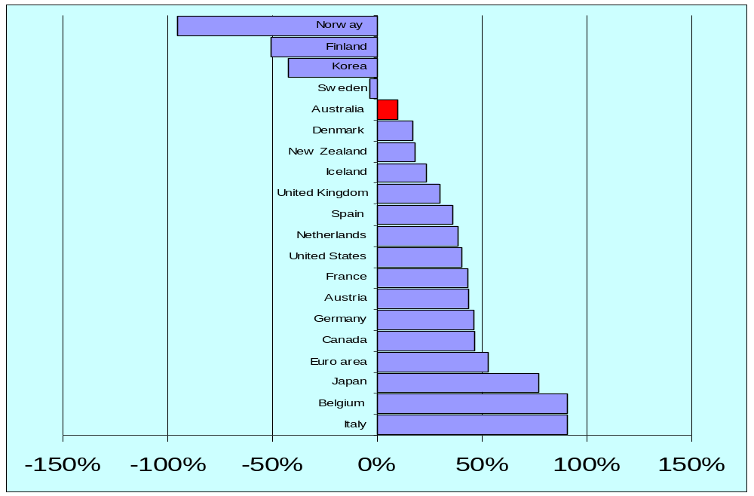
Net Government Liabilities

Slide 6
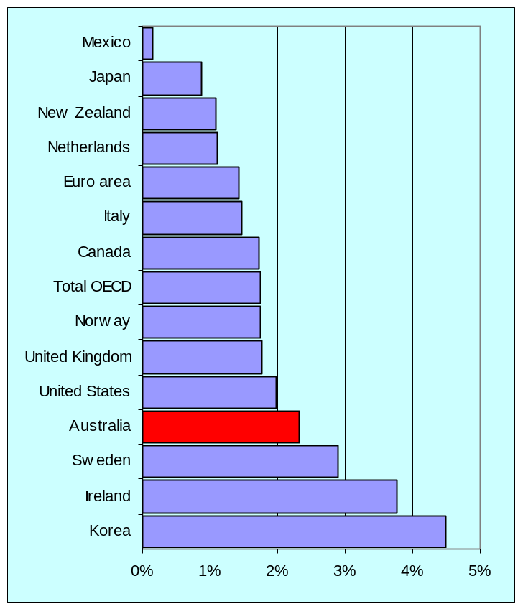
Business Productivity Growth 92-03*
*forecast

Slide 7
Australia as a leader in government and economic reform
US and New Zealand reform was less fair
New Zealand reform too ambitious and undermined the political system that underpinned it
  moving to proportional representation

Slide 8
Australia as a leader in government and economic reform
There has been more continuity in Australian policy. The political consensus for change has been stronger, and there has been limited backsliding despite changes of government . . . . Indeed, by contrast with New Zealand’s record of stop-start reform . . . Australia has adopted a remarkably consistent, coherent and credible strategy of economic reform over the last two decades.
Roger Kerr, CEO NZ Roundtable 2002

Slide 9
Australia as a leader in government and economic reform
  Innovator and world leader in programs such as
    Income contingent loans for education (HECs)
    Child support through ATO
    AIDS policy
  World leading institutions at the top of government
    Reserve Bank of Australia
    High Court

Slide 10
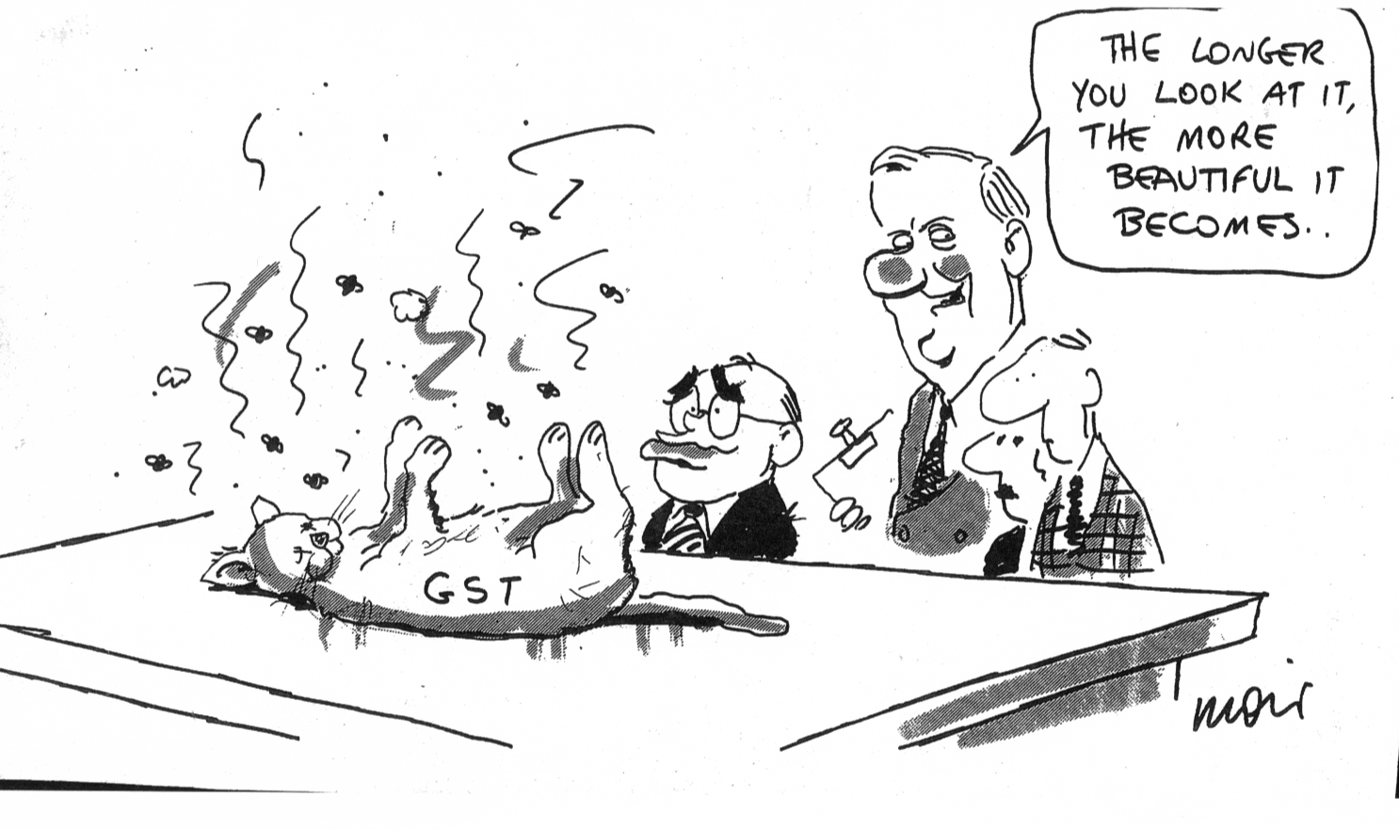
Australia as a leader in government and economic reform

Slide 11
Maintaining our excellence
  Acknowledge it
  Move beyond our:
    pessimism
    cultural cringe
  We won’t stay at the forefront if we don’t realise we’re there
  If we’re at the forefront, we have to keep innovating
    we can’t wait and imitate

Slide 12




Traditional ideas of the economy

Slide 13


Micro reform 1983-2002:
Facilitating internal and external trade
Information: a new field of reform

Slide 14
Information: a new field of reform
  Information is fundamental to efficient markets - to getting what we want out of the economy
  Political support in consumer affairs, financial regulation
  Information is also increasingly important to the things that matter more as you get richer - quality of life

Slide 15
Information: a new field of reform
  Our economy generates a lot of information
  But it’s often ignored or even concealed.
    Fairly good consumer information for most products
    Much less so for services
  Consider quality of working life
    Worker’s Compensation premiums are a good proxy for OHS performance. Comparative WC premiums should be brought to the attention of job seekers.
    Employers could report on employee reported job satisfaction according to agreed auditable standards

Slide 16
Information and Healthcare
Health illustrates the importance of information
In NY State careful collection and statistical analysis of cardiac by-pass surgery paved way for
  reorganisation of service
  diagnosing major and minor problems
  reduction of 41% in risk adjusted post operative mortality over three years
Similar achievements with similar principles in Wimmera Base Hospital in Horsham Victoria.

Slide 17

Information and Healthcare
  Growing enthusiasm for greater information and disclosure
  So far mostly from a ‘managerial’ rather than consumer orientation
  ‘Report on Government Services’
    Already publishes range of system generated ‘performance measures’
    Eg. re-admission and ‘adverse event’ measurements

Slide 18
Information: a new field of reform
  But it should become increasingly consumer oriented
  Which are the best hospitals, specialists etc?
    Most consumers have no reliable way of knowing
    Yet the system is generating information which should be brought to consumers’ attention when making choices.
    Patient reported satisfaction

Slide 19
Information and Healthcare
  Can we extend this push for more information elsewhere?
  We should do so in full knowledge of the pitfalls.
  Two critical and related issues:
    Dealing with incentives to mislead and conceal
    Maintaining high professional and ethical standards

Slide 20
Pitfalls
A major problem is getting engagement by providers, administrators and politicians
  NY media sensationalised early reports
  Pressure for cessation of program and/or suppression of publication
  Some surgeons wondering about avoiding ‘bad risks’
Administrators addressed problems
  Held the line
  Educated surgeons about risk rating
  Educated media and got responsible reporting

Slide 21
Pitfalls
The alternative to a tough but thorough and professional collaboration between stakeholders is dysfunction.
  Resistance by practitioners
  Short term focus by politicians
  Manipulation by administrators
Where measures are not close to consumer experience, the issue of manipulation by practitioners and administrators arises

Slide 22
Pitfalls
In UK ‘New Labour’ has been keen on performance measurement
Some elementary lessons are being learned.
  Bristol Eye Hospital reduced waiting times by neglecting follow up appointments - damaging some patients’ eyesight!
  Some hospitals have reduced waiting lists by redesignating trolleys as beds with wheels, or removing the wheels!
  Simple mis-reporting of varying shades of dishonesty

Slide 23
Responses
  We also demand independent validation of achievement against targets, to avoid the sort of massaging of the figures that diminishes trust in the political process. It is ridiculous that inflation and unemployment statistics are published by a neutral body, while the equally important figures for public service performance are not.
  Commons Public Administration Committee Chairman Tony Wright

Slide 24
Responses
  Report on Government Service Provision
    Driven by central agencies
    Consensual model makes audit and reporting on sensitive areas difficult
  Little awareness of these pitfalls being shown
    Voluntary reporting of sensitive data
    Little attention given to audit or to the perverse incentives generated
    And the importance of retaining the good things about professional cultures of care

Slide 25
Responses
  Challenge is to get hard headed self reporting culture minimising perverse incentives, leaving the altruistic side of clinical culture in tact.
  There are no silver bullets.
  But manufacturing production technologies give us some clues
  TQM, or ‘lean production’ provide some important clues
    First drive out fear!
    Use people’s innate preference for
      doing a good rather than a bad job
      co-operating to achieve good results
    Measurement is used primarily to to support good performance
    Detection of bad performance a by-product.

Slide 26
Responses
Driving out fear
  Healthcare protocols that trade legal indemnity for immediate, full disclosure of adverse information
Legal system’s understanding of negligence remains a problem for public (and possibly private) reporting
Could top performing institutions qualify for
  some simpler ‘no-fault’ compensation scheme?
  Suspension of res ipsa loquitur

Slide 27
Responses
Prior risk rating and reporting of outcomes deals with incentives to turn patients away
Auditing where possible and appropriate
Patient satisfaction is difficult to manipulate.
  Patients can also be asked to confirm clinicians reporting

Slide 28
‘Prognostic Auctions’
Deals with many problems
Decentralises information generation
Removes many perverse incentive problems
Two pieces of information required
  Estimate of prognosis - eg 5% expected adverse event rate
  Correction for past record

Slide 29

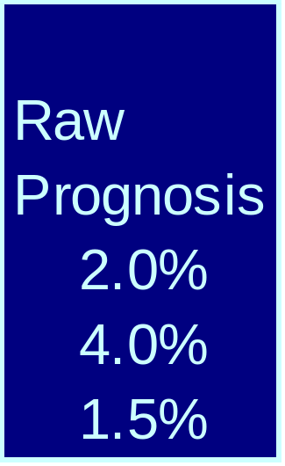
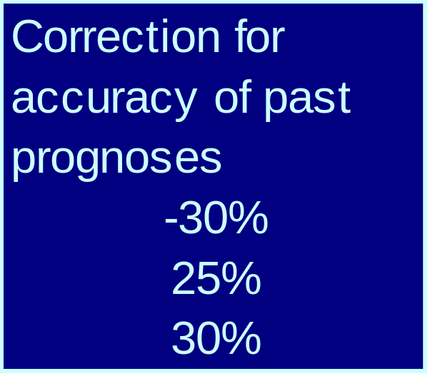
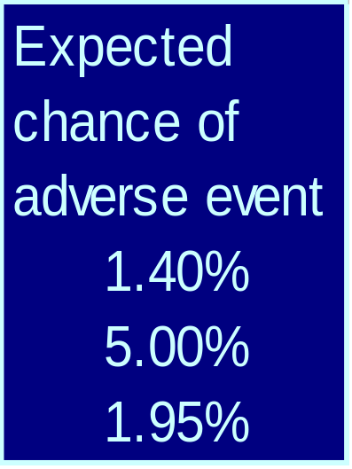
‘Prognostic Auctions’

Slide 30
‘Prognostic Auctions’
Creates a ‘prognostic auction’ for service provision- client can assess ‘bids’
Incentive problems are neutralised by being ‘internalised’
Generates mass of unbiased information for
  administrators
  practitioners
  consumers
Supports practitioners’ and administrators ongoing development with rich feedback on their own and others’ performance

Slide 31
Conclusion
  None of this is a panacea
  Progress requires courage - as always - but also a balance
    Reforming clinical cultures, and preserving the best about them
    Tough-mindedness in face of vested interests, that is not bloody mindedness
    Audit and independence while minimising adversarialism

