Slide 1
PIP104 PROFESSIONAL PRACTICE-II VIVA-VOCE
Customer Support Chat Bot for Hospital Management Assistant
Batch Number:CSG04
Roll number Student name Under the Supervision of,
20211CSG0069 ANTOSH
20211CSG0046 SWAMY BU
20211CSG0049 SHIVAPRASAD Dr. Harish Kumar K S
Assistant Professor
School of Computer Science &Engineering
Presidency University

Slide 2
Introduction :
In today’s fast-paced digital landscape, customer support plays a pivotal role in ensuring business success, yet traditional models often face challenges such as high operational costs, long response times, and inconsistent service. As companies strive to meet the growing demand for efficient and personalized assistance, generative Artificial Intelligence (AI) has emerged as a transformative solution. Unlike traditional AI systems, generative AI can produce dynamic, human-like conversations, enabling virtual assistants and chatbots to provide more flexible and context-aware responses.

Slide 3
Literature Review :
The evolution of customer support systems has been influenced by advancements in Artificial Intelligence, particularly in the development of chatbots, virtual assistants, and other automated tools. The section reviews existing research in AI-powered customer support based on rule-based systems, machine learning-driven models, generative AI, multimodal capabilities, and associated challenges in their implementation. Early chatbot systems were essentially rule-based and relied on a set of predefined scripts and decision trees to process users' queries. These early systems used keyword matching and pattern recognition to process input, and they were restricted in handling complex or ambiguous inputs (Shawar & Atwell, 2007). Although these rule-based chatbots introduced basic automation, they failed to bring flexibility and unable to carry out human-like conversations, which often created user dissatisfaction in real life applications.

Slide 4
Proposed Methodology :
Standardization of Component Libraries
• Tailwind CSS encourages utility-first styling, but it lacks built-in design systems or predefined component libraries, requiring developers to manually design reusable components. • Research Gap: There is limited research on how to efficiently standardize reusable component libraries while maintaining customization flexibility.

Slide 5
Objectives :
1.Enhance Hospital Management Efficiency: Simplify routine tasks such as appointment scheduling, patient inquiries, and information dissemination through an interactive chatbot. 2.Enable 24/7 Customer Support: Ensure round-the-clock availability for patient queries, minimizing response time and improving satisfaction.

Slide 6
System Design & Implementation :
1. Architecture Design Type: Single-Page Application (SPA) Core Technologies: • React: For building reusable UI components. • TypeScript: For static typing, ensuring code correctness and maintainability. • Vite: As the build tool for efficient development and optimized production builds. • TailwindCSS: For styling with a utility-first approach.

Slide 7
Structure:
• Root Component: The application is mounted onto a single HTML (id="root") using React DOM. • Component-Based Design: Encapsulation of UI logic and styles into small, reusable React components. • Responsive Design: Enabled via TailwindCSS utilities and media queries.
Frontend Flow:
1. HTML loads the main.tsx entry point, initializing the React app. 2. React manages routing, rendering, and state updates dynamically on the client side. 3. TailwindCSS provides consistent and responsive styles.

Slide 8
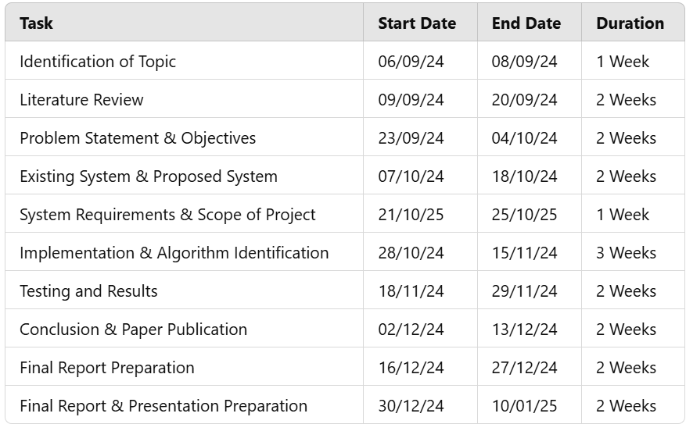
Timeline of Project :

Slide 9
Outcomes / Results Obtained :
Functional Outcomes • Single Page Application (SPA): o A fully functional SPA, where navigation between pages/components happens seamlessly without full-page reloads. • Reusable Components: o Modular and reusable React components for building the UI, adhering to React's best practices. • Responsive Design: o A responsive layout achieved using TailwindCSS, ensuring the application works well across devices (mobile, tablet, desktop).

Slide 10
Conclusion :
In conclusion, the integration of modern development tools and libraries such as Vite, React, TypeScript, ESLint, Tailwind CSS, and PostCSS creates an efficient and streamlined environment for building high-quality web applications. Vite enhances the development experience with its fast build times and hot module replacement (HMR), significantly speeding up the iterative development process. React provides a powerful and flexible way to create user interfaces with reusable components, while TypeScript introduces static typing, offering better code quality, tooling, and error checking. ESLint ensures that the code adheres to best practices, improving maintainability and reducing the risk of bugs by enforcing consistent coding standards. Tailwind CSS simplifies styling through utility-first classes, allowing for quick and responsive designs without writing custom CSS. It integrates well with Post CSS for further optimizations like autoprefixing, ensuring broad browser compatibility.

Slide 11
References :
Shekhar, E. S., Goyal, D. S., & Jain, U. (2024). Enhancing customer engagement with AI and ML: Techniques and case studies. International Journal of Computer. Retrieved from academia.edu
Ekechi, C. C., Chukwurah, E. G., Oyeniyi, L. D., & Others. (2024). AI-infused chatbots for customer support: A cross-country evaluation of user satisfaction in the USA and the UK. International Journal of .... Retrieved from fepbl.com
Behera, R. K., Bala, P. K., & Ray, A. (2024). Cognitive chatbot for personalized contextual customer service: Behind the scene and beyond the hype. Information Systems Frontiers. Springer.
Alexander, T. (2024). Proactive customer support: Re-architecting a customer support/relationship management software system leveraging predictive analysis/AI and machine learning. Engineering: Open Access. Retrieved from opastpublishers.com
Banik, B., Banik, S., & Annee, R. R. (2024). The role of AI in enhancing customer engagement and loyalty. Revista de Inteligencia Artificial en .... Retrieved from redcrevistas.com
Maj, M., Dmowski, A., Nowak, R., & Mędzelowski, T. (2024). Enhancing customer service in shopping malls with an advanced chatbot-integrated concierge device. Retrieved from um.edu.mt
Arya, S., Bhaskar, A., & Gupta, K. (2024). Conversational AI: A treatise about vying chatbots. 2nd International .... IEEE Xplore.
Bhattacharyya, S. S. (2024). Study of adoption of artificial intelligence technology-driven natural large language model-based chatbots by firms for customer service interaction. Journal of Science and Technology Policy. Retrieved from emerald.com

Slide 12
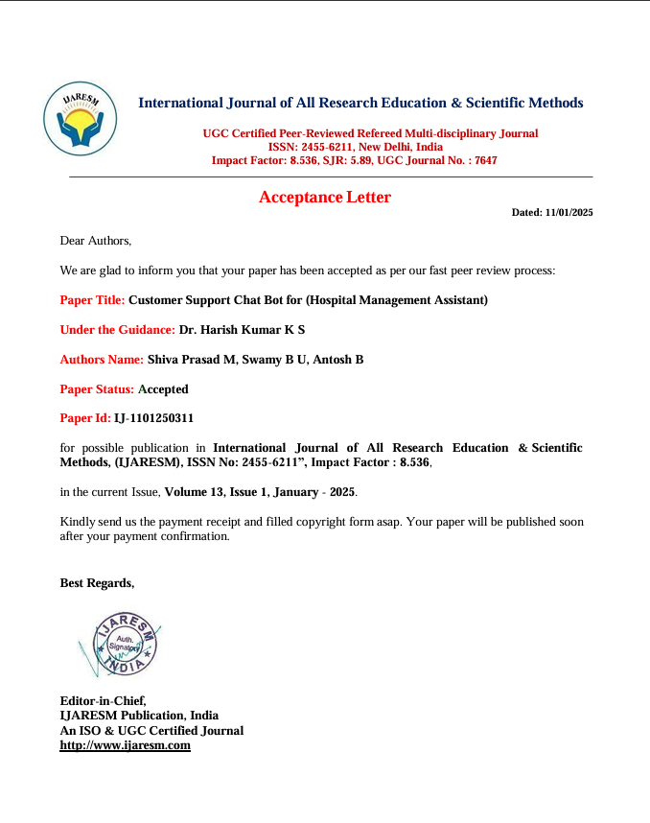
Publication Details

Slide 13

Thank You

