Slide 1
Introduction to Routing

Slide 2
The Routing Problem
Apply after placement
Input:
  Netlist
  Timing budget for, typically, critical nets
  Locations of blocks and locations of pins
Output:
  Geometric layouts of all nets
Objective:
  Minimize the total wire length, the number of vias, or just completing all connections without increasing the chip area.
  Each net meets its timing budget.

Slide 3
Steiner Tree
For a multi-terminal net, we can construct a spanning tree to connect all the terminals together.
But the wire length will be large.
Better use Steiner Tree:
  A tree connecting all terminals and some additional nodes (Steiner nodes).
Rectilinear Steiner Tree:
  Steiner tree in which all the edges run horizontally and vertically.
Steiner
Node

Slide 4
Routing is Hard
Minimum Steiner Tree Problem:
  Given a net, find the steiner tree with the minimum length.
  This problem is NP-Complete!
May need to route tens of thousands of nets simultaneously without overlapping.
Obstacles may exist in the routing region.

Slide 5
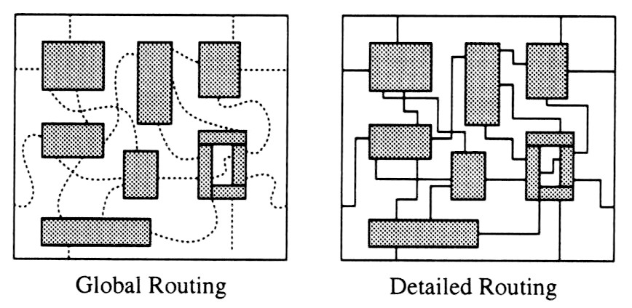
General Routing Problem
Two phases:

Slide 6
Global Routing
Global routing is divided into 3 phases:
  1. Region definition
  2. Region assignment
  3. Pin assignment to routing regions

Slide 7
Region Definition
Divide the routing area into routing regions of simple shape (rectangular):
  Channel: Pins on 2 opposite sides.
  2-D Switchbox: Pins on 4 sides.
  3-D Switchbox: Pins on all 6 sides.
Switchbox
Channel

Slide 8
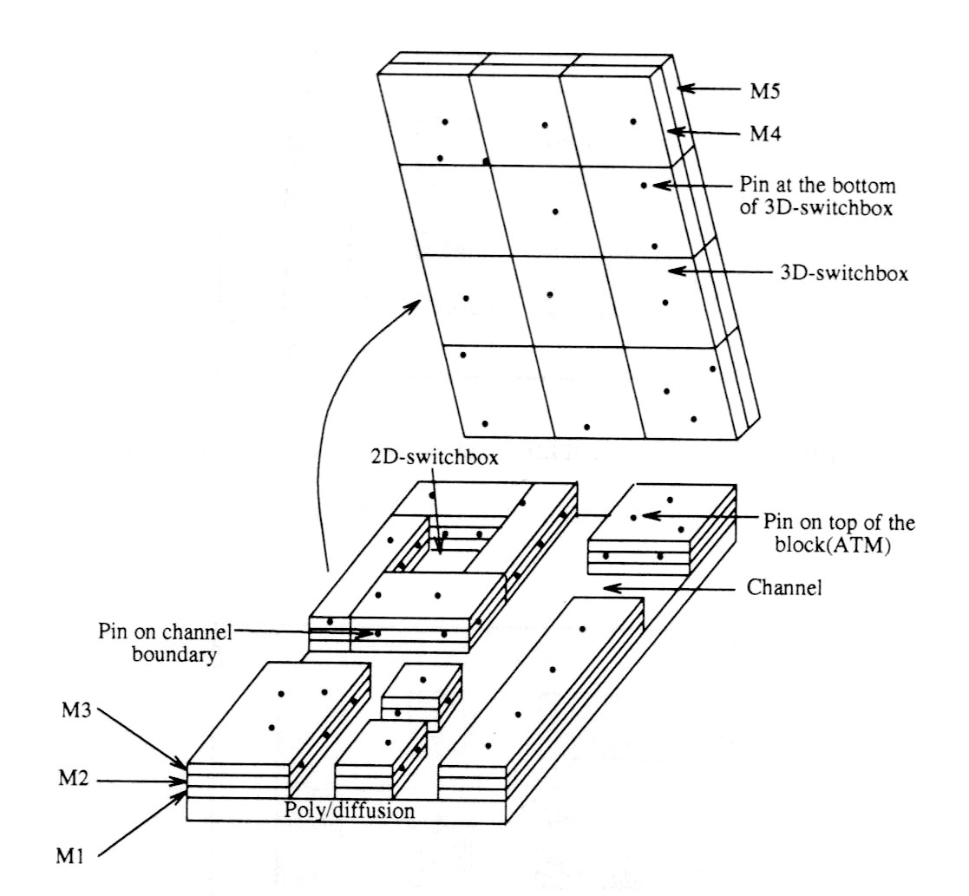
Routing Regions

Slide 9
Routing Regions in
Different Design Styles
Gate-Array
Standard-Cell
Full-Custom
Feedthrough Cell

Slide 10
Region Assignment
  Assign routing regions to each net. Need to consider timing budget of nets and routing congestion of the regions.

Slide 11
Approaches for Global Routing
Sequential Approach:
  Route the nets one at a time.
  Order dependent on factors like criticality, estimated wire length, etc.
  If further routing is impossible because some nets are blocked by nets routed earlier, apply Rip-up and Reroute technique.
  This approach is much more popular.

Slide 12
Approaches for Global Routing
Concurrent Approach:
  Consider all nets simultaneously.
  Can be formulated as an integer program.

Slide 13
Pin Assignment
  Assign pins on routing region boundaries for each net. (Prepare for the detailed routing stage for each region.)

Slide 14
Detailed Routing
Three types of detailed routings:
  Channel Routing
  2-D Switchbox Routing
  3-D Switchbox Routing
Channel routing → 2-D switchbox → 3-D switchbox
If the switchbox or channels are unroutable without a large expansion, global routing needs to be done again.

Slide 15
Extraction and Timing Analysis
After global routing and detailed routing, information of the nets can be extracted and delays can be analyzed.
If some nets fail to meet their timing budget, detailed routing and/or global routing needs to be repeated.

Slide 16
Kinds of Routing
Global Routing
Detailed Routing
  Channel
  Switchbox
Others:
  Maze routing
  Over the cell routing
  Clock routing

Slide 17
Maze Routing

Slide 18
Maze Routing Problem
Given:
  A planar rectangular grid graph.
  Two points S and T on the graph.
  Obstacles modeled as blocked vertices.
Objective:
  Find the shortest path connecting S and T.
This technique can be used in global or detailed routing (switchbox) problems.

Slide 19
Grid Graph
S
S
S
X
X
T
T
X
X
T
Area Routing
Grid Graph
(Maze)
Simplified
Representation

Slide 20
Maze Routing
S
T

Slide 21
Lee’s Algorithm
“An Algorithm for Path Connection and its Application”, C.Y. Lee, IRE Transactions on Electronic Computers, 1961.

Slide 22
Basic Idea
A Breadth-First Search (BFS) of the grid graph.
Always find the shortest path possible.
Consists of two phases:
  Wave Propagation
  Retrace

Slide 23
An Illustration
S
0
1
2
3
1
2
3
3
4
5
5
4
5
T
6

Slide 24
Wave Propagation
At step k, all vertices at Manhattan-distance k from S are labeled with k.
A Propagation List (FIFO) is used to keep track of the vertices to be considered next.
S
0
S
0
1
2
3
S
0
1
2
3
1
2
3
1
2
3
3
3
4
5
T
T
5
4
5
T
6
After Step 0
After Step 3
After Step 6

Slide 25
Retrace
Trace back the actual route.
Starting from T.
At vertex with k, go to any vertex with label k-1.
S
0
1
2
3
1
2
3
3
4
5
5
4
5
T
6
Final labeling

Slide 26
How many grids visited using Lee’s algorithm?
13
12
11
10
7
6
7
7
9
10
12
11
10
9
6
5
6
7
8
9
10
11
12
11
10
9
8
7
6
5
4
7
8
9
10
11
10
9
8
7
6
5
4
3
6
7
8
9
10
7
6
5
4
3
2
1
2
3
4
5
6
7
8
9
6
5
4
3
2
1
S
1
2
3
4
5
6
7
8
9
8
7
6
3
2
1
2
3
4
5
6
7
8
9
10
9
8
7
3
5
6
7
8
9
10
11
10
9
8
9
10
7
6
7
8
9
10
11
12
11
10
11
12
11
10
9
8
9
10
11
12
13
12
11
12
13
12
11
9
13
10
10
11
12
12
13
13
12
11
10
11
12
13
13
13
12
11
12
13
13
12
T
13
13

Slide 27
Time and Space Complexity
For a grid structure of size w × h:
  Time per net = O(wh)
  Space = O(wh log wh) (O(log wh) bits are needed to store each label.)
For a 4000 × 4000 grid structure:
  24 bits per label
  Total 48 Mbytes of memory!

Slide 28
Improvement to Lee’s Algorithm
Improvement on memory:
  Aker’s Coding Scheme
Improvement on run time:
  Starting point selection
  Double fan-out
  Framing
  Hadlock’s Algorithm
  Soukup’s Algorithm

Slide 29
Aker’s Coding Scheme to Reduce Memory Usage

Slide 30
Aker’s Coding Scheme
For the Lee’s algorithm, labels are needed during the retrace phase.
But there are only two possible labels for neighbors of each vertex labeled i, which are, i-1 and i+1.
So, is there any method to reduce the memory usage?

Slide 31
Aker’s Coding Scheme
One bit (independent of grid size) is enough to distinguish between the two labels.
Sequence:
...… (what sequence?)
(Note: In the sequence, the
labels before and after each
label must be different in
order to tell the forward or
the backward directions.)
S
T

Slide 32
Schemes to Reduce Run Time
1. Starting Point Selection:
2. Double Fan-Out: 3. Framing:
T
S
S
T
S
S
T
T

Slide 33
Hadlock’s Algorithm to Reduce Run Time

Slide 34
Detour Number
For a path P from S to T, let detour number d(P) = # of grids directed away from T, then
L(P) = MD(S,T) + 2d(P)
So minimizing L(P) and d(P) are the same.
length
shortest Manhattan distance
D
D
D: Detour
d(P) = 3
MD(S,T) = 6
L(P) = 6+2x3 = 12
D
S
T

Slide 35
Hadlock’s Algorithm
Label vertices with detour numbers.
Vertices with smaller detour number are expanded first.
Therefore, favor paths without detour.
3
2
2
2
2
2
2
2
1
1
2
2
1
S
0
2
1
0
0
1
0
0
2
T
2
1
1
2
2
3
2
2
2
2
2

Slide 36
Soukup’s Algorithm to Reduce Run Time

Slide 37
Basic Idea
Soukup’s Algorithm: BFS+DFS
  Explore in the direction towards the target without changing direction. (DFS)
  If obstacle is hit, search around the obstacle. (BFS)
May get Sub-Optimal solution.
2
2
1
1
S
1
1
1
1
T
2
1
1
2
2

Slide 38
How many grids visited using Hadlock’s?
S
T

Slide 39
How many grids visited using Soukup’s?
S
T

Slide 40
Multi-Terminal Nets
For a k-terminal net, connect the k terminals using a rectilinear Steiner tree with the shortest wire length on the maze.
This problem is NP-Complete.
Just want to find some good heuristics.

Slide 41
Multi-Terminal Nets
This problem can be solved by extending the Lee’s algorithm:
  Connect one terminal at a time, or
  Search for several targets simultaneously, or
  Propagate wave fronts from several different sources simultaneously.

Slide 42
Extension to Multi-Terminal Nets
1st Iteration
2nd Iteration
S
0
1
2
T
3
S
0
S
0
S
0
S
0
2
3
1
1
1
3
T
2
T
2
2

