Slide 1



ICISCAS 2026 · Education Technology
Portable Learning
Environment
A Guided Teaching Tool to Improve Instructional Effectiveness
in Practical Computing Courses
Haryanto S.T., M.Sc
Haryanto462@gmail.com

Slide 2
"How many of you have lost the first
30 minutes of a computing class
just to install a library?"
This is not a setup problem.
This is a learning problem.
ICISCAS 2026 · Portable Learning Environment

Slide 3
Motivation & Problem
Class time disappears before learning begins
Setup Consumes Class Time
Ambiguous Errors
The first 20–40 min are lost to package installs, Jupyter config, and Git issues
Students can't tell coding errors from environment errors
Confusing Tool Landscape
Invisible Submission Status
Jupyter, JupyterHub, GitHub, and GitHub Classroom are easily mixed up
It's unclear if assignments were actually pushed; help is not instant
Consequence: cognitive load shifts from learning to tool troubleshooting.
ICISCAS 2026 · Portable Learning Environment

Slide 4
Preliminary Evidence
The problem is real — we measured it
~20 min
3 of 5
4 of 5
average setup time observed in a typical Python lab session before any learning begins
students encountered at least one environment error unrelated to their code
students reported uncertainty about whether their assignment was submitted correctly
⚠ Informal baseline observation, AY 2020 (n=1 class). Digital image processing class, Electronic engineering, Ming Chi University of Technology
What this tells us:
Nearly half of a 90-minute lab vanishes before any instruction begins. The problem is not anecdotal — it is measurable and addressable.
ICISCAS 2026 · Portable Learning Environment

Slide 5
Why Now? The AI Era Shift
When AI writes code, 'learning' in computing classes must be redefined
BEFORE AI
AI ERA (NOW)
Setup steals time from the skills that matter most
LLMs generate code → value shifts to reasoning, debugging, understanding
AI can fake output → the learning process must be visible
Student value = ability to produce code
Final output was sufficient for assessment
Setup was an accepted 'entry cost' to learning
The Assessment Problem: Without visible process, AI-generated code looks identical to student-authored code. GitHub commit history makes the learning process auditable — not just the final output.
ICISCAS 2026 · Portable Learning Environment

Slide 6
Theoretical Foundation
01
02
Cognitive Load Theory
Scaffolding / ZPD
Sweller (1988)
Vygotsky (1978); Wood et al. (1976)
Setup friction creates extraneous cognitive load, consuming capacity away from the core learning material.
Checklists and guided flows act as scaffolds that progressively lead students toward independence.
03
04
Self-Efficacy Theory
Technology Acceptance Model
Bandura (1977)
Davis (1989)
Visible progress at each step reinforces students' sense of competence and confidence to continue.
Perceived usefulness and ease of use determine whether instructors will actually adopt the tool.
ICISCAS 2026 · Portable Learning Environment

Slide 7
Research Questions & Contributions
Research Questions
Contributions
RQ1
Does a guided flow reduce time-to-first-activity in class?
Design
Guided teaching flow unifying notebooks, Git, and GitHub Classroom
RQ2
Does PLE reduce instructor support burden?
Artifact
Open-source desktop implementation (PyQt6) ready for testing
RQ3
How do instructors & students perceive its usability and ease of use?
Evaluation
Metrics framework and instruments for measuring real-classroom impact
ICISCAS 2026 · Portable Learning Environment

Slide 8
Related Work
PLE unifies capabilities scattered across multiple tools
Tool / Platform
Guided Flow
Submission Status
Pre-flight Check
Course Mode
Local / Offline
Portable Learning Environment (ours)
✓
✓
✓
✓
✓
Google Colab
✗
~
✗
✗
✗
GitHub Codespaces
✗
~
✗
✗
~
JupyterHub + nbgrader
✗
✓
✗
~
✓
GitHub Classroom (standalone)
~
✓
✗
✗
✗
✓ available ~ partial / indirect ✗ not available — illustrative comparison for positioning
What the Literature Says:
Scaffolded coding environments → faster time-to-first-submission (Azevedo et al., 2023). Git-based workflows reduce grading ambiguity (Papadopoulos & Tegos, 2022). Environment setup is #1 barrier in undergrad data science labs (Odden et al., 2024).
ICISCAS 2026 · Portable Learning Environment

Slide 9
System Design: Guided Teaching Flow
1
2
3
4
5
Select Mode
Set Delivery
Clone Assignment
Monitor Progress
Assist Students
Course type
(lecture, programming,
AI/ML, image, lab)
Local Jupyter
or JupyterHub
GitHub Classroom
one-click clone
Checklist & live
status dashboard
Help Center
& error guidance
Theory mapping:
Scaffolding
Cognitive Load ↓
Self-Efficacy ↑
Checklists guide students step-by-step toward independence
Pre-flight checks & automation eliminate extraneous load
Visible status at each step reinforces a sense of progress
ICISCAS 2026 · Portable Learning Environment

Slide 10
A Day in the Life
What it actually looks like in class
8:00
8:03
8:05
8:07
Instructor opens PLE
Students clone assignment
Jupyter opens automatically
Class starts learning
Selects 'Image Processing Lab' course type, runs Pre-flight Check — all green
PLE auto-clones GitHub Classroom repo to local machine with one click
Correct notebook opens at the right path; assignment checklist appears
Not troubleshooting. Not reinstalling. Actually learning.
7 min.
That is the difference between a class that starts with learning and one that starts with troubleshooting.
From zero to active instruction in under 7 minutes — that's the PLE promise.
ICISCAS 2026 · Portable Learning Environment

Slide 11
Architecture & Implementation
PyQt6 desktop app embedding Jupyter and automating Git workflows
INTERFACE
PyQt6 + Qt WebEngine
LOCAL PRACTICE
Native desktop UI with embedded browser for Jupyter
Jupyter Notebook
Local
Minimal infra · runs on student laptop
Port 8899+ · ideal for code & light data tasks
COMPUTE
Local Jupyter (8899+) / JupyterHub
Dual-mode: student laptop or campus-managed server
COLLABORATION
Git + GitHub Classroom (token)
CAMPUS CONTROL
Automated clone, commit, push with status tracking
JupyterHub
Managed
Package control · unified env · GPU access
Ideal for AI/ML and large datasets
SCIENCE STACK
NumPy · Pandas · scikit-image · TensorFlow
Managed scientific environment per course type
ICISCAS 2026 · Portable Learning Environment

Slide 12
Built for Real-World Constraints
Global South — wherever resources are limited
Most EdTech Tools Assume:
The Reality in Many Universities:
✓ Stable, fast internet connectivity
✗ Intermittent or throttled connectivity
✓ Homogeneous student hardware
✗ Mixed hardware — old lab PCs + student phones
✓ An IT department to maintain servers
✗ Limited or no dedicated IT support
✓ Cloud-first infrastructure by default
✗ Student-owned laptops ARE the lab
✓ Institutional GitHub / Codespaces licenses
✗ No institutional cloud licensing
PLE runs locally · works offline after setup · no admin rights required · no cloud dependency
ICISCAS 2026 · Portable Learning Environment

Slide 13
Methodology: Design Science Research
Hevner et al. (2004) — iterative build-and-evaluate cycle
1
2
3
4
5
Identify Problem
Design Artifact
Demonstrate
Evaluate
Communicate
Setup friction & its impact on teaching efficacy
Guided flow, course modes, pre-flight, status tracking
Deploy in real lab sessions
Measure objective metrics + perceptions
Paper, open-source artifact, instructor guide
Complete
Complete
Complete
Planned
In Progress
ICISCAS 2026 · Portable Learning Environment

Slide 14
Expected Outcomes
⚠ Data not yet collected — figures below are measurable targets / hypotheses, not empirical results.
H1
Setup Time
H2
Support Tickets
↓
Time-to-first-activity drops significantly vs. baseline
↓
Environment-related help requests decrease
H3
Submission Rate
H4
Perception
↑
Successful assignment submission rate increases
↑
High TAM usability scores; NASA-TLX cognitive load decreases
ICISCAS 2026 · Portable Learning Environment

Slide 15
Honest Limitations
Acknowledging boundaries strengthens research credibility
01
02
Single-institution, single instructor
Novelty effect
The pilot run in one class with one instructor (the author). Generalizability is limited — replication across institutions is needed.
Students may perform better simply because the tool is new. A longitudinal study is needed to separate novelty from genuine learning improvement.
03
04
GitHub dependency
No LMS integration yet
PLE assumes GitHub access for clone and push. It does not operate in fully offline or GitHub-blocked institutional environments.
PLE does not yet connect to Moodle, Canvas, or similar platforms — instructors must manage two systems in parallel during the pilot phase.
These are not excuses — they define the agenda for PLE version 2 and the research roadmap.
ICISCAS 2026 · Portable Learning Environment

Slide 16
Conclusion
Our proposed classroom environment offers sophisticated teaching opportunities, especially when created to combine conceptual knowledge and hands-on experience or expertise with methods and skills to improve models for pedagogy and teaching efficacy in the programming course.
ICISCAS 2026 · Portable Learning Environment

Slide 17
"Good teaching environment serve a teaching quality"
Haryanto
ICISCAS 2026 · Portable Learning Environment

Slide 18
References
Foundational references — adapt to conference citation style
[1] Bandura, A. (1977). Self-efficacy: Toward a unifying theory of behavioral change. Psychological Review, 84(2), 191–215.
[2] Davis, F. D. (1989). Perceived usefulness, perceived ease of use, and user acceptance of information technology. MIS Quarterly, 13(3),
[3] Hevner, A. R., March, S. T., Park, J., & Ram, S. (2004). Design science in information systems research. MIS Quarterly, 28(1), 75–105.
[4] Kluyver, T., et al. (2016). Jupyter Notebooks — a publishing format for reproducible computational workflows. ELPUB, 87–90.
[5] Sweller, J. (1988). Cognitive load during problem solving: Effects on learning. Cognitive Science, 12(2), 257–285.
[6] Vygotsky, L. S. (1978). Mind in Society: The Development of Higher Psychological Processes. Harvard University Press.
[7] Wood, D., Bruner, J. S., & Ross, G. (1976). The role of tutoring in problem solving. Journal of Child Psychology and Psychiatry, 17(2), 89–100.
[8] Azevedo, R., et al. (2023). Scaffolded coding environments and student engagement in CS1. Computers & Education, 191, 104612.
[9] Papadopoulos, P. M., & Tegos, S. (2022). Git-based workflows in introductory programming: Effects on grading ambiguity. J. of Computer Assisted Learning.
[10] Odden, T. O. B., et al. (2024). Barriers in undergraduate data science labs: A cognitive load perspective. CBE-Life Sciences Education.
ICISCAS 2026 · Portable Learning Environment

Slide 19
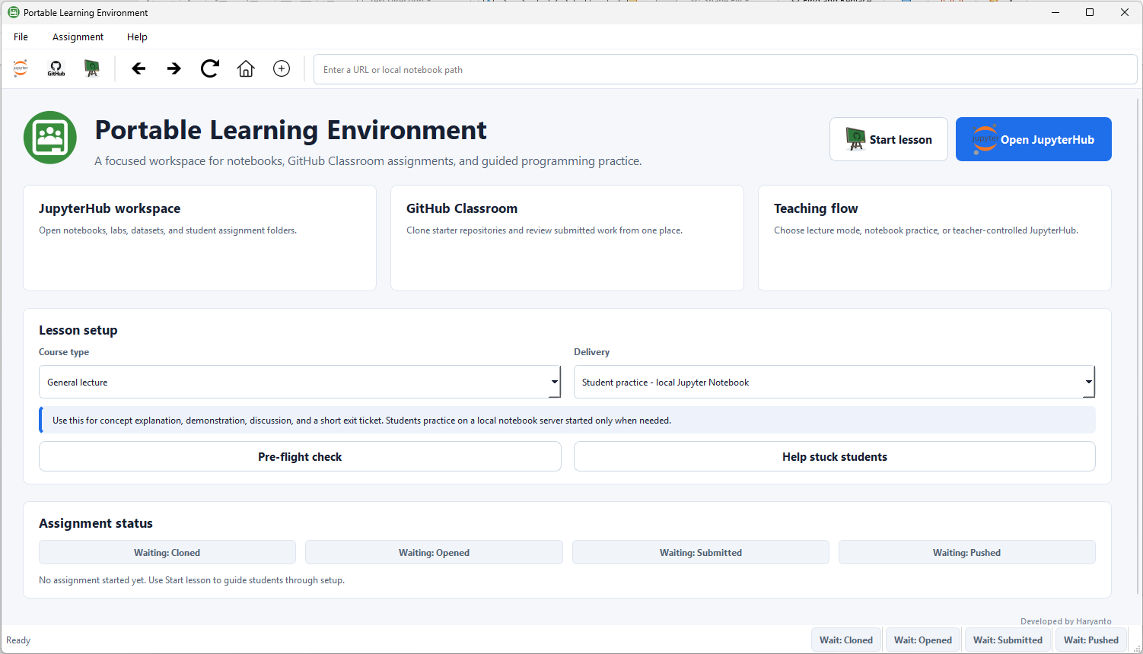
User Interface of the PLE
ICISCAS 2026 · Portable Learning Environment

