Slide 1
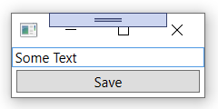
CheckedWindow
1) Initilisation
Control searches CheckedWindow, registers.
CheckedWindow then registers to control’s events.
2) Data entry
Control raises event
CheckedWindow queries all other controls to calculate
HasICheckChanged and IsAvailable. If their values change,
CheckedWindow calls OnICheckChanged and
OnIsAvailableChanged.
2a) update
Save Button
CheckedWindow listen to the Window.Closing event
If HasICheckChanged is true, it marks all the controls with changed data and asks the user if he really wants to close the window and lose the entered data.
3) User wants to
Close window

