Slide 1







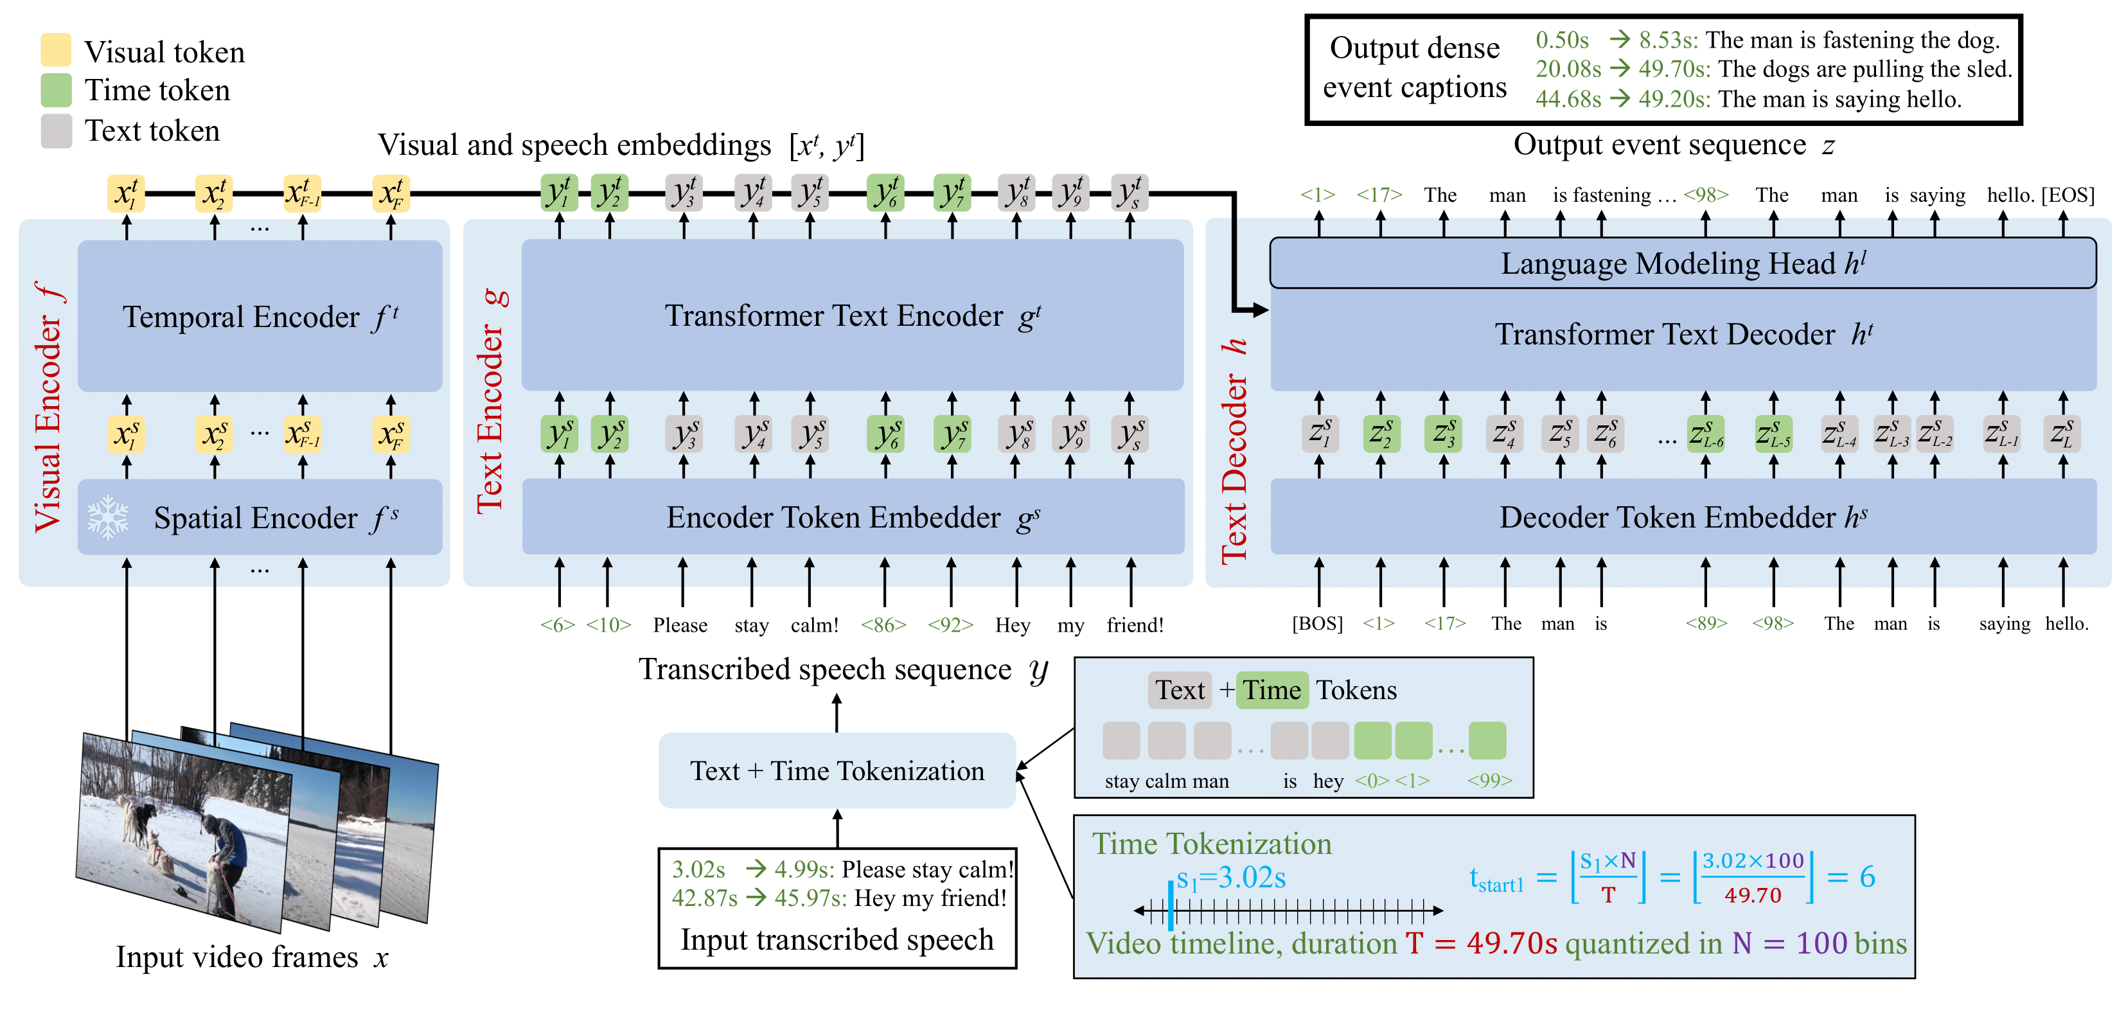
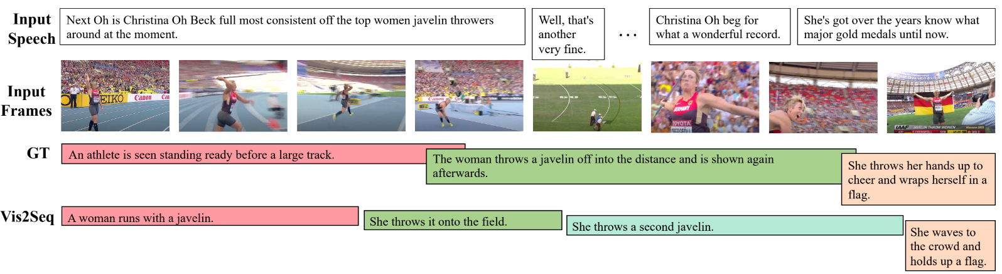
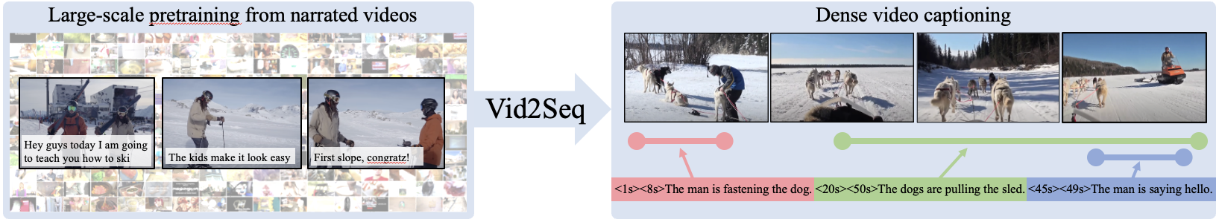
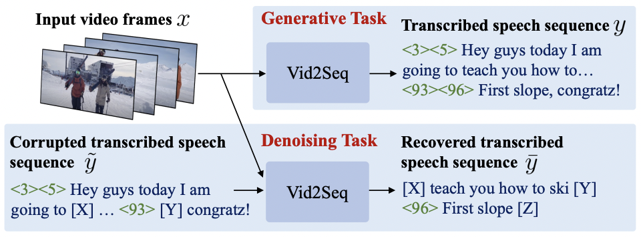
Vid2Seq: Large-Scale Pretraining of a Visual Language Model for Dense Video Captioning
Antoine Yang†*, Arsha Nagrani§, Paul Hongsuck Seo§, Antoine Miech♯, Jordi Pont-Tuset§, Ivan Laptev†, Josef Sivic¶, Cordelia Schmid§
§Google Research †Inria Paris and Ecole Normale Supérieure, PSL ♯DeepMind ¶CIIRC, CTU in Prague *Work done as Google intern.
Overview
The Vid2Seq Model
Comparison to SoTA
Dense Video Captioning
➤ Generate temporally localized captions for all events in an untrimmed minutes-long video.
➤ Dense video captioning benchmarks.
Model | YouCook2 | VidSTG m_vIoU | VidSTG vIoU@0.3 | ViTT |  |  | ActivityNet Captions
 | SODA | CIDEr | METEOR | SODA | CIDEr | METEOR | SODA | CIDEr | METEOR
SoTA | 4.4 [1] | 25.0 [3] | 4.7 [1] | - | 25.0 [3] | 8.1 [3] | 5.5 [4] | 29.0 [1] | 8.0 [1]
Vid2Seq | 7.9 | 47.1 | 9.3 | 13.5 | 43.5 | 8.5 | 5.8 | 30.1 | 8.5
Motivation
➤ Prior dense video captioning methods contain task-specific components like event counters [1].
➤ Pix2seq [2] shows that it is possible to tackle object detection via language modeling.
➤ Event localization performance.
Model | YouCook2 | VidSTG m_vIoU | ViTT |  | ActivityNet Captions
 | Recall | Precision | Recall | Precision | Recall | Precision
SoTA | 20.7 [3] | 20.6 [3] | 32.2 [3] | 32.1 [3] | 59.0 [4] | 60.3 [4]
Vid2Seq | 27.9 | 27.8 | 42.6 | 46.2 | 52.7 | 53.9
➤ Video paragraph captioning benchmarks.
Contributions
➤ Vid2Seq: a visual language model that can densely caption untrimmed videos by generating a single sequence of (text and time) tokens.
➤ Vid2Seq considerably benefits from pretraining on unlabeled narrated videos at scale, by using transcribed speech sentences and corresponding timestamps as pseudo dense captioning annotations.
➤ SoTA on 3 dense video captioning datasets, 2 video paragraph captioning benchmarks, 2 video clip captioning datasets and promising few-shot results.
➤ Code: https://github.com/google-research/scenic/tree/main/scenic/projects/vid2seq
➤ Video clip captioning benchmarks.
➤ Sequence construction: both the transcribed speech input and the dense event captioning annotations are cast as a sequence of text sentences interleaved with time tokens grounding the text in the video.
➤ Architecture: visual encoder, text encoder and text decoder.
➤ Initialization: CLIP visual backbone and T5 language model.
Model | YouCook2 | VidSTG m_vIoU | ActivityNet Captions
 | CIDEr | METEOR | CIDEr | METEOR
SoTA w/ GT proposals | 35.7 [5] | 15.9 [5] | 27.3 [1] | 16.6 [6]
Vid2Seq w/ learnt proposals | 50.1 | 24.0 | 28.0 | 17.0
Model | MSR-VTT | VidSTG m_vIoU | MSVD
 | CIDEr | METEOR | CIDEr | METEOR
SoTA | 60.0 [7] | 29.9 [8] | 120.6 [8] | 41.3 [8]
Vid2Seq | 64.6 | 30.8 | 146.2 | 45.3
Pretraining Vid2Seq on narrated videos
Qualitative results
➤ We use transcribed speech sentences and corresponding timestamps as pseudo dense event captioning annotations.
➤ Pretraining is done using untrimmed videos by exploiting speech timestamps with time tokens → crucial to performance.
➤ Pretraining Dataset: YT-Temporal-1B (18 million narrated videos).
➤ Finetuning on various tasks is done with a language modeling loss.
➤ More at https://www.youtube.com/watch?v=3oEHSU5ExsI.
Few-Shot Dense Video Captioning
➤ Generative objective: predict speech given visual inputs.
➤ Denoising objective: predict masked tokens given noisy speech and visual inputs → benefits multi-modal reasoning.
➤ New setting using a small fraction of the downstream dataset for finetuning.
Data | YouCook2 | VidSTG m_vIoU | VidSTG vIoU@0.3 | ViTT |  |  | ActivityNet Captions
 | SODA | CIDEr | METEOR | SODA | CIDEr | METEOR | SODA | CIDEr | METEOR
1% | 2.4 | 10.1 | 3.3 | 2.0 | 7.4 | 1.9 | 2.2 | 6.2 | 3.2
10% | 3.8 | 18.4 | 5.2 | 10.7 | 28.6 | 6.0 | 4.3 | 20.0 | 6.1
50% | 6.2 | 32.1 | 7.6 | 12.5 | 38.8 | 7.8 | 5.4 | 27.5 | 7.8
100% | 7.9 | 47.1 | 9.3 | 13.5 | 43.5 | 8.5 | 5.8 | 30.1 | 8.5
References
[1] T. Wang, et al., End-to-End Dense Video Captioning with Parallel Decoding. In ICCV 2021.
[2] T. Chen, et. al., Pix2seq: A Language Modeling Framework for Object Detection. In ICLR 2022.
[3] W. Zhu, et al., End-to-end Dense Video Captioning as Sequence Generation. In COLING 2022.
[4] Q. Zhang, et al., Unifying Event Detection and Captioning as Sequence Generation via Pre-Training. In ECCV 2022.
[5] J. Lie, et al., MART: Memory-Augmented Recurrent Transformer for Coherent Video Paragraph Captioning. In ACL 2020.
[6] J.S. Park, et al., Adversarial Inference for Multi-Sentence Video Description. In CVPR 2019.
[7] P.H. Seo, et al., End-to-end Generative Pretraining for Multimodal Video Captioning. In CVPR 2022.
[8] K. Lin, et al., SwinBERT: End-to-End Transformers with Sparse Attention for Video Captioning. In CVPR 2022.

