Slide 1






Vid2Seq: Large-Scale Pretraining of a Visual Language Model for Dense Video Captioning
Antoine Yang, Arsha Nagrani, Paul Hongsuck Seo, Antoine Miech, Jordi Pont-Tuset, Ivan Laptev, Josef Sivic, Cordelia Schmid
Project page: https://antoyang.github.io/vid2seq.html
Paper: https://arxiv.org/abs/2302.14115

Slide 2
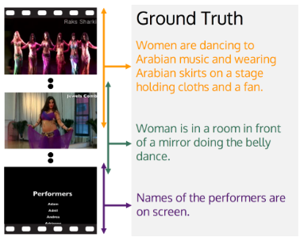
Dense Video Captioning
Task: generate temporally localized captions for all events in an untrimmed minutes-long video.
Prior approaches (e.g. [Wang 2021]): are task specific and trained only on manually annotated datasets.
Example from the ActivityNet-Captions dataset [Krishna 2017].
[Krishna 2017] Dense-Captioning Events in Videos, Ranjay Krishna et al, ICCV 2017.
[Wang 2021] End-to-End Dense Video Captioning with Parallel Decoding, Teng Wang et al, ICCV 2021.

Slide 3
The Vid2Seq model
Formulates dense video captioning as a sequence-to-sequence problem.
Time is quantized and jointly tokenized with the text.
Model architecture: visual encoder, text encoder and text decoder.

Slide 4
Pretraining Vid2Seq on untrimmed narrated videos
Speech is also cast as a single sequence of text and time tokens.
Generative objective: given visual inputs, predict speech.
Denoising objective: given visual inputs and noisy speech, predict masked tokens.

Slide 5
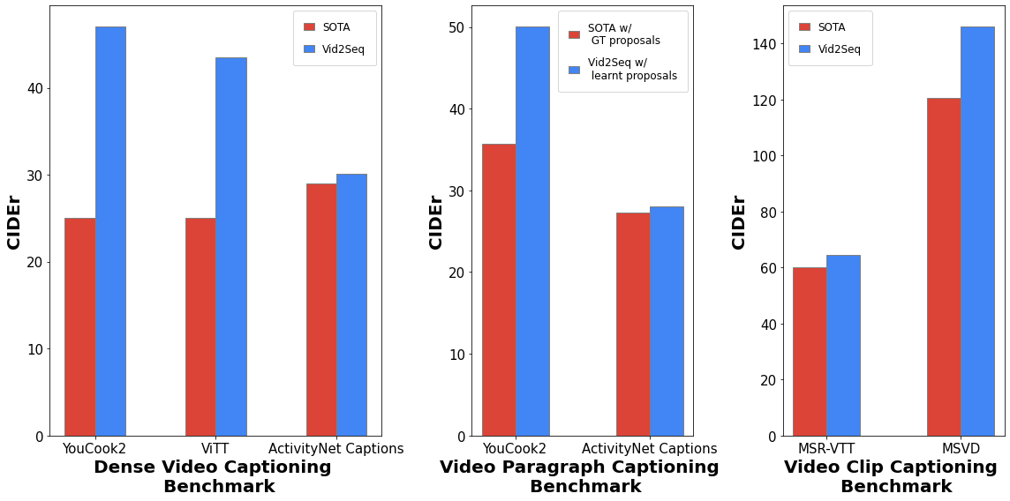
Vid2Seq improves the SoTA on various video captioning tasks.
[Wang 2021] End-to-End Dense Video Captioning with Parallel Decoding, Teng Wang et al, ICCV 2021.
[Zhu 2022] End-to-end Dense Video Captioning as Sequence Generation, Wanrong Zhu et al, COLING 2022.
[Lei 2020] MART: Memory-Augmented Recurrent Transformer for Coherent Video Paragraph Captioning, Jie Lei et al, ACL 2020.
[Seo 2022] End-to-end Generative Pretraining for Multimodal Video Captioning, Paul Hongsuck Seo et al, CVPR 2022.
[Lin 2022] SwinBERT: End-to-End Transformers with Sparse Attention for Video Captioning, Kevin Lin et al, CVPR 2022.

Slide 6
Benefits of pretraining on untrimmed narrated videos with time tokens
Pretraining input |  | YouCook2 | VidSTG m_vIoU | VidSTG vIoU@0.3 | ActivityNet Captions
Untrimmed | Time tokens | SODA | CIDEr | F1 | SODA | CIDEr | F1
✗ | ✗ | 4.0 | 18.0 | 18.1 | 5.4 | 18.8 | 49.2
✓ | ✗ | 5.5 | 27.8 | 20.5 | 5.5 | 26.5 | 52.1
✓ | ✓ | 7.9 | 47.1 | 27.3 | 5.8 | 30.1 | 52.4

Slide 7
Effect of pretraining losses and modalities
The visual inputs only model benefits from the generative objective.
The denoising objective helps the model with visual+speech inputs.
Finetuning Input |  | Pretraining losses |  | YouCook2 | VidSTG m_vIoU | VidSTG vIoU@0.3 | ActivityNet Captions
Visual | Speech | Generative | Denoising | SODA | CIDEr | F1 | SODA | CIDEr | F1
✓ | ✗ | No pretraining |  | 3.0 | 15.6 | 15.4 | 5.4 | 14.2 | 46.5
✓ | ✓ | No pretraining |  | 4.0 | 18.0 | 18.1 | 5.4 | 18.8 | 49.2
✓ | ✗ | ✓ | ✗ | 5.7 | 25.3 | 23.5 | 5.9 | 30.2 | 51.8
✓ | ✓ | ✓ | ✗ | 2.5 | 10.3 | 15.9 | 4.8 | 17.0 | 48.8
✓ | ✓ | ✓ | ✓ | 7.9 | 47.1 | 27.3 | 5.8 | 30.1 | 52.4

Slide 8
Vid2Seq generalizes well to few-shot settings.
We find that pretraining is crucial for few-shot generalization.
Data | YouCook2 | VidSTG m_vIoU | VidSTG vIoU@0.3 | ViTT |  |  | ActivityNet Captions
 | SODA | CIDEr | METEOR | SODA | CIDEr | METEOR | SODA | CIDEr | METEOR
1% | 2.4 | 10.1 | 3.3 | 2.0 | 7.4 | 1.9 | 2.2 | 6.2 | 3.2
10% | 3.8 | 18.4 | 5.2 | 10.7 | 28.6 | 6.0 | 4.3 | 20.0 | 6.1
50% | 6.2 | 32.1 | 7.6 | 12.5 | 38.8 | 7.8 | 5.4 | 27.5 | 7.8
100% | 7.9 | 47.1 | 9.3 | 13.5 | 43.5 | 8.5 | 5.8 | 30.1 | 8.5

Slide 9
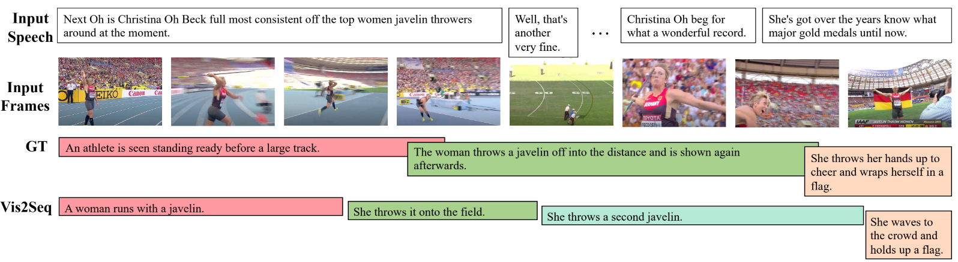
Qualitative dense video captioning results
More examples at: https://www.youtube.com/watch?v=3oEHSU5ExsI

Slide 10
Conclusion
We introduce Vid2Seq, a new visual language model for dense video captioning.
We show how Vid2Seq can be effectively pretrained on unlabeled narrated videos at scale.
The pretrained Vid2Seq model improves the SoTA on 3 dense video captioning datasets, 2 video paragraph captioning datasets and 2 video clip captioning datasets, and generalizes well to few-shot setting.

