Slide 1





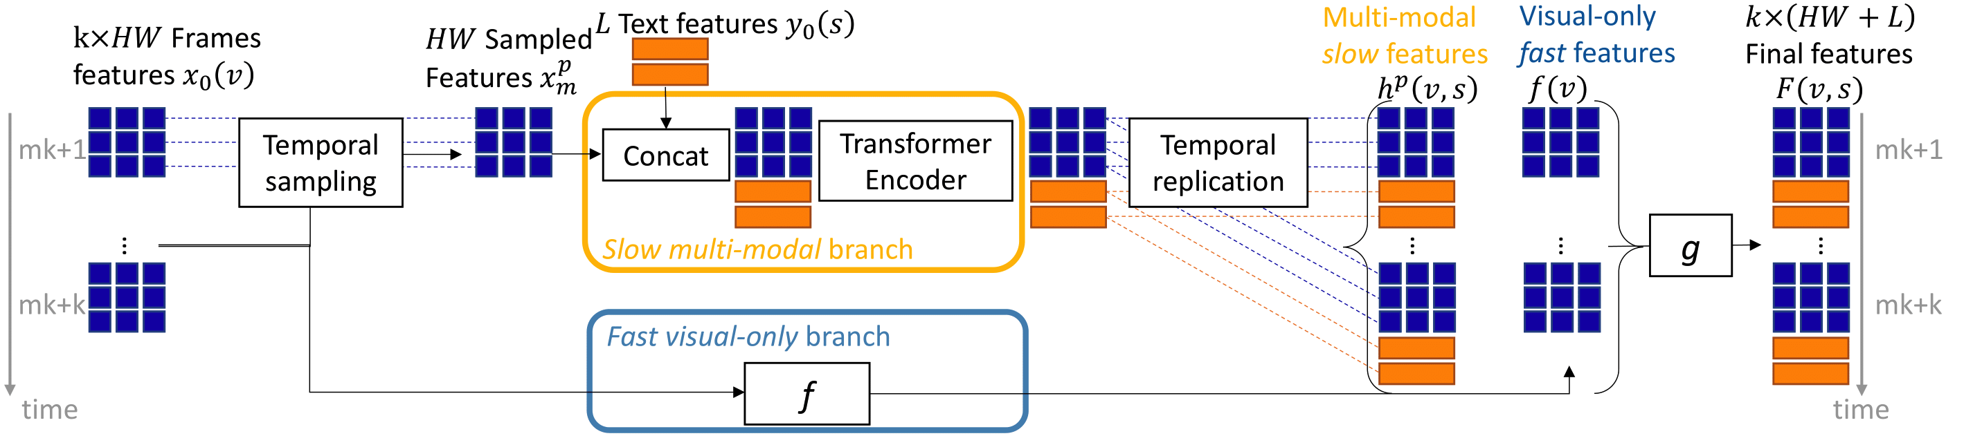
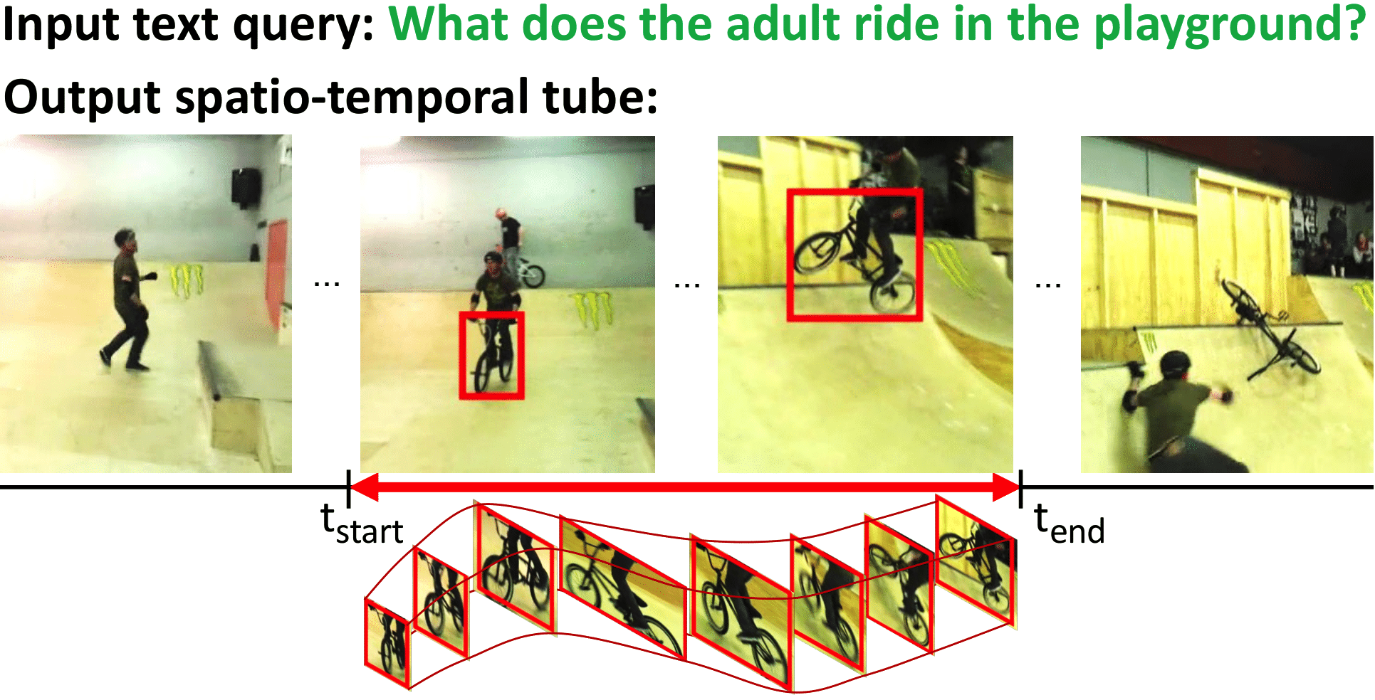
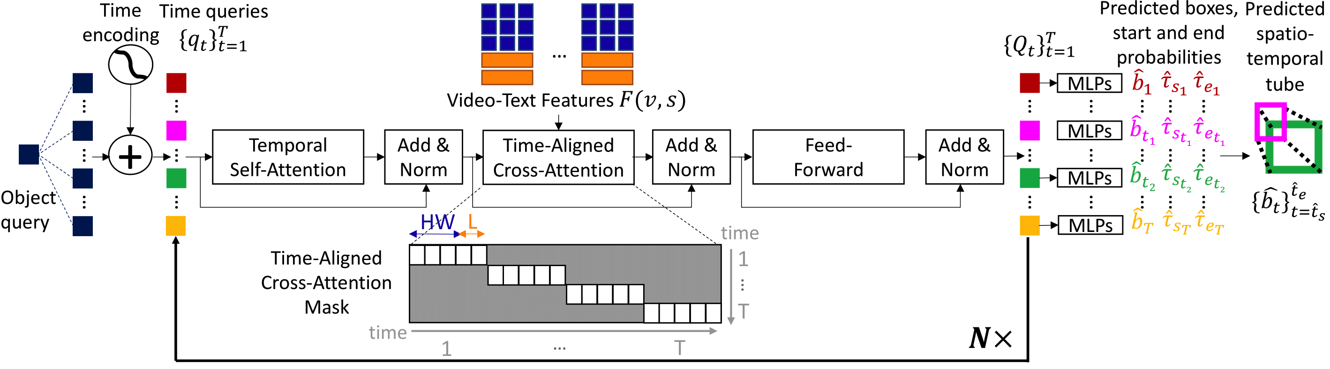
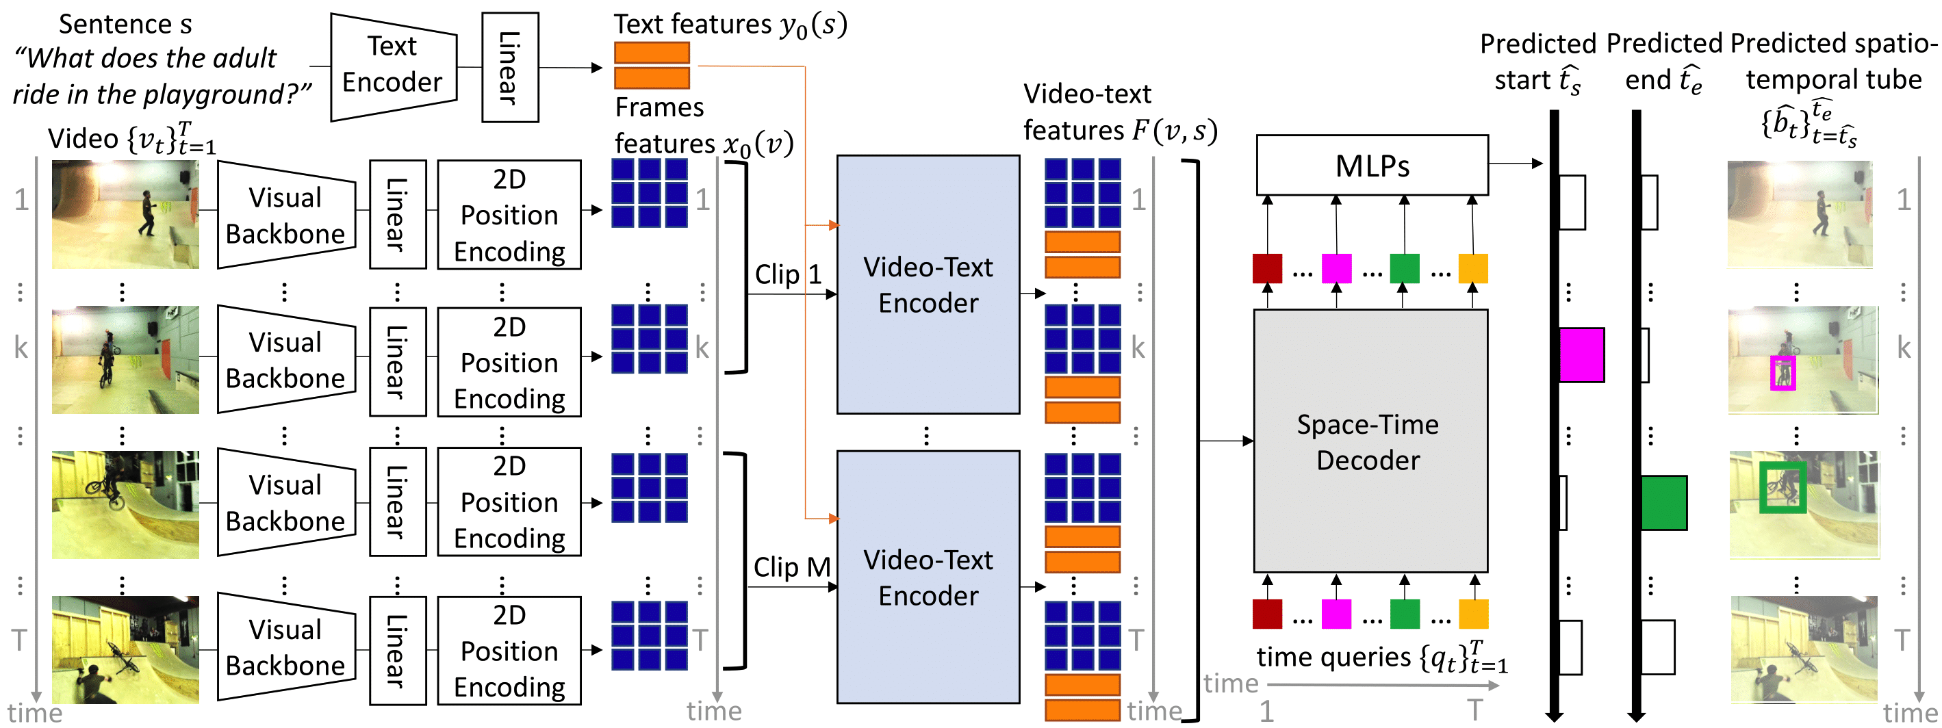
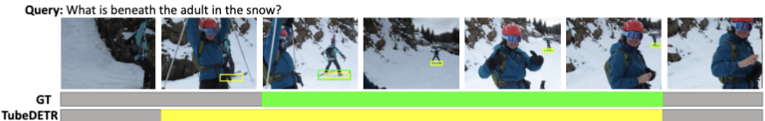
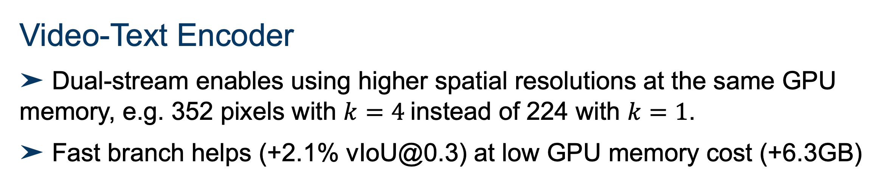
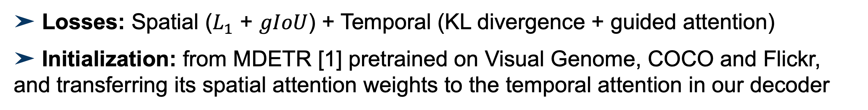
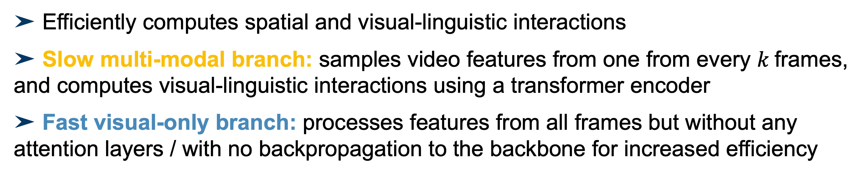
TubeDETR: Spatio-Temporal Video Grounding with Transformers
Antoine Yang^{1,2}, Antoine Miech³, Josef Sivic⁴, Ivan Laptev^{1,2}, Cordelia Schmid^{1,2}
¹Inria Paris ²Ecole Normale Supérieure, PSL ³DeepMind ⁴CIIRC, CTU in Prague
Overview
Video-Text Encoder
Ablation studies (VidSTG)
Spatio-Temporal Video Grounding Task
Space-Time Decoder
➤ Time encoding helps, especially for temporal localization (+22.0% tIoU)
➤ Temporal self-attention helps (+4.5% vIoU@0.3)
➤ Given an input video, localize a spatio-temporal tube corresponding to an input natural language query
Initialization
➤ MDETR [1] initialization helps esp. for spatial localization (+9.2% m_sIoU)
➤ Transferring spatial attention to temporal attention helps (+3.3% vIoU@0.3)
Motivation
➤ Existing approaches rely on object proposals [2], tube proposals [3] or upsampling layers [4], hence use different representations for spatial and temporal localization
➤ Spatio-Temporal Video Grounding requires efficient modeling of temporal, spatial and visual-linguistic interactions
➤ Efficiently computes spatial and visual-linguistic interactions
➤ Slow multi-modal branch: samples video features from one from every $k$frames, and computes visual-linguistic interactions using a transformer encoder
➤ Fast visual-only branch: processes features from all frames but without any attention layers / with no backpropagation to the backbone for increased efficiency
Video-Text Encoder
➤ Dual-stream enables using higher spatial resolutions at the same GPU memory, e.g. 352 pixels with $k=4$instead of 224 with $k=1$.
➤ Fast branch helps (+2.1% vIoU@0.3) at low GPU memory cost (+6.3GB)
Contributions
➤ A space-time decoder that reasons about time queries, which are used for both spatial and temporal localization
➤ A dual-stream video-text encoder that efficiently encodes spatial and multi-modal interactions
Space-Time Decoder
Comparison to the state of the art
➤ State-of-the-art results on VidSTG and HC-STVG
Method | Pretraining data | VidSTG Declarative vIoU | VidSTG Declarative vIoU@0.3 | VidSTG Interrogative vIoU | VidSTG Interrogative vIoU@0.3 | HC-STVG1 vIoU | HC-STVG1 vIoU@0.3
STGRN [2] | Visual Genome | 19.8 | 25.8 | 18.3 | 21.1 | - | -
STGVT [3] | Visual Genome + Conceptual Cap. | 21.6 | 29.8 | - | - | 18.2 | 26.8
STVGBert [4] | ImageNet + Visual Genome + Conceptual Cap. | 24.0 | 30.9 | 22.5 | 26.0 | 20.4 | 29.4
Ours | ImageNet + Visual Genome + COCO + Flickr | 30.4 | 42.5 | 25.7 | 35.7 | 32.4 | 49.8
➤ Models temporal interactions and predicts the tube using the video-text features
➤ Inputs: time encodings called time queries, one per frame, and video-text features
➤ Architecture: Transformer decoder with block-diagonal cross-attention, ie succession of temporal self-attention, time-aligned cross-attention, feed-forward layers
➤ Prediction heads: Multi-layer perceptrons on top of the contextualized time queries
Qualitative results
Links
➤ Code and models: https://github.com/antoyang/TubeDETR
➤ Online Demo: http://stvg.paris.inria.fr/
Training
➤ Losses: Spatial ($L_{1}$ + $gIoU$) + Temporal (KL divergence + guided attention)
➤ Initialization: from MDETR [1] pretrained on Visual Genome, COCO and Flickr, and transferring its spatial attention weights to the temporal attention in our decoder
References
[1] A. Kamath et al., MDETR -- Modulated Detection for End-to-End Multi-Modal Understanding. In ICCV 2021.
[2] Z. Zhang et al., Spatio Temporal Video Grounding for Multi-Form Sentences. In CVPR, 2020.
[3] Z. Tang, et. al., Human-centric Spatio-Temporal Video Grounding With Visual Transformers. In TCSVT, 2021.
[4] R. Sui et. al., STVGBert: A Visual-linguistic Transformer based Framework for Spatio-temporal Video Grounding. In ICCV, 2021..

