Slide 1


NAS evaluation is frustratingly hard
Antoine Yang, Pedro M. Esperança, Fabio M. Carlucci
Huawei Noah’s Ark Lab, London, UK
ICLR2020 Poster Session
Paper: https://arxiv.org/abs/1912.12522
Code: https://github.com/antoyang/NAS-Benchmark

Slide 2
Background
Neural Architecture Search (NAS):
Automated design of a neural architecture for a given task
3 main components:
A search space: set of architectures that can be found
A search strategy: Random Search, Evolution, RL, Bayesian, Gradient-based …
A training protocol: way we evaluate architectures
Issues related to the evaluation of search strategies:
Nowadays, most NAS methods fail to compare against an adequate baseline
Unclarity about the contribution of each component to the final result
Our main contributions:
A benchmark of 8 NAS methods on 5 datasets with Random Sampling Baseline
A study of the contribution of each component
Search Space
Search Method
Evaluation Method

Slide 3
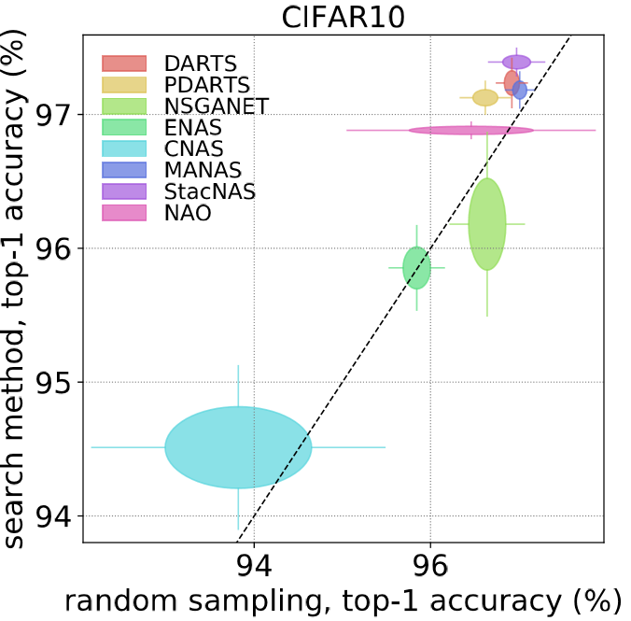
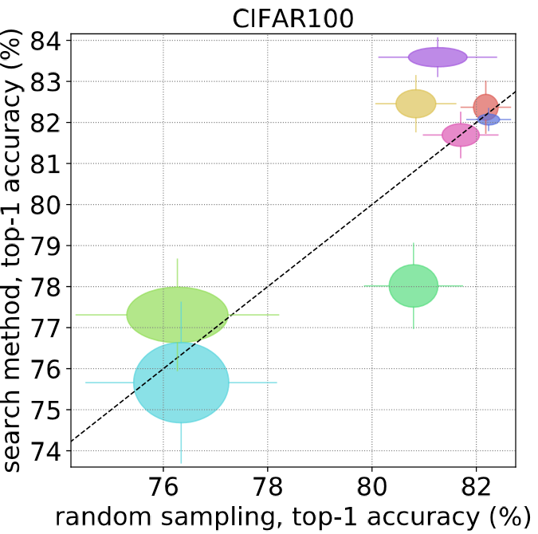
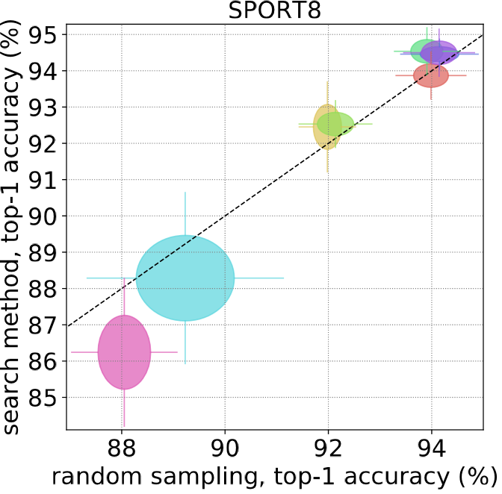
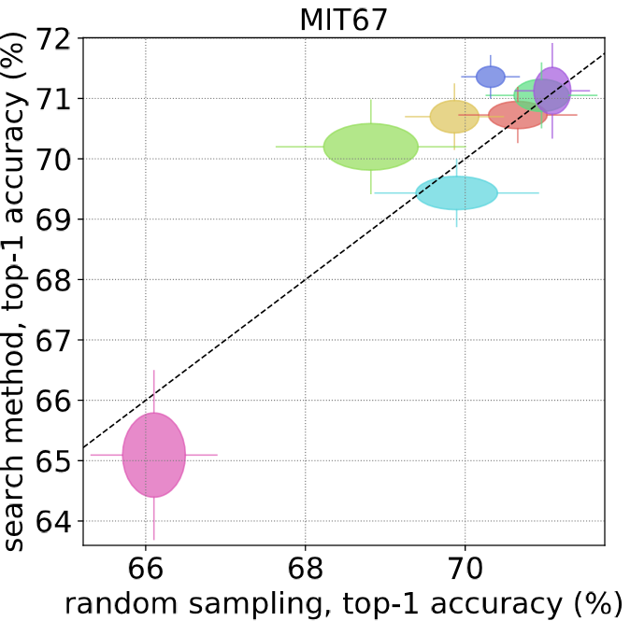
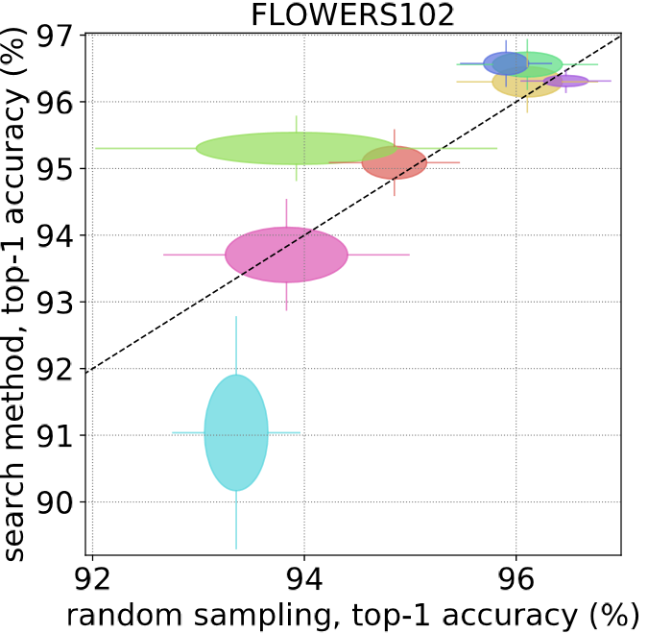
NAS Benchmark
Method selection: 8 fast open-source NAS methods
Random Sampling Baseline: Randomly sample architectures from the method’s search space (no search) and train them with the method’s training protocol
Consistency, Generalization:
Average results over 8 runs
Use a variety of 5 CV datasets
Results:
The NAS methods barely beat this trivial baseline
Substantial differences between the different random samplings

Slide 4
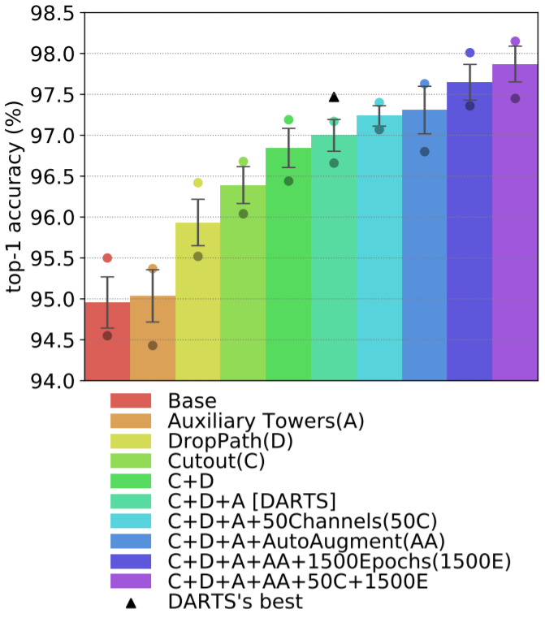
Comparison of training protocols
Goal: Evaluate the importance of the different components in the final test accuracy
Methodology: Train the same 8 randomly sampled architectures from DARTS search space with diverse protocols and report averaged results on CIFAR10
Results:
Significant differences between the different protocols: 3% gap between the worst and the best
The best out of 8 random architectures with best protocol achieves 98.15% test accuracy (0.25% below state-of-the-art*)
*XNAS: Neural Architecture Search with Expert Advice, Niv Nayman et al, 2019

Slide 5
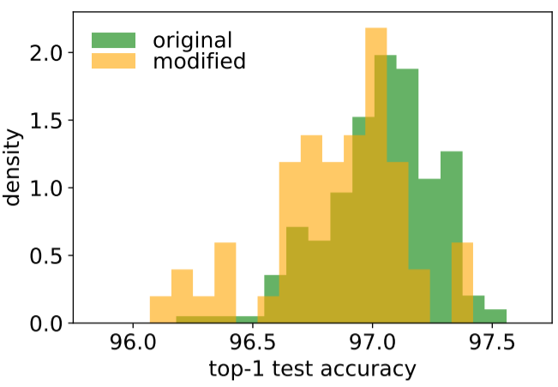
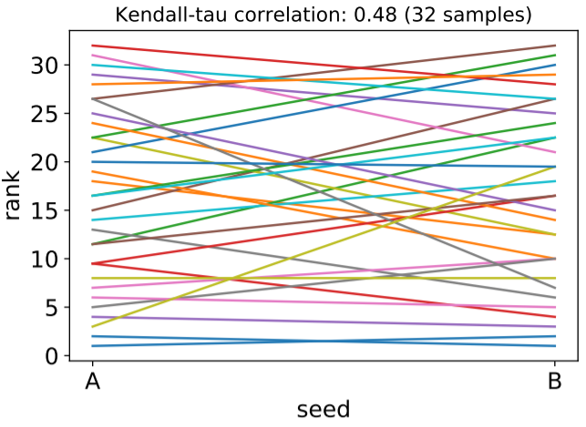
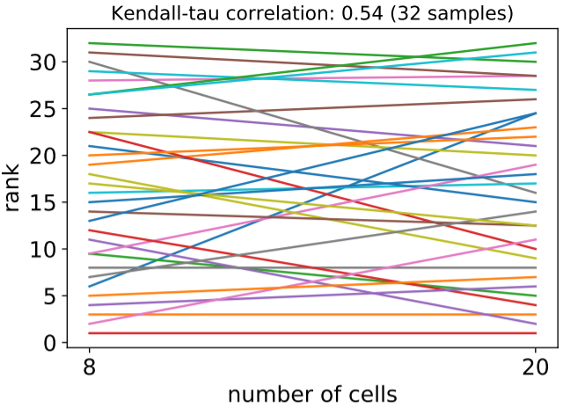
Study of DARTS’ search space
Random Sampling Distribution:
Randomly sample 214 architectures in DARTS’ search space and train them with DARTS’ protocol
Narrow accuracy range: average 97.03 ± 0.23, min 96.18, max 97.56
Importance of the Micro-Structure: Similar study and observations with 56 architectures sampled from a modified search space based on (inefficient) vanilla convolutions
Importance of the Training Seed:
Randomly sample 32 architectures and train them with 2 different seeds
Architectures’ ranking heavily changes: Kendall Tau 0.48
Importance of the Depth Gap: Similar study and observations with 32 architectures and 2 different number of cells: Kendall Tau 0.54

Slide 6
Discussion and Best Practices
Comparing with baselines:
Either report a result with same training protocol / search space than previous works (e.g. NAS-Bench-101*)
Either update the results of previous works with your new training protocol / search space
Random Sampling is a simple, search-free and powerful baseline
Search Space Design: If the goal of AutoML / NAS is to ﬁnd the optimal architecture without human intervention, a wider search space (with a less constrained macro-structure) is a more interesting challenge than a narrow one.
Generability: Evaluating on datasets with various sizes, image sizes, class granularity and learning task could avoid overfitting and highlight a costly hyperparameter tuning. This cost should be reported, if parameters have to be further tuned for other datasets / tasks.
Reproducibility: Importance of providing all hyperparameters (including the seed) and open-sourcing the code
*NAS-Bench-101: Towards Reproducible Neural Architecture Search, Chris Ying et al., 2019

Slide 7
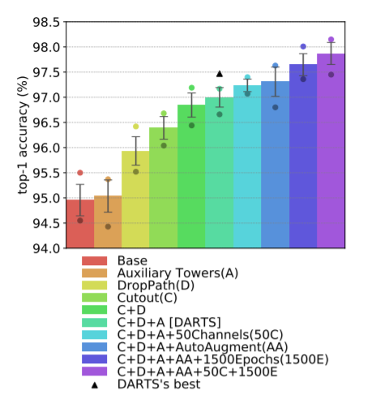
ICLR webpage thumbnail
Comparison of search methods with Random Sampling on CIFAR10
Comparison of different training protocols

