Slide 1




Hungry Hippos
App developed by: Anthony Pasquariello, Max Huesser, Shivani Bhatia, and
Abraham Cohen

Slide 2


Overview
Hungry Hippos is an exciting, yet simple game where a hungry hippo tries to eat candy and avoid bombs. The user helps feed the hippo by guiding it left and right. The purpose behind “Hungry Hippos” is to create a game that is easy to play and suitable for all ages.

Slide 3

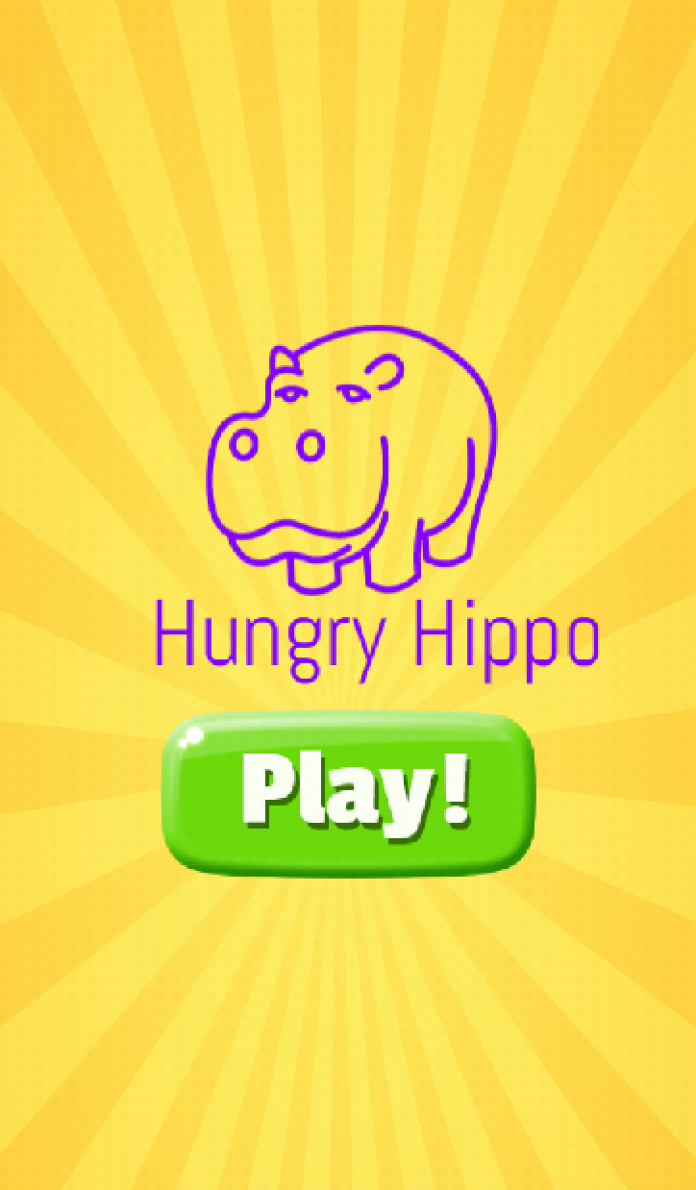
MENU
The Menu Screen acts as the gateway to our game. It renders the logo, background, and play button for the user to see and begin the game.
Continue to game screen

Slide 4
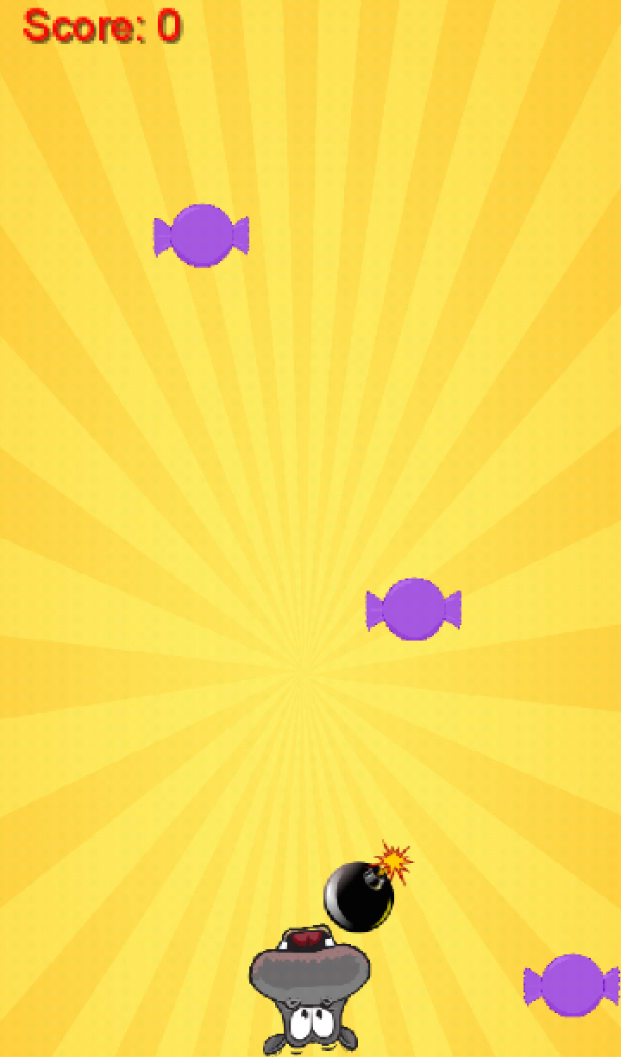
Game
Pieces of candy collected
The Game Screen is where most of the gameplay interactions take place. First, all of the images are rendered. Then, the user must use her or her finger to move the hippo left or right to collect candy. They must avoid the bombs and eat all of the falling candy pieces otherwise they will lose.
Candy
Bomb
Hold down and move hippo left and right

Slide 5


Game Object Handling
Columns
Falling objects
We first define the basic layout of our screen to be a grid with a set number of columns that correlate to a certain number of pixels. Once the grid is defined, an array of bombs and candy can have elements can “fall” vertically through the columns at time intervals so that they do not overlap.

Slide 6

Game Hippo Handling
Screen Interaction:
In order to move the hippo left and right, the user must hold the hippo icon. If the users finger touches the screen and moves, the hippo image follows. From a rendering perspective, this movement is a Boolean function that returns true when touched and then enters a function that takes in the x-coordinate of the finger to then move the hippo a set number of pixels to the left or right.
Hippo Movement

Slide 7
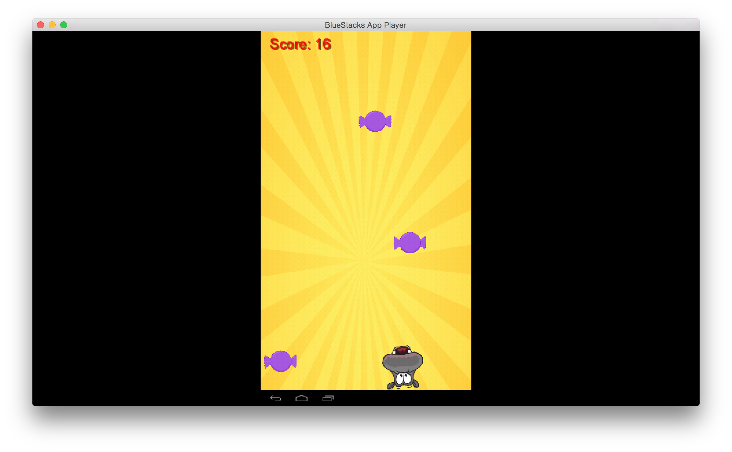
Game Progression
After the hippo eats a piece of candy, the score increases by one and objects still continue to fall. As the score increases, the time it takes for objects to fall decreases.

Slide 8
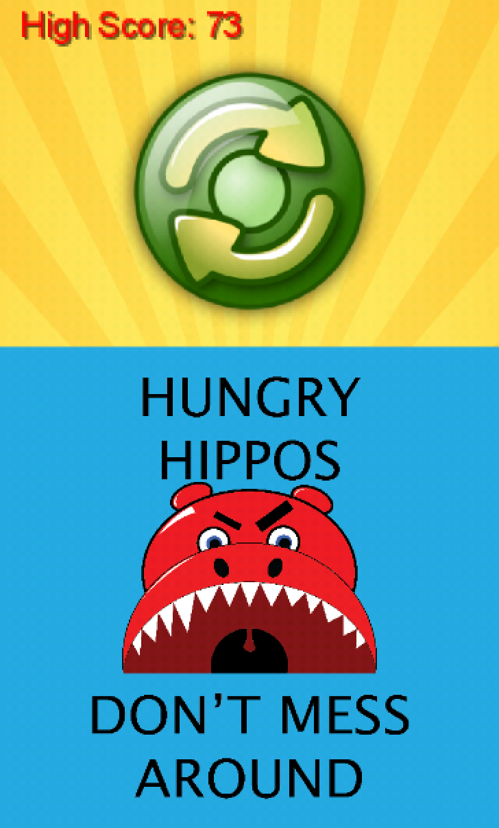
End
Overall high score
Play again
If the player misses a piece of candy or hits a bomb, they will be brought to the end screen. Here, the user has the option to replay the game.

Slide 9
Classes and States
CLASS: MyGDXGame
-Create all objects and images
-Create bomb and candy arrays and iterators
-Define and declare touch inputs
-Declare results of all actions
Instead of using multiple classes to build the game, this app uses one class and defines three states to switch between screens. The app is navigated via if statements based off of certain touch and button inputs.
STATE: MENU STATE
-Render logo and background
-Draw in play button and hippo image
STATE: GAME STATE
-Render in hippo and game objects
-Update screen after every candy is eaten
-Check for user touch handling
STATE: END STATE
-Render in replay button and slogan at bottom
-Update high score
-Clear the board

Slide 10


Thank You!
Remember to Download and Feed a Hungry Hippo Today!

