Slide 1

Lab Book 1.0. Waveguides
Student:

Slide 2
Instructions General
SCRIPTS
From GitHub →
Fork the repo: https://github.com/cccanvas-upv/cifoin-lab1.git
Clone the repo using VSCode
Run the Jupyter Notebook:
WAVEGUIDES_Student.ipynb
W (width)
W (width)
Core
Core
h_core
h
(height)
Cladding
Cladding
Slab
h_slab
deep waveguide
shallow waveguide

Slide 3
Learning outcome #1 – Effective index of a waveguide
INSTRUCTOR:
Present Python and GDSFactory: materials, output, results.
Explain how to run a simulation for a particular cross-section.
Showcase how to change between shallow and deep waveguide.
Describe how to change the wavelength and width for the waveguide analysis.
Describe the outputs.
ALL EXAMPLE #1: waveguide width 1.2 µm, deep wvg, wavelength start and end same 1.55 µm → all ”Run”
ALL: Follow instructor, that will show how to 1) plot mode, 2) explore the results (neff …)
The differences in the refractive indices of silicon, SiO2, and silicon nitride are significant, but in all cases, the relationship between n and wavelength is nonlinear. I assume that is why they are used for different applications. I can see that for the given parameters, only the fundamental mode's field (and maybe the second mode's) is mostly confined to the core. This is related to their refractive index.

Slide 4
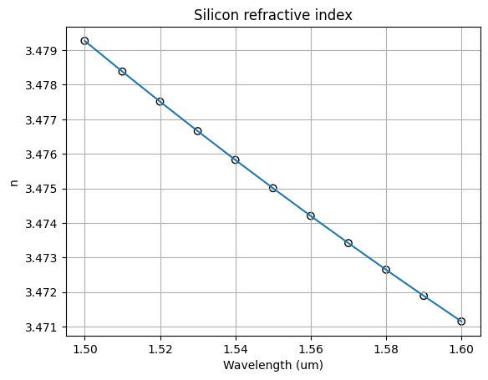
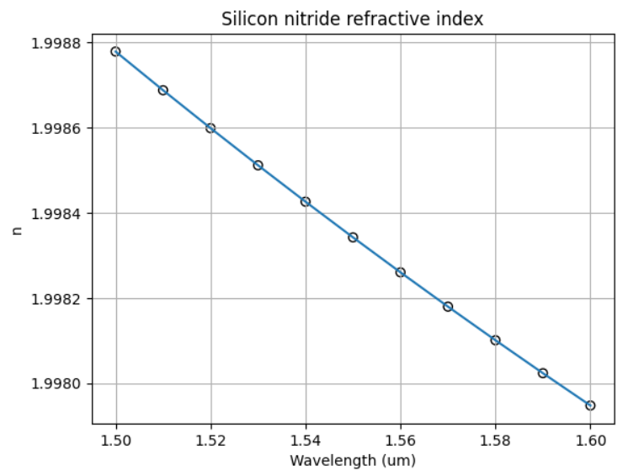
Learning outcome #1 – Effective index of a waveguide

Slide 5
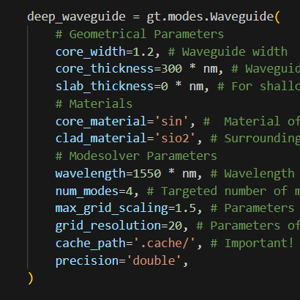
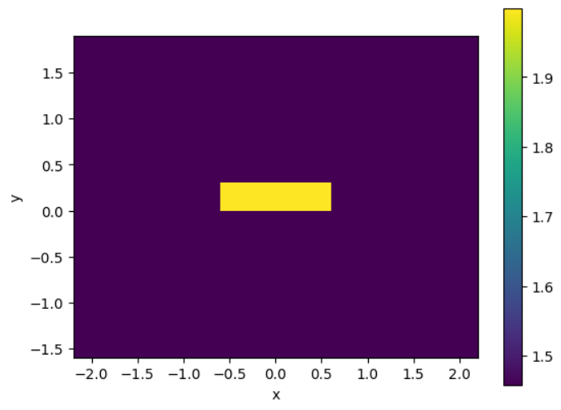
Learning outcome #1 – Effective index of a waveguide
Parameters:
Effective index of each mode:
1.60524792+0.00010066j, 1.52829803+0.00017753j, 1.45072999+0.00019228j, 1.43325817+0.00021838j
Fraction_te for each mode:
0.99505426, 0.01004259, 0.96264794, 0.047651
Fraction_tm for each mode:
0.00494574, 0.98995741, 0.03735206, 0.952349

Slide 6
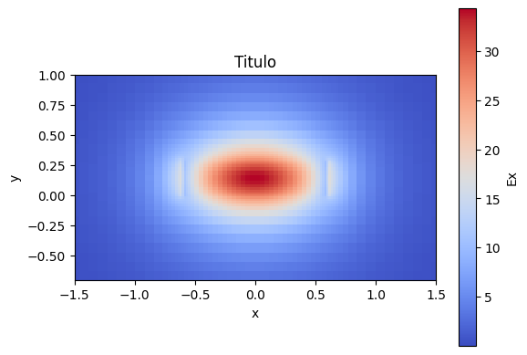
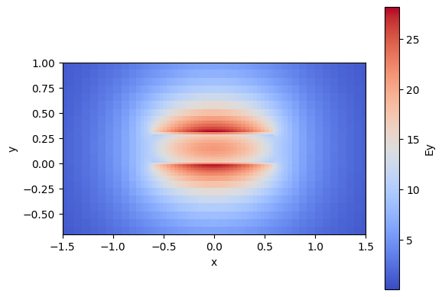
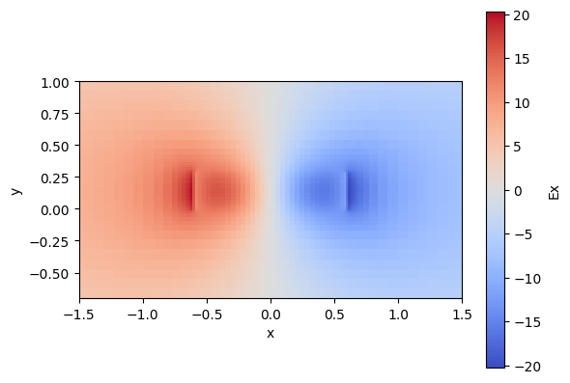
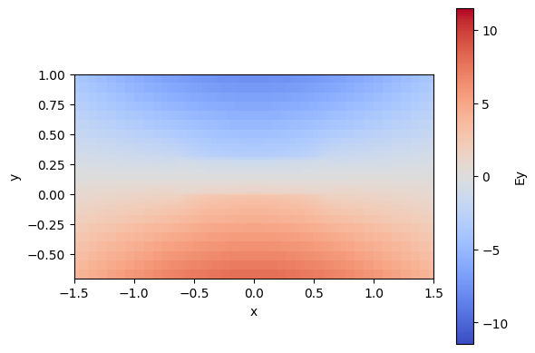
Learning outcome #1 – Effective index of a waveguide

Slide 7
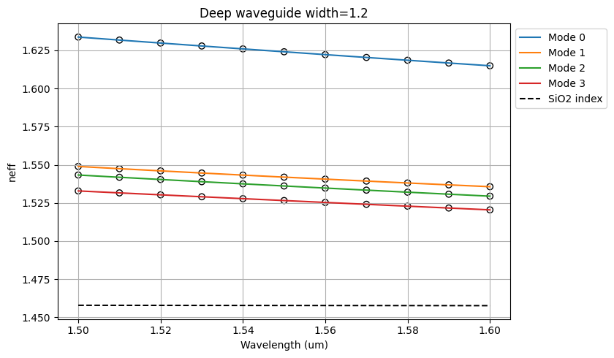
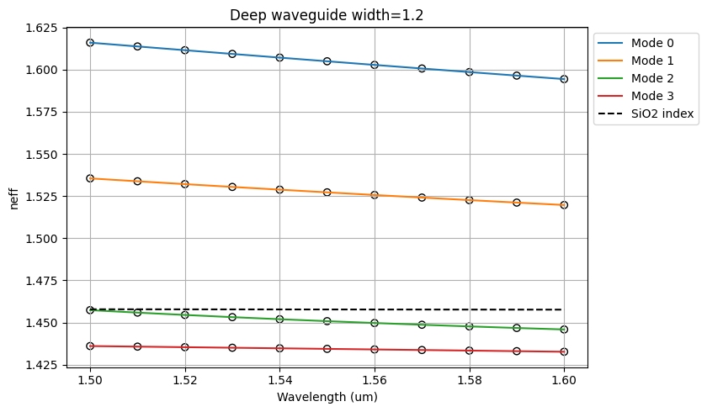
Learning outcome #2 – Wavelength behavior Wavelength 1.5-1.6 µm (step 0.01 µm) – width 1.2 µm
shallow waveguide
Paste plot here
deep waveguide
Paste plot here
slab = 150nm
The effective refractive index (neff) is higher in shallow waveguides than in deep waveguides, and this effect becomes more pronounced as the mode number increases. Furthermore, the decrease in neff with increasing wavelength is similar for both types of waveguides.

Slide 8
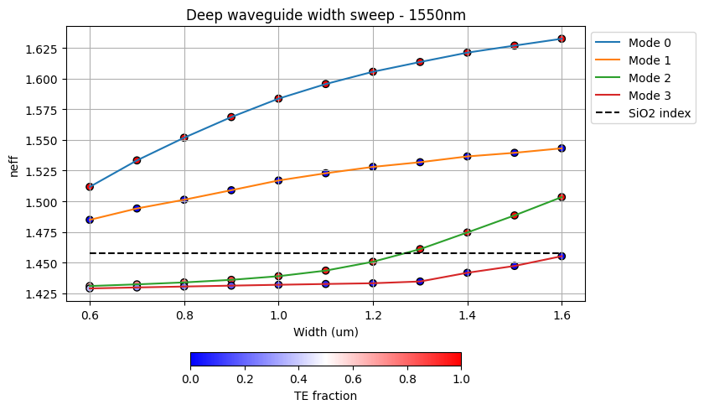
Learning outcome #3 – Width dependence Width 0.6 - 1.6 µm (step 0.1 µm) – Wavelength 1.55 µm
deep waveguide
Paste plot here
As the waveguide width increases, the phase velocity of modes 1 and 2 decreases (corresponding to an increase in neff), whereas modes 2 and 3 exhibit an increase in velocity (a decrease in neff).

Slide 9
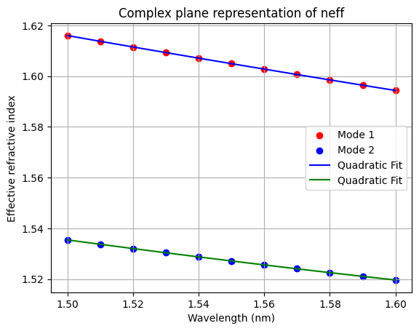
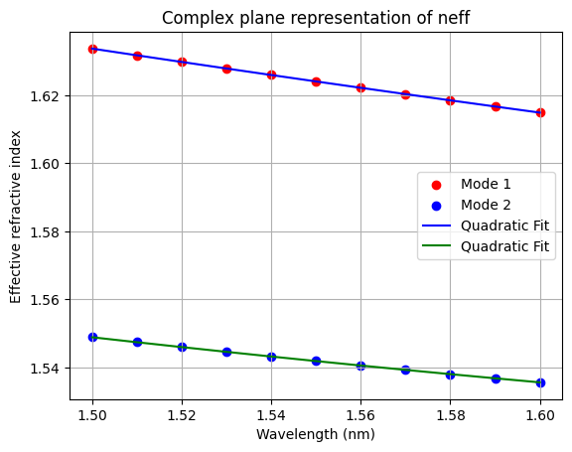
Learning outcome #4 – Waveguide compact model - Find the compact models of the following waveguides: Deep waveguide, h=300nm, w=1.2um - Shallow waveguide, core h=300nm, slab h=150 nm, w = 1.2um
deep waveguide
neff_TE0 vs $λ$ with the second-degree polynomial fit
& neff_TM0 vs $λ$ with the second-degree polynomial fit
shallow waveguide
neff_TE0 vs $λ$ with the second-degree polynomial fit
& neff_TM0 vs $λ$ with the second-degree polynomial fit
slab: 150nm
Find the second-degree polynomial coefficients and relate them with the group index and the dispersion parameter. $\left\{\begin{aligned}n_{eff}=n_{1} \\ n_{g}=n_{1}−n_{2}λ_{0} \\ D=−\frac{2λ_{0}n_{3}}{c}\left[\frac{s^{2}}{m}\right]\end{aligned}\right.$
Comment on the results found for the TE0 and TM0 for both deep and shallow waveguides.

Slide 10
Learning outcome #4 – Waveguide compact model - Find the compact models of the following waveguides: Deep waveguide, h=300nm, w=1.2um - Shallow waveguide, core h=300nm, slab h=150 nm, w = 1.2um
second-degree polynomial coefficients for short waveguide, D:
Quadratic fit coefficients (mod1): [ 0.0956958 -0.18817489 1.62409063]
Quadratic fit coefficients (mod2): [ 0.14801168 -0.1325985 1.54189536]
Ng for mode 1: 1.9157617116968038
Ng for mode 2: 1.7474230444068224
D for mode 1: -989.5411991849512 ps/(km*nm)
D for mode 2: -1530.5127982607453 ps/(km*nm)
second-degree polynomial coefficients for deep waveguide, D:
Quadratic fit coefficients (mod1): [ 0.09735507 -0.21617695 1.60491663]
Quadratic fit coefficients (mod2): [ 0.15383171 -0.15795878 1.52718923]
Ng for mode 1: 1.939990900810061
Ng for mode 2: 1.7720253478666539
D for mode 1: -1006.6987866653995 ps/(km*nm)
D for mode 2: -1590.694823439326 ps/(km*nm)
Deep waveguides are better at keeping the light in.

Slide 11
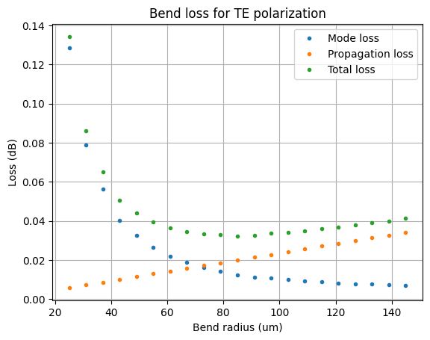
Learning outcome #5 – Bend waveguide radius vs. loss – deep Find neff_TE0 for wvl 1.55 µm, width 1.2 µm for R=25,50,75,100, 125,150 µm
deep waveguide
Paste Total Loss (dB/90º) vs R & neff_TE0 vs R
Comment results, which is the safe radius?, consider safe means less than 0.1 dB/90º.
Safe radius is under ~25um.

Slide 12
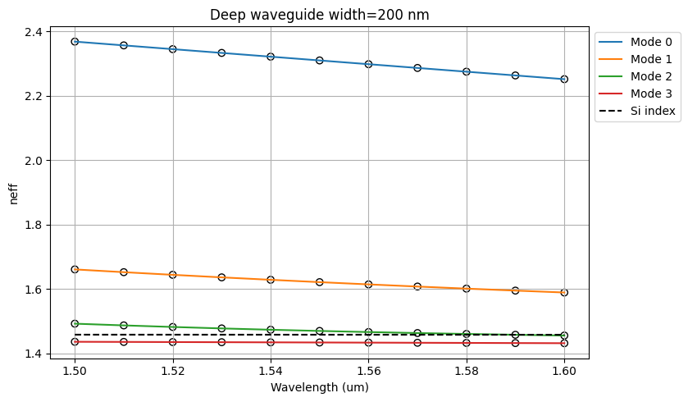
EXTRA 1
deep waveguide
Paste Total Loss (dB/90º) vs R & neff_TE0 vs R
Neff is much higher for Si especialy for low-n modes.

Slide 13
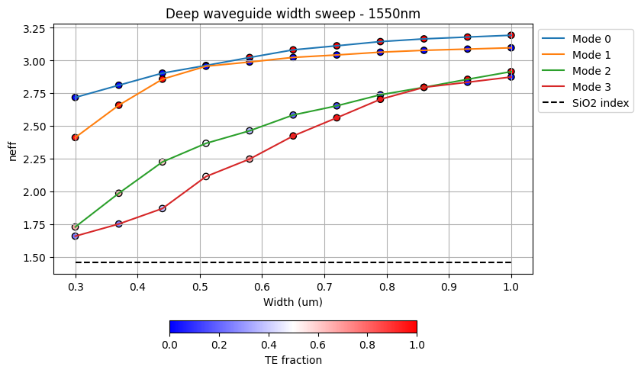
EXTRA 2
deep waveguide
Paste Total Loss (dB/90º) vs R & neff_TE0 vs R
The neff is significantly (too high) higher for silicon (Si), and the curvature of the effective index plots exhibits a more logarithmic character. There is probably a comutational error.

Slide 14
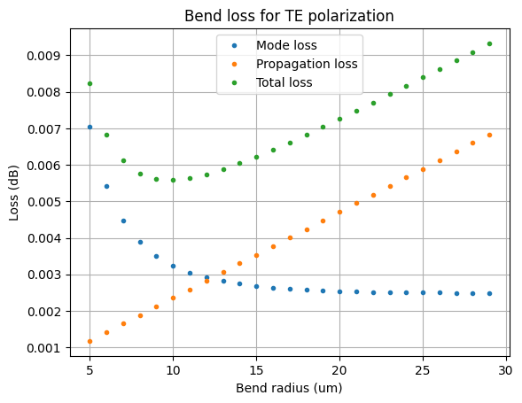
EXTRA 3
deep waveguide
Paste Total Loss (dB/90º) vs R & neff_TE0 vs R
The safe bending radius is extremely small but increases rapidly with changing radius.

Slide 15

Thank you

