Slide 1

Lab Book 2.0. Couplers
Student:

Slide 2
Instructions General
SCRIPTS
From GitHub →
Fork the repo: https://github.com/cccanvas-upv/cifoin-lab2.git
Clone the repo using VSCode
Terminal + ‘uv sync’
Run the Jupyter Notebook:
COUPLERS_Student.ipynb
Cross-Sections to be studied:
w (width)
w (width)
h
(height)
Core
Core
h
(height)
MMI Body
g
(gap)
Cladding
Cladding
Directional coupler (DC)
Multimode Interference (MMI) coupler

Slide 3
Directional coupler

Slide 4

Learning outcome #1 – Directional coupler cross-section in GDSFactory
INSTRUCTOR:
Present Python and GDSFactory implementation of DC cross-section
Describe how to obtain the beating length $L_{π}$
Describe the outputs.
ALL EXAMPLE #1: waveguide width 1.2 µm, gap between waveguides 0.6 µm, deep wvg, wavelength start and end same 1.55 µm → all ”Run”
ALL: Follow instructor, that will show how to 1) plot mode, 2) explore the results (neff …)
Document all your results (neff, plot fields of different modes, comparison between different polarizations…)
Neff of four modes: 1.60942484+1.02849974e-04j 1.60116589+9.83178135e-05j
1.53540293+1.77367472e-04j 1.52057329+1.77190584e-04j
Fraction Te for four modes: 0.994898 , 0.99527537, 0.00888064, 0.01130183
Fraction Tm for four modes: 0.005102 , 0.00472463, 0.99111936, 0.98869817
This time we have to waveguides instead of one.
L_pi_TE: 93.83767536699492
L_pi_TM: 52.26022367744298

Slide 5
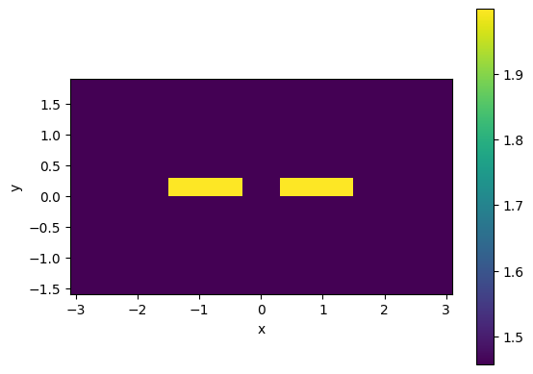
Learning outcome #1 – Directional coupler cross-section in GDSFactory

Slide 6
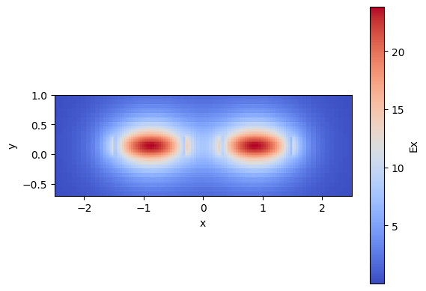
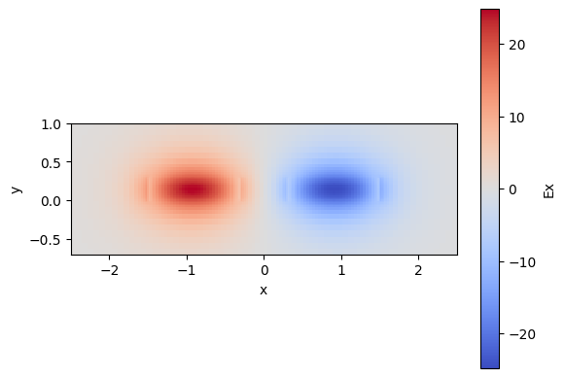
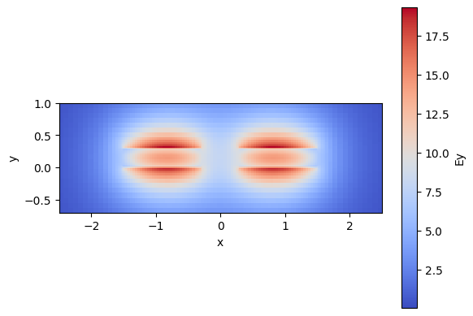
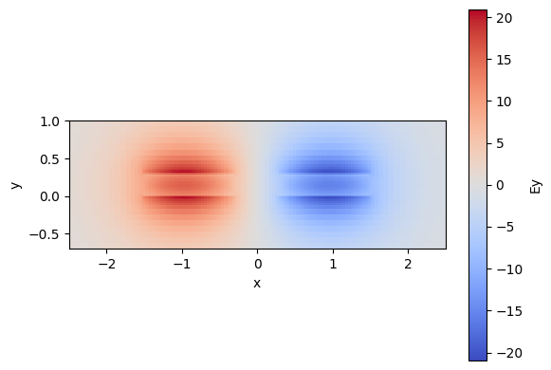
Learning outcome #1 – Directional coupler cross-section in GDSFactory

Slide 7
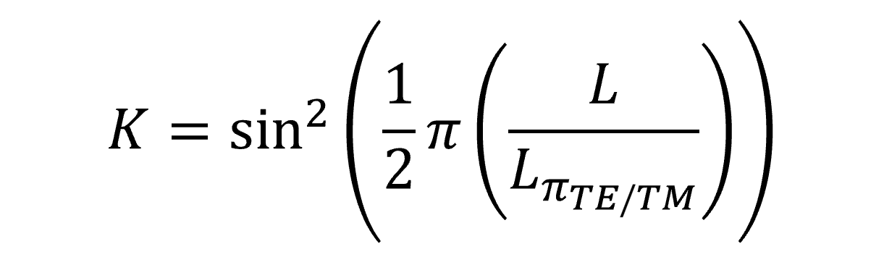
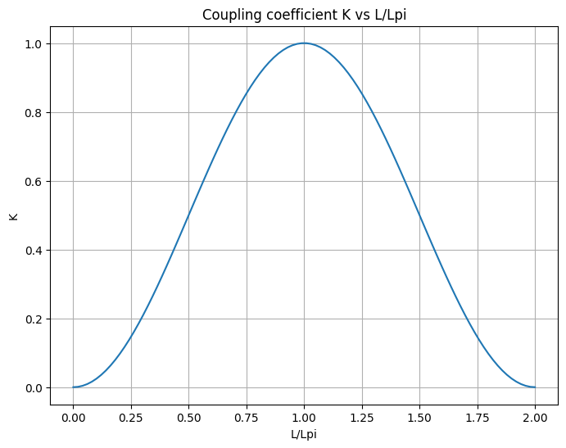
Learning outcome #2 – Directional coupler length and coupling coefficient Wavelength 1.5 µm – width 1.2 µm – gap 0.6 µm – thickness 300 nm
deep waveguide
Paste L/Lpi vs K plot here
Comment results (distance needed for a complete energy transfer between waveguides, distance needed for splitting power in half.. )
distance needed for a complete energy transfer between waveguides: 93.83767537 um
distance needed for splitting power in half: 46.91883768 um

Slide 8
Learning outcome #3 – 2x2 Directional Coupler Wavelength 1.55 µm – Sweep gaps between 0.2 and 1.2 µm in steps of 0.2 µm
deep waveguide
Paste propagation plots and output text here (next slides)
Comment results (Coupling relationship, Lpi, losses, … )
An increase in the gap width decreases the coupling strength, which leads to an exponentially longer coupling length (Lpi) and lower insertion losses.

Slide 9
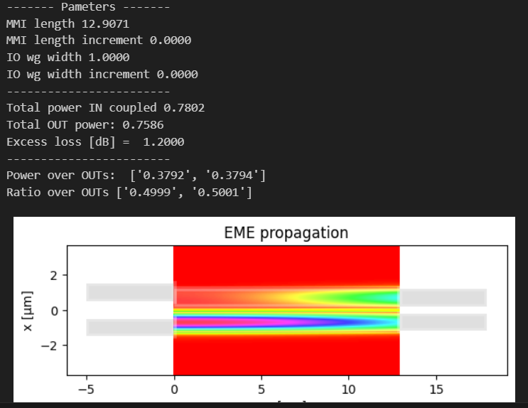
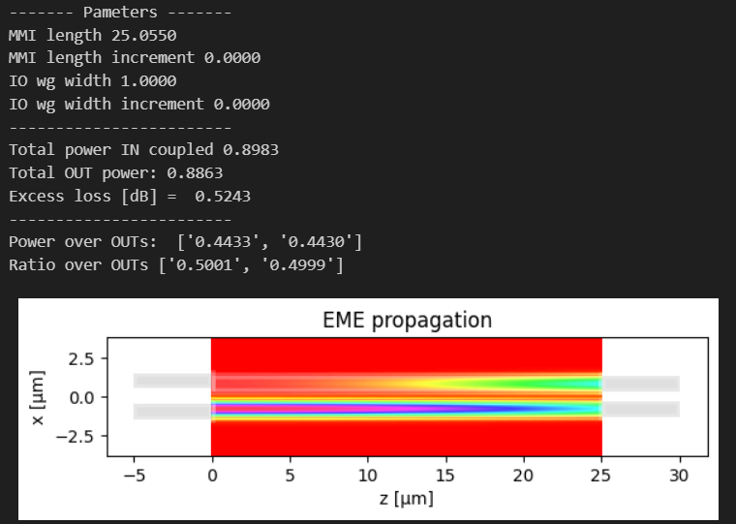
Learning outcome #2 – Directional coupler length and coupling coefficient Wavelength 1.5 µm – width 1.2 µm – gap 0.6 µm – thickness 300 nm
Gap: 200nm
Gap: 400nm

Slide 10
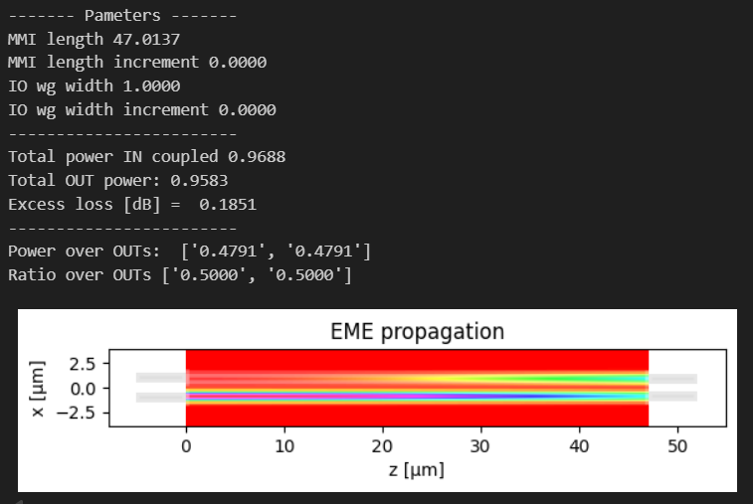
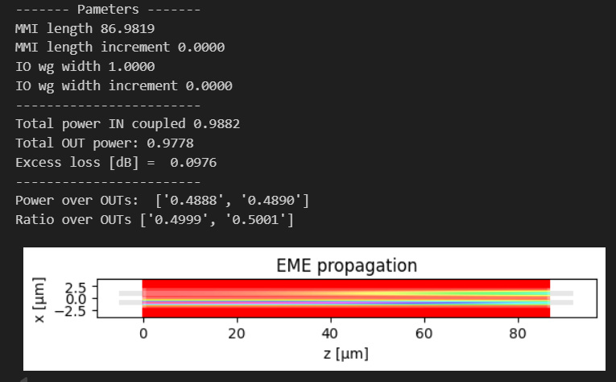
Learning outcome #2 – Directional coupler length and coupling coefficient Wavelength 1.5 µm – width 1.2 µm – gap 0.6 µm – thickness 300 nm
Gap: 600nm
Gap: 800nm

Slide 11
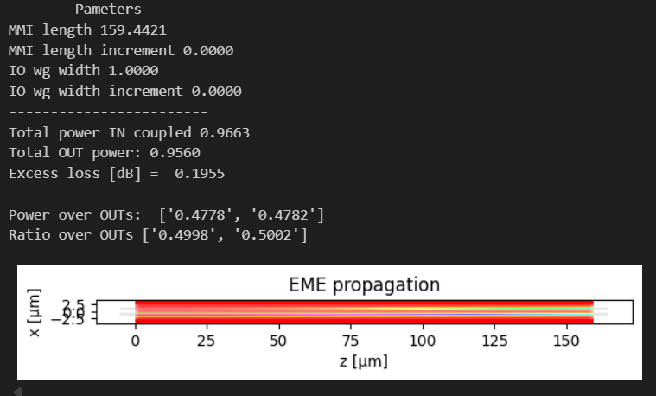
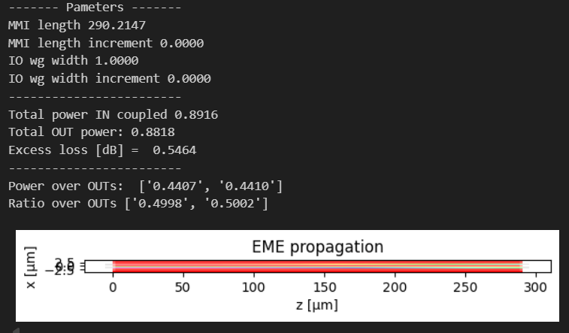
Learning outcome #2 – Directional coupler length and coupling coefficient Wavelength 1.5 µm – width 1.2 µm – gap 0.6 µm – thickness 300 nm
Gap: 1000nm
Gap: 1200nm

Slide 12
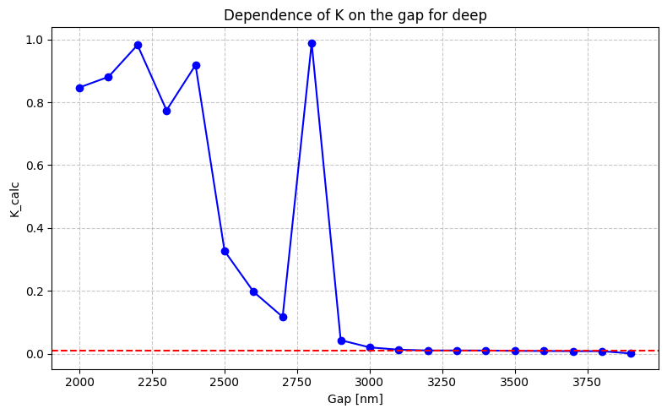
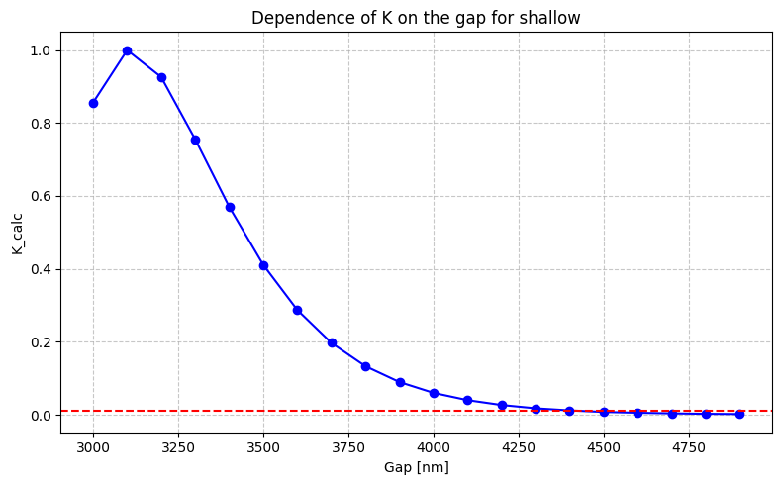
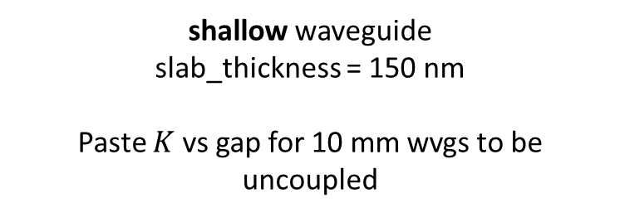
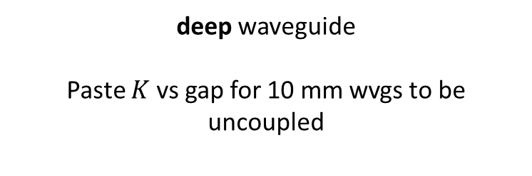
Learning outcome #4 – Parallel uncoupled waveguides – TE0 mode Wavelength 1.55 µm, width 1.0 µm, gap to be found for uncoupled wvgs
deep waveguide
Paste $K$ vs gap for 10 mm wvgs to be uncoupled
shallow waveguide
slab_thickness = 150 nm
Paste $K$ vs gap for 10 mm wvgs to be uncoupled
Hints:
All waveguides running in parallel are coupled somehow. Controlling the degree of coupling is key for those waveguides you don’t want coupling over certain level (i.e. uncoupled waveguides). Uncoupled waveguide definition, we will use K<0.01. Parallel waveguide length = 10 mm (typical length of a chip). Find minimum gap shallow / deep w=1.0µm wvl 1.55 µm.
Shallow: 4500 nm
Deep: 3200 nm

Slide 13
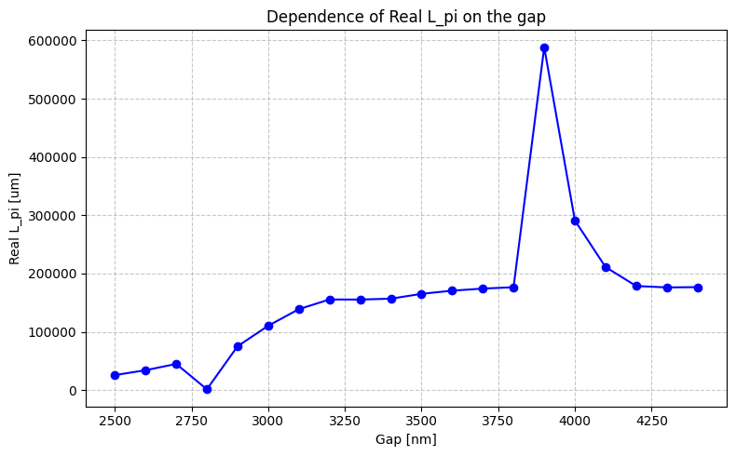
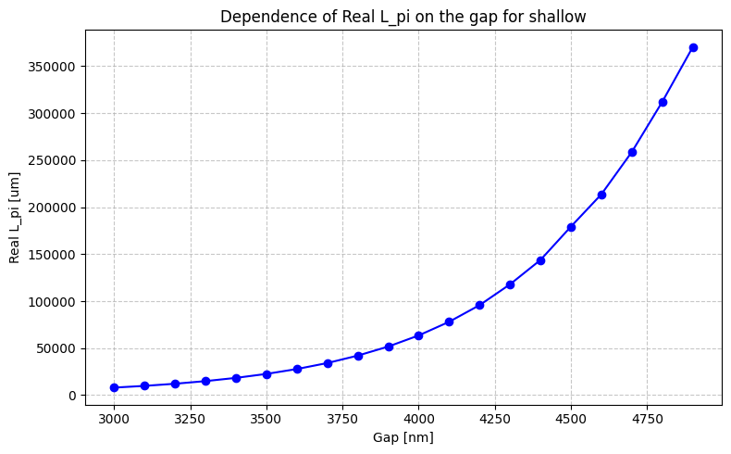
for deep

Slide 14
Multimode Interferometer (MMI) Coupler

Slide 15

Learning outcome #5 – Multimode Interference (MMI) Coupler cross-section
INSTRUCTOR:
Present Python and GDSFactory implementation of DC cross-section
Describe how to obtain the length $L_{π}$
Describe the outputs.
ALL EXAMPLE #2: waveguide width 12 µm, gap between waveguides 0.6 µm, deep wvg, wavelength start and end same 1.55 µm → all ”Run”
ALL: Follow instructor, that will show how to 1) plot mode, 2) explore the results (neff …)
Document all your results (neff, plot fields of different modes, comparison between different polarizations…)

Slide 16
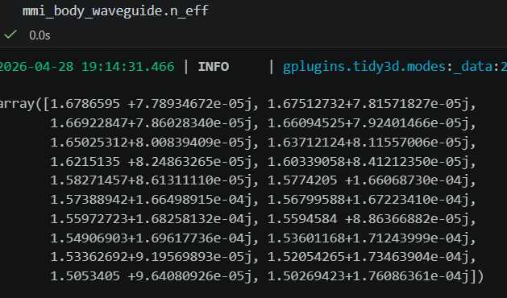

Slide 17
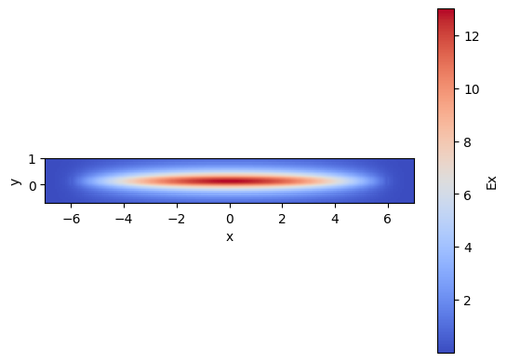
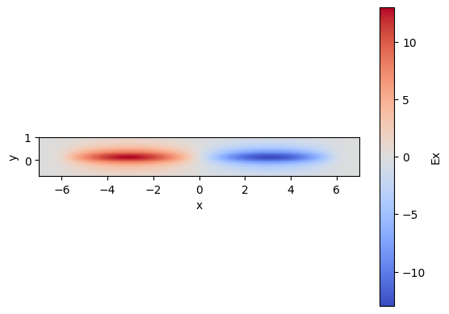
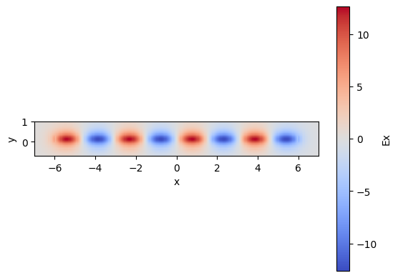

Slide 18
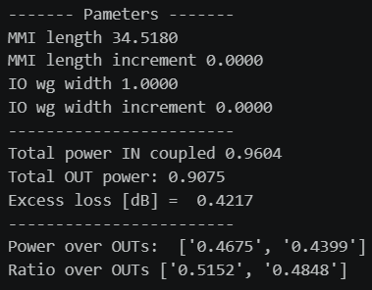
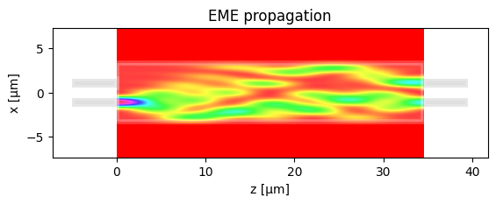
Learning outcome #6 – 6.1 2x2 Multimode Interference Coupler Wavelength 1.55 µm, wMMI = 6.6 µm
deep waveguide
Paste propagation plots and console results
Comment results (Coupling relationship, Lpi, losses, comparison with Directional Coupler… )

Slide 19
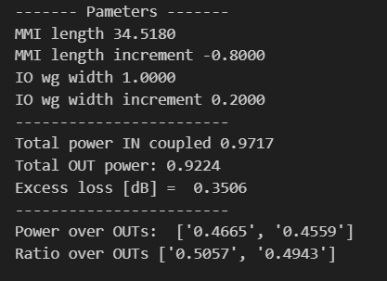

Learning outcome #6.2 – 2x2 Multimode Interference Coupler - Optimization Wavelength 1.55 µm, wMMI = 6.6 µm
deep waveguide
Paste propagation plot and console results
Target: make equal ratio over outputs (even if not 0.5) and minimize excess loss (even if not 0.0 dB)
With same settings of previous LO, now adjust try to manually optimize the MMI by changing iteratively:
- Change dL_MMI
- Change I/O waveguide position +/- dy
Hints: observe the 2D EME propagation results to guide you to the best settings of a) and b).
Comment results
The optimization was successful. The adjusted parameters resulted in an almost perfect 50/50 power splitting ratio with a low excess loss of 0.35 dB.

Slide 20
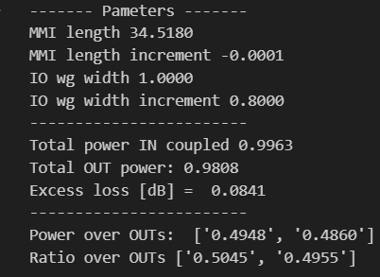
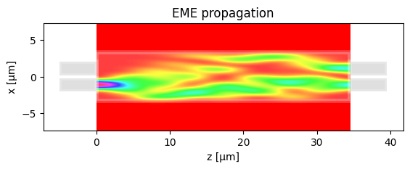
Learning outcome #6.3 – 2x2 Multimode Interference Coupler – Optimization (II) Wavelength 1.55 µm, wMMI = 6.6 µm
deep waveguide
Paste propagation plot and console results
Target: make ratio over outputs 0.5 + excess loss < 0.1 dB
With same settings of previous LO, now modify the notebook so I/O waveguides have a different width.
- The nominal I/O waveguide width you have been using is 1.0 µm, increase it.
(Warning! Every time you change the I/O waveguide width you have to re-run modes calculation)
Hints: observe the 2D EME propagation results to guide you to the best settings of a) and b).
Comment results
Target achieved. Increasing the I/O waveguide width reduced the excess loss to ~0.084 dB (satisfying the < 0.1 dB requirement) while preserving an optimal power splitting ratio of 0.5045 to 0.4955.

Slide 21
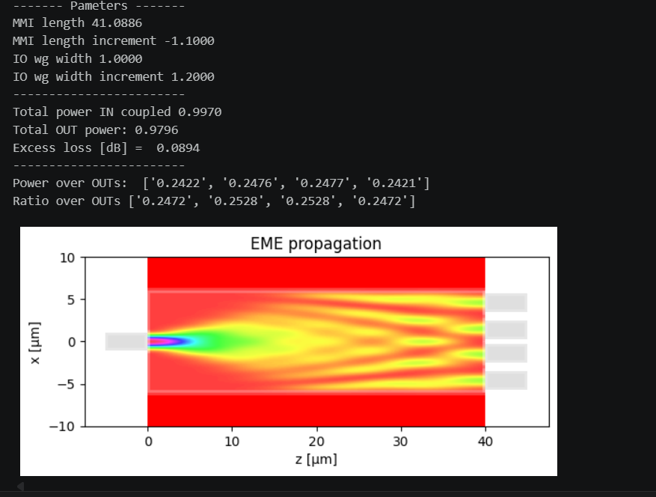
Learning outcome #7 – 1x4 Multimode Interference Coupler Wavelength 1.55 µm, wMMI = ? µm
deep waveguide
Paste propagation plots and console results
Repeat all the design process for a 1x4 MMI Coupler.
wMMI = 12 um

Slide 22


Extra #1 – Directional coupler gap dependence Wavelength 1.55 µm, width 1.0 µm, gap 0.2-2.4 µm (step 0.2 µm)
deep waveguide
Paste $L_{π}$ vs gap for TE and TM plot here
shallow waveguide
Paste $L_{π}$ vs gap for TE and TM plot here
slab = 150nm
Make conclusions and observations from your results

Slide 23


Extra #2 – Directional wavelength dependence Wavelengths from 1.5 to 1.7 µm, gap = 0.6 µm, width 1.0 µm
deep waveguide
Paste $L_{π}$ vs wvl for TE and TM plot here
shallow waveguide
Paste $L_{π}$ vs wvl for TE and TM plot here
slab = 150nm
Comment results

Slide 24
Extra #3 – MMI coupler wavelength dependence Wavelengths from 1.5 to 1.7 µm, wMMI = 6.6 µm
deep waveguide
Paste $L_{π}$ vs wvl for TE and TM plot here
shallow waveguide
Paste $L_{π}$ vs wvl for TE and TM plot here
slab = 150nm
Comment results (Important. Compare with Directional Coupler)

Slide 25


Extra #4 – MMI coupler body width dependence Wavelength 1.55 µm, wMMI = 5-10 µm (steps 0.5 µm)
deep waveguide
Paste $L_{π}$ vs width for TE and TM plot here
shallow waveguide
Paste $L_{π}$ vs width for TE and TM plot here
slab = 150nm
Polarization independent coupler: is there any point for which the MMI coupler can work identically for TE and TM? Answer yes / no and explain why?

Slide 26

Thank you

